Slide 1
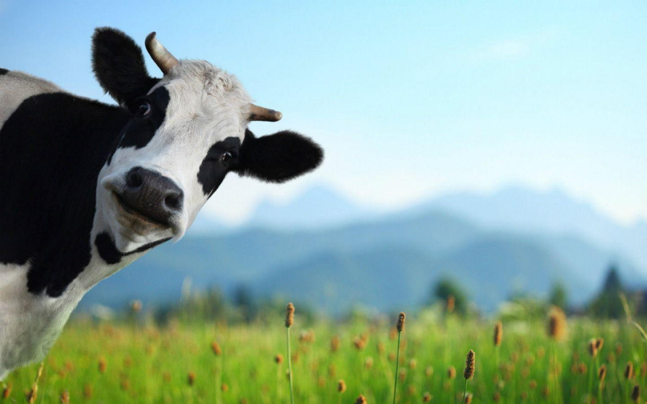
Noah A. Legall Committee Meeting
January 12th, 2021
University of Georgia
Institute of Bioinformatics
https://wallpapercave.com/cows-wallpapers

Slide 2
Outline

