Slide 1

Noah A. Legall Committee Meeting
January 12th, 2021
University of Georgia
Institute of Bioinformatics
https://wallpapercave.com/cows-wallpapers

Slide 2
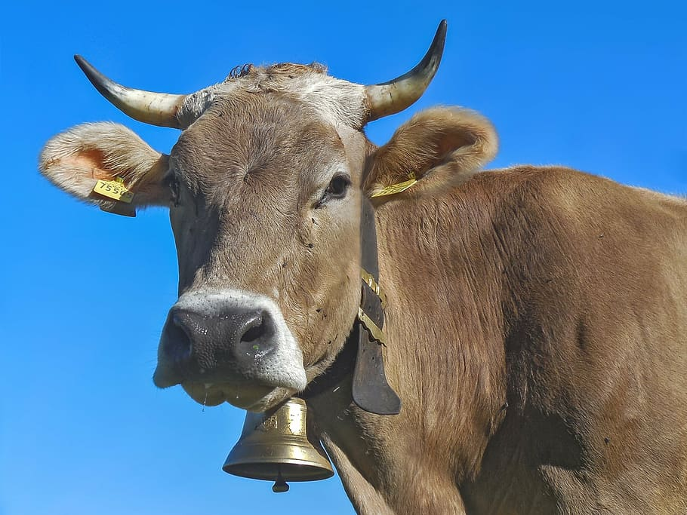
Outline
Introduction
Specific Aims
Preliminary Analysis
https://www.pxfuel.com/en/free-photo-euqgf

Slide 3
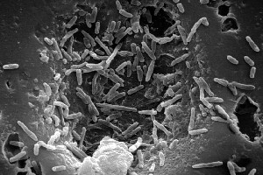
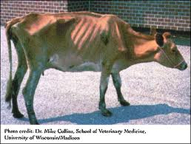
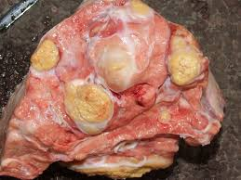
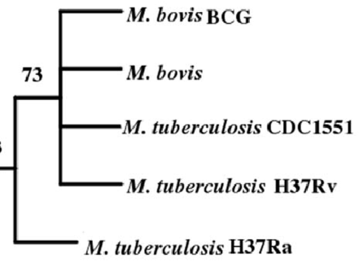
Mycobacterium bovis – Quick Facts
Introduction
Mycobacterium bovis is the bacterial pathogen that causes bovine tuberculosis (bTB)
Gram positive, rod shaped
Chronic respiratory complications, weight loss, lymphatic and lung lesions
Highly related to Mycobacterium tuberculosis
Wide host range
Notes:
Mycobacterium bovis picture: https://microbewiki.kenyon.edu/index.php/Mycobacterium_bovis
Cow picture: https://www.barfblog.com/2016/06/nz-tb-testing-important-for-food-safety/
Lesion picture: https://www.vetstream.com/treat/bovis/farmer-factsheets/tuberculosis
Phylogeny: Anchor-Based Whole Genome Phylogeny (ABWGP): A Tool for Inferring Evolutionary Relationship among Closely Related Microorganims

Slide 4


Consistent M. bovis transmission at wildlife-livestock interface
Introduction
Close spatial proximity leads to frequent exposure, spillover risk.
Reservoirs of infection: species populations that can transmit disease within itself as well as externally to other species populations.
Limits the effectiveness of control measures for bTB.
Critical need to limit transmission and reservoir formation

Slide 5
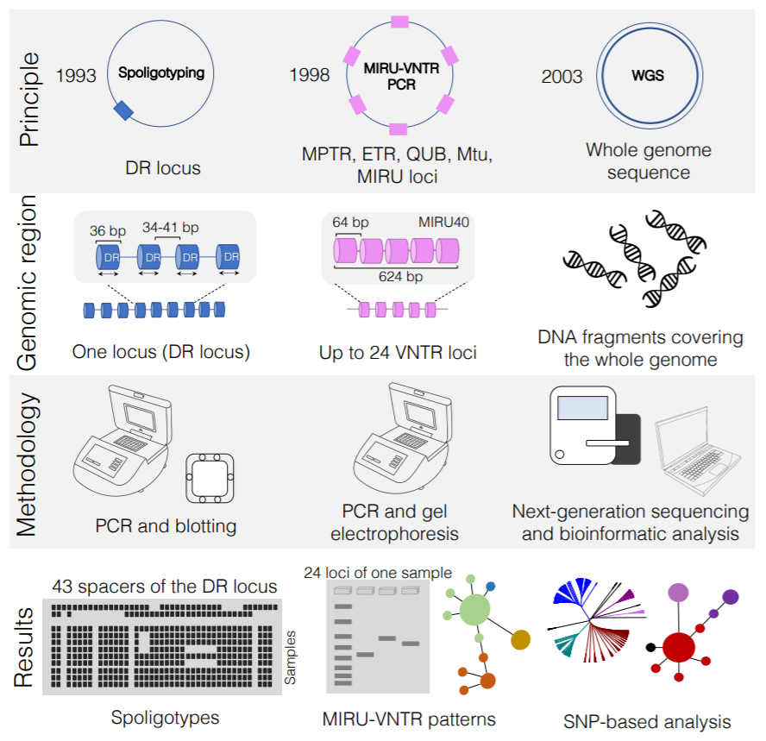
Genotyping M. bovis as a tool to track transmission
Introduction
Next generation sequencing (NGS) more commonplace, increasing resolution
Spoligotyping
MIRU-VNTR
Whole Genome Sequencing
Only highly conserved sequence info is used
Variable genomic elements overlooked

Slide 6





Phylodynamic framework to unravel factors affecting transmission
Introduction
Phylodynamics: the study of how epidemiological, immunological, and evolutionary processes act and potentially interact to shape phylogeny.
Bayesian framework
Host jumps, geographic diffusion.
Integration of ecological & environmental factors.
https://www.slideshare.net/torstenseemann/visualizing-the-pan-genome-australian-society-for-microbiology-tue-8-jul-2014

Slide 7
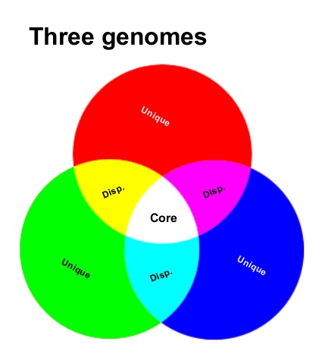
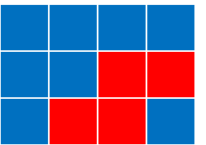
Pangenome framework for bTB analysis
Introduction
Pangenome analysis for M. bovis
Core genome
Accessory genome
Potential to link host-specific evolutionary signatures to reservoir formation
Genes
. . .
. . .
Isolates
. . .
https://www.slideshare.net/torstenseemann/visualizing-the-pan-genome-australian-society-for-microbiology-tue-8-jul-2014

Slide 8
M. bovis transmission knowledge gaps
Specific Aims
How can the inclusion of the core genome and accessory genome elevate current M. bovis transmission analyses?
What external factors influence geographic transmission of M. bovis?
Can a pangenomic framework be utilized to understand host specific evolutionary signatures that are precursory to reservoir formation?
https://www.slideshare.net/torstenseemann/visualizing-the-pan-genome-australian-society-for-microbiology-tue-8-jul-2014

Slide 9
Specific Aims
Specific Aims
Aim 1 – Develop a platform for the analysis, storage, and access of M. bovis pangenomic data
Aim 2 - Determine environmental, ecological, and geographic factors that contribute to M. bovis evolution and global spread.
Aim 3 - Use host associated M. bovis genomic data to find genomic signatures suggesting host adaptation.

Slide 10
Question 1
How can M. bovis genomic data be easily processed, stored, and utilized to accelerate genomic surveillance analyses?

Slide 11
Specific Aims
Specific Aims
Aim 1 – Develop a platform for the analysis, storage, and access of M. bovis pangenomic data
Aim 2 - Use Bayesian Phylodynamic framework to correlate ecological, environmental factors that contribute to M. bovis evolution and global spread.
Aim 3 - Use host associated M. bovis genomic data to find genomic signatures suggesting host adaptation.

Slide 12
Reference guided M. bovis pipeline vSNP
Specific Aims
Genome sequencing of M. bovis more commonplace, necessitates the automation of variant identification
USDA vSNP pipeline developed for variant calling for bTB & other livestock diseases
Pros:
Makes variant calling easier
Conventional bioinformatic tools for variant calling
Cons:
Not fully automated
Ignores accessory genome
M. bovis specific variant calling not benchmarked

Slide 13
Sub-questions (Aim 1)
Specific Aims
What combination of variant calling software leads to most accurate precision in M. bovis SNP identification?
How can we store SNP & gene data alongside auxiliary metadata to maintain scalability?
What are proper techniques of extracting stored pangenomic data to allow efficient dissemination of data?

Slide 14
Sub-questions (Aim 1)
Specific Aims
What combination of variant calling software leads to most accurate precision in M. bovis SNP identification?
Simulation benchmarking
How can we store SNP & gene data alongside auxiliary metadata to maintain scalability?
RDBMS + HMM
What are proper techniques of extracting stored pangenomic data to allow efficient dissemination of data?
REST API

Slide 15
Question 2
Do ecological and environmental factors such as land-use and climate data influence geographic transmission of M. bovis?

Slide 16
Specific Aims
Specific Aims
Aim 1 – Develop a platform for the analysis, storage, and access of M. bovis pangenomic data
Aim 2 – Use Bayesian Phylodynamic framework to correlate ecological, environmental factors that contribute to M. bovis evolution and global spread.
Aim 3 - Use host associated M. bovis genomic data to find genomic signatures suggesting host adaptation.

Slide 17
M. bovis global transmission
Specific Aims
Phylogeography: connecting historical processes in evolution with spatial distributions that scale temporally.
Recent publication explored the global geographic spread of M. bovis, few things still can be learned:
Bayesian generalized linear modelling (glm): regression method to link predictor data with transition rates between geographic regions
Limited research in phylodynamics, but question seen in different genotyping methods

Slide 18
Sub-questions (Aim 2)
Specific Aims
What is appropriate substitution model for global M. bovis isolates?
Given temporal sampling data, can we filter sequence data that deviate from root-divergence to time of sampling regression?
What are the optimal molecular clock and tree prior models?
What are appropriate transition rates for M. bovis between geographic regions?
What ecological and environmental metrics are associated with geographic transition rates?

Slide 19
Sub-questions (Aim 2)
Specific Aims
What is appropriate substitution model for global M. bovis isolates?
IQ-Tree model selection based on BIC value.
Given temporal sampling data, can we filter sequence data that deviate from root-divergence to time of sampling regression?
IQ-Tree ML tree used as input for Tempest software
What are the optimal molecular clock and tree prior models?
Time-tree inference with BEAST. Multiple runs using various priors
What are appropriate transition rates for M. bovis between geographic regions?
Discrete-trait diffusion analysis within BEAST.
What ecological and environmental metrics are associated with geographic transition rates?
Generalized Linear Modeling analysis within BEAST.

Slide 20
Question 3
How do specific genomic characteristics within the M. bovis genome assist in host species specificity?

Slide 21
Specific Aims
Specific Aims
Aim 1 – Develop a platform for the analysis, storage, and access of M. bovis pangenomic data
Aim 2 - Use Bayesian Phylodynamic framework to correlate ecological, environmental factors that contribute to M. bovis evolution and global spread.
Aim 3 - Use host associated M. bovis genomic data to find genomic signatures suggesting host adaptation.

Slide 22
M. bovis evolutionary signatures for host adaptation
Specific Aims
Host Adaptation: refers to the evolution of a pathogen such that it can infect, cause disease, and circulate in a host species population.
Identification of host adaptive genetic signatures could reveal mechanisms required for successful host switch, critical host-pathogen interactions.
Pangenome framework can assist in identifying genomic signatures:
Homologous Recombination
Sites of Positive Selection
Gene presence/absence
Gene-to-gene interactions
M. bovis phylogenomic study found general evolutionary patterns
Do these patterns vary across species?

Slide 23
Sub-questions (Aim 3)
Specific Aims
Does clustering of the M. bovis accessory genome reveal any host specificity?
Do M. bovis isolate’s core genomes cluster genetically based on core genome variation?
Are different regions of the genome experience Homologous Recombination or Positive Selection differently based on host species?
Are there any key gene or gene-to-gene interactions that are based on host species?

Slide 24
Sub-questions (Aim 3)
Specific Aims
Does clustering of the M. bovis accessory genome reveal any host specificity?
Principal Component Analysis (PCA)
Do M. bovis isolate’s core genomes cluster genetically based on core genome variation?
IQ-Tree ML Phylogeny of core genome
Are different regions of the genome experience Homologous Recombination or Positive Selection differently based on host species?
Utilization of Gubbins for Homologous Recombination Analysis
Develop software to compute Tajima’s D statistic using sliding window
Are there any key gene or gene-to-gene interactions that are based on host species?
Perform ANOVA F-test, Mutual Information calculation,
panGWAS analysis with Scoary, gene association networks with Coinfinder
Support Vector Machine, Random Forest Classification

Slide 25
M. bovis spillback leads to economic burden
Introduction
Spillover can lead to formation of two opposite outcomes:
Maintenance populations: transmission within the species population can be sustained
Dead-End hosts: transmission of disease occurs rarely within a species population
Maintenance populations that contribute to constant spillback are the focus of disease control programs.

Slide 26
Whole Genome Sequencing for bTB surveillance
Introduction
Mutations in the M. bovis genome can accumulate in a time frame that can be observable over a few years.
M. bovis Genetic similarity ~ Transmission dynamics
t₀
t₁
t₂
t₃
t₄
t₅
Time of Infection

Slide 27
Whole Genome Sequencing for bTB surveillance
Introduction
Whole Genome Sequencing (WGS) is utilized to track changes in individual nucleotides.
Compare to an established reference genome.
Infer a time rooted phylogenetic tree
The combination of genomic, temporal, spatial, and host metadata for a single M. bovis isolate help to define these dynamics.
Coalescent process
t₀
t₁
t₂
t₃
t₅
Time of Infection

Slide 28
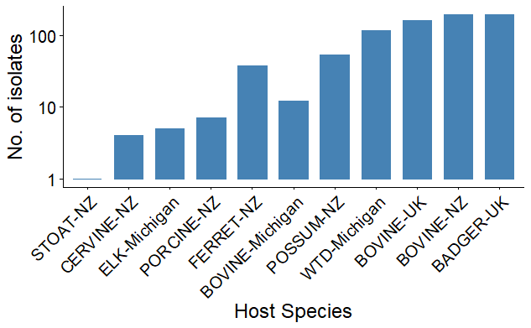
Preliminary Analysis Data
Preliminary Research
To understand if there was any relationship between genomic variability and host status, I pulled sequence data from three nations that have distinct maintenance hosts for M. bovis:
USA: white-tailed deer
UK: badger
NZ: bushtail possum

Slide 29
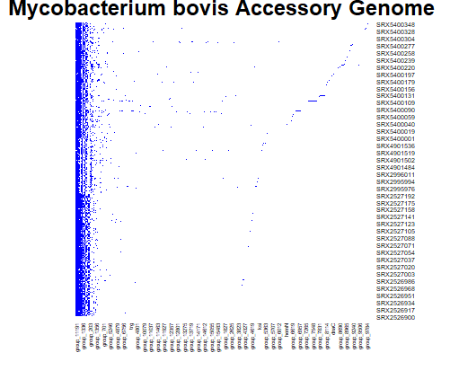
M. bovis Pangenomic Framework
Preliminary Research
Once the data was collected, inferring the pangenome was the next step to investigate genomic attributes.
Core Genome
Areas of Selection + Homologous Recombination
Maximum Likelihood Phylogenetic Tree
Accessory Genome
Principal Component Analysis (PCA) clustering

Slide 30
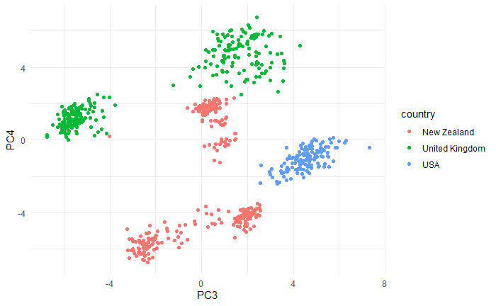
Regional clustering of accessory genome
Preliminary Research

Slide 31
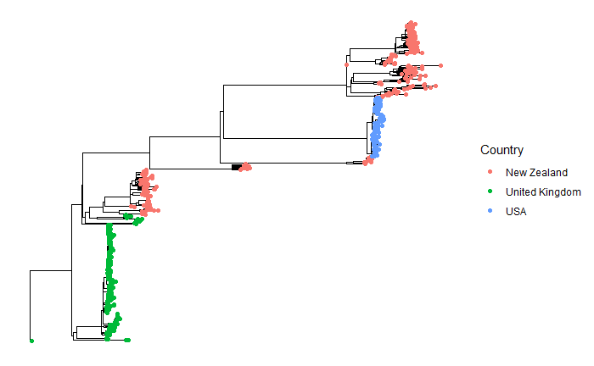
Regional clustering of core genomes
Preliminary Research

Slide 32
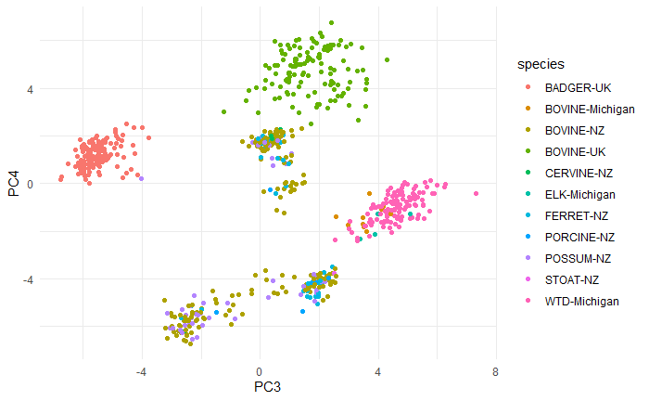
Multi-host clustering of accessory genome
Preliminary Research

Slide 33
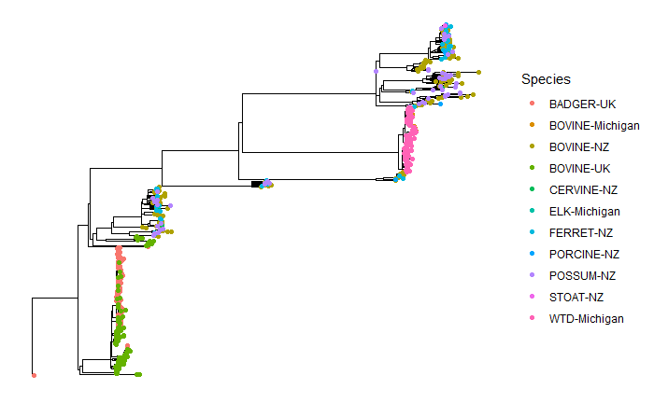
Multi-host clustering of core genomes
Preliminary Research

Slide 34
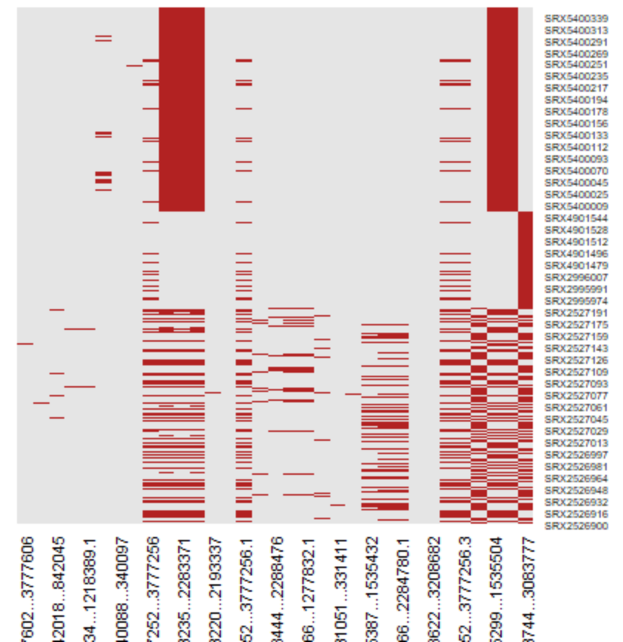
Limited regions of homologous recombination
Preliminary Research

Slide 35
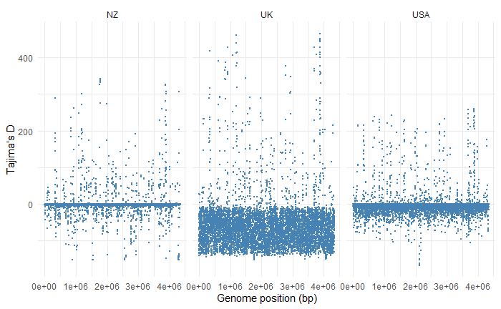
Conflicting signal from United Kingdom isolates
Preliminary Research

Slide 36
Timeline
Specific Aims
Time | Spring 2021 | Summer 2021 | Fall 2021 | Spring 2022 | Summer 2022
Aim 1
Aim 2
Aim 3

Slide 37




Thank you
Salvador Lab
Ruijie (Rachel) Xu
Rodrigo Campos
Ehsan Suez
Hind Azami, PhD
Bahl Lab
Jiani Chen
Lambo Damodaran
Zach Petty
Cody Dailey
Subhan Ullah
Swan Tan
Leke Lyu
Gabriella Veytsal
Ridwan Hossain
Committee
Liliana Salvador, PhD
Justin Bahl, PhD
Liang Liu, PhD
Douda Bensasson, PhD

