Slide 1
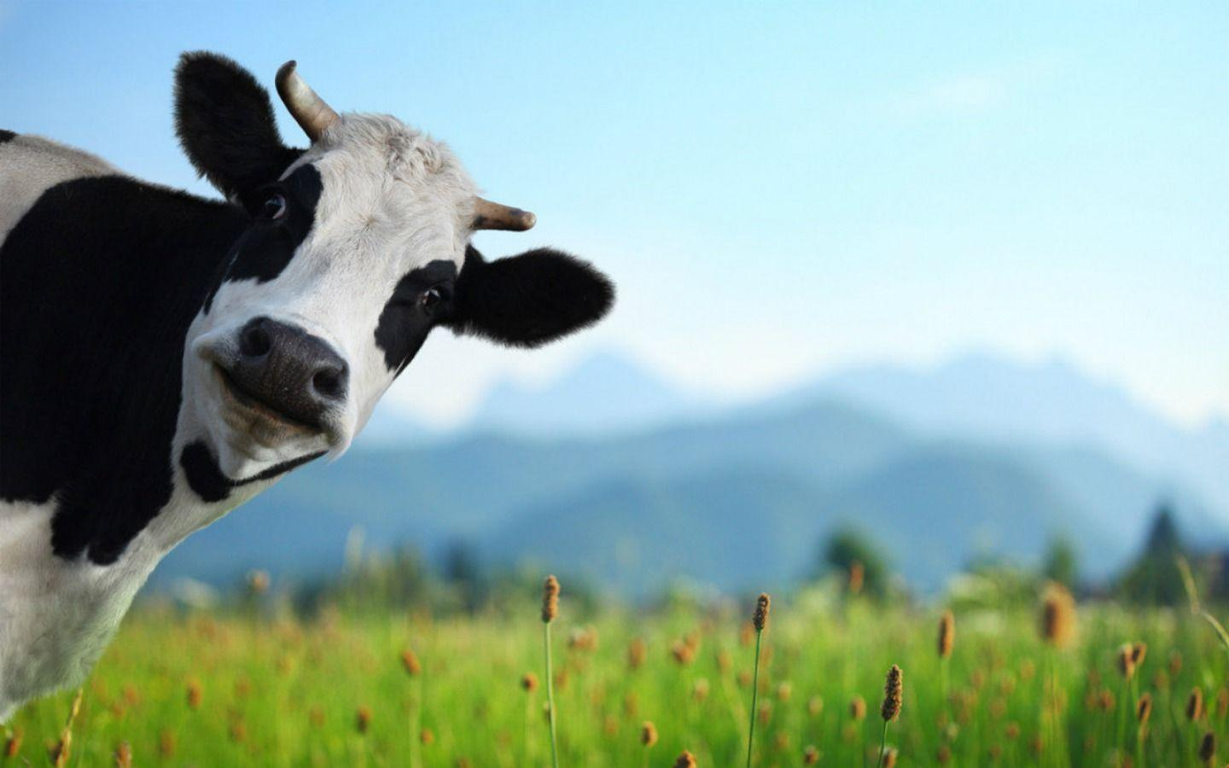
Noah A. Legall Committee Meeting
January 12th, 2021
University of Georgia
Institute of Bioinformatics
https://wallpapercave.com/cows-wallpapers

Slide 2
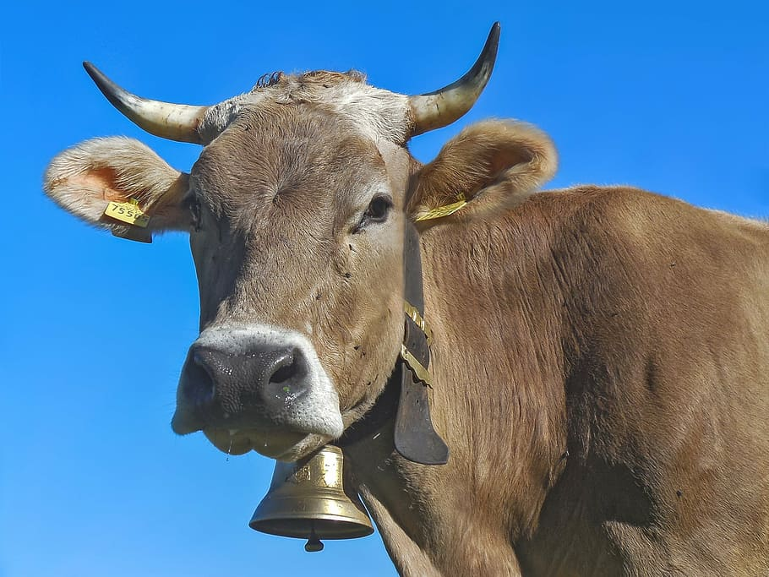
Outline
Introduction
Research Question
Preliminary Results
Specific Aims
https://www.pxfuel.com/en/free-photo-euqgf

Slide 3
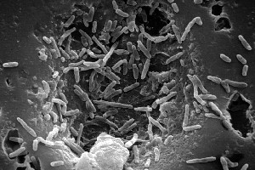
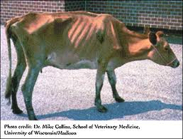
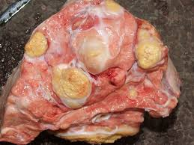
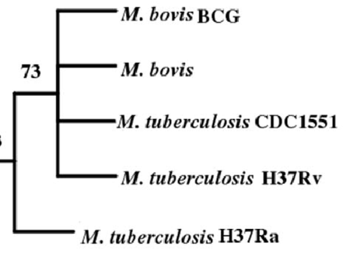
Mycobacterium bovis – Quick Facts
Introduction
Mycobacterium bovis is the bacterial pathogen that causes bovine tuberculosis (bTB)
Chronic respiratory complications, weight loss, and lymphatic and lung lesions
Contracted through multiple avenues, mainly inhalation of aerosols
Animal adapted, limited human – human transmission
Highly related to Mycobacterium tuberculosis complex (MTBC) species
Notes:
Mycobacterium bovis picture: https://microbewiki.kenyon.edu/index.php/Mycobacterium_bovis
Cow picture: https://www.barfblog.com/2016/06/nz-tb-testing-important-for-food-safety/
Lesion picture: https://www.vetstream.com/treat/bovis/farmer-factsheets/tuberculosis
Phylogeny: Anchor-Based Whole Genome Phylogeny (ABWGP): A Tool for Inferring Evolutionary Relationship among Closely Related Microorganims

Slide 4


M. bovis spillback leads to economic burden
Introduction
Implicated as a bacterial pathogen that exists on the wildlife-livestock interface.
Spillover into wildlife population from infected cattle.
Creation of maintenance population in the wildlife.
Finally, spillback into the economically valuable livestock population.

Slide 5
M. bovis spillback leads to economic burden
Introduction
Spillover can lead to formation of two opposite outcomes:
Maintenance populations: transmission within the species population can be sustained
Dead-End hosts: transmission of disease occurs rarely within a species population
Maintenance populations that contribute to constant spillback are the focus of disease control programs.

Slide 6
Whole Genome Sequencing for bTB surveillance
Introduction
Mutations in the M. bovis genome can accumulate in a time frame that can be observable over a few years.
M. bovis Genetic similarity ~ Transmission dynamics
t₀
t₁
t₂
t₃
t₄
t₅
Time of Infection

Slide 7
Whole Genome Sequencing for bTB surveillance
Introduction
Whole Genome Sequencing (WGS) is utilized to track changes in individual nucleotides.
Compare to an established reference genome.
Infer a time rooted phylogenetic tree
The combination of genomic, temporal, spatial, and host metadata for a single M. bovis isolate help to define these dynamics.
Coalescent process
t₀
t₁
t₂
t₃
t₅
Time of Infection

Slide 8
What genomic changes facilitate maintenance transmission?
Research Questions
Genomic changes on the population level within a maintenance host population should accumulate.
Cattle
Badger

Slide 9





What factors contribute to spillover of M. bovis?
Research Questions
Anthropogenic, agricultural, and ecological factors might influence transmission dynamics.

Slide 10
What factors contribute to spillover of M. bovis?
Research Questions
Can analysis of the genomic variability of M. bovis isolates elucidate what factors across the molecular, population, and global scale affect spillover transmission?

Slide 11
Preliminary Analysis Data
Preliminary Research
To understand if there was any relationship between genomic variability and host status, I pulled sequence data from three nations that have distinct maintenance hosts for M. bovis:
USA: white-tailed deer
UK: badger
NZ: bushtail possum

Slide 12
M. bovis Pangenomic Framework
Preliminary Research
Once the data was collected, inferring the pangenome was the next step to investigate genomic attributes.
Core Genome
Areas of Selection + Homologous Recombination
Maximum Likelihood Phylogenetic Tree
Accessory Genome
Principal Component Analysis (PCA) clustering

Slide 13
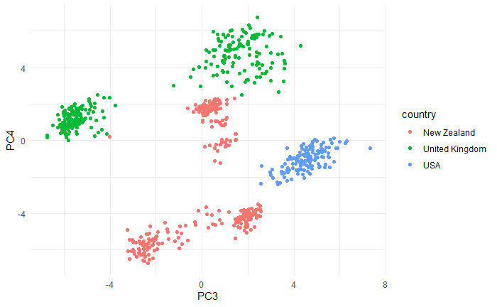
Regional clustering of accessory genome
Preliminary Research

Slide 14
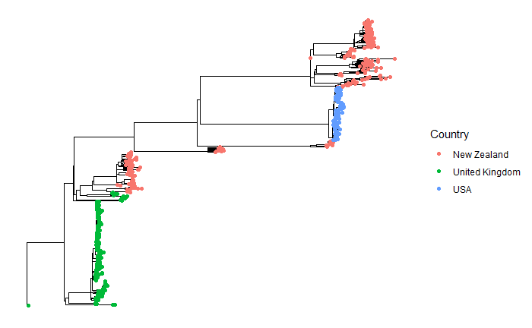
Regional clustering of core genomes
Preliminary Research

Slide 15
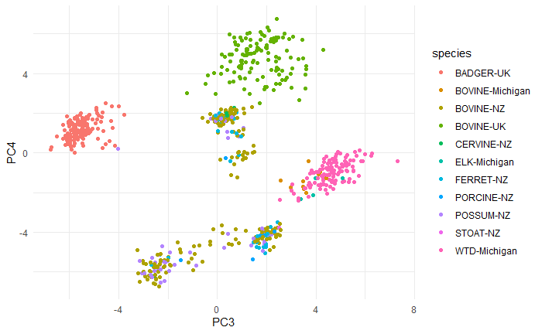
Multi-host clustering of accessory genome
Preliminary Research

Slide 16
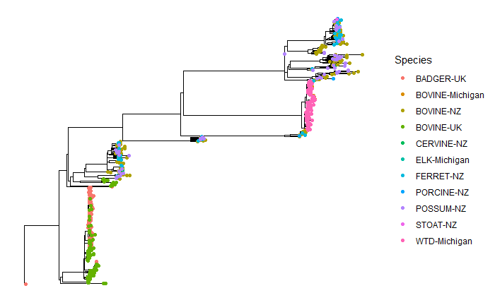
Multi-host clustering of core genomes
Preliminary Research

Slide 17
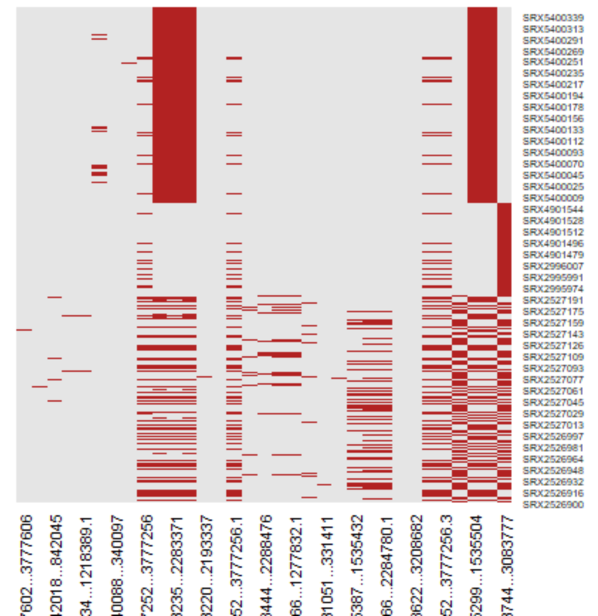
Limited regions of homologous recombination
Preliminary Research

Slide 18
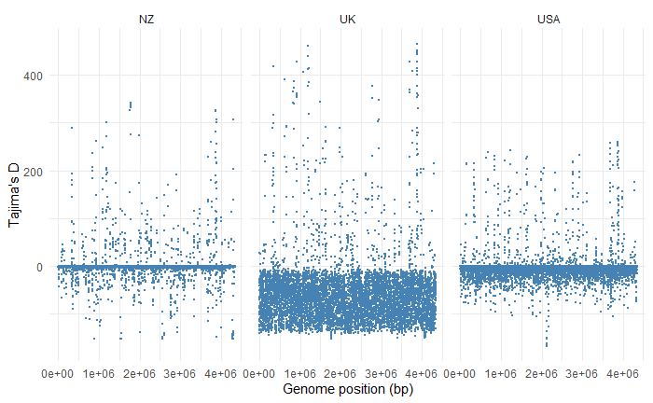
Conflicting signal from United Kingdom isolates
Preliminary Research

Slide 19
Preliminary Result discussion
Preliminary Research

Slide 20
Specific Aims
Specific Aims
Aim 1 - Apply a reference agnostic machine learning approach to find genes that are enriched for different species and regions.
Aim 2 - Develop a M. bovis WGS genotyping pipeline for continual pathogen surveillance.
Aim 3 - Utilize a Bayesian framework to analyze a M. bovis time-tree for understanding anthropogenic and ecological factors that impact transmission.

Slide 21
Aim 1
Specific Aims
Aim 1 - Apply a reference agnostic machine learning approach to find genes that are enriched for different species and regions.
Growing amount of literature that develop methods for analyzing pangenome data and using statistics to relate to host status
Anti-microbial Resistance
Host Range
My preliminary results suggest the accessory genome of M. bovis, in terms of gene presence & absence, is distinct based on geographic region and perhaps species (UK badgers & cattle).
Assess gene frequencies for key maintenance host/ geographic region genes
Mutual Information test
Bonferroni corrected Chi-squared test
Bonferroni corrected ANOVA F-test
Support Vector Machine Classification
Random Forest Classification

Slide 22
Aim 2
Specific Aims
Aim 2 - Develop a M. bovis WGS genotyping pipeline for continual pathogen surveillance.
WGS of M. bovis isolates will soon be a preferred way of characterizing isolates and surveilling transmission
USDA vSNP pipeline
Opportunity to improve
software benchmarking
Hidden Markov Model Alignment support (quicker reference based alignment)
pipeline management software
Automatic integration w/ NextStrain open source website
Develop this pipeline and make it available to M. bovis research community

Slide 23
Aim 3
Specific Aims
Aim 3 - Utilize a Bayesian framework to analyze a M. bovis time-tree for understanding anthropogenic and ecological factors that impact transmission.
Phylodynamics: defined as the study of how epidemiological, immunological, and evolutionary processes act and potentially interact to shape phylogeny.
Bayesian framework useful for outbreak investigation.
Transition rates between different states (Host jumps, geographic diffusion).
Integration of ecological & anthropogenic factors to see what influences these transitions.
For M. bovis, multiple studies employ phylodynamics, but literature review shows no study has investigated how these factors influence transmission dynamics.
Collect ecological data based on temporal, spatial parameters
Collect sequence data compiled from Aim 2
Utilize a generalized linear model approach to insinuate which factors contribute to transmission between regions.

Slide 24
Timeline
Specific Aims
Time | Spring 2021 | Summer 2021 | Fall 2021 | Spring 2022 | Summer 2022
Aim 1
Aim 2
Aim 3

