Slide 1
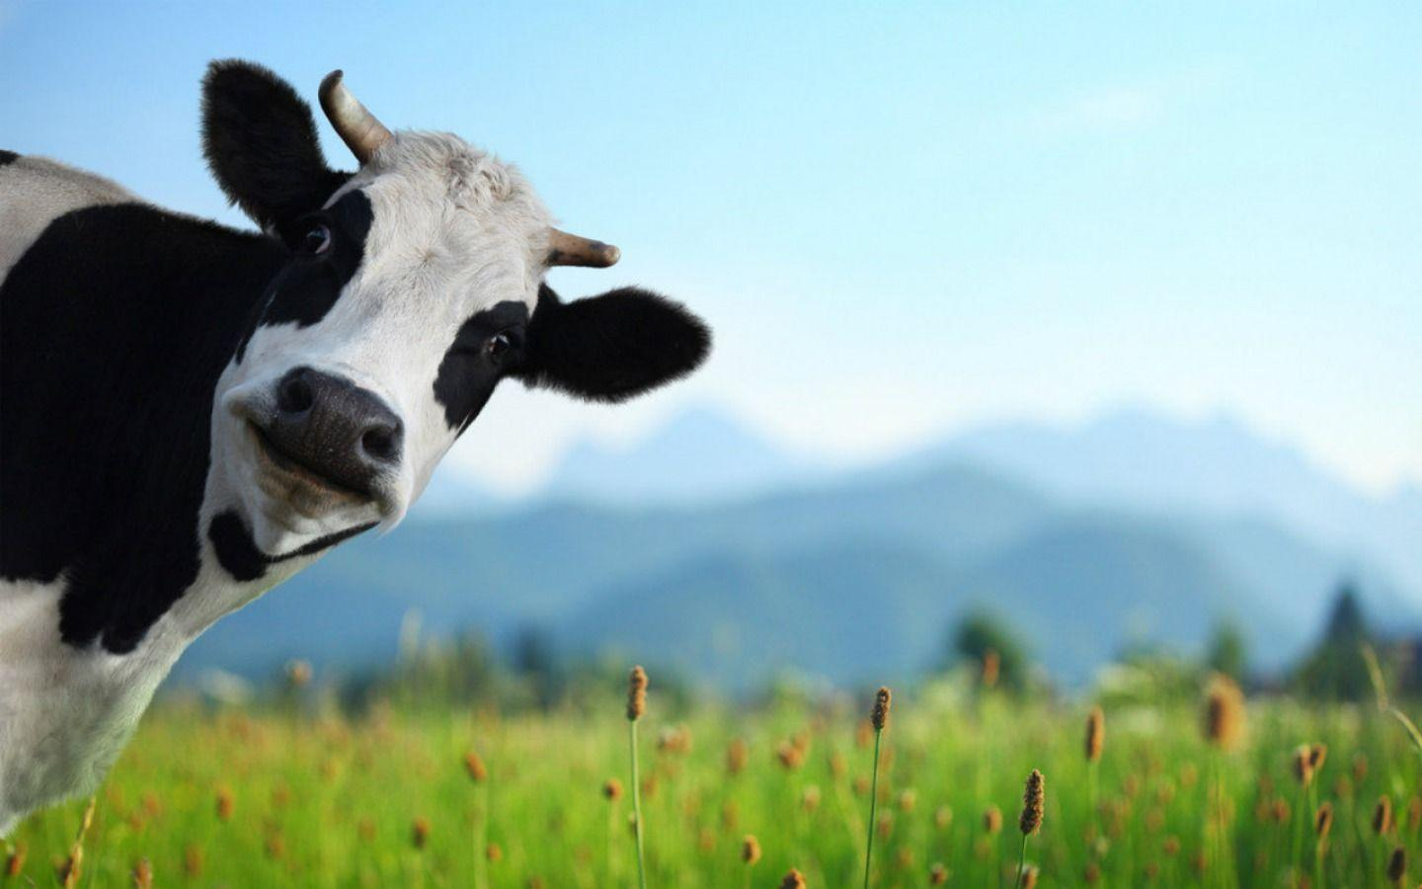
Noah A. Legall Committee Meeting
January 12th, 2021
University of Georgia
Institute of Bioinformatics
https://wallpapercave.com/cows-wallpapers

Slide 2
Outline
Introduction
Research Question
Preliminary Results
Specific Aims

Slide 3
Mycobacterium bovis – Quick Facts
Mycobacterium bovis is the bacterial pathogen that causes bovine tuberculosis (bTB)
Chronic respiratory complications, weight loss, and lymphatic and lung lesions
Contracted through multiple avenues, mainly inhalation of aerosols
Animal adapted, limited human – human transmission
Highly related to Mycobacterium tuberculosis complex (MTBC) species

Slide 4
M. bovis spillback leads to economic burden
Implicated as a bacterial pathogen that exists on the wildlife-livestock interface.
Spillover into wildlife population from infected cattle.
Creation of maintenance population in the wildlife.
Finally, spillback into the economically valuable livestock population.
Spillover can lead to formation of two opposite outcomes:
Maintenance populations: transmission within the species population can be sustained
Dead-End hosts: transmission of disease occurs rarely within a species population
Maintenance populations that contribute to constant spillback are the focus of disease control programs.

Slide 5
Whole Genome Sequencing for bTB surveillance
Whole Genome Sequencing (WGS) is utilized to track changes in individual nucleotides.
Compare to an established reference genome.
Mutations in the M. bovis genome can accumulate in a time frame that can be observable over a few years.
M. bovis Genetic similarity ~ Transmission dynamics
The combination of genomic, temporal, spatial, and host metadata for a single M. bovis isolate help to define these dynamics.

Slide 6
Research Question
The transmission dynamics between maintenance hosts and dead-end hosts are fluid and fundamentally different. This suggests:
Genomic changes on the population level within a maintenance host population should accumulate.
Anthropogenic, agricultural, and ecological factors might influence transmission dynamics.
Can analysis of the genomic variability of M. bovis isolates elucidate what factors across the molecular, population, and community scale lead to efficient transmission of spillover hosts?

Slide 7
Preliminary Analysis Data
To understand if there was any relationship between genomic variability and host status, I pulled sequence data from three nations that have distinct maintenance hosts for M. bovis:
USA: white-tailed deer
UK: badger
NZ: bushtail possum

Slide 8
M. bovis Pangenomic Framework
Once the data was collected, inferring the pangenome was the next step to investigate genomic attributes.
Core Genome
Areas of Selection + Homologous Recombination
Maximum Likelihood Phylogenetic Tree
Accessory Genome
Principal Component Analysis (PCA) clustering

Slide 9
PCA result

Slide 10
Phylogenetic Tree Result

Slide 11
Homologous Recombination Result

Slide 12
Selection Result

Slide 13
Preliminary Result discussion

Slide 14
Specific Aims
Aim 1 – Apply a reference agnostic machine learning approach to find genes and gene interactions that are enriched in different species.
Aim 2 - Development of a M. bovis WGS genotyping pipeline for continual pathogen surveillance.
Chapter 3 – Utilize a Bayesian framework to analyze a M. bovis time-tree for understanding anthropogenic and ecological factors that impact transmission.

