Slide 1
UNCLASSIFIED
Certificate Generator
Salvador Melendez, Ph.D.
Computer Engineer
DEVCOM DAC
10 Nov 2019
UNCLASSIFIED

Slide 2
BacKGROUND
UNCLASSIFIED
Identified Issue:
When presenting Professional Development Events (PDEs), cybersecurity analysts give out certificates of participation to students, faculty, and other cybersecurity professional. The creation of such certificates can be time consuming whenever there is a considerable number of people attending the workshop.
Proposed Solution:
A set of Python Scripts to create, organize, and keep track of all attendees. This is a command line script with friendly menus to generate all the needed certificates with unique codes for each of the events; this becomes useful in case another entity requires a verification of authenticity for any of the given certificates.
UNCLASSIFIED

Slide 3



CERT-Gen system
UNCLASSIFIED
List of Participants
+
=
Python Scripts
Certificate
PROCESS:
A list of participants is filled out (name, last name, and email).
The Python Scripts take care of the creation of all the certificates with unique codes.
Certificates are organized and placed on specific folders.
A file keeps track of all the events and attendees.
UNCLASSIFIED

Slide 4
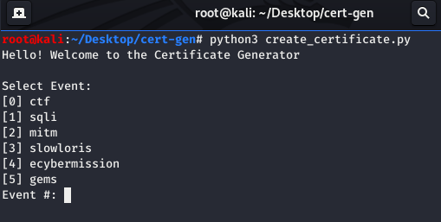
ERB-GEN GUI
UNCLASSIFIED
1
2
1 – To run the main Python Script, open a Terminal window and type:
python3 create_certificate.py
2 – A small menu will provide the user with the available events.
Select the one that applies to your Professional Development Event (PDE)
UNCLASSIFIED

Slide 5
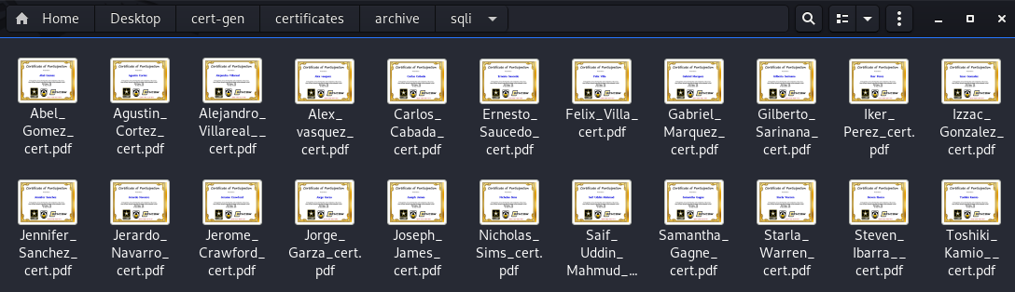
CERTIFICATES OF PARTICIPATION
UNCLASSIFIED
3
3 – All the generated certificates of participation will be organized on their corresponding folder
UNCLASSIFIED

Slide 6

CERTIFICATES OF PARTICIPATION
UNCLASSIFIED
4
5
6
4 – Name of Participant
5 – Name of Event, place, and date
6 – Unique Code
UNCLASSIFIED

Slide 7
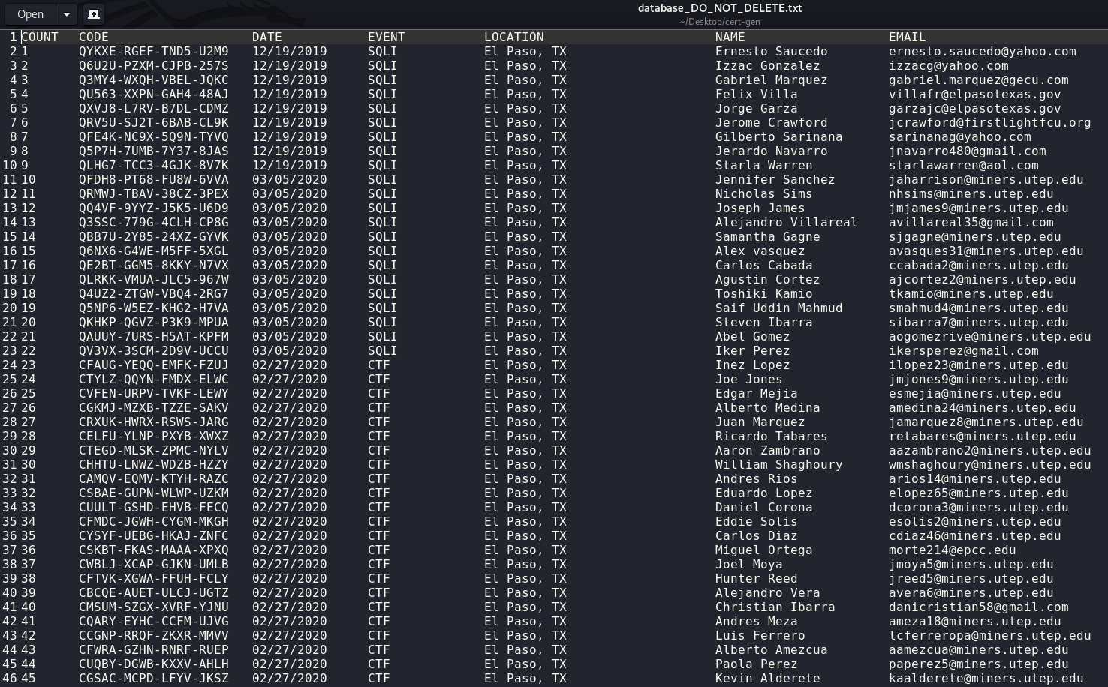
CERTIFICATES OF PARTICIPATION
UNCLASSIFIED
7
7 – File that keeps track of all participants
UNCLASSIFIED

Slide 8
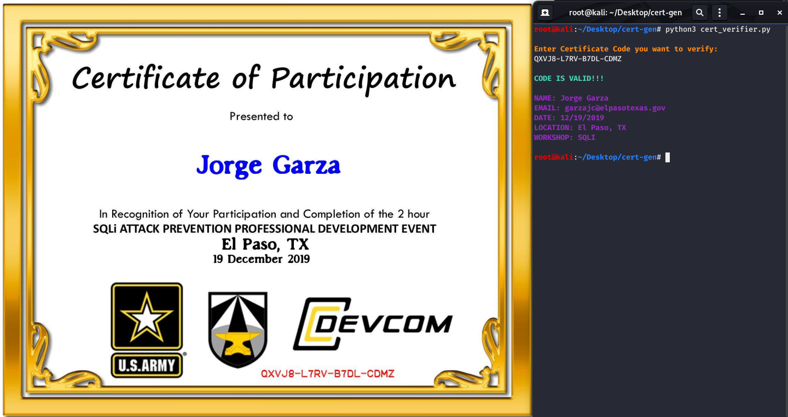
CERTIFICATES OF PARTICIPATION
UNCLASSIFIED
8
9
10
8 – To run the certificate verifier, open a Terminal window and type:
python3 cert_verifier.py
9 – Enter the Code you want to verify
10 – Verify if Code is valid or not
UNCLASSIFIED

Slide 9

Contact Information
UNCLASSIFIED
Salvador Melendez, Ph.D.
UNCLASSIFIED email: salvador.melendez3.civ@army.mil
UNCLASSIFIED

