Slide 1
UNCLASSIFIED
Emerging Results Brief (ERB) Generator
Salvador Melendez, Ph.D.
Computer Engineer
DEVCOM DAC
28 Apr 2020
UNCLASSIFIED

Slide 2
BacKGROUND
UNCLASSIFIED
Identified Issue:
When attending cyber assessments, the team lead must present the Emerging Results Brief (ERB) to the customers/stakeholders.
This is usually done by creating a PowerPoint slide deck with all the findings gathered by the other cyber analysts throughout the week.
Usually the team lead has to spend a good amount of time the day before the final presentation; putting slides together for every finding: 1) affected hosts, 2) posture, 3) issues, 4) mitigation strategies, and 5) screenshots as evidence.
Proposed Solution:
A Python Script with a Graphical User Interface (GUI) in the front end and some methods in the backend. This will save a lot of time and effort to the team lead preparing the ERB.
UNCLASSIFIED

Slide 3




ERB-Gen system
UNCLASSIFIED
Dradis Data
+
=
or
FRIC Data
Python Script
PowerPoint
PROCESS:
Data from Dradis or FRIC is exported into your “Desktop”
Dradis or FRIC data is ingested into the Python Script
Using the GUI, the team lead will be able to:
Input the team lead’s information
Input the event’s information
Select the Dradis zip file or the FRIC folder with the correct data
Edit each of the findings (e.g. name, hosts, issues, posture, mitigation)
Re-arrange the findings in a different order
Add and/or delete any findings (if needed)
Select, re-arrange, delete the screenshots for each of the findings
Produce a PowerPoint Presentation
UNCLASSIFIED

Slide 4
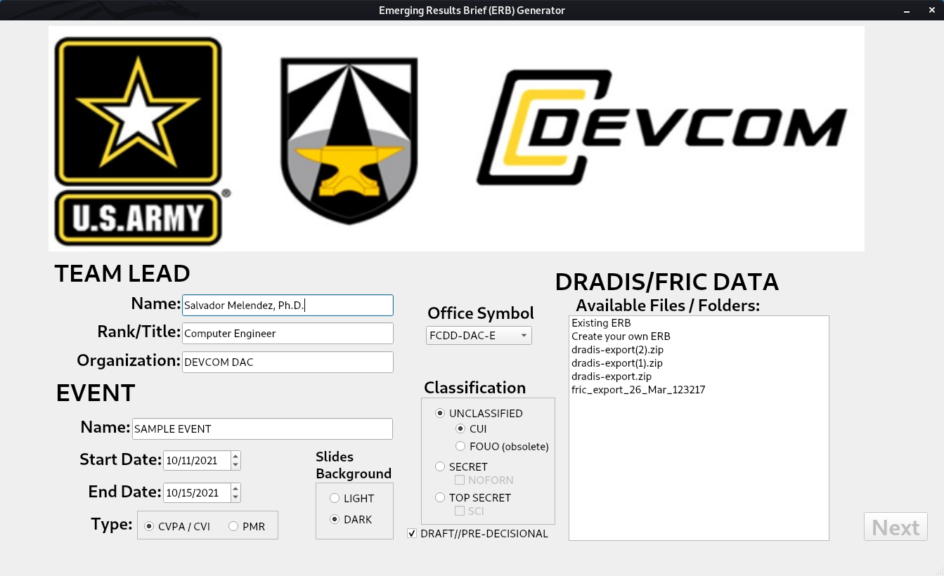
ERB-GEN GUI
UNCLASSIFIED
Page #1
1
3
2
1 – Team Lead’s Information: name, title, organization, office symbol
2 – Event’s Information: name, start/end dates, type, slides background, classification
3 – Dradis/FRIC Data: available files/folders with exported Dradis/FRIC data
UNCLASSIFIED

Slide 5
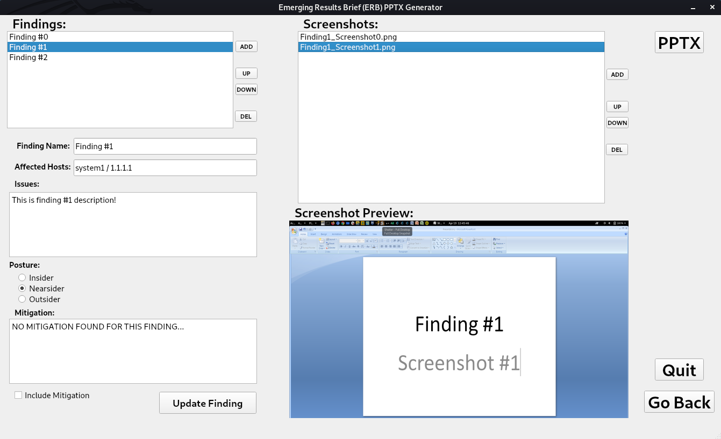
ERB-GEN GUI
UNCLASSIFIED
Page #2
1
3
4
7
6
2
5
8
1 – Findings List
2 – Finding’s Fields
3 – “Add/Up/Down/Delete” buttons to re-arrange the findings
4 – Screenshots List
5 – Screenshot Preview
6 – “Add/Up/Down/Delete” buttons to re-arrange the screenshots
7 – “PPTX” button to create the PowerPoint File
8 – “Quit” / “Go Back” buttons
UNCLASSIFIED

Slide 6

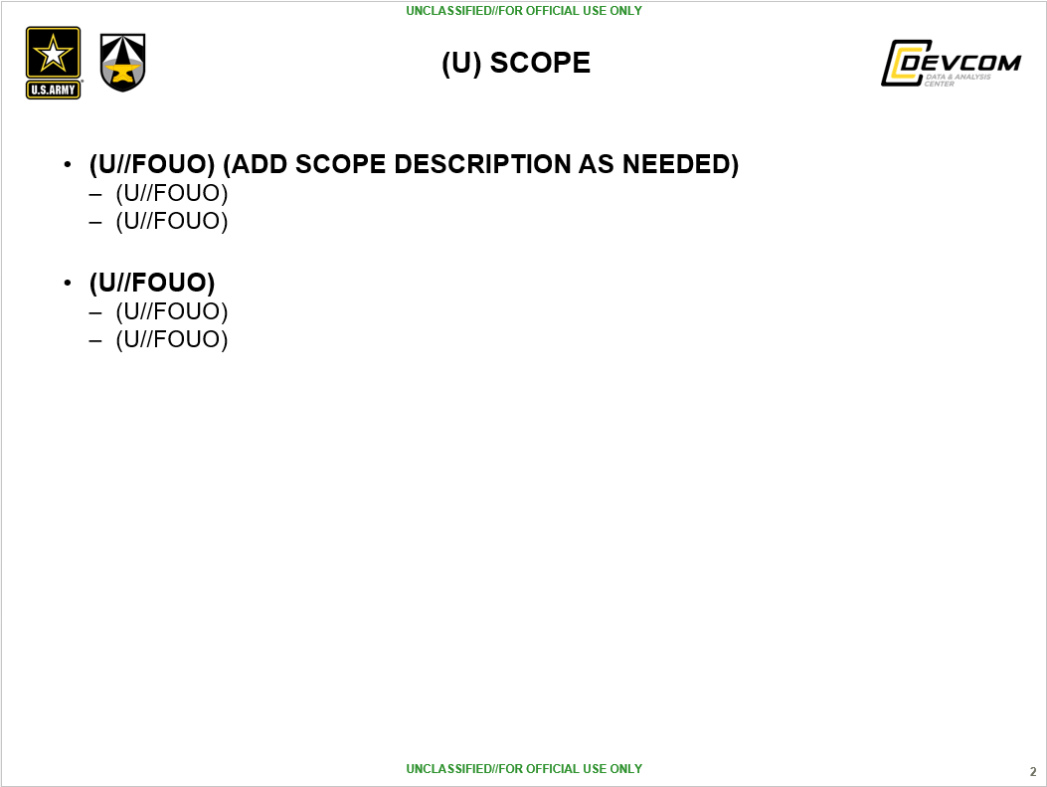
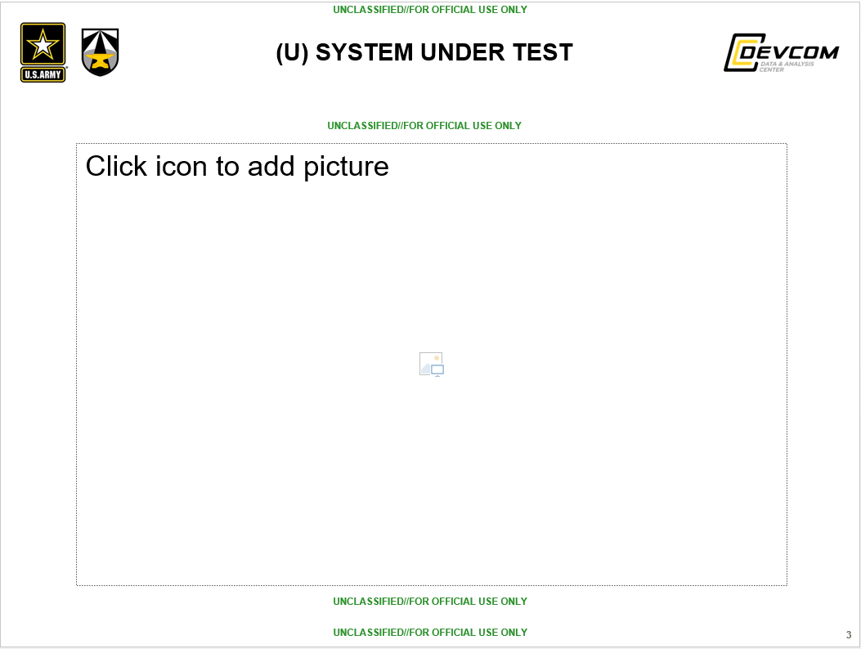
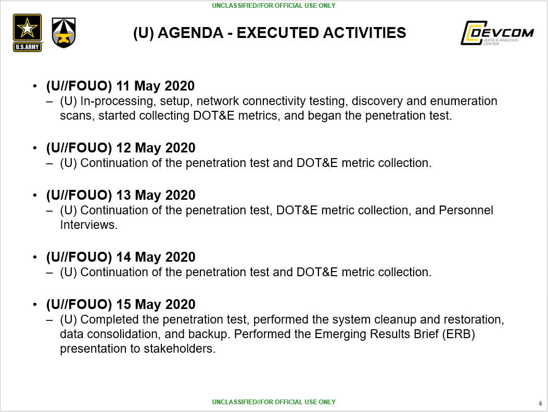
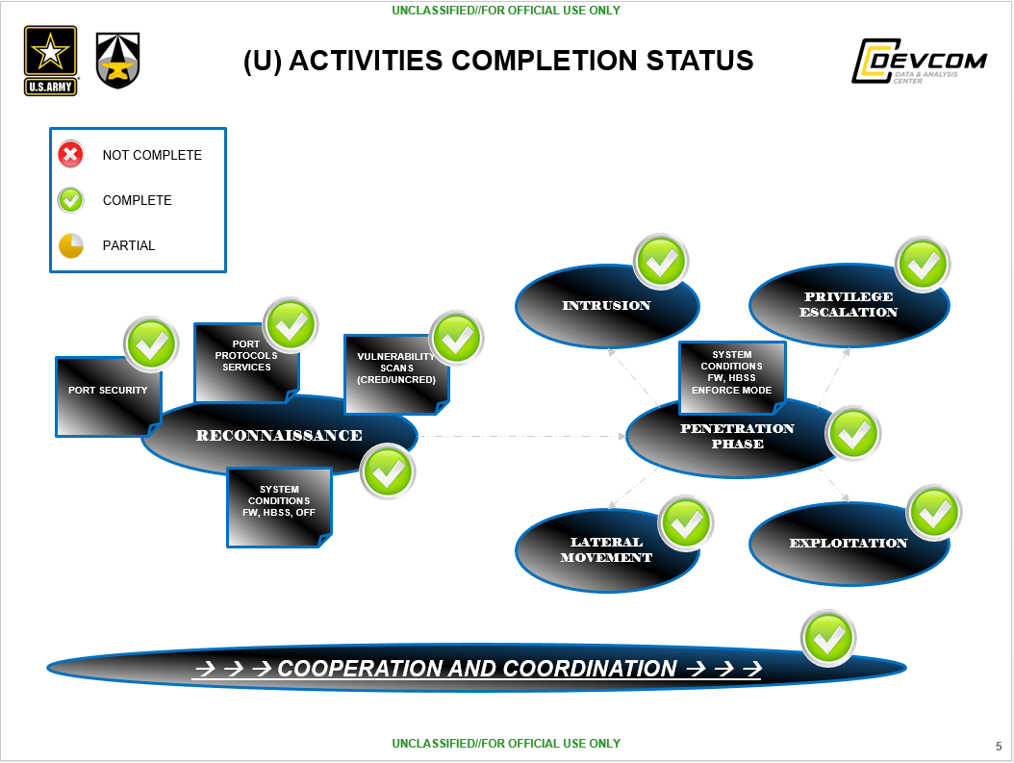
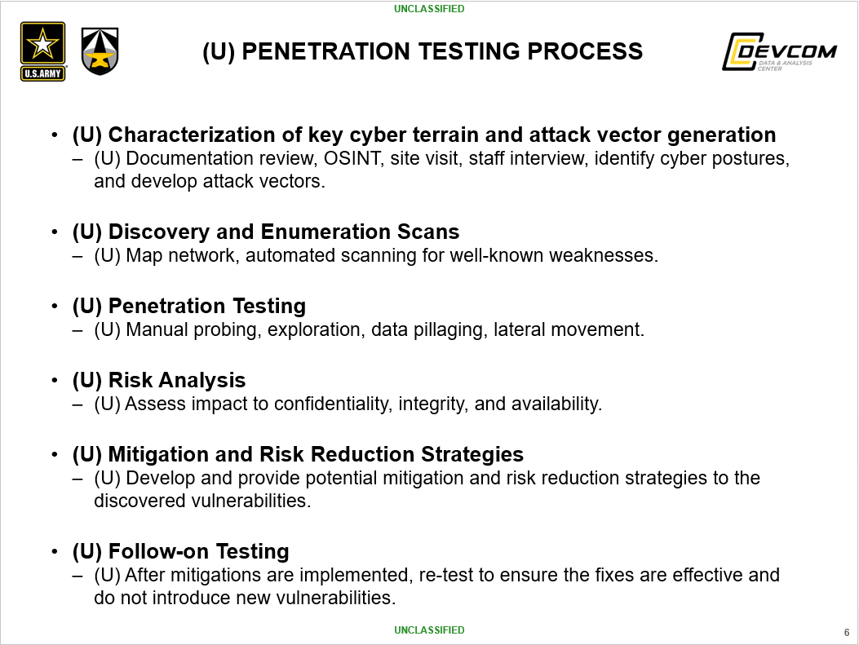
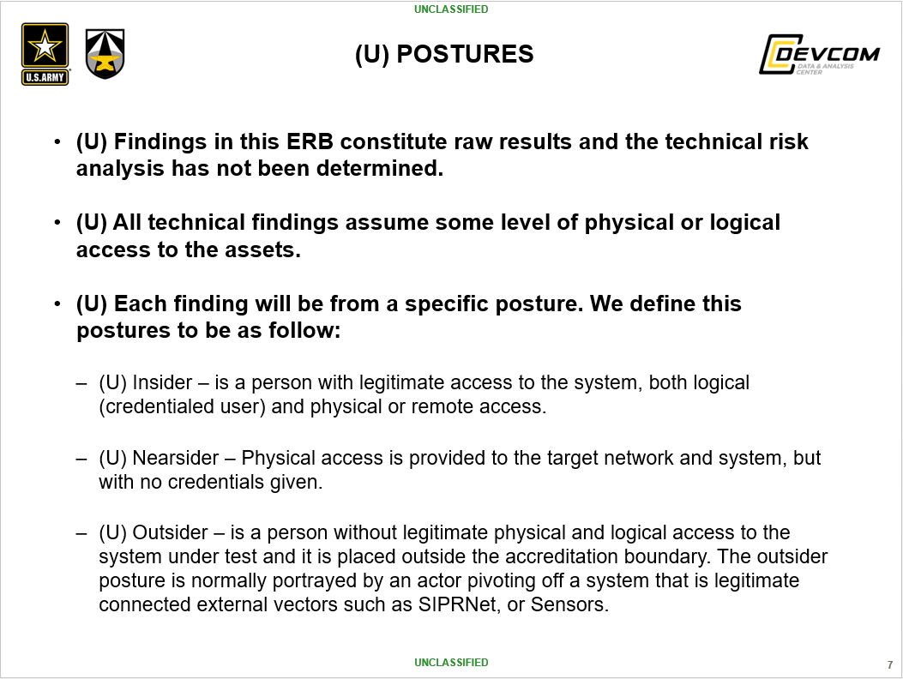
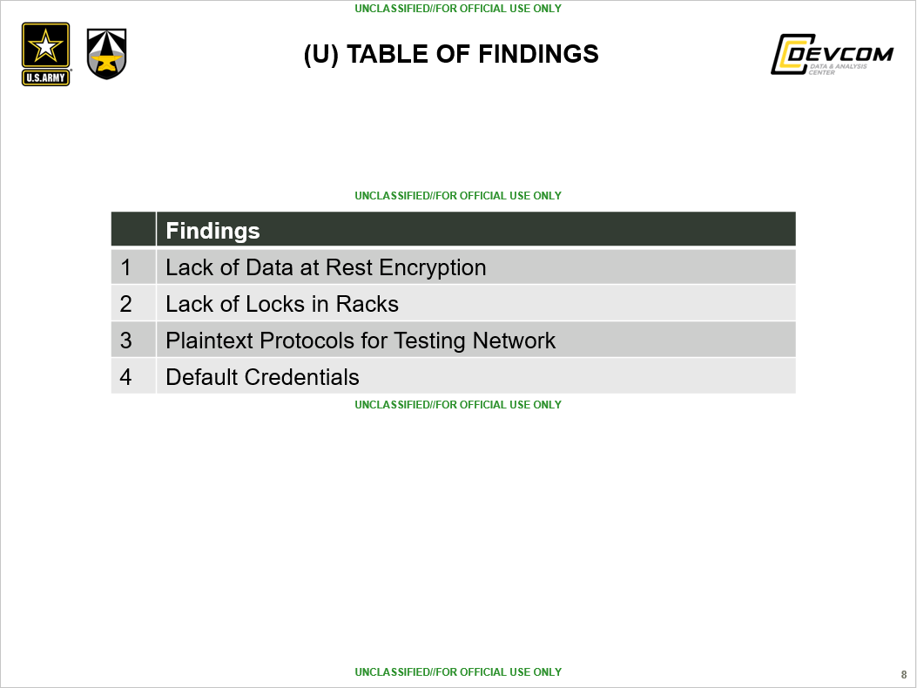
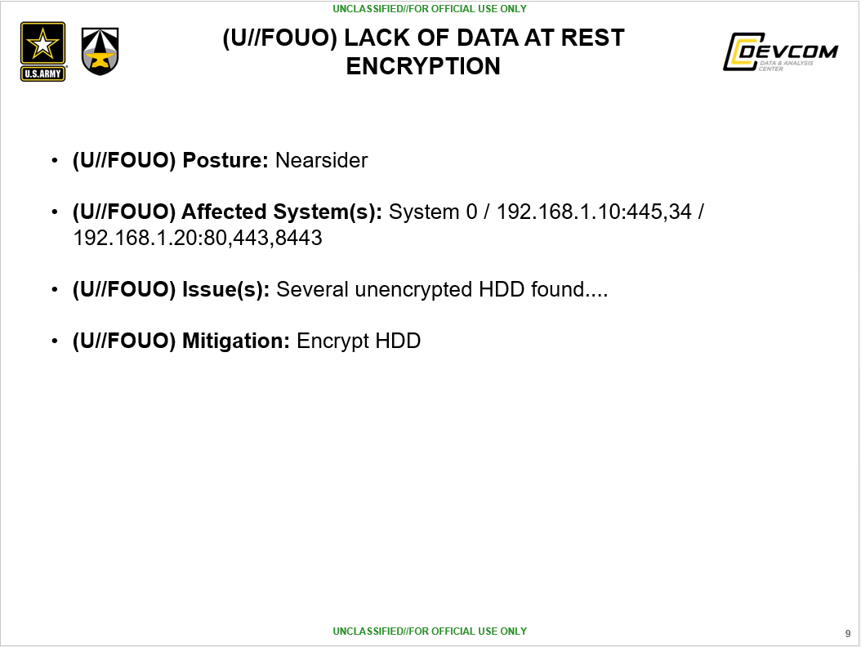
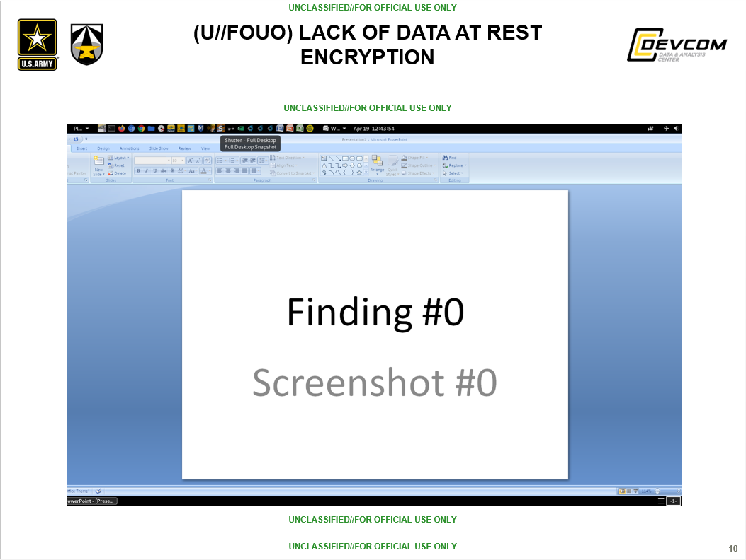
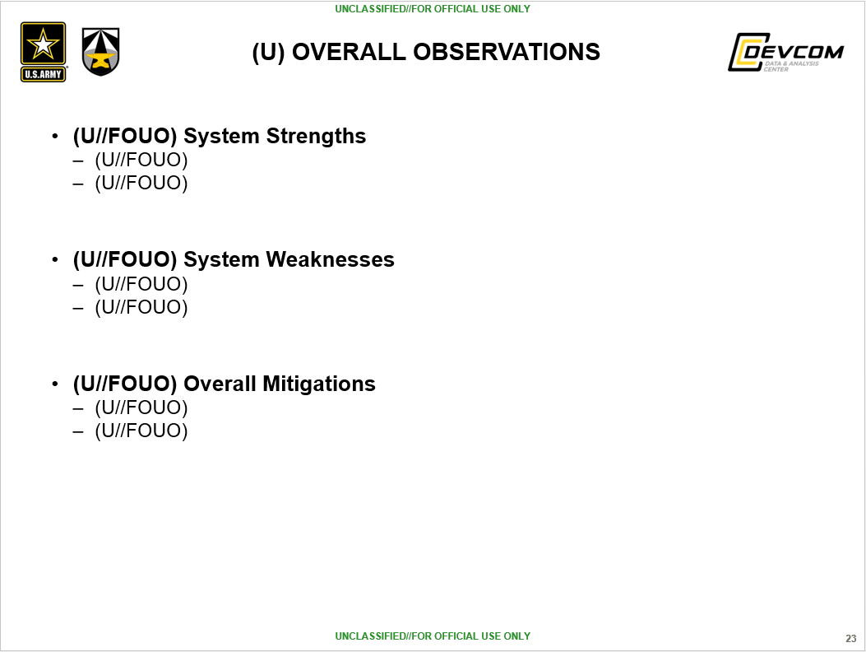
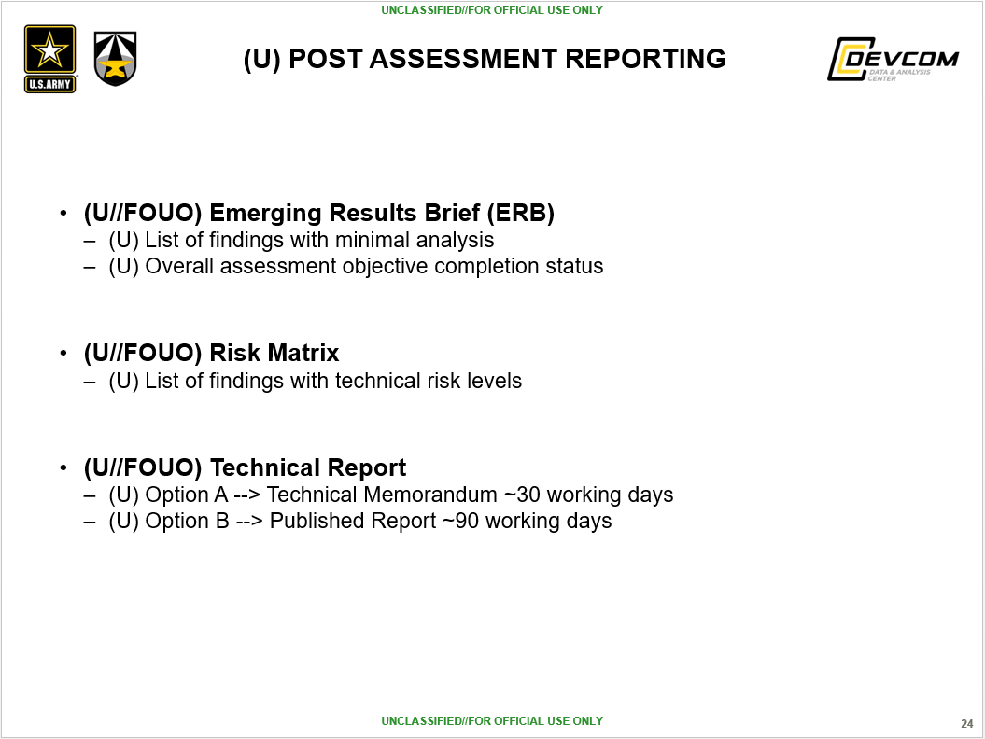
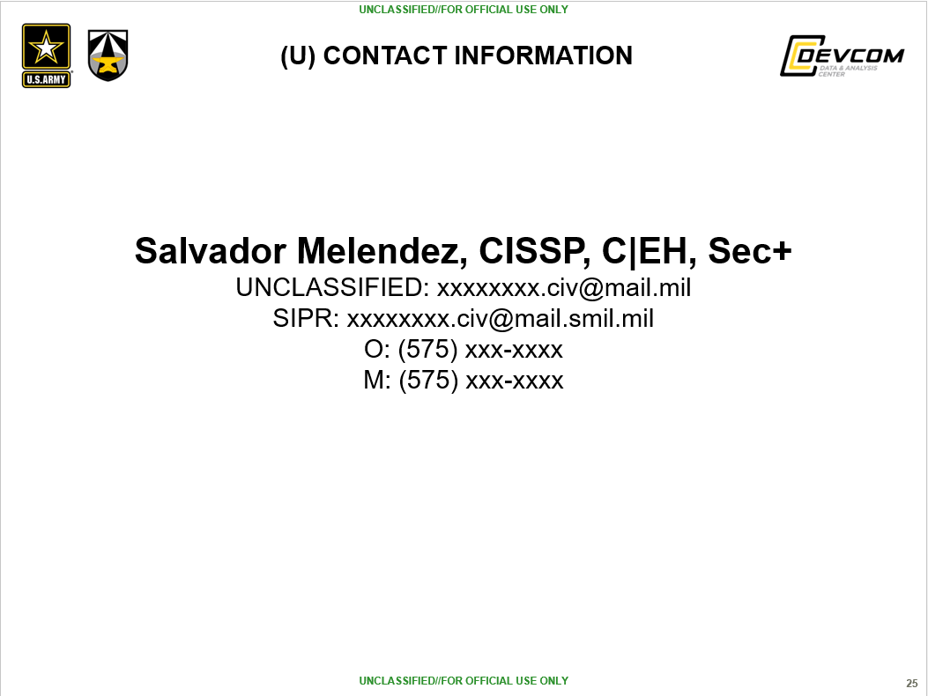
POWERPOINT SLIDE DECK
UNCLASSIFIED
Cover Page
Scope
System Under Test
Agenda
Completion Status
PenTest Process
Postures
Table of Findings
Finding’s Info
(Hots, Issues, Posture, Mitigation)
Screenshots
Overall Observations
Post Assessment Reporting
Contact Information
UNCLASSIFIED

Slide 7
TUTORIAL
UNCLASSIFIED
INSTRUCTIONS ON HOW TO USE THE ERB GENERATOR:
Unzip the file "erb-gen_v3.3.zip" into your "Desktop".
You should have a folder named "erb-gen" with several files.
Export your Dradis findings into your "Desktop".
It should be a zip file called "dradis-export".
Do NOT rename it and do NOT unzip it.
Open a Terminal window and navigate to the "erb-gen" folder:
cd /root/Desktop/erb-gen
Run the tool with this command --> python3 erb-gen.py
Use the GUI to generate your PPTX file; it should be self-explanatory.
When you hit the "PPTX" button, you should have your ERB in your "Desktop".
Open the Windows VM and use Microsoft Office PowerPoint to open the ERB file (recommended).
Complete the slides that are specific to your event.
UNCLASSIFIED

Slide 8

Contact Information
UNCLASSIFIED
Salvador Melendez, Ph.D.
UNCLASSIFIED email: salvador.melendez3.civ@army.mil
UNCLASSIFIED

