Slide 1
CUI//DRAFT//PRE-DECISIONAL
(U) SAMPLE EVENT
(U) Emerging Results Brief (ERB)
Salvador Melendez, Ph.D.
Controlled by: FCDD-DAC-E CUI Category: DCRIT, Export Control Distribution/Dissemination Controls: D POC: Salvador Melendez, Ph.D., (575) 678-xxxx
DISTRIBUTION STATEMENT D. Distribution authorized to the Department of Defense and U.S. DOD contractors only; administrative or operational use; export control; vulnerability information (October 2021). Other requests for this document shall be referred to Director, U.S. Army DEVCOM Data & Analysis Center, White Sands Missile Range, NM 88002.
Computer Engineer
DEVCOM DAC
15 Oct 2021
CUI//DRAFT//PRE-DECISIONAL

Slide 2
(U) SCOPE
CUI//DRAFT//PRE-DECISIONAL
(CUI) <<Add Scope description as needed>>
(CUI)
(CUI)
(CUI)
(CUI)
(CUI)
CUI//DRAFT//PRE-DECISIONAL

Slide 3
(U) SYSTEM UNDER TEST
CUI//DRAFT//PRE-DECISIONAL
CUI
CUI
CUI//DRAFT//PRE-DECISIONAL

Slide 4
(U) AGENDA - EXECUTED ACTIVITIES
CUI//DRAFT//PRE-DECISIONAL
(CUI) 11 Oct 2021
(U) In-processing, setup, network connectivity testing, discovery and enumeration scans, started collecting DOT&E metrics, and began the penetration test.
(CUI) 12 Oct 2021
(U) Continuation of the penetration test and DOT&E metric collection.
(CUI) 13 Oct 2021
(U) Continuation of the penetration test, DOT&E metric collection, and Personnel Interviews.
(CUI) 14 Oct 2021
(U) Continuation of the penetration test and DOT&E metric collection.
(CUI) 15 Oct 2021
(U) Completed the penetration test, performed the system cleanup and restoration, data consolidation, and backup. Performed the Emerging Results Brief (ERB) presentation to stakeholders.
CUI//DRAFT//PRE-DECISIONAL

Slide 5
(U) ACTIVITIES COMPLETION STATUS
CUI//DRAFT//PRE-DECISIONAL
CUI
CUI
CUI//DRAFT//PRE-DECISIONAL

Slide 6
(U) PENETRATION TESTING PROCESS
CUI//DRAFT//PRE-DECISIONAL
(U) Characterization of key cyber terrain and attack vector generation
(U) Documentation review, OSINT, site visit, staff interview, identify cyber postures, and develop attack vectors.
(U) Discovery and Enumeration Scans
(U) Map network, automated scanning for well-known weaknesses.
(U) Penetration Testing
(U) Manual probing, exploration, data pillaging, lateral movement.
(U) Risk Analysis
(U) Assess impact to confidentiality, integrity, and availability.
(U) Mitigation and Risk Reduction Strategies
(U) Develop and provide potential mitigation and risk reduction strategies to the discovered vulnerabilities.
(U) Follow-on Testing
(U) After mitigations are implemented, re-test to ensure the fixes are effective and do not introduce new vulnerabilities.
CUI//DRAFT//PRE-DECISIONAL

Slide 7
(U) POSTURES
CUI//DRAFT//PRE-DECISIONAL
(U) Findings in this ERB constitute raw results and the technical risk analysis has not been determined.
(U) All technical findings assume some level of physical or logical access to the assets.
(U) Each finding will be from a specific posture. We define this postures to be as follow:
(U) Insider – is a person with legitimate access to the system, both logical (credentialed user) and physical or remote access.
(U) Nearsider – physical access is provided to the target network and system, but with no credentials given.
(U) Outsider – is a person without legitimate physical and logical access to the system under test and it is placed outside the accreditation boundary. The outsider posture is normally portrayed by an actor pivoting off a system that is legitimate connected external vectors such as SIPRNet, or Sensors.
CUI//DRAFT//PRE-DECISIONAL

Slide 8
(U) Table of Findings
CUI//DRAFT//PRE-DECISIONAL
CUI
 | Findings
1 | Finding #0
2 | Finding #1
3 | Finding #2
CUI
CUI//DRAFT//PRE-DECISIONAL

Slide 9
(CUI) Finding #0
CUI//DRAFT//PRE-DECISIONAL
(CUI) Posture: Nearsider
(CUI) Affected System(s): system0 / 0.0.0.0
(CUI) Issue(s): This is finding #0 description!
CUI//DRAFT//PRE-DECISIONAL

Slide 10
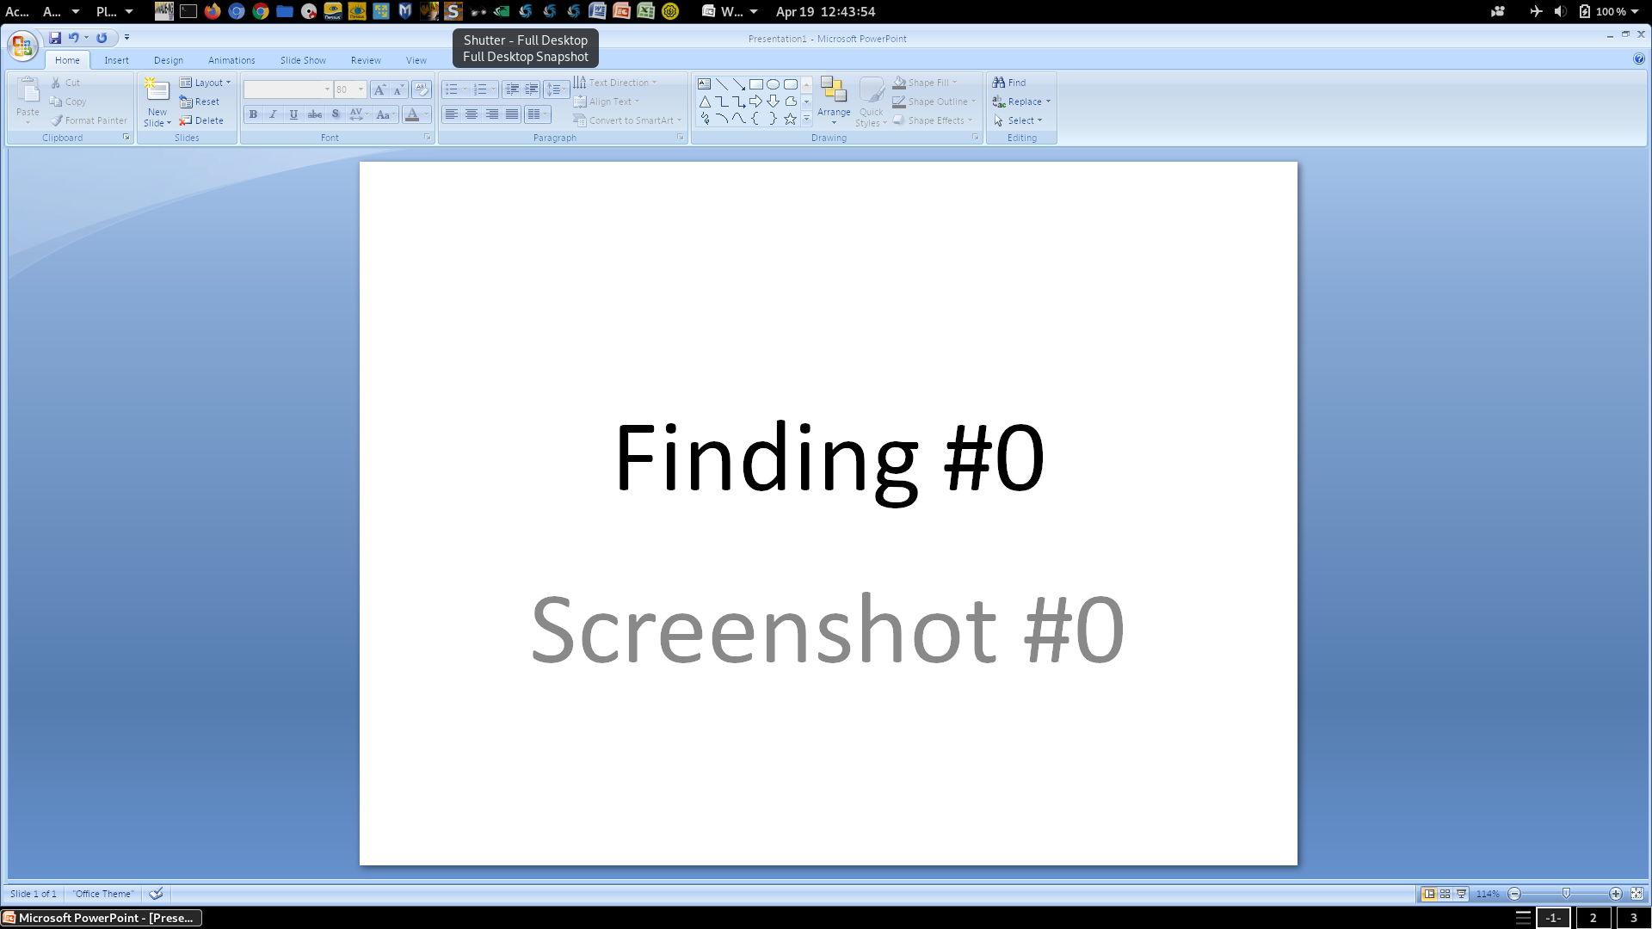
(CUI) Finding #0
CUI//DRAFT//PRE-DECISIONAL
CUI
CUI
CUI//DRAFT//PRE-DECISIONAL

Slide 11

(CUI) Finding #0
CUI//DRAFT//PRE-DECISIONAL
CUI
CUI
CUI//DRAFT//PRE-DECISIONAL

Slide 12

(CUI) Finding #0
CUI//DRAFT//PRE-DECISIONAL
CUI
CUI
CUI//DRAFT//PRE-DECISIONAL

Slide 13
(CUI) Finding #1
CUI//DRAFT//PRE-DECISIONAL
(CUI) Posture: Nearsider
(CUI) Affected System(s): system1 / 1.1.1.1
(CUI) Issue(s): This is finding #1 description!
CUI//DRAFT//PRE-DECISIONAL

Slide 14
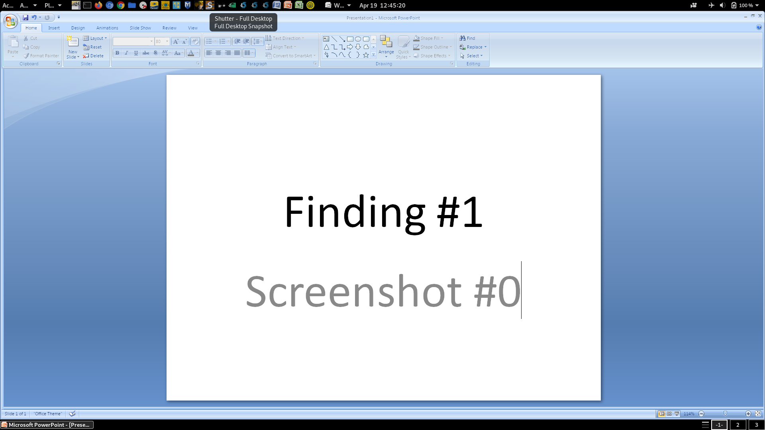
(CUI) Finding #1
CUI//DRAFT//PRE-DECISIONAL
CUI
CUI
CUI//DRAFT//PRE-DECISIONAL

Slide 15
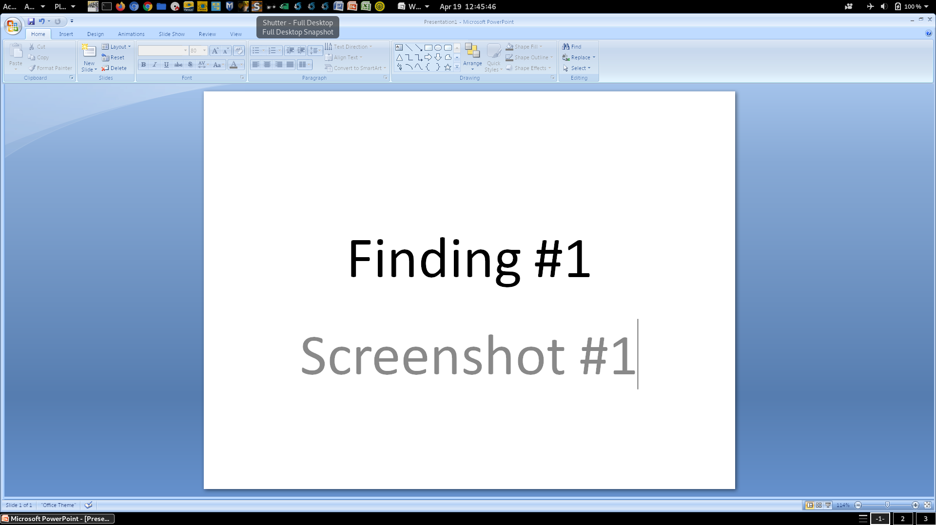
(CUI) Finding #1
CUI//DRAFT//PRE-DECISIONAL
CUI
CUI
CUI//DRAFT//PRE-DECISIONAL

Slide 16
(CUI) Finding #2
CUI//DRAFT//PRE-DECISIONAL
(CUI) Posture: Nearsider
(CUI) Affected System(s): system2 / 2.2.2.2
(CUI) Issue(s): This is finding #2 description!
CUI//DRAFT//PRE-DECISIONAL

Slide 17

(CUI) Finding #2
CUI//DRAFT//PRE-DECISIONAL
CUI
CUI
CUI//DRAFT//PRE-DECISIONAL

Slide 18
(U) OVERALL OBSERVATIONS
CUI//DRAFT//PRE-DECISIONAL
(CUI) System Strengths
(CUI)
(CUI)
(CUI) System Weaknesses
(CUI)
(CUI)
(CUI) Overall Mitigations
(CUI)
(CUI)
CUI//DRAFT//PRE-DECISIONAL

Slide 19
(U) POST ASSESSMENT REPORTING
CUI//DRAFT//PRE-DECISIONAL
(CUI) Emerging Results Brief (ERB)
(U) List of findings with minimal analysis
(U) Overall assessment objective completion status
(CUI) Assessment Results Matrix (ARM)
(U) List of findings with technical risk levels
(CUI) Technical Report
(U) Option A --> Technical Memorandum ~30 working days
(U) Option B --> Published Report ~90 working days
CUI//DRAFT//PRE-DECISIONAL

Slide 20
(U) Contact Information
CUI//DRAFT//PRE-DECISIONAL
Salvador Melendez, Ph.D.
UNCLASSIFIED: xxxxxxxx.civ@army.mil
SIPR: xxxxxxxx.civ@mail.smil.mil
O: (575) xxx-xxxx
M: (575) xxx-xxxx
CUI//DRAFT//PRE-DECISIONAL

