Slide 1
UNCLASSIFIED
DECODING / ENCODING
Professional Development Event (PDE)
Salvador Melendez, Ph.D.
Computer Engineer
DEVCOM DAC
17 Jun 2018
UNCLASSIFIED

Slide 2

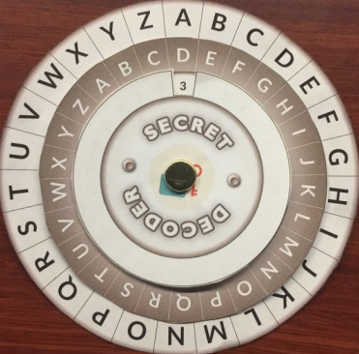
Encryption Fundamentals
UNCLASSIFIED
What is a Secret Message?
A message that is unreadable and does not make sense when you see it.
Some SIMPLE types of encoding:
The alphabet is moved by a number of spaces
Example: number of spaces = 3
shark
{3, 16, 8}
Scrambler
Cipher
Page
Word
Line
Shifting Machine
Book Cipher
Shifting Cipher
UNCLASSIFIED

Slide 3
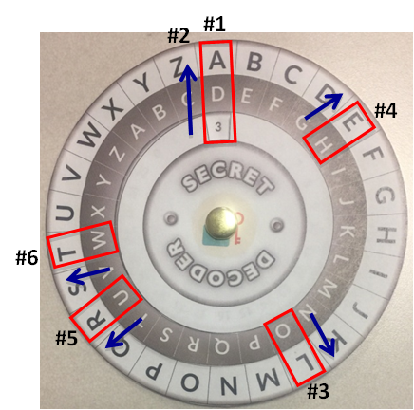
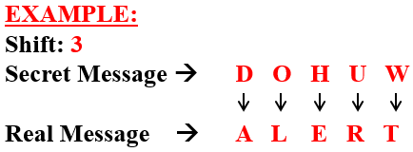
SHIFTING CIPHER
UNCLASSIFIED
Align letter “A” on the WHITE circle with the SHIFT number.
Do NOT rotate the disks after such alignment.
To DECODE, look for the letter of the SECRET message on the BROWN circle and the REAL message letter will be the one on the WHITE circle.
NOTE: The SHIFT NUMBER may be DIFFERENT for each SECRET message.
UNCLASSIFIED

Slide 4
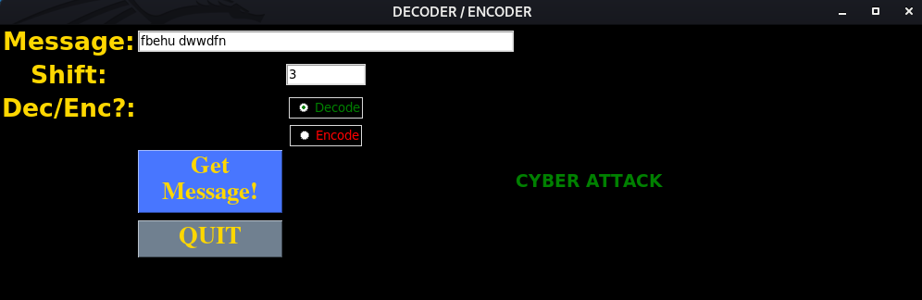
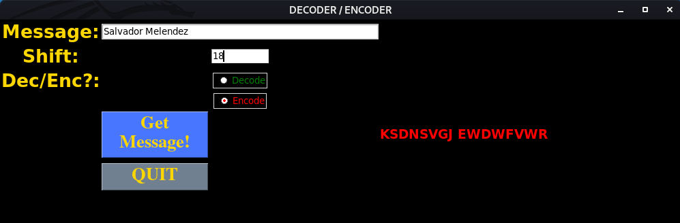
DECODER / ENCODER
UNCLASSIFIED
To run the Python Script, open a Terminal window and type:
python3 decoder.py
Decode Example:
1
2
3
1 – Type the message you want to encode/decode
2 – Type the Shift number
3 – Select if you want to decode or encode
4 – Click on “Get Message!”
5 – Read the decoded/encoded message
4
5
Encode Example:
UNCLASSIFIED

Slide 5

Contact Information
UNCLASSIFIED
Salvador Melendez
UNCLASSIFIED email: salvador.melendez3.civ@army.mil
UNCLASSIFIED

