Slide 1
UNCLASSIFIED
STEGANOGRAPHY
Professional Development Event (PDE)
Salvador Melendez, Ph.D.
Computer Engineer
DEVCOM DAC
29 Jun 2020
UNCLASSIFIED

Slide 2
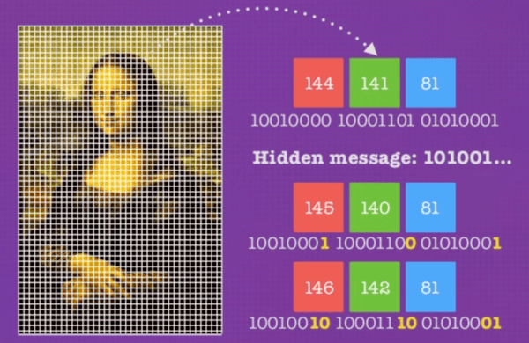
BacKGROUND
UNCLASSIFIED
What is Steganography?
A technique used to hide data within an ordinary file (e.g. image, sound, text, etc.) to keep information secret from a naked eye.
Steganography can be combined with Encryption to provide more security
This PDE uses Steganography on Images.
Each pixel in the image has colors defined in RGB (Red, Green, Blue) format → Color intensity ranges from 0 to 255
UNCLASSIFIED

Slide 3
APPROACH
UNCLASSIFIED
Technique:
Define an Alphabet to represent the characters in binary → 9 bits:
Character | Binary
Empty | 000000000
Space | 000000001
a | 000000010
b | 000000011
c | 000000100
d | 000000101
e | 000000110
f | 000000111
g | 000001000
h | 000001001
i | 000001010
j | 000001011
k | 000001100
l | 000001101
m | 000001110
n | 000001111
o | 000010000
p | 000010001
q | 000010010
r | 000010011
s | 000010100
t | 000010101
u | 000010110
v | 000010111
w | 000011000
x | 000011001
y | 000011010
z | 000011011
Character | Binary
A | 000011100
B | 000011101
C | 000011110
D | 000011111
E | 000100000
F | 000100001
G | 000100010
H | 000100011
I | 000100100
J | 000100101
K | 000100110
L | 000100111
M | 000101000
N | 000101001
O | 000101010
P | 000101011
Q | 000101100
R | 000101101
S | 000101110
T | 000101111
U | 000110000
V | 000110001
W | 000110010
X | 000110011
Y | 000110100
Z | 000110101
0 | 000110110
1 | 000110111
Character | Binary
2 | 000111000
3 | 000111001
4 | 000111010
5 | 000111011
6 | 000111100
7 | 000111101
8 | 000111110
9 | 000111111
~ | 001000000
` | 001000001
! | 001000010
@ | 001000011
# | 001000100
$ | 001000101
% | 001000110
^ | 001000111
& | 001001000
* | 001001001
( | 001001010
) | 001001011
_ | 001001100
- | 001001101
= | 001001110
+ | 001001111
[ | 001010000
] | 001010001
{ | 001010010
} | 001010011
Character | Binary
\ | 001010100
| | 001010101
; | 001010110
: | 001010111
" | 001011000
' | 001011001
< | 001011010
> | 001011011
, | 001011100
. | 001011101
? | 001011110
/ | 001011111
Why 9 bits?
UNCLASSIFIED

Slide 4
APPROACH
UNCLASSIFIED
Technique:
We’ll be using 9 bits to make it multiple to the number of colors (3) → RGB.
Each character will be hidden in 3 pixels.
Each pixel has a color in RGB.
Example:
UNCLASSIFIED

Slide 5
APPROACH
UNCLASSIFIED
Technique:
We’ll encode the bits by checking if they are Odd or Even:
Odd → 1 / Even → 0
We have 4 cases:
1) The Pixel Value is Even and the Bit is ‘0’ → Keep the Pixel Value Even
2) The Pixel Value is Even and the Bit is ‘1’ → Make the Pixel Value Even by adding 1
3) The Pixel Value is Odd and the Bit is ‘0’ → Make the Pixel Value Odd by substracting 1
4) The Pixel Value is Odd and the Bit is ‘1’ → Keep the Pixel Value Odd
UNCLASSIFIED

Slide 6
APPROACH
UNCLASSIFIED
Example:
124
148
236
122
158
69
90
80
149
UNCLASSIFIED

Slide 7
APPROACH
UNCLASSIFIED
Technique:
To decode the message, we reverse engineer it with the same method:
0
0
0
0
0
1
0
0
1
h
UNCLASSIFIED

Slide 8
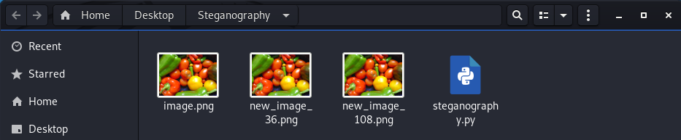
APPROACH
UNCLASSIFIED
Technique:
How do we know WHERE is the END of the message?
We append the following sequence to the message → \n*
How do we keep images/messages in our working folder?
Example:
message
end message
The number in the file name, tells you the COLUMN in which the message is hidden!
The message is hidden VERTICALLY
Original Image
Encoded Message #36
Encoded Message #108
UNCLASSIFIED

Slide 9
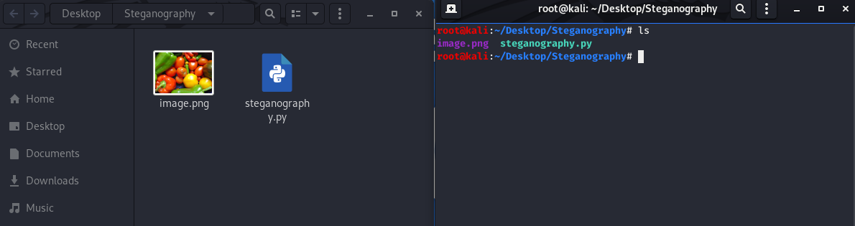
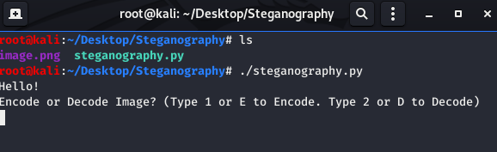
IMPLEMENTATION
UNCLASSIFIED
We’ll implement Steganography on images with a Python script
How do we run it?
Go to the Steganography Folder and make sure you have a ‘.png’ image and the steganography.py script.
Run the scrip by typing → python3 steganography.py
UNCLASSIFIED

Slide 10
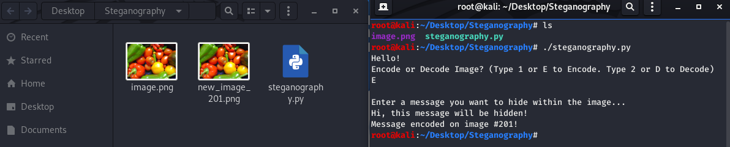
IMPLEMENTATION
UNCLASSIFIED
You will be prompted if you want to “Encode” or “Decode”.
Type “1” or “E” or “e” to Encode
Type “2” or “D” or “d” to Decode
When Encoding, just type any message you want to hide and press “enter” at the end.
A new image is created with a random number (remember it’s the column where the message is hidden)
UNCLASSIFIED

Slide 11
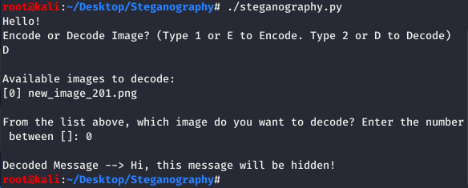
IMPLEMENTATION
UNCLASSIFIED
When Decoding, just type the number between [ ] to select one of the available images
UNCLASSIFIED

Slide 12

Contact Information
UNCLASSIFIED
Salvador Melendez
UNCLASSIFIED email: salvador.melendez3.civ@army.mil
UNCLASSIFIED

