Slide 1
A
Regional Potential Species Pool
B
Signatures of Environmental Filtering (EF)
Phylogenetic and Functional Diversity
Dispersal and Chance Filter
Low Abiotic Stress
(Low SST)
High Abiotic Stress
(High SST)
Suite of Diverse Functional Traits
Similar Functional Traits
Abiotic Environmental Filter
EF Signature
Phylogenetic Clustering in a Community
Community of Closely Related Species
Biotic Interactions Filter
Final Community
Figure 1. A) Key filters for community assembly. B) Signatures of environmental filtering.

Slide 2
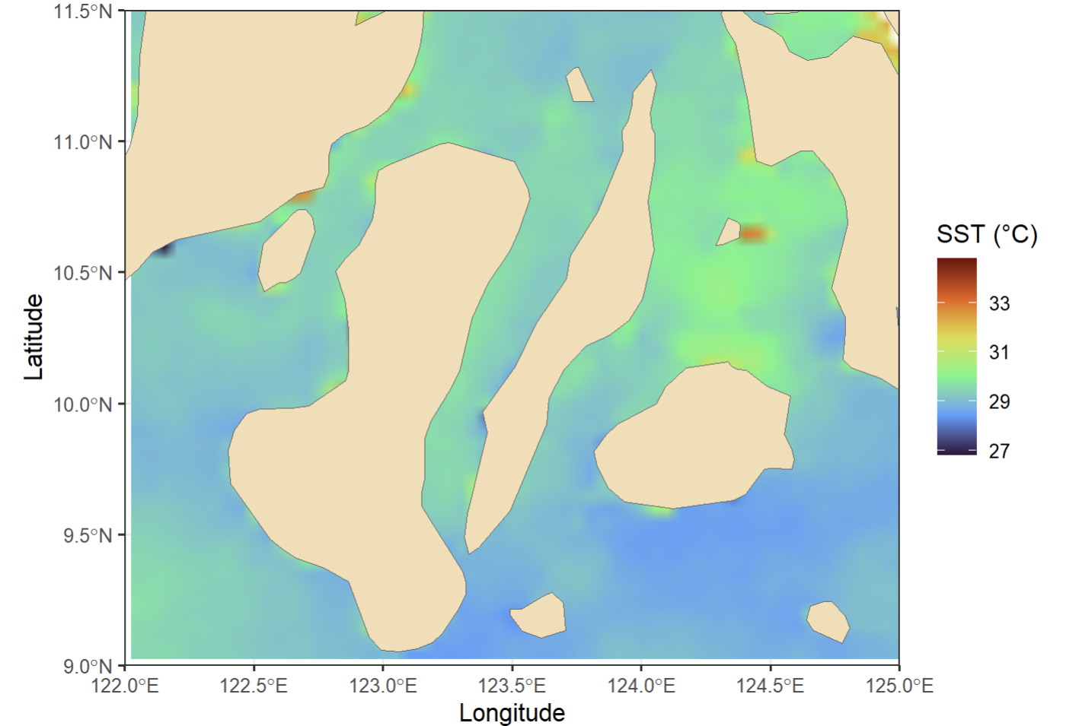
11.5°N
11°N
10.5°N
10°N
9.5°N
9°N
Panay
Bantayan
Leyte
SST (°C)
Camotes Islands
Guimaras
Island
33
29
Latitude
Cebu
31
27
Bohol
Negros
Bohol Sea
Camiguin
Island
Sampling Sites
Sulu Sea
Siquijor
122°E 122.5°E 123°E 123.5°E 124°E 124.5°E 125°E
Longitude
Figure 2. Map of 2019 sea surface temperature in the Visayas region, overlapped with potential sampling sites.

