Slide 1




AIutami: a Vocal Multicontext AIModerator
Project: “Murder Mistery on the line”
Group 8:
Simone Cosenza
Salvatore Pio Conte
Sara Imparato
AUI 2025-2026

Slide 2
UNG

Slide 3


USERS
NEEDS
Primary:
Students, Researchers, Colleagues
Feeling heard & included
Reduce interruptions & overlap
Maintain focus and productivity
Encourage hesitant participants
Secondary:
Teachers, Managers, Therapists
Moderators / Facilitators
Tertiary:
Educational institutions, Companies
GOALS
CONTEXT
Regulate turn-taking (one speaker at a time)
Track participation patterns
Provide real-time AI interventions
Generate periodic and final summaries
Manage session lifecycle phases
Web-based application
Small groups (2–8 participants)
Real-time vocal interaction
Collaborative scenarios (study, workplace...)
Structured session phases
CONSTRAINTS
ASR–LLM–TTS latency
Speech recognition errors
LLM behavioral limitations
Cloud-based audio processing
Single-server scalability limits

Slide 4

STATE OF THE ART

Slide 5



RESEARCH
EXISTING PRODUCTS
IDENTIFIED GAP
MUCA – Multi-User Chat Assistant
Multiuser Conversational Agents
LLMs as Facilitators
LLMs Get Lost in Multi-Turn Conversation
Video Conferencing Platforms (Zoom, Microsoft Teams, Google Meet)
Transcription Tools (Otter.ai)
Conversation Intelligence Platforms (Gong)
Modality
Context Awareness
Architectural Robustness
Formalization of multi-user moderation
AI influence on participation dynamics
Task-awareness vs. task-agnostic moderation
Performance degradation in multi-turn dialogue
Need for structured state and memory mechanisms
Real-time voice infrastructure
Manual turn-taking management
Passive transcription/documentation
Post-hoc analytics (not live intervention)
Absence of real-time AI moderation
No integration of voice + AI moderation in real time
Limited task-aware conversational facilitation
Over-reliance on prompt-only approaches
Weak dialogue state coherence in long interactions
Need for explicit state tracking and structured memory

Slide 6
SOLUTION -
UX DESIGN

Slide 7
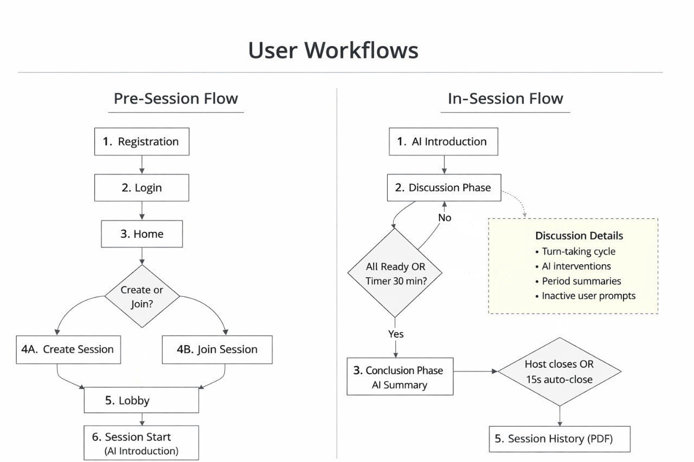
User Workflows

Slide 8
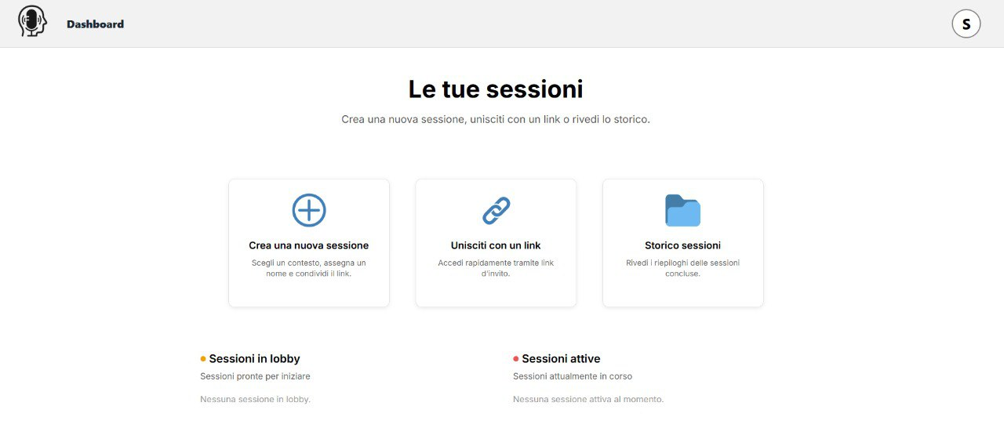
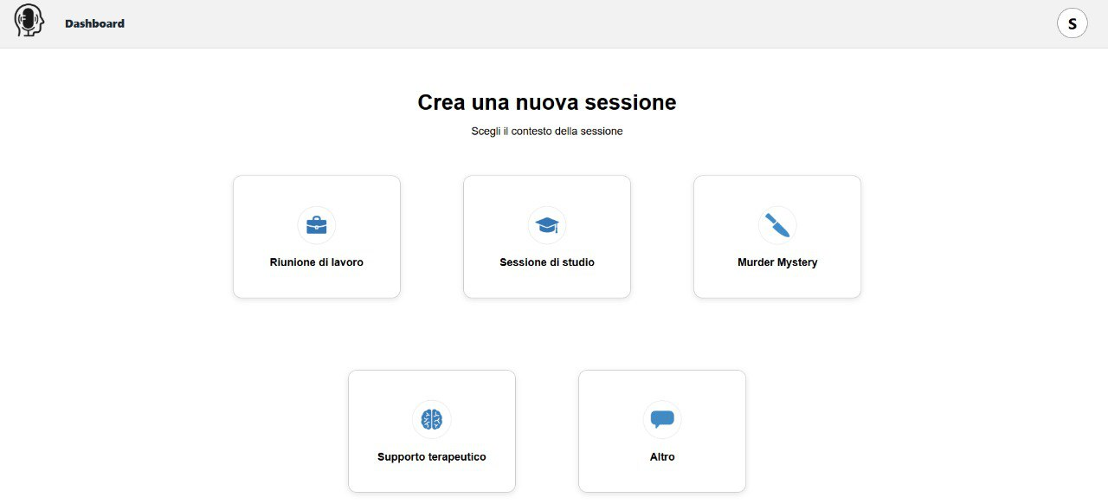
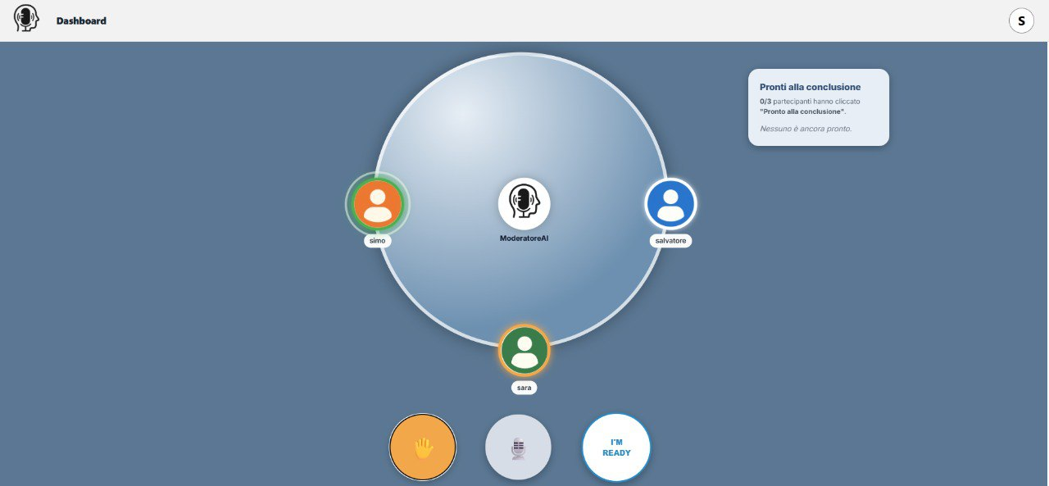
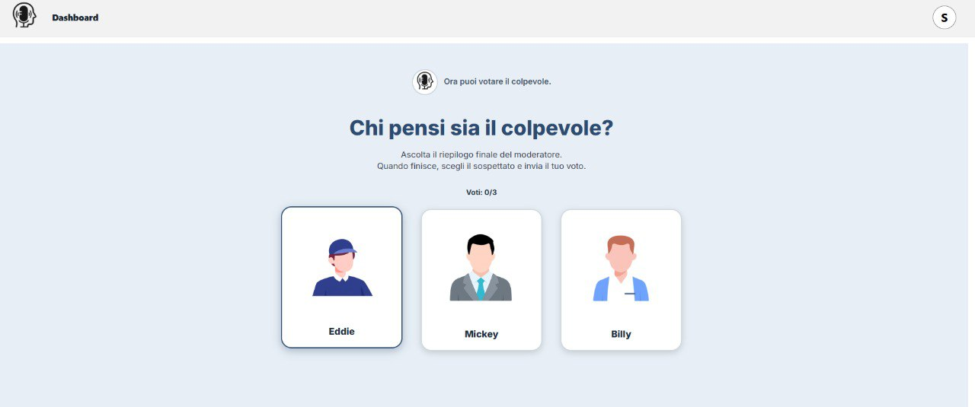

Slide 9
SOLUTION -
TECHNOLOGY

Slide 10
Deployment
Software Architecture
Azure VM
Session Management → session lifecycle
WEB
DB
REDIS
Turn Management → speaking turn coordination
Audio Transport → WebRTC server-side forwarding
Speech Recognition → real-time transcription (Azure STT)
AI Moderation → intervention decisions (Azure OpenAI)
Azure Services
STT
OpenAI
TTS
Text-to-Speech → moderator voice synthesis (Azure TTS)

Slide 11
Moderation Pipeline
Human Turn Ends
Load State
Evaluate Triggers
Call LLM
Apply Filters
Final Decision
→
→
→
→
→
Trigger System
Type | Trigger | Action
Turn-based | Every 6 human turns | Forced summary
Time-based | Silence, inactive user, 30 min limit | Prompt / Solicitation / Conclusion
Event-based | "Ready to conclude" button | Contextual message

Slide 12
Prompt Engineering - Structure
SYSTEM PROMPT
USER MESSAGE
JSON OUTPUT
Moderator role
Intervention rules
Current summary
Last turn text
Speaker name
Turns per user
Session Phase
Updated summary
should_ai_speak
message_to_say
reason
score
→
→

Slide 13
Normal Mode Prompt
Forced Summary Prompt
Purpose: After each human turn, decide if the moderator should intervene
Purpose: Every 6 human turns, generate a discussion summary
Intervention criteria:
Monopolization → one participant dominates
Exclusion → someone is not participating
Off-topic → discussion goes off track
Conflict → aggressive tones or personal attacks
Direct request → participant asks for help
Message structure:
Gentle correction (only if needed)
Recap of clues discussed so far
Open question on unexplored aspects
Output example:
{
"message_to_say": "So far we've
heard that the butler had access
to the room, but no one has
mentioned
the weapon yet...",
"correction_reason": null
}
Output example:
{
"should_ai_speak": true,
"message_to_say": "Lucia, what
do you think?",
"reason": "exclusion",
"intervention_score": 0.75
}

Slide 14
Forced Conclusion Prompt
Report Generation Prompt
Purpose: Generate final message when session ends
Purpose: Generate text report for completed session
Message structure:
Discussion summary
Voting instructions
Thank participants
Report sections:
Final result
→ guilty party, how many guessed correctly
Participant votes
→ who chose whom (✓/✗)
Participation stats
→ turns per person + AI interventions
Discussion summary
→ reworked from running summary
Final analysis
→ brief commentary on how it went
Adapts tone based on reason:
timer_expired
→ acknowledges work done despite time limit
all_participants_ready
→ values their decision to conclude
Output example:
{ "message_to_say": "Great work!
You analyzed several clues... Now
select who you think is
guilty.Thanks for using AIutami!"
}
Output:
Plain text (no JSON), 300-500 words

Slide 15
VALUE
PROPOSITION

Slide 16



VALUE FOR USERS
WHY A GOOD SOLUTION
COMPETITIVE LANDSCAPE
Participation Balance
Focus & Alignment
Reduced Social Friction
Voice-first moderation
Proactive AI intervention
Structured state management
Task-aware facilitation
Balanced automation
Video Conferencing Platforms
Transcription Services
Conversation Intelligence Tool
Equitable speaking opportunities
Prevention of monopolization
Periodic alignment through summaries
Transparent participation tracking
More democratic discussions
Real-time voice integration (ASR + LLM + TTS)
Context-aware moderation logic
Explicit turn tracking & state storage
Controlled AI intervention (cooldown + triggers)
Structure without replacing human agency
No competitor integrates voice + active moderation
Others are infrastructure-only or passive
No structured turn management
No real-time participation balancing
AIutami shapes conversations live

Slide 17
DISCUSSIO
AND
FUTURE WORK

Slide 18



CRITICAL REFLECTION
LIMITATIONS
FUTURE DEVELOPMENTS
Audio pipeline complexity
AI intervention calibration
Real-time component integration
Single-server architecture
Scenario-specific moderation logic
Cloud service dependenc
Context generalization
Adaptive AI moderation
WebRTC + ASR integration requires precise audio normalization
Sample-rate mismatch can compromise voice quality
AI activity must be carefully balanced (cooldown + triggers)
Separation of Redis (ephemeral) and PostgreSQL (persistent) is effective
Real-time AI systems demand tight orchestration across modules
Limited horizontal scalability
Tailored to Murder Mystery context
Dependence on Azure services
Latency tied to LLM response time
External processing of audio data
Configurable moderation profiles
Multi-context session templates
Adaptive intervention thresholds
Learning from session outcomes
Participant feedback integration

Slide 19
Thanks!
Team: Project 8
Simone Cosenza, Sara Imparato, Salvatore Pio Conte
AUI 2025-2026

