Slide 1
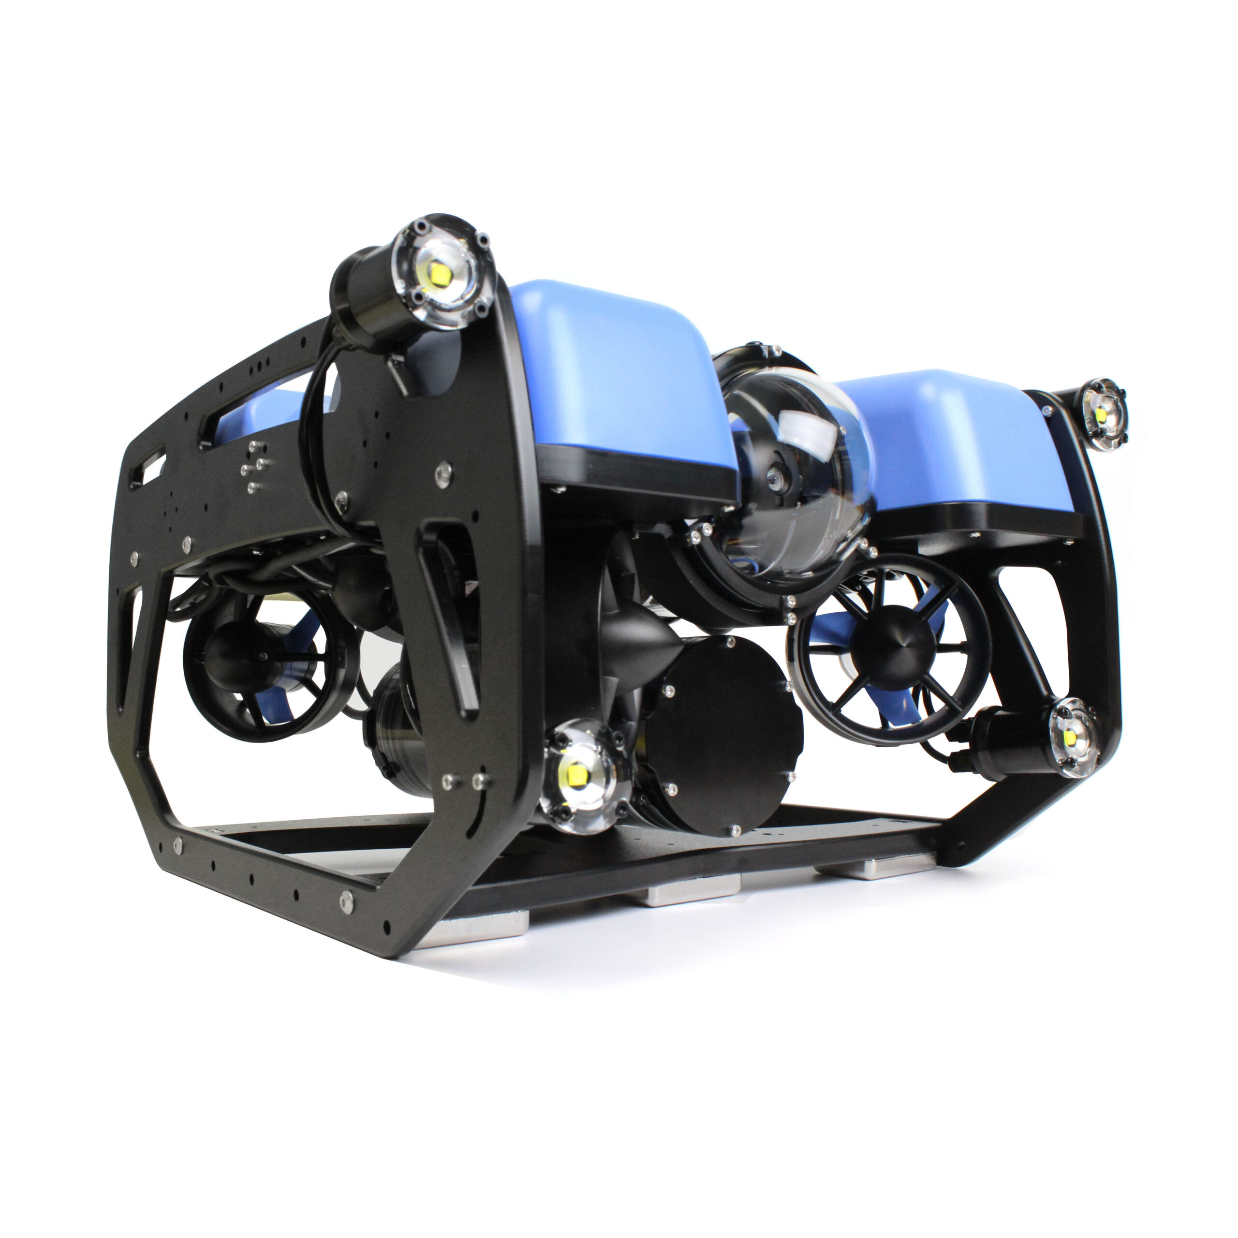
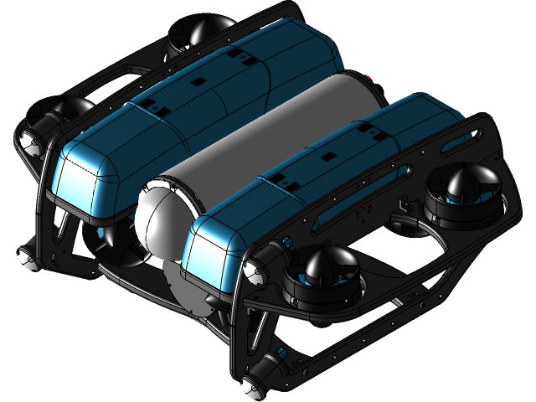
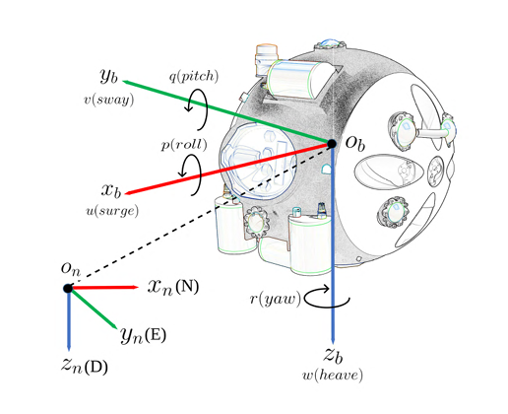
DIPARTIMENTO DI INGEGNERIA ELETTRICA E TECNOLOGIE DELL’INFORMAZIONE
SCUOLA POLITECNICA E DELLE SCIENZE DI BASE
Field and Service Robotics Technical Project
Control of an Underwater Robot (BlueROV2)
Student: Salvatore De Luca P38000281
Notes:
The Technical Project I worked on consists in the modelling and control of an Underwater Robot

Slide 2

Contents
Introduction
Modelling
Kinematic Model
6-DOF Dynamic Model
BlueROV2
Controllers
Feedback Linearizing Control
Sliding Mode Control
Results and comparison
CONTENTS

Slide 3
Introduction
This project explores the modelling and control of an Underwater Robot, with a focus on BlueROV2 Heavy (Blue Robotics)
First a 6-DOF dynamic model has been developed
Control of such vehicles is a rather complex and challenging task, due the highly non-linear terms of the model
Two non-linear control strategies have been tested to make the robot follow a desired trajectory
INTRODUCTION
Notes:
In particular the project is focused on modelling a BlueROV2, so a 6-DOF dynamic model has been developed. Underwater robots are characterized by highly non linear terms, so control of such vehicles could be challenging, for this reason one can adopt Model-Based control technique to obtain some sort of compensation of the non linearities. In this project two non linear control strategies have been developed and tested in simulation to make to ROV follow a trajectory

Slide 4

Modelling
Reference Frames
NED frame
Body frame
Nomenclature
Pose vector in the NED frame
$η={\left[x y z φ θ ψ \right]}^{T}$
Twist vector in the body-fixed frame
$ν={\left[u v w p q r\right]}^{T}$
Force and moments acting on the vehicle in the body fixed frame
$$u={[M Y Z K M N]}^{T}$$
MODELLING (1)
Notes:
To compute the model two frames have been considered:
a NED reference frame, which refers to the real world, where the x,y,z axes points toward north,east and downwards NORMAL to the earth’s surface
A Body frame attached to the body of the vehicle and fixed with respect to it, the center of such a frame typically coincides with the center of mass of the body
Once the frame have been fixed we can define
the pose vector in the NED reference frame
a twist vector in the body-fixed frame
the vector of forces and moments that act on the vehicle in the body fixed frame

Slide 5
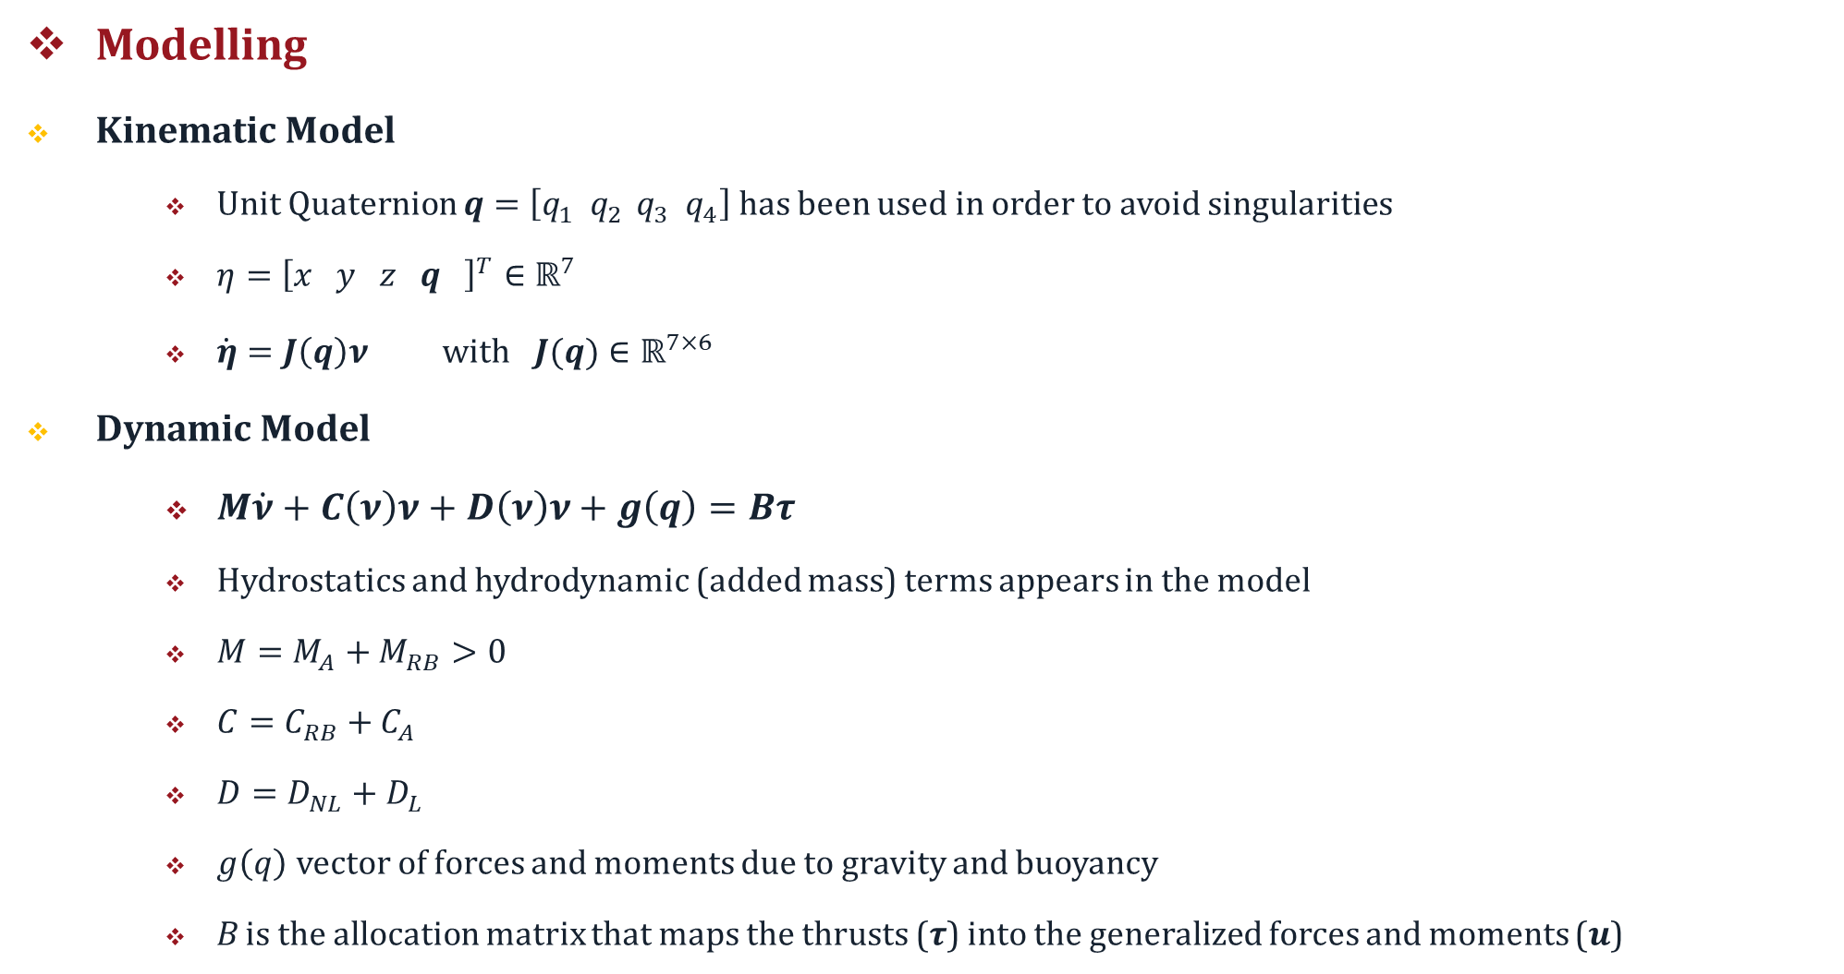
Modelling
Kinematic Model
Unit Quaternion $q=\left[q_{1}{ q}_{2 }q_{3}{ q}_{4}\right]$ has been used in order to avoid singularities
$η={\left[x y z q \right]}^{T}∈ℝ^{7}$
$\dot{η}=J\left(q\right)ν$ with $J(q)∈ℝ^{7×6 }$
Dynamic Model
$M\dot{ν}+C\left(ν\right)ν+D\left(ν\right)ν+g\left(q\right)=Bτ$
Hydrostatics and hydrodynamic (added mass) terms appears in the model
$M=M_{A}+M_{RB}>0$
$C=C_{RB}+C_{A}$
$D=D_{NL}+D_{L}$
$g\left(q\right)$ vector of forces and moments due to gravity and buoyancy
B is the allocation matrix that maps the thrusts ($τ$) into the generalized forces and moments ($u$)
MODELLING (2)
Notes:
Then the kinematic model has been derived. Unit Quaternion has been used to represent orientation (since from the simulation singularities of Euler Angles occurred). This implies that the pose vector is a 7x1 vector and the Jacobian that describe the mapping from world frame coordinates and body frame coordinate has more rows than columns
Then a 6-DOF dynamic model has been derived. In this model both hydrostatics and hydrodynamic effects appear. In fact when a body moves in a fluid whose density is comparable with the body density, one should take into account that the particles around the moving body exhibit non zero acceleration, then a reaction force is necessary to achieve an acceleration and this hydrodynamic effect is treated as an additional mass from a modelling point of view
So then M is a sum of the rigid-body inertia matrix and the added mass inertia
The Coriolis and centrifugal matrix is the sum of a term regarding the rigid body and a term regarding the added mass
The damping matrix is a sum of linear damping and a non linear damping term
The g is the vector of forces and moments due to gravity and buoyancy (the force that the fluid exerts in the partially or completely submerged body)
B is the allocation matrix that maps the actual thrusts of the vehicle into the generalized force and moments

Slide 6
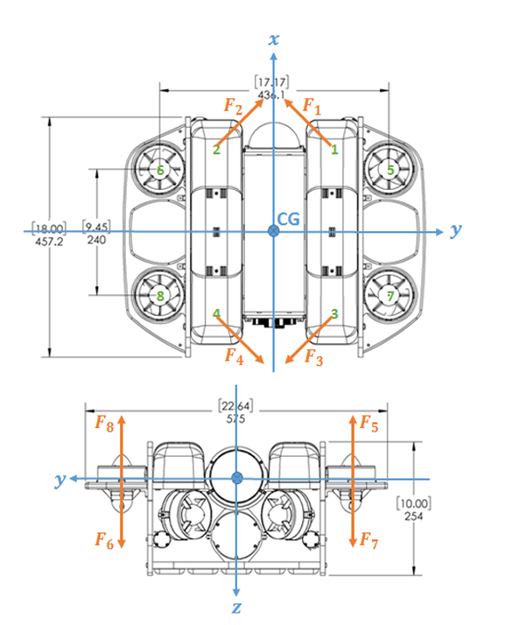
BlueROV2
The physical system used for this project is the BlueROV2Heavy (BlueRobotics 2018a)
Eight thrusters instead of six
Fully actuated
BLUEROV2
Notes:
The vehicle considered in the project is BlueROV2 in Heavy Configuration. Eight thrusters are mounted on the vehicle instead of six in the classical configuration and the configuration is such that the vehicle is fully actuated. This can be verified by computing the rank of the allocation matrix, and also from an heuristic point of view by looking at the thrusters configuration depicted in figure.

Slide 7
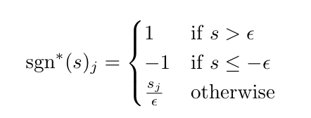
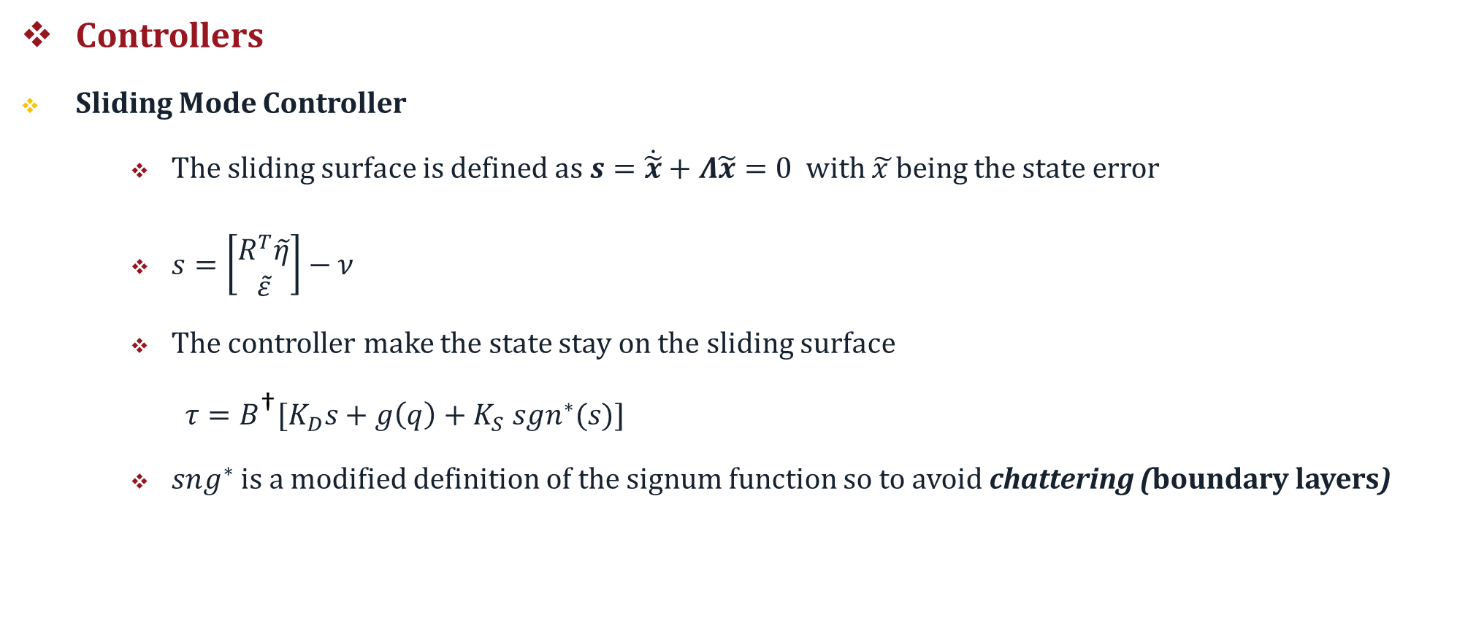
Controllers
Sliding Mode Controller
The sliding surface is defined as $s=\dot{\tilde{x}}+Λ\tilde{x}=0$with $\tilde{x }$being the state error
$s=\left[\begin{matrix}R^{T}\tilde{η} \\ \tilde{ε}\end{matrix}\right]−ν$
The controller make the state stay on the sliding surface
$τ=B^{\text{†}}[K_{D}s+g\left(q\right)+K_{S}{ sgn}^{∗}(s)$]
$sng^{∗}$ is a modified definition of the signum function so to avoid chattering (boundary layers)
CONTROLLERS(1)
Notes:
The controllers that have been developed are the sliding mode controller and a feedback linearizing controller.
S is R’eta_tilde,epsilon tilde – the twist vector.
The main idea of sliding mode controller is to define a sliding surface in terms of the state error vector and its derivative, then the controller, once the sliding condition is satisfied, force the state to remain on the sliding surface. This may cause a high control activity due also to the presence of a switching part of the controller (the sign function). So typically such controllers may suffer from chattering effect. To overcome that a boundary layer strategy has been adopted modifying accordingly the signum function. This will cause the error do not stay on the sliding surface but force the error to stay in the boundary layer (and so it will be norm bounded)

Slide 8
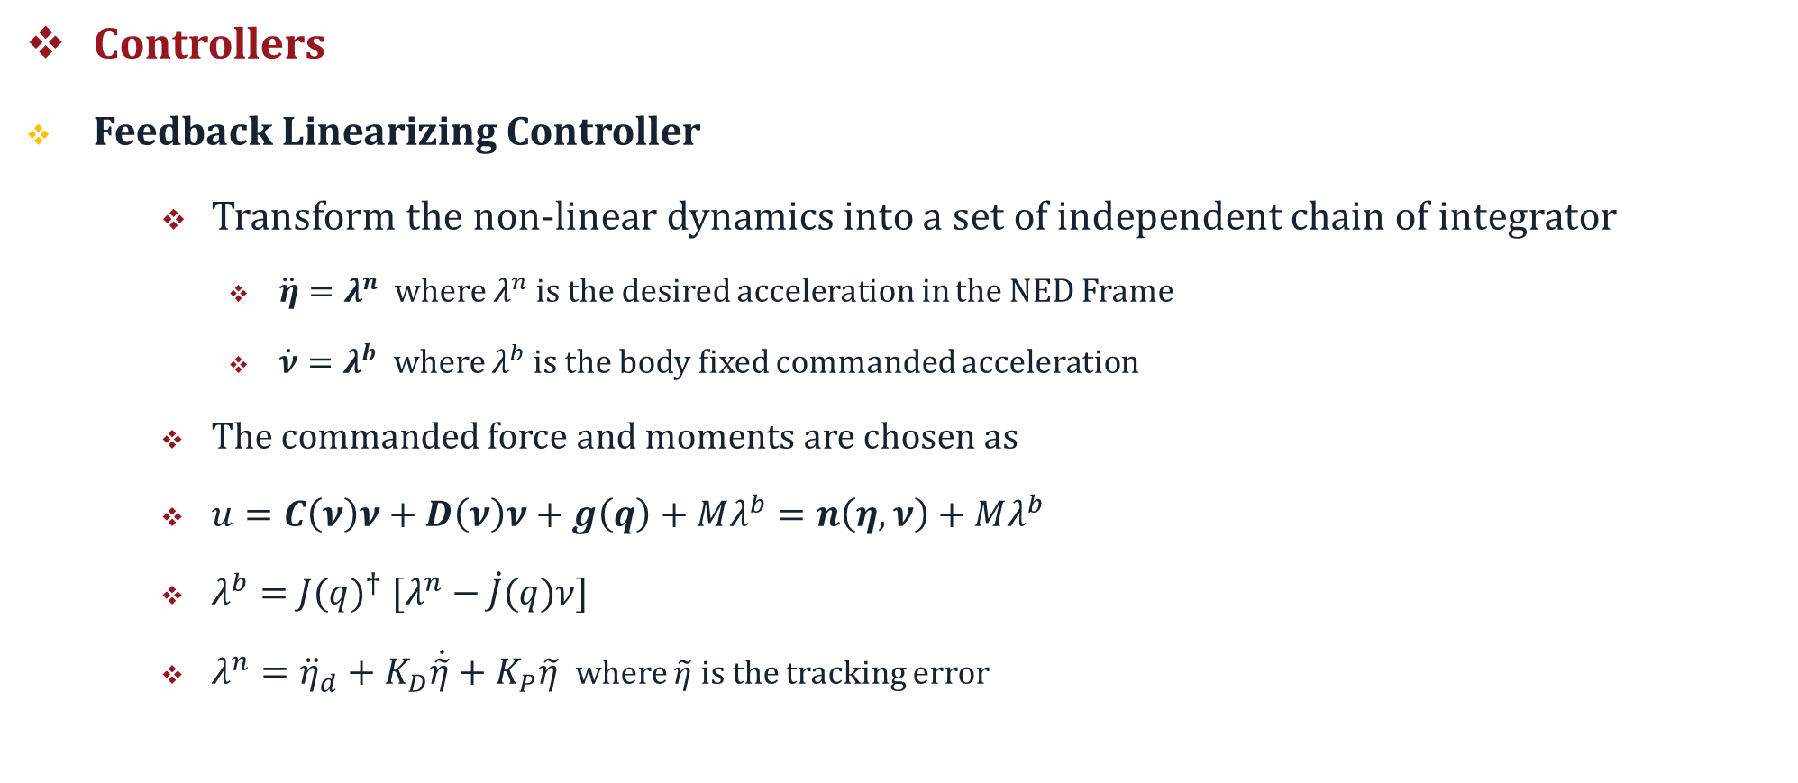
Controllers
Feedback Linearizing Controller
Transform the non-linear dynamics into a set of independent chain of integrator
$\ddot{η}=λ^{n}$ where $λ^{n}$ is the desired acceleration in the NED Frame
$\dot{ν}=λ^{b}$ where $λ^{b}$ is the body fixed commanded acceleration
The commanded force and moments are chosen as
$u=C\left(ν\right)ν+D\left(ν\right)ν+g\left(q\right)+Mλ^{b}=n\left(η,ν\right)+Mλ^{b}$
$λ^{b}={J(q)}^{† }[λ^{n}−\dot{J}(q)ν]$
$λ^{n}={\ddot{η}}_{d}+K_{D}\dot{\tilde{η}}+K_{P}\tilde{η}$ where $\tilde{η}$ is the tracking error
CONTROLLERS(2)
Notes:
Feedback linearizing approach is to obtain a dynamic model linear and decoupled, so a set of independent integrators, as we can see from the formulas. The control input is chosen as a sum of a non linear compensating term, and M times the body fixed commanded acceleration, which is given by the following expression (we have to use the pseudo inverse since we are adopting unit quaternion representation).
Then the commanded acceleration in the body frame consists of a feedforward in the acceleration and a PD action on the tracking error.

Slide 9
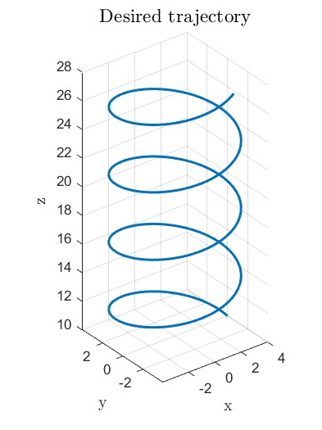
Simulation
Carried out in Matlab-Simulink
Solver ode45 (Dormand-Prince), otherwise singular solutions may occur in the integration
The objective is to make the ROV follow a desired 3D trajectory
Tuning of the parameters via tiral-and-error
SIMULATION (1)
Notes:
Simulation has been carried out in Matlab Simulink. The solver adopted was Dormand-Prince because the system is quite stiff. Otherwise singular solutions in the numerical integration occur. The objective is to make the ROV follows a trajectory in the 3D space, a helix in particular,whereas for the orientational part the controller should ensure that the initial value of the quaternion (1,0,0,0) stays the same during the motion. Tuning of the control gains have been tuned via trial and error.

Slide 10
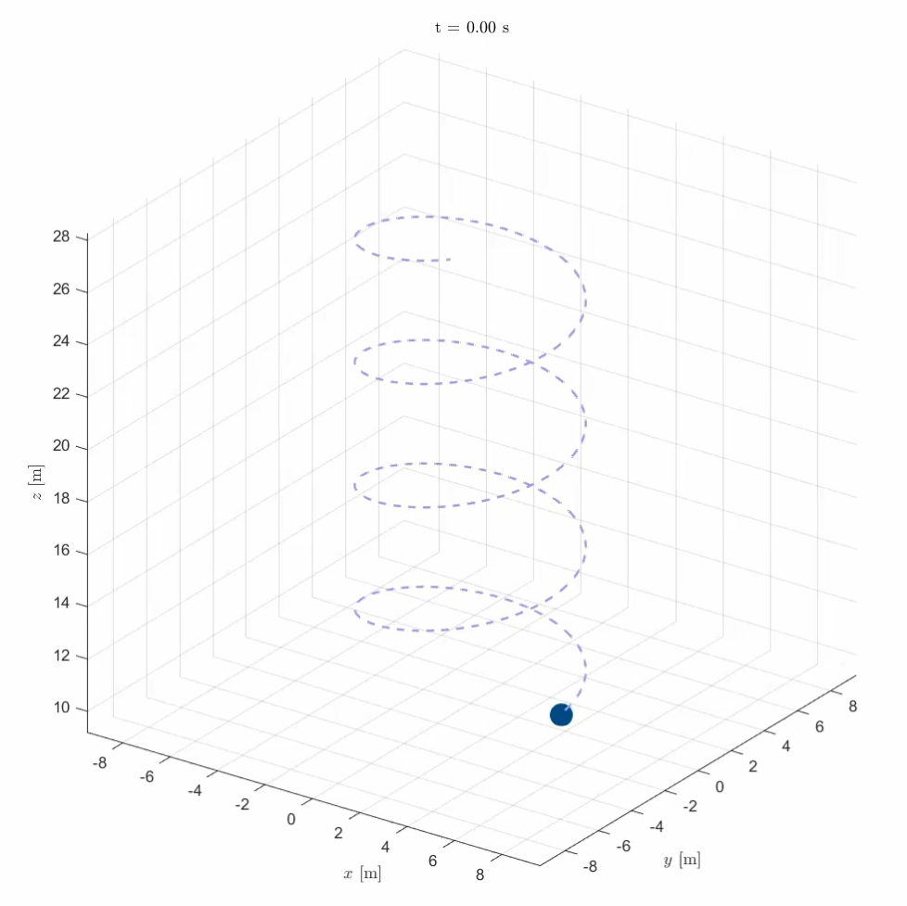
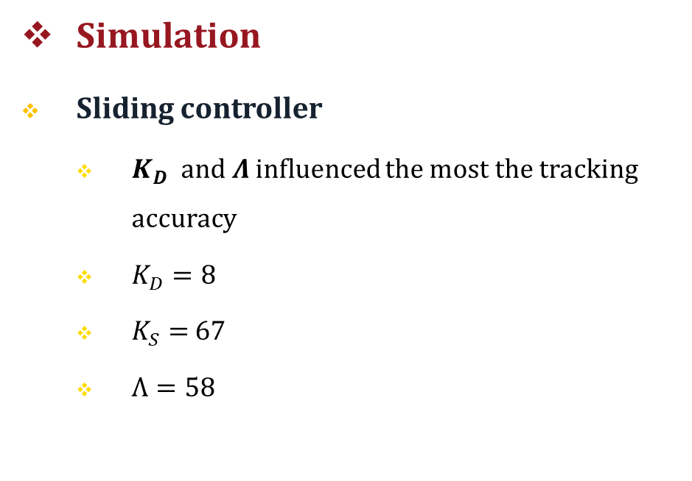
Simulation
Sliding controller
$K_{D}$ and $Λ$ influenced the most the tracking accuracy
$K_{D}=8$
$K_{S}=$ 67
$Λ=58$
SIMULATION (2)
Notes:
For the Sliding Controller it was noticed that the KD gain and the Lambda were the parameters that most influenced the tracking precision. In the video we can see the result and we can already observe that the trajectory is tracked correctly

Slide 11
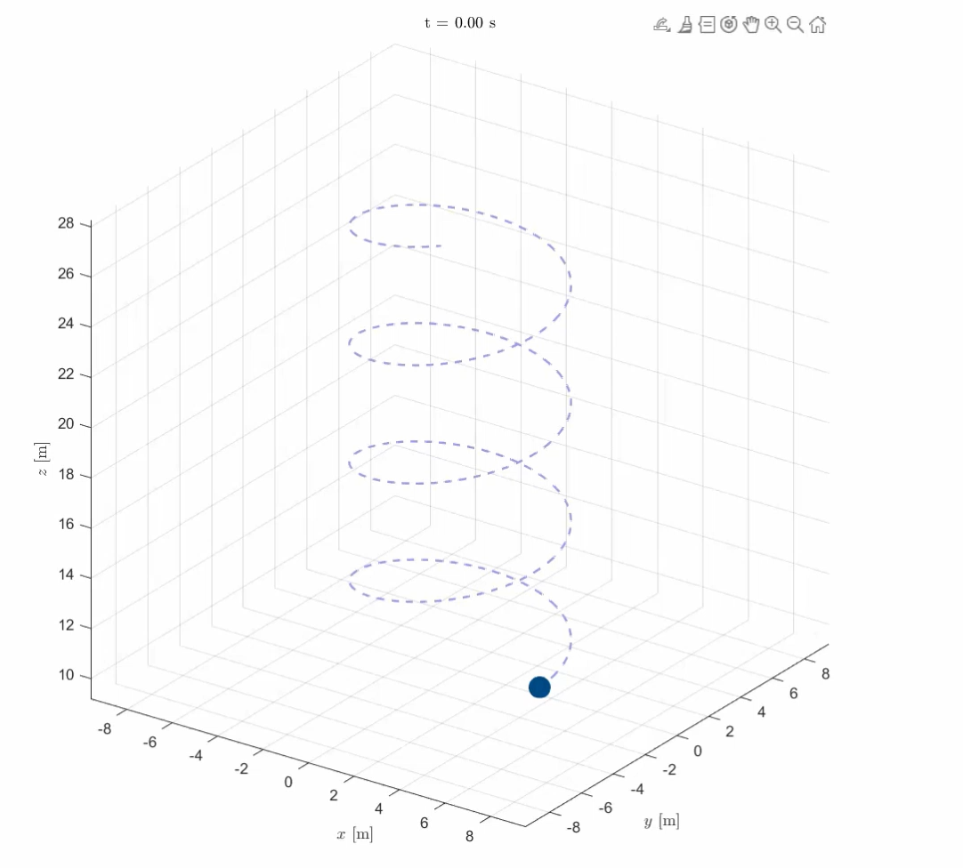
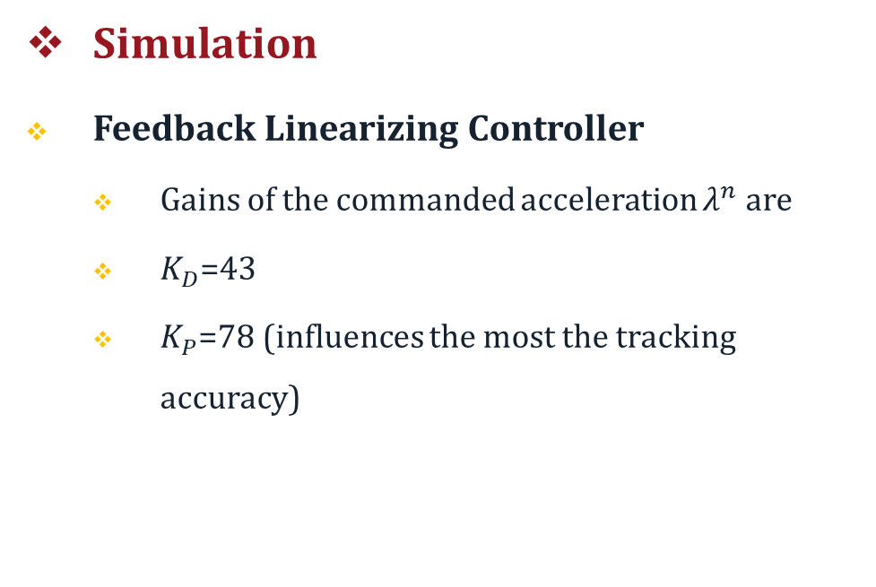
Simulation
Feedback Linearizing Controller
Gains of the commanded acceleration $λ^{n}$ are
$K_{D}$=43
$K_{P}$=78 (influences the most the tracking accuracy)
SIMULATION (3)
Notes:
In the Feedback Linearizing controller case the proportional gain is chosen greater than the derivative one since with this choice we could obtain sufficiently small tracking errors. From the comparison among the two video it’s possible to see that in this case the tracking is slightly inaccurate with respect to the former case.

Slide 12
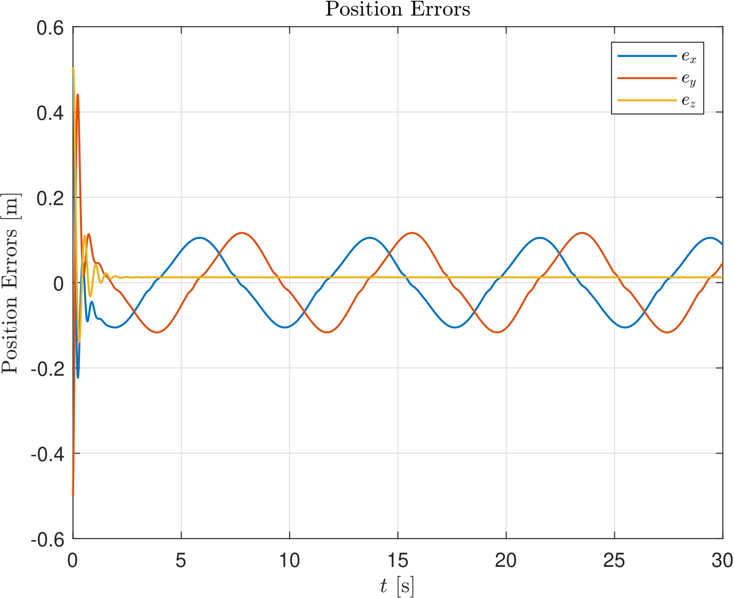
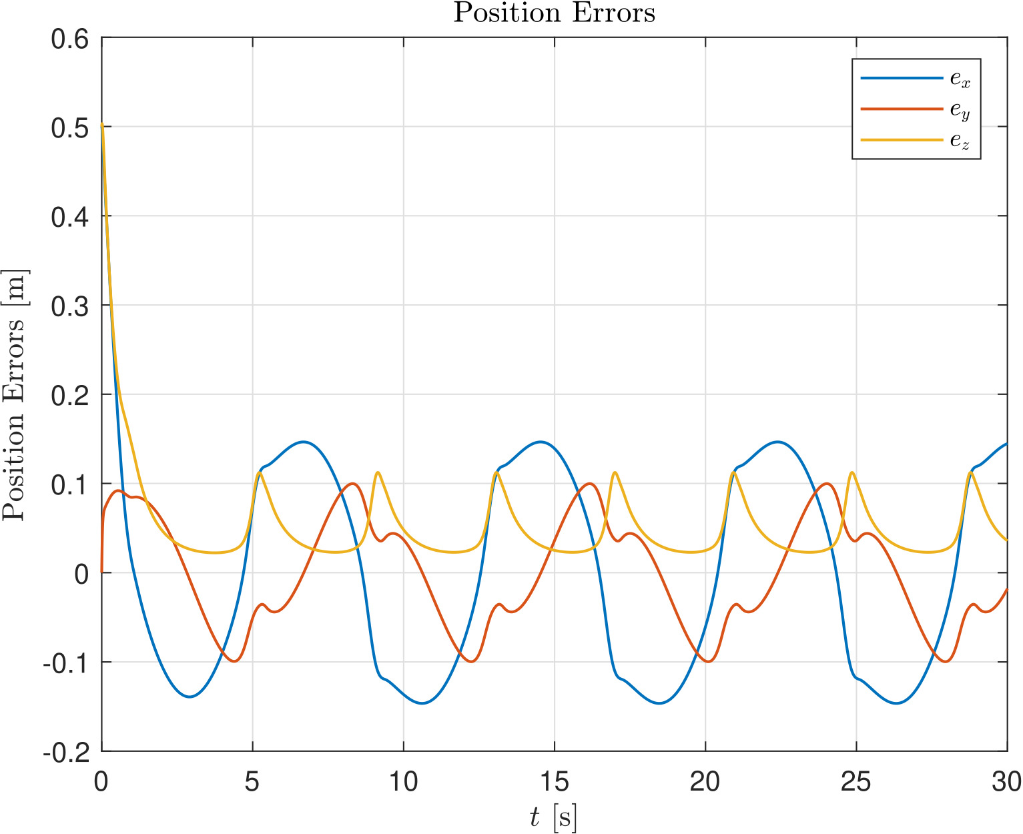
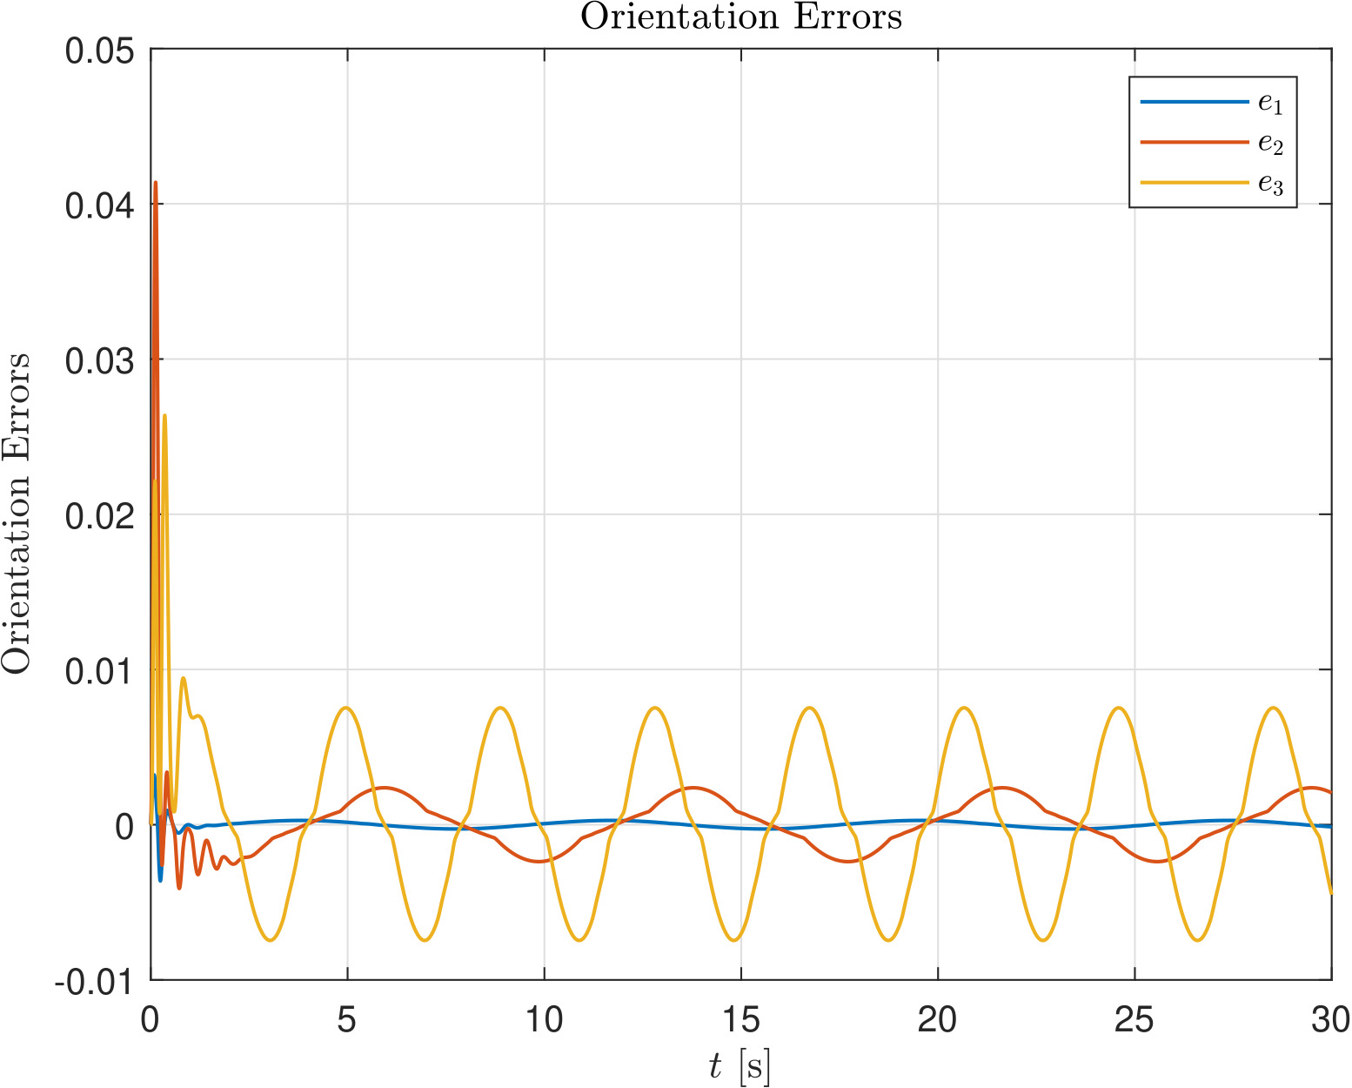
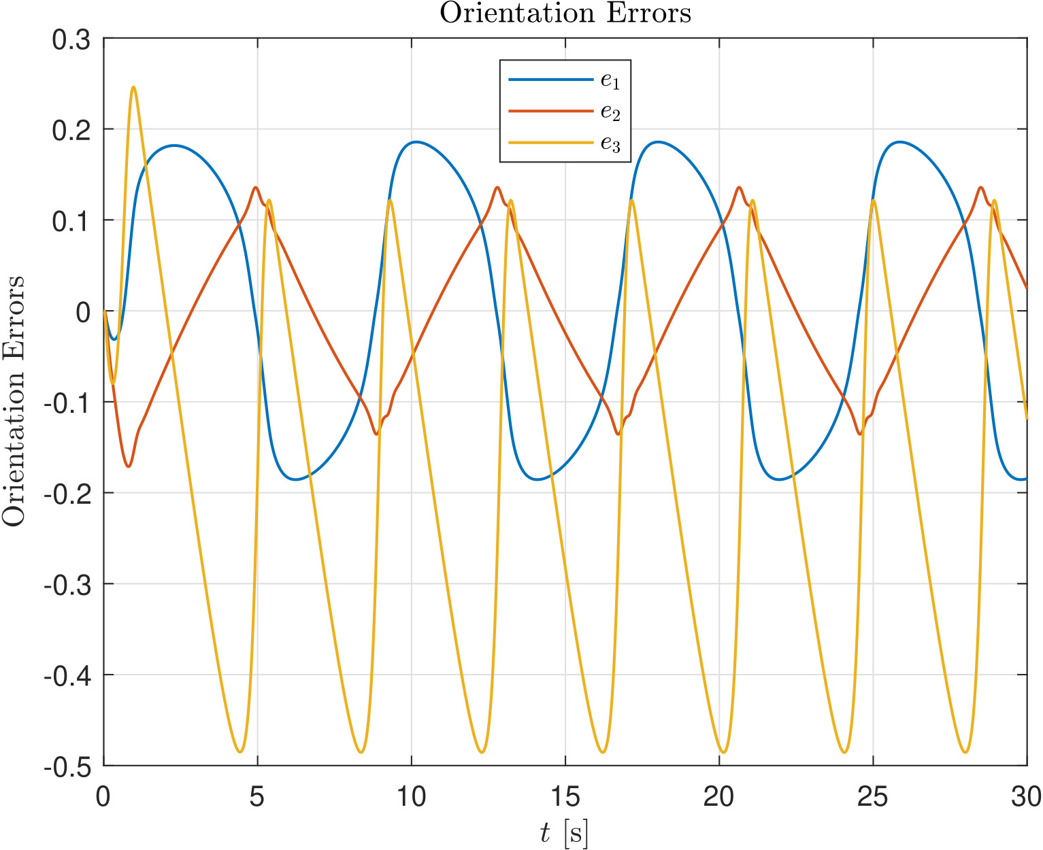
Results and Comparison (errors)
Sliding Control
Feedback linearizing controller
Norm bounded-errors in both cases
z-component tracked better with sliding mode
Higher orientation error with FL control
RESULTS AND COMPARISON (1)
Notes:
By looking at the errors plot in fact it’s possible to see that in both cases norm bounded errors have been achieved. In the Feedback Linearizing controller the z-component is tracked worse than in the sliding mode case. The main difference is in terms of orientation error since it’s smaller of 1 order of magnitude in the sliding mode case.

Slide 13
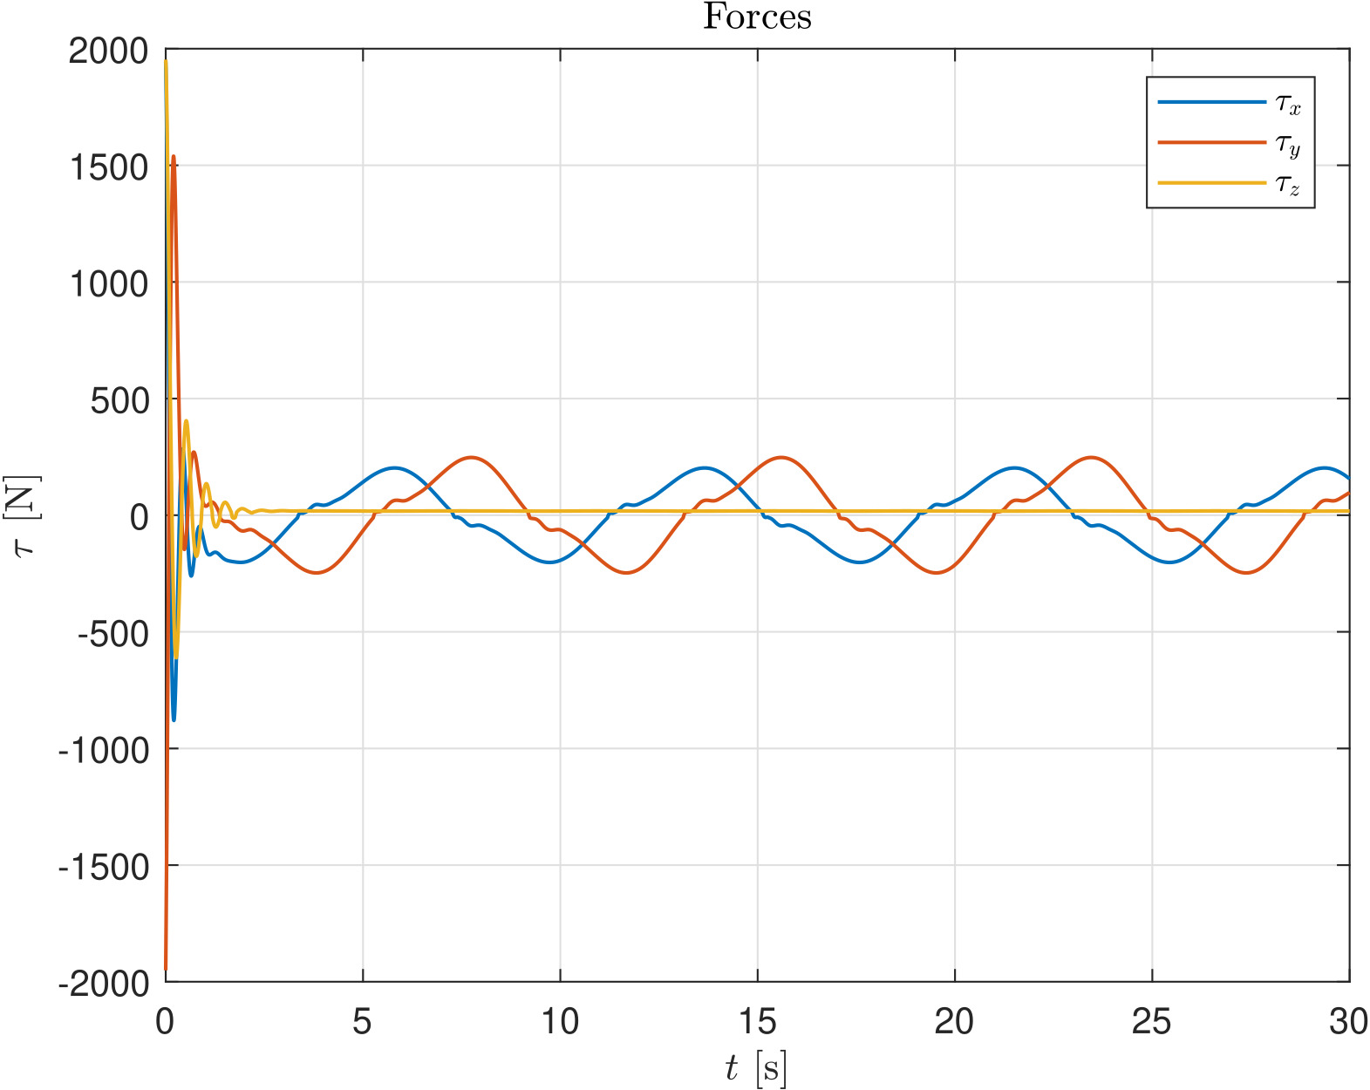
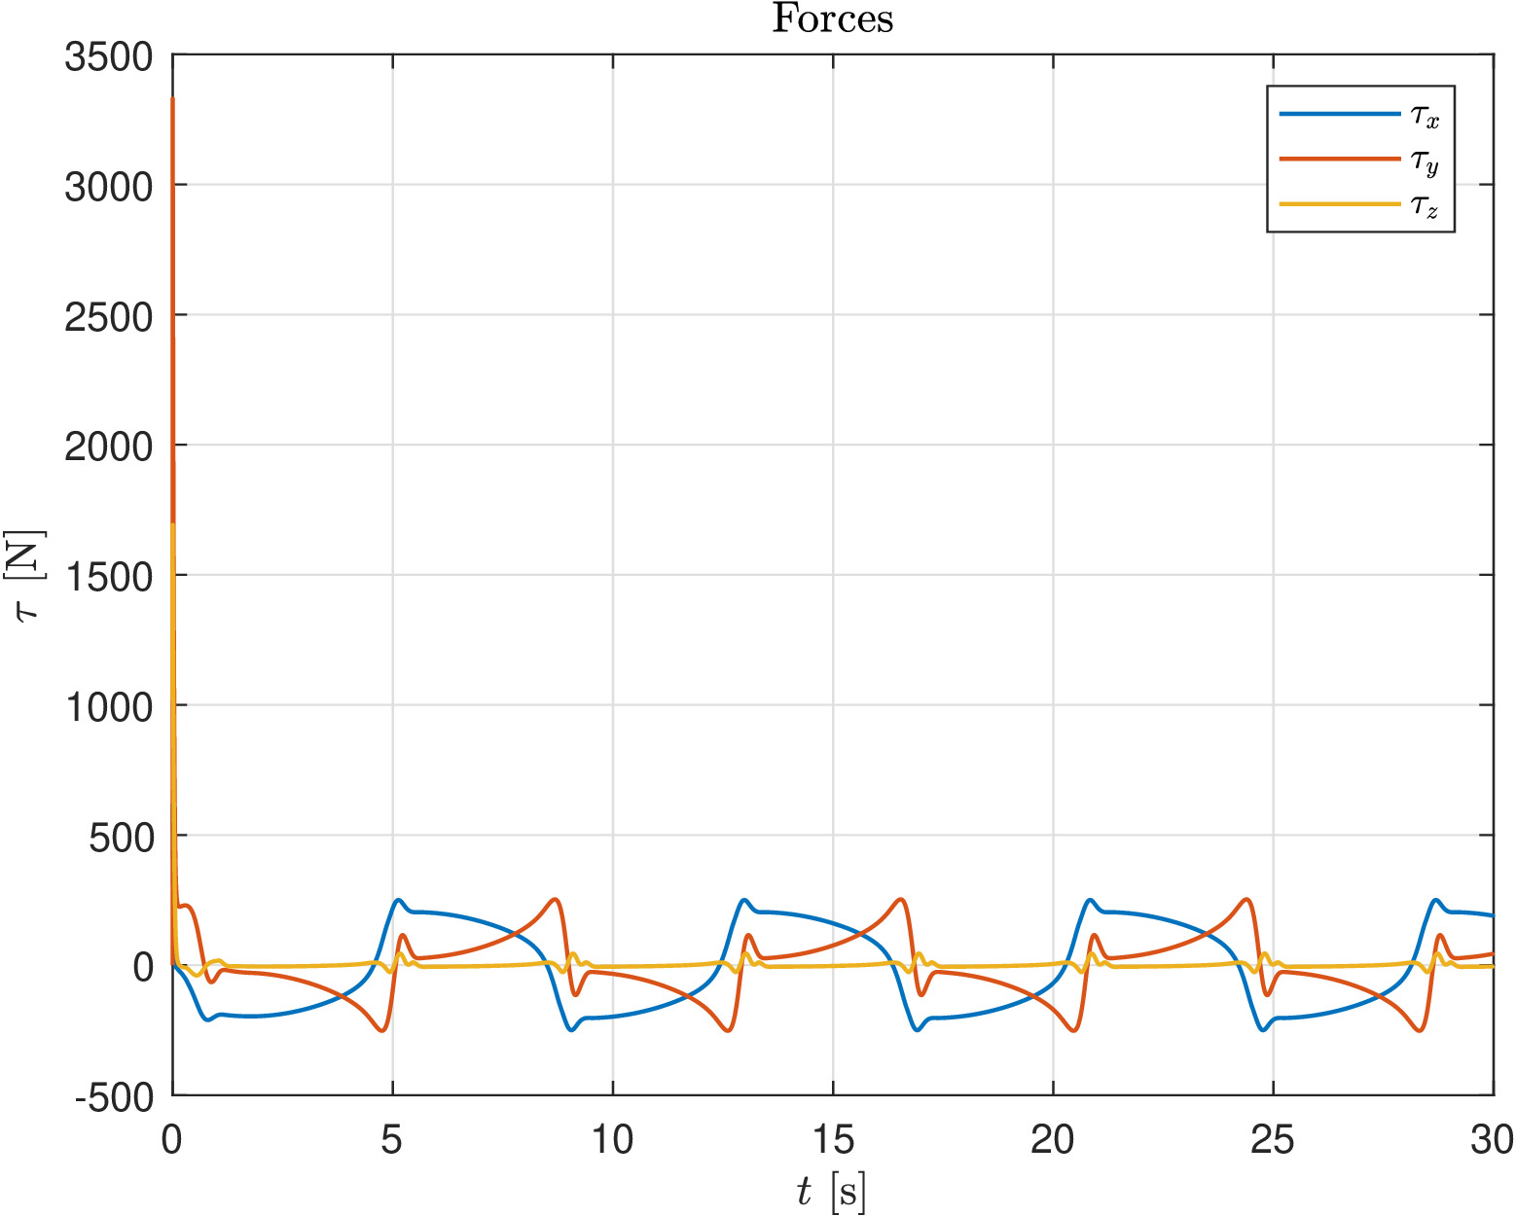
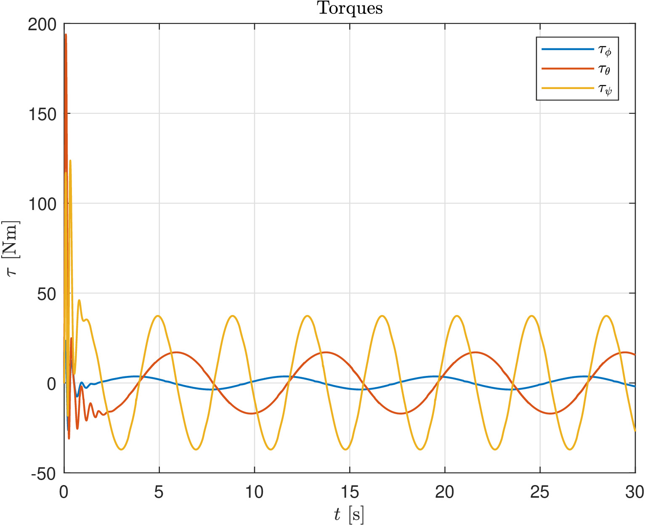
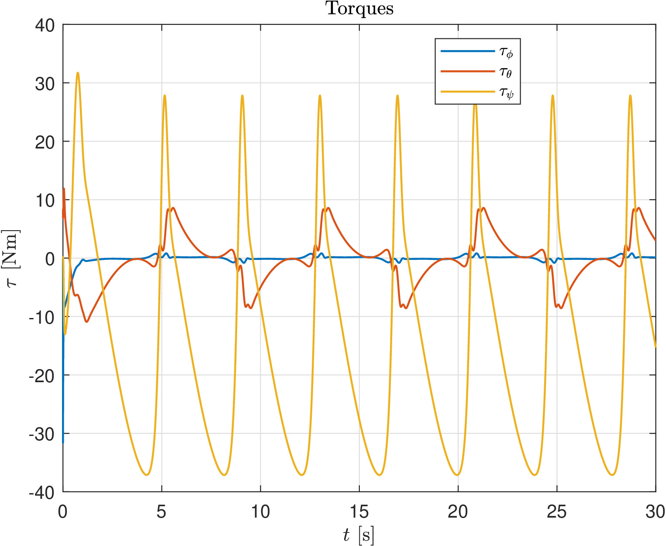
Results and Comparison (control inputs)
Sliding mode controller
Feedback linearizing controller
Order of magnitude of the forces is comparable, although in the FL case the initial peaks are greater
Torques slightly smaller in the FL case
High frequency components in the FL control action
RESULTS AND COMPARISON (2)
Notes:
Concerning the control inputs the order of magnitude of the forces is comparable, although in the second case the peaks are greater. The torques are slightly smaller in the FL case, and also in this second case the control input has more components in high frequency.

Slide 14
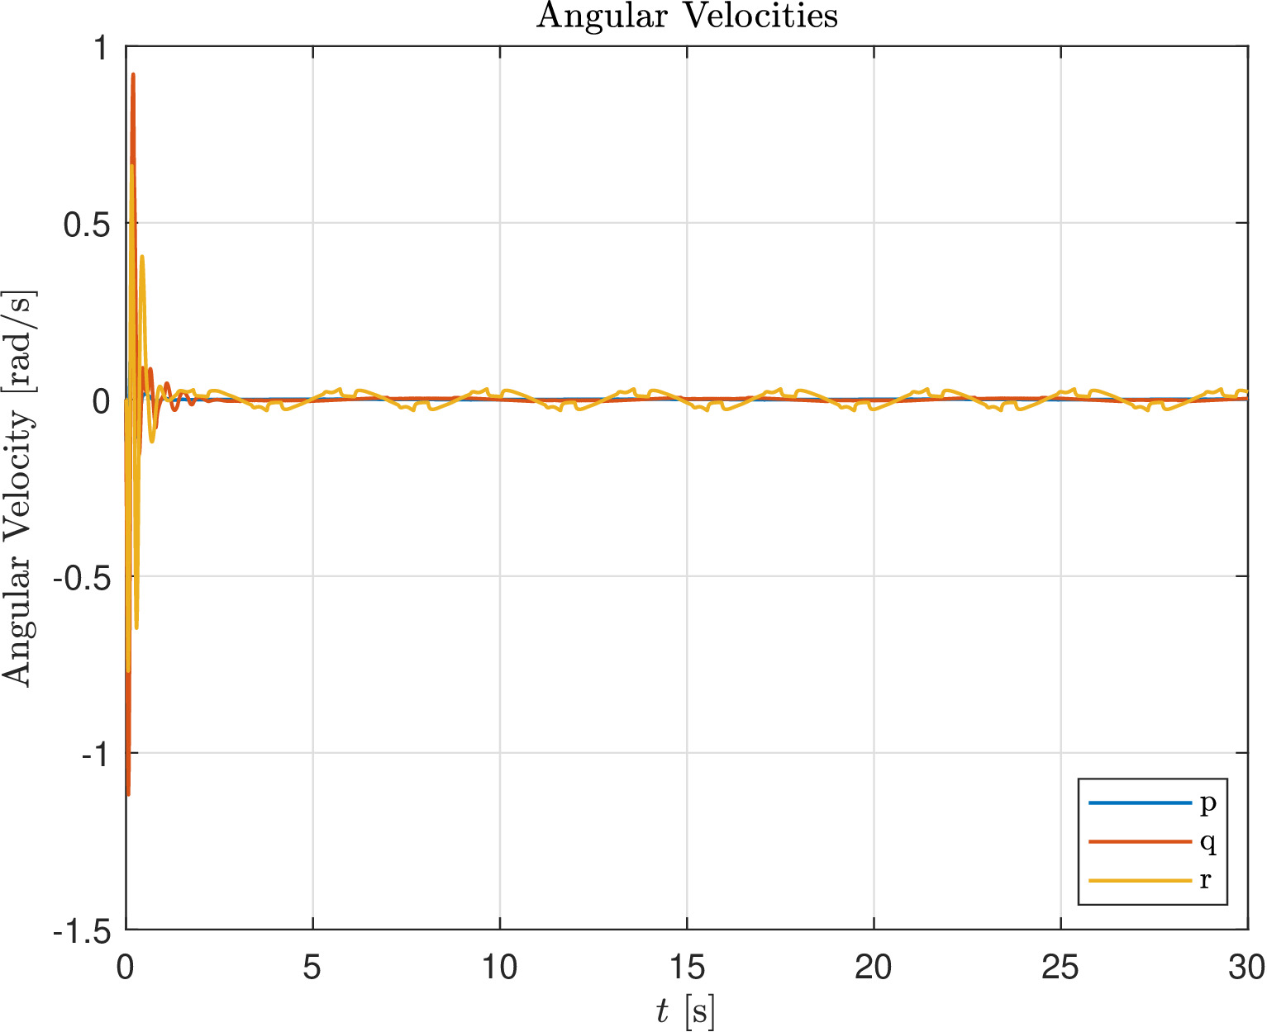
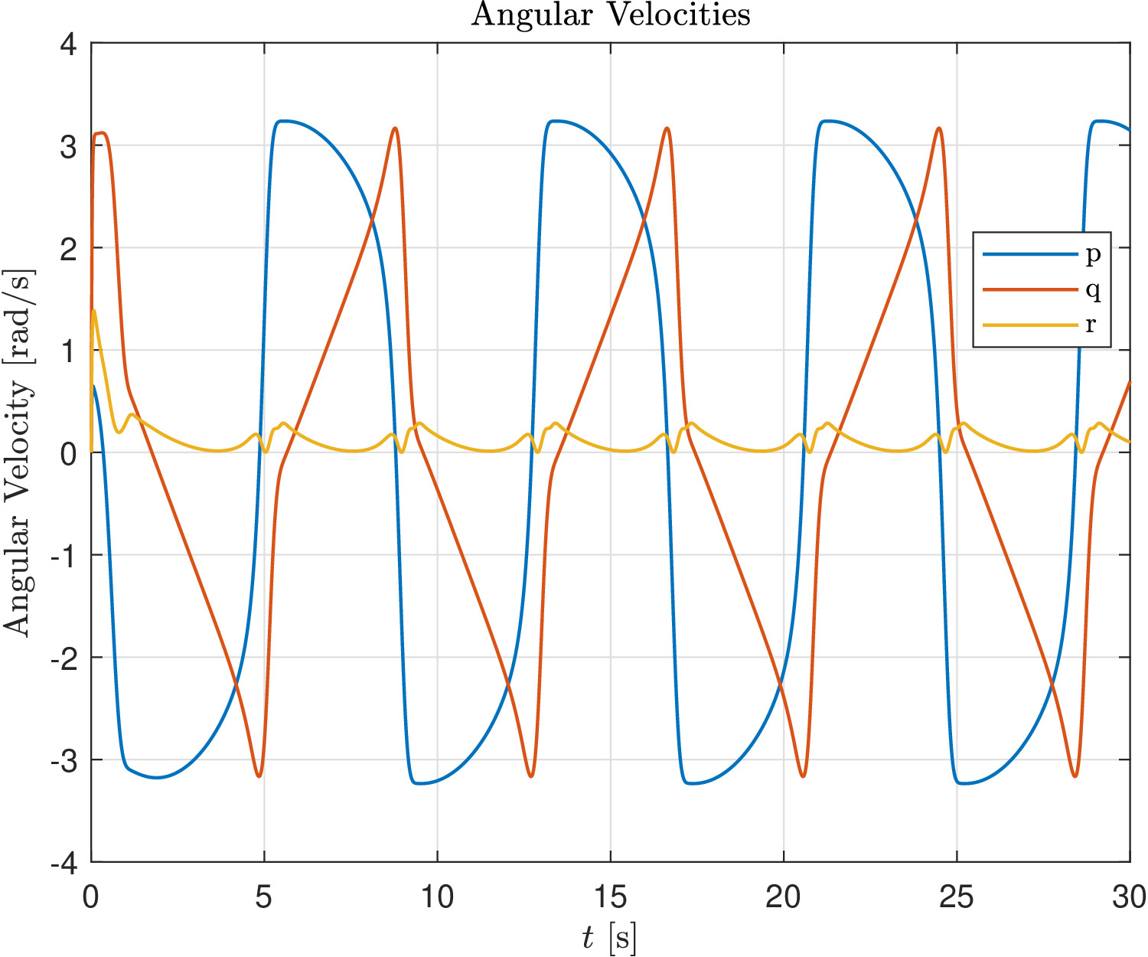
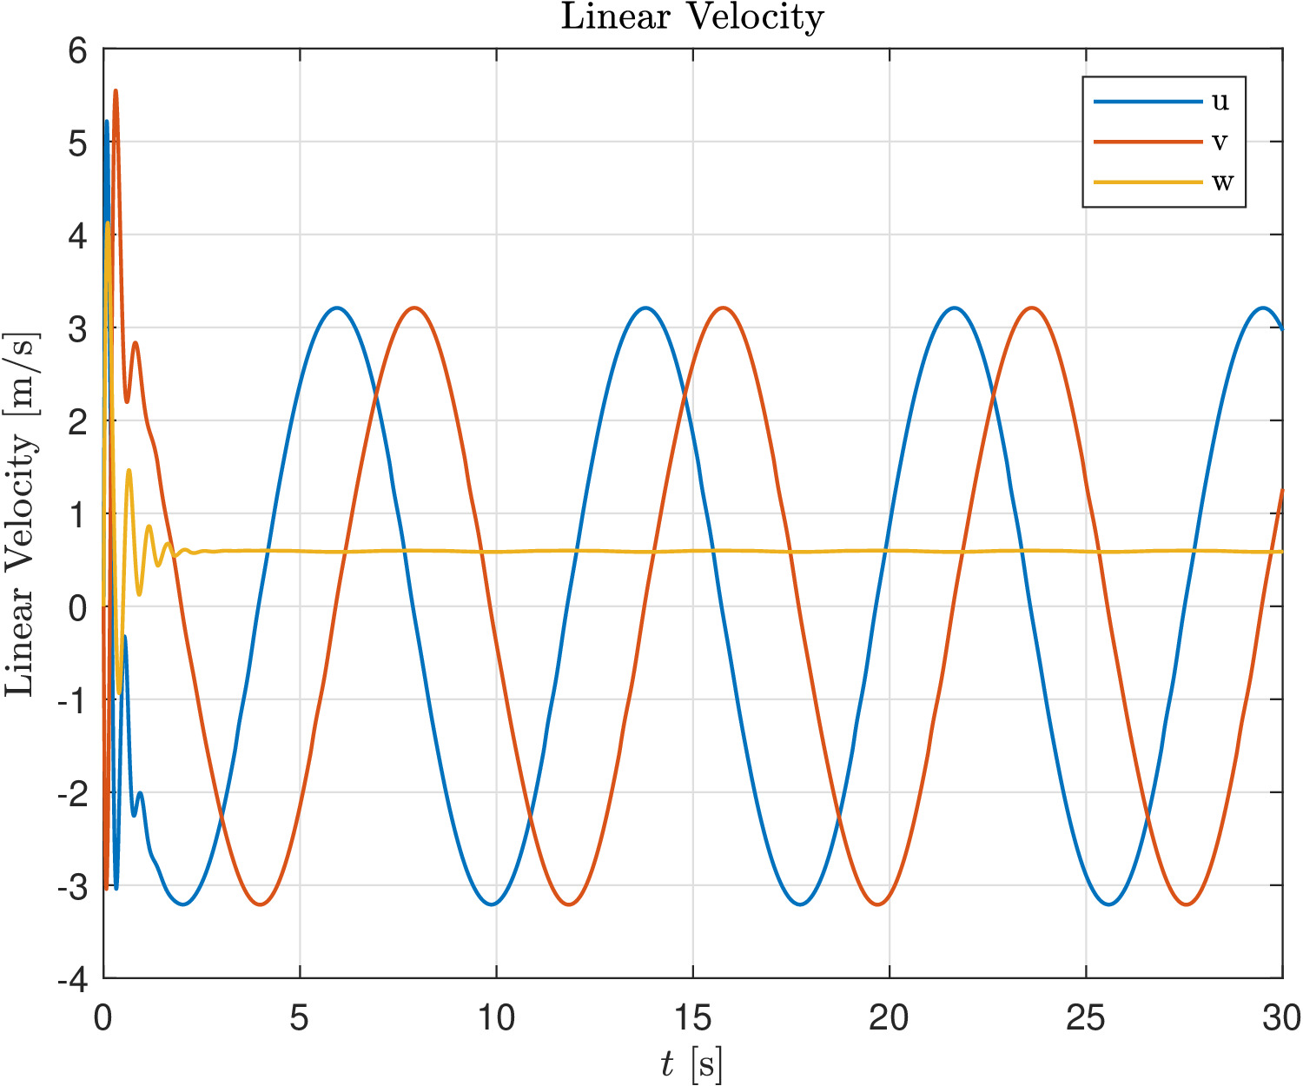
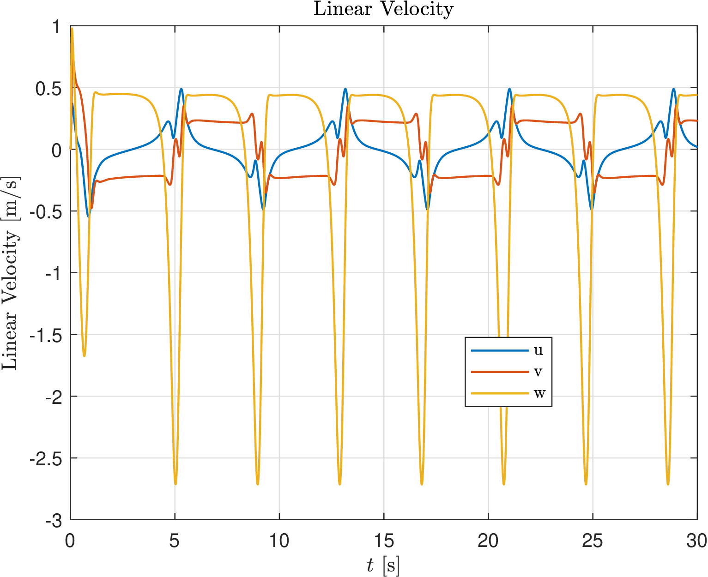
Results and Comparison (twists)
Sliding mode controller
Feedback linearizing controller
Angular velocities reach smaller values in the Sliding mode case
Yaw component r oscillates around zero in both cases
Heave component w constant in sliding mode
Peaks of linear velocities smaller in the FL case
RESULTS AND COMPARISON (3)
Notes:
Finally, for the twists the angular velocities reach smaller values in the sliding mode case, and the yaw components in both cases oscillates around the zero, whereas the heave component of the linear velocities reaches a constant values, and it’s periodic in the feedback linearizing control case. Regarding the other components of linear velocity the peaks of linear velocities are smaller in this second case.

Slide 15
Conclusions
The project compared two non linear control strategies
Both the controllers exhibited satisfatory behaviour in terms of tracking
Sliding Control demonstrated greater accuracy once the chattering problem has been solved
Further Developments
Insert uncertainties in the dynamic model to test robustness
Motion planning including also a trajectory for the orientational part of the ROV
CONCLUSIONS AND FURTHER DEVELOPMENTS
Notes:
So to summarize the project compared two non linear control strategy. In both cases norm bounded trajectory error has been achieved with satisfactory behaviour. Sliding Control demonstrated greater accuracy in particular concerning the orientational part.
As further developments one should test the robustness of such controllers inserting some uncertainties and also how good they are in terms of disturbance rejection (current effect has not been addressed).
And finally such control law should be tested to track a trajectory planned accordingly also for the orientational part.

Slide 16
THANK YOU FOR THE ATTENTION 🦈🌊
GREETINGS
Notes:
Thank you for the attention ❤️

