Slide 1
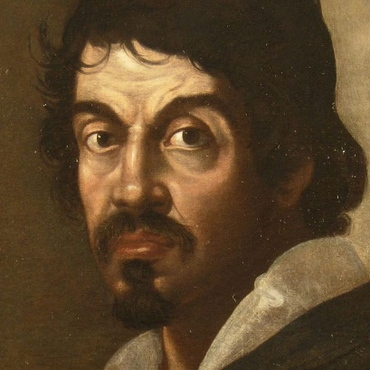
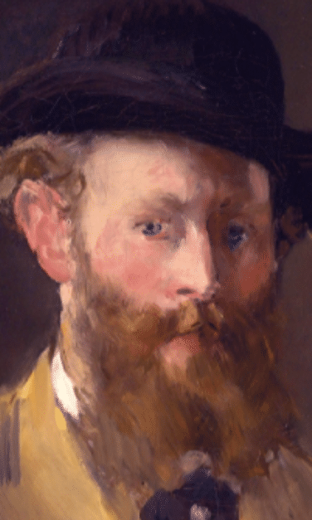
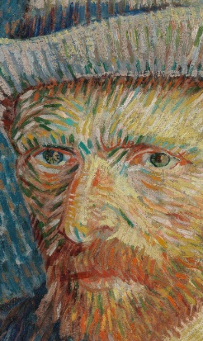
PROJECT WORK ON PAINTER STYLE RECOGNITION
UNISA – DIEM Machine Learning Group 28

Slide 2
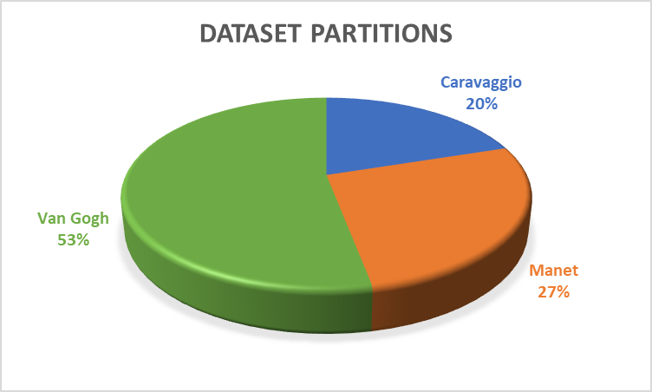

Dataset building
“Handmade” search
Search realized by a smart Google Images crawler
Canva samples
Careful selection
8771 images

Slide 3

Dataset splitting
Since the final private test set is balanced,
we decided to obtain a balanced validation set too,
even if the original collected dataset was unbalanced
Validation set: 1080 images
Caravaggio | Manet | Van Gogh
360 360 360
Dataset
Training set: 7691 images
Caravaggio | Manet | Van Gogh
1445 2014 4232

Slide 4

Pre-processing pipeline
Since the training set was unbalanced, we used random
oversampling to balance it and to obtain a model with good
performances on average across all classes
Oversampling implicitly ensures that all the batches provided to the network during the training are balanced
Before Oversampling
After Oversampling
Training set: 7691 images
Caravaggio | Manet | Van Gogh
1445 2014 4232
Training set: 12696 images
Caravaggio | Manet | Van Gogh
4232 4232 4232

Slide 5

Pre-processing pipeline
We decided to use on-the-fly image data
augmentation on the training set
to avoid overfitting as much as possible
Transformations on Training set:
rescale = 1./255
brightness_range = (0.3, 1.3)
shear_range = 20
rotation_range = 10
horizontal_flip
fill_mode = 'reflect'
Transformations on Validation set:
rescale = 1./255
resizing to 299x299

Slide 6


Network Architecture
The technique we selected is transfer learning because it allows to
have a very deep network already trained on a vast dataset
InceptionResNetV2
Last layer: 3 neurons, one for each class ('caravaggio', 'manet', vangogh')
We adapted all photos to these dimensions by
providing to flow_from_directory method the
right target_size parameter: (299, 299)
Image input size:
299-by-299

Slide 7

Training Hyperparameters
Activation function last layer: softmax
Loss function: categorical cross-entropy
Optimization algorithm: Adam
Batch size: 32
Early Stopping: the learning procedure stops when validation accuracy does not increment anymore after 3 epochs
ModelCheckPoint
3 PHASES
Significant reduction of learning rate (phase 2 and phase 3) to avoid
(or reduce) overfitting and to readapt in a slow and incremental
way the pretrained weights on the available dataset

Slide 8
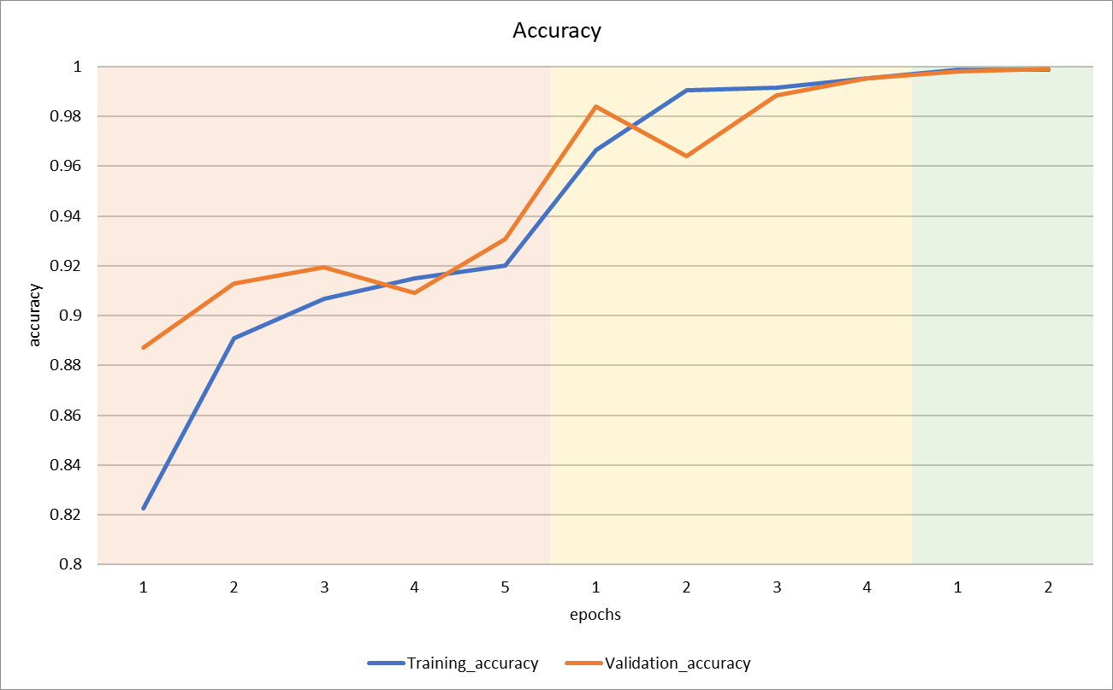
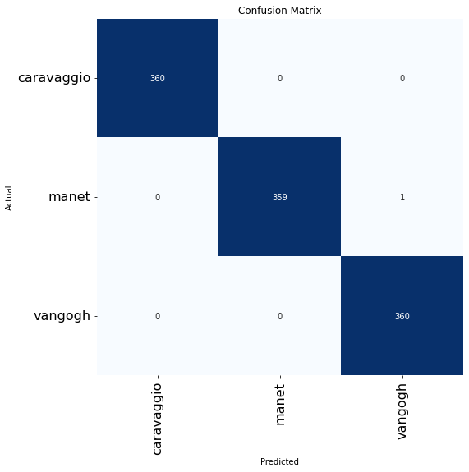

Performance Analysis
Validation Accuracy: 0.9991
Validation Loss: 0.0053
Top-2 classification accuracy: 1
Precision: 1 | 1 | 1
Recall: 1 | 1 | 1
F1-score: 1 | 1 | 1
Confusion matrix

Slide 9
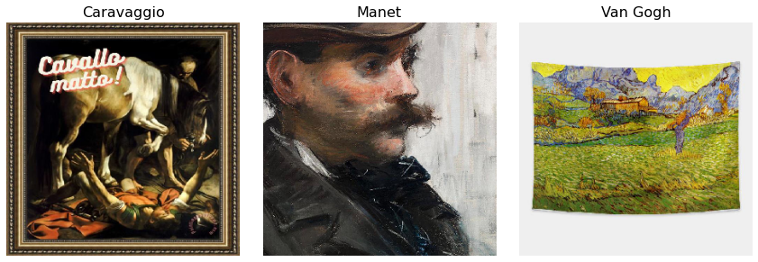
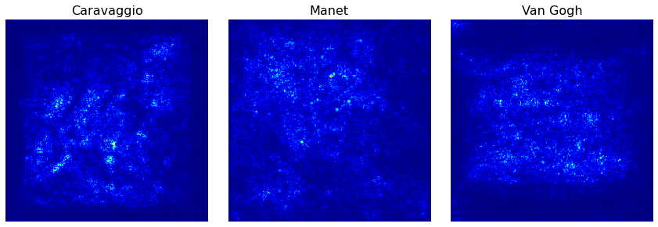

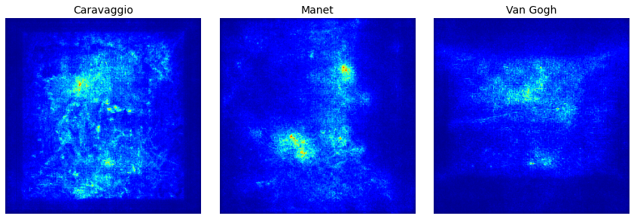
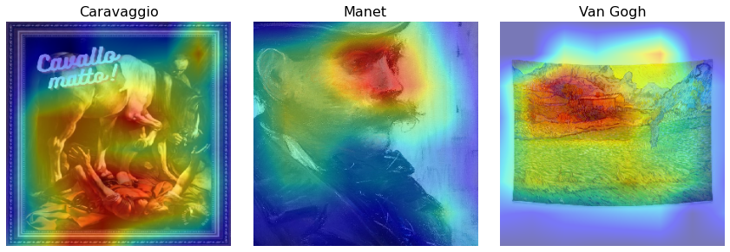
Further Analysis
Samples
Saliency maps
SmoothGrad maps
GradCam maps

Slide 10
THANKS FOR WATCHING
UNISA – DIEM Machine Learning Group 28

