Slide 1
Computational Auditory Scene Analysis (CASA) for Separating Monophonic Music
Bachelor’s Thesis
Nikita Mortuzaiev
May 4th, 2022
Supervisor: Ing. Mgr. Ladislava Smítková Janků, Ph.D.

Slide 2
Objectives
Research the field of CASA, its applications and goals
Study existing works
Implement a CASA system to process monophonic piano music
Experiment with the implemented system

Slide 3
What is CASA?
CASA is a study of auditory scene analysis by computational means
Relates to the “cocktail party effect”
Aims to separate sounds from mixtures
Tries to mimic the mechanisms in the human ear
The goal is to find an “ideal binary mask”

Slide 4
Typical Architecture
Peripheral Analysis
Feature Extraction
Mid-Level Representations
Scene Organization
Resynthesis

Slide 5
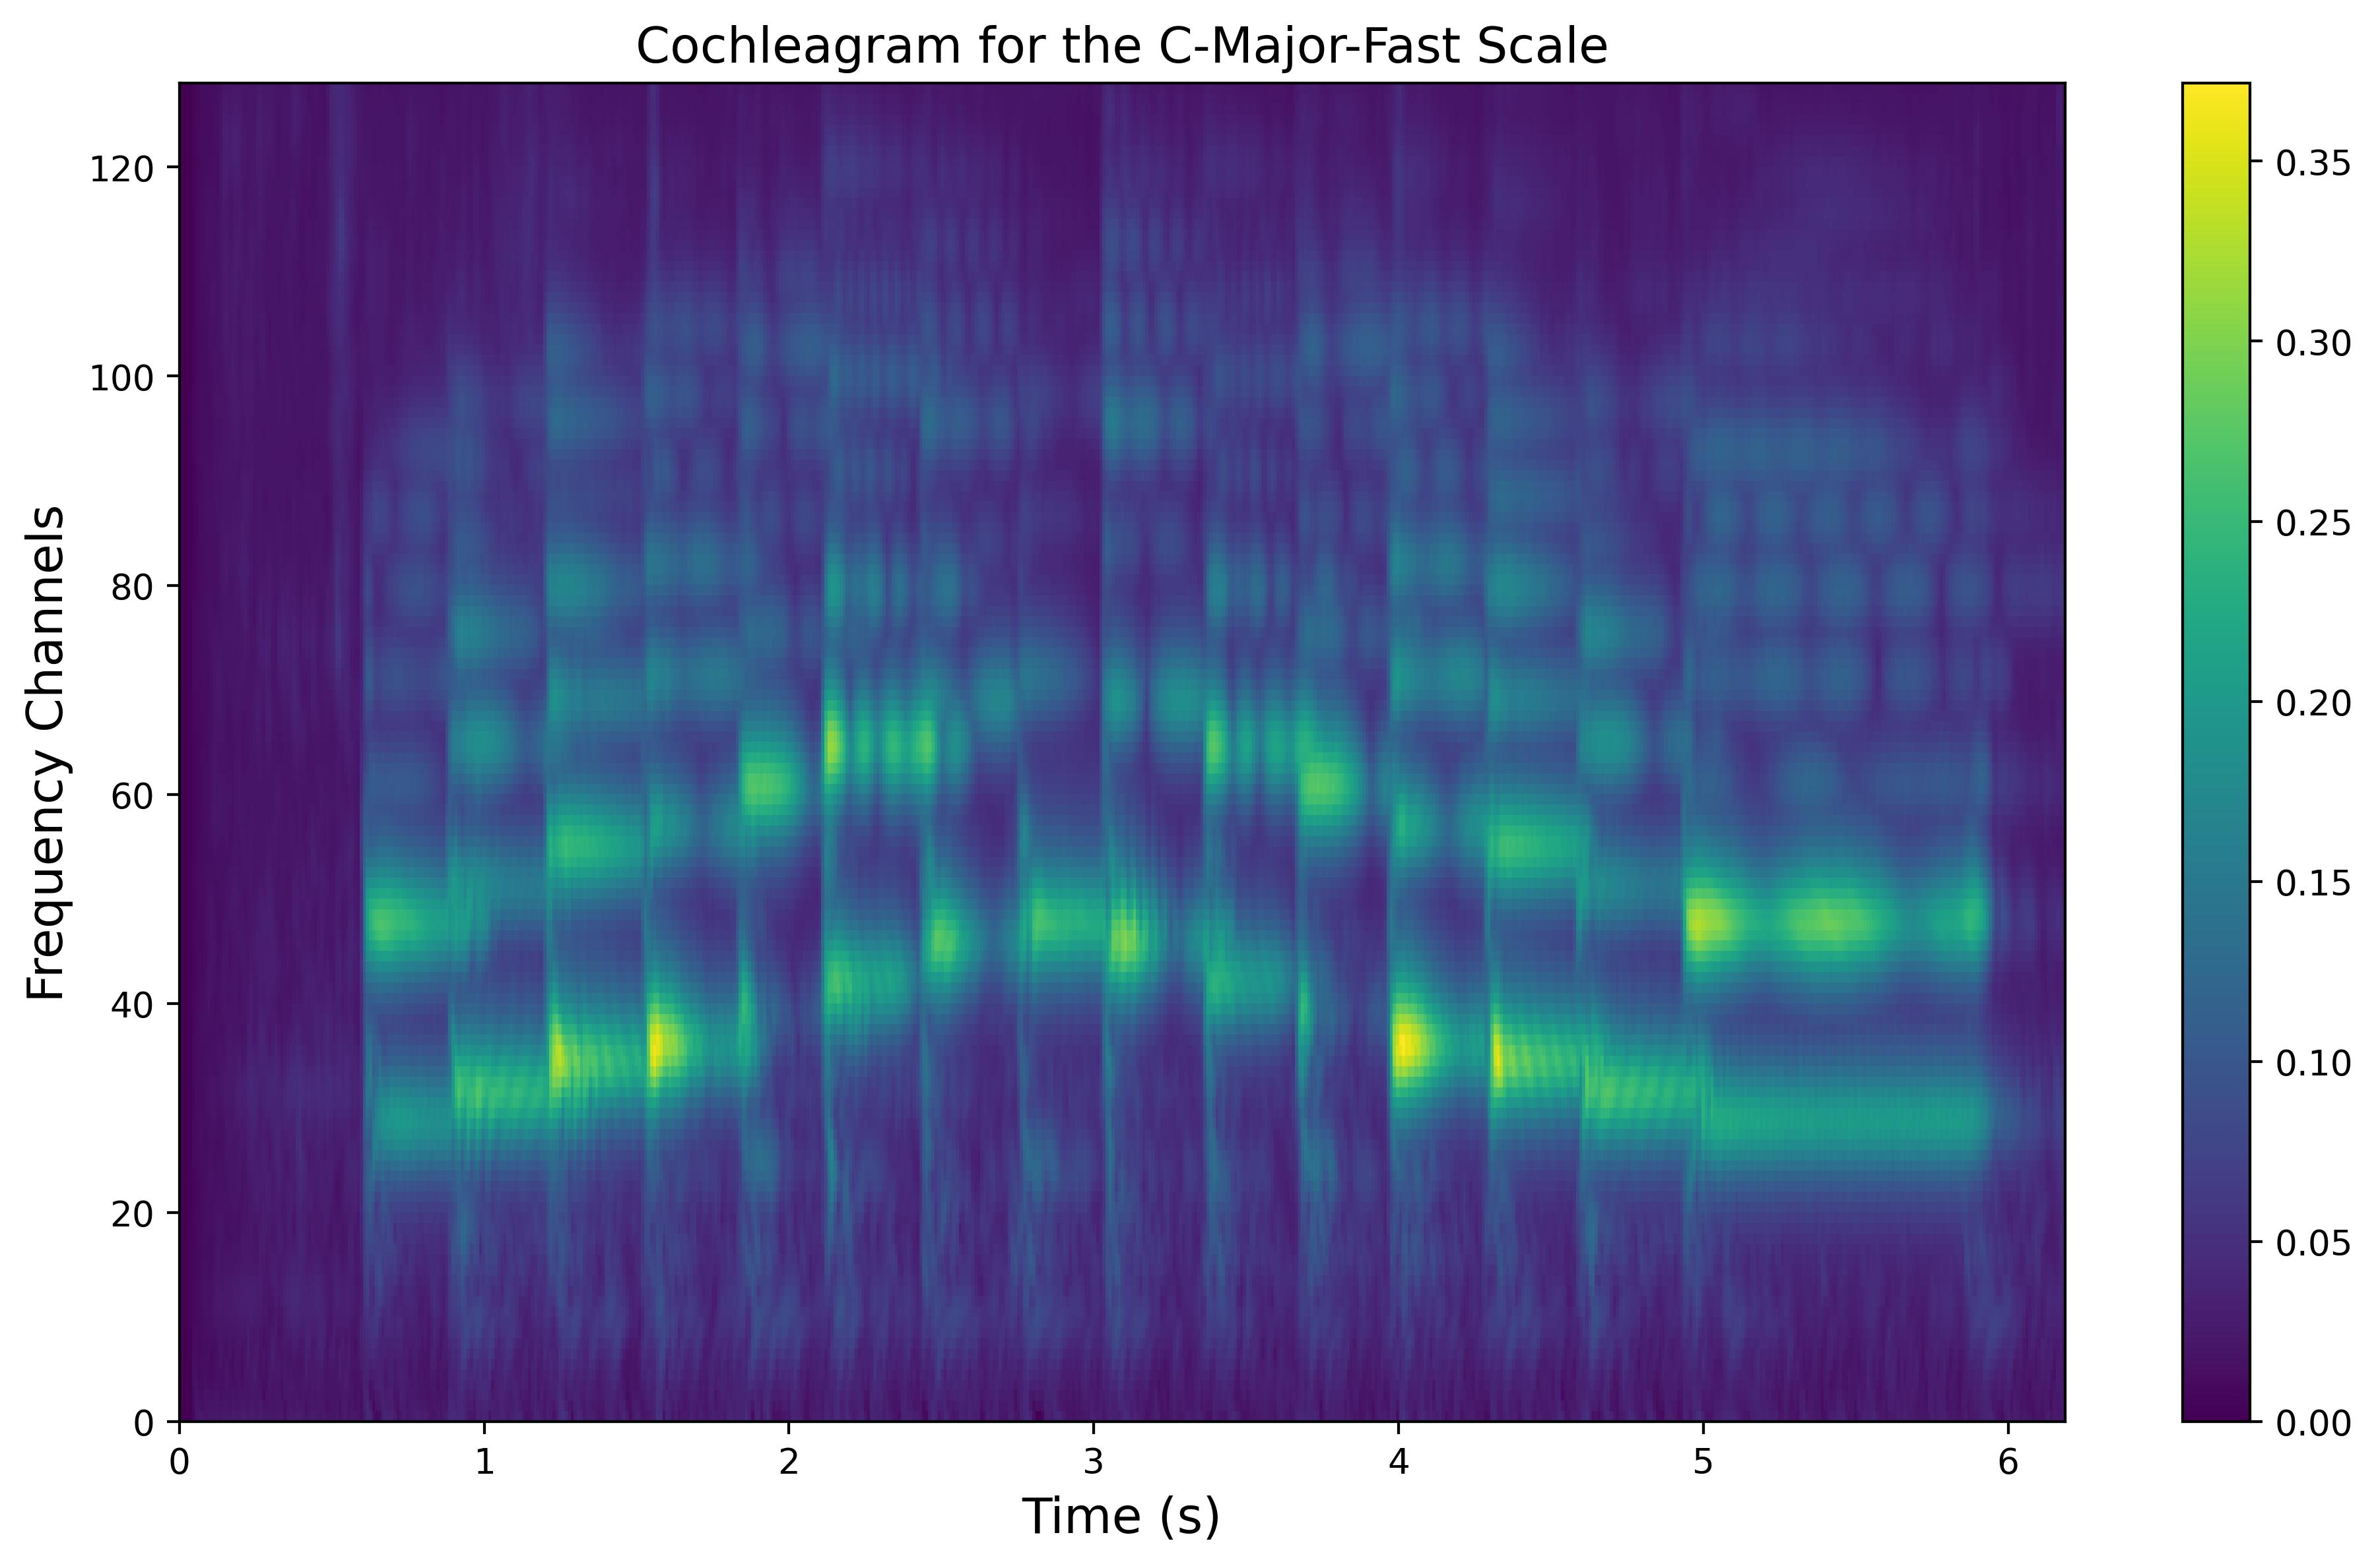
Cochleagram

Slide 6
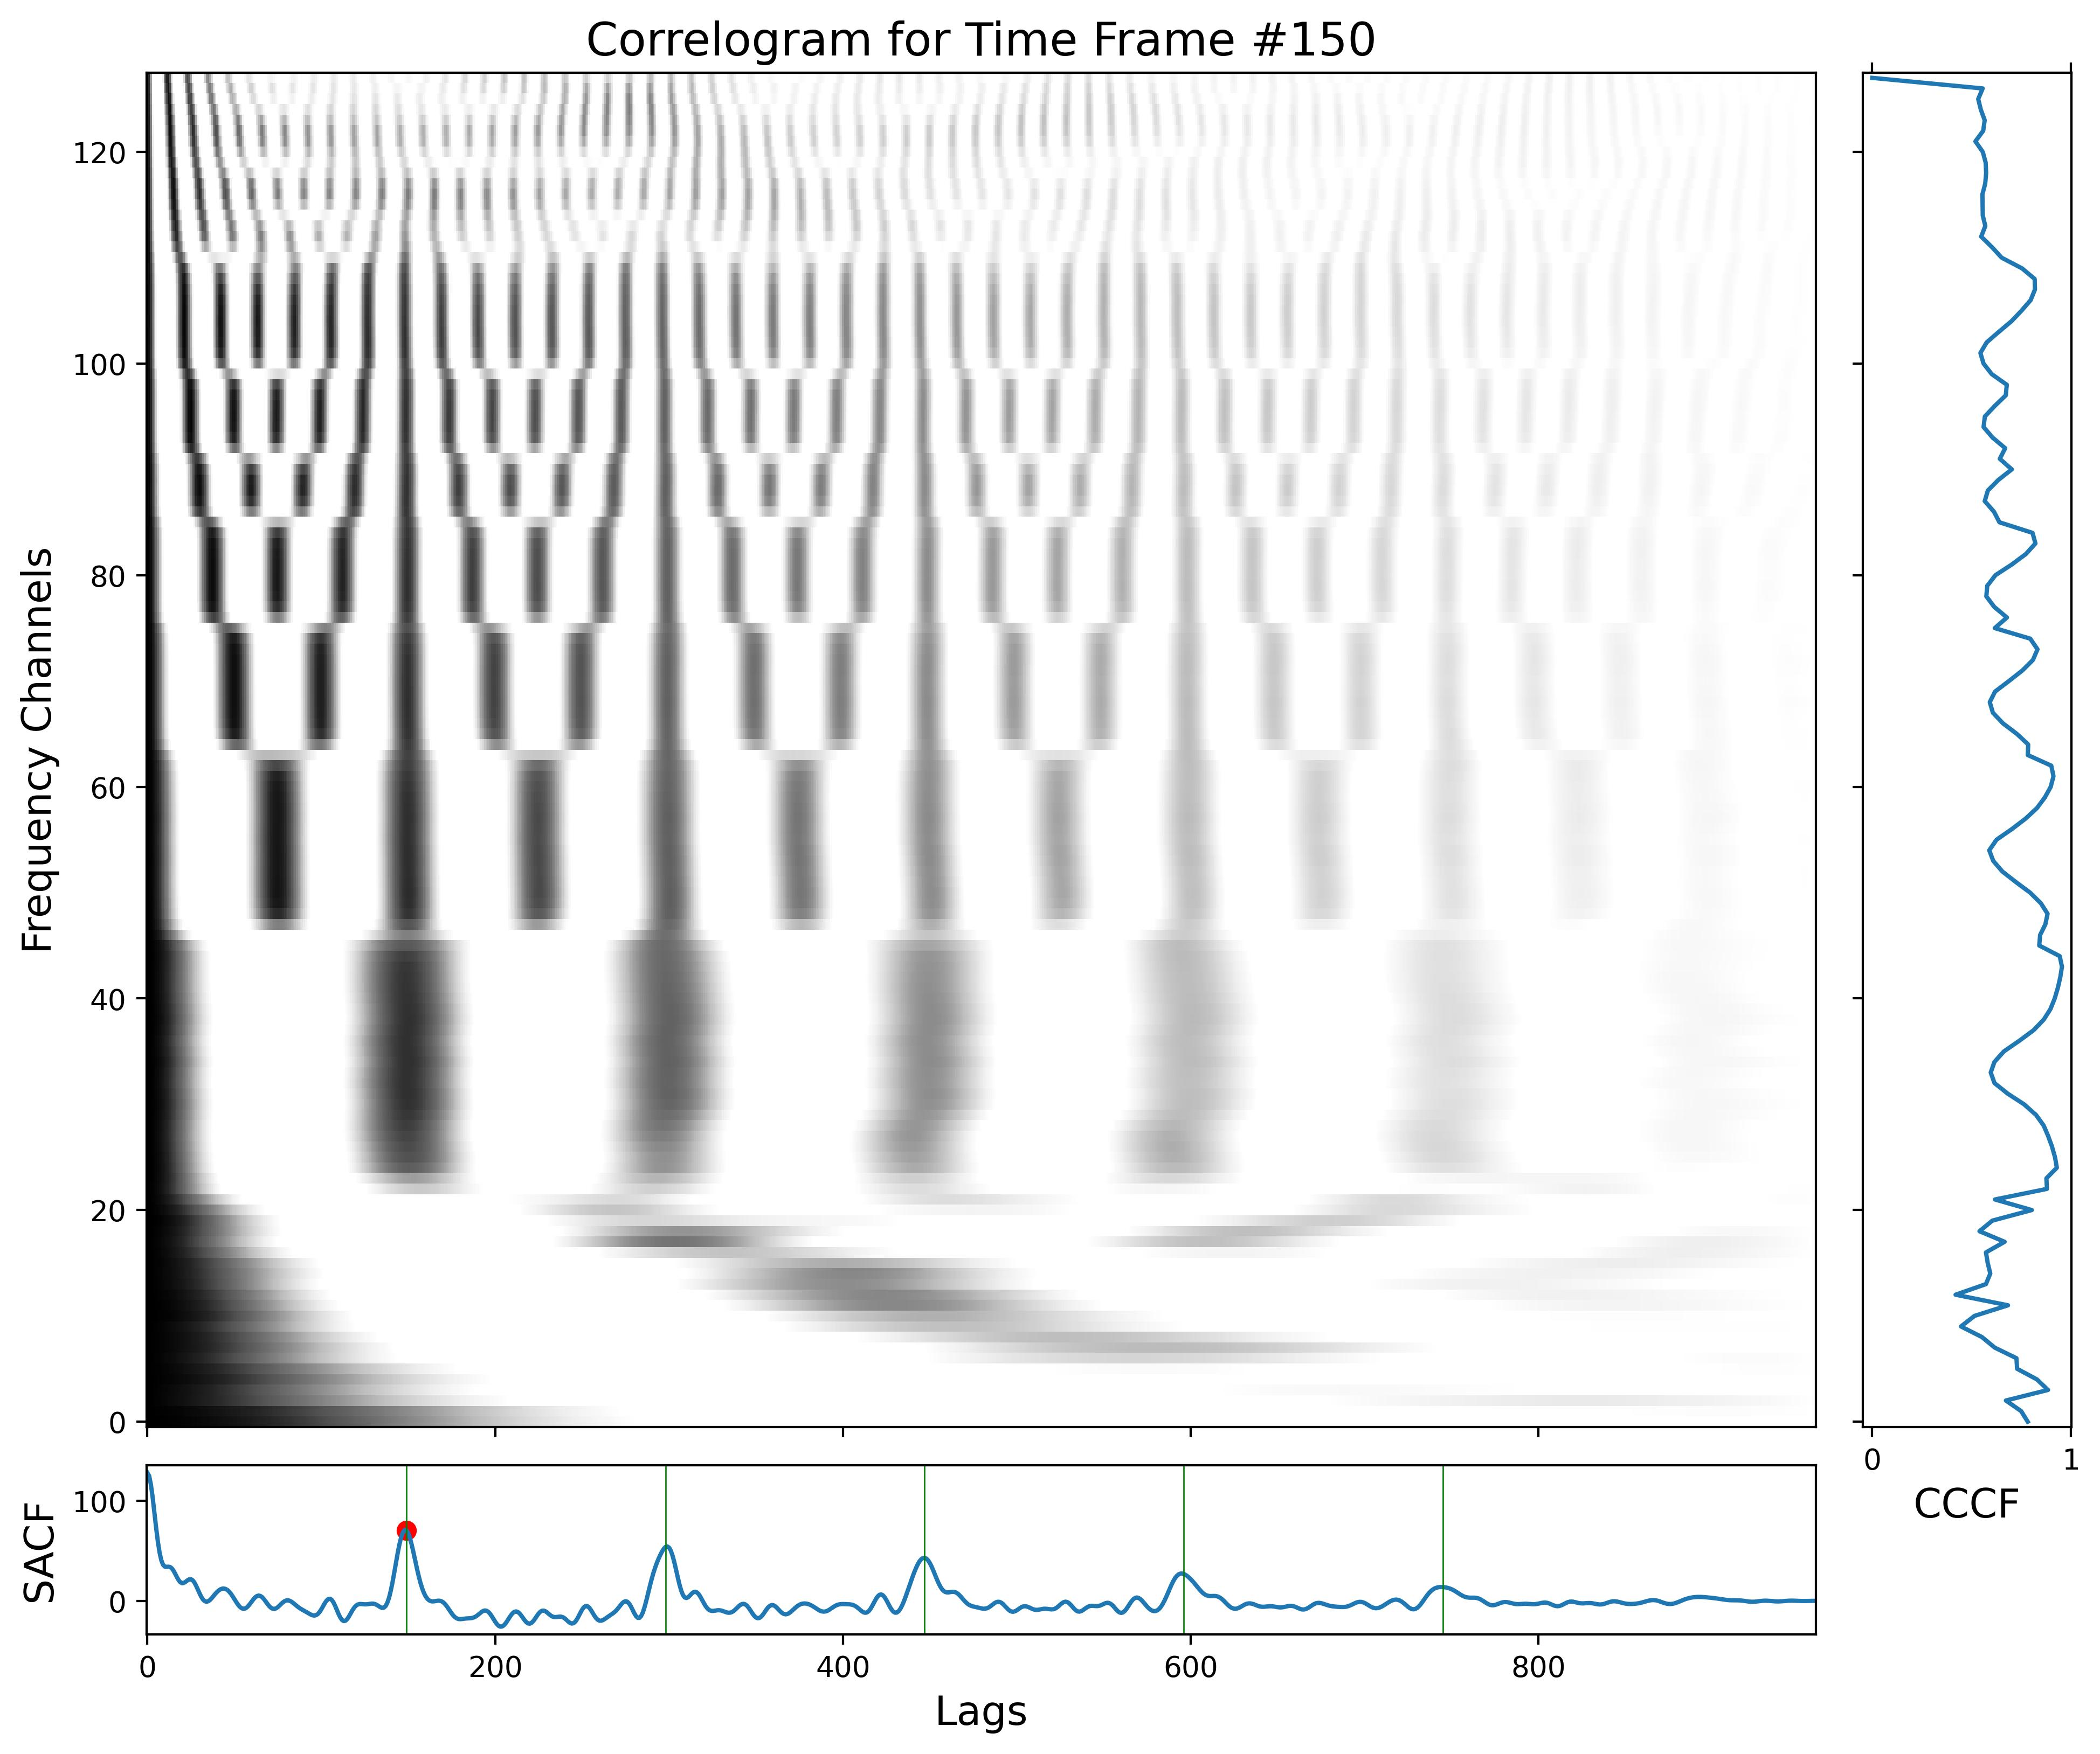
Feature Extraction

Slide 7
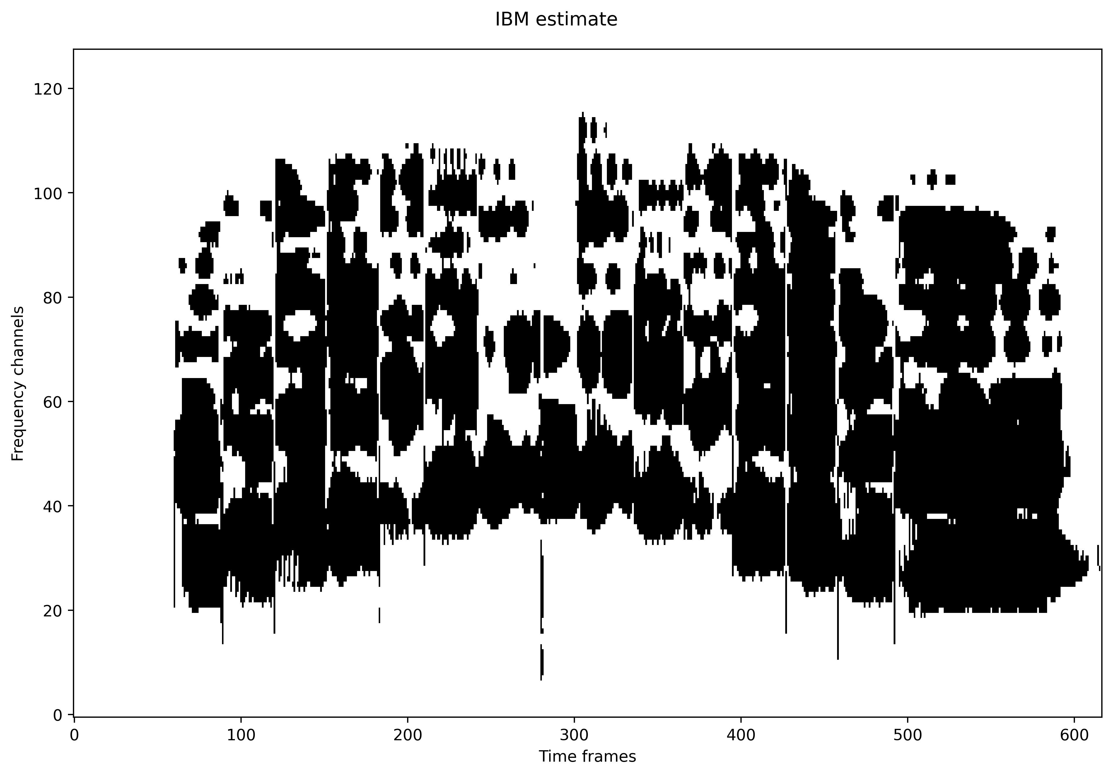
Segmentation and Grouping

Slide 8
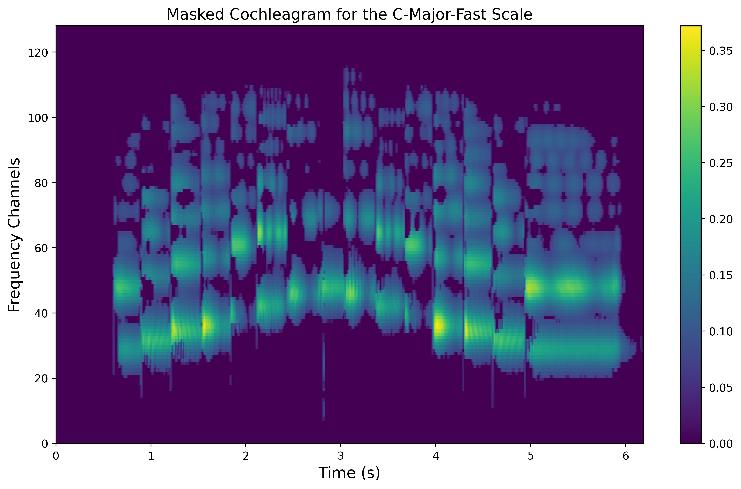
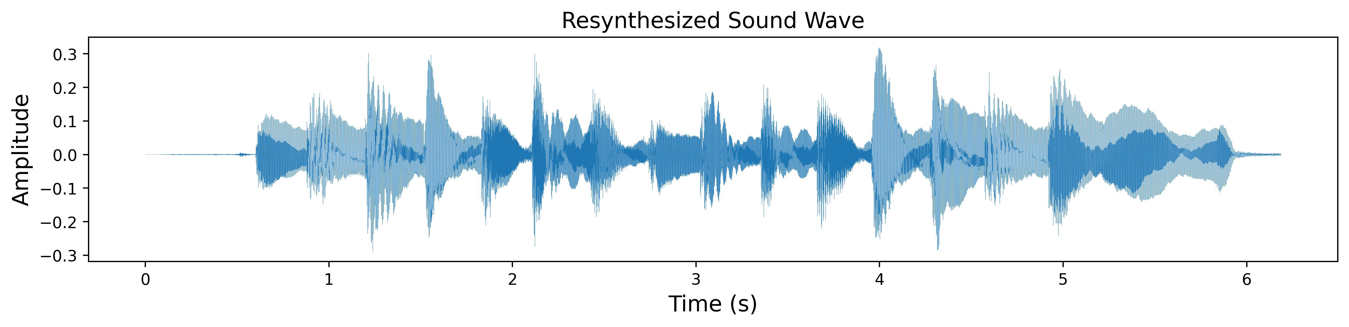
Resynthesis

Slide 9
Experiments
White noise backgrounds
Other prerecorded backgrounds
Tests in connection with a simple classifier
Other experiments

Slide 10
Thank You for Your Attention!

Slide 11
Opponent’s Questions
One
Two
Three

