Slide 1
Computational Auditory Scene Analysis (CASA) for Separating Monophonic Music
Bachelor’s Thesis
Nikita Mortuzaiev
May 4th, 2022
Supervisor: Ing. Mgr. Ladislava Smítková Janků, Ph.D.

Slide 2
Objectives
Research the field of CASA, its applications and goals
Study existing works
Implement a CASA system to process monophonic piano music
Experiment with the implemented system

Slide 3
Auditory Scene Analysis
The term was coined by Albert Bregman in 1990
ASA is described as the process of integrating “auditory objects” into meaningful streams
In simple words, it relates to the human ability to separate sounds
Bregman made a lot of experiments to emphasize simultaneous and sequential grouping

Slide 4
Computational ASA
CASA is a study of auditory scene analysis by computational means
Relates to the “cocktail party effect”
Aims to separate sounds from mixtures
Tries to mimic the mechanisms in the human ear
The goal is to find an “ideal binary mask”

Slide 5
Typical Architecture
Peripheral Analysis
Feature Extraction
Mid-Level Representations
Scene Organization
Resynthesis

Slide 6
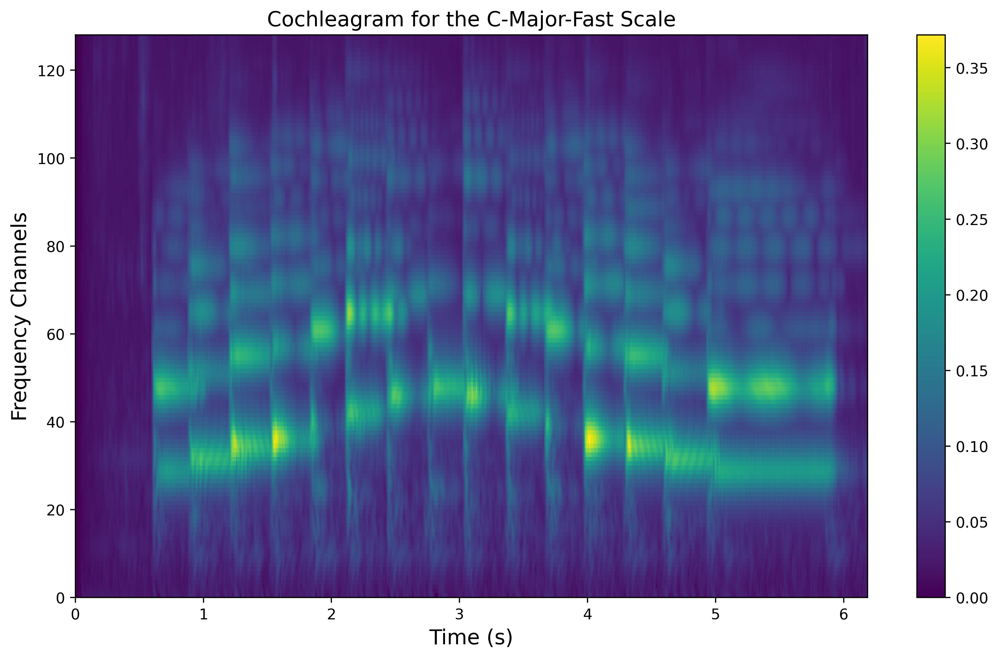
Cochleagram

Slide 7
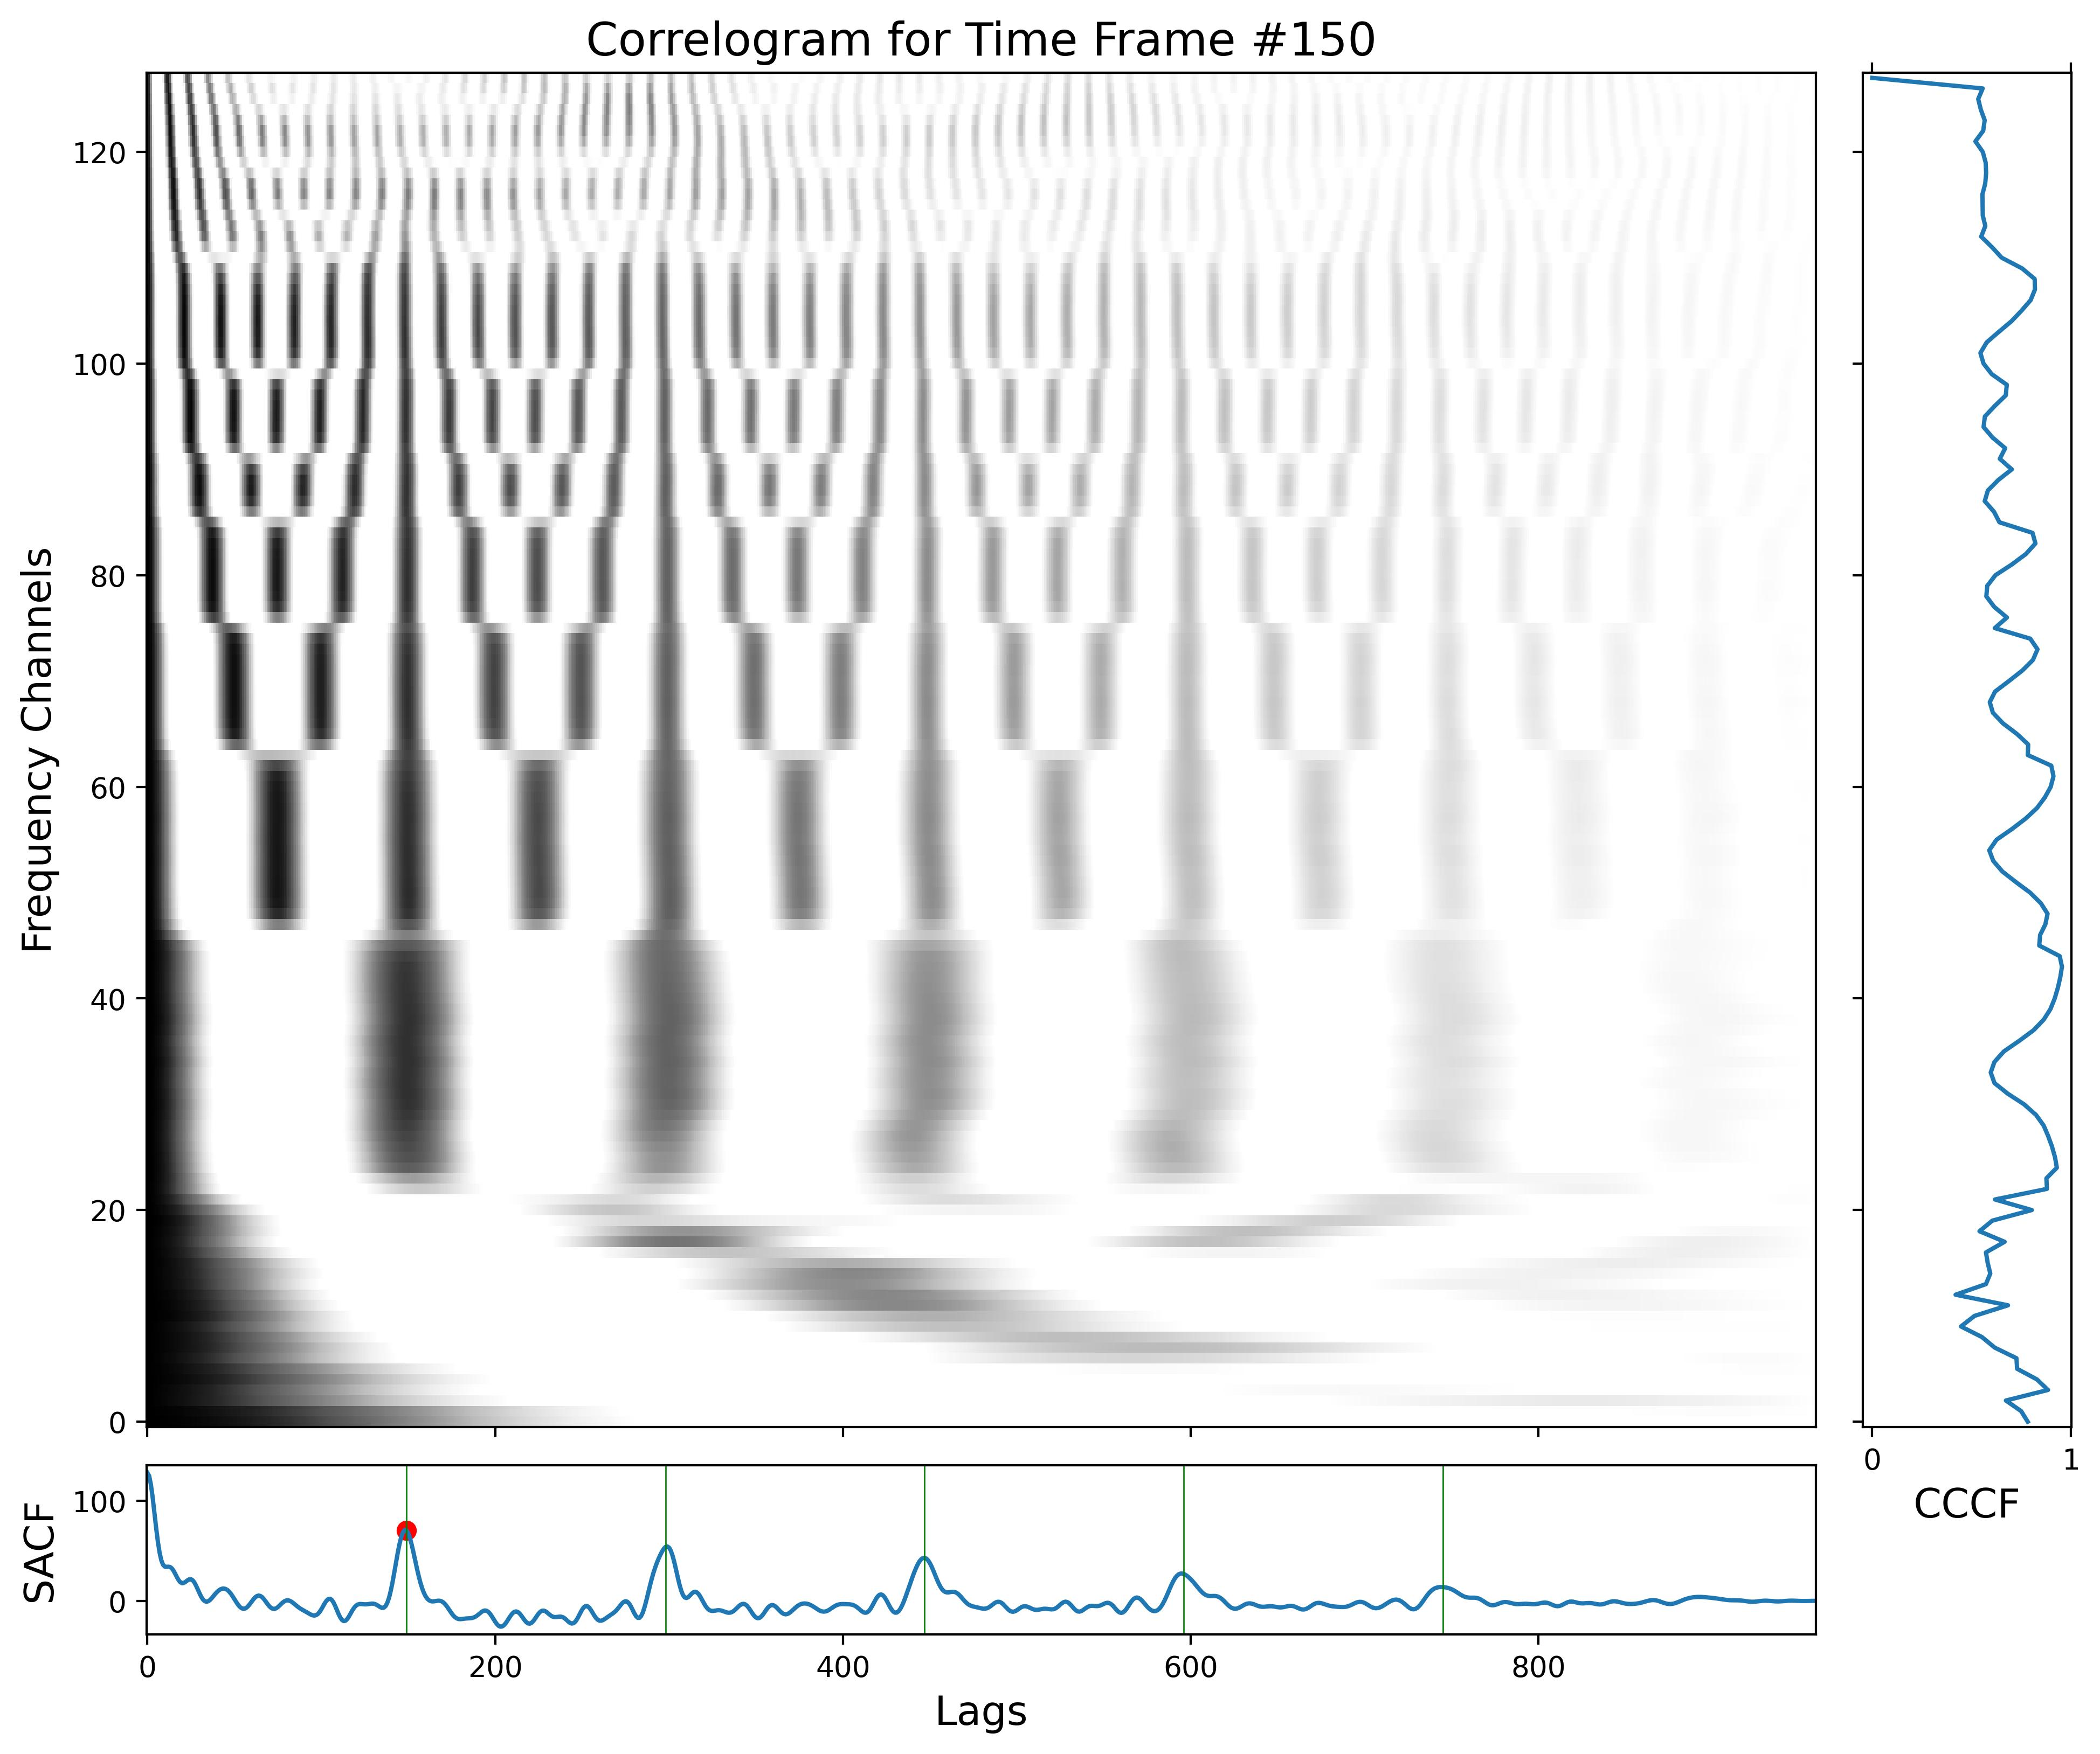
Feature Extraction

Slide 8
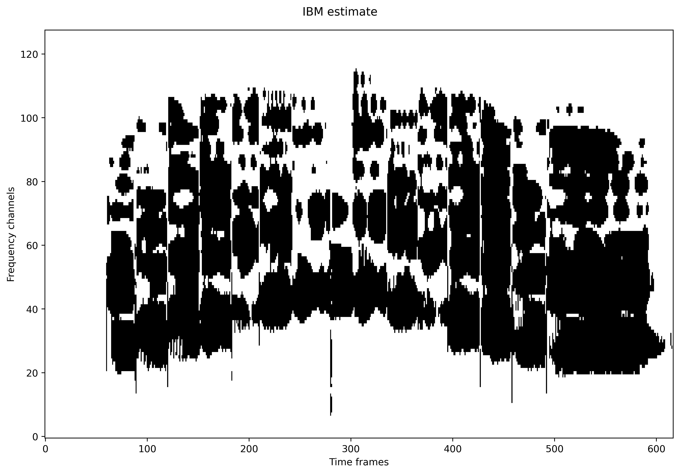
Segmentation and Grouping

Slide 9
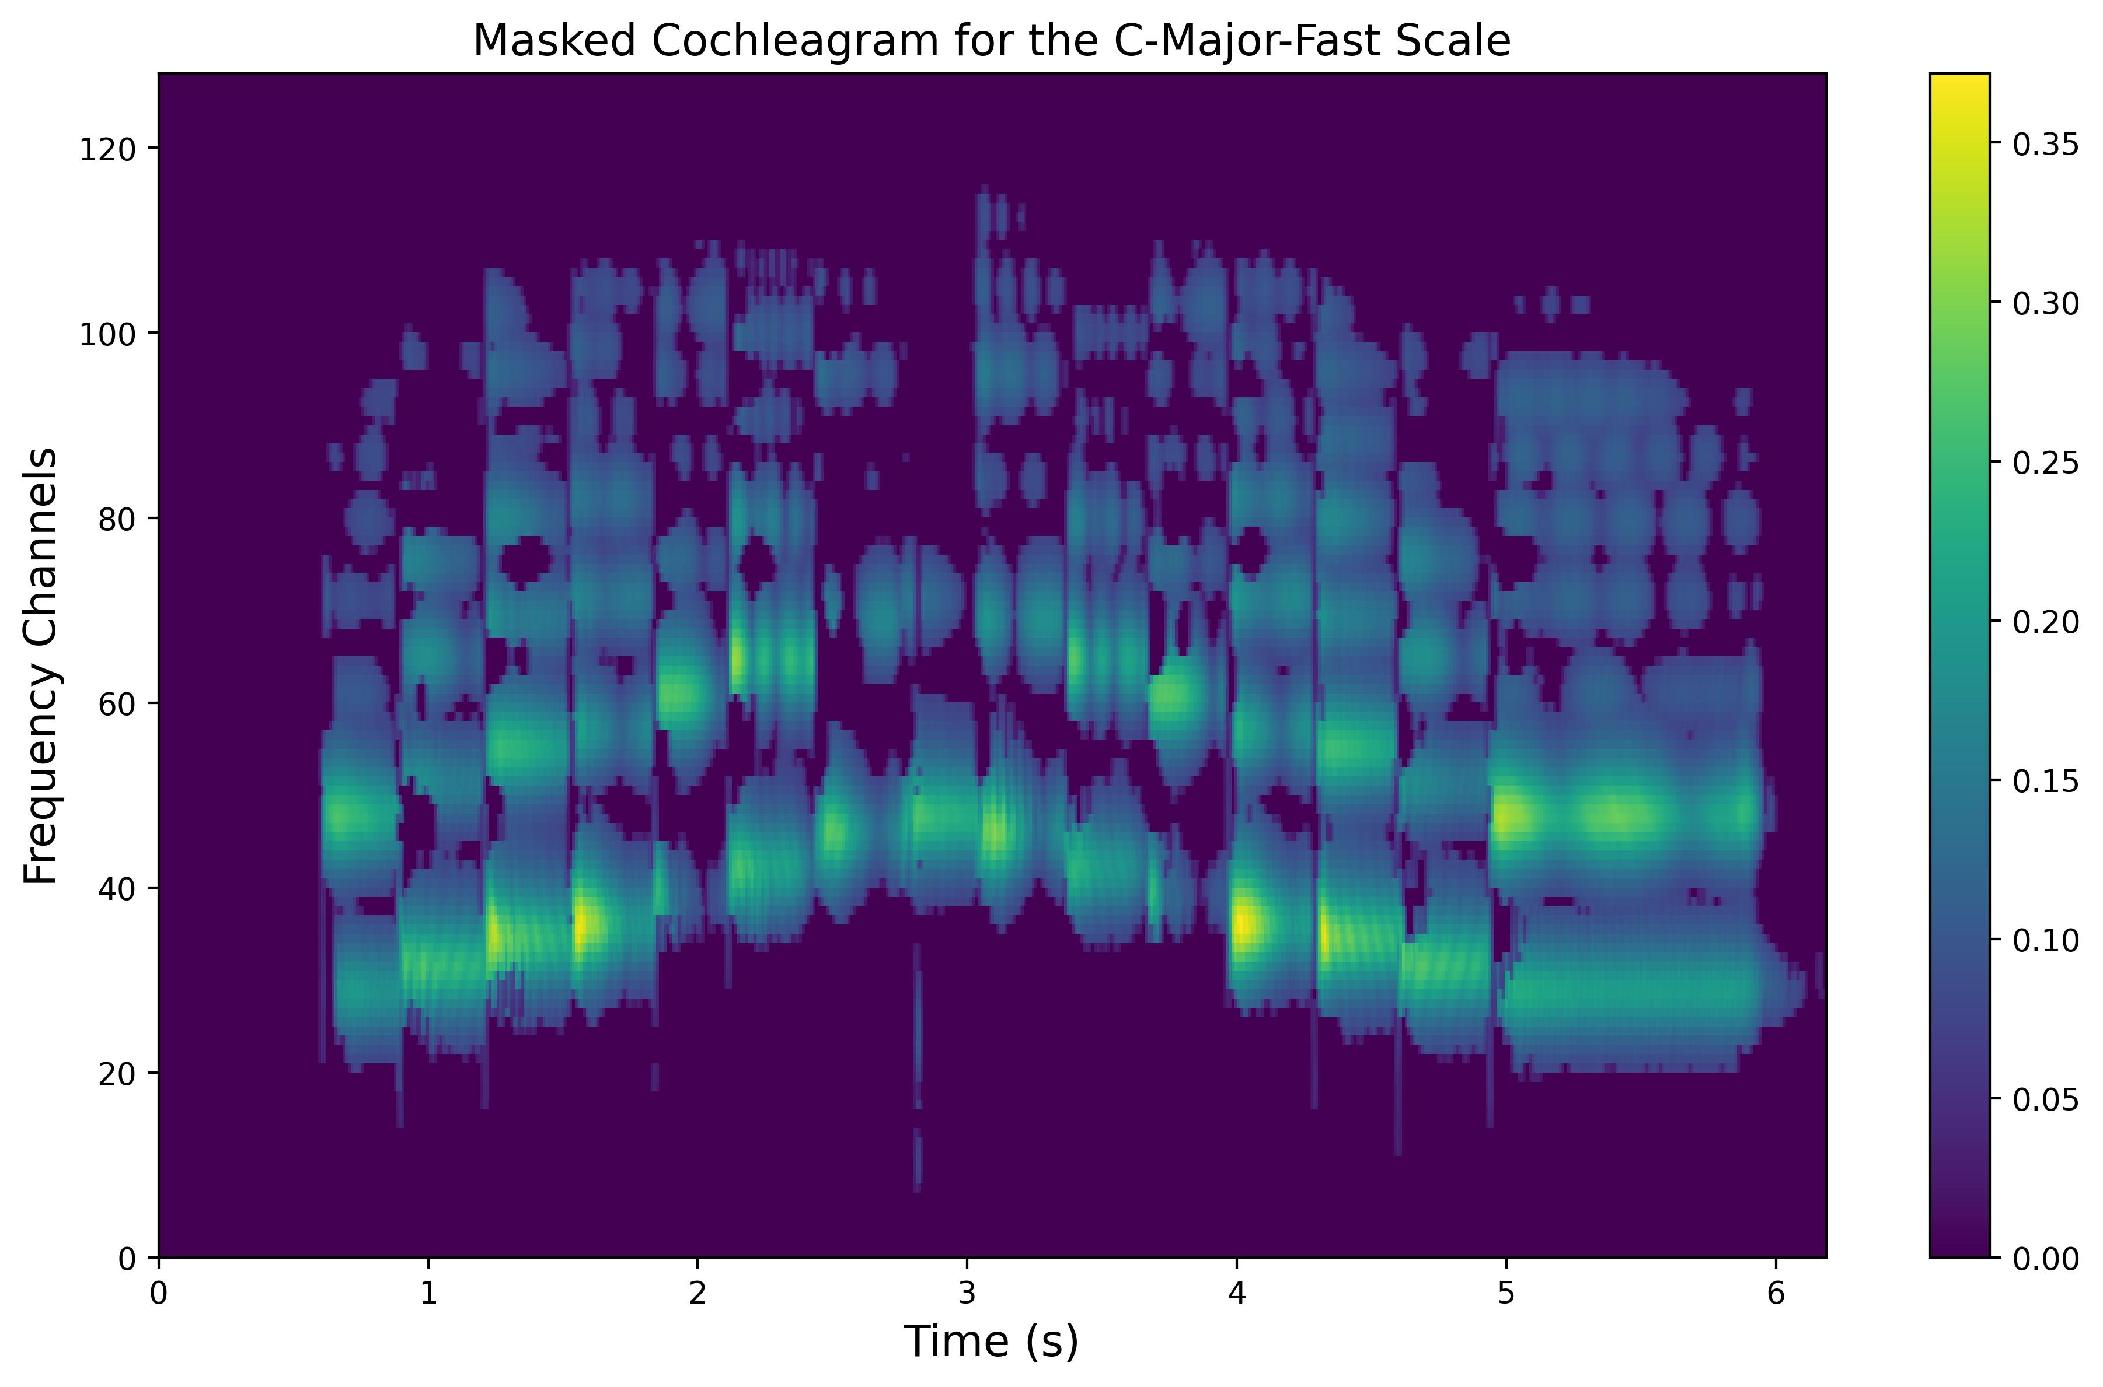
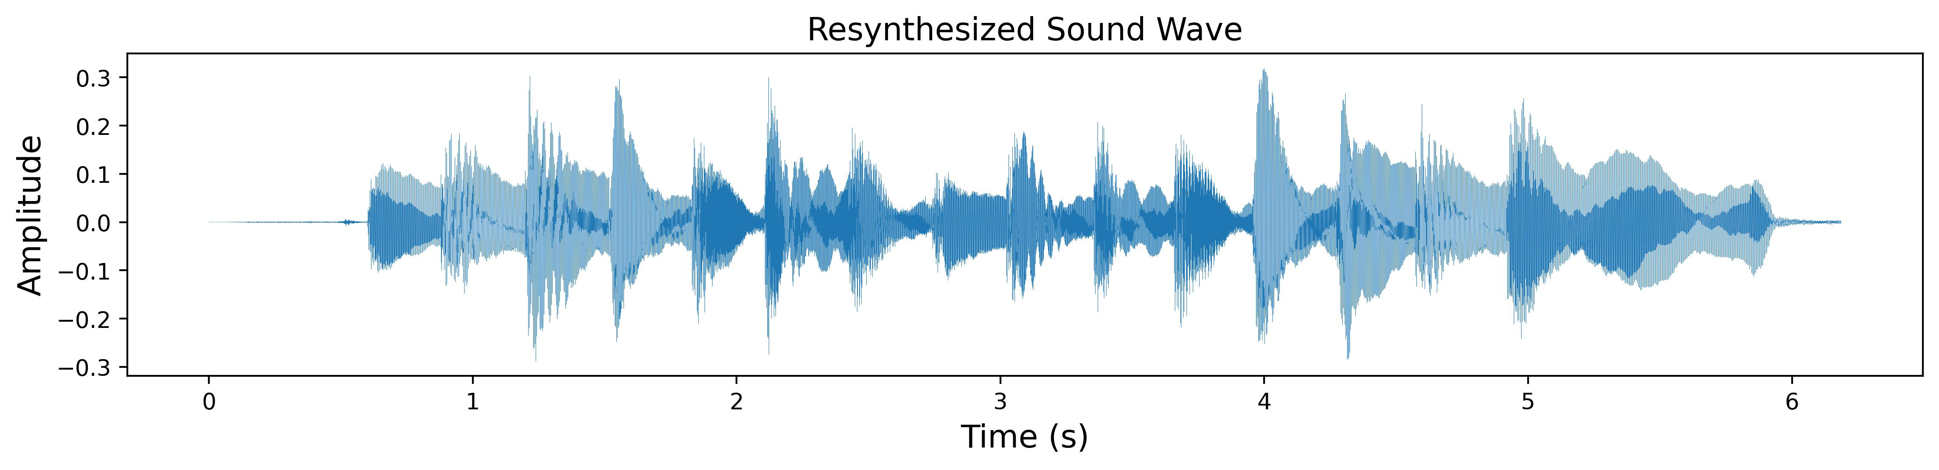
Resynthesis

Slide 10
Experiments
White noise backgrounds
Other prerecorded backgrounds
Tests in connection with a simple classifier
Other experiments

Slide 11
Dataset
34 piano recordings stored as two channels in WAV files
Various major and minor scales in different modes
Perfect melodic fourths and octaves
All piano keys one after another in different octaves
36 background sounds: clanging, grinding, rattling, etc.
Rustling paper or a plastic bag, ticking lock, clatter of kitchen utensils…

Slide 12
Experiments with White Noise and Other Backgrounds
Input Sounds
CASA processing
Output IBMs
WN/Backgrounds

Slide 13
Experiments with a Simple Classifier
Input Sounds
Precomputed IBMs
Multiclass Classifier
Input Scale Predictions
WN/Backgrounds

Slide 14
Thank You for Your Attention!

Slide 15
Opponent’s Questions
Which further extensions/improvements would you suggest for your model? (“Jaké další možnosti rozšíření byste navrhl pro Váš model?”)
Where do you see its further use? (“Kde spatřujete jeho další využití?”)

