Slide 1
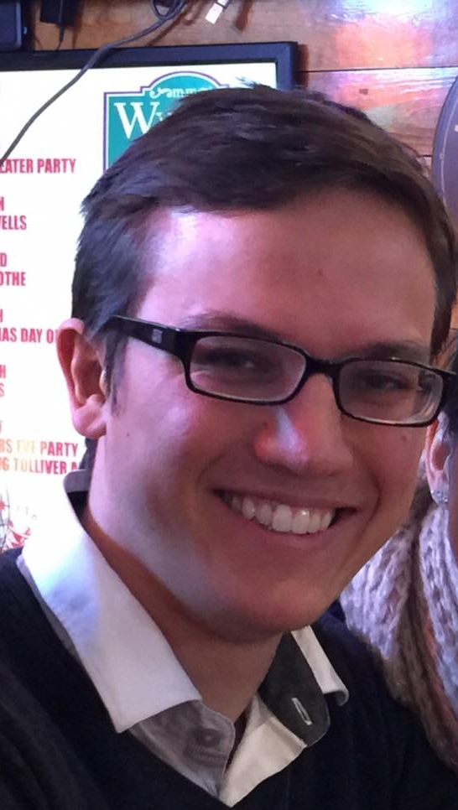
Sebastian Alvis
About Me Research Experience Coding Experience Resume / CV D&D Applications
Notes:
Make “D&D” the Logo from WotC?
Have brief descriptions of each nav bar item on the main page, but separate pages with more detail on each (?)

Slide 2
About Me
I am Sebastian Alvis, a 24-year-old once-aspiring physicist, coding enthusiast, cat lover, and dungeon master. I have completed my second year of the Physics PhD program at UW, complete with Master’s Degree, and am now looking for internship experience to ease my way into an entry-level Software Developer position.

Slide 3
Research Experience
Experimental physics research is heavily multidisciplinary. My year and a half with the Majorana experiment involved engineering, programming, and data science.
Engineering
There is a germanium detector at UW of the same style that the Majorana experiment uses. In working to bring this detector to working capacity, I used Autodesk Inventor to design, install, and test three-dimensional parts. I have maintained this detector’s assembly, repaired the turbopump it uses, and am currently redesigning it to incorporate suggested changes from a report on a variable alpha-source scanner.
Programming
The primary software package used in all of physics is ROOT, which creates unique data structures, improves parallelization on large amounts of data, and has tools to visualize and analyze data. I learned ROOT through teaching myself, and used it to learn Majorana’s data and the analysis tasks I performed. I mounted ROOT onto Python and C++ and build modules and scripts to parallelize my data processing and perfect my data-quality-checking workflow.
Data Science
My initial analysis consisted of tracking a parameter across detectors and time, finding areas where it was unstable, and fixing them using existing scripts, which required occasional debugging and modification. Later analyses performed an instability quantification, calculating the parameter shift that encapsulated a few percent of the data. This was used as a benchmark to validate instability levels.
Notes:
Link to root, link to Jason, link to Majorana

Slide 4
Coding Experience
University of Illinois at Urbana-Champaign Classwork
CS 125, Intro to Computer Science, Java and Coding Basics
CS 173, Discrete Structures, Logic and Programming Mathematics
CS 225, Data Structures, C++ and data structures
CS 233, Computer Architecture, low level architecture implementation
CS 433, Computer System Organization, high level architecture implementation and parallel programming
CS 450, Numerical Analysis, Python and Algorithms
University of Washington Classwork
Various Physics classes, Mathematica
CSE 344, Introduction to Database Management, Query languages, database styles, transactions
Research Work
Python, numpy, matplotlib, created modules
C++, std::vector
ROOT
Personal Website
Uses HTML, CSS, JavaScript, Bootstrap
All learned from Code Academy

Slide 5
Resume / CV

Slide 6
D&D Applications
In order to gain experience with web development, I needed a personal project to motivate myself to get the work done. Dungeons and Dragons has long been an enjoyable game that brings family and friends together for me, and has recently been a huge creative outlet (writing characters, backstories, campaigns). Written in Javascript, and hopefully soon, Jquery, Angular, and ReactJS.
These applications are mostly tailored to Dungeon Masters, including roll simulations to speed up NPC / monster combat, and random ability score / hit point dice rollers. Both DMs and players can make good use of the character sheet generator, and speed comparison tools.

