Slide 1
CookBook
the new idea of enjoying the world of cooking

Slide 2




The project was developed with
Nodejs
express
mongodb
javascript
css

Slide 3
What is CookBook?
CookBook is a community created for the purpose of bringing people together and uniting them through the world of cooking.
CookBook gives every registered user the opportunity to share their ideas or recipes.

Slide 4
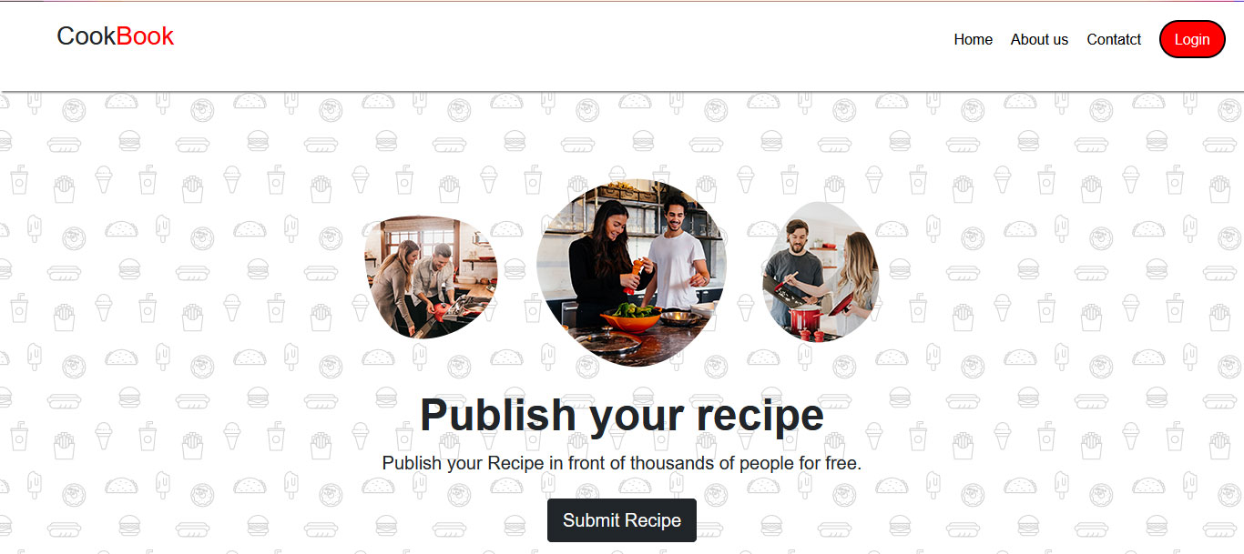
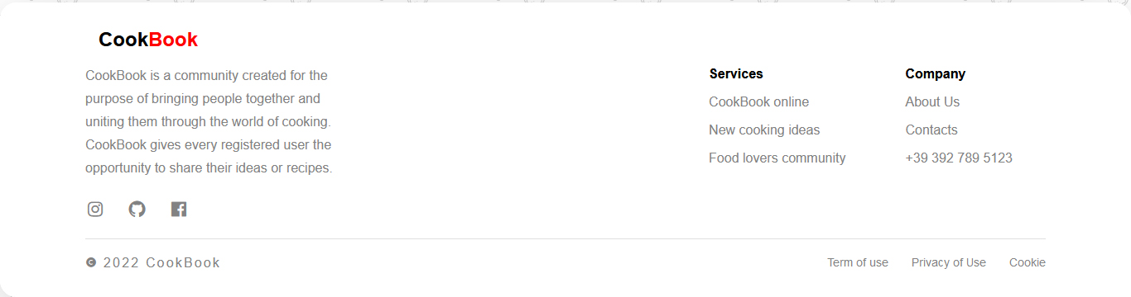
This is the home page

Slide 5
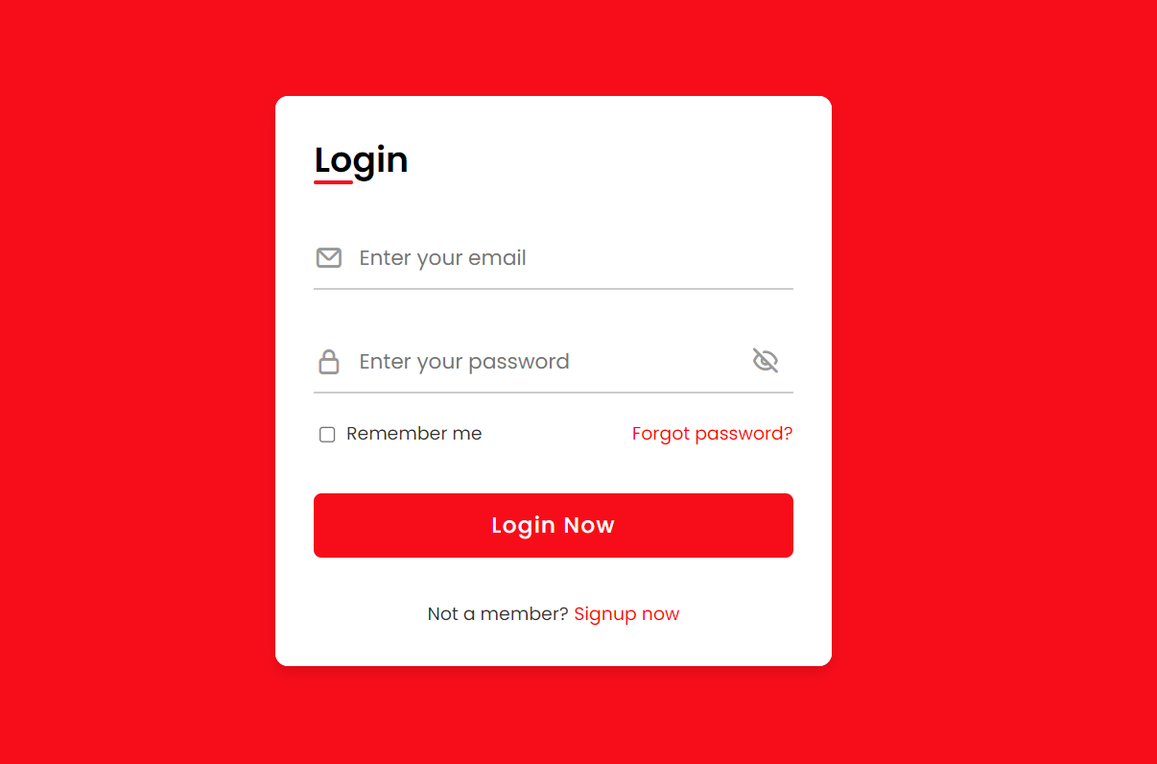
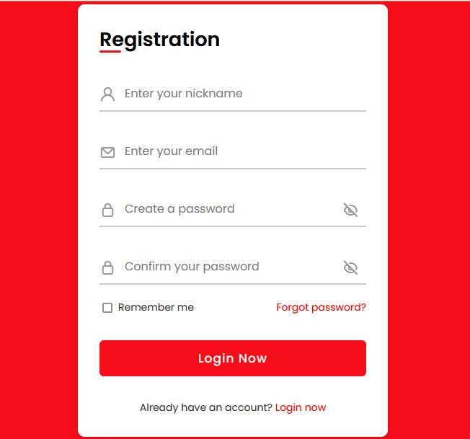
This is the sign-in or sign-up page

Slide 6
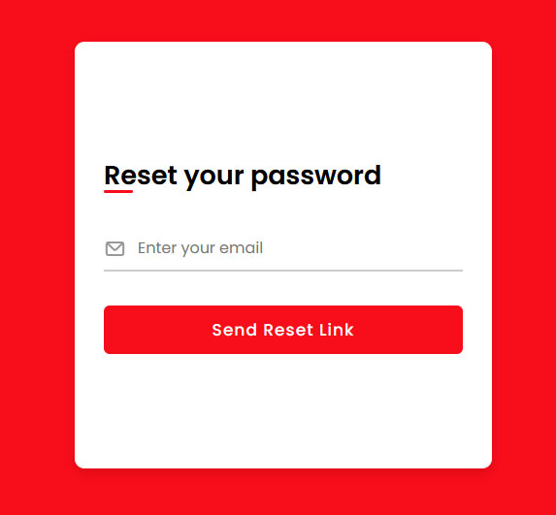
If you can’t remember your password you can reset it on the button "forgot your password"

Slide 7
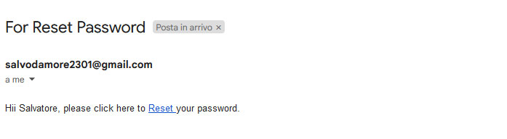

Second step for reset password

Slide 8
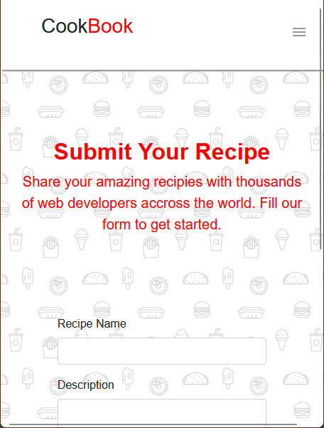
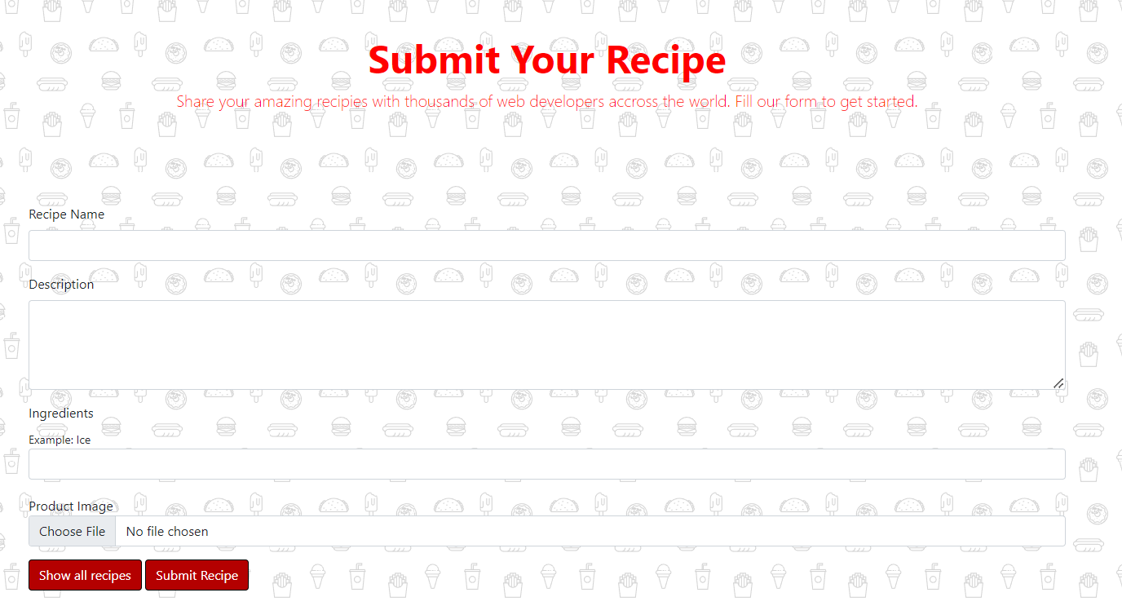
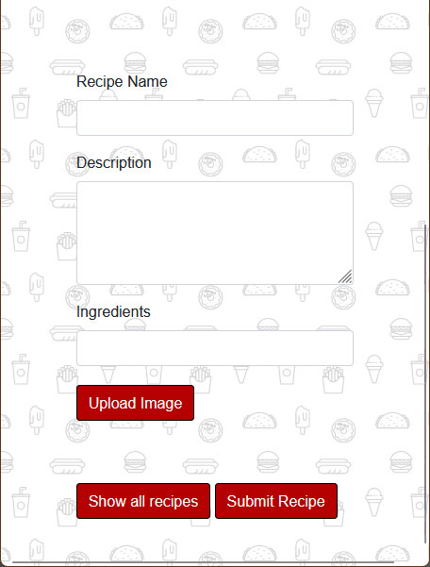
This is the section for publication the recipe

Slide 9
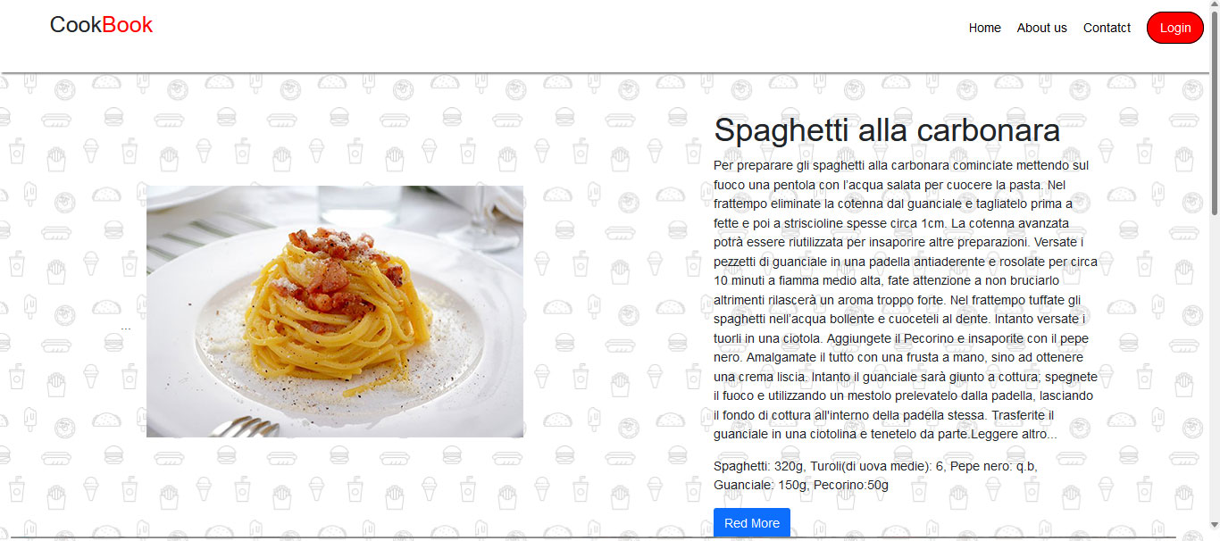
Recipe already posted

Slide 10
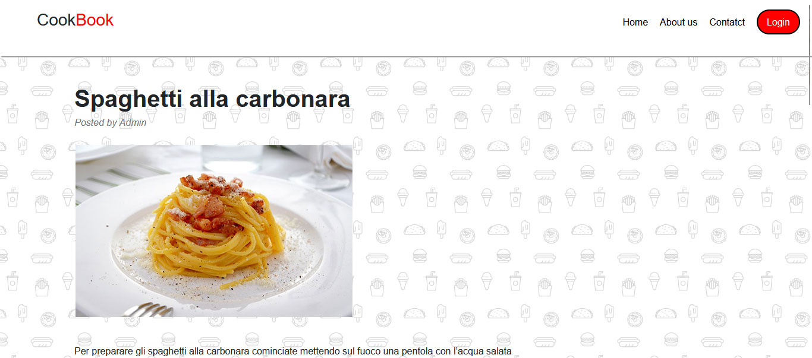
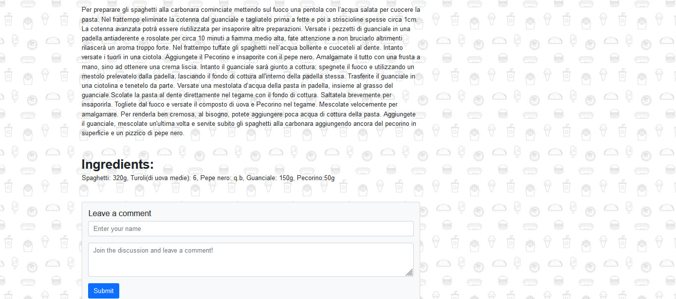
Recipe already posted

Slide 11
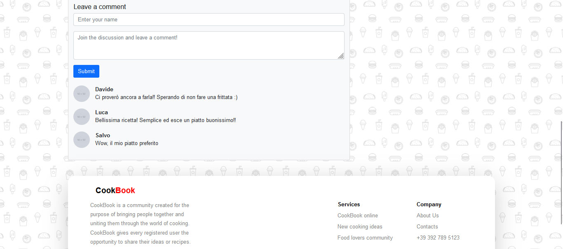
Comments section

Slide 12
Deployed by
Salvo D’amore 0124002246
Riccardo Maione 0124002391
Davide Montuori 0124002374

