Slide 1

ML 2023 Project
Authors: Salvatore Ergoli (660527), Silvio Calderaro (625577), Antonio Brau (530304)
Team name: Burdos
Master degree: Digital Humanities, Physics
Emails: s.ergoli@studenti.unipi.it, s.calderaro1@studenti.unipi.it, a.brau@studenti.unipi.it
Project: Type B

Slide 2
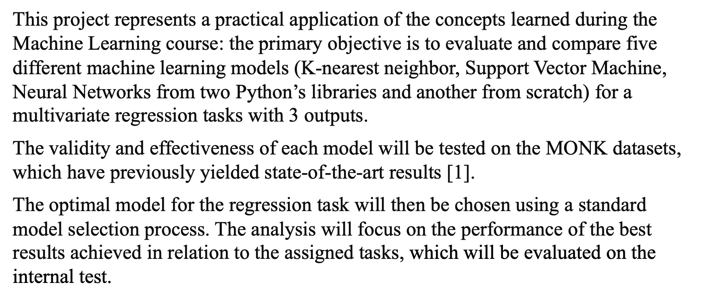
Objectives

Slide 3
Models
KNN from the scikit-learn [2] library;
SVM from the scikit-learn library (SVC and SVR);
MLP from the Keras [3] library (KerasClassifier and KerasRegressor);
MLP from the scikit-learn library (MLPClassifier and MLPRegressor);
NN from scratch.

Slide 4
Monk 1
Models | Parameters | MSE (TR/TS) | Accuracy (TR/TS)
KNN | n_neighbors: 27, weights: distance, metric: minkowski, p: 1 | 0.0 / 0.19 | 100% / 80%
SVC | C: 100, gamma: auto, kernel: rbf | 0.0 / 0.0 | 100% / 100%
MLP SGD (scikit-learn) | η: 0.2, α: 0.5, batch size: 8, epochs: 400 | 0.003/ 0.006 | 100% / 100%
MLP SGD (Keras) | η: 0.8, α: 0.8, batch size: 8, epochs: 300 | 10e-5 / 6.3462e-05 | 100% / 100%
MLP SGD (Our model) | η: 0.8, α: 0.8, batch size: 8, epochs: 300 | 0.0005 / 0.002 | 100% / 100%

Slide 5
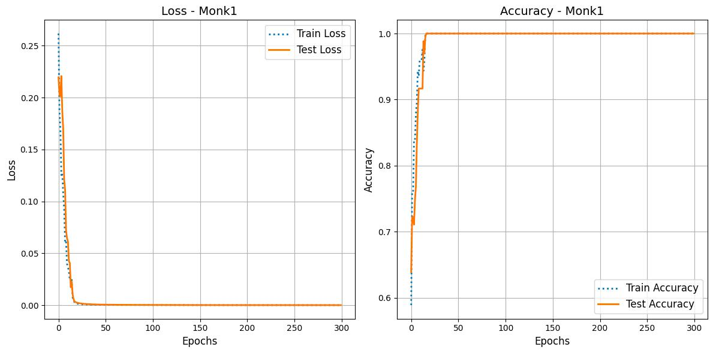
MLP SGD Keras for MONK 1: learning curves
MSE
ACCURACY

Slide 6
Monk 2
Models | Parameters | MSE (TR/TS) | Accuracy (TR/TS)
KNN | n_neighbors: 36, weights: distance, metric: minkowski, p: 3 | 0.0 / 0.19 | 100% / 80%
SVC | C: 50, degree: 2, gamma: scale, kernel: poly | 0.0 / 0.0 | 100% / 100%
MLP SGD (scikit-learn) | η: 0.3, α: 0.4, batch size: 4, epochs: 400 | 0.04 / 0.04 | 100% / 100%
MLP SGD (Keras) | η: 0.5, α: 0.7, batch size: 8, epochs: 300 | 10e-5/7.0070e-05 | 100% / 100%
MLP SGD (Our model) | η: 0.9, α: 0.8, batch size: 1, epochs: 300 | 10e-5/10e-5 | 100% / 100%

Slide 7
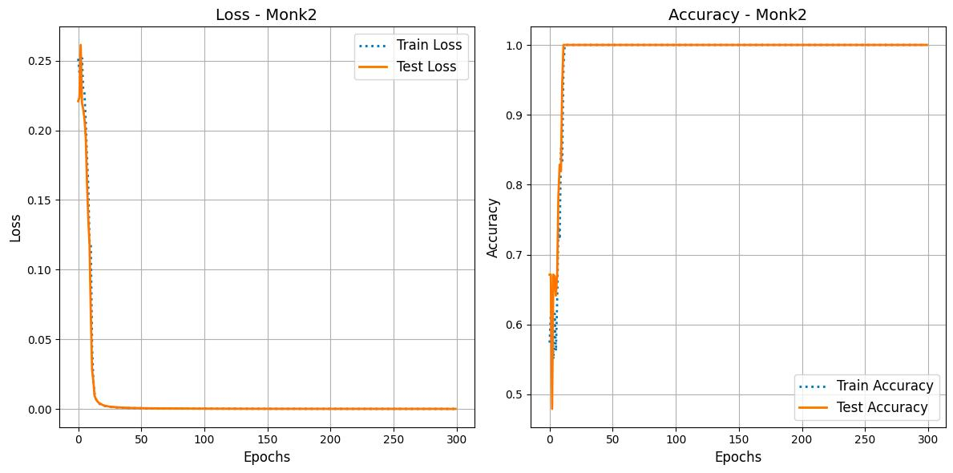
MLP SGD Keras for MONK 2: learning curves
MSE
ACCURACY

Slide 8
Monk 3
Models | Parameters | MSE (TR/TS) | Accuracy (TR/TS)
KNN | n_neighbors: 50, weights: distance, metric: minkowski, p: 1 | 0.0 / 0.05 | 100% / 94%
SVC | C: 1, kernel: linear | 0.06 / 0.02 | 93.4% / 97.2%
MLP SGD (scikit-learn) | learning rate: adaptive, η: 0.1, α: 0.5, λ: 0.5, batch size: auto, epochs: 400, nesterovs momentum: True | 0.09 / 0.08 | 91.7% / 97.2
MLP SGD without reg. (Keras) | η: 0.01, α: 0.7, batch size: 8, epochs: 300 | 0.0439 / 0.0453 | 94.6% / 95.6%
MLP SGD with reg. (Keras) | η: 0.5, α: 0.7, λ: 0.01, batch size: 8, epochs: 300 | 0.0604 / 0.0602 | 95.8% / 96.5%
MLP ADAM (Our model) | η: 0.01, batch size: 8, epochs: 300, β1: 0.9, β2: 0.999, | 0.005 / 0.004 | 94.2% / 96.9%

Slide 9
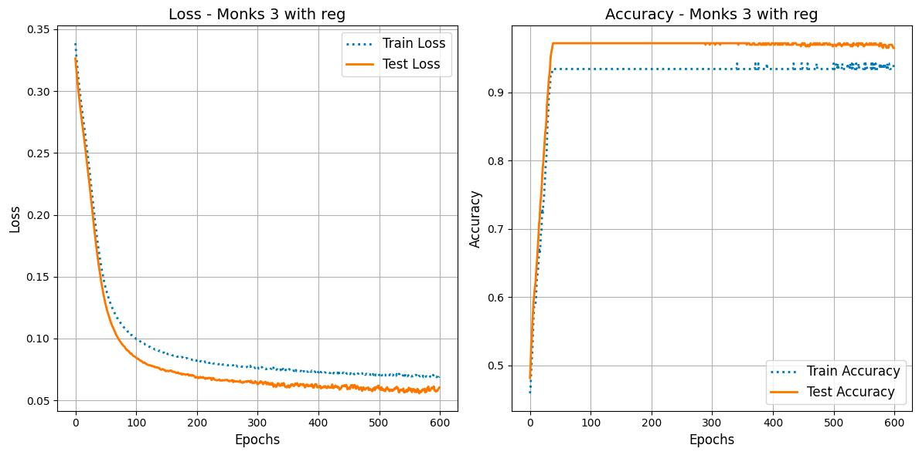
MLP SGD Keras for MONK 3 (with reg.): learning curves
MSE
ACCURACY

Slide 10
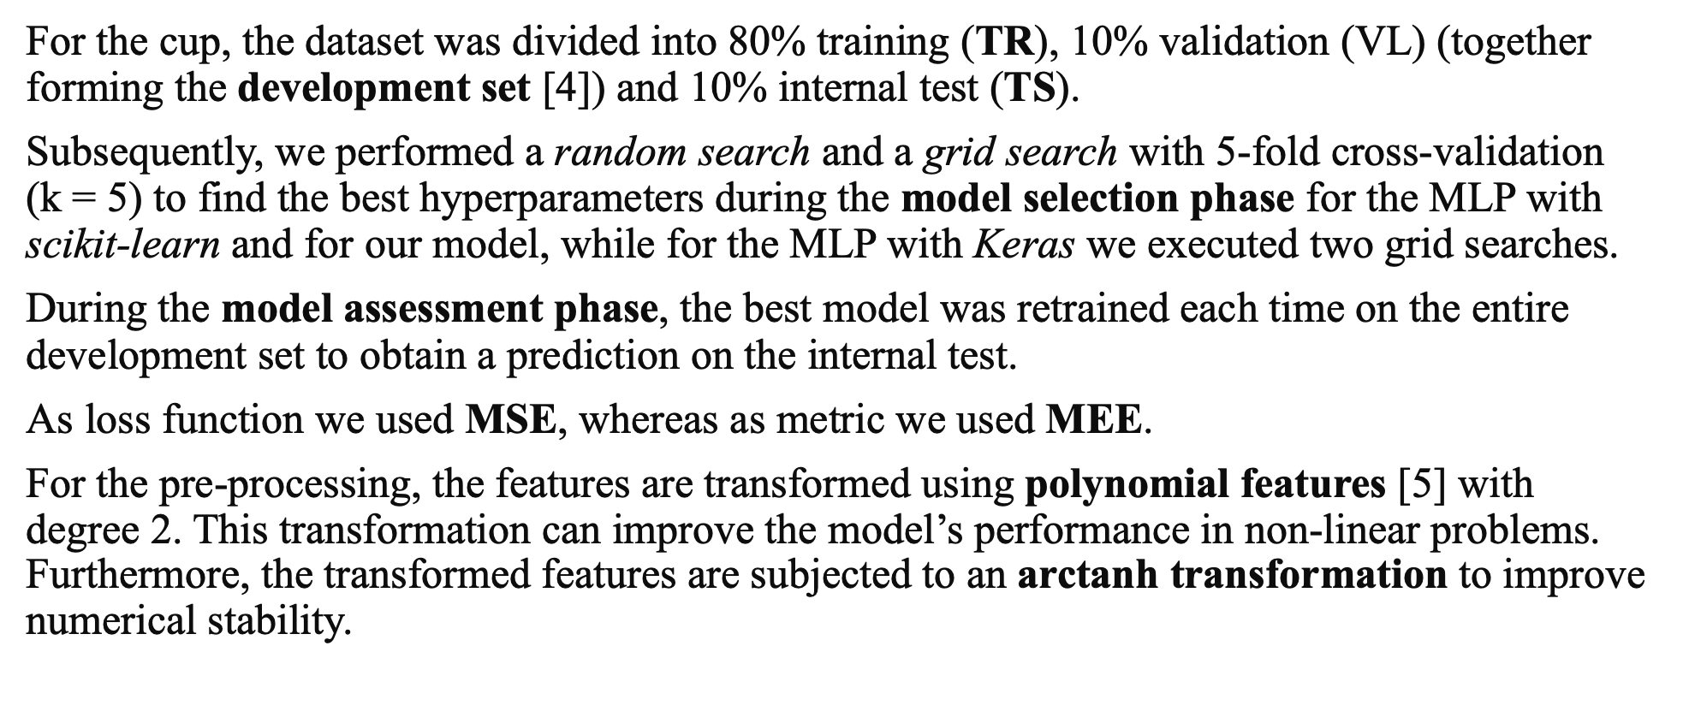
Cup validation schema: data splitting, model selection and model assessment NN

Slide 11
Cup results: K-nn
The K-Nearest Neighbor (KNN) algorithm for regression was employed using the KNeighborsRegressor class from the scikit-learn library. We executed a grid search on the following hyperparameters:
  n_neighbors;
  weights: a neighbor weighting function, with values ‘uniform’ (all neighbors have the same weight) or ‘distance’ (closer neighbors have a higher weight);
  p: distance metric used, with value 1 (Manhattan distance) or 2 (Euclidean distance).
Parameters | MSE (TR/VAL) | MEE (TR/VAL) | MSE (TS) | MEE (TS)
n_neighbors: 4, p: 2, metric: distance | 3.08e-13 / 2.47 | 5.35e-7 / 2.21 | 3.45 | 2.47

Slide 12
Cup results: SVR
We runned three different grid searches for linear kernel, poly kernel and RBF kernel, which implement a cross-validation with 5 folds.
After each grid search, the best set of hyperparameters is identified and an SVR model is trained using those optimal hyperparameters on the training data. The performance of the trained model is then evaluated on the dev set and the internal test set using metrics such as mean squared error (MSE) and mean Euclidean error (MEE).
Kernel | Parameters | MSE (TR/VAL) | MEE (TR/VAL) | MSE TS | MEE TS
Linear | C: 10, gamma: scale, epsilon: 0.1 | 1.14 / 1.18 | 1.42 / 1.46 | 2.56 | 1.90
Poly | C: 1000, gamma: scale, coef0: 0.0, degree: 2, epsilon: 0.01 | 0.04 / 0.05 | 0.27 / 0.28 | 0.17 | 0.52
RBF | C: 1000, gamma: scale, epsilon: 0.01 | 0.01 / 0.15 | 0.01 / 0.15 ± 0.01 | 0.11 | 0.45 ± 0.06

Slide 13
Cup results: MLP scikit-learn and MLP Keras
Models | Parameters | MSE (TR/VAL) | MEE (TR/VAL) | MSE TS | MEE TS
MLP scikit-learn | Solver: adam, batch size: 16, η: 0.0001, β1: 0.87, β2: 0.98, activation: tanh, α: 0.008, hidden units: 150 | 0.01 / 0.13 | 0.12 ± 0.0 / 0.41 ± 0.05 | 0.16 | 0.401 ± 0.043
MLP Keras | Solver: sgd, batch size: 32, η: 0.003, activation: tanh, α: 0.7, lambda: 0.001, Hidden layers: 3, hidden units: 150 | 0.02 / 0.14 | 0.14 ± 0.0 / 0.41 ± 0.05 | 0.135 | 0.471 ± 0.043

Slide 14
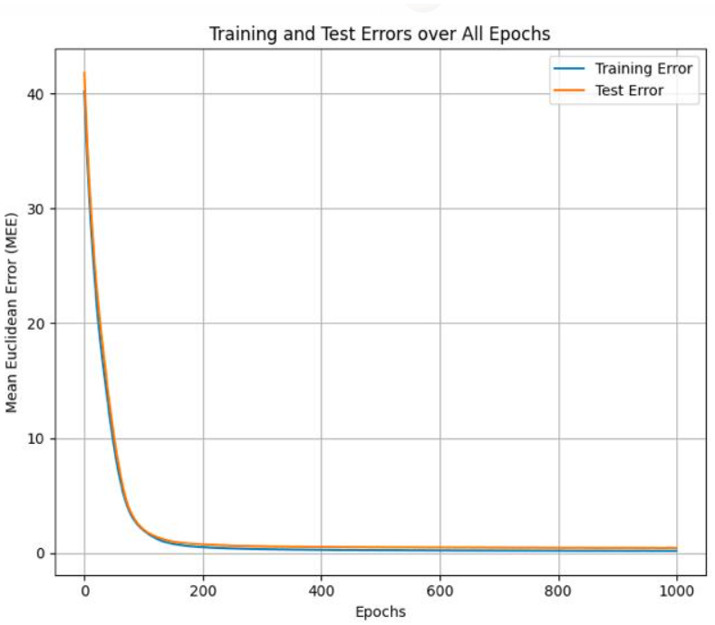
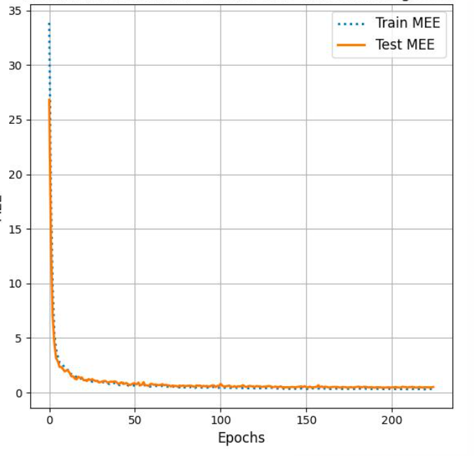
Cup results: MLP scikit-learn and MLP Keras
MEE scikit-learn
MEE Keras

Slide 15
Cup results: our model
We developed from scratch a fully connected Multi-Layer Perceptron (MLP) that uses the backpropagation algorithm for training. The main features of the implementation are:
  Optimizers: the network can be trained using various optimizer, like batch gradient descent (GD), Stochastic Gradient Descent (SGD), ADAM Optimizer;
  Regularization techniques: L2 regularization (weight decay), L1 regularization;
  Early stopping: which stops training when performance on validation set starts to deteriorate;
  Momentum: to accelerate the convergence of the gradient descent algorithm,;
  Gradient clipping: to prevent gradient explosion;
  Activation functions: the implementation includes various activation functions such as tanh, sigmoid, reLU, etc...
  Loss functions: various loss functions have been incorporated, including Huber Loss and Mean Squared Error (MSE).
In summary, the developed neural network is highly flexible, allowing for a general number of layers and units per layer and includes various optimization and regularization techniques to improve performance and generalization.

Slide 16
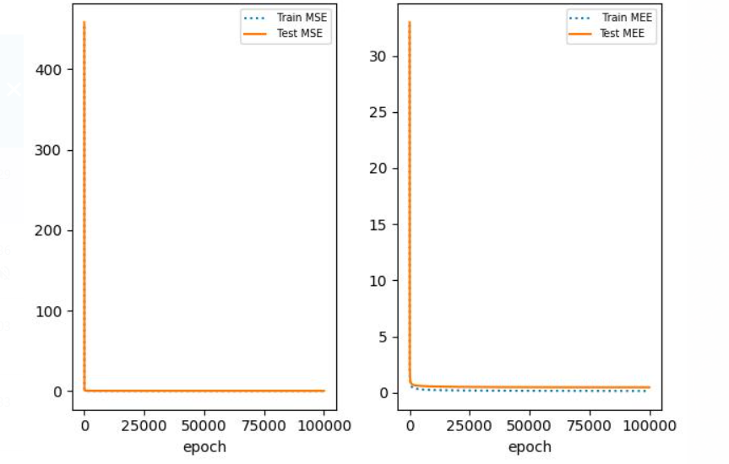
Cup results: our model
Parameters | MSE (TR/VAL) | MEE (TR/VAL) | MSE (TS) | MEE (TS)
α: 0.3, λ: 0.0005, η: 0.018, batch size: full, activation: tanh, hidden units: 150 | 3.08e-13 / 2.47 | 5.35e-7 / 2.21 | 0.114 | 0.407 ±
MSE
MEE

Slide 17
Ensemble
We explore ensemble techniques to amalgamate predictions from our most effective models, which were trained with the best-found hyperparameters during the model selection phase.
We examine two ensemble strategies:
  Arithmetic average: the arithmetic average entails aggregating predictions from each individual model by computing their mean;
  Weighted average by performance: the weighted average involves assigning distinct weights to each model's predictions before computing the aggregate. We chose to average the predictions of the different neural networks first, and then average this combined prediction with the SVM predictions. This approach aimed to leverage the complementary strengths of neural networks and SVMs, potentially enhancing the overall predictive performance of the ensemble.
We conducted experiments by averaging several models making predictios in the validation set. It's worth noting that neural networks trained with the best-found hyperparameters during the model selection phase have already undergone an averaging process across five trials, specifically for SGD and Adam optimizers.
Additionally, the neural network trained using the gradient descent (GD) optimizer utilized a learning scheduler that required a validation set for training. Consequently, we split the training set into 10 folds, and for each fold, we trained the neural network on the remaining 9 folds. We then averaged the predictions made by each of these models on the test set

Slide 18
Ensemble
Models | MEE TR | MEE VAL | MEE INT TS
Our model | 0.15 | 0.41 | 0.407
MLP Keras | 0.14 | 0.41 | 0.471
MLP scikit-learn | 0.12 | 0.40 | 0.401
SVR | 0.15 | 0.45 | 0.429
Arithmetic avg | 0.13 | 0.40 | 0.386
Weighted avg | 0.14 | 0.41 | 0.388

Slide 19
Conclusions
This project gave us the opportunity to test different models with various libraries to gain practical experience and confidence with the theoretical aspects covered in class.
In the obtained results, it emerges that the best model is the ensemble using the weighted average compared to the individual models identified. The weighted average allowed assigning different weights to the models based on their performance, giving more importance to the more accurate models.
Furthermore, the development of the project has highlighted that the pre-processing phase was important for managing the distribution of data and carefully evaluating the metrics.
This result highlights the importance of exploring different pre-processing and machine learning techniques and combining the models optimally to achieve the best possible performance.

Slide 20
Bibliography
[1] Wnek,J.. (1992). MONK's Problems. UCI Machine Learning Repository. https://doi.org/10.24432/C5R30R.
[2] scikit-learn site: http://scikit-learn.org/
[3] keras site: https://keras.io/api
[4] Course notes “Model assessment (Evaluation/Validation) and Model Selection
[5] https://machinelearningmastery.com/polynomial-features-transforms-for-machine-learning/

