Slide 1
Operating Systems
[ ]
Week 8: Concurrency
Lecturer: Chandara Chea
2025

Slide 2
Assessment
Attendance 10%
Lab 20%
Quiz 5%
Mid-term 20%
Project 15%
Final 30%

Slide 3
Review
In a single-processor multiprogramming system, ability to manage multiple tasks or processes at the same time. These tasks may be executed sequentially, but the system is designed to switch between them (e.g., via context switching) to make it appear that they're running simultaneously.
In a multiple-processor system(Parallelism): refers to true simultaneous execution of tasks, typically across multiple processors or cores. The tasks are literally running at the same time in different processing units (cores or machines).
Example: Parallelism is like having multiple chefs working in a kitchen simultaneously, while concurrency is like one chef multitasking between different cooking tasks.

Slide 4
Review (cont)
Race Conditions: occur when multiple threads access shared data concurrently, leading to inconsistent results due to lack of proper synchronization.
Lock: synchronization technique that ensures only one thread or process can access a critical section of code or a shared resource at a time, preventing race conditions and ensuring data consistency.

Slide 5
Mutual Exclusive (MuTex)
There are 2 common types of locks:
Mutual Exclusive: a locking mechanism that ensures mutual exclusion. It allows only one thread to access a critical section of code at a time. If another thread tries to acquire the mutex while it's already locked, it will be blocked until the mutex becomes available.
Mutex is typically implemented with blocking behavior. If the lock is unavailable, the thread is put to sleep and will be woken up when the mutex is released.

Slide 6
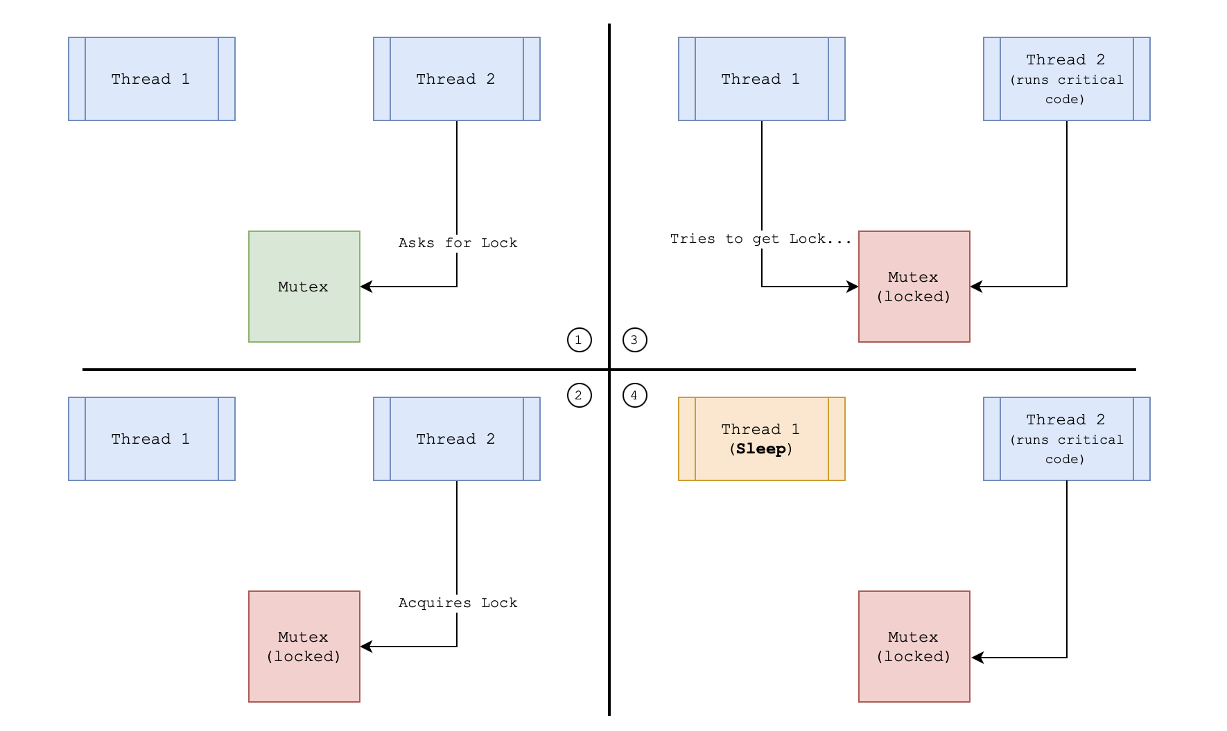

Slide 7
Spinlock
A spinlock is another type of lock that works by continuously spinning in a loop while trying to acquire the lock. If the lock is already held by another thread, the thread does not sleep; instead, it busy-waits (spins) until the lock is released.
Spinlocks are often used in scenarios where the lock is expected to be held for a very short period, as spinning is generally more efficient than putting a thread to sleep and waking it up.

Slide 8
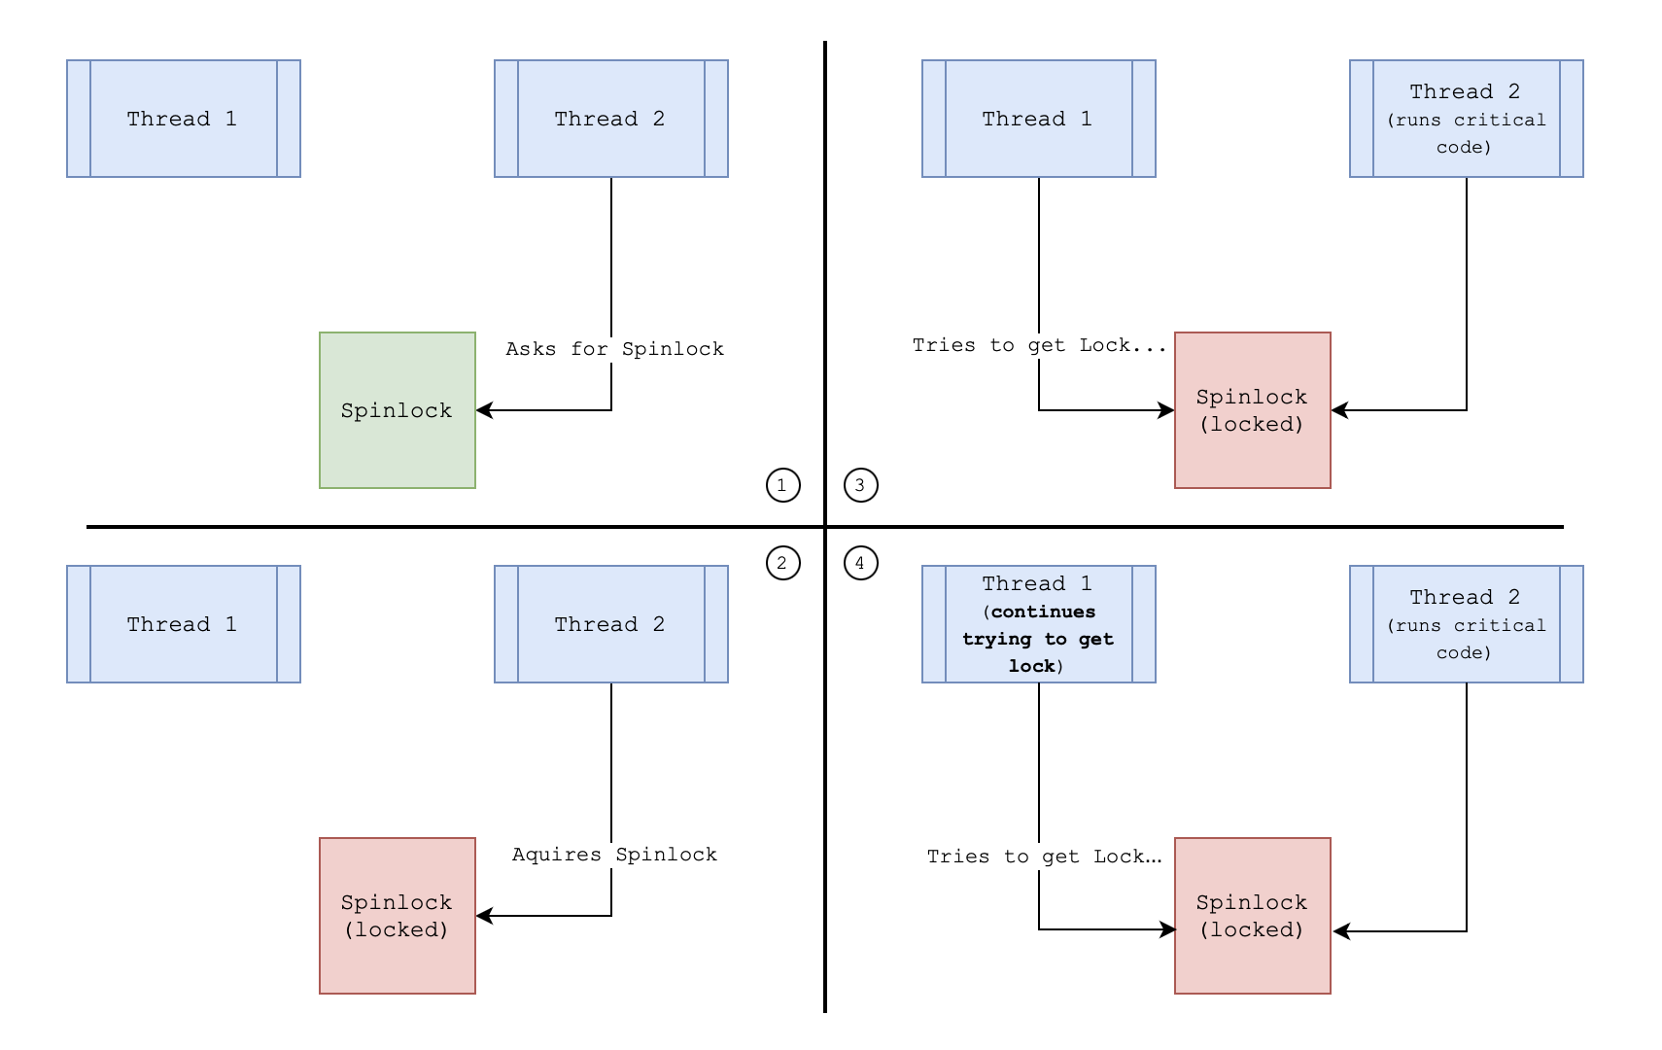

Slide 9
Semaphore
A semaphore is a more advanced synchronization primitive that can control access to a fixed number of resources.
A semaphore maintains a count that determines how many threads can access a shared resource at the same time. The count starts at a predefined value and is adjusted (incremented or decremented) as threads acquire or release the resource.
Wait (P or Acquire operation): When a thread wants to acquire a resource, it performs the wait operation. This decreases the semaphore's count. If the count is greater than zero, the thread proceeds; if it's zero, the thread is blocked until the count is greater than zero (indicating that a resource is available).
Signal (V or Release operation): When a thread releases a resource, it performs the signal operation. This increments the semaphore's count, potentially waking up other threads that were waiting for the semaphore.

Slide 10
two main types of semaphores:
Binary Semaphore
Takes only two values: 0 or 1.
Used to ensure mutual exclusion (only one thread can access a critical section at a time).
Counting Semaphore:
Can take any non-negative integer value.
Used to control access to a pool of resources (e.g., a limited number of printers).

Slide 11
Binary Semaphore
Binary Semaphore is often used to ensure that only one thread can access a critical section at a time.
Example: if a thread is using a resource, the semaphore is set to 0 (locked). When the thread is done, it signals (sets the semaphore to 1), allowing another thread to access the resource.
T1 -> Wait -> Semaphore = 0
T1 -> Signal -> Semaphore = 1
T2 -> Wait -> Semaphore = 0

Slide 12
Counting Semaphore
Counting Semaphores are used when there is a fixed number of resources, such as printers or database connections. The semaphore value indicates how many resources are available.
Example: if there are 3 printers, the semaphore starts at 3. Each time a print job is initiated, the semaphore is decremented. When a print job finishes, the semaphore is incremented.
Semaphore = 3 (3 printers)
T1 -> Wait -> Semaphore = 2
T2 -> Wait -> Semaphore = 1
T3 -> Wait -> Semaphore = 0
T4 -> Wait -> Semaphore = 0 (waits)

Slide 13
Deadlock
When used properly and carefully, synchronization can prevent race conditions, but then another problem rears its ugly head. The use of locks requires threads to wait (acquire blocks when another thread is holding the lock), so it’s possible to get into a a situation where two threads are waiting for each other — and hence neither can make progress.
Deadlock occurs when two or more processes are unable to proceed because each is waiting for the other to release resources. This creates a situation where none of the processes can continue, and the system becomes stuck.
Example: Process A holds Resource 1 and needs Resource 2. Process B holds Resource 2 and needs Resource 1. Both processes are stuck in this situation, unable to proceed.

Slide 14
Deadlock
Conditions:
Mutual Exclusion: At least one resource must be held in a non-shareable mode.
Hold and Wait: A process is holding one resource and waiting for additional resources held by others.
No Preemption: Resources cannot be forcibly taken from a process.
Circular Wait: A set of processes are each waiting for another in the set, forming a cycle.

Slide 15
To be continued

Slide 16
Quiz
https://www.slido.com/
2888411
Your Group – Your Name
Example:
1 - Chan Kosal
2 - Tep Mony

