Slide 1
AI ROADMAP | CURRENT-STATE GAPS
QC EXISTS • VERSION ALIGNMENT IS THE GAP
Where today’s gaps emerge across the RWD workflow
QC is documented in the Excel workbook. The key problem is keeping scientific intent, QC requirements, source mappings, code and released outputs on the same controlled version.
1
SCIENTIFIC
INTENT
2
SPECIFICATION +
QC WORKBOOK
3
SOURCE &
MAPPING
4
BUILD / ADS &
TLF CREATION
5
QC &
VALIDATION
6
RELEASE &
REFRESH
Protocol • SAP • RDQ
Excel specification / QC sheet
Dictionary • schema • profiling
R / Python implementation
Independent QC • reconciliation
Outputs • evidence • next cut
GAP
GAP
GAP
GAP
GAP
GAP
Interpretation & decision capture
Version and change control
Source variability & semantics
Manual translation & low reuse
QC / build misalignment
Lineage, audit & documentation
• Ambiguities resolved in meetings, email or memory
• Rationale is difficult to reuse
• Detailed QC exists, but workbook copies can diverge
• Changes do not automatically propagate
• Tables and variables differ by source / refresh
• Equivalence relies on manual judgement
• Spec and QC requirements are re-keyed into code
• Similar variables can be built differently
• QC code is maintained separately from build logic
• Revision mismatch and late defects remain possible
• Hard to bind exact spec, QC, code, cut and output
• Evidence can drift across refresh cycles
CROSS-CUTTING ACROSS
EVERY HAND-OFF
Knowledge fragmentation
Version & change control
Scalability & consistency
Traceability & provenance
The gaps compound across the lifecycle — they are not a coding-only problem.
NEXT → Governed knowledge + agent orchestration
+ deterministic acceptance
GOVERNED AGENTIC RWD ANALYTICS
Opening context • current-state workflow gaps

Slide 2
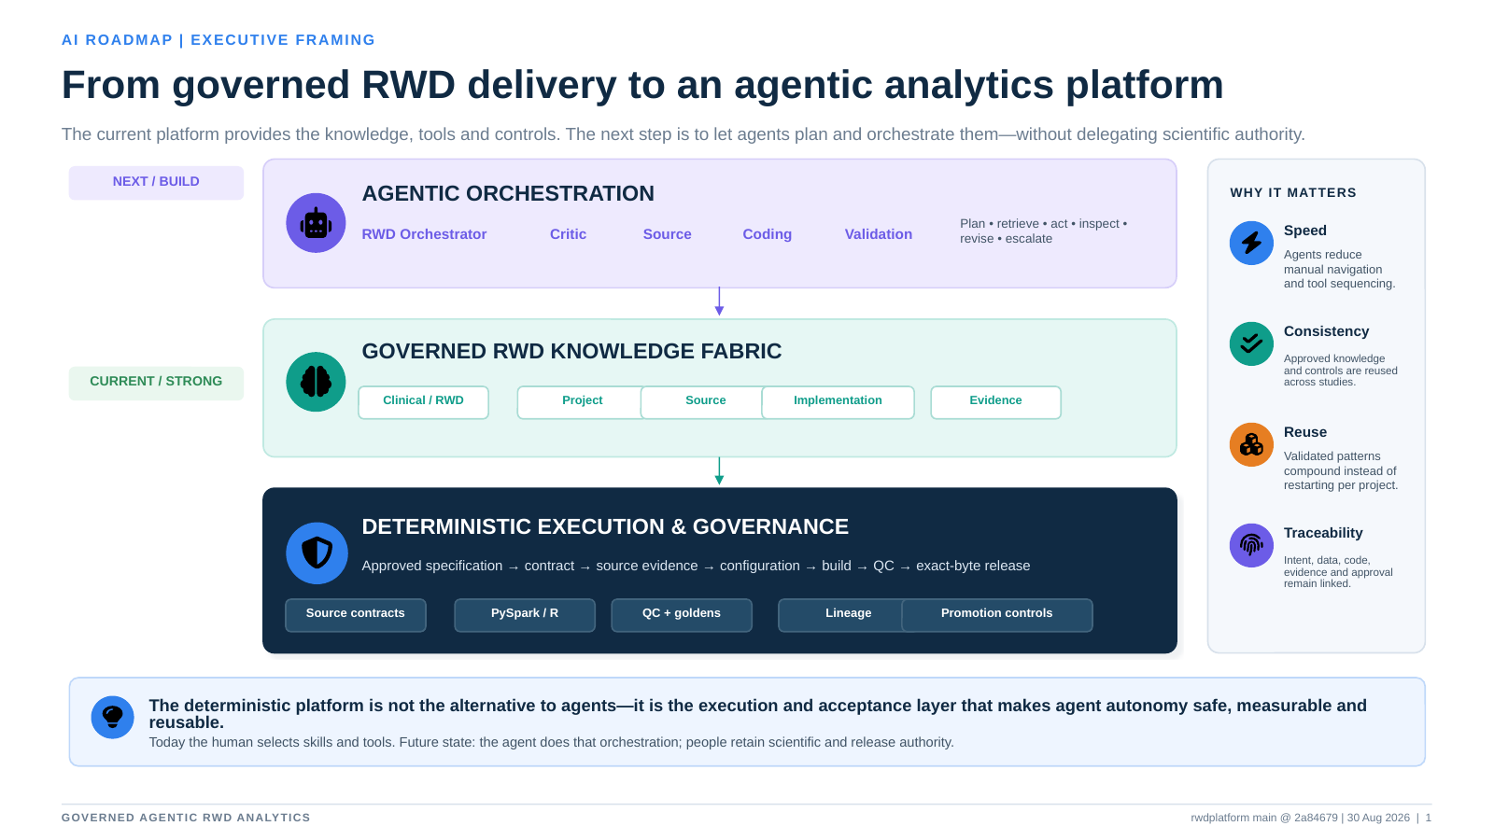

Slide 3
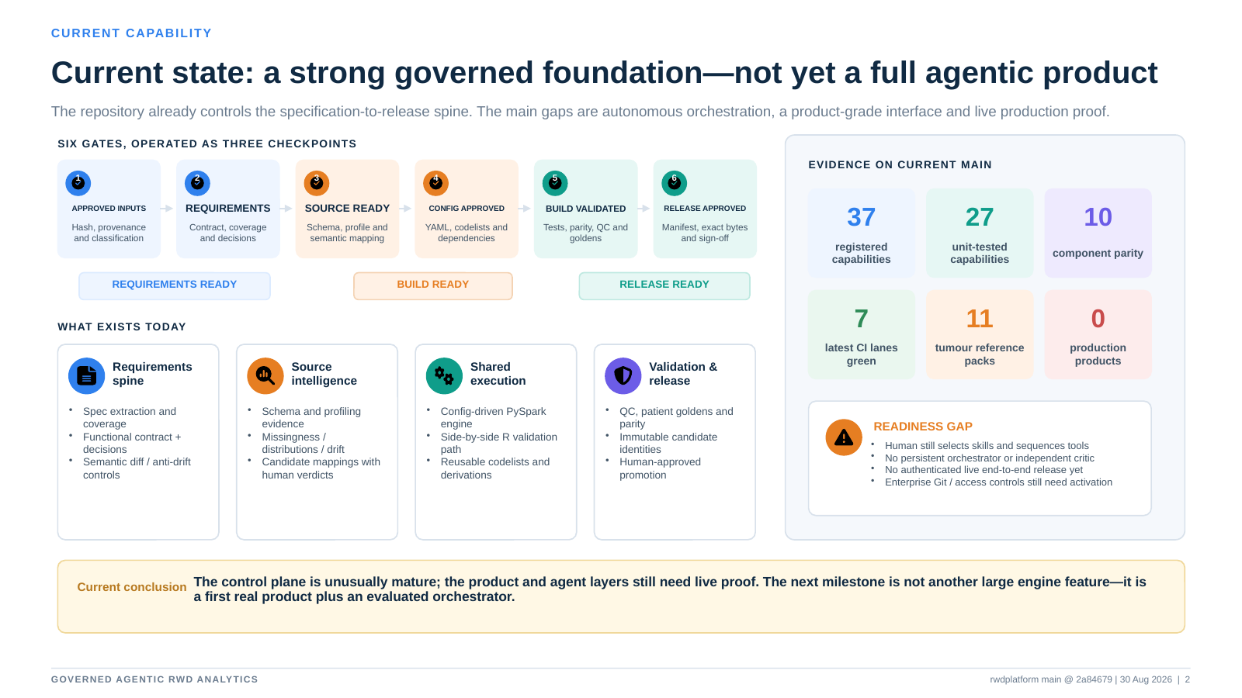

Slide 4
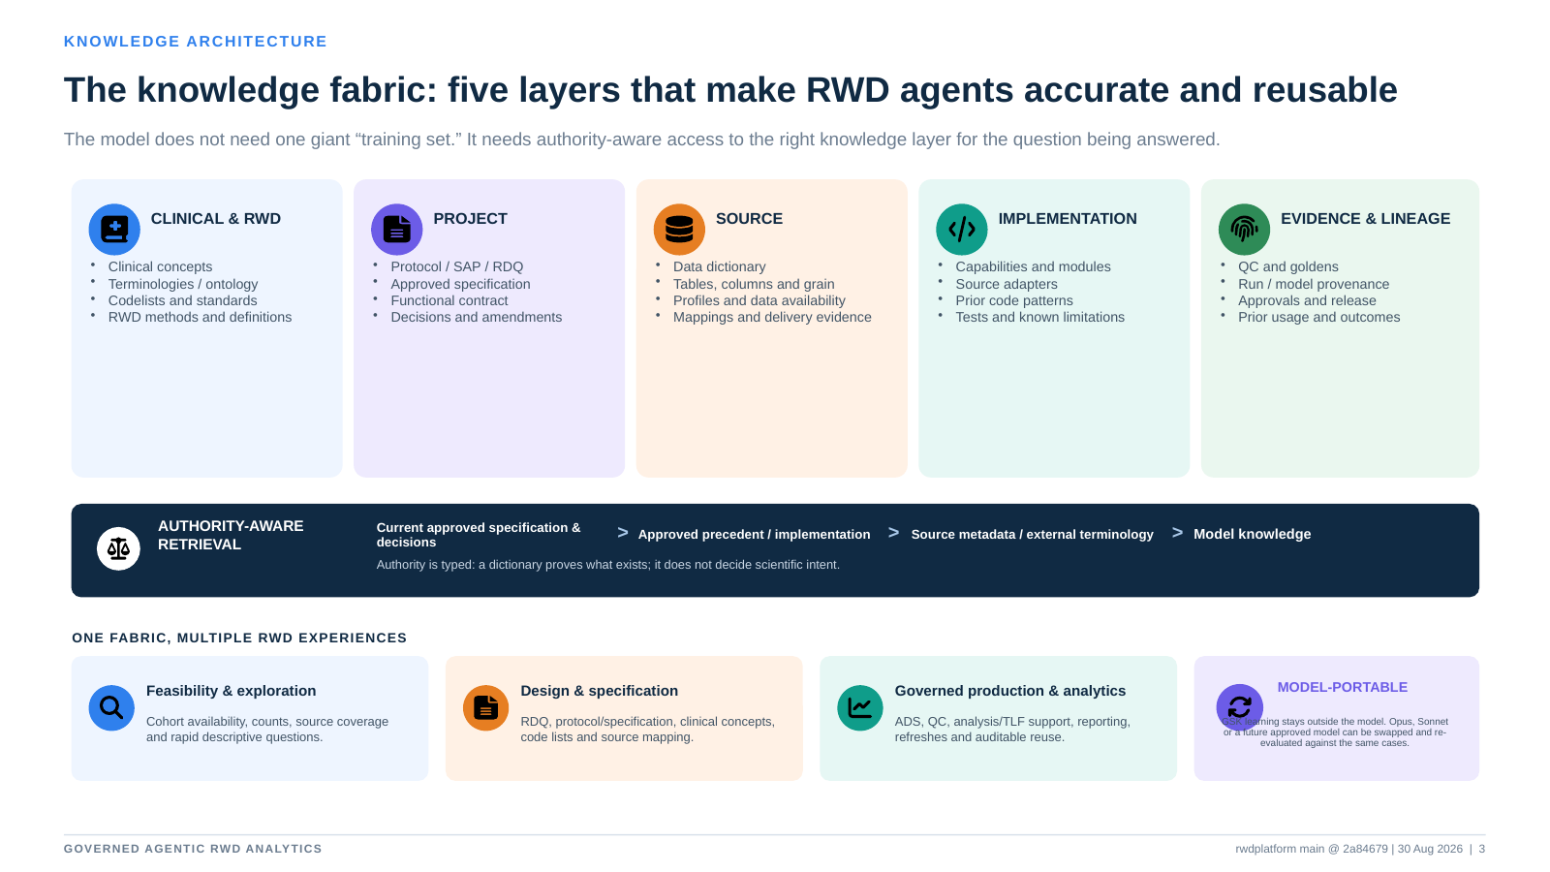

Slide 5
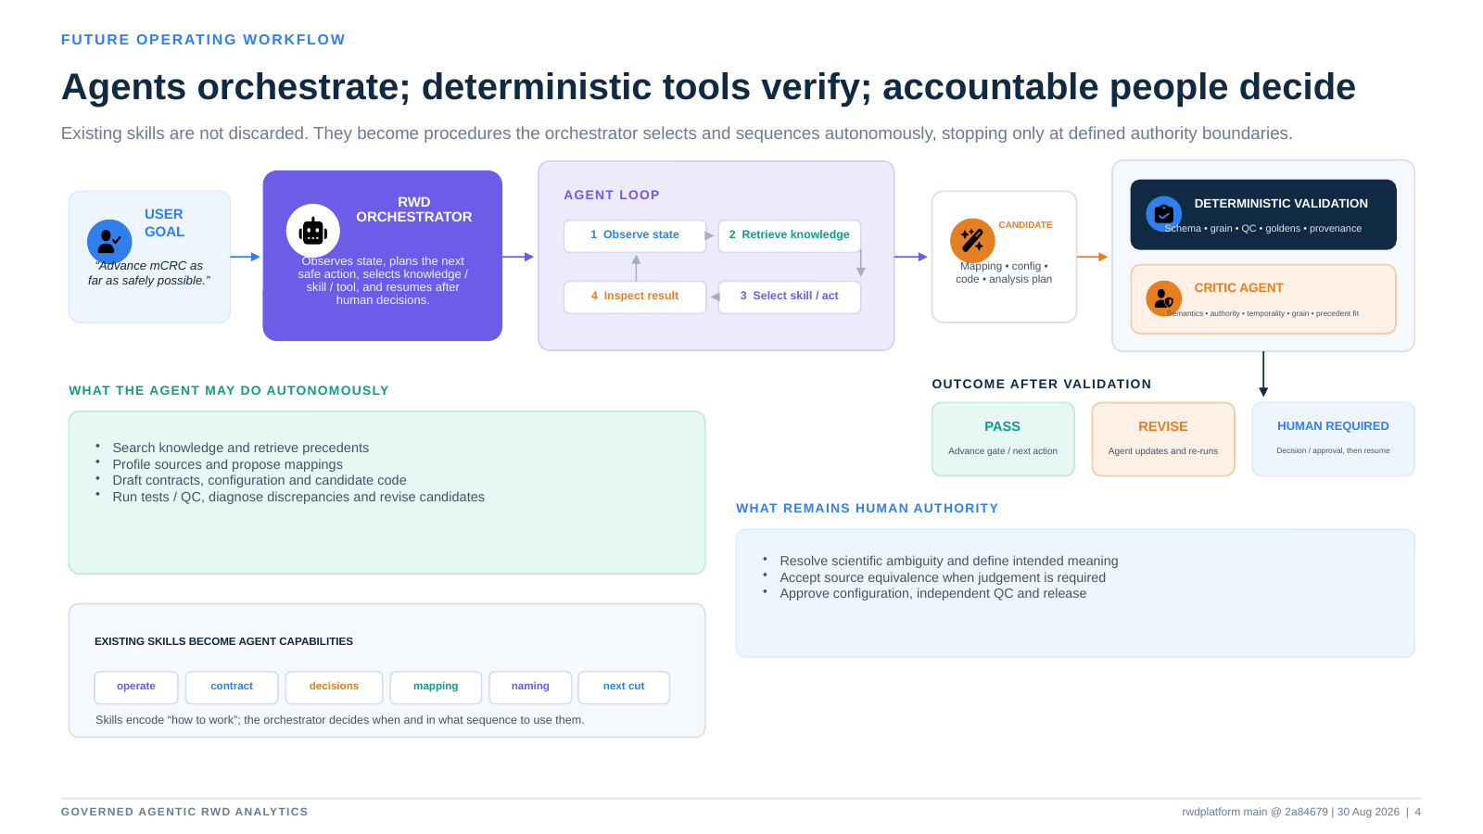

Slide 6
