Slide 1

MEDICAL MICROBIOLOGY AND INFECTIOUS DISEASES
CODING WORKSHOP
Presents
Using ggplot2 to visualize data and statistical results
INSTRUCTED BY
Samantha Lee
Department of Biochemistry and Medical Genetics
umlee285@myumanitoba.ca
Educational series supported by the Department of MMID to promote knowledge translation and dissemination among students and researchers

Slide 2
INFORMATION FOR PARTICIPANTS
All workshops are being recorded and posted to the
MMID Coding Workshop - YouTube
Question and Answer period will not be recorded.

Slide 3
LEARNING OBJECTIVES
Become familiar with ggplot2
Learn how to run basic statistical tests in R
Learn how to add statistics to ggplots

Slide 4
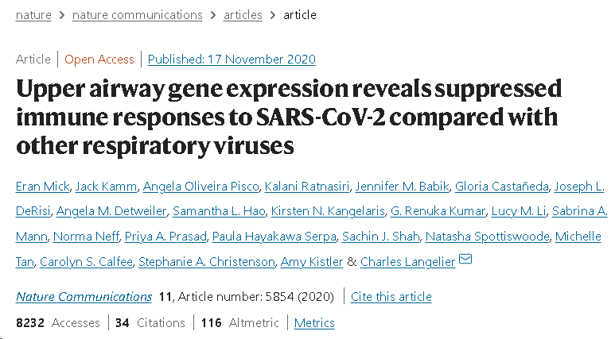
THE DATA SET

Slide 5

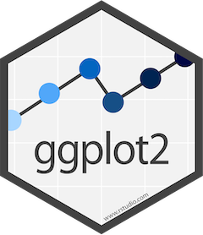
GGPLOT2
Part of the tidyverse
Any plot you can make in base R can be recreated in ggplot2
ggplot2 offers a clean and simple workflow

Slide 6
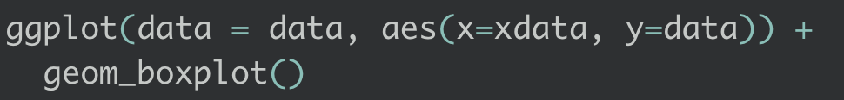
GGPLOT2 USAGE
Start with a ggplot()
Supply data and aesthetics (aes) to ggplot()
aes() also specifies x and y data; some plots only need one
Add layers using “+”
Base layer is type of plot, usual takes the form of “geom_plot()” where plot is the type of plot – e.g. geom_boxplot()
Can also specify themes, aesthetics, facets, and more..

Slide 7
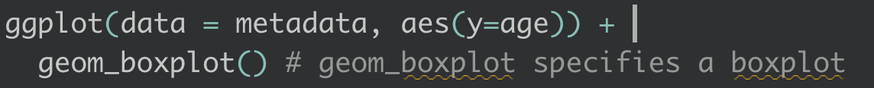
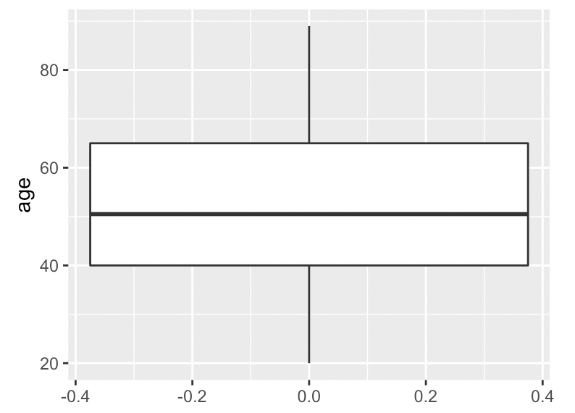
BOXPLOT OF AGE

Slide 8
I’ll switch to the R markdown document…

Slide 9
HELPFUL RESOURCES
George & Fay Yee Centre for Health Care Innovation
Choosing the correct statistical test in SAS, STATA, SPSS, and R
R for data science
R graphics cookbook
ggplot2 cheat sheet
The R graph gallery: ggplot2
How to make any graph in ggplot2
Data carpentry: Data visualization with ggplot2

Slide 10
THANK YOU FOR ATTENDING!
The Q&A Session will now begin.
Please make sure to fill out the Exit Survey
We value your feedback!
More questions? Please email us at
mmid.coding.workshop@gmail.com or post them to the workshop slack channel
Educational series supported by the Department of MMID to promote knowledge translation and dissemination among students and researchers

