Slide 1
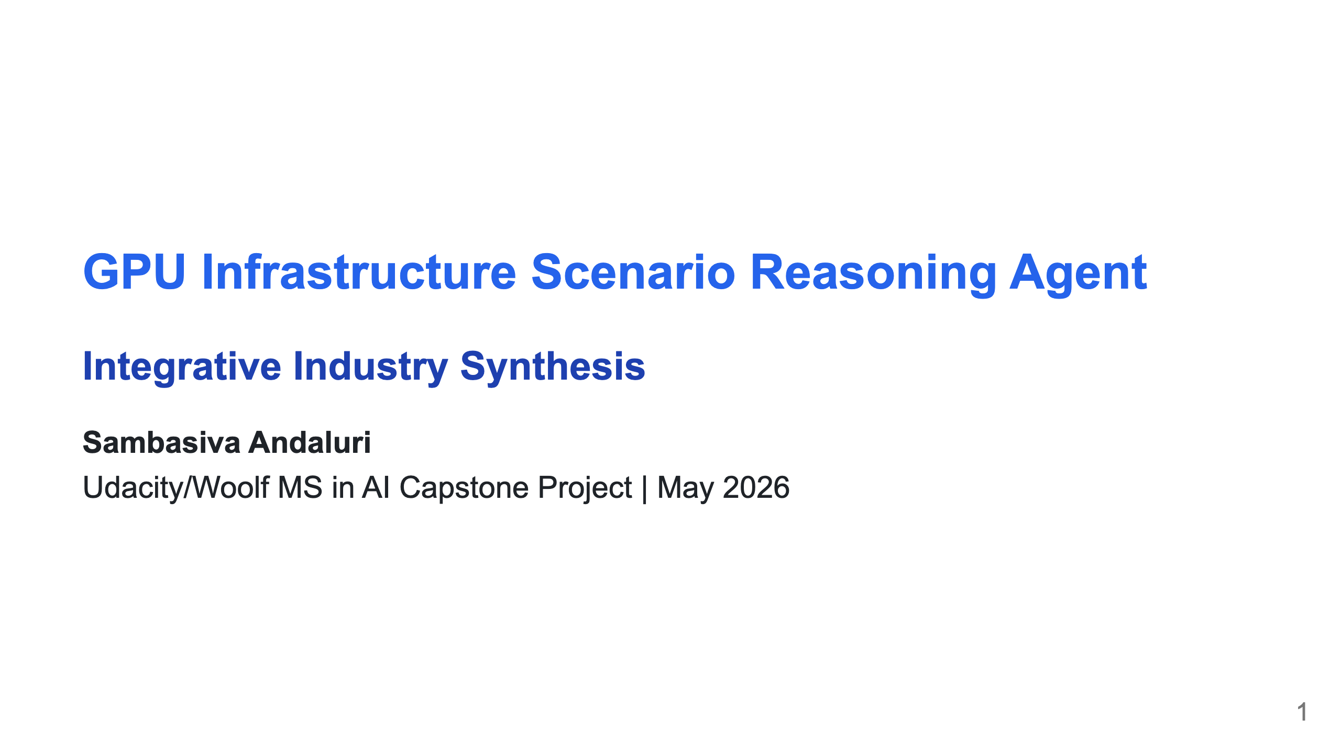
Notes:
MERMAID SETUP: Option 1: Use marp-cli with mermaid support npx @marp-team/marp-cli@latest --html -o presentation.pdf presentation.md Option 2: Pre-render Mermaid diagrams at https://mermaid.live Then replace mermaid code blocks with ![](diagram.png) Option 3: Use VS Code with "Marp for VS Code" + "Markdown Preview Mermaid Support" extensions

Slide 2
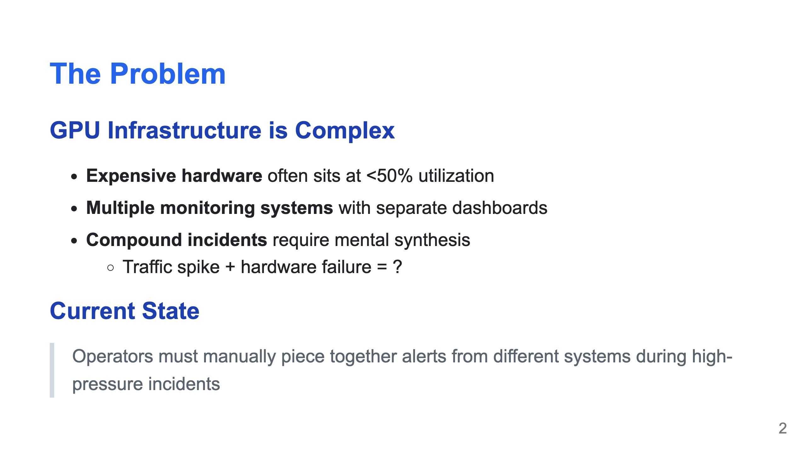

Slide 3
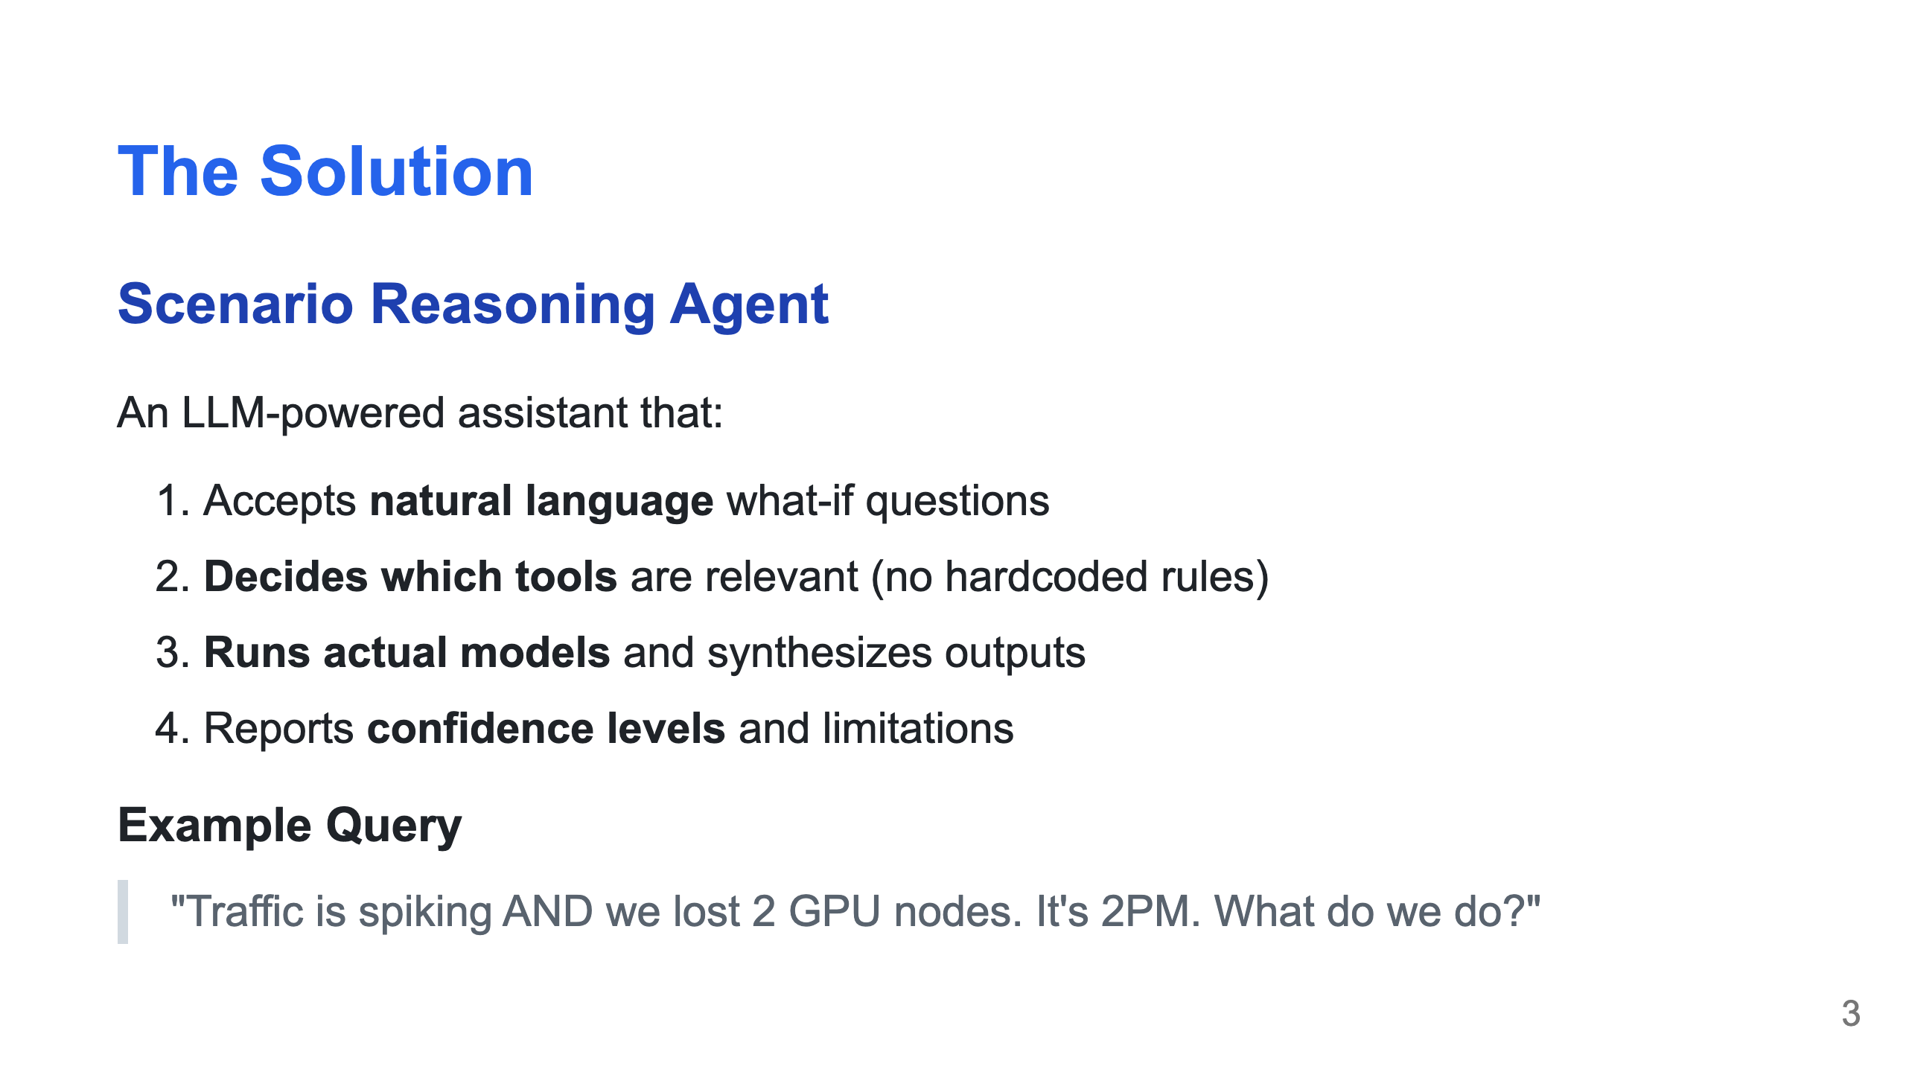

Slide 4
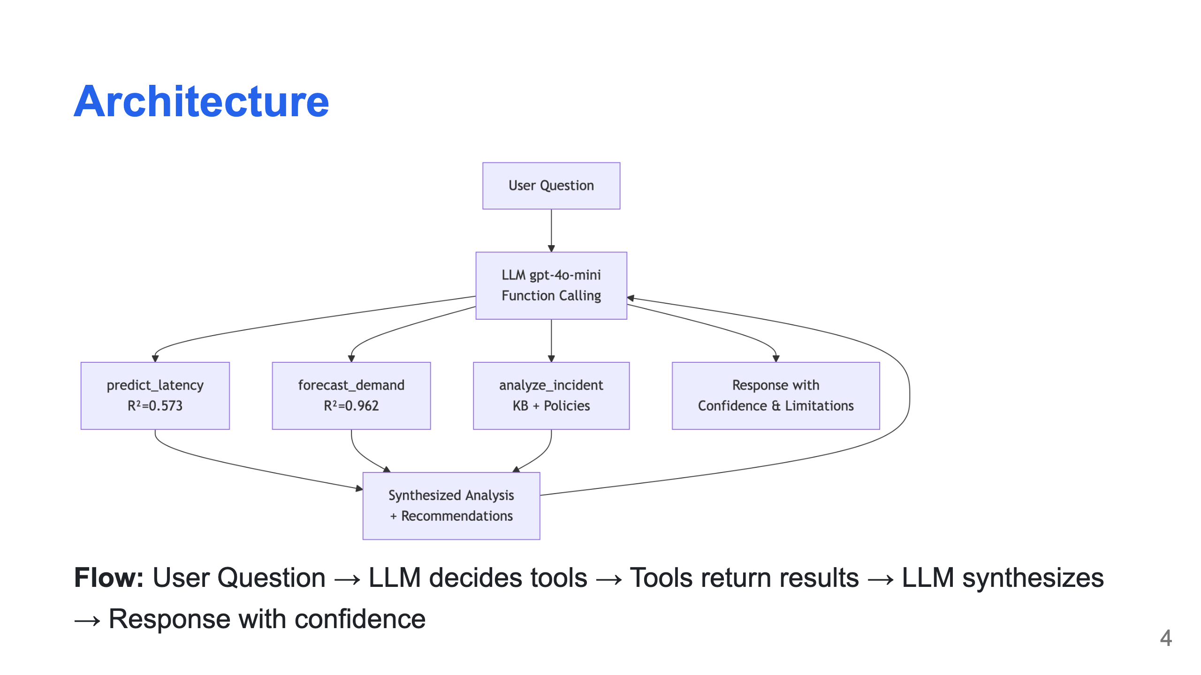
Notes:
Generate from diagrams.md using mermaid.live

Slide 5
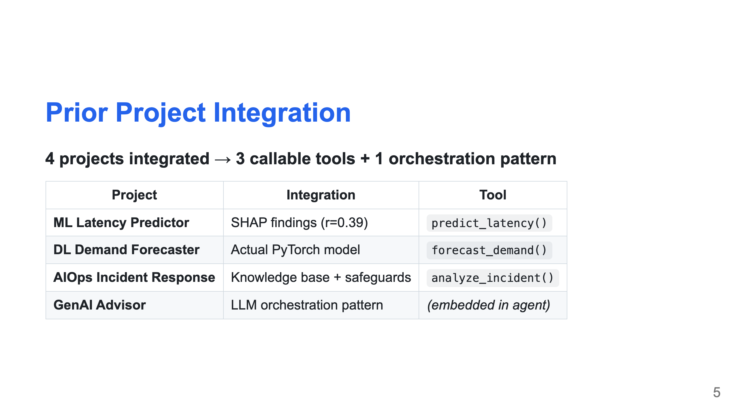

Slide 6
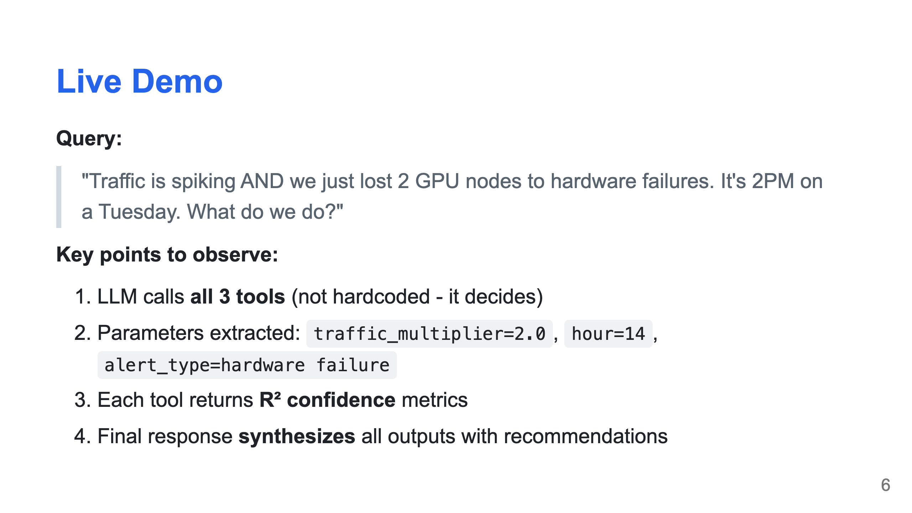

Slide 7
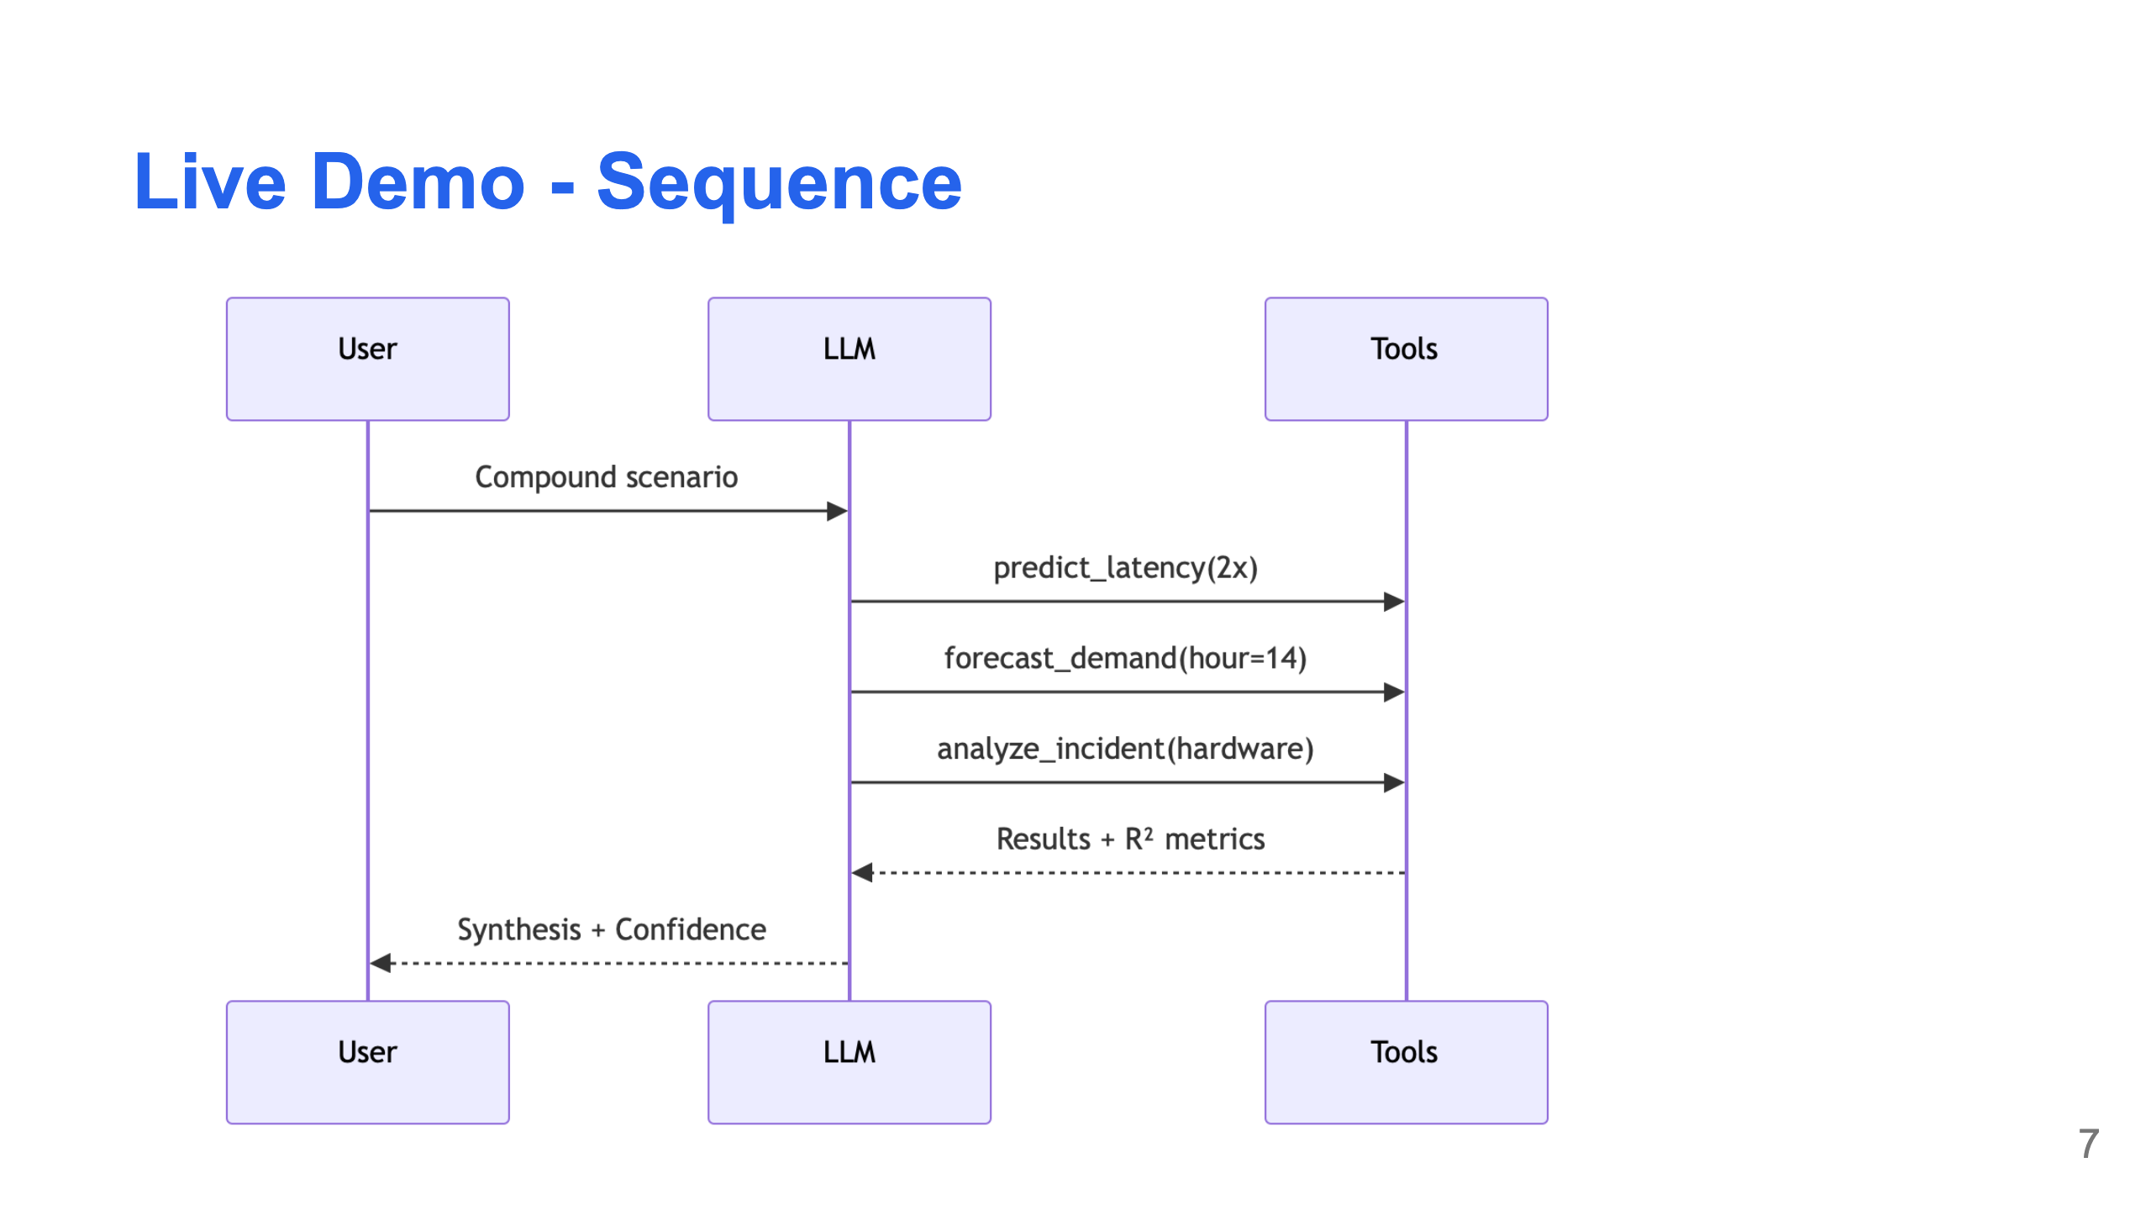
Notes:
Generate from diagrams.md

Slide 8
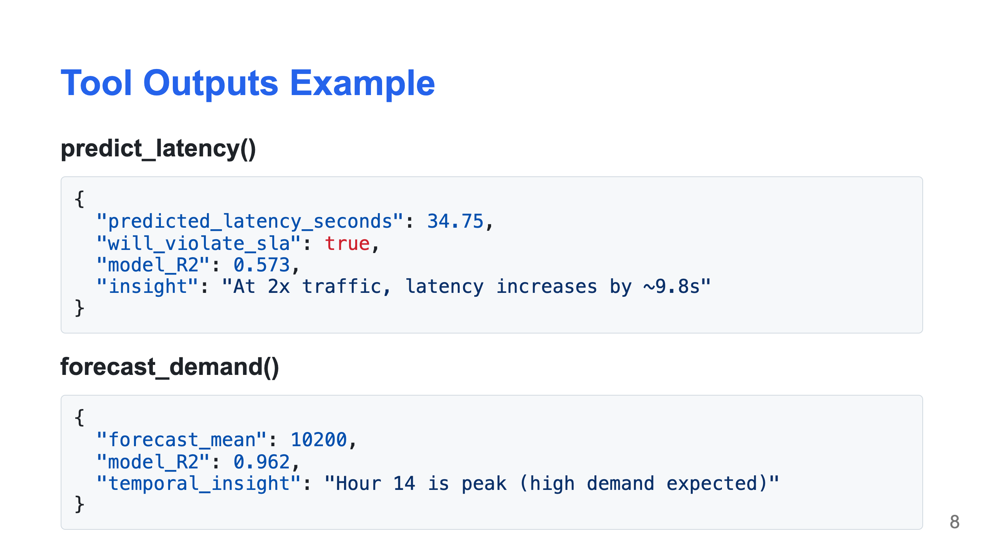

Slide 9
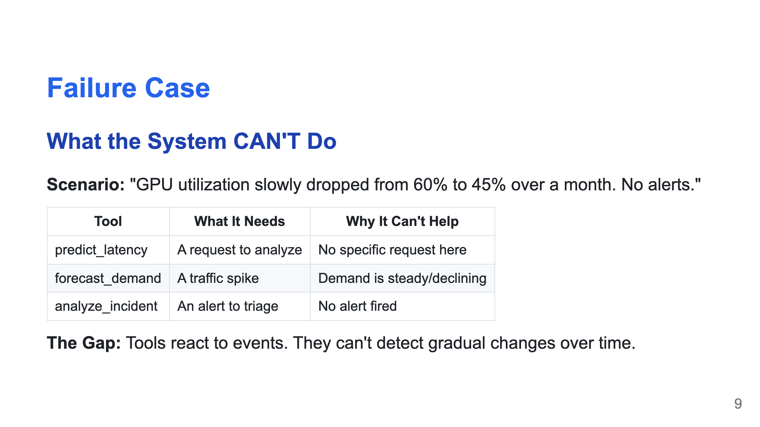

Slide 10
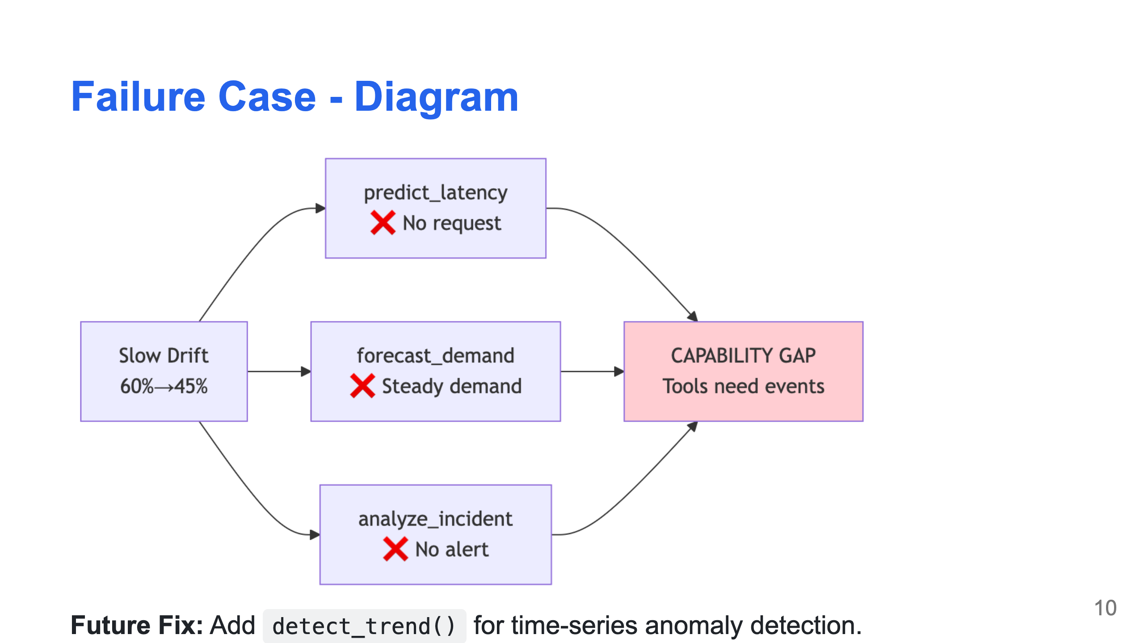
Notes:
Generate from diagrams.md

Slide 11
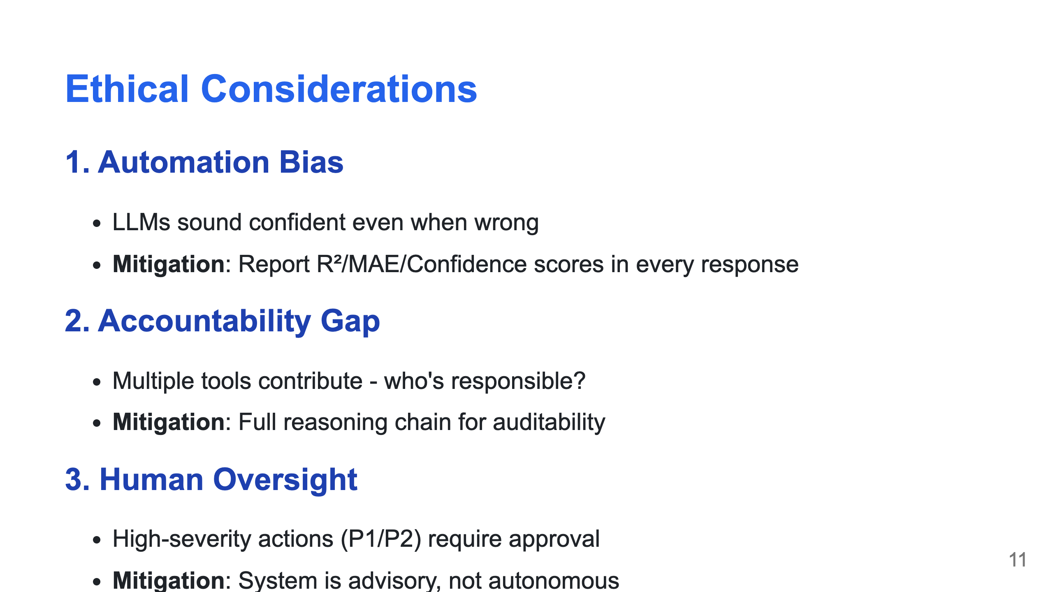

Slide 12
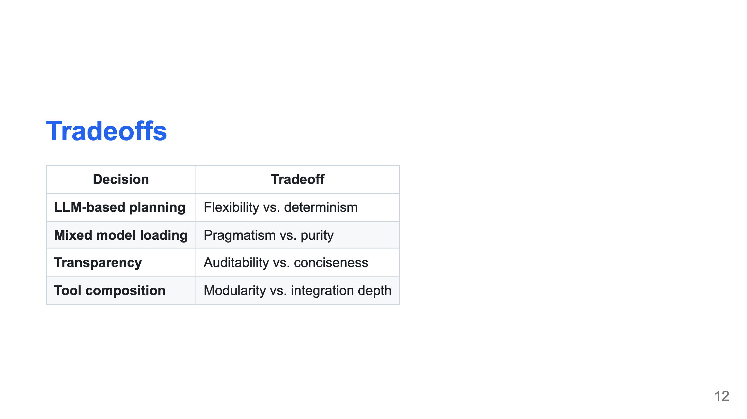

Slide 13
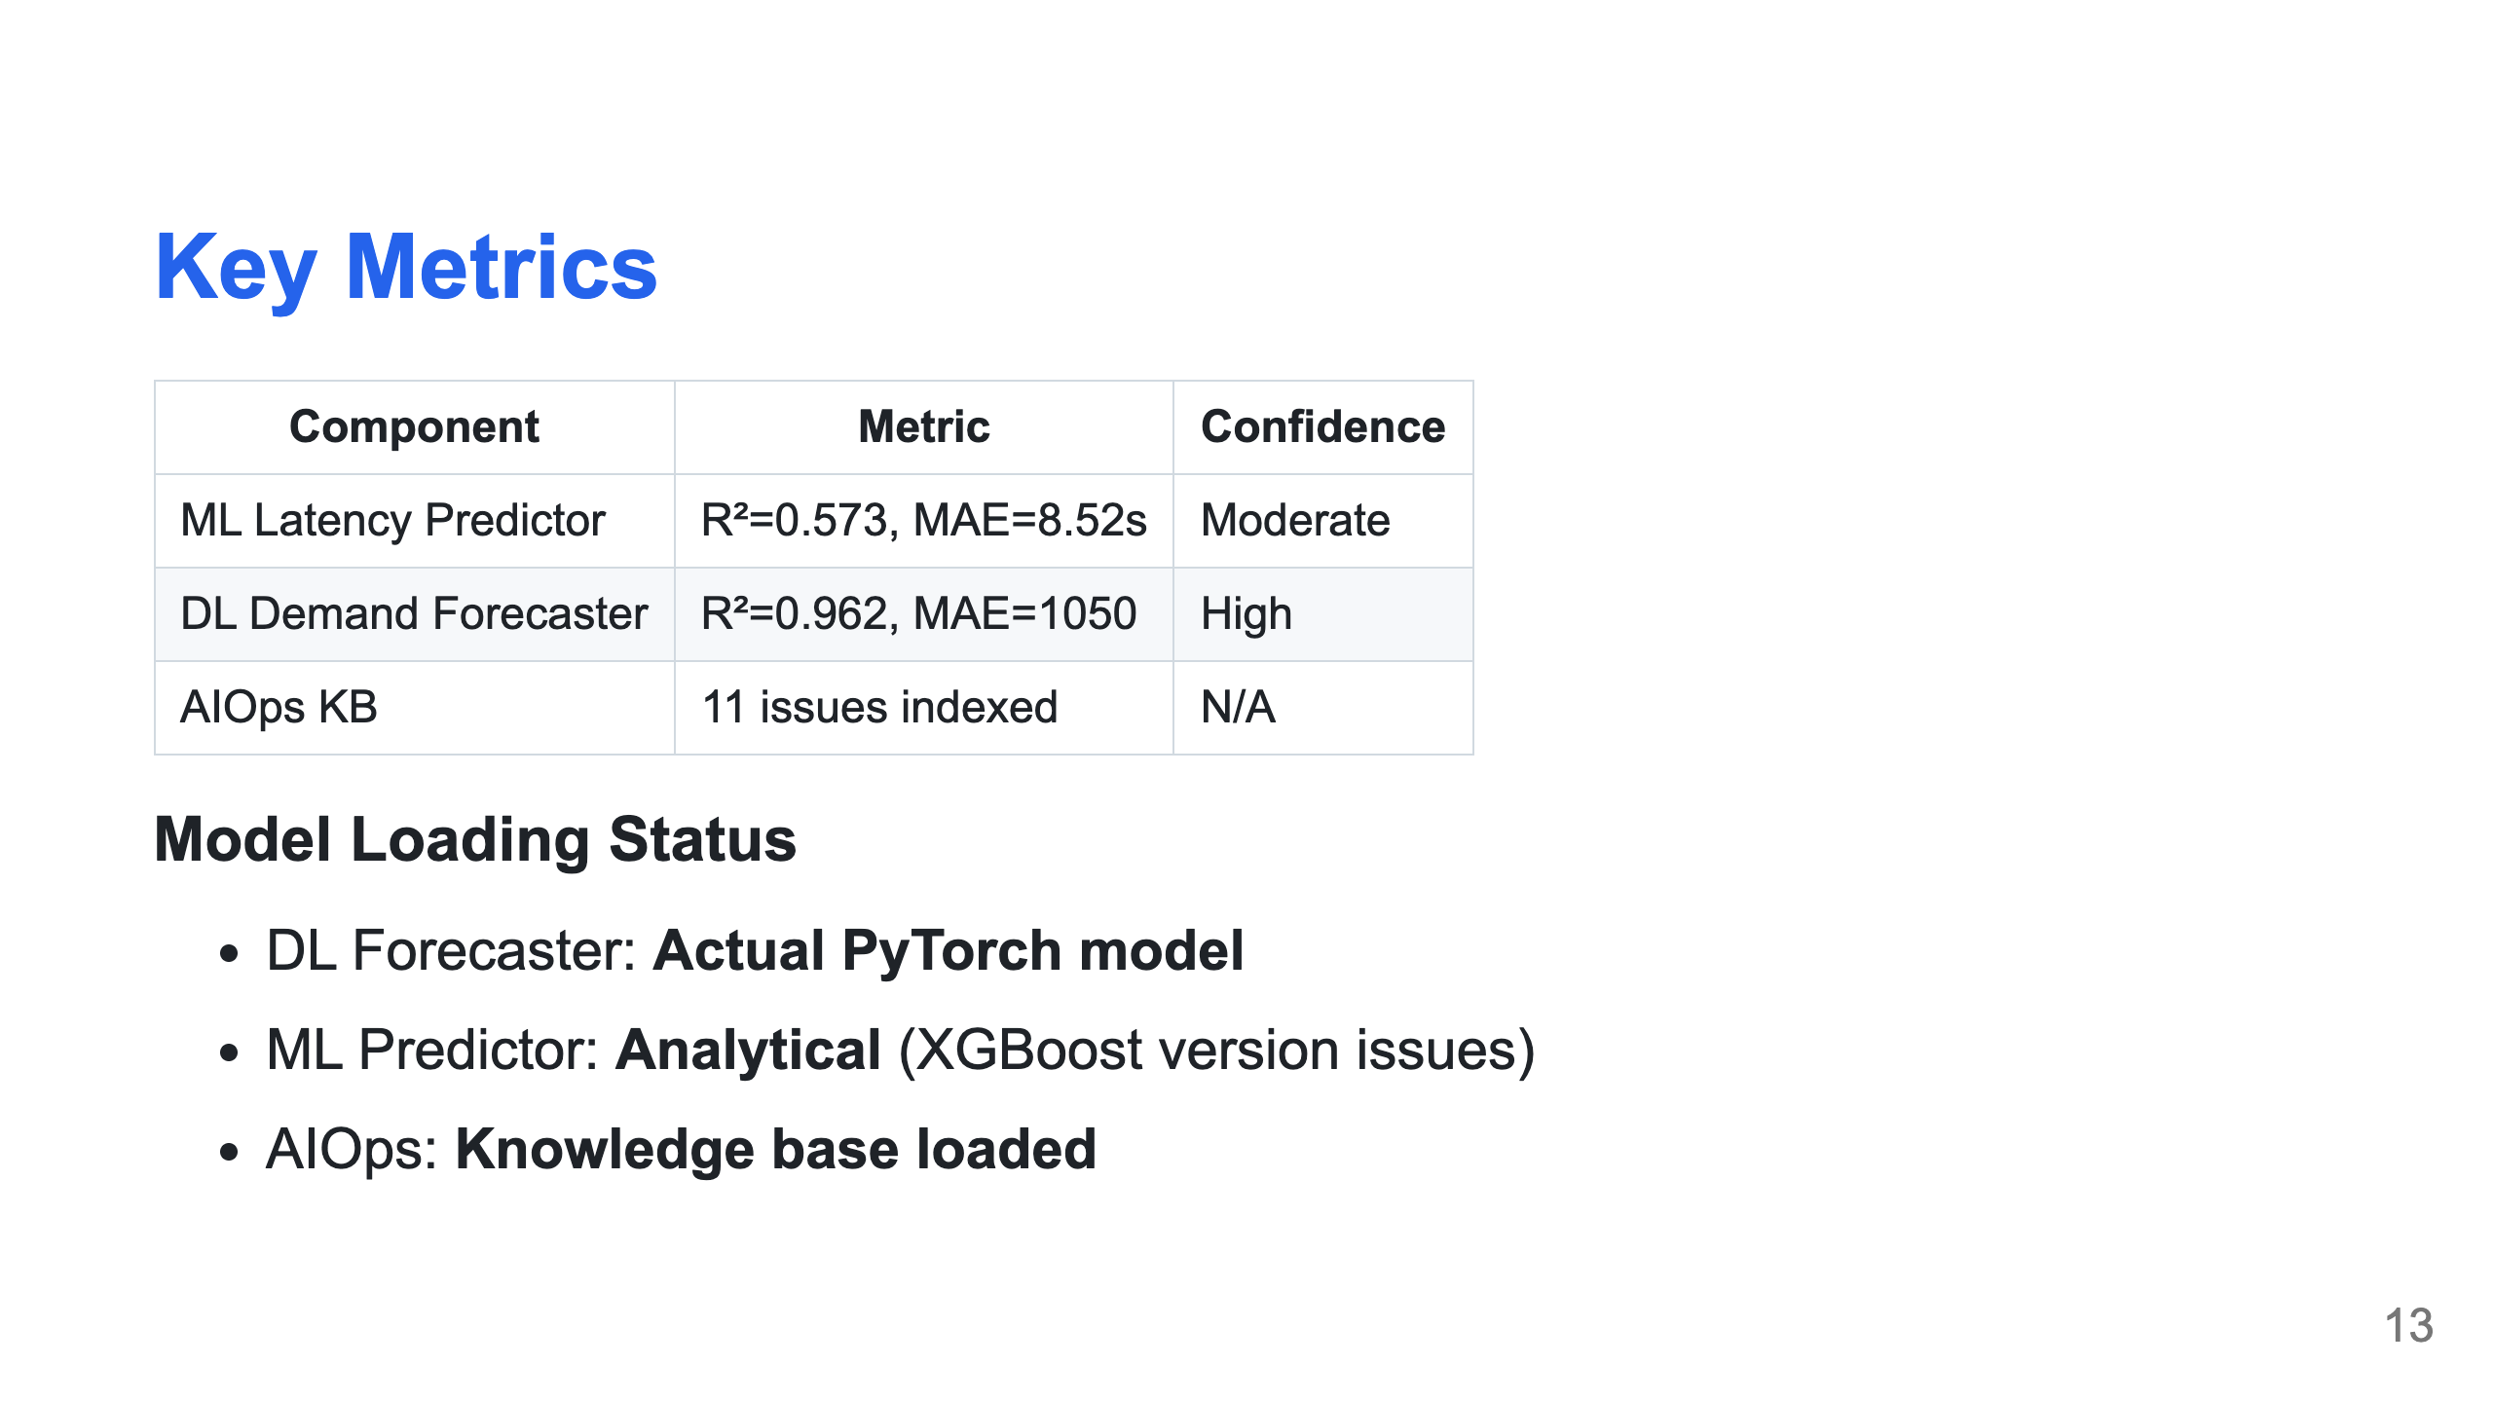

Slide 14
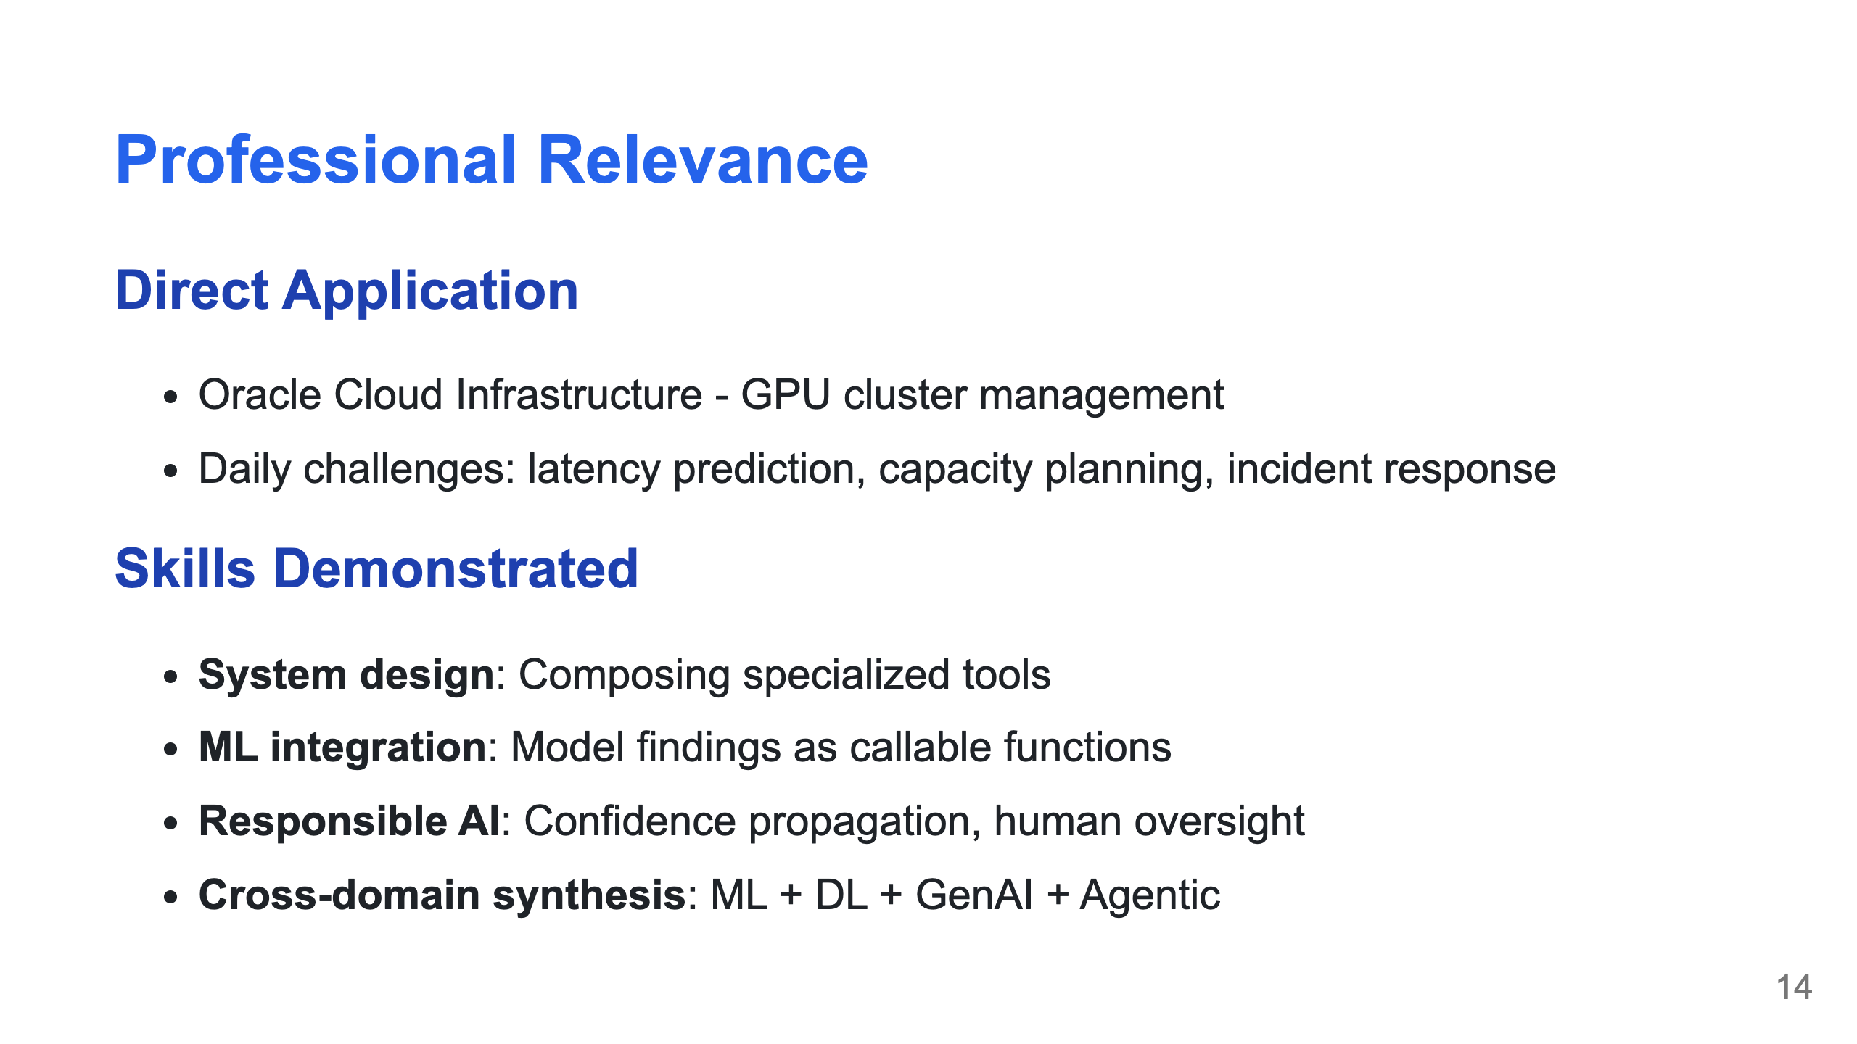

Slide 15
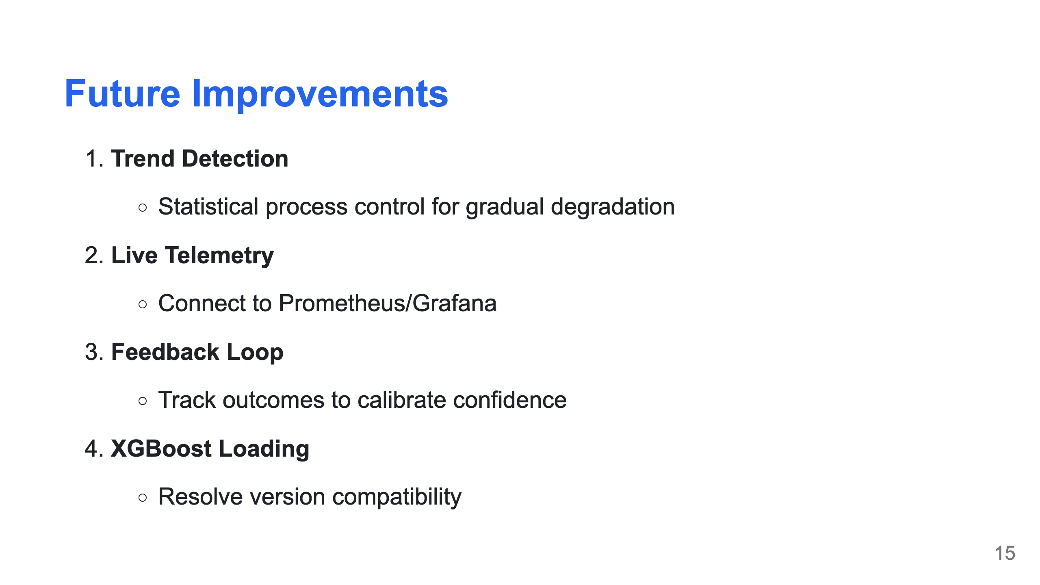

Slide 16
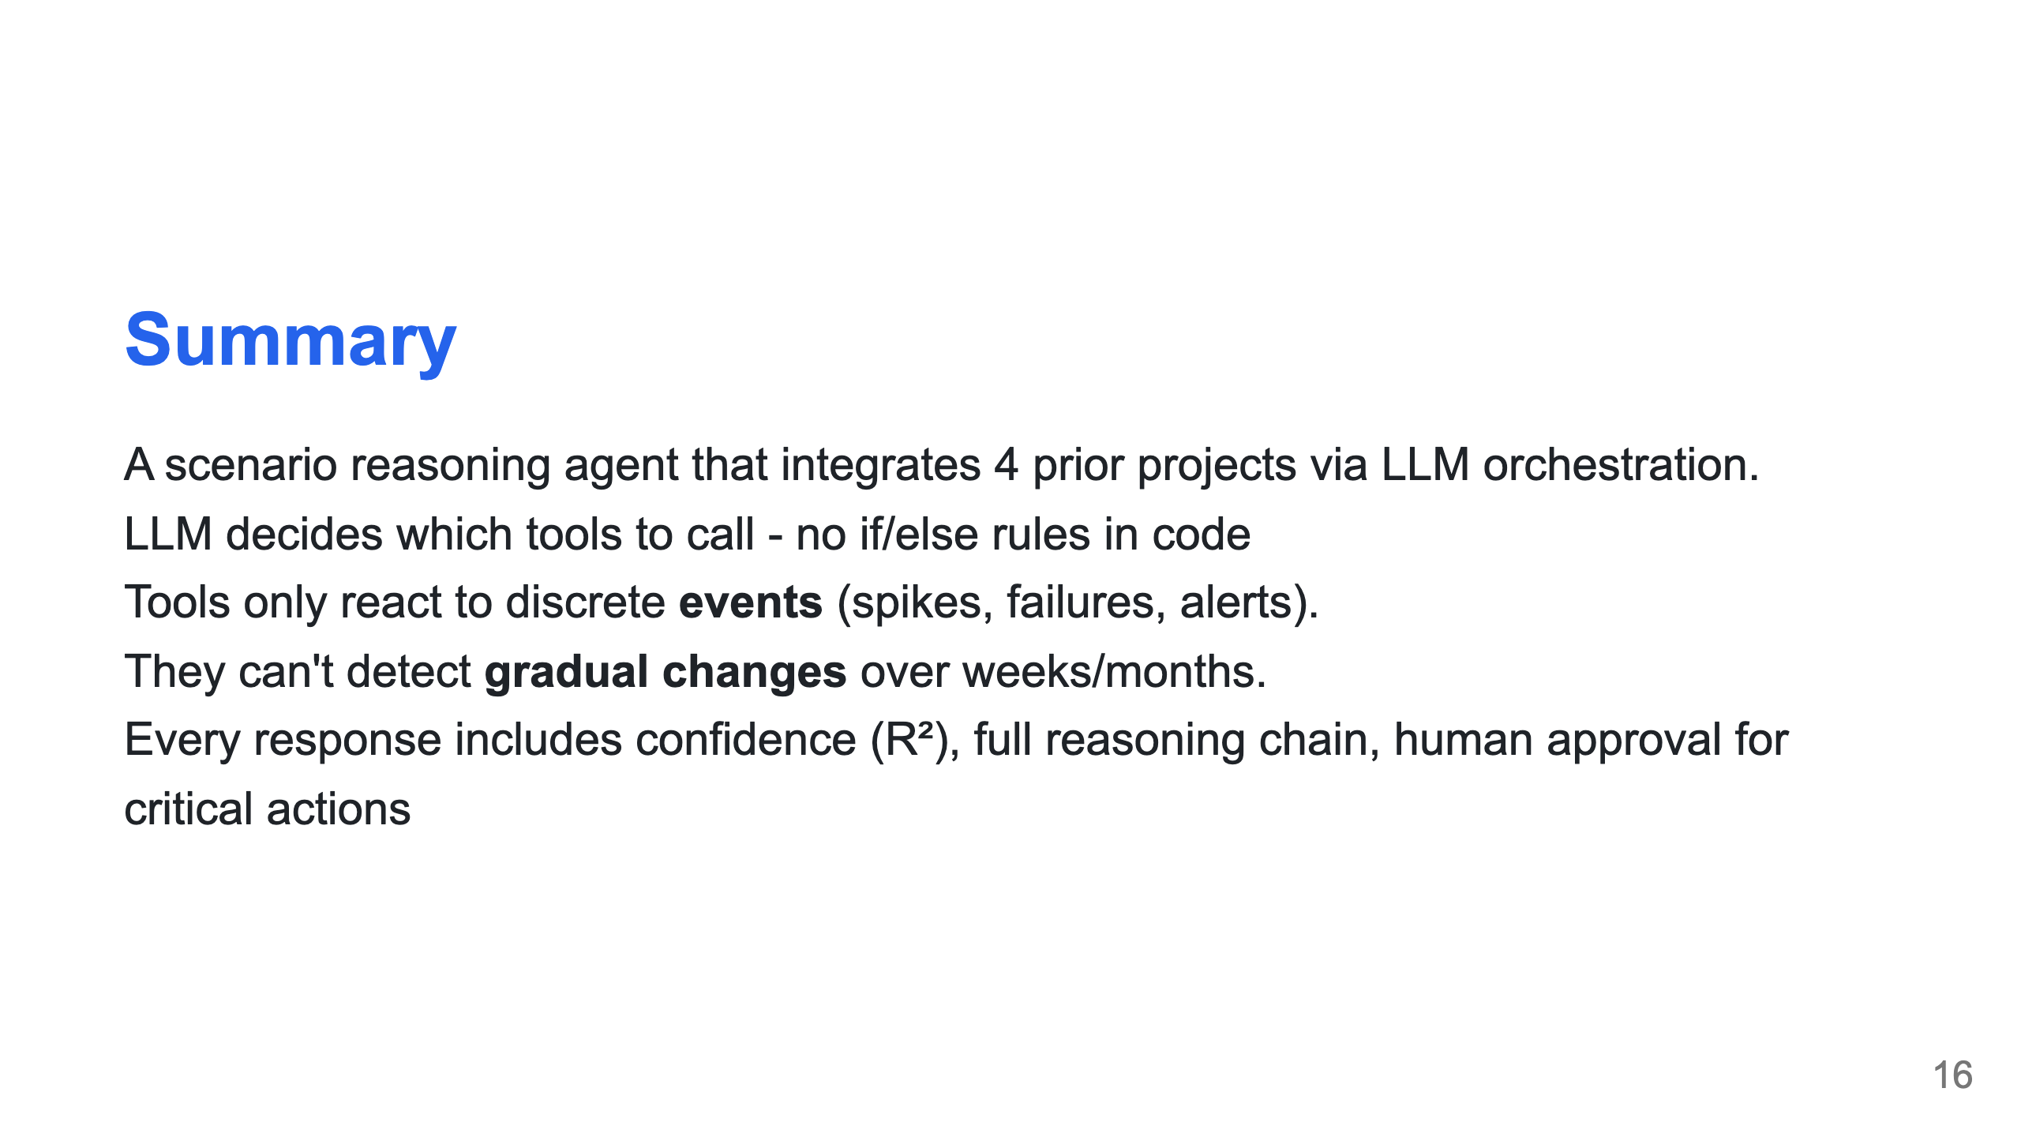

Slide 17


Slide 18
