Slide 1


Data Analysis for Health Management Organization Data
Predicting expensive health care
Shreya Zope | Atharva Vakharkar |
Samarth mengji | Somia Abdelrahman

Slide 2


Goals and business case
Main goals:
To create a model to predict why some people need more healthcare
To create a model to predict what kind of people will be expensive in terms of healthcare costs
Business case:
Developing a model to predict that evaluates the people who are going to take the expensive healthcare
Additional analysis will also result in the kind of people who will buy more healthcare.

Slide 3
Data information
Attributes:
Age
BMI
Children
Smoker
Location
Location type
Education level
Yearly physical
Exercise
Marital Status
Hypertension
Gender
Cost
The dataset contains healthcare cost information from an HMO (Health Management Organization)
Each row in the dataset represents a person’s information
The number of rows is 7582 and the columns are 14
Data Characteristics: Multivariate

Slide 4
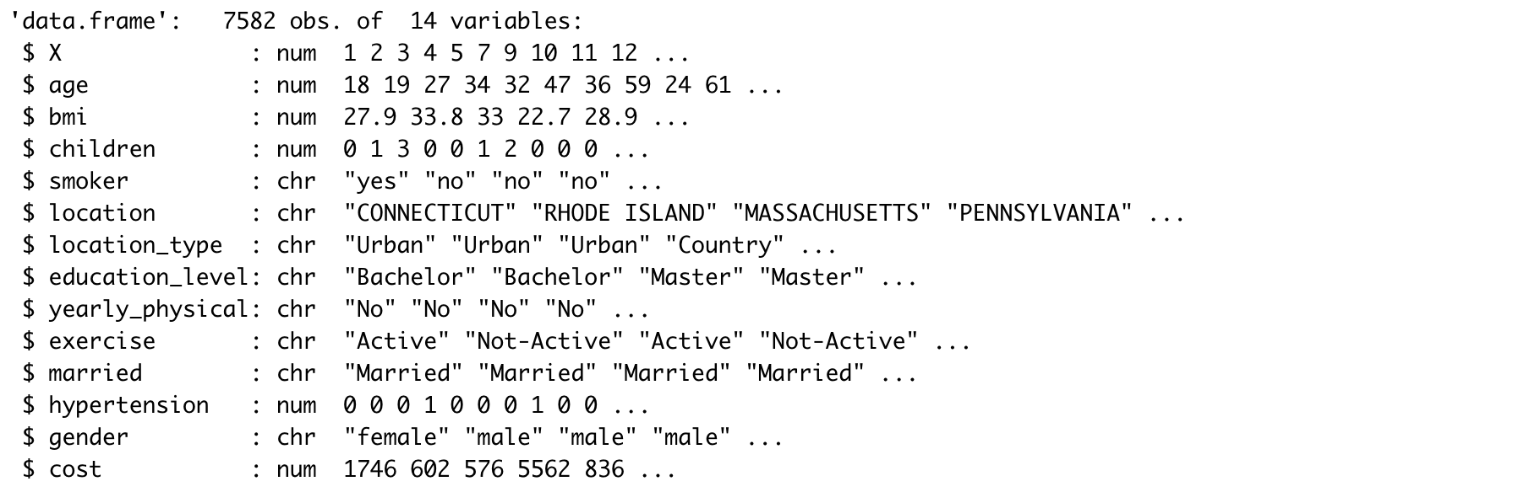

DATA SUMMARY
Data is categorized as quantitative and non-quantitative data.
Quantitative data is further processed to filter out the test and NULL values.
Rows – 7582
Variables - 14
PROCESS USED
1. Data cleaning
2. Data Exploration
3. Data visualization

Slide 5
Business questions:
How does BMI, Age, Exercise, and Smoker impact healthcare costs?
Why do some parameters like children, location, location type, education, married, gender not affect the overall healthcare cost?
Which aspect of a person affects the health care cost the most?
How can a customer save on healthcare costs?
What kind of people will spend the most on health care costs?

Slide 6
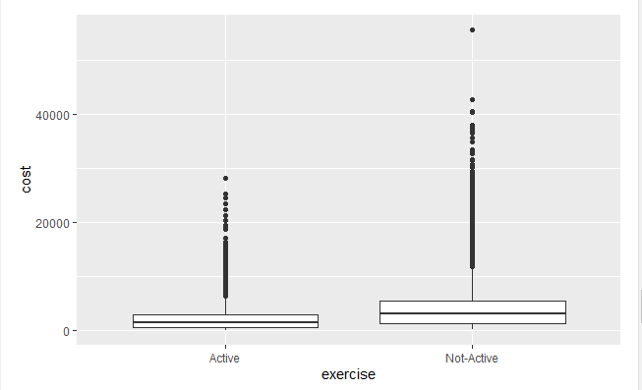
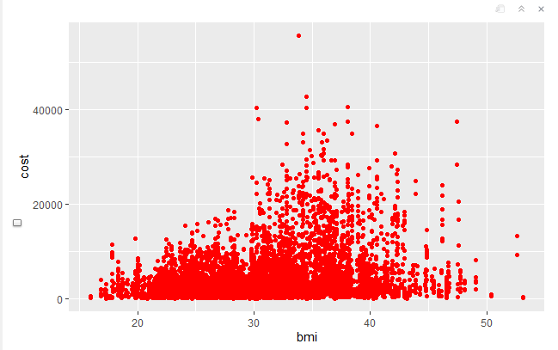
How does BMI, Age, Exercise, and Smoker impact healthcare costs?
AFTER ANALYSING DIFFERENT DATA ATTRIBUTES, BMI, AGE, EXERCISE, AND SMOKING AFFECT THE HEALTHCARE EXPENDITURE THE MOST.
IT IS OBSERVED THAT PEOPLE WHO HAVE HIGHER THAN RECOMMENDED BMI AND DON’T WORK OUT PAY MORE COSTS.

Slide 7
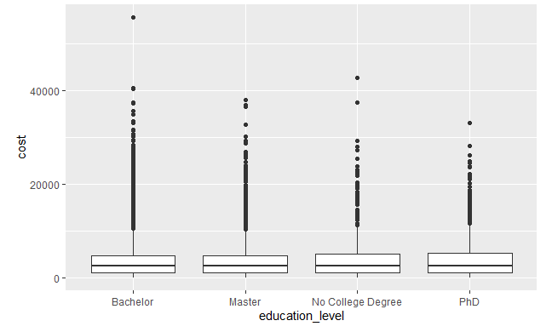
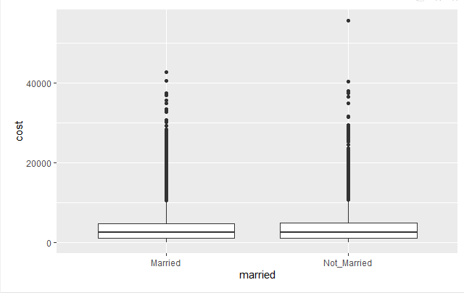
Why do some parameters like children, location, location type, education, married, gender not affect the overall healthcare cost?
The above-mentioned factors showcased very slight differences in the costs since these attributes do not directly contribute to any health-related discrepancies. Hence these were not considered for further analysis.

Slide 8
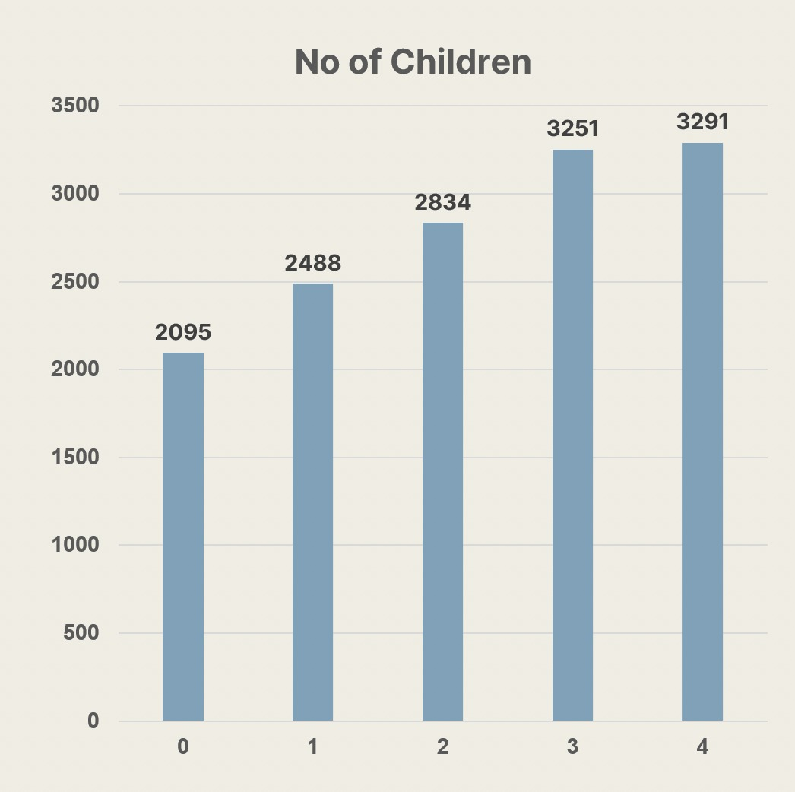
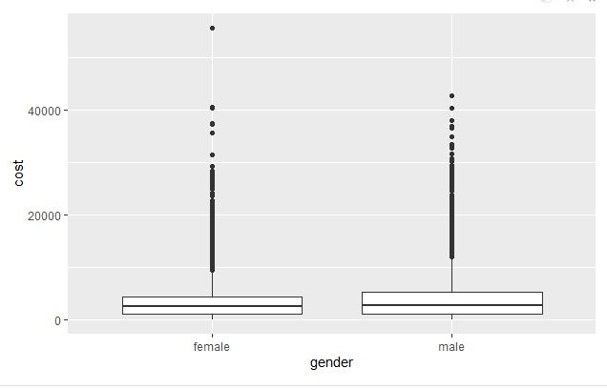
Why do some parameters like children, location, location type, education, married, gender not affect the overall healthcare cost?
Insights: More children lead to increased medical costs as chances of incurring medical treatment increases
Action: Roll out family planning and educational initiatives with an emphasis on the financial consequences of it.

Slide 9
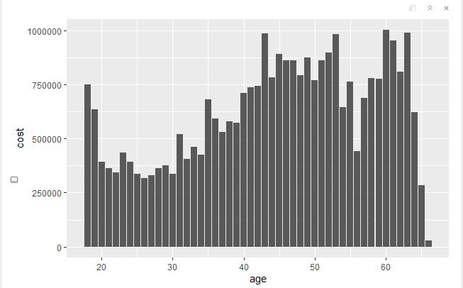
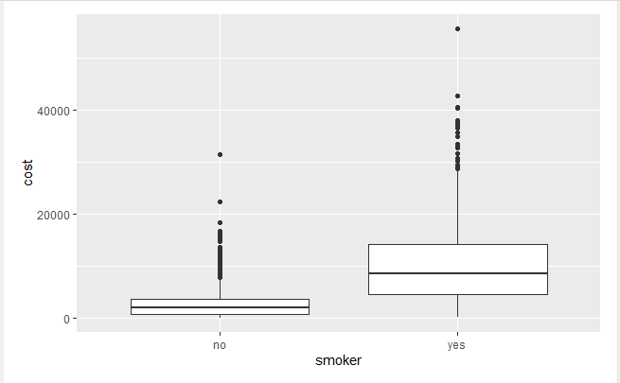
How does BMI, Age, Exercise, and Smoker impact healthcare costs?
ALSO, AS THE AGE INCREASES, THE COSTS INCREASE ACCORDINGLY.
SMOKING WAS A MAJOR FACT OBSERVED IN THE INCREASE IN COSTS.

Slide 10
Which aspect of a person affects the health care cost the most?
The Smoking factor was found to have the most impact on cost differences among all the people. We can see a lot of difference in the medians for expenses against the smoker.

Slide 11
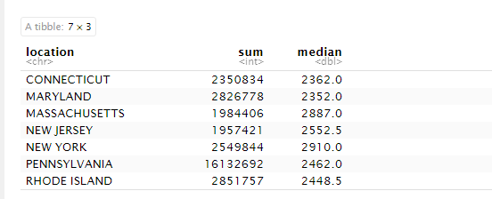
How are the healthcare costs distributed with respect to states ?
We can observe the population distribution and the average costs spent on healthcare services. New York and Massachusetts spend quite more than other mentioned states.

Slide 12
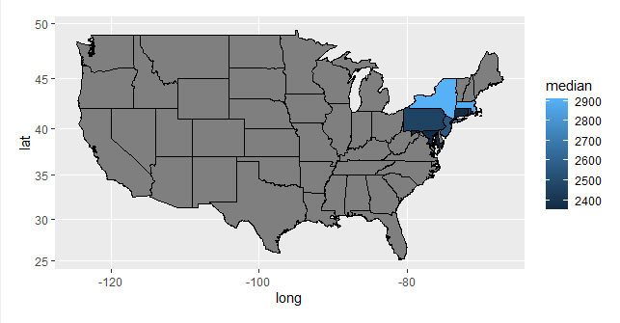
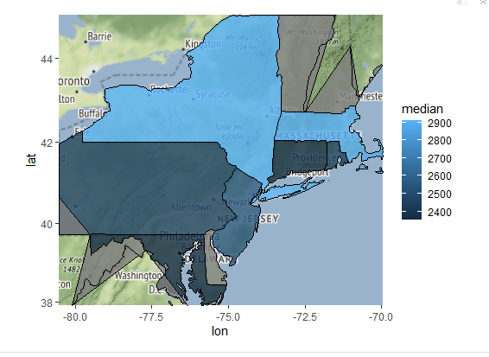
Which Regions have the highest net expenditure on healthcare costs ?
The highlighted regions are the considered states to analyzes the expenditures according to states where lighter shade reflects more expense on healthcare costs. New York state tops among them.

Slide 13
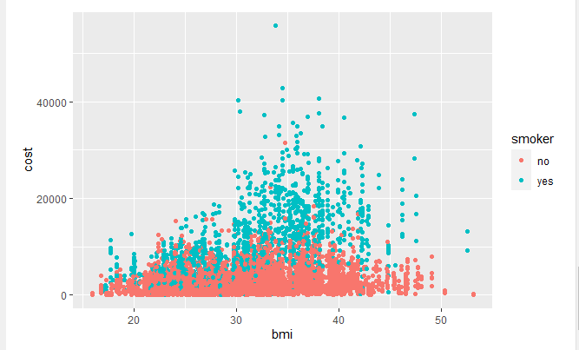
What kind of people will spend the most on health care costs?
People having more than recommended BMI and also smoke, tend to spend the most on healthcare expenses.

Slide 14
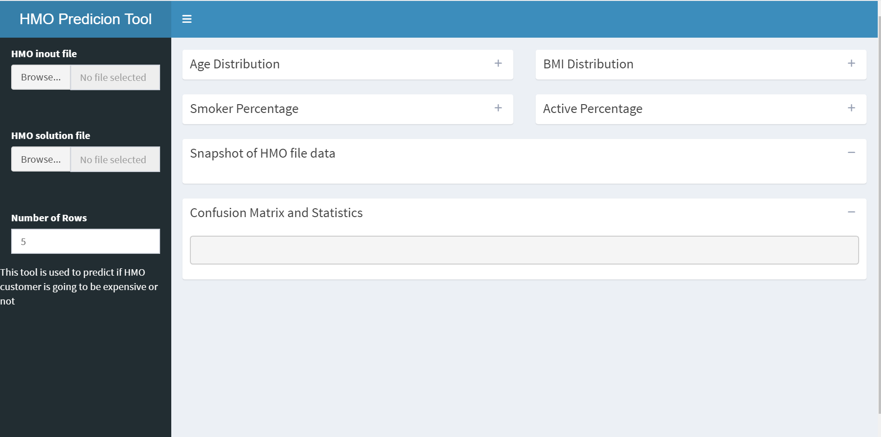
HMO interactive Prediction TOOL
Link for shiny app - https://sabdelra.shinyapps.io/HMO_Tool/

Slide 15
Recommendation & Actionable Insights
HMO can save cost by taking preventive approach as following:
Smoking is considered the main factor to drive the cost, Thus, HMO can initiate health awareness campaigns to encourage its customers to cease smoking.
HMO also can develop wellness programs to encourage its customer to adopt healthy lifestyles.(Reduce BMI(31) , and become more physically active). The wellness program can include: premium discounts, cash rewards, gym memberships.
Higher Insurance plan price for customers aged 60 and above

Slide 16
Machine Models used on HMO Data
We did test three different model as following
Model | Comment
Linear Regression | The model did not perform well in predicting the cost (Accuracy 65%)
Support Vector Machines | The model perform well in predicting the “not expensive” customer but not the “expensive one” (Accuracy 85%)
Decision Tree | The model perform well in both predicting the “not expensive” customer (97%) and the “expensive” ones (61%) (Accuracy 88%)

Slide 17
Thank you!

