Slide 1
Selected Lessons Learned Building the KCP53000
Samuel A. Falvo II <kc5tja@arrl.net>

Slide 2
I do not have a name! I have a number!
I am a free core!

Slide 3
Use numbers, not names.
KCP53000 went through several names during its development.
  Original name long forgotten.
  Polaris (trademarked by AMD for a family of GPUs)
  Now, KCP53000.
We want what Intel, AMD, et. al. doesn't want.
Be proactive in avoiding legal issues.

Slide 4
Avoid Premature Pipelining.
Get it working first!

Slide 5
Avoid pipelining at first.
Build slow, sequenced, working implementation first.
First four attempts at building pipelined CPU failed.
Hockey-stick complexity; can't keep it all in my head at once.
Premature evil is the root of all optimization.

Slide 6
Avoid pipelining at first.
Fifth attempt finally successful.
  Two stage pipeline.
  PLA-based sequencer and decode logic, just like the 6502.
  Instruction fetch and execute currently take turns.
  Easy to alter PLA to allow overlapping fetch and execution later.

Slide 7
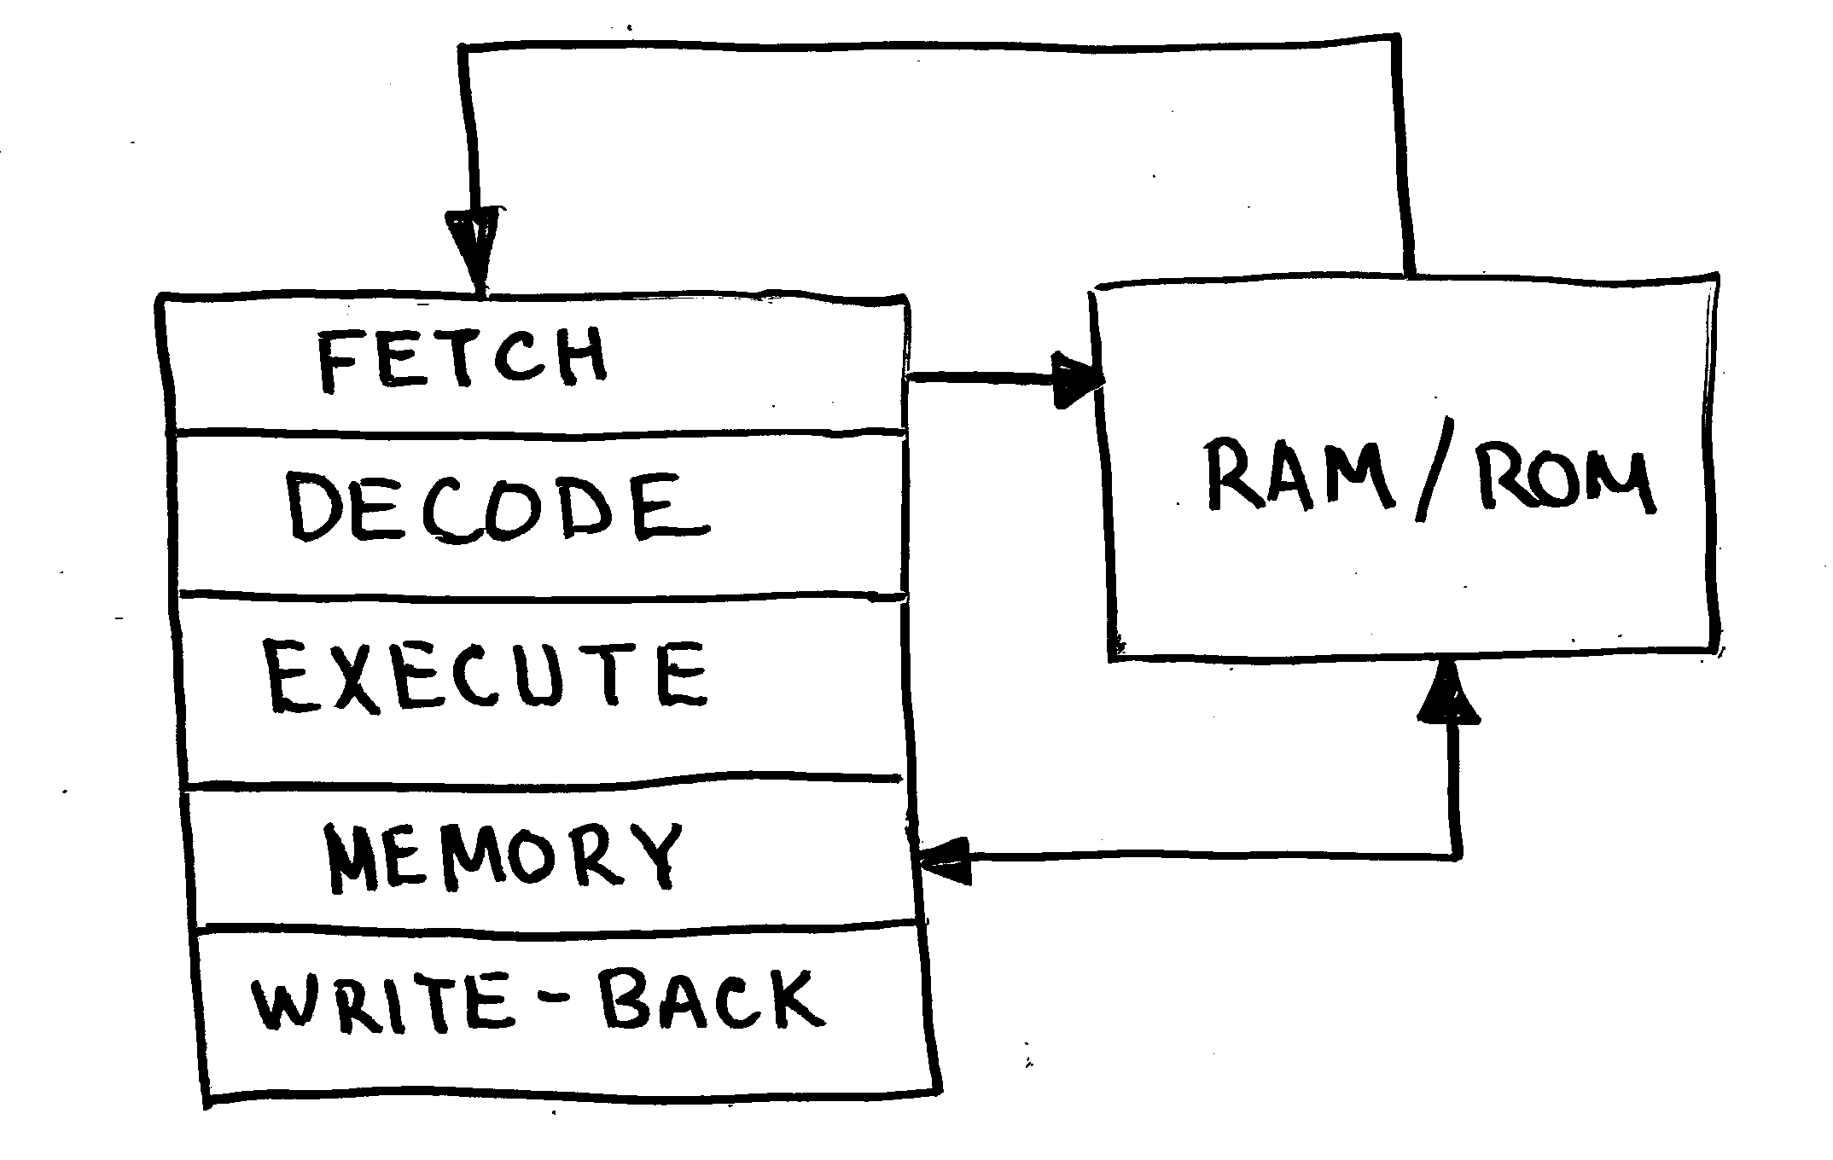
Pipeline design documents are misleading.
They're not wrong; but they're not right either.
Only data-flow shown; control-plane obscured.

Slide 8
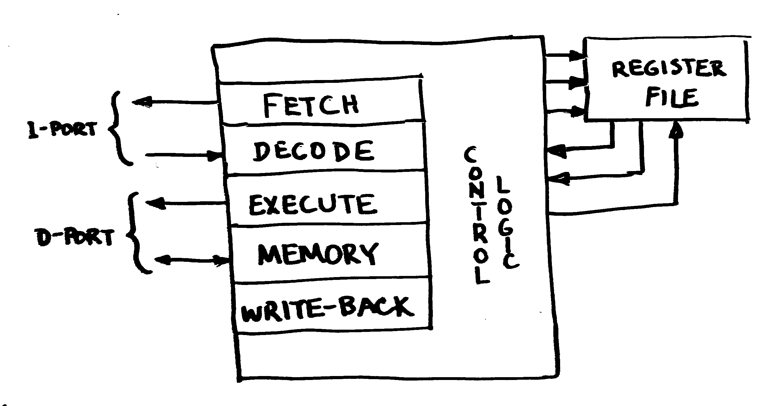
Pipeline design documents are misleading.
Pipeline stages are really independent functioning units, under centralized control.

Slide 9
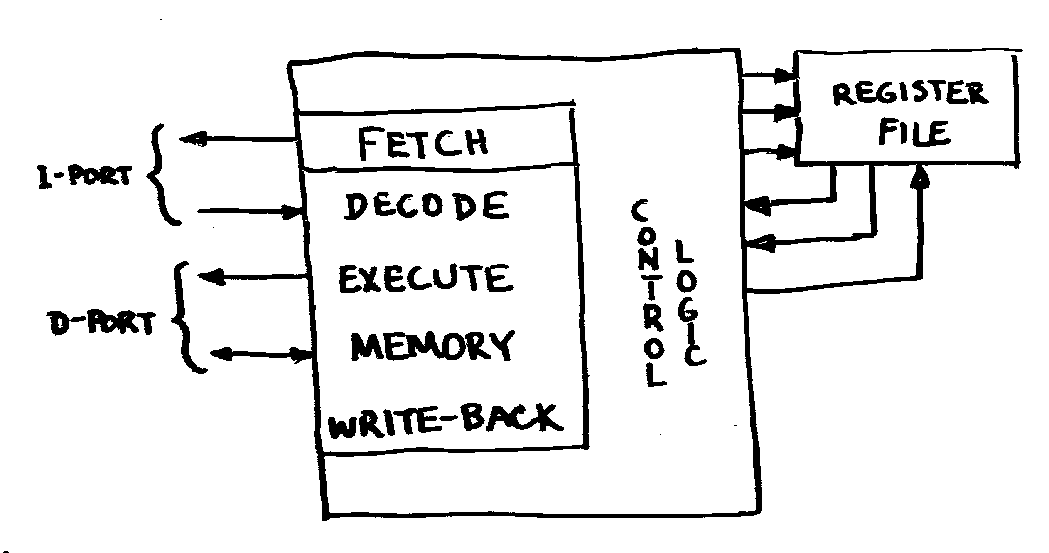
Pipeline design documents are misleading.
Separation of concerns makes refactoring easier later on.
Compare ideal vs. current KCP53000 pipeline.

Slide 10
Pipeline design documents are misleading.
Opportunities for Optimization
These compound; given same 25MHz clock, design that once ran 6 MIPS now can run 16 MIPS to 24 MIPS.
Optimization | Minimum | Maximum
Overlap instruction fetch and execution | 60% | 100%
Perform both source register fetches at once | 25% | 33%
Overlap instruction fetch and register write-back | 30% | 50%

Slide 11
Count Furcula!
64 bits! Ah … ah … ah!

Slide 12
Furcula Bus
Fork of Wishbone B3 to better meet CPU's needs.
Justified data transfers; no byte lanes.
Full address bus exposed; no low address erasure.
SIZ_O[1:0] exposed to indicate transfer size.
SIGNED_O exposed to indicate sign-extension.
Otherwise, identical to Wishbone B3.
In retrospect, exposing SIGNED_O was a bit of a mistake, but thankfully not a terribly big one.

Slide 13
Wishbone vs. Furcula Comparison
Wishbone byte-lanes
 | Byte 0 | Byte 1 | Byte 2 | Byte 3 | Hword 0 | Hword 1 | Word
DAT_IO[7:0] | X |  |  |  | X |  | X
DAT_IO[15:8] |  | X |  |  | X |  | X
DAT_IO[23:16] |  |  | X |  |  | X | X
DAT_IO[31:24] |  |  |  | X |  | X | X

Slide 14
Wishbone vs. Furcula Comparison
Furcula Justification
 | Byte 0 | Byte 1 | Byte 2 | Byte 3 | Hword 0 | Hword 1 | Word
DAT_IO[7:0] | X | X | X | X | X | X | X
DAT_IO[15:8] |  |  |  |  | X | X | X
DAT_IO[23:16] |  |  |  |  |  |  | X
DAT_IO[31:24] |  |  |  |  |  |  | X

Slide 15
Why Furcula?
Allows direct CPU-to-external-circuitry connection.
Intel CPUs pre-decode size and lower address bits to break data into individual byte lanes.
Buses out-live CPUs.
Supporting legacy buses requires resynthesizing information from byte lane enables.
Thus, bus bridge circuitry must "undo" what CPU-internal circuitry already did.

Slide 16
Why Furcula?
Therefore, just let external circuitry handle alignment and sign-extension exactly once.
Trivial to bridge to Wishbone B3.
  Just needs some data bus multiplexors to route data to/from byte lanes.
  Handful of gates to decode byte lane select signals.
  Sign-extension logic.

Slide 17
Shoulda, Woulda, Coulda.
I should have chosen
Wishbone B4 over Wishbone B3.

Slide 18
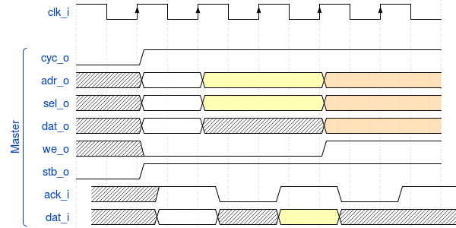
Wishbone B3

Slide 19
Wishbone B3
Closer in scope to PCI than it is to AXI4.
ACK_I must:
  assert in same cycle to achieve single-cycle performance. (<= 35ns for 25MHz)
  negate after transaction completes.

Slide 20
Wishbone B3
To get 100% efficiency on bus, you must:
  Use fully asynchronous slave logic that responds in 35ns or less (assuming 25MHz bus).
  Ensure at least one address bit changes between cycles, so slave can detect end of one cycle and start of another.
  Alternatively, explicitly declare adjacent transactions to the same address undefined, and assume software does the right thing.

Slide 21
Wishbone B3
Why It Fails for Kestrel-3:
Bus bridges and adapters add propegation delays to address decoding logic.
Brings max. clock speed from around 100MHz to 29MHz on Xilinx parts. Ouch!
Demonstrably incompatible with PSRAM chip timings on Nexys-2 board.
Kestrel-3 takes around 33ns from address valid to ACK_I. (Remember, 35ns was our limit!)

Slide 22
Wishbone B3
Why It Fails for Kestrel-3:
Improving performance requires introducing multiple clock domains, one for CPU, one for Wishbone bus, one for RAM.
Requires FIFOs and hard to debug async interlocks to work successfully.
Works comfortably at somewhere below 20MHz clock speeds for something the size of Kestrel-3.
For anything faster, you start to want something that works more closely and more locally with FPGA resources.

Slide 23
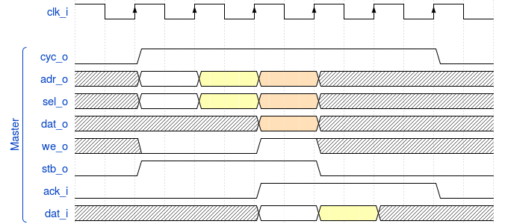
Wishbone B4 Pipelined

Slide 24
Wishbone B4 Pipelined
or: How I learned to stop worrying and love the clock!
CYC_O asserted as long as at least one cycle remains unterminated. Can still be used as a bus request.
STB_O now is the prime determinant in whether or not a bus cycle is valid or not.
ACK_I no longer scoped by STB_O. It may arrive at any time after a corresponding STB_O (in order).
STALL_I (not shown) used to throttle master if required.

Slide 25
Wishbone B4 Pipelined
Address decode latency not cured by increasing clock or introducing pipelining. So why bother?
Wishbone 3 works great at lower speeds because you have lots of time to generate ACK from address and STB.
As clock period approaches propegation delay between LUTs, glitches increasingly manifest.
DFFs work like synchronizers. Every LUT has a corresponding DFF; adding them costs nothing.

Slide 26
Wishbone B4 Pipelined
Address decode latency not cured by increasing clock or introducing pipelining. So why bother?
Pipelining supports overlapping bus transactions without altering address decode latency.
Easier to synchronize across different clock domains.
Easier to bridge across different protocols. (Wishbone to RapidIO, for example.)

Slide 27
Thanks, Everyone! Q&A
Email | Samuel A. Falvo II <kc5tja@arrl.net>
Web | https://kestrelcomputer.github.io/kestrel
GitHub | https://github.com/kestrelcomputer

