Slide 1
Fluctuation Plots Sam Grant 7th June 2019

Slide 2
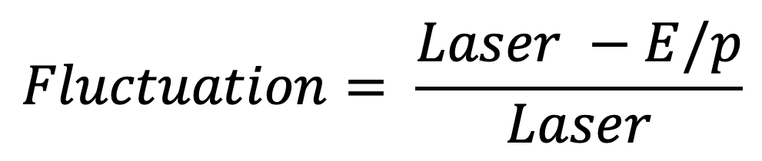
$$Fluctuation= \frac{Laser −E/p}{Laser}$$

Slide 3
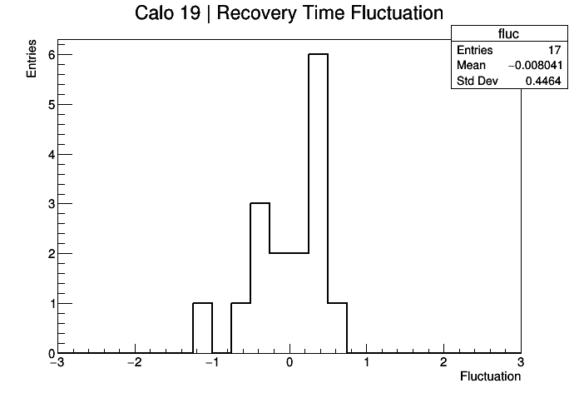
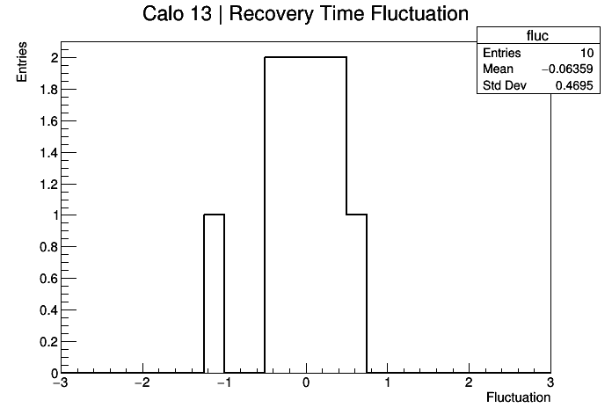

Slide 4
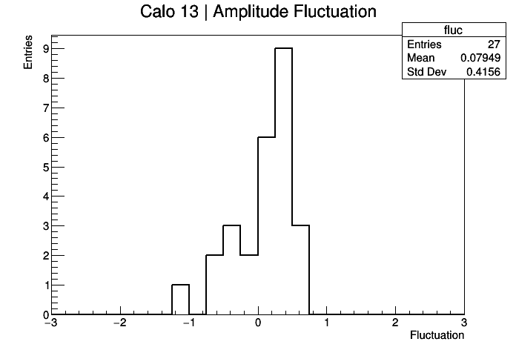
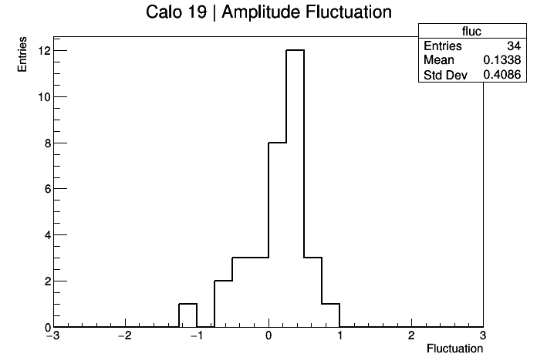

Slide 5
Is this telling me that the average fluctuation is around 40% (from the standard deviations)?

