Slide 1
In Fill Gain Corrections: E/p vs Laser Sam Grant UCL Muons Meeting 23th June 2019

Slide 2
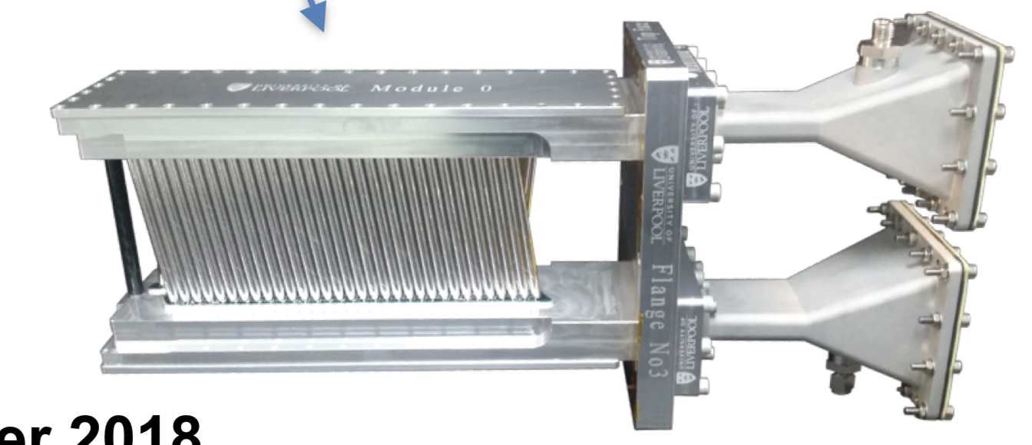
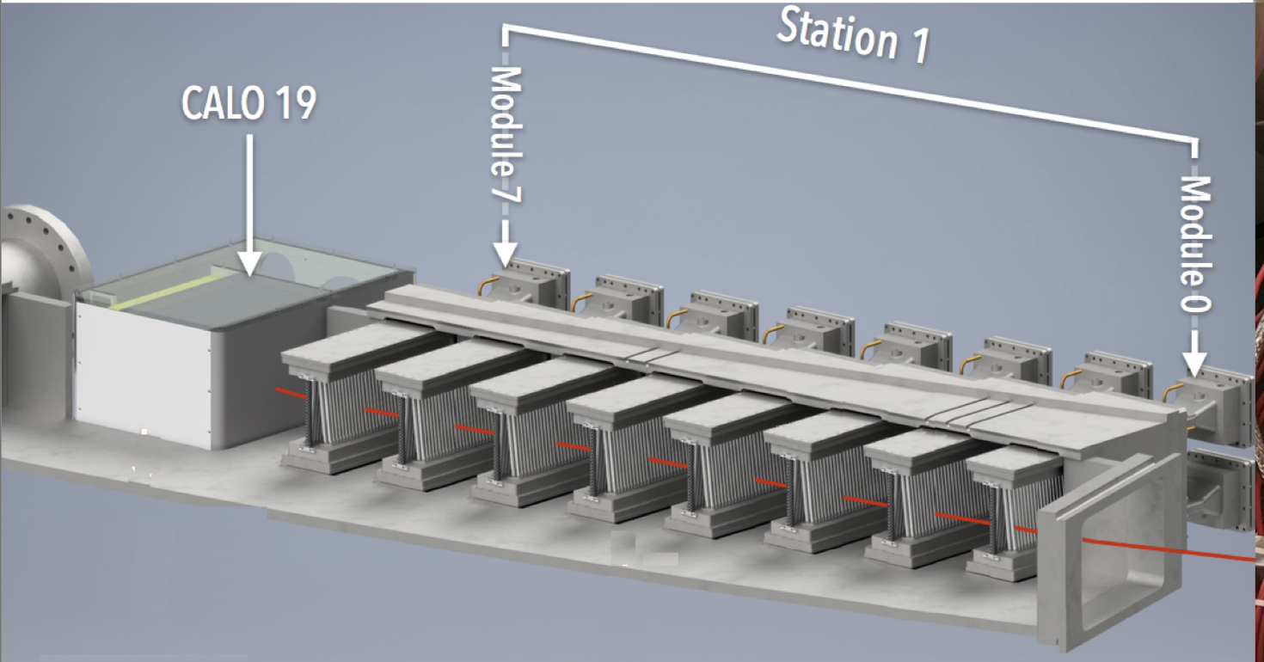
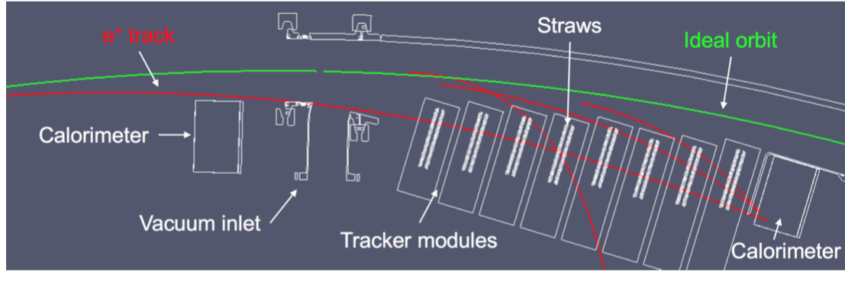
Trackers!
Layers of wire under high voltage, encased in straws filled with an argon-ethane gas mix
Provides information about track momentum and position
Two sets of 8 modules, in front of calorimeters 13 and 19.
Very useful for studying systematics as well!
Ionisation -> Charges drift to wires -> Read out and reconstruct -> No worries

Slide 3
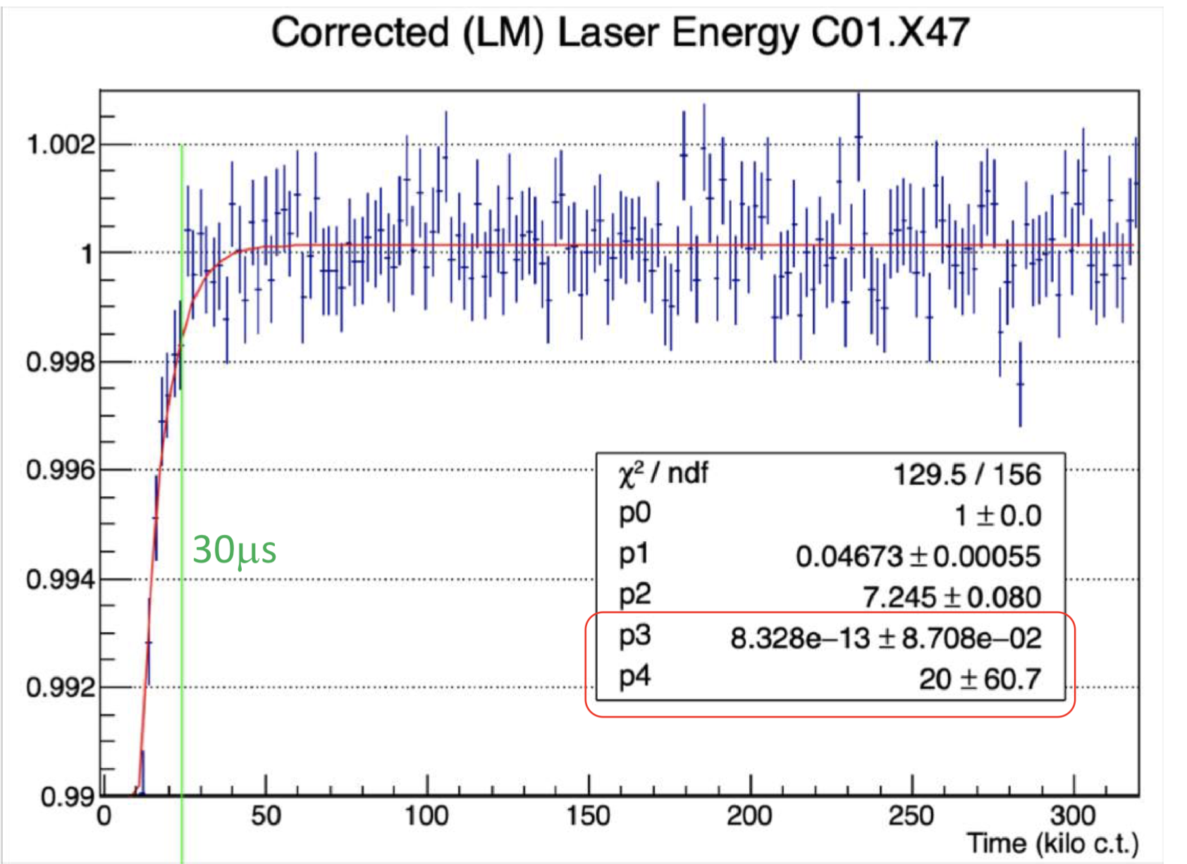
Gain sag!
Sudden drop and subsequent recovery in gain at early times
This is due to bunching after injection saturating the calorimeters
Must be fitted and corrected in processing
Amplitude p₁ and time constant p₂ are used for gain corrections

Slide 4
The E/p ratio
Tracker-calo matched tracks provide a different way to measure gain, so we can perform an independent cross check of the laser.
Gain = measured energy / true energy
E = p, and trackers do not “see” gain sag, so:
Gain = cluster energy (calo) / track momentum (tracker)
Gain = E/p

Slide 5
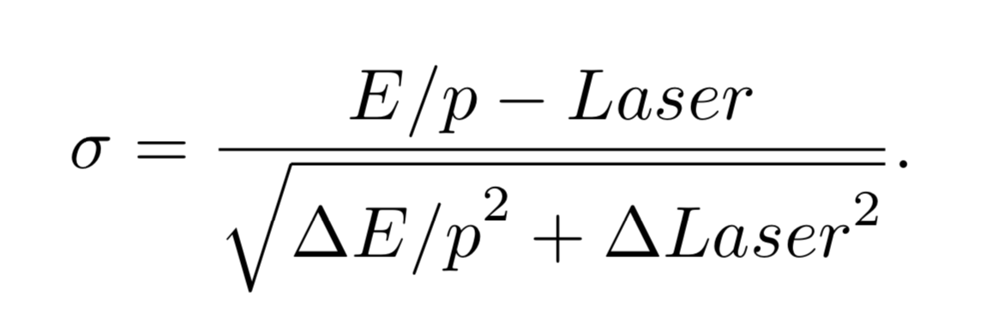
Overview
Derive the recovery times and amplitudes using E/p
Quantify the level of deviation between laser and E/p:
We can use the pull per crystal in units of sigma
As well as the fractional uncertainty per crystal

Slide 6
Cuts on fits per crystal
These are vital, but I’m not sure about them tuning them. Is it OK to cut on the parameters themselves?
//QUALITY CUTS
// Require high stats
if (N < 100000) continue;
// Require reasonable reduced chi squared
if(chiSqrNDF < 0.25 || chiSqrNDF > 4) continue;
// Cut unphysical params as last resort
if(tau > 25 || A > 0.1) continue;

Slide 7
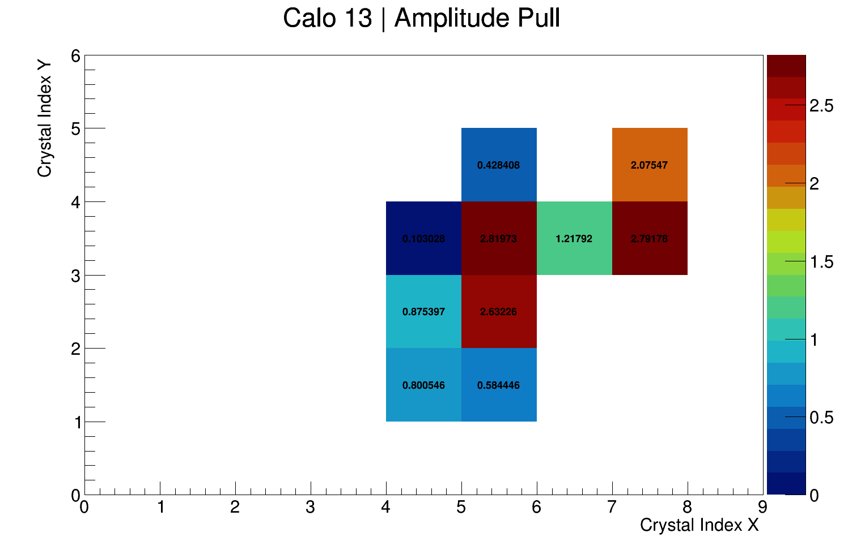
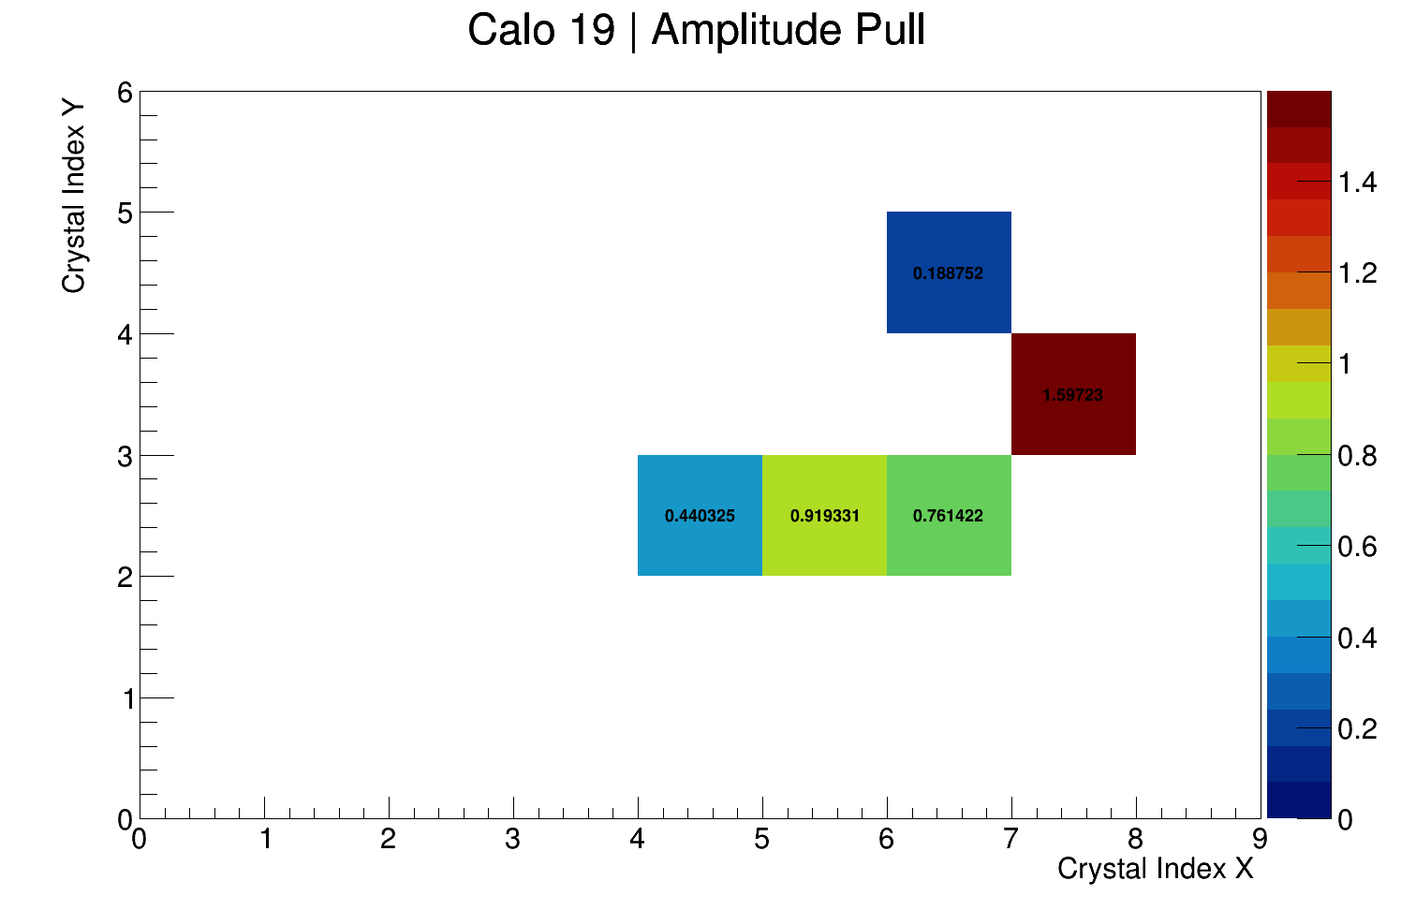
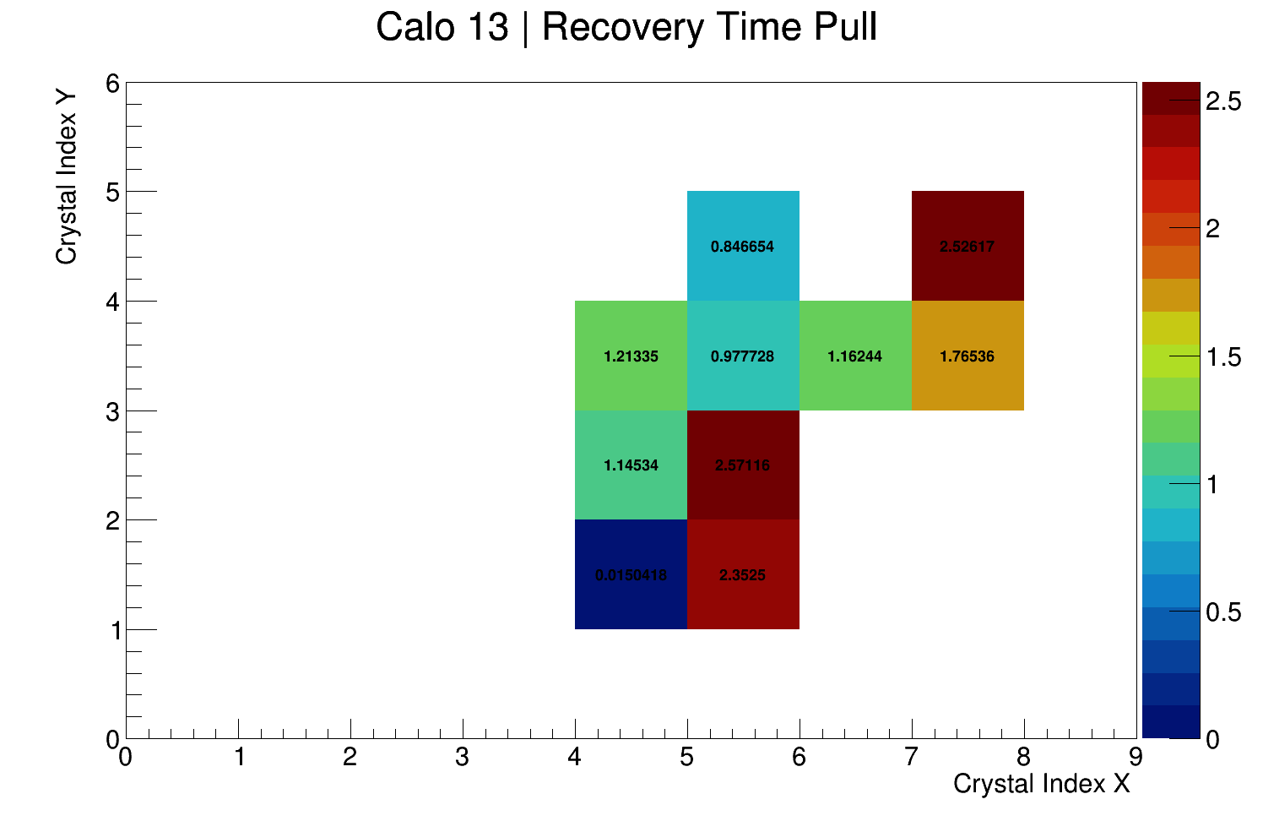
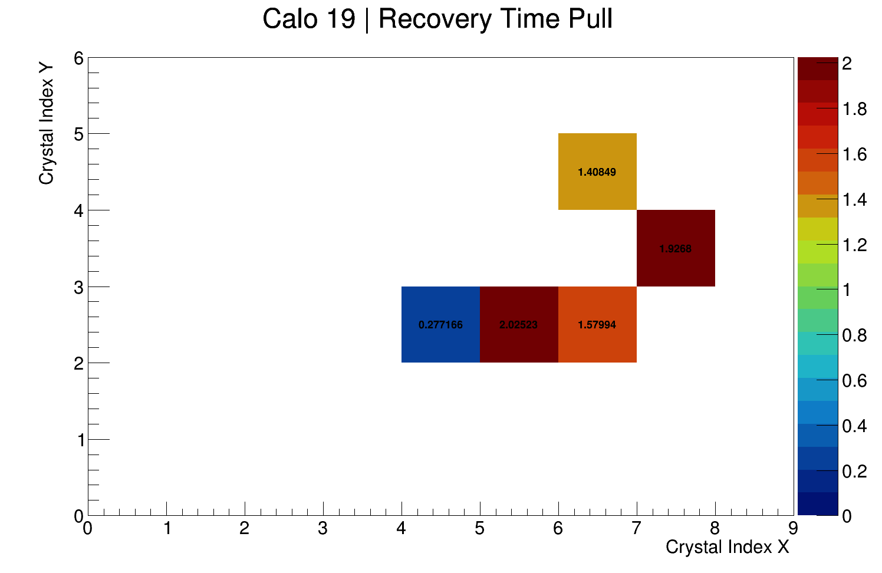
Cuts Illustration (Pull)

Slide 8
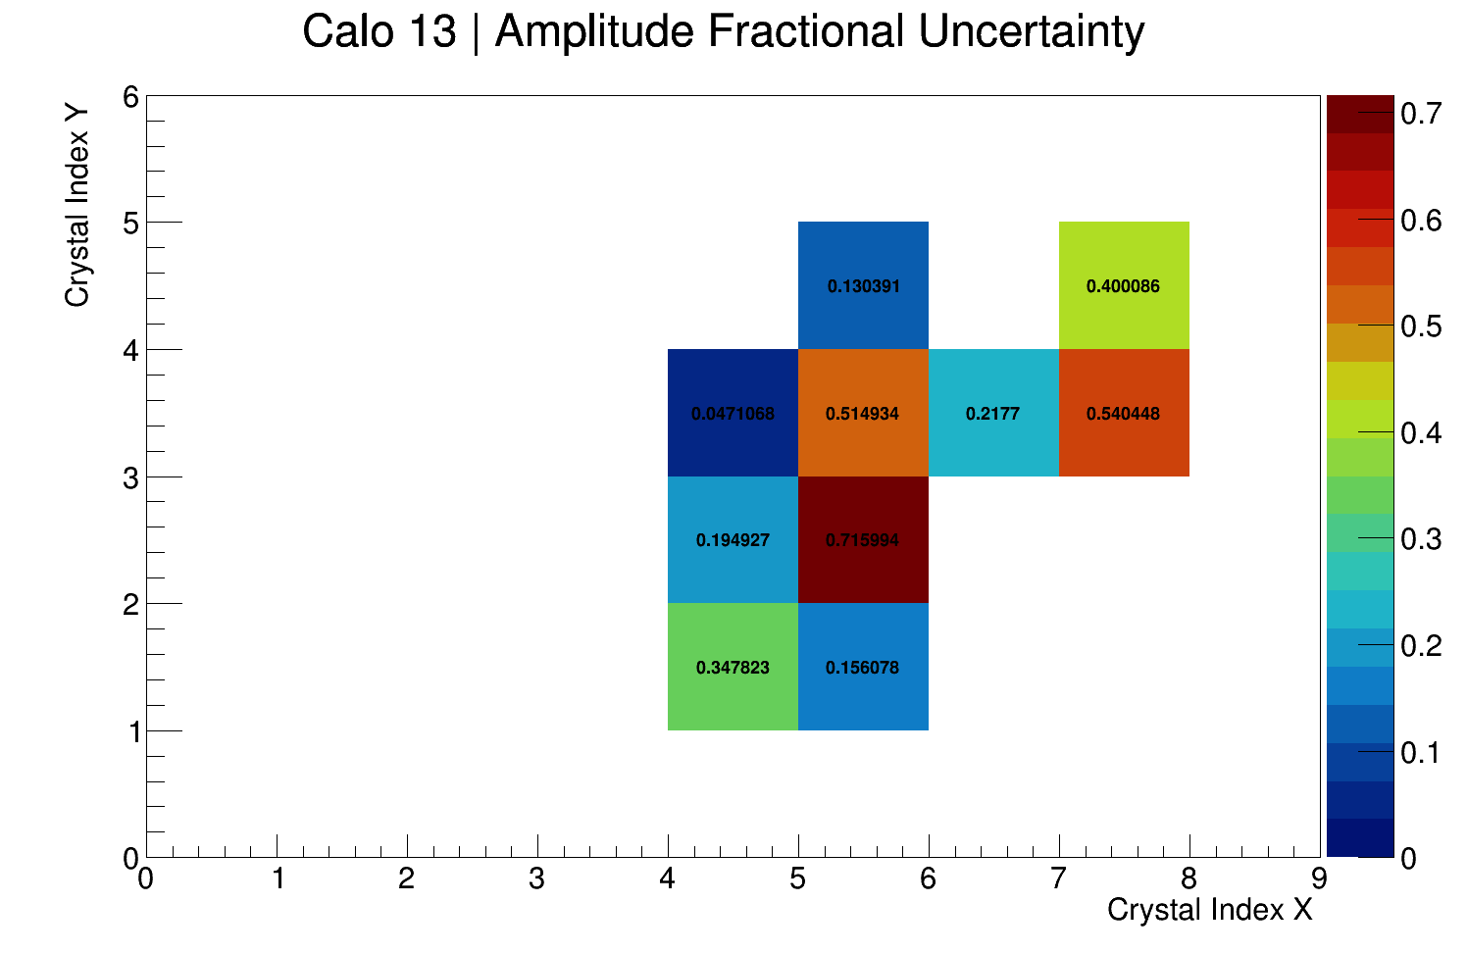
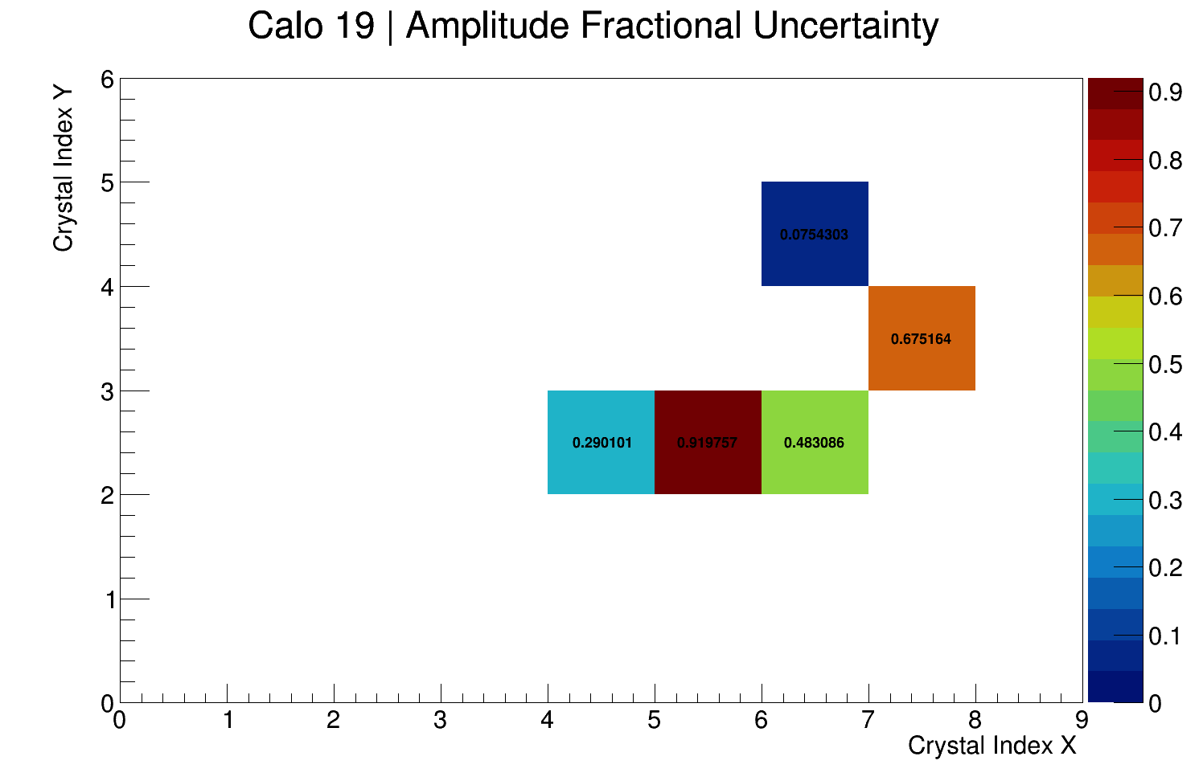
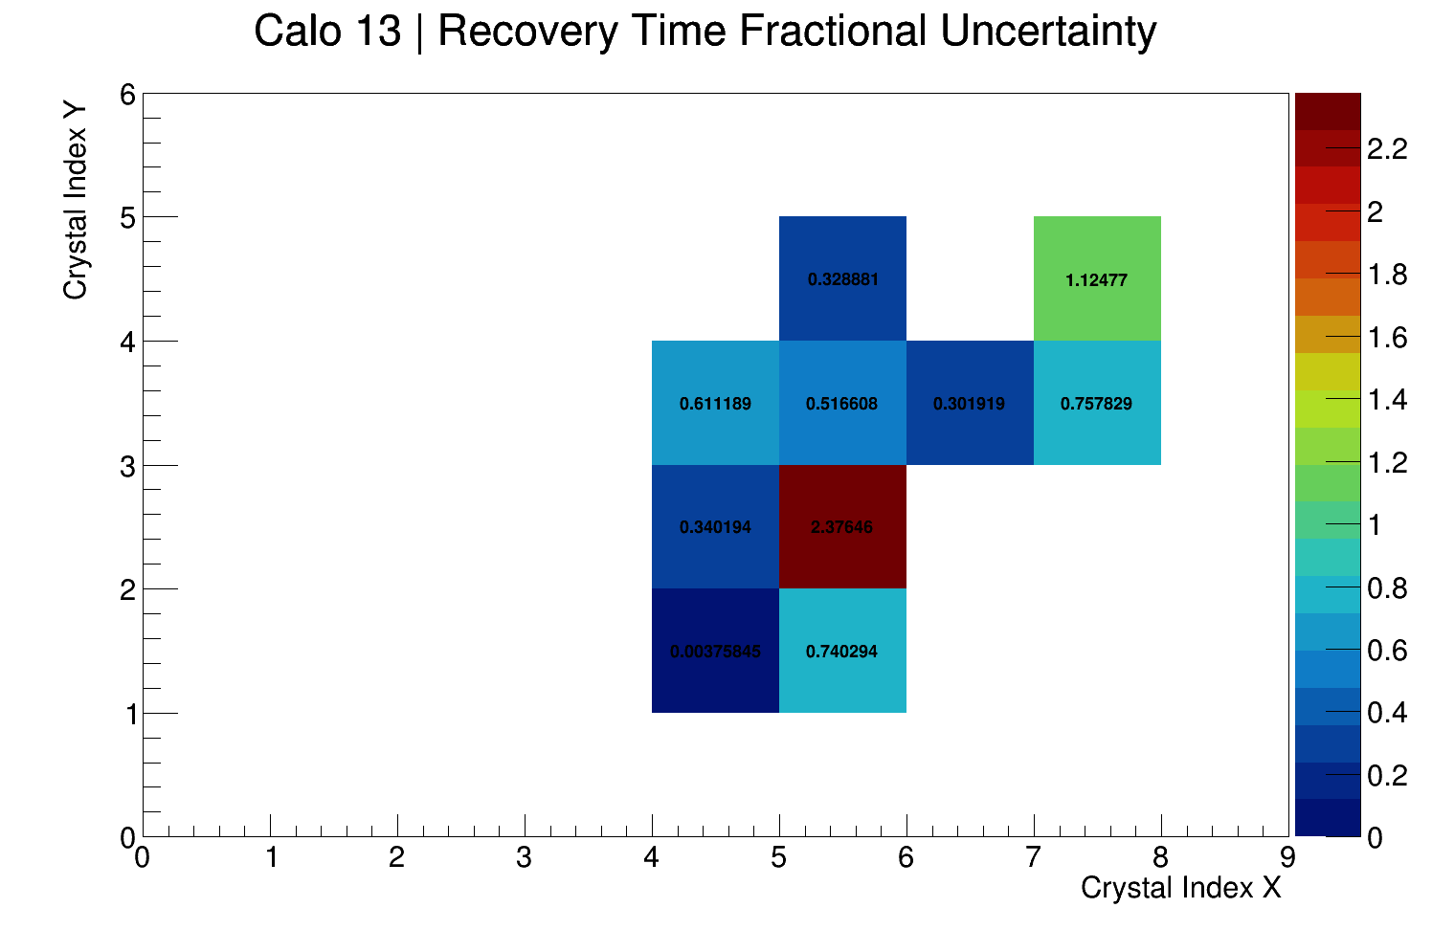
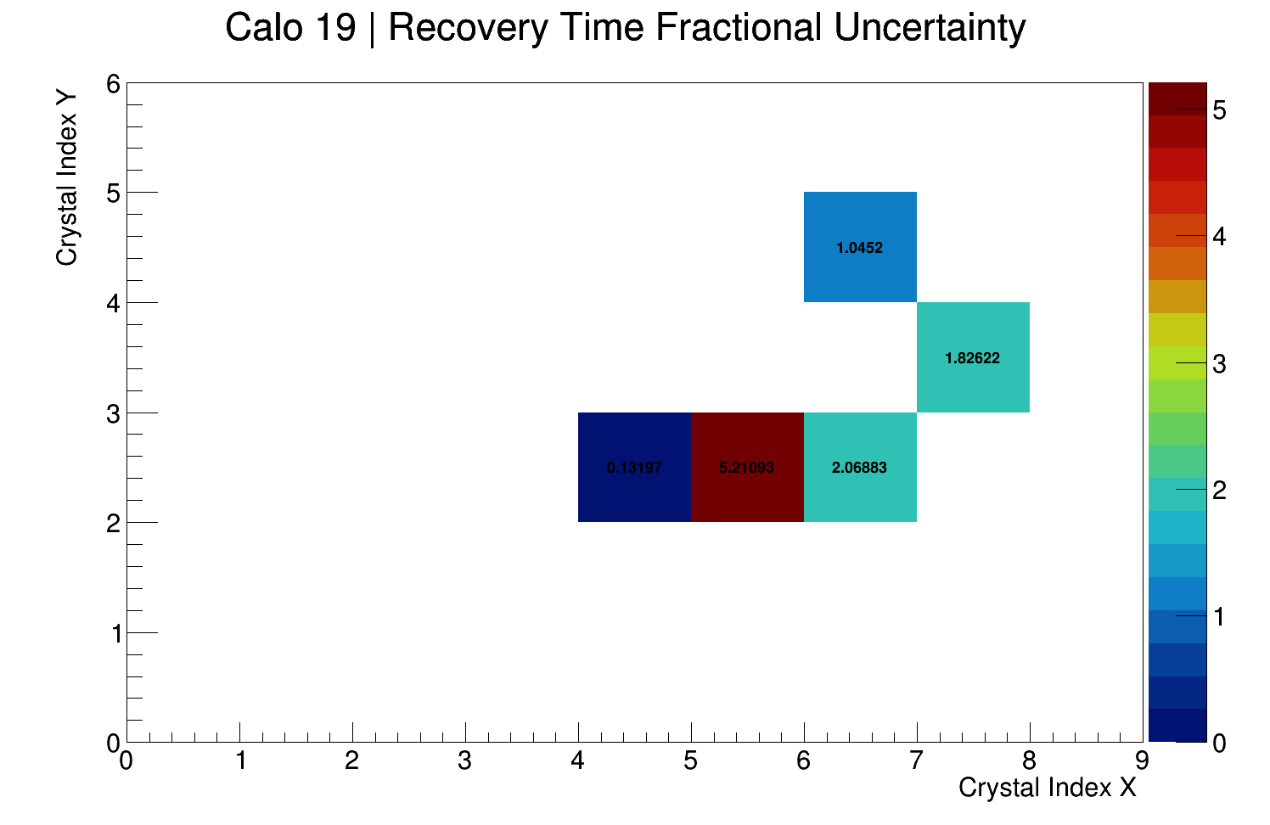
Cuts Illustration (Fractional Uncertainty)

Slide 9
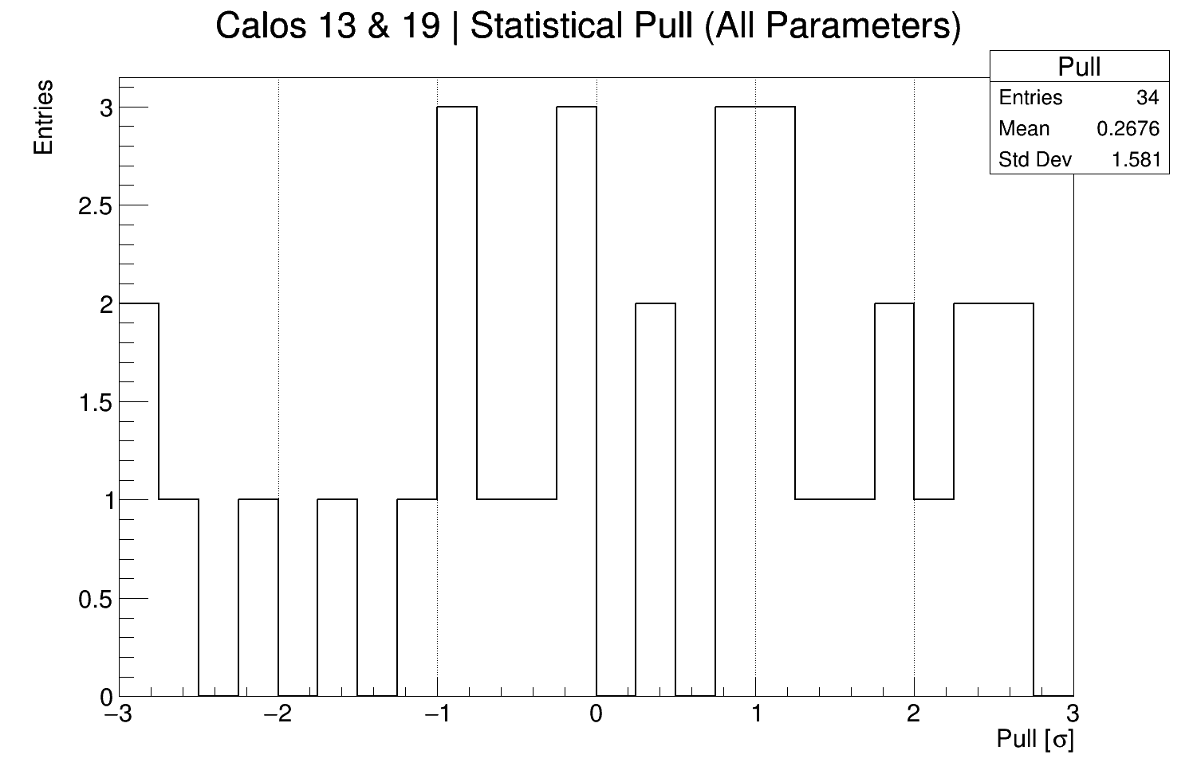
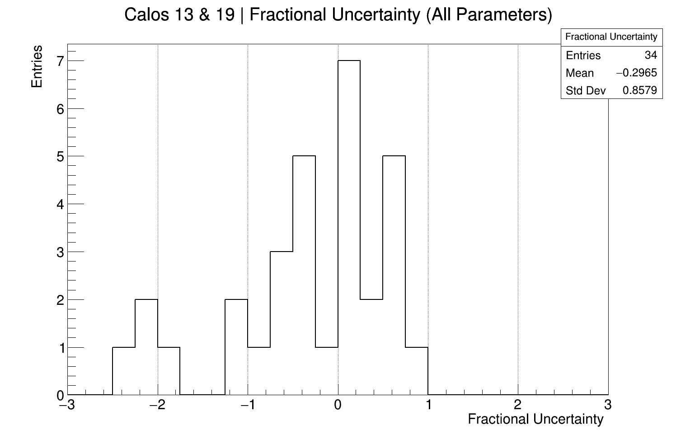
Cuts Illustration (1D Distributions)

Slide 10
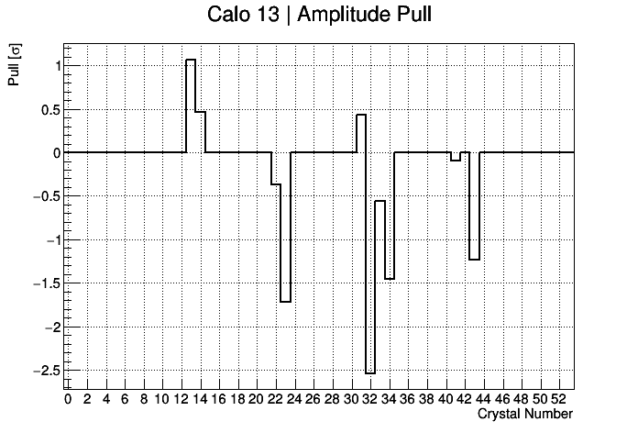
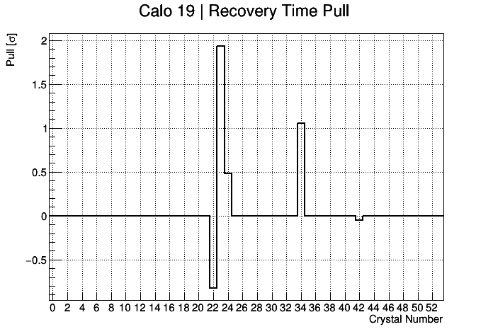
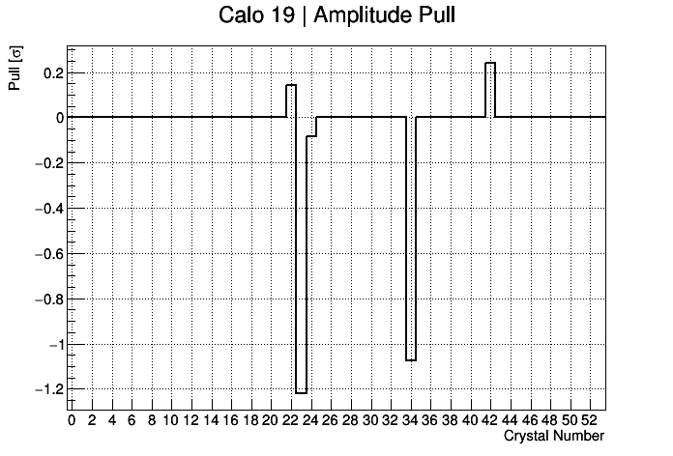
Pull
With quality cuts all crystals lie within 3 sigma, which is good!

Slide 11
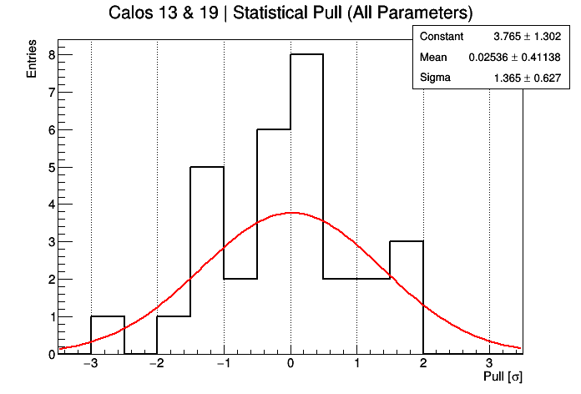
Pull
With quality cuts all crystals lie within 3 sigma, which is good!
Total std dev is about 1.5 sigma

Slide 12
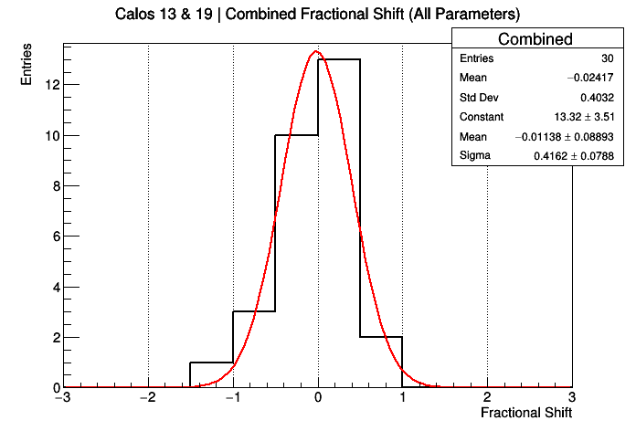
Fractional Shift
Looks like the shift (percentage uncertainty) is about 40%, this could be a useful systematic

Slide 13
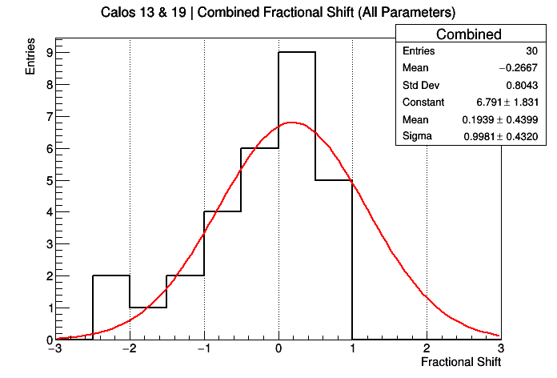
Fractional Shift
Anna gave me a load of new laser data yesterday and it has made things much worse ☹

Slide 14
Summary
This is a very simple thing to do in theory!
I’ve been spending a lot of time going back and forth with cuts:
I want to retain as many crystals as possible
I want cuts to be well motivated
I want it to work with the new data

Slide 15
Fractional Shift
The fractional shift equation does not account for uncertainties…

