Slide 1
Independent check of gain corrections based on the E/p ratio 2.5 Europe ω_{a} Meeting Sam Grant 5th April 2019

Slide 2
Overview
Using 60 hour data set with the tracker groups latest quality cuts applied (courtesy of Joe Price)
Try to fit functions to E/p vs t and E/p vs E
Get fit parameters

Slide 3
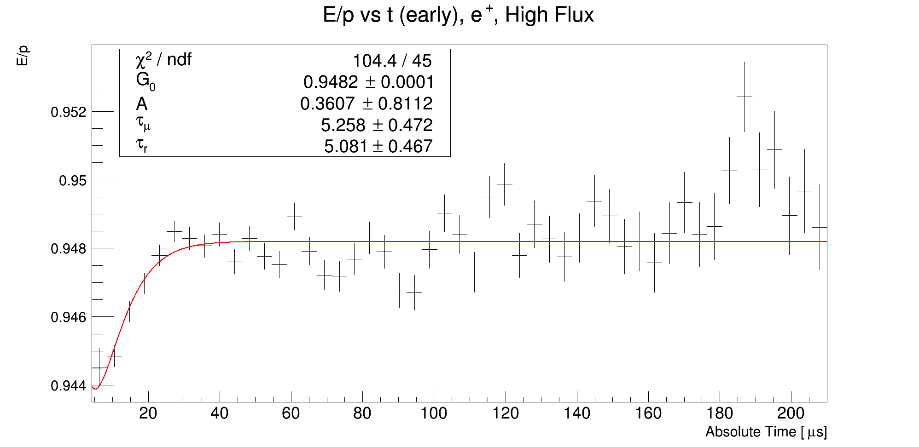
E/p vs t - Fit
EXT PARAMETER APPROXIMATE STEP FIRST
NO. NAME VALUE ERROR SIZE DERIVATIVE
1 G_0 9.48199e-01 8.39000e-05 -1.86799e-07 -6.16358e+00
2 A 3.60743e-01 8.11206e-01 7.85307e-03 -5.57215e-01
3 tau_mu 5.25772e+00 4.72466e-01 -2.22005e-03 -1.10039e+00
4 tau_r 5.08051e+00 4.67119e-01 1.75206e-03 1.09826e+00

Slide 4
E/p vs t - Comments
Fit function borrowed from slide 10 of:
https://gm2-docdb.fnal.gov/cgi-bin/private/RetrieveFile?docid=4571&filename=gain_sipm_Detector_meeting.pdf&version=1
𝛕_{μ} = 5.3±0.5 μs & 𝛕_{r} = 5.1±0.5 μs
Χ²/ndf of 2.32 is a bit high
The distribution is clearly oscillating past 20 μs, and the fit does not account for this
Maybe adding an oscillating part would help

Slide 5
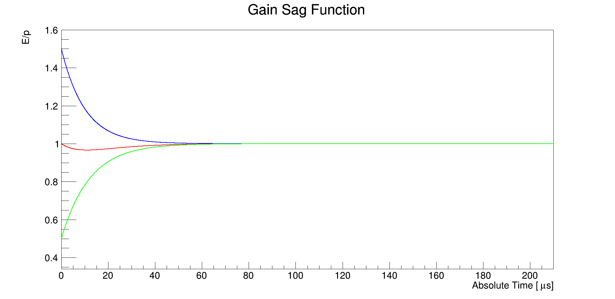
E/p vs t - Illustration
Rising Green Curve: Dependent on 𝛕_{μ}
Falling Blue Curve: Dependent on 𝛕_{r}

Slide 6
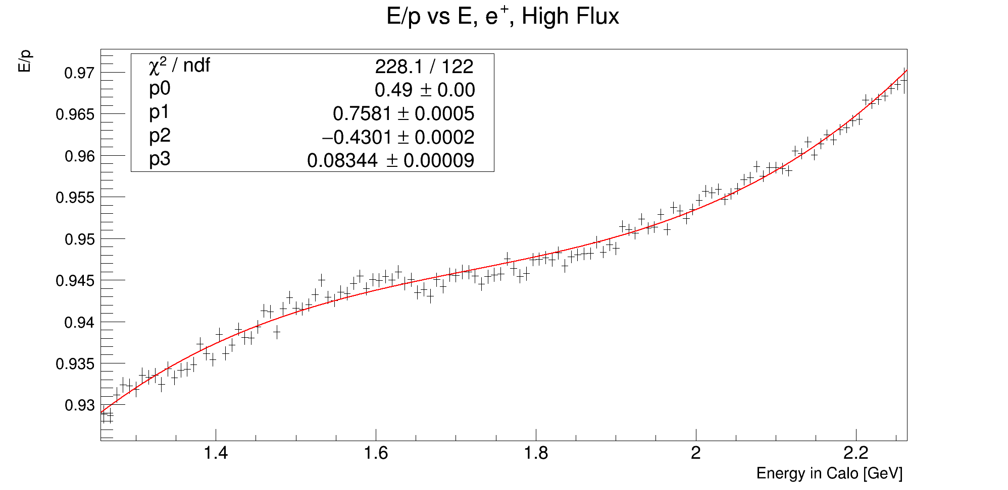
E/p vs E
EXT PARAMETER APPROXIMATE STEP FIRST
NO. NAME VALUE ERROR SIZE DERIVATIVE
1 p0 4.89951e-01 5.44679e-04 1.16813e-07 1.49051e-03
2 p1 7.58138e-01 4.76039e-04 1.80754e-07 -2.95563e-03
3 p2 -4.30076e-01 2.45102e-04 1.02538e-07 -6.27429e-03
4 p3 8.34415e-02 8.81044e-05 1.98940e-08 1.35465e-02

Slide 7
E/p vs t - Comments
Cubic fit is just a guess
Χ²/ndf of 1.87 is also a bit high
This distribution is also oscillating if you look closely, the fit does not account for this
Again, maybe adding an oscillating part would help

Slide 8
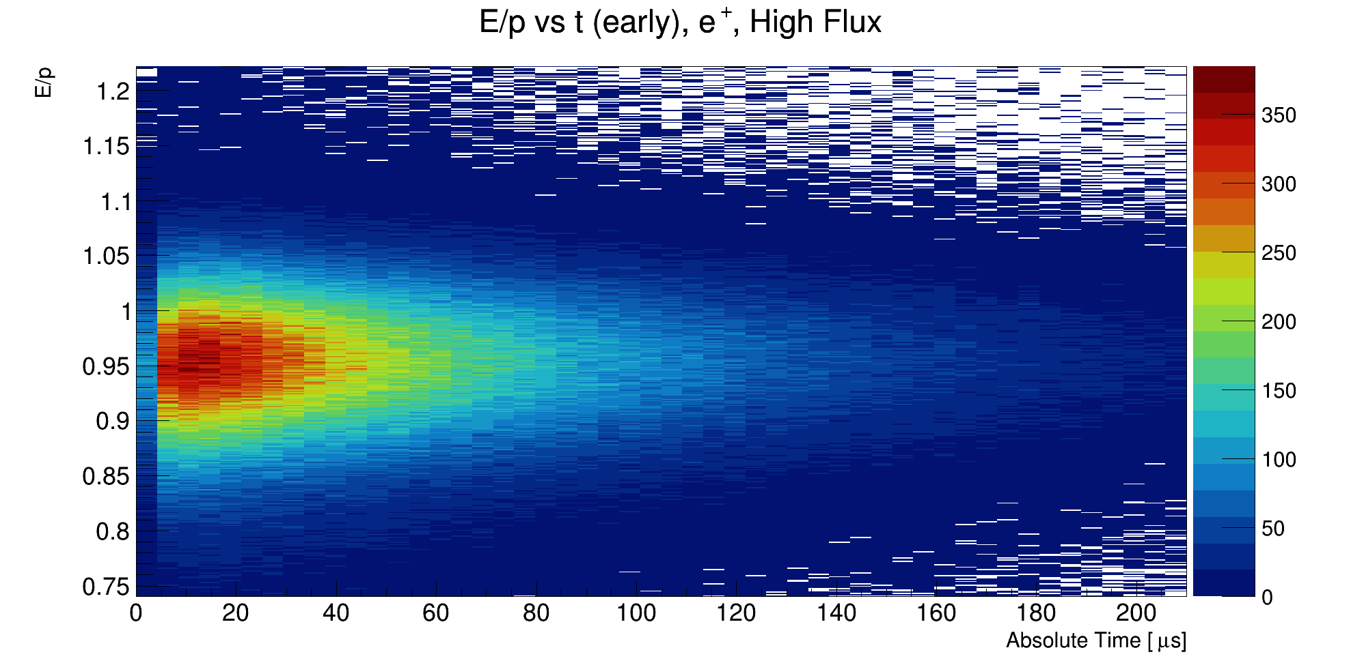
Backup: E/p vs t (early), 2D

Slide 9
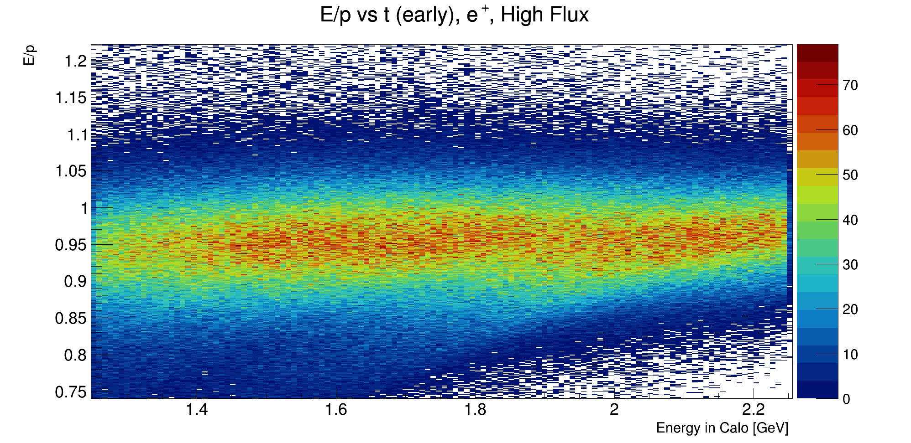
Backup: E/p vs E, 2D

