Slide 1
In Fill Gain Corrections: E/p vs Laser Sam Grant UCL Muons Meeting 15th July 2019

Slide 2
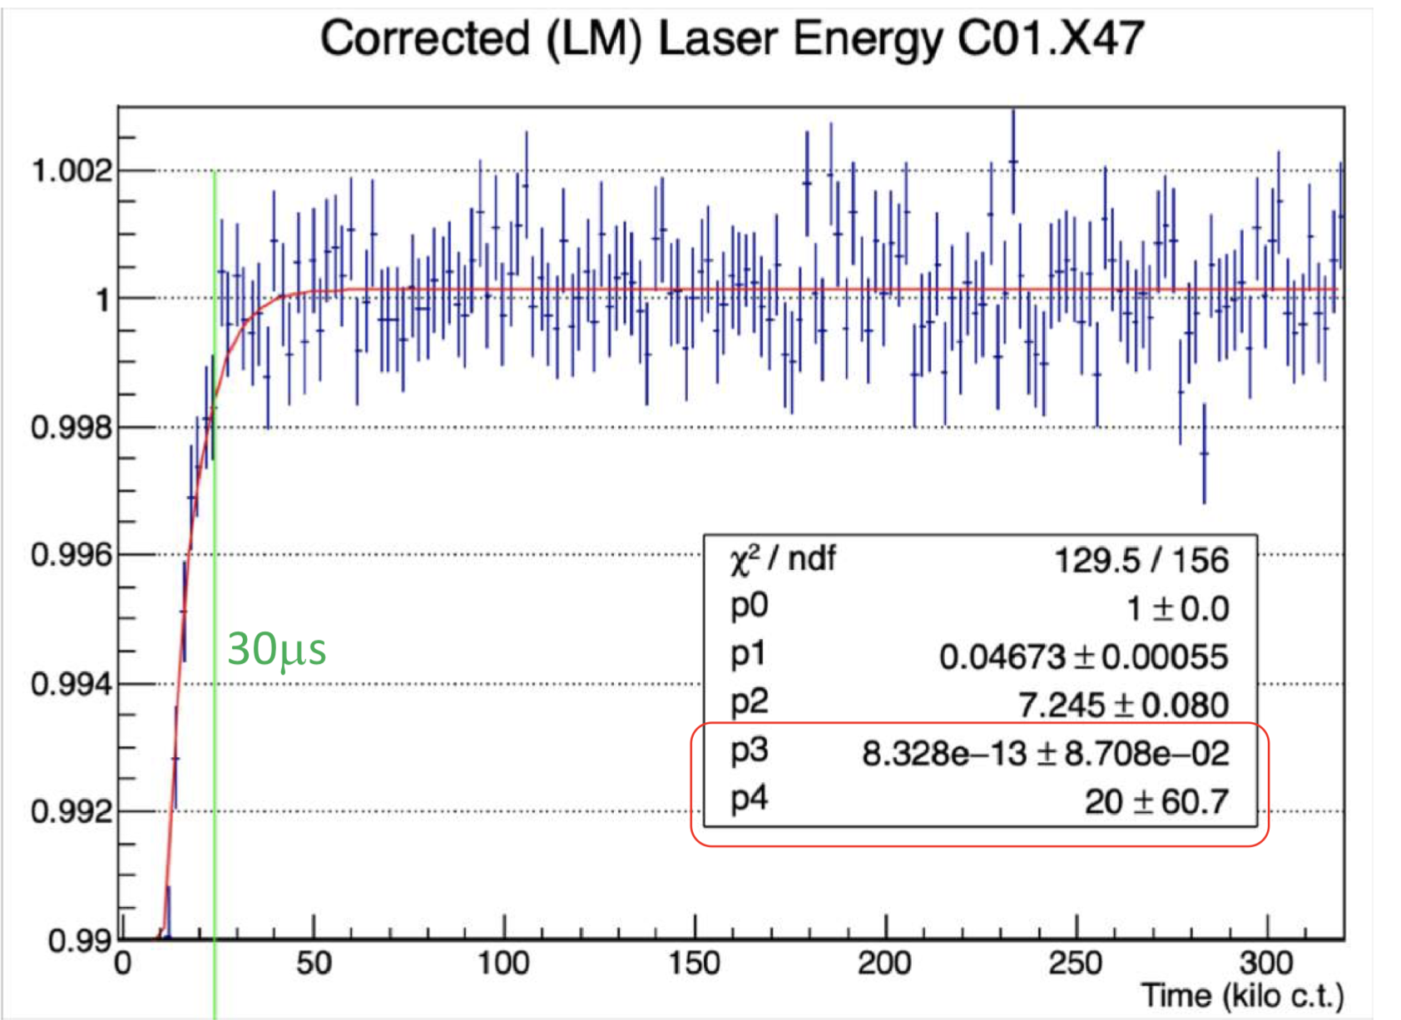
Refresher
1. Derive the in fill recovery times and amplitudes using the E/p ratio
2. Quantify the level of deviation between laser and E/p

Slide 3
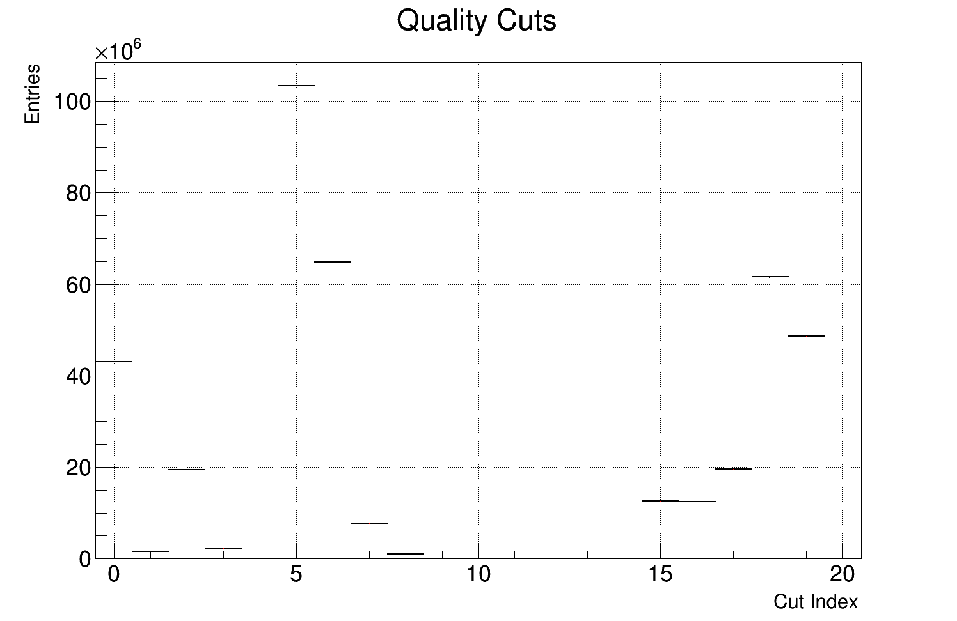
Problem: Statistics Limited
Need to win back some stats while maintaining quality of tracks, here are the quality cuts where we lose tracks:
0. Number of hits (total and U/V)
| u - v | hits <= 4
Fraction of missed layers
Drift time
Non failed track
P value
Track residuals < 500 um
Track entrance x window
Track entrance y window
Non failed vertex
No volumes hit
Vertex uncertainty R
Vertex uncertainty Y
Extrapolation distance forwards
Extrapolation distance backwards
Time difference 12
Time difference 18
Radial difference
Energy window
Positron log(E/p)
Lost muon log(E/p)

Slide 4
Problem: Statistics Limited
Good track cuts: either quite small or extremely important
0. Number of hits (total and U/V)
| u - v | hits <= 4
Fraction of missed layers
Drift time
Non failed track
P value
Track residuals < 500 um
Track entrance x window
Track entrance y window
Non failed vertex
No volumes hit
Vertex uncertainty R
Vertex uncertainty Y
Extrapolation distance forwards
Extrapolation distance backwards
Time difference 12
Time difference 18
Radial difference
Energy window
Positron log(E/p)
Lost muon log(E/p)

Slide 5
Problem: Statistics Limited
Good vertex cuts: never switched on anyway
0. Number of hits (total and U/V)
| u - v | hits <= 4
Fraction of missed layers
Drift time
Non failed track
P value
Track residuals < 500 um
Track entrance x window
Track entrance y window
Non failed vertex
No volumes hit
Vertex uncertainty R
Vertex uncertainty Y
Extrapolation distance forwards
Extrapolation distance backwards
Time difference 12
Time difference 18
Radial difference
Energy window
Positron log(E/p)
Lost muon log(E/p)

Slide 6
Problem: Statistics Limited
Good track-calo match cuts: energy window cut the is least important and most aggressive
0. Number of hits (total and U/V)
| u - v | hits <= 4
Fraction of missed layers
Drift time
Non failed track
P value
Track residuals < 500 um
Track entrance x window
Track entrance y window
Non failed vertex
No volumes hit
Vertex uncertainty R
Vertex uncertainty Y
Extrapolation distance forwards
Extrapolation distance backwards
Time difference 12
Time difference 18
Radial difference
Energy window
Positron log(E/p)
Lost muon log(E/p)

Slide 7
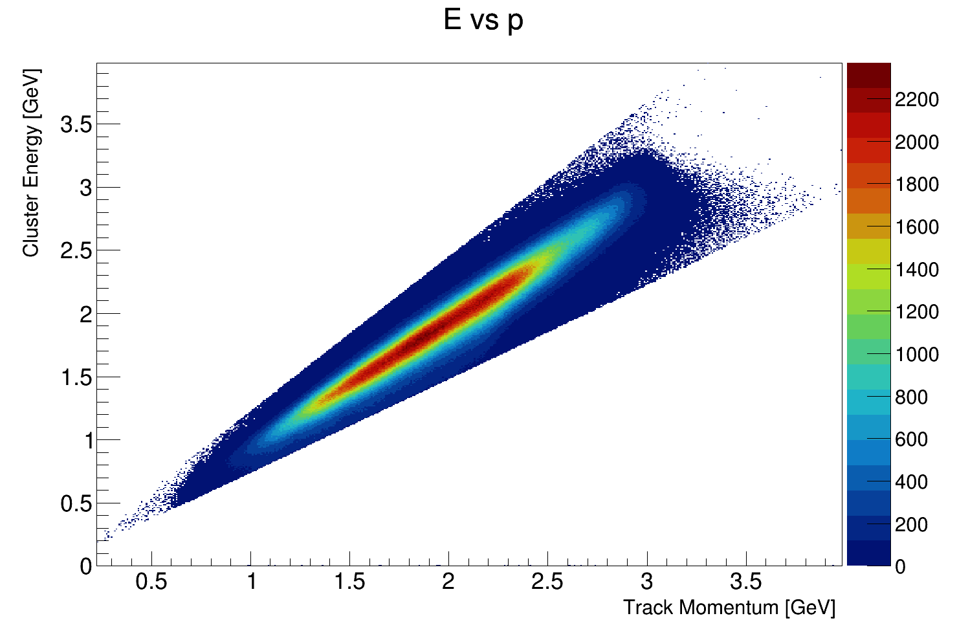
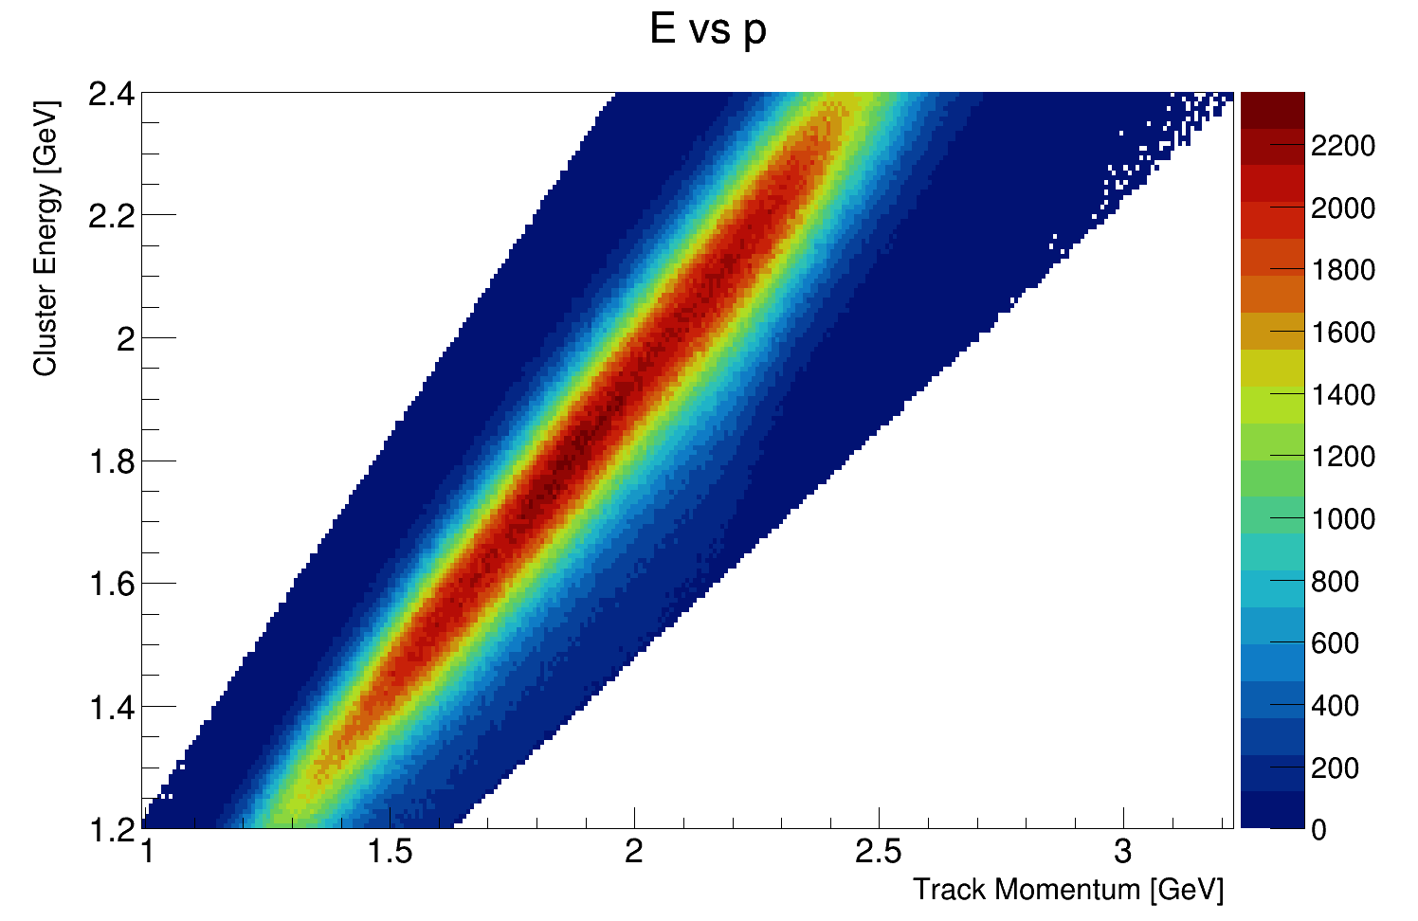
Energy window
Originally intended to avoid anything weird happening at the extremes, let’s drop it

Slide 8
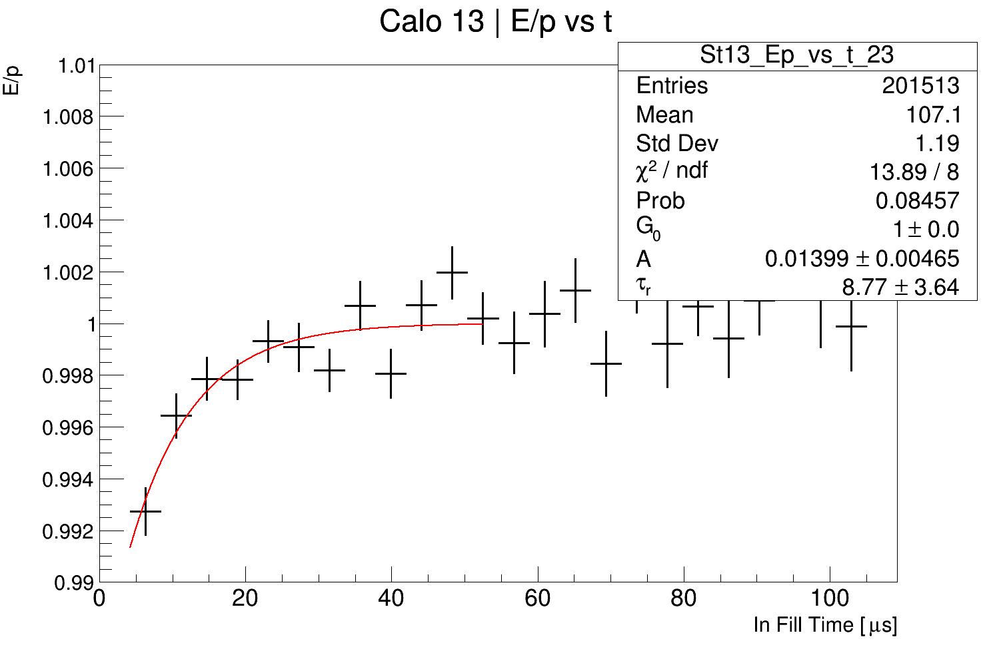
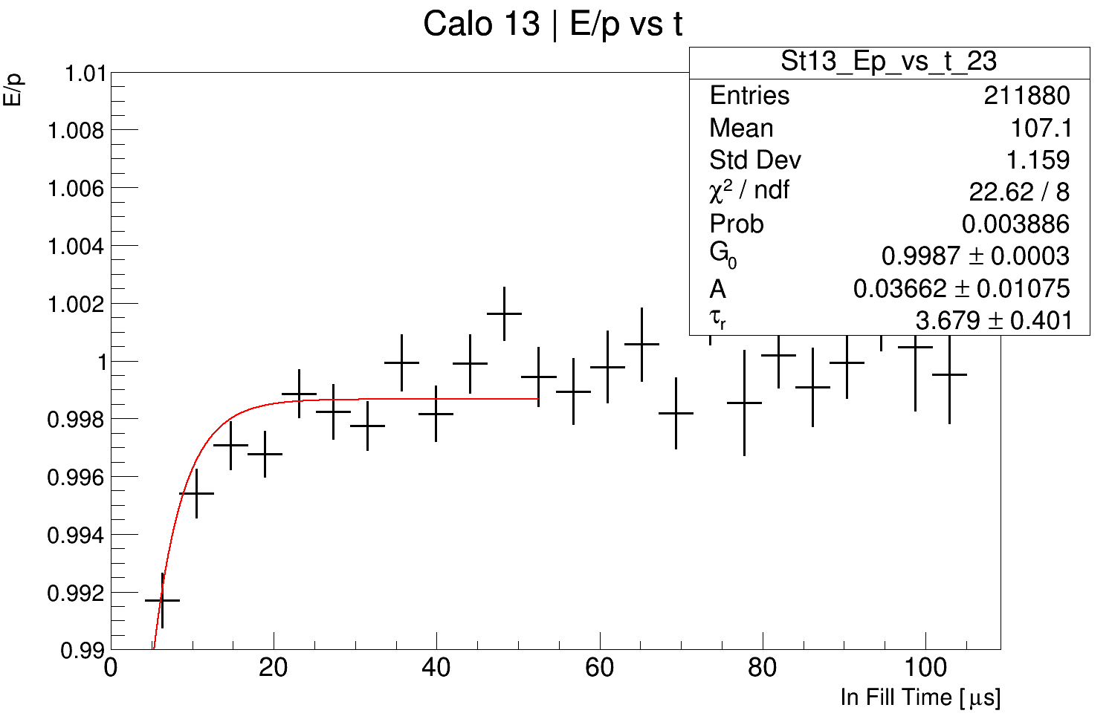
Fits per crystal example
You gain between 10,000 and 30,000 tracks per crystal, it has some affect on fits that were causing issues before.
Before
After

Slide 9
One more thing
I reduced the range of the fits from 50 to 12.5 g-2 cycles (52.5 μs), this helps!
I also expanded the quality cuts on the fits slightly:
if (quality) {
// Avoid low stats
if (N < 100000) continue;
// Require a reasonable reduced chi square
if( chiSqrNDF < 0.25 || chiSqrNDF > 4) continue;
// Require low relative error
if( tau_err > 0.5*tau || A_err > 0.5*A) continue;
// Get rid of infinite errors please!
if( isnan(tau_err) == true || isnan(A_err) == true ) continue;
// Chop anything a factor of 100 greater than the expectation
if(tau > 100 || A > 1) continue;
}

Slide 10
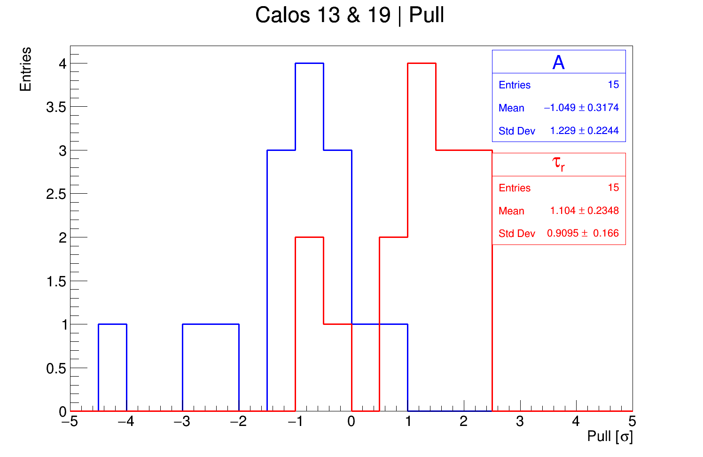
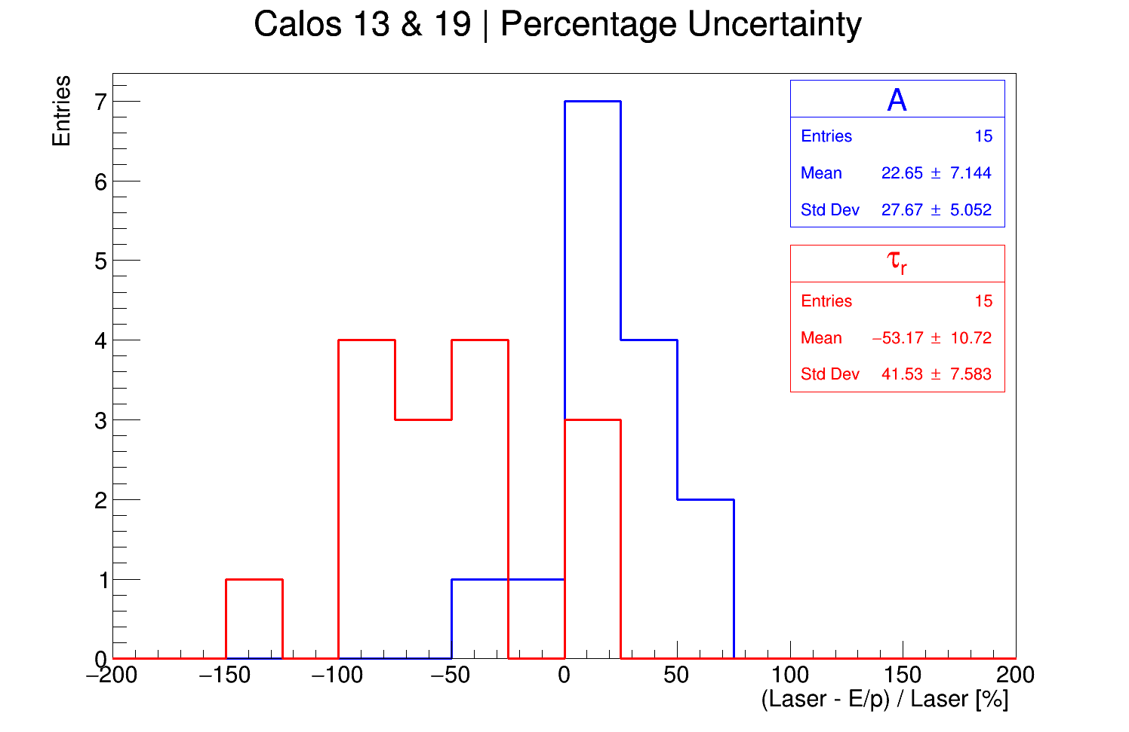
Deviation between E/p and laser
You still only get 15 crystals in the end…

Slide 11
Deviation between E/p and laser
And some odd ones… calo 13, xtal 32 and calo 19, xtal 24

Slide 12
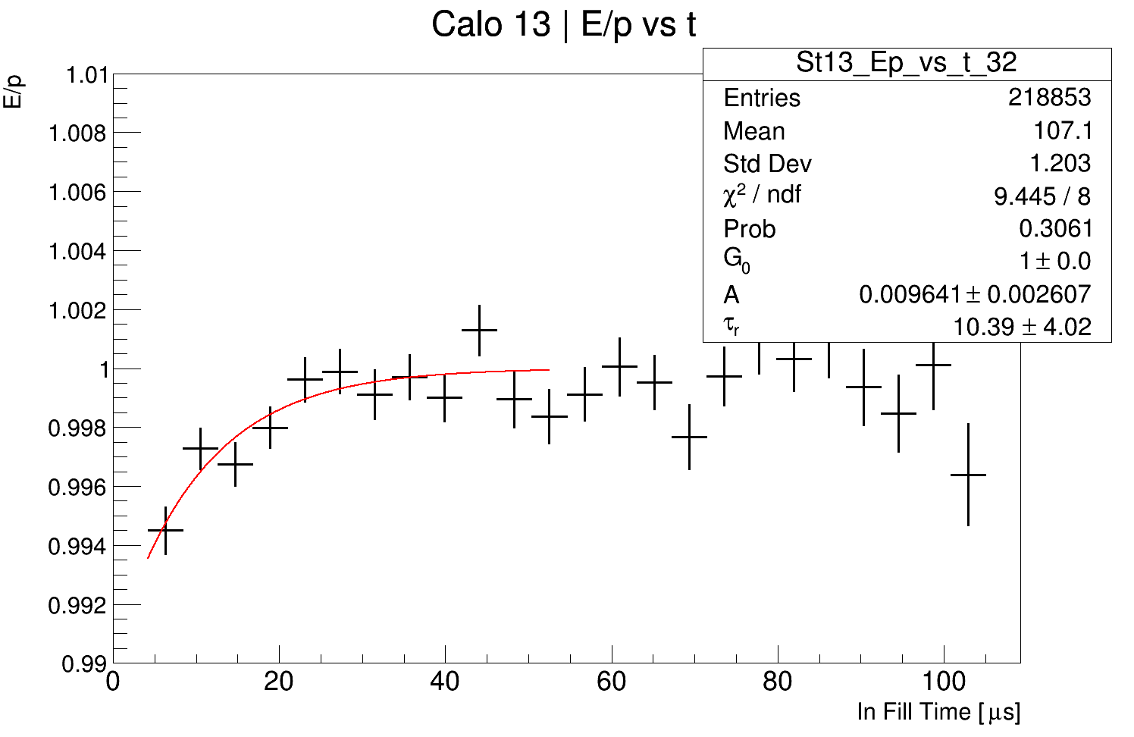
Calo 13 Xtal 32, never mind
The lifetime is too long because it’s being pulled by that bin at t ~ 45 μs…
…The important thing with the pull distribution is that the standard deviation is OK anyway.

Slide 13
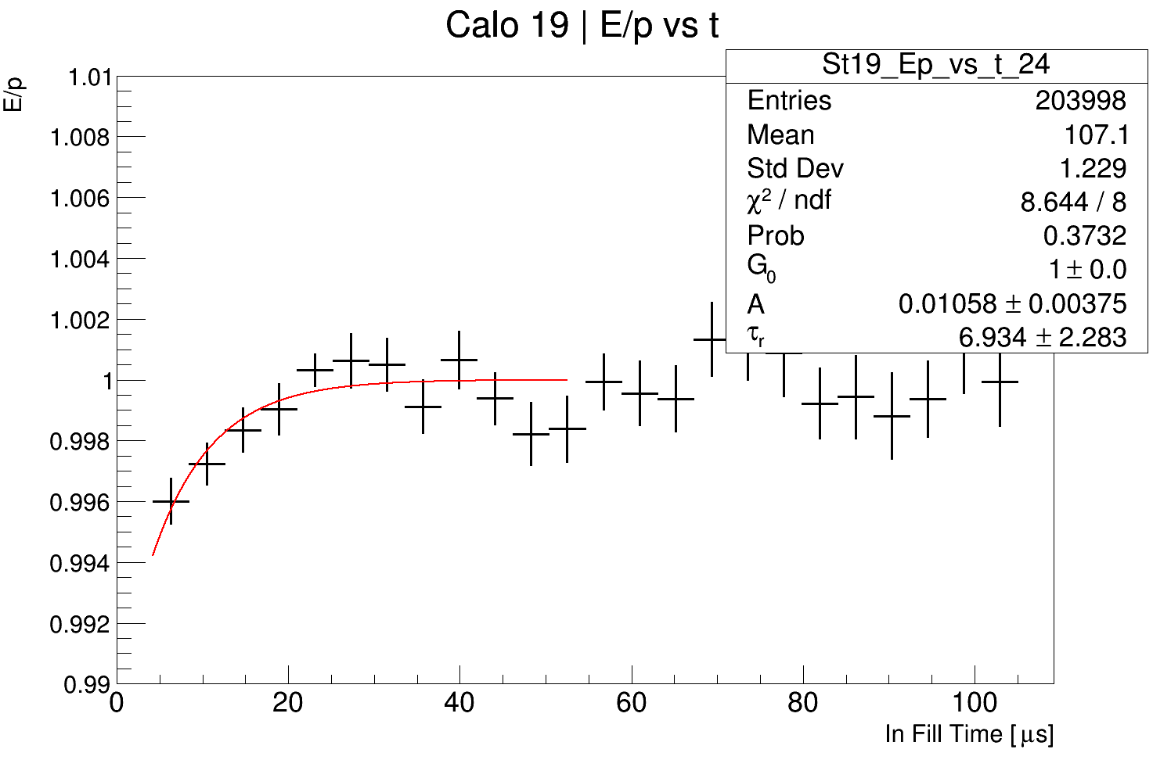
Calo 19 Xtal 24, never mind
I think this is due to the amplitude being so small, for both E/p and the laser, that the % uncertainty becomes inflated

Slide 14
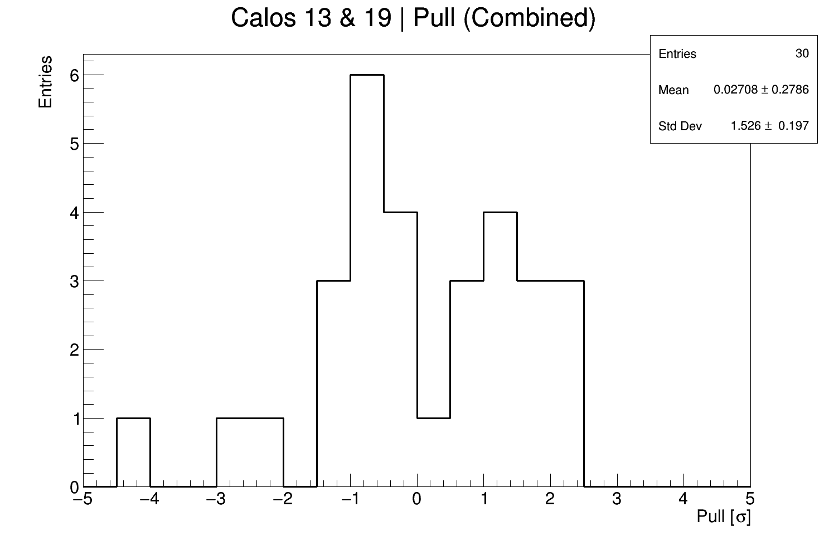
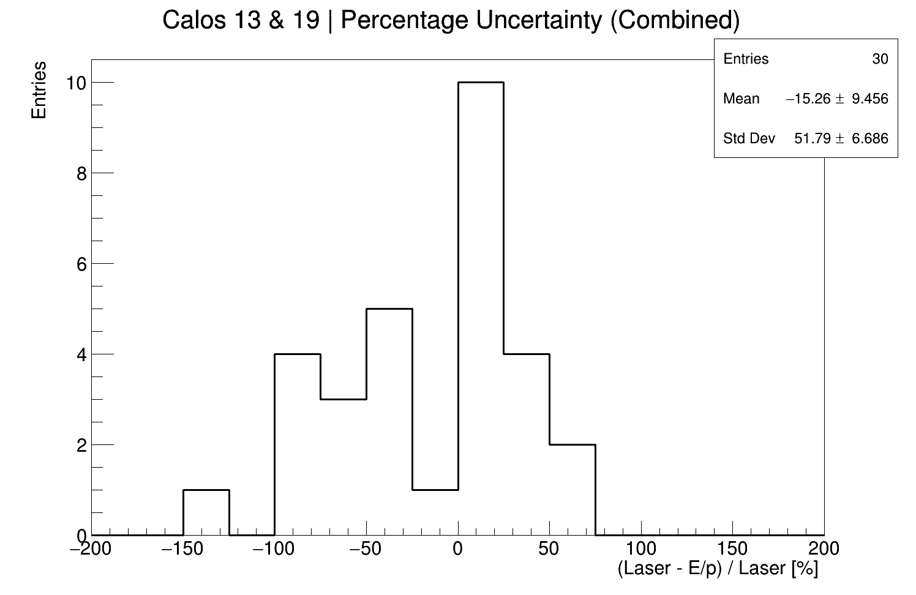
Deviation between E/p and laser
So the level of uncertainty on the in fill gain parameters is estimated to be 52+/-7%

Slide 15
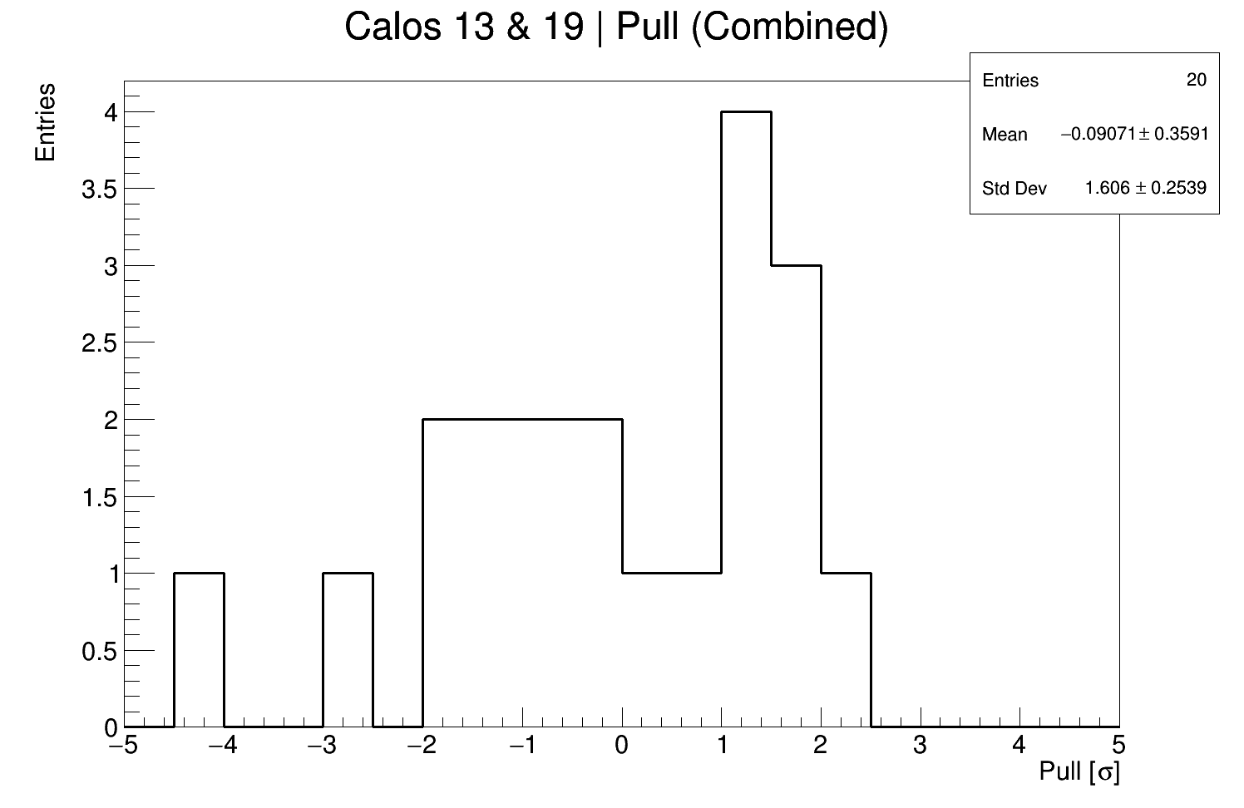
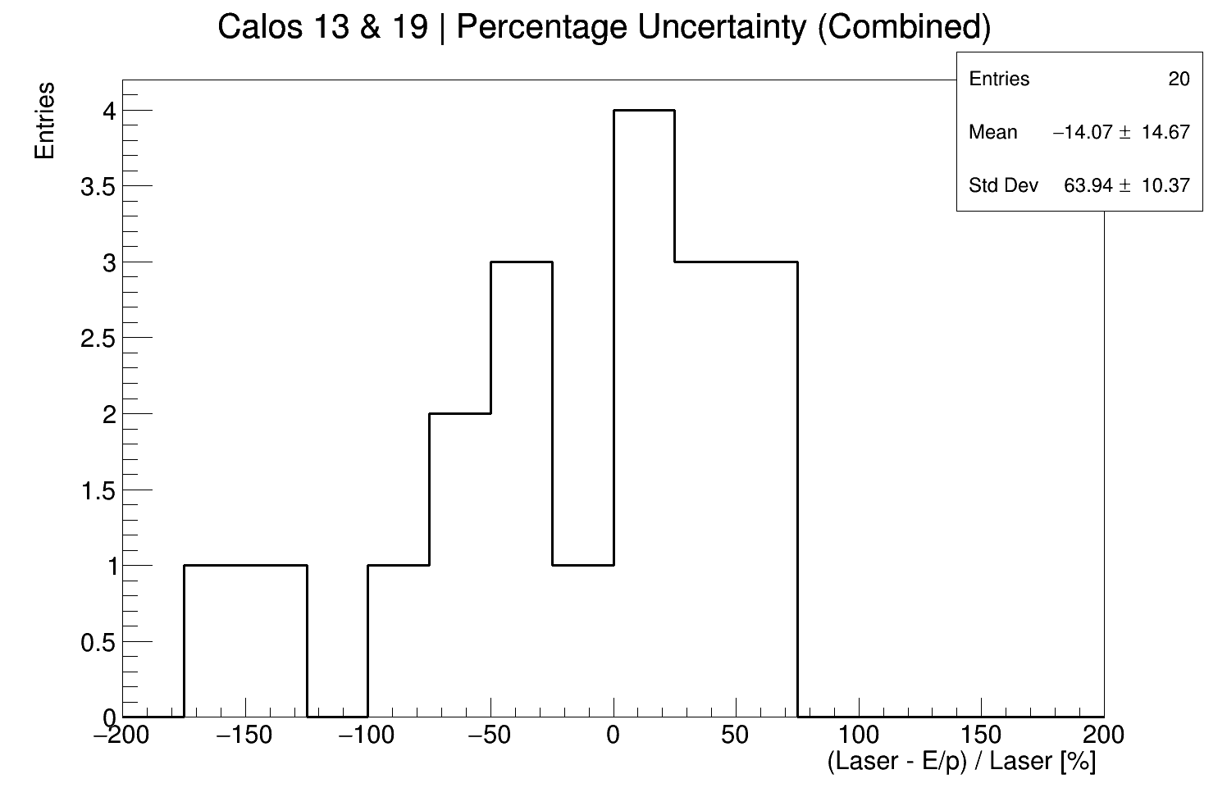
Deviation between E/p and laser,
with energy cut
With the energy cut it’s 60+/-10%
Some improvement in the end, you win 5 extra crystals (only one from calo 19).

Slide 16
Summary
My results are consistent with the laser, with a standard deviation on the pull of 1.5+/-0.2 σ
I estimate the percentage uncertainty on the laser results to be 52+/-7%, but in reality it’s probably much lower than this
I really think this is as good as it gets with the E/p method and the 60 hour dataset
I’m going have another look at getting the IFG parameters per breakout board using this method today
Then I’m going to write a note and put it on doc db

Slide 17
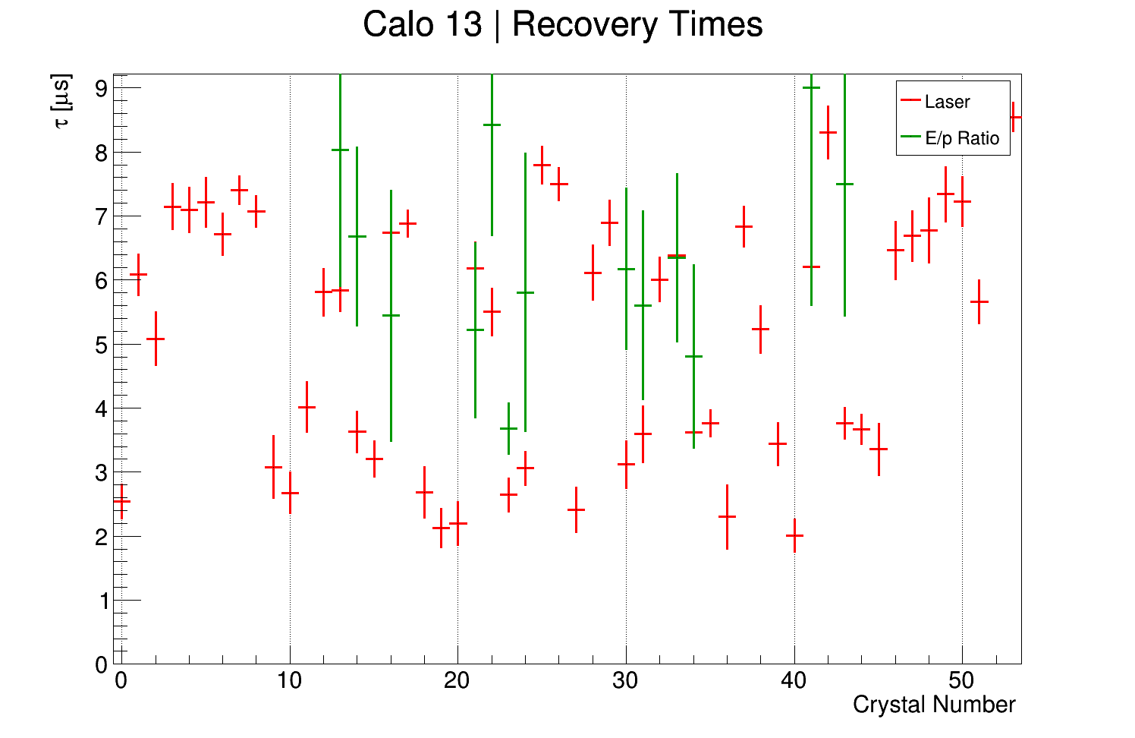
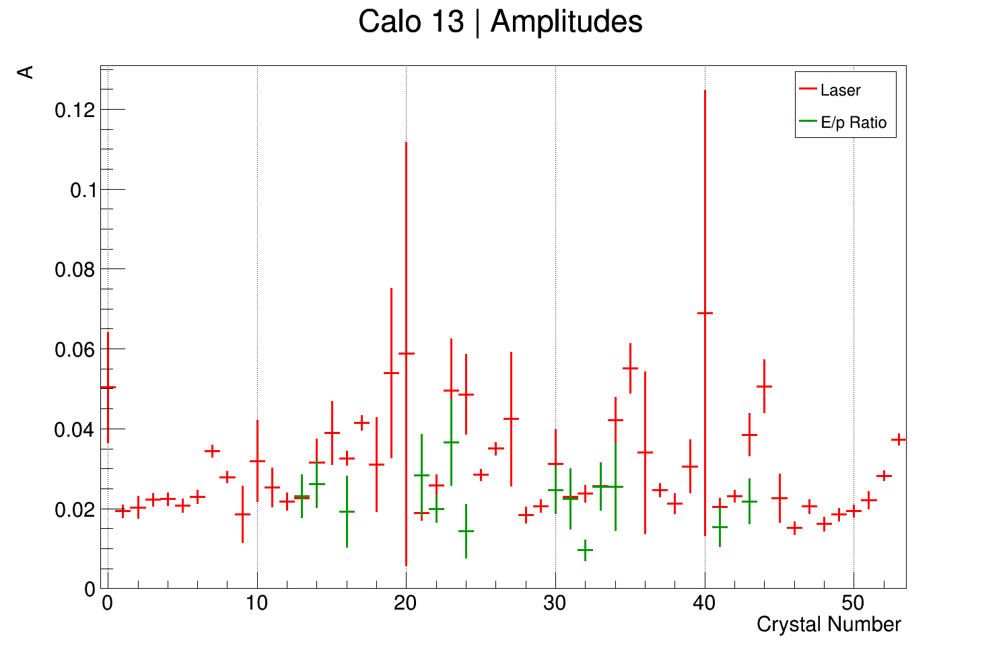
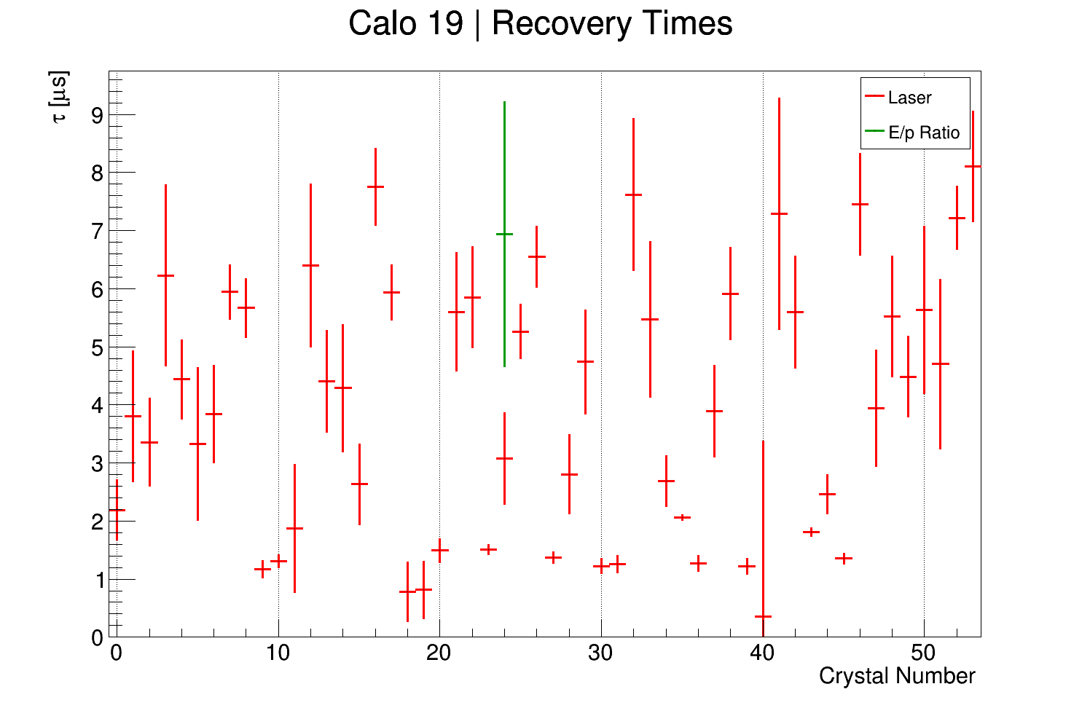
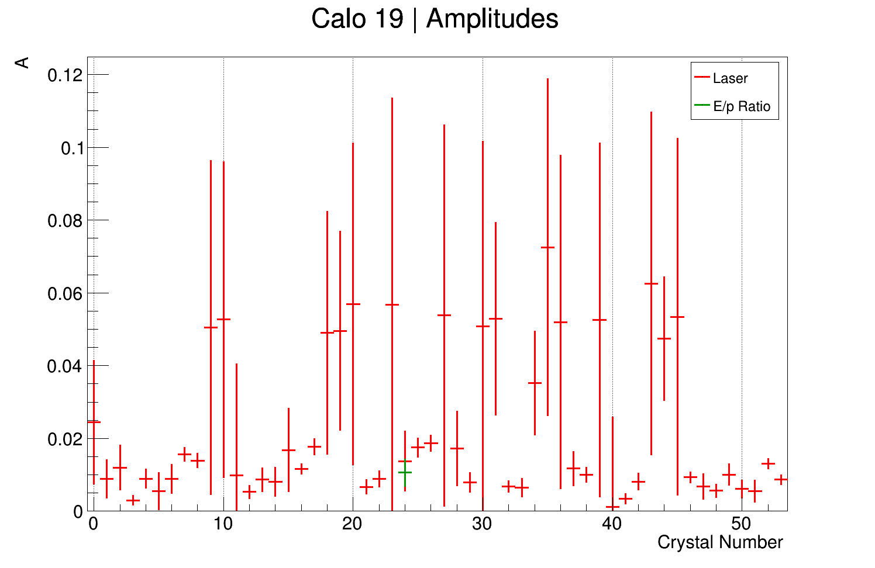
Scatter Plots!

