Slide 1
Uncertainties from E/p vs time for the 60 hour Sam Grant Europa omega_a 9th August 2019

Slide 2
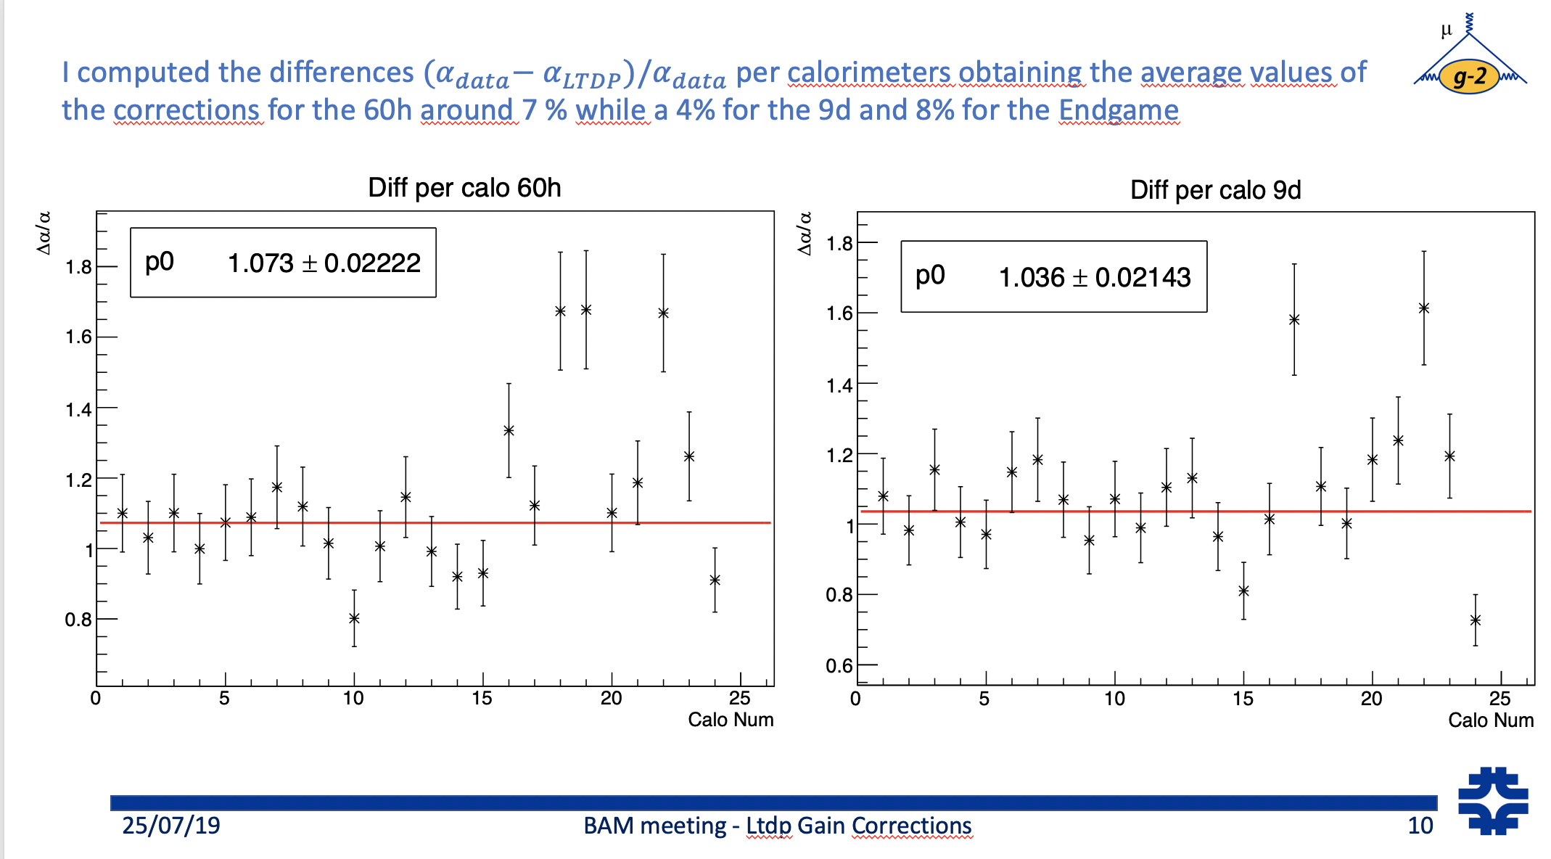
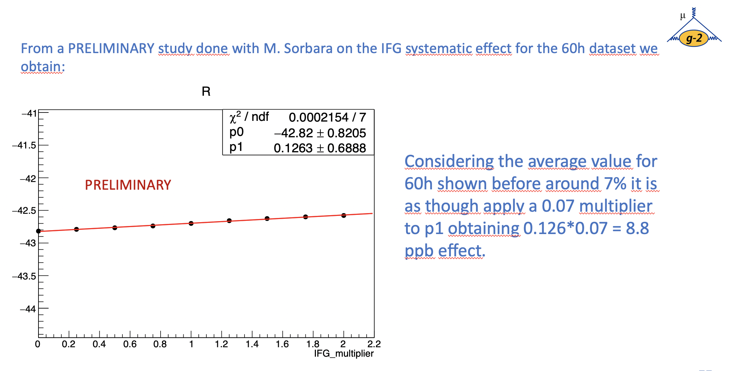
Introduction
I want a useful systematic from this study (see previous talks on doc db)
I decided to borrow an idea from Elia’s BAM talk (GM2-doc-18943):

Slide 3
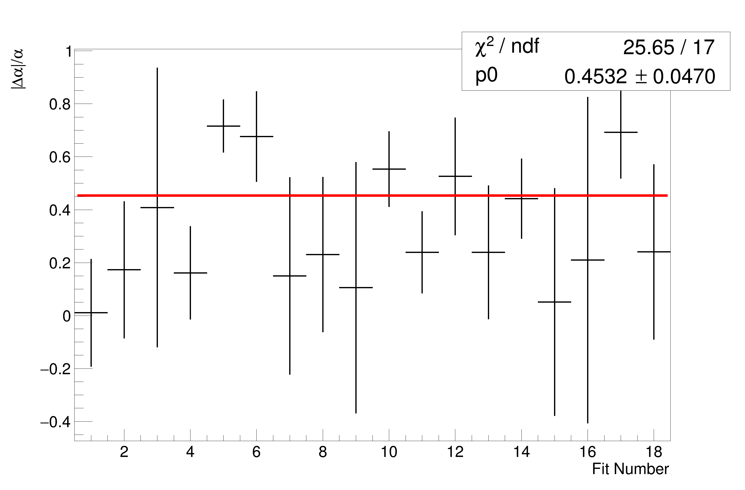
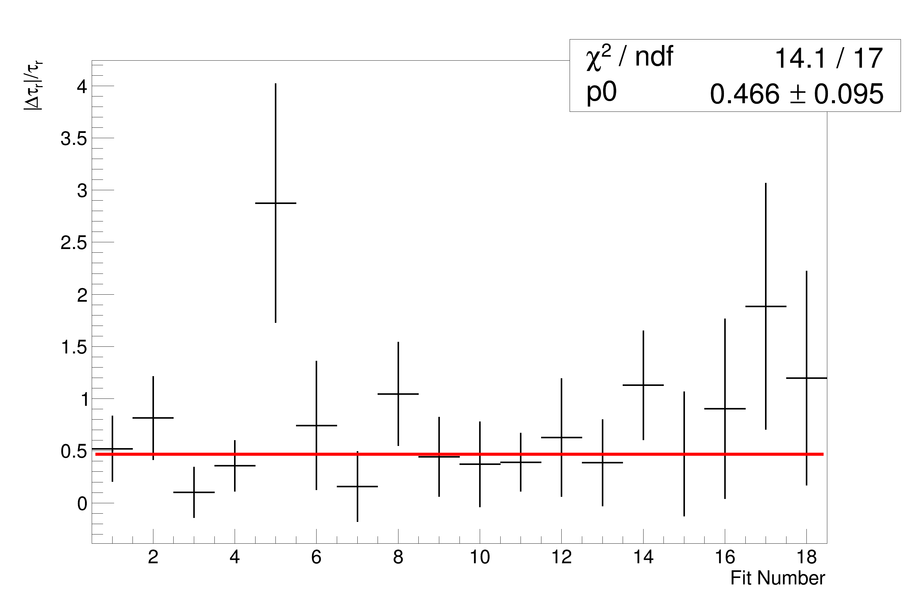
My Fits
|∆⍺|/⍺ = 45 ± 5%
|∆𝛕_{r}|/ 𝛕_{r} = 47 ± 10%

Slide 4

$$δR$$
$\frac{\left|∆α\right|}{α}=45±4\%$
$(0.1263±0.6888)×\left(0.45±0.04\right)=$
$$0.057 ±0.312 ppm$$
$δR≈57 pbb$

Slide 5
End
The error on the error is so large the result is meaningless.
Does it make sense to get an error on the error
How does the IFG multiplier work?

