Slide 1
In Fill Gain Corrections: E/p vs Laser Sam Grant Europa ω_{a} Meeting 14th June 2019

Slide 2
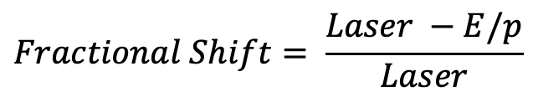
Overview
Derive the recovery times and amplitudes using E/p
We don’t care about outliers, so cut these
Quantify the level of deviation between laser and E/p:
We can use the pull per crystal in units of sigma
As well as the fractional shift per crystal
$$Fractional Shift= \frac{Laser −E/p}{Laser}$$

Slide 3
Cuts on fits per crystal
These are vital, but I’m still tuning them. Is it OK to cut on the parameters themselves?
//QUALITY CUTS
// Require high stats
if (N < 100000) continue;
// Allow reduced chi squared +/- 25% from unity
if(chiSqrNDF < 0.25 || chiSqrNDF > 4) continue;
// Cut unphysical params as last resort
if(tau > 25 || A > 0.1) continue;

Slide 4
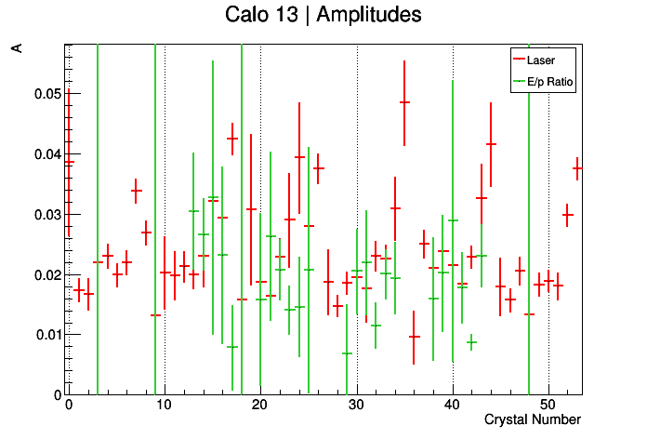
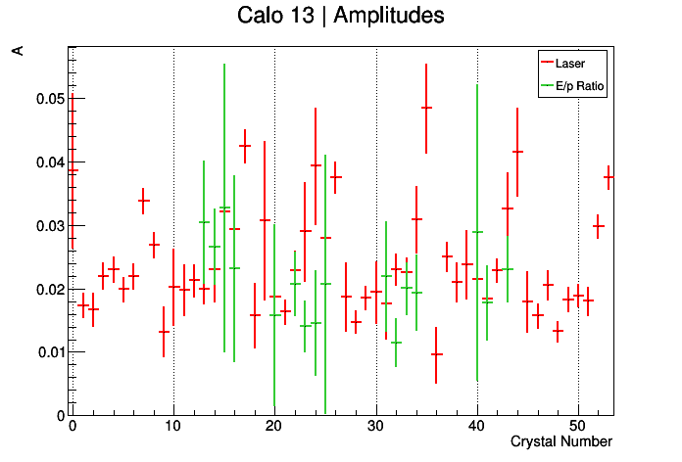
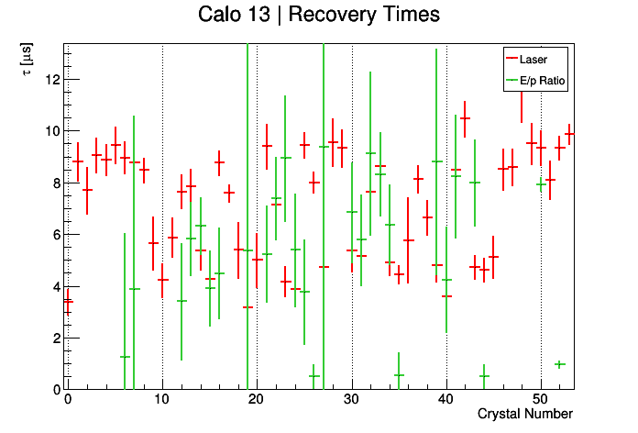
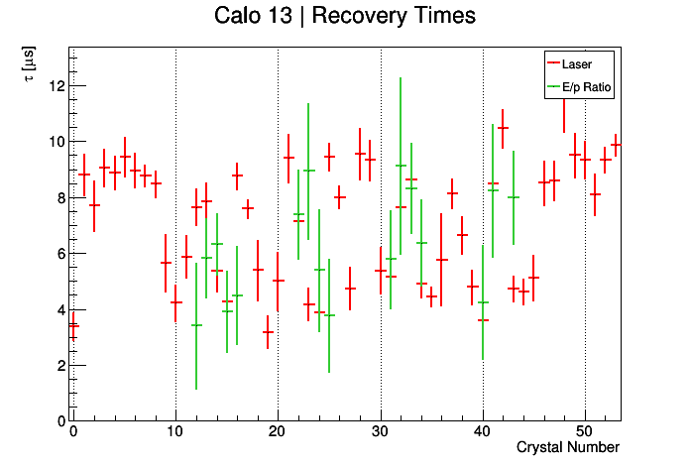
Cuts Illustration

Slide 5
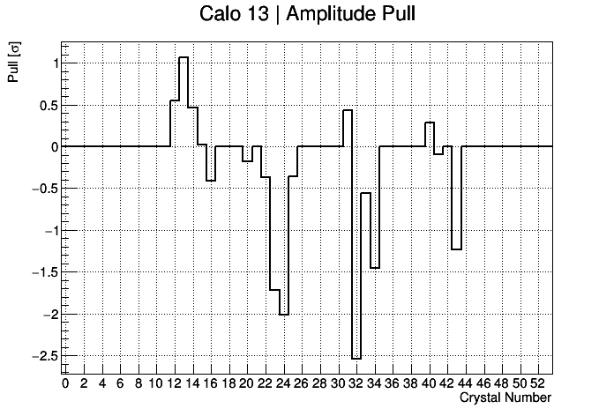
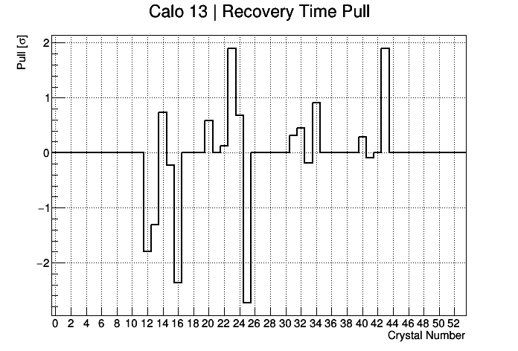
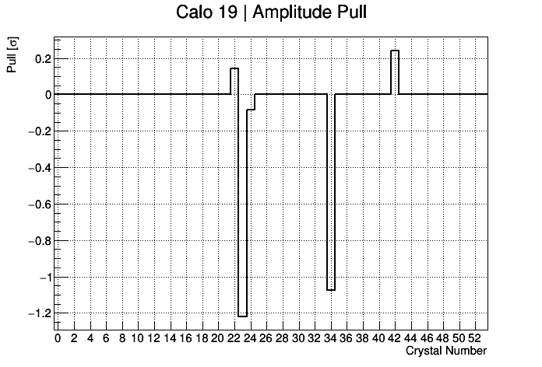
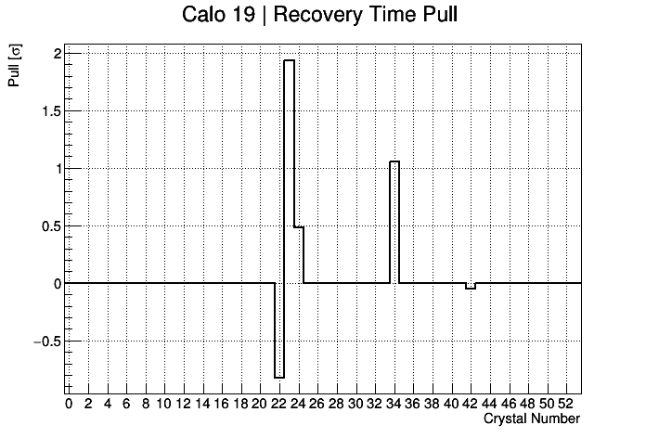
Pull
Showed this an Elba but never in this meeting…
With quality cuts all crystals lie within 3 sigma, which is good!

Slide 6
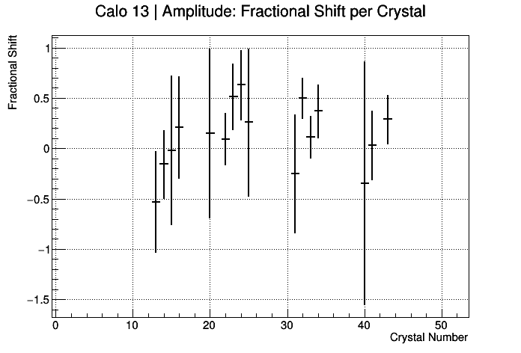
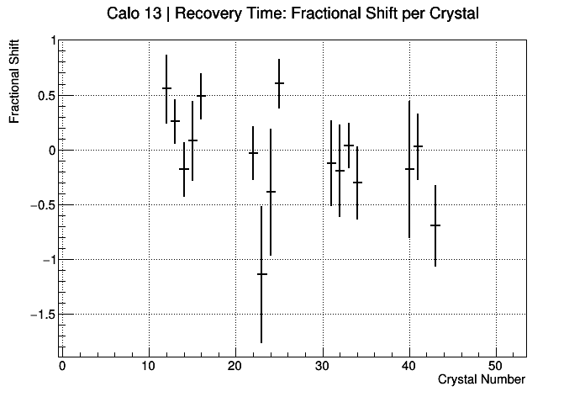
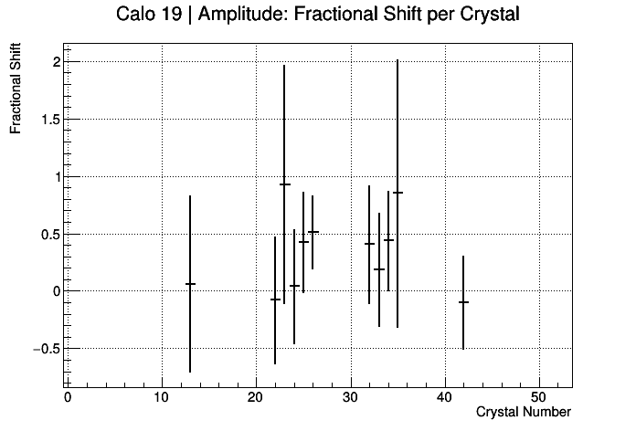
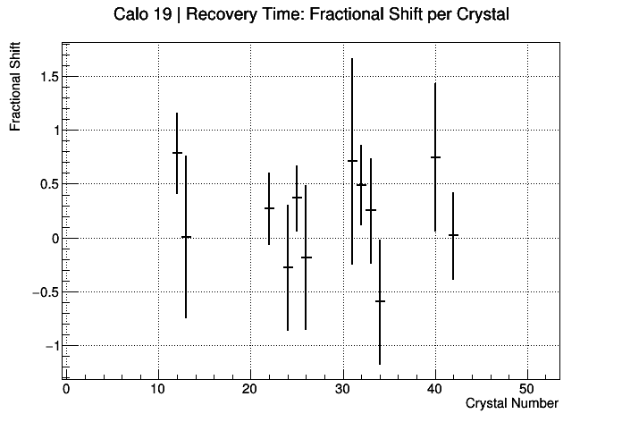
Fractional Shift
I had to require that the error < 2 to remove outliers (mostly).
The fractional shift equation does not account for uncertainties…

Slide 7
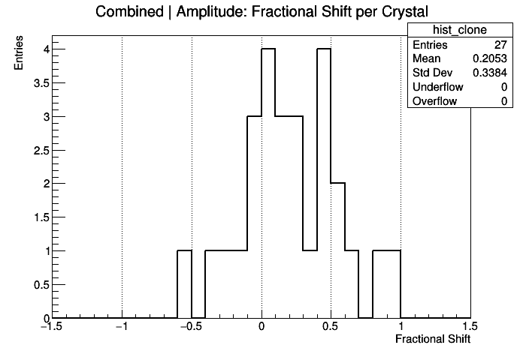
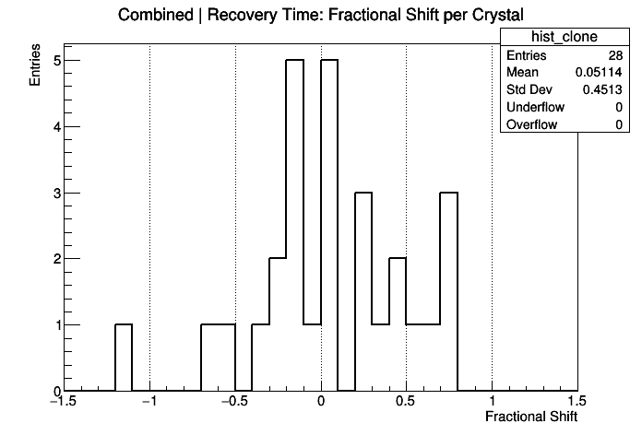
Fractional Shift
Outlier, xtal 23 calo 13
It looks like the fractional shift is around 30-40% looking at the standard deviation, but I still need to settle on how to clean up the outliers.

Slide 8
Outlier, xtal 23 calo 13.
Outlier, I can’t motivate a good reason to get rid of this…

Slide 9
Summary
This is a very simple thing to do in theory!
I’ve been spending a lot of time going back and forth with cuts:
I want to retain as many crystals as possible
I want cuts to be well motivated

