Slide 1
Independent check of gain corrections based on E/p vs time (ongoing) ω_{a} Meeting Sam Grant (ω_{a} Europa) 30th April 2019

Slide 2
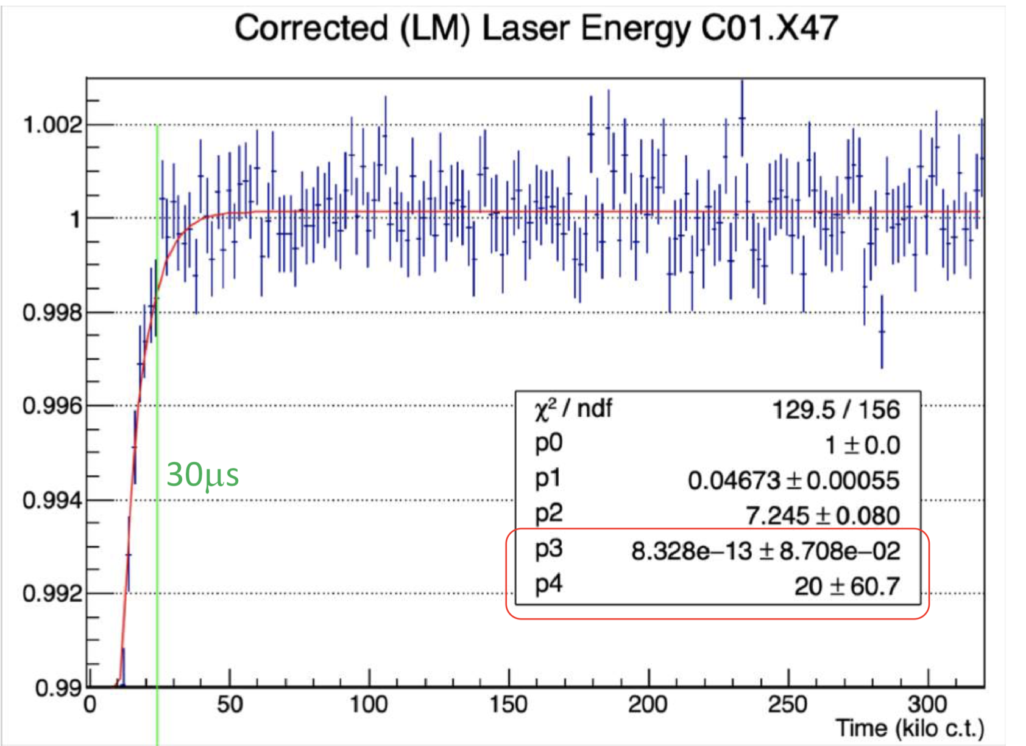
Gain sag
Just after injection there is a slight drop and subsequent recovery of gain, which must then be corrected!
We can double check the results from the laser, and hence the gain corrections, by using tracker-calo matched tracks.
Credit: ω_{a} Europa
https://gm2-docdb.fnal.gov/cgi-bin/private/ShowDocument?docid=17009

Slide 3
E/p ratio
Tracker-calo matched tracks provide a different way to measure gain.
The trackers measure the track curvature to get momentum, p, which is not affected by the flash
The calorimeter give the cluster energy, E, of the same track
Particles are relativistic, so E=p
E/p is therefore equivalent to gain

Slide 4
Method
Make 2D plots of E/p vs t
Fit y-projections of each x-bin with gaussians, and plot the gaussian mean and it’s error (a better alternative to a profile)
Separate tracks according to breaker board
Cut on the fractional energy: max crystal energy / total cluster energy
Normalise E/p according the gaussian mean E/p per crystal
Fit resulting distribution to extract the recovery time and gain sag amplitude

Slide 5
Details!
Using Europa Ntuples, available in:
gm2/data/g2be/Production/Trees/v9_17_01/60hr/
Tracker group’s quality flag: “Track quality = true”. See James Mott (2019):
https://gm2-docdb.fnal.gov/cgi-bin/private/ShowDocument?docid=16444
Cluster track time difference between -8 and +3 ns for station 12, and between -9 and +1 ns for station 18
Radial difference, dR < 30 mm
Positron selection:
-0.3 < Log(E/p) < 0.2;
Region of highest flux:
1.2< E [GeV] < 2.4

Slide 6
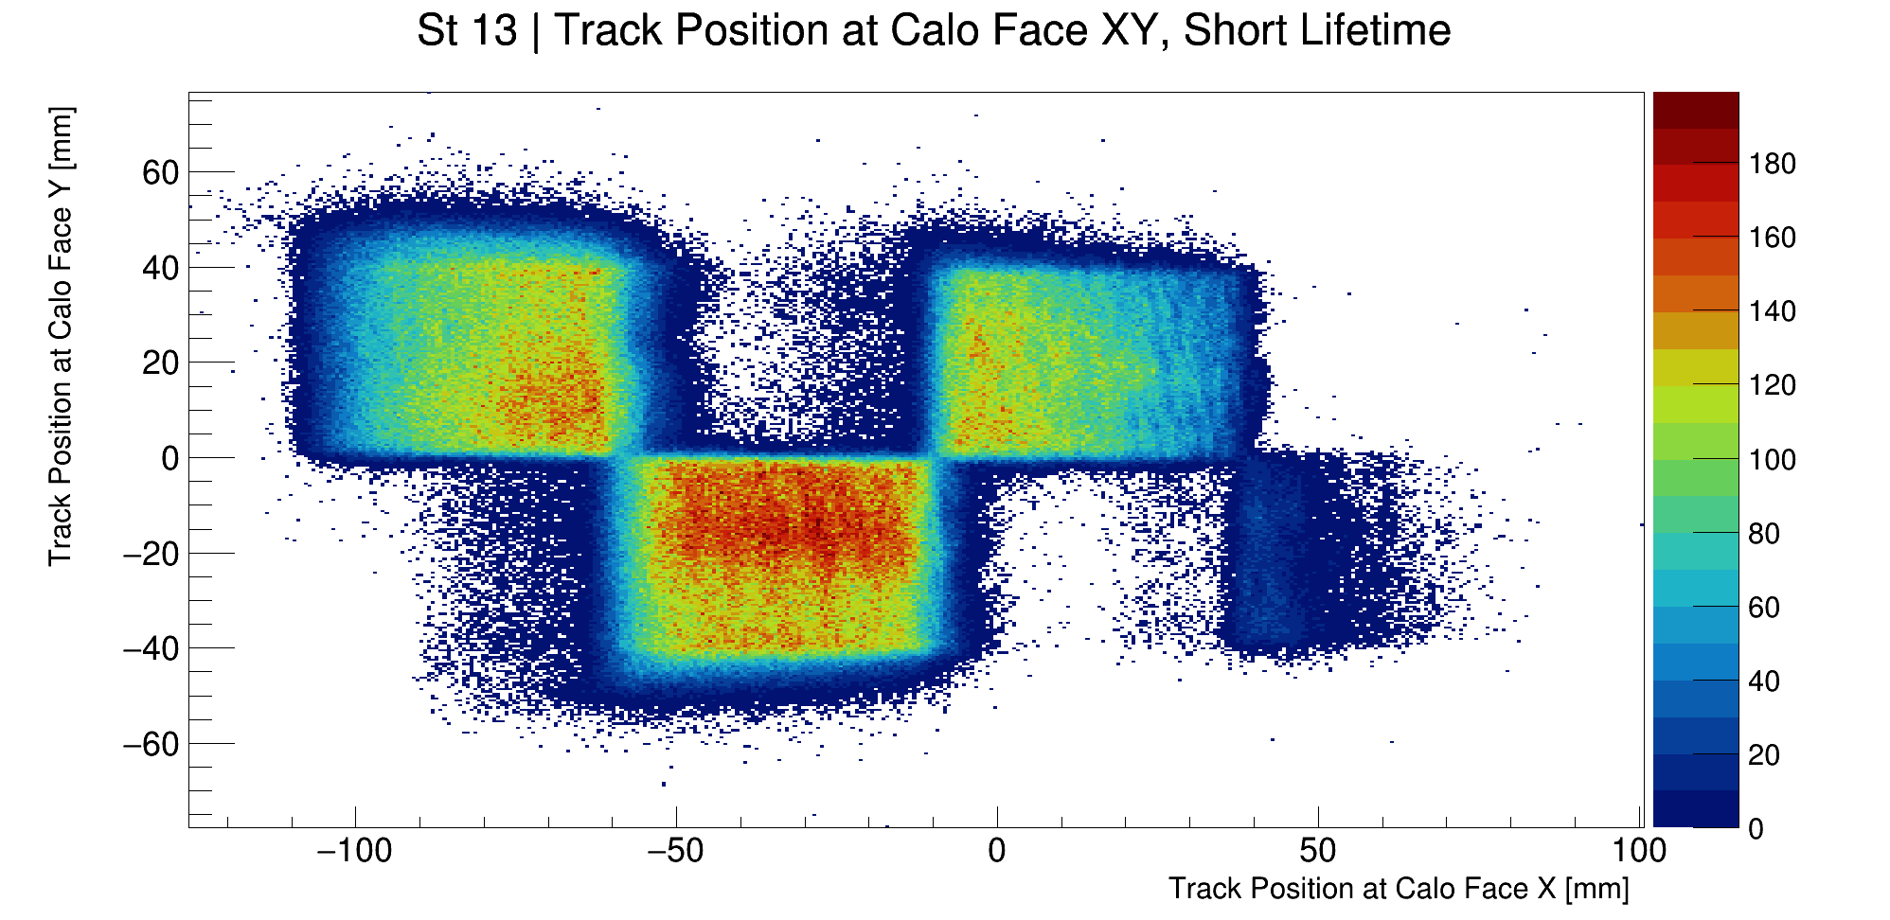
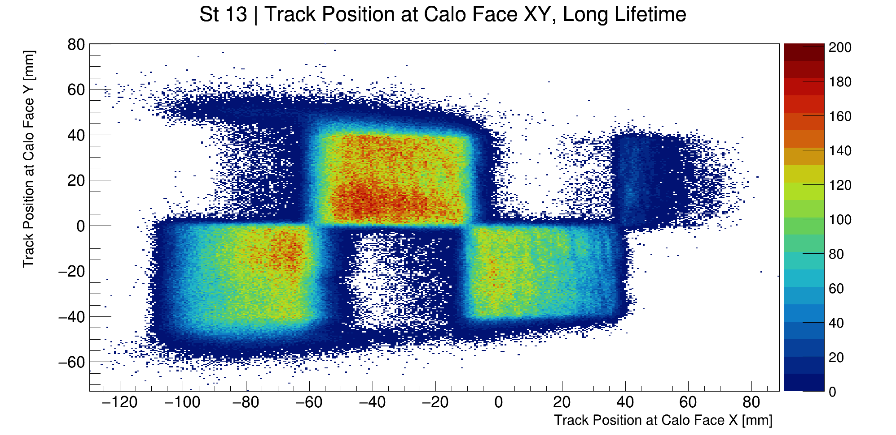
Breaker Boards
Different breaker boards mean different recovery times, when combining crystals it is important to only combine those connected to the same board
Short Life Times (by crystal), xtalShort[22]= {0, 9, 10, 11, 14, 15, 18, 19, 20, 23, 24, 27, 30, 31, 34, 35, 36, 39, 40, 43, 44, 45}
See Jason Hempstead (2018):
https://gm2-docdb.fnal.gov/cgi-bin/private/ShowDocument?docid=12263&version=1

Slide 7
Energy fraction cut
Define the fractional energy = (max crystal energy) / (total cluster energy)
Make initial cut at 60%
“Every crystal/SiPM has a different recovery function. If you mix together many of them together, the resulting function has no a clear meaning.”

Slide 8
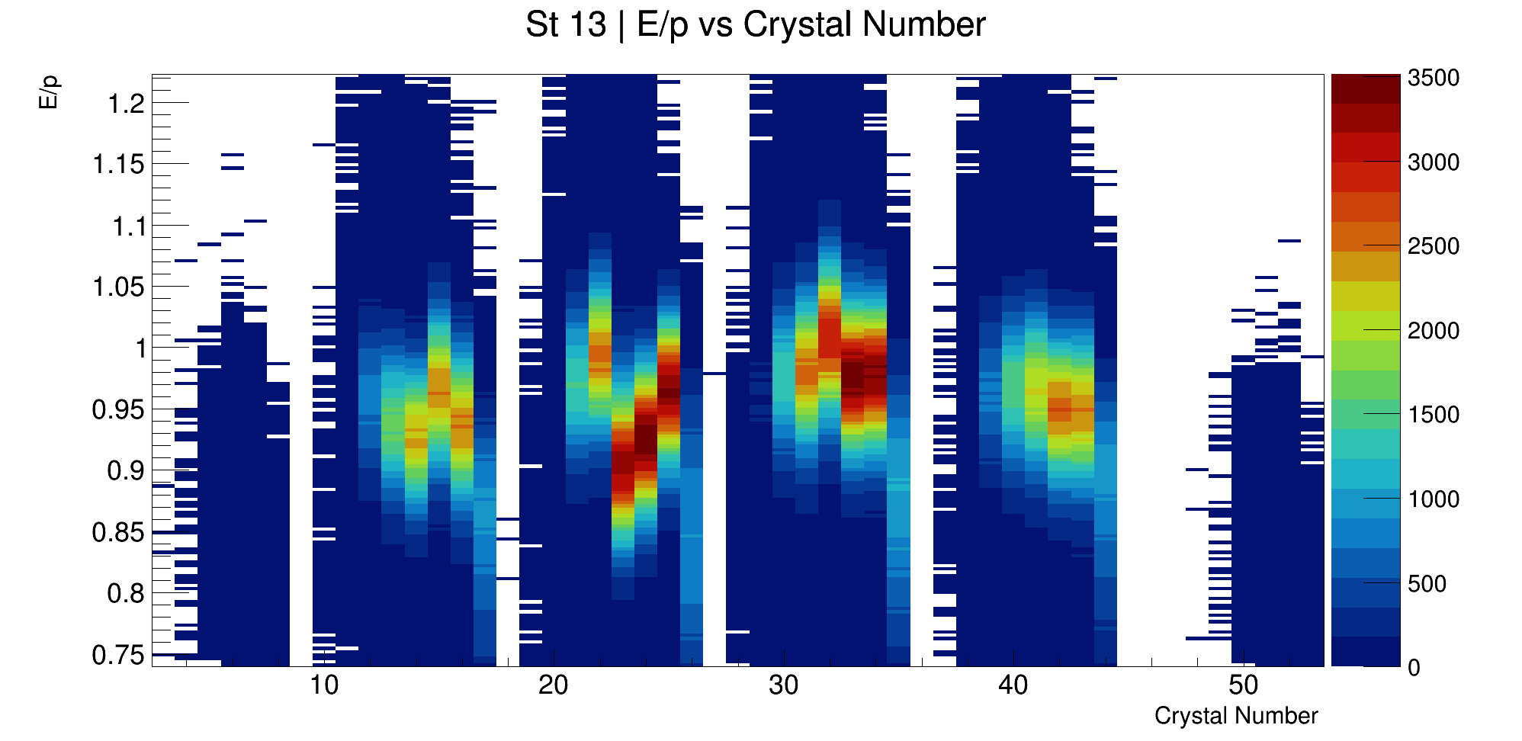
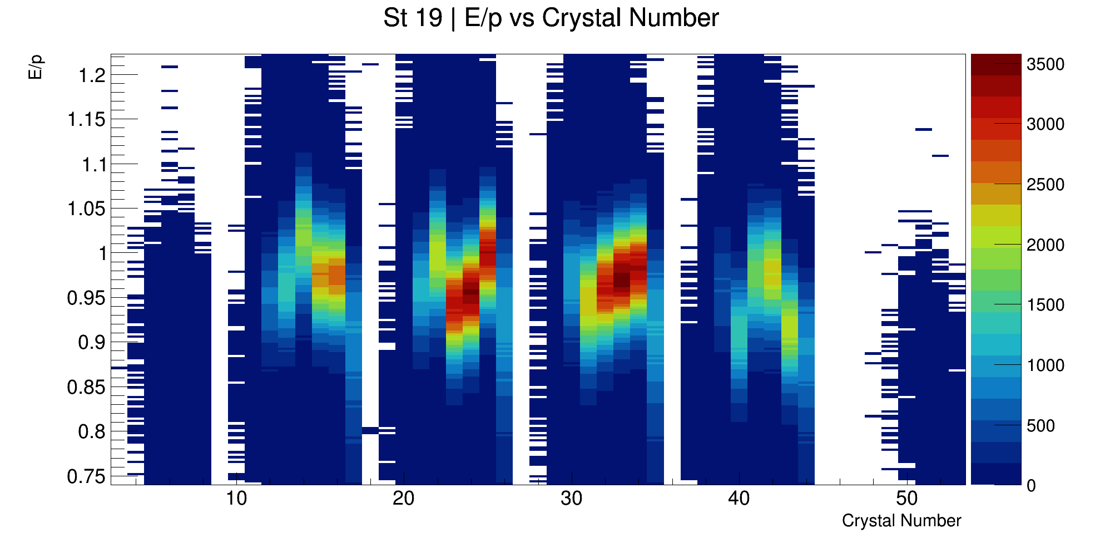
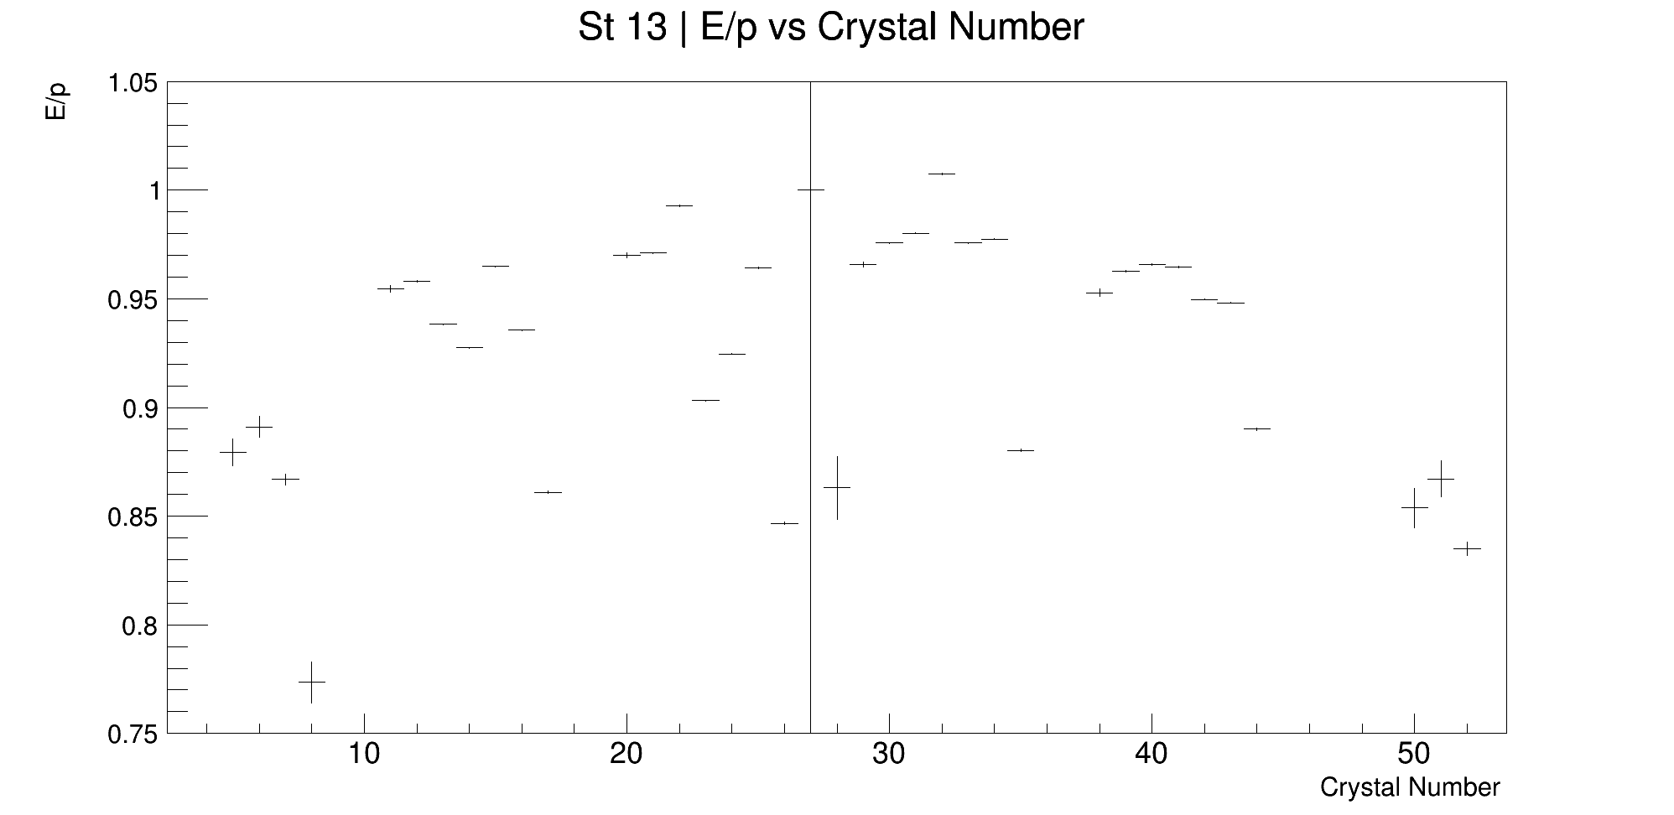
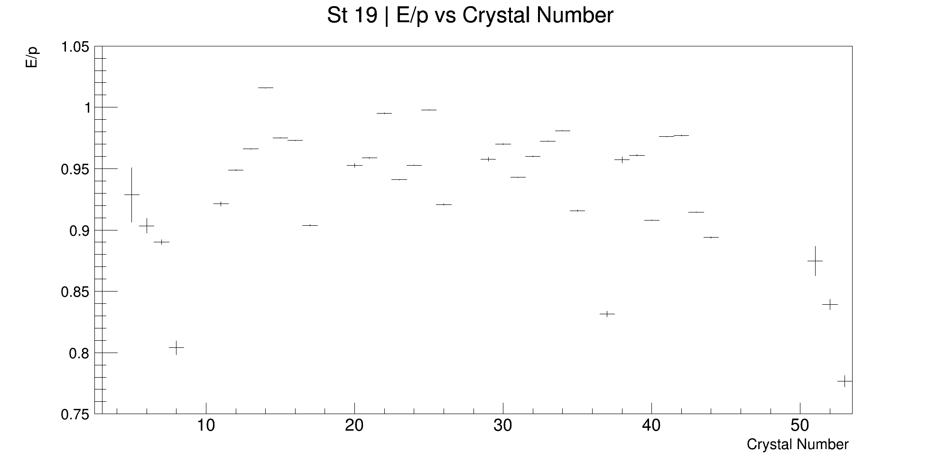
E/p normalisation at time > 60 μs
Different crystals have different mean values of E/p.
Find the gaussian mean E/p per crystal, after 60 μs (after the flash)
Normalise E/p crystal by crystal using these values

Slide 9
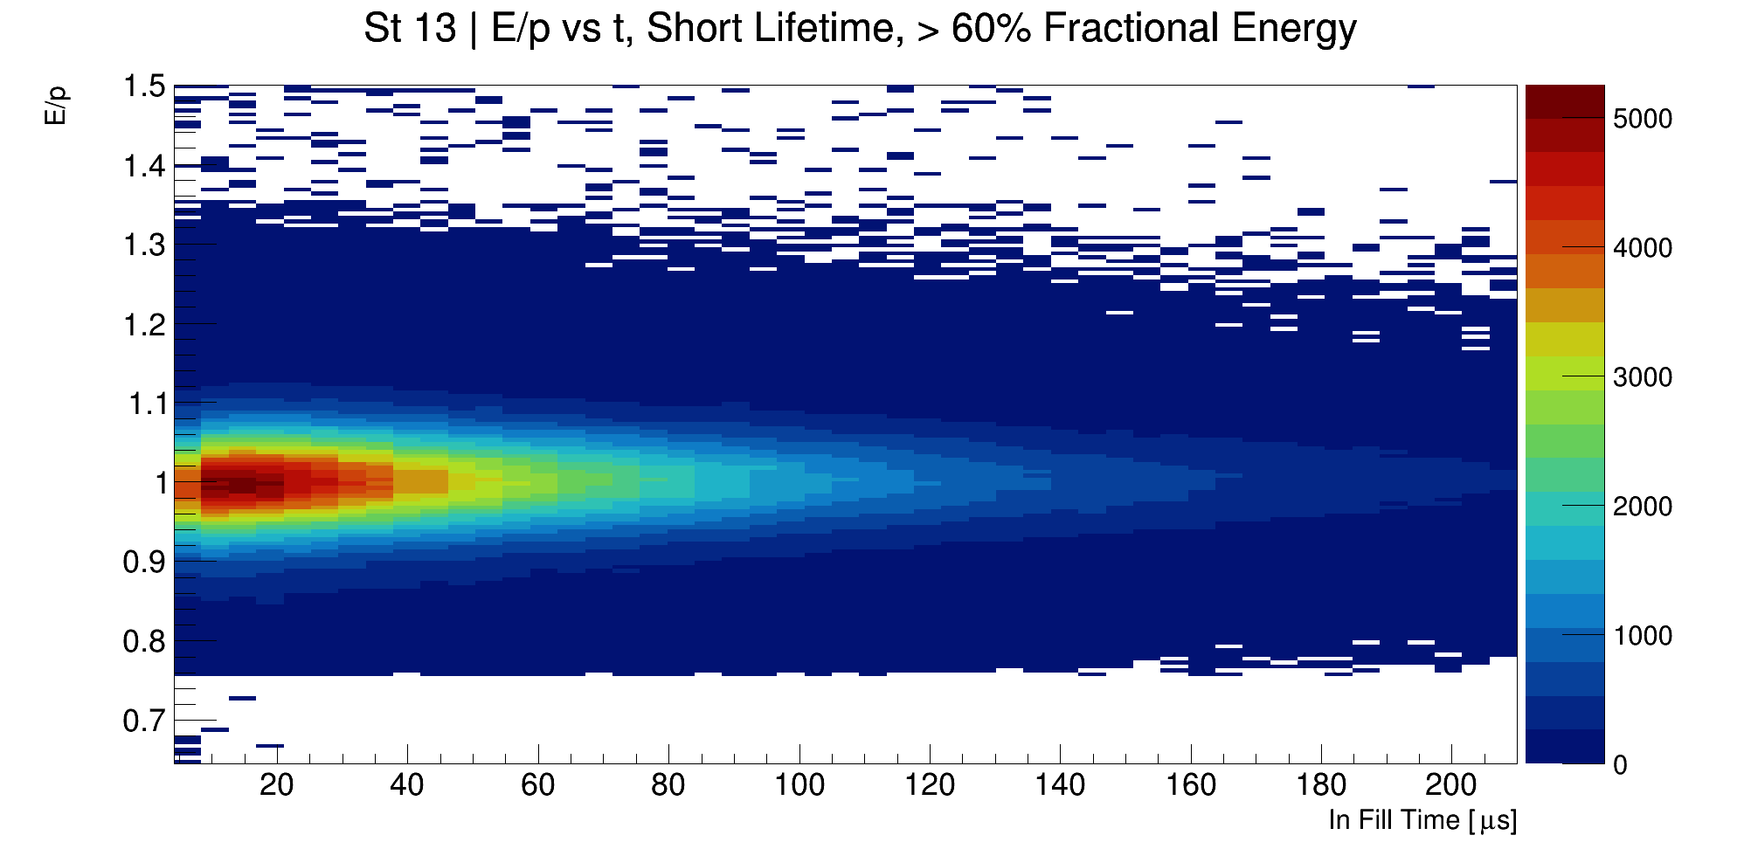
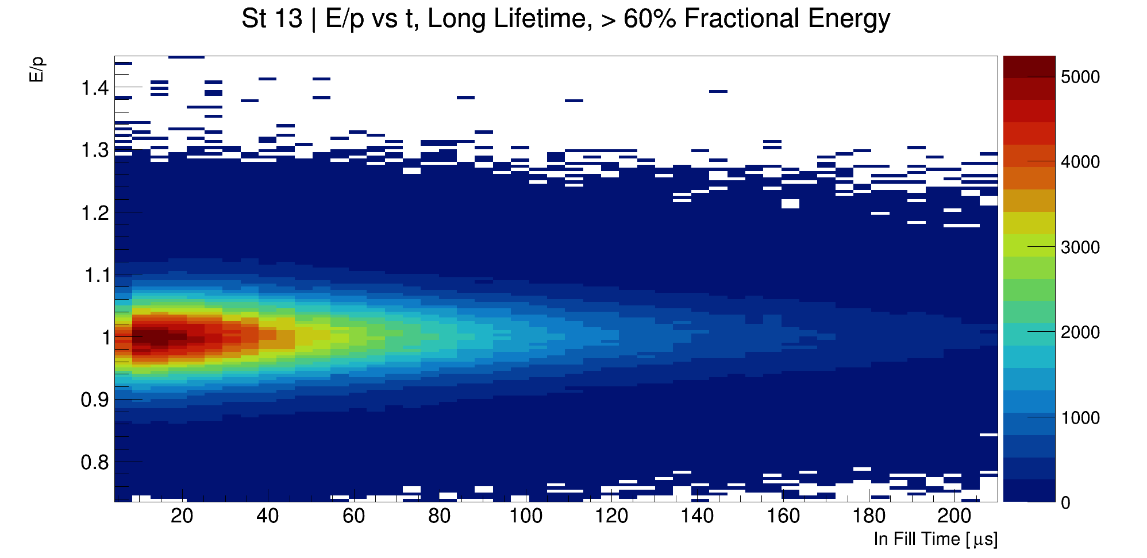
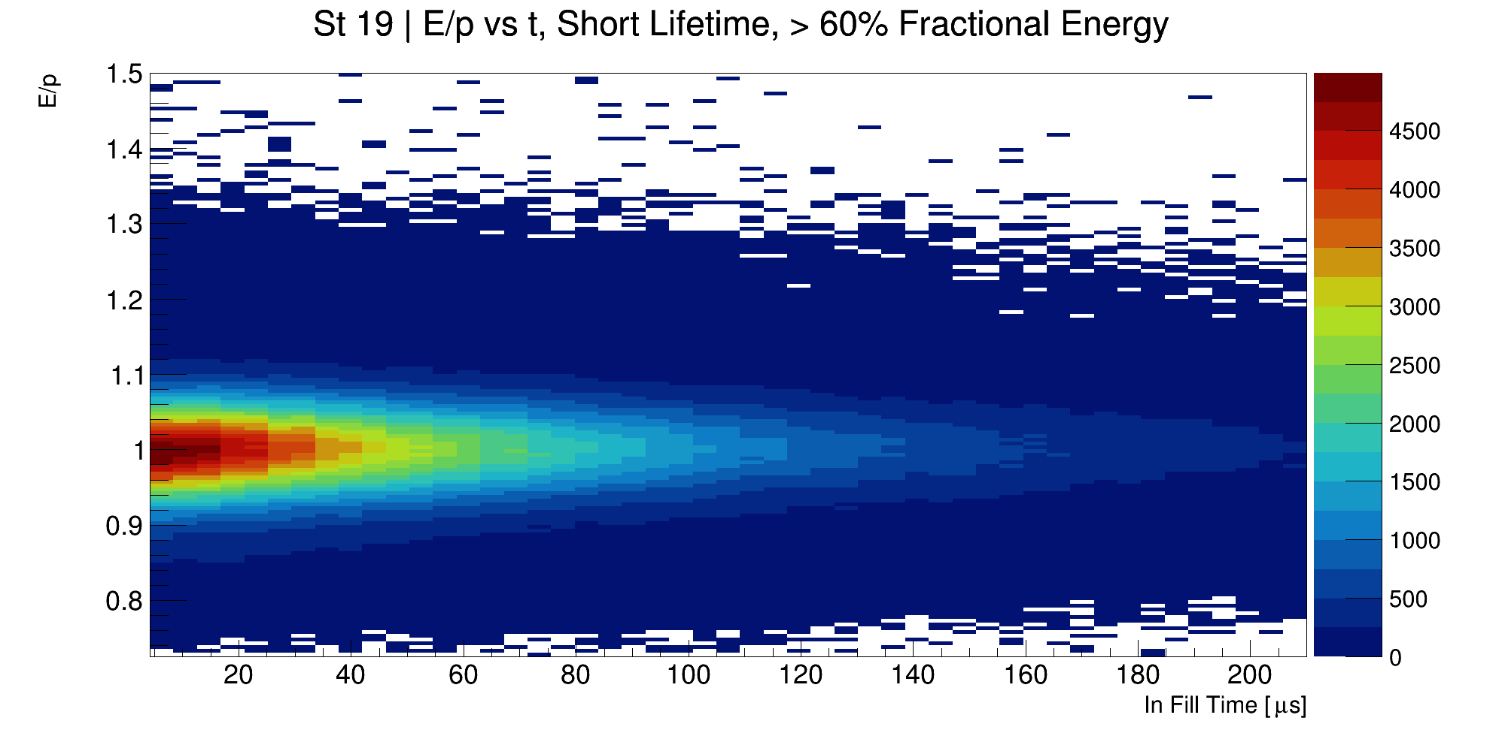
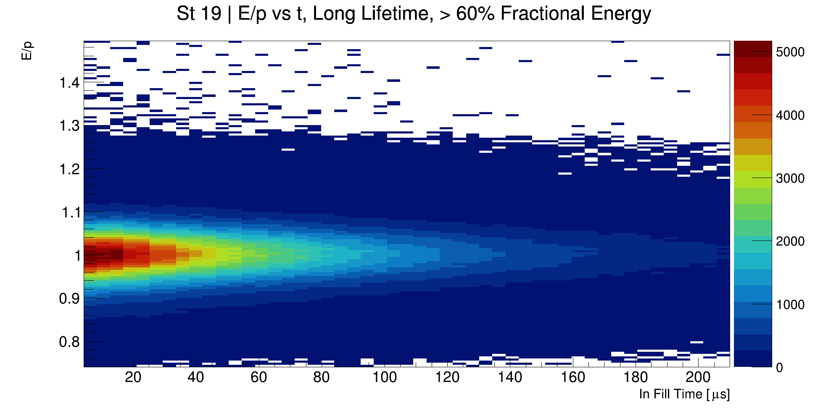
Normalised E/p vs time 2D plots, > 60% fractional energy cut

Slide 10
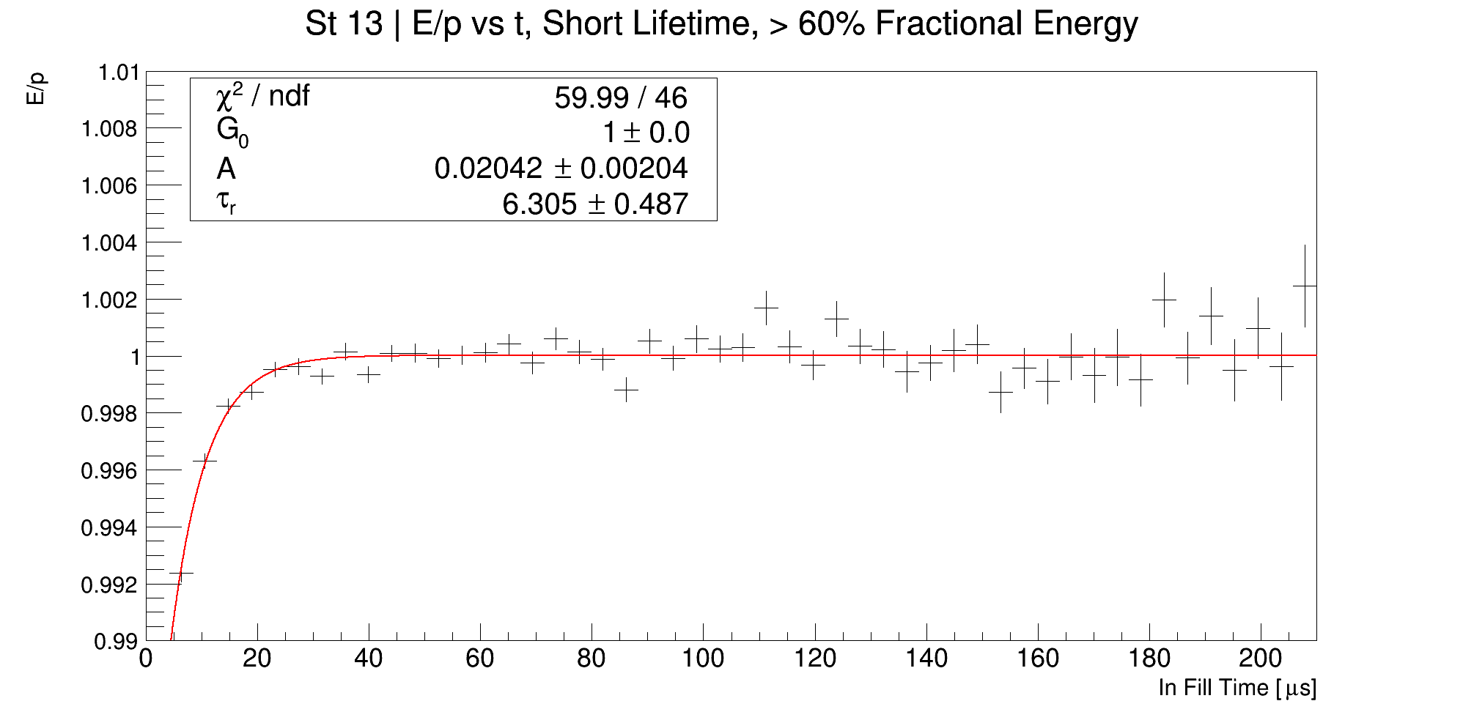
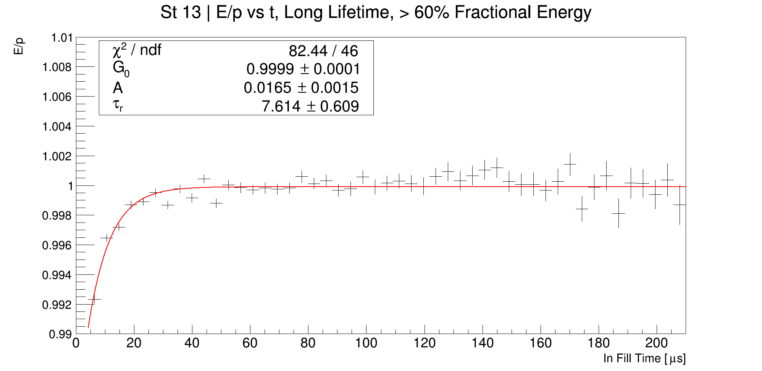
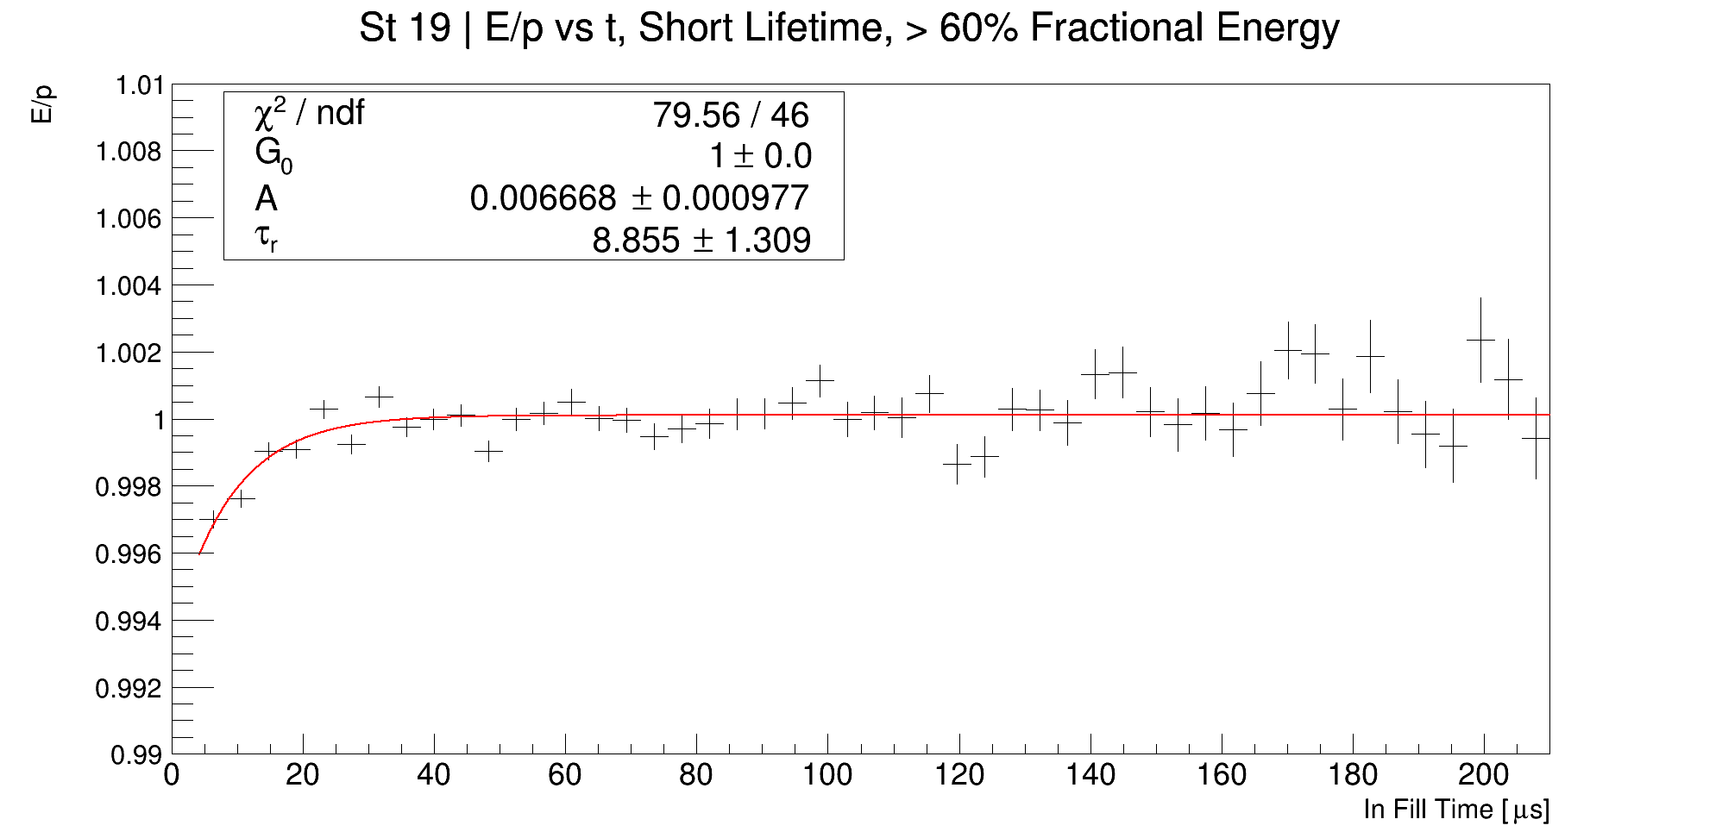
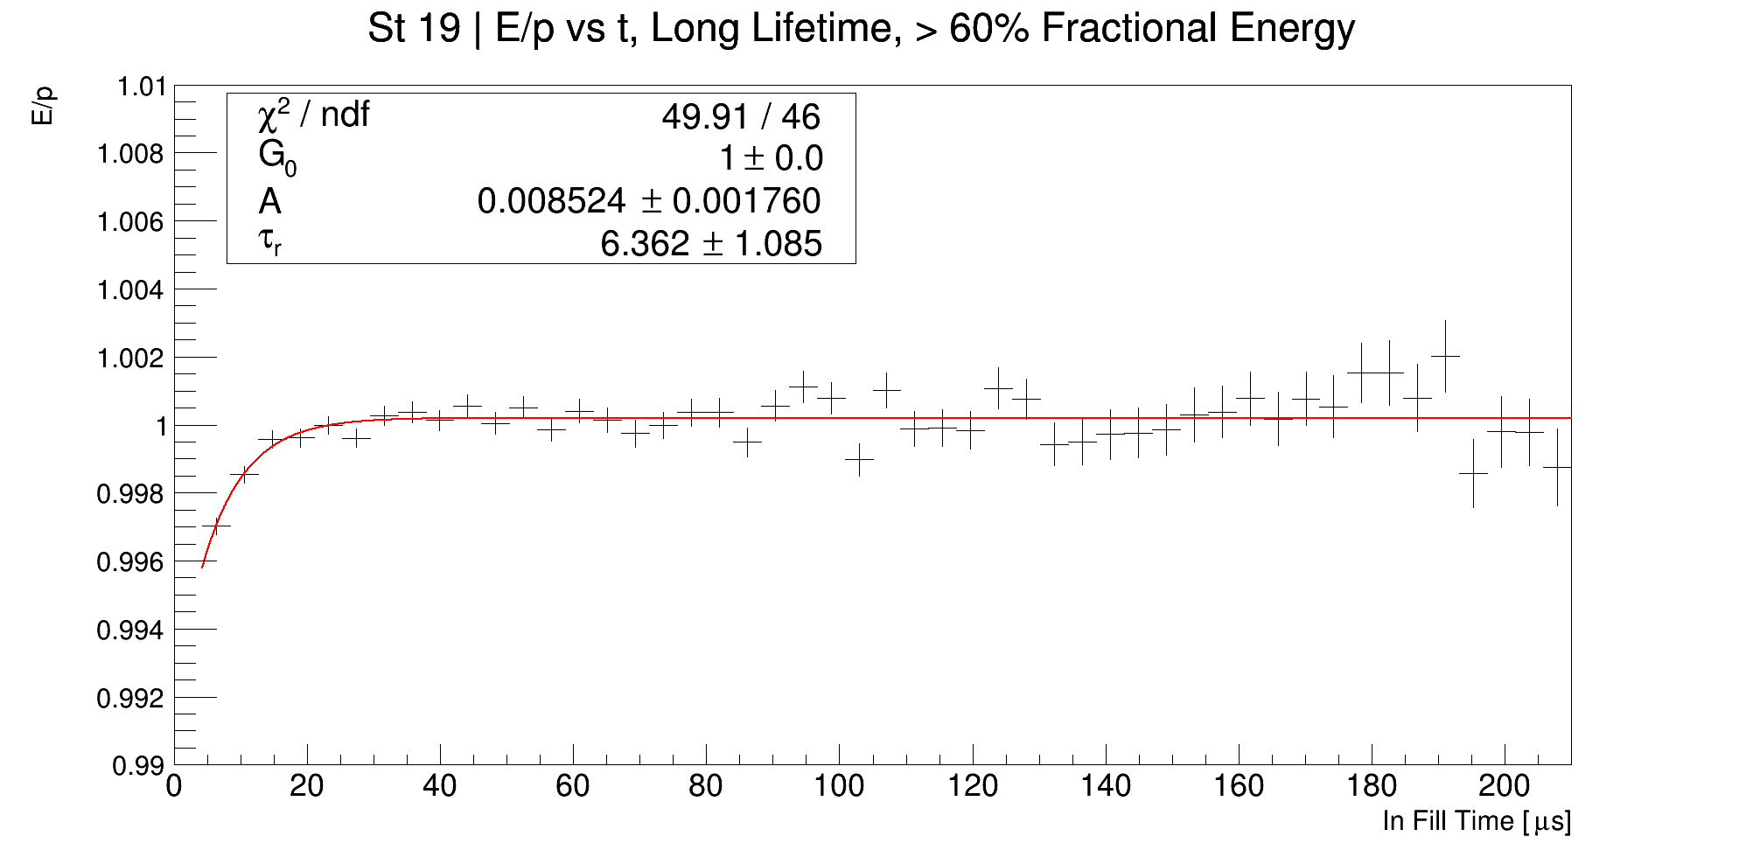
Recovery times per station, > 60% fractional energy cut

Slide 11
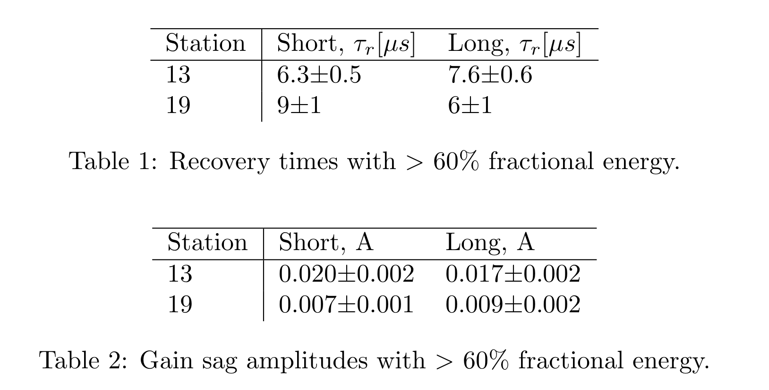
Tables of recovery times, > 60% fractional energy
Also increased the fractional energy cut to > 99%. This makes almost no difference, and so I think > 60% is OK, and gives more stats!

Slide 12
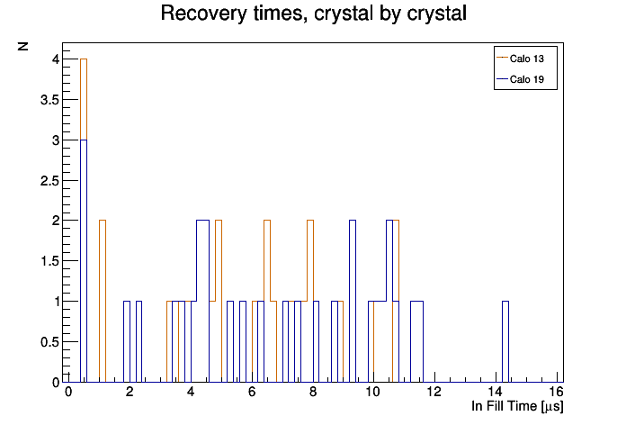
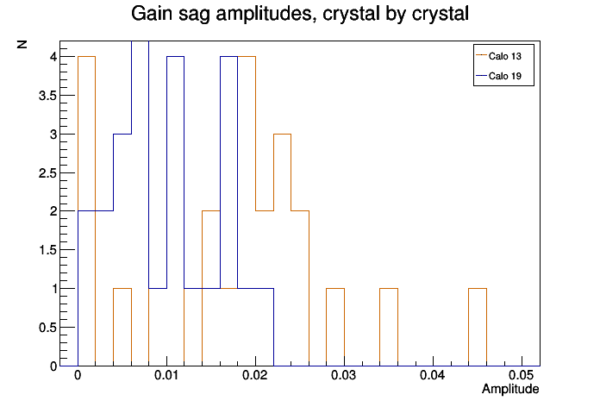
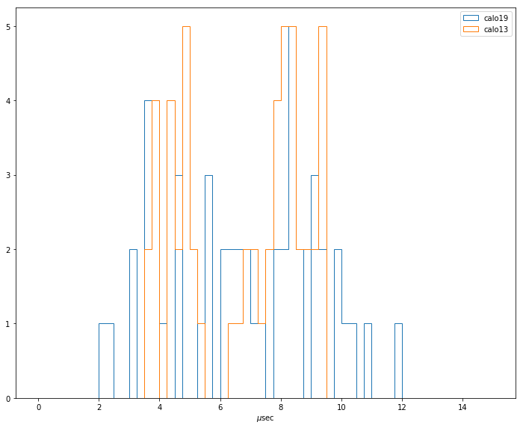
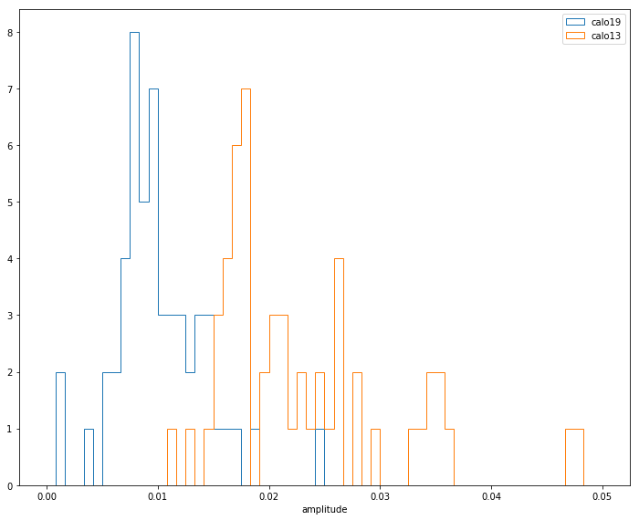
Results from crystal by crystal fits (top), compared with results from the laser system (bottom)

Slide 13
Conclusion
Work in progress!
Confirmation that we can see gain sag with the E/p ratio on a subset of crystals for calos 13 and 19.
Preliminary values of amplitude and recovery time are compatible with those observed with the laser
Planning on performing a side-by-side analysis with gain corrected ntuples when they become available
Working with Nandita Raha to cross check E/p means with MIP peaks.

Slide 14
BACKUP

Slide 15
Demonstration of gaussian fits
St13, short lifetime, > 60%

Slide 16

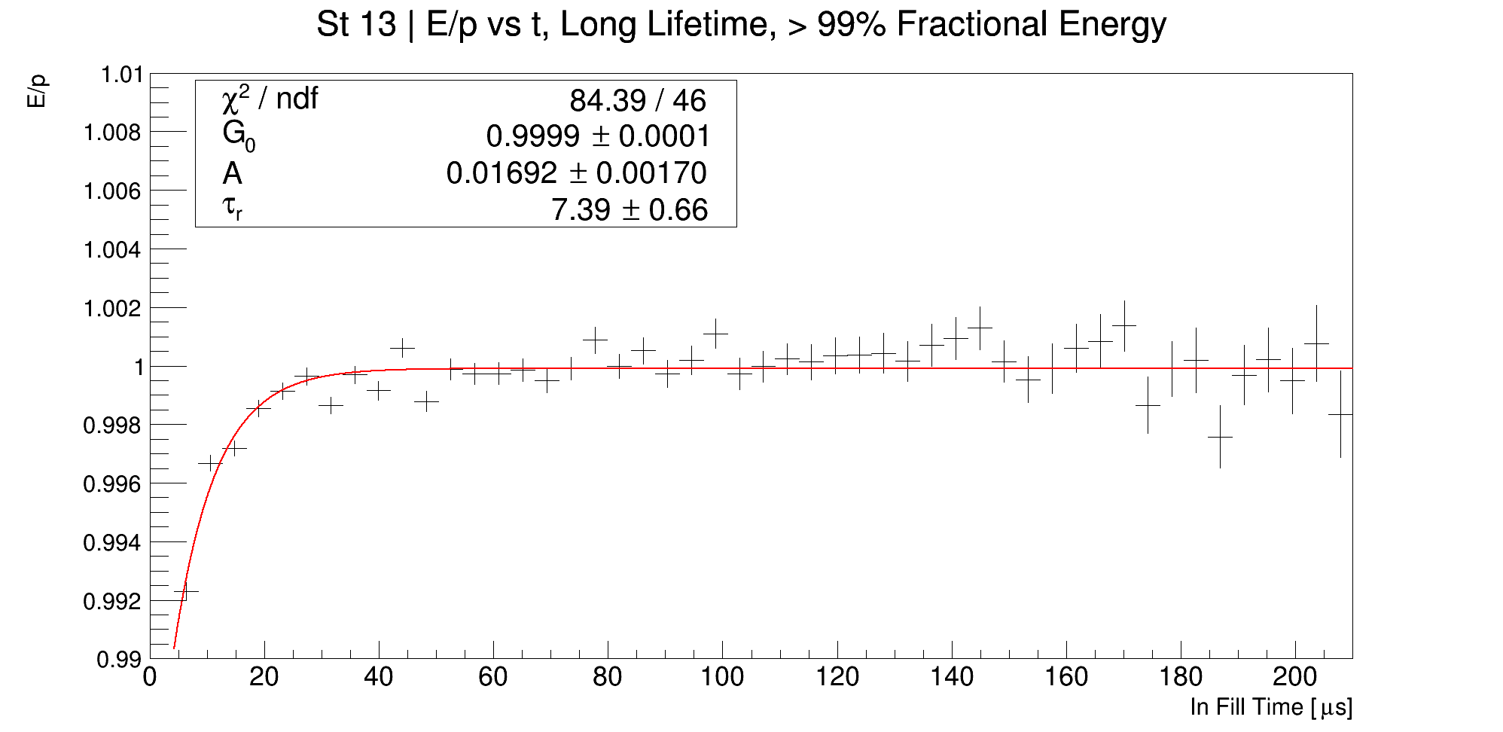
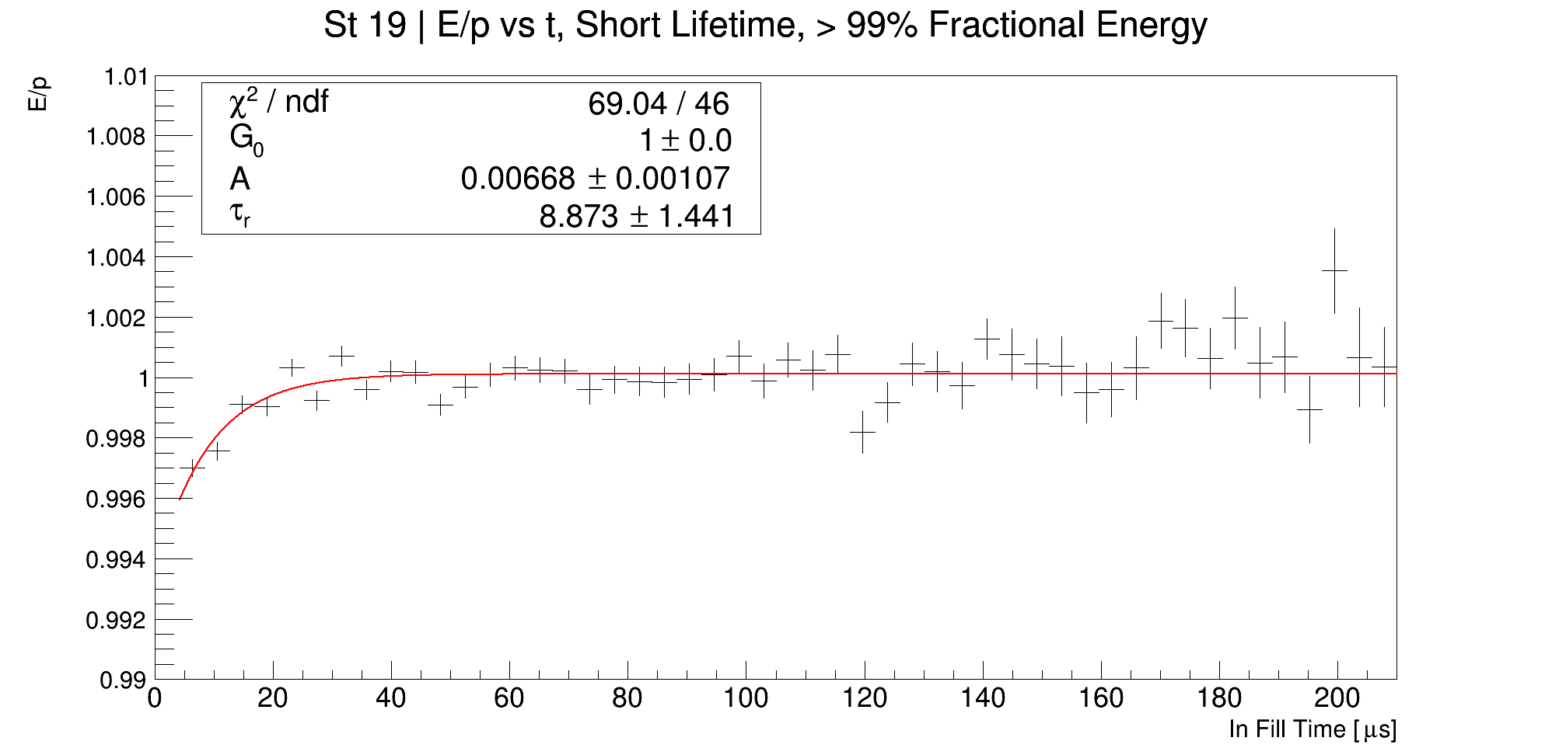

Recovery times per station, > 99% fractional energy

Slide 17
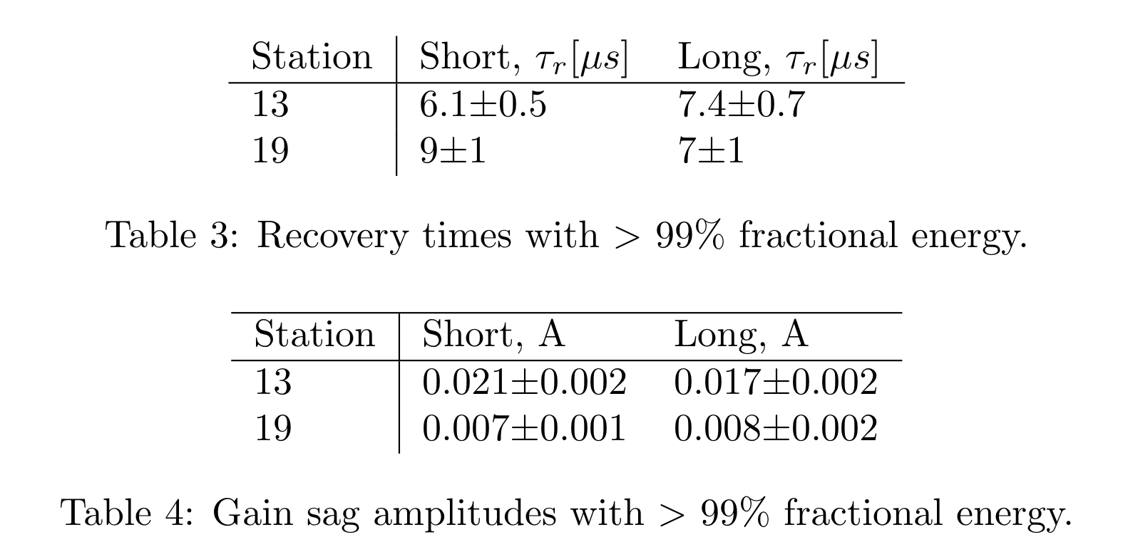
Tables of recovery times, > 99% fractional energy

Slide 18
Time difference (dt), radial difference (dR), log(E/p)
Credit: Gavin Hesketh

