Slide 1
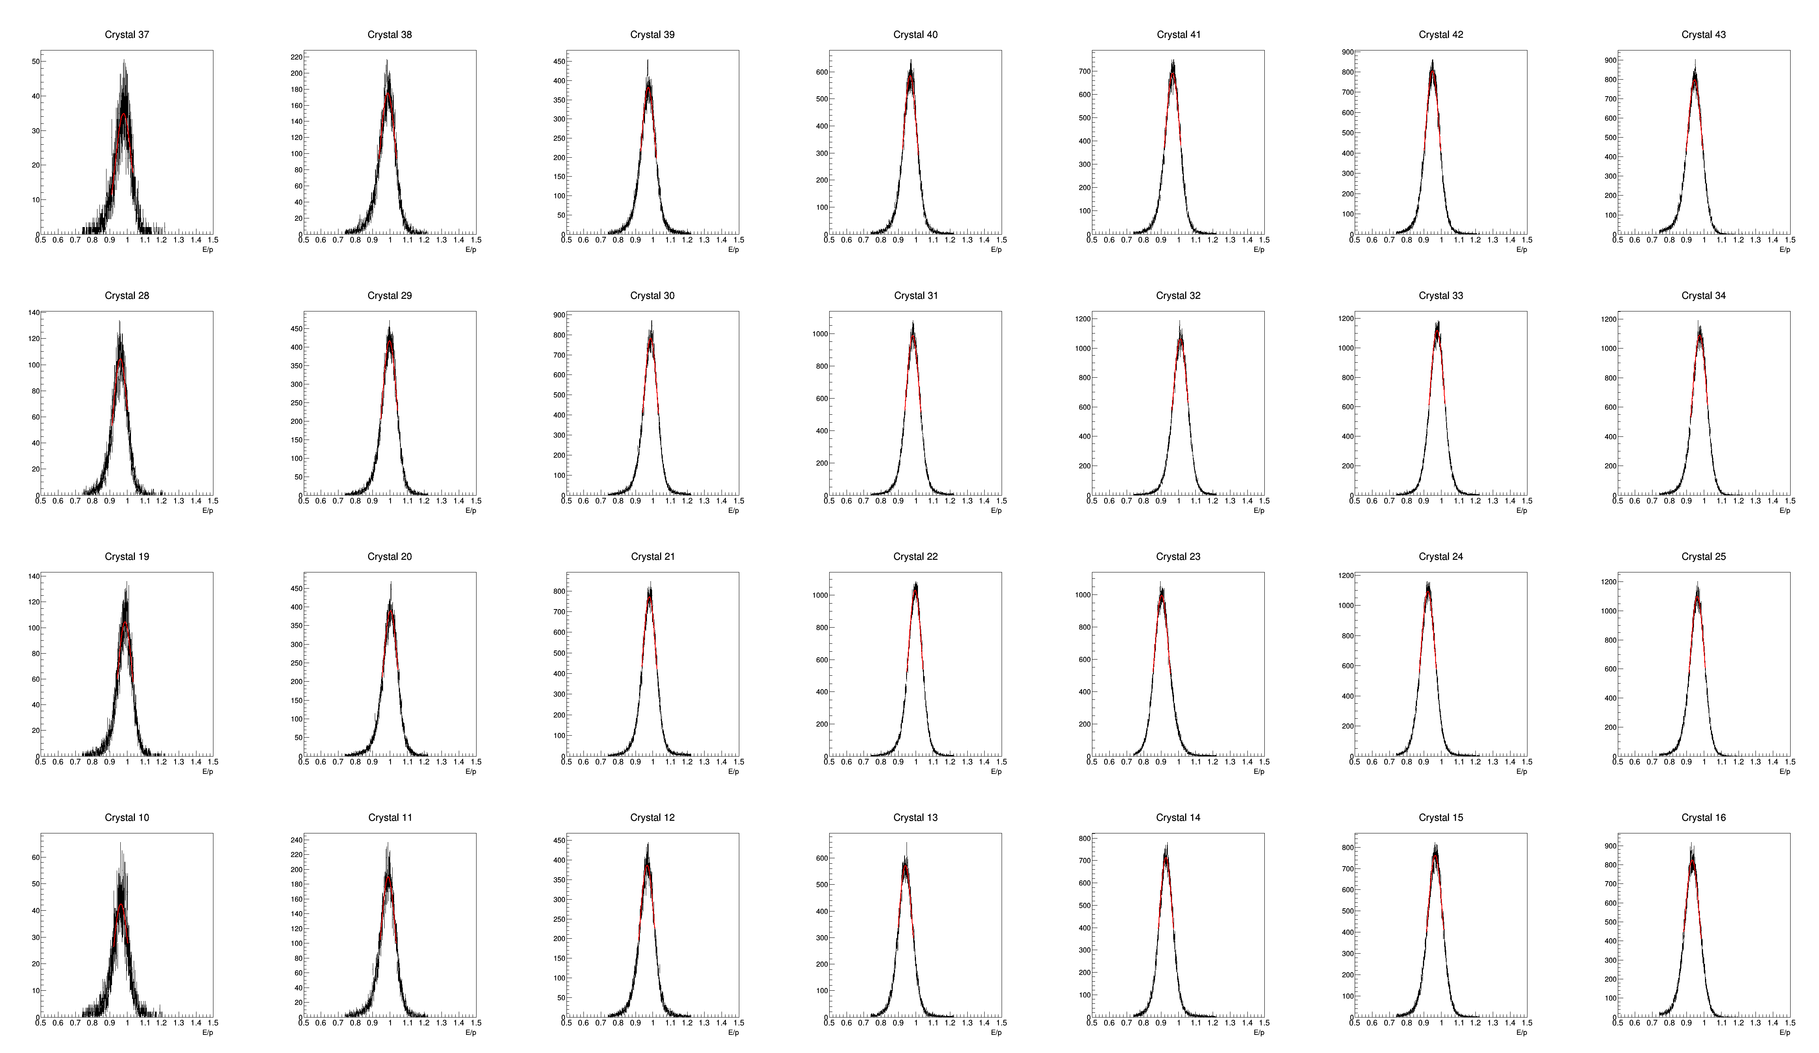
Beam
Ring center

Slide 2
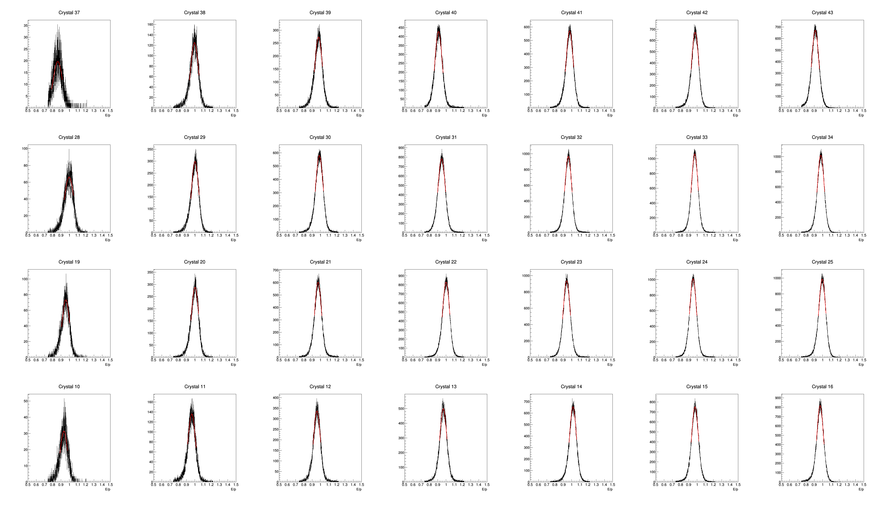
Beam
Ring center

