Slide 1
Residual oscillation in E/p vs time Sam Grant xx^{th} August 2019

Slide 2
Introduction
Aaron did a talk on his endgame fits, where he included a term to account for “residual gain perturbation”: GM2-doc-18865
I think that this means that the gain will have a dependence on the g-2 oscillation
Can I see this in E/p?

Slide 3
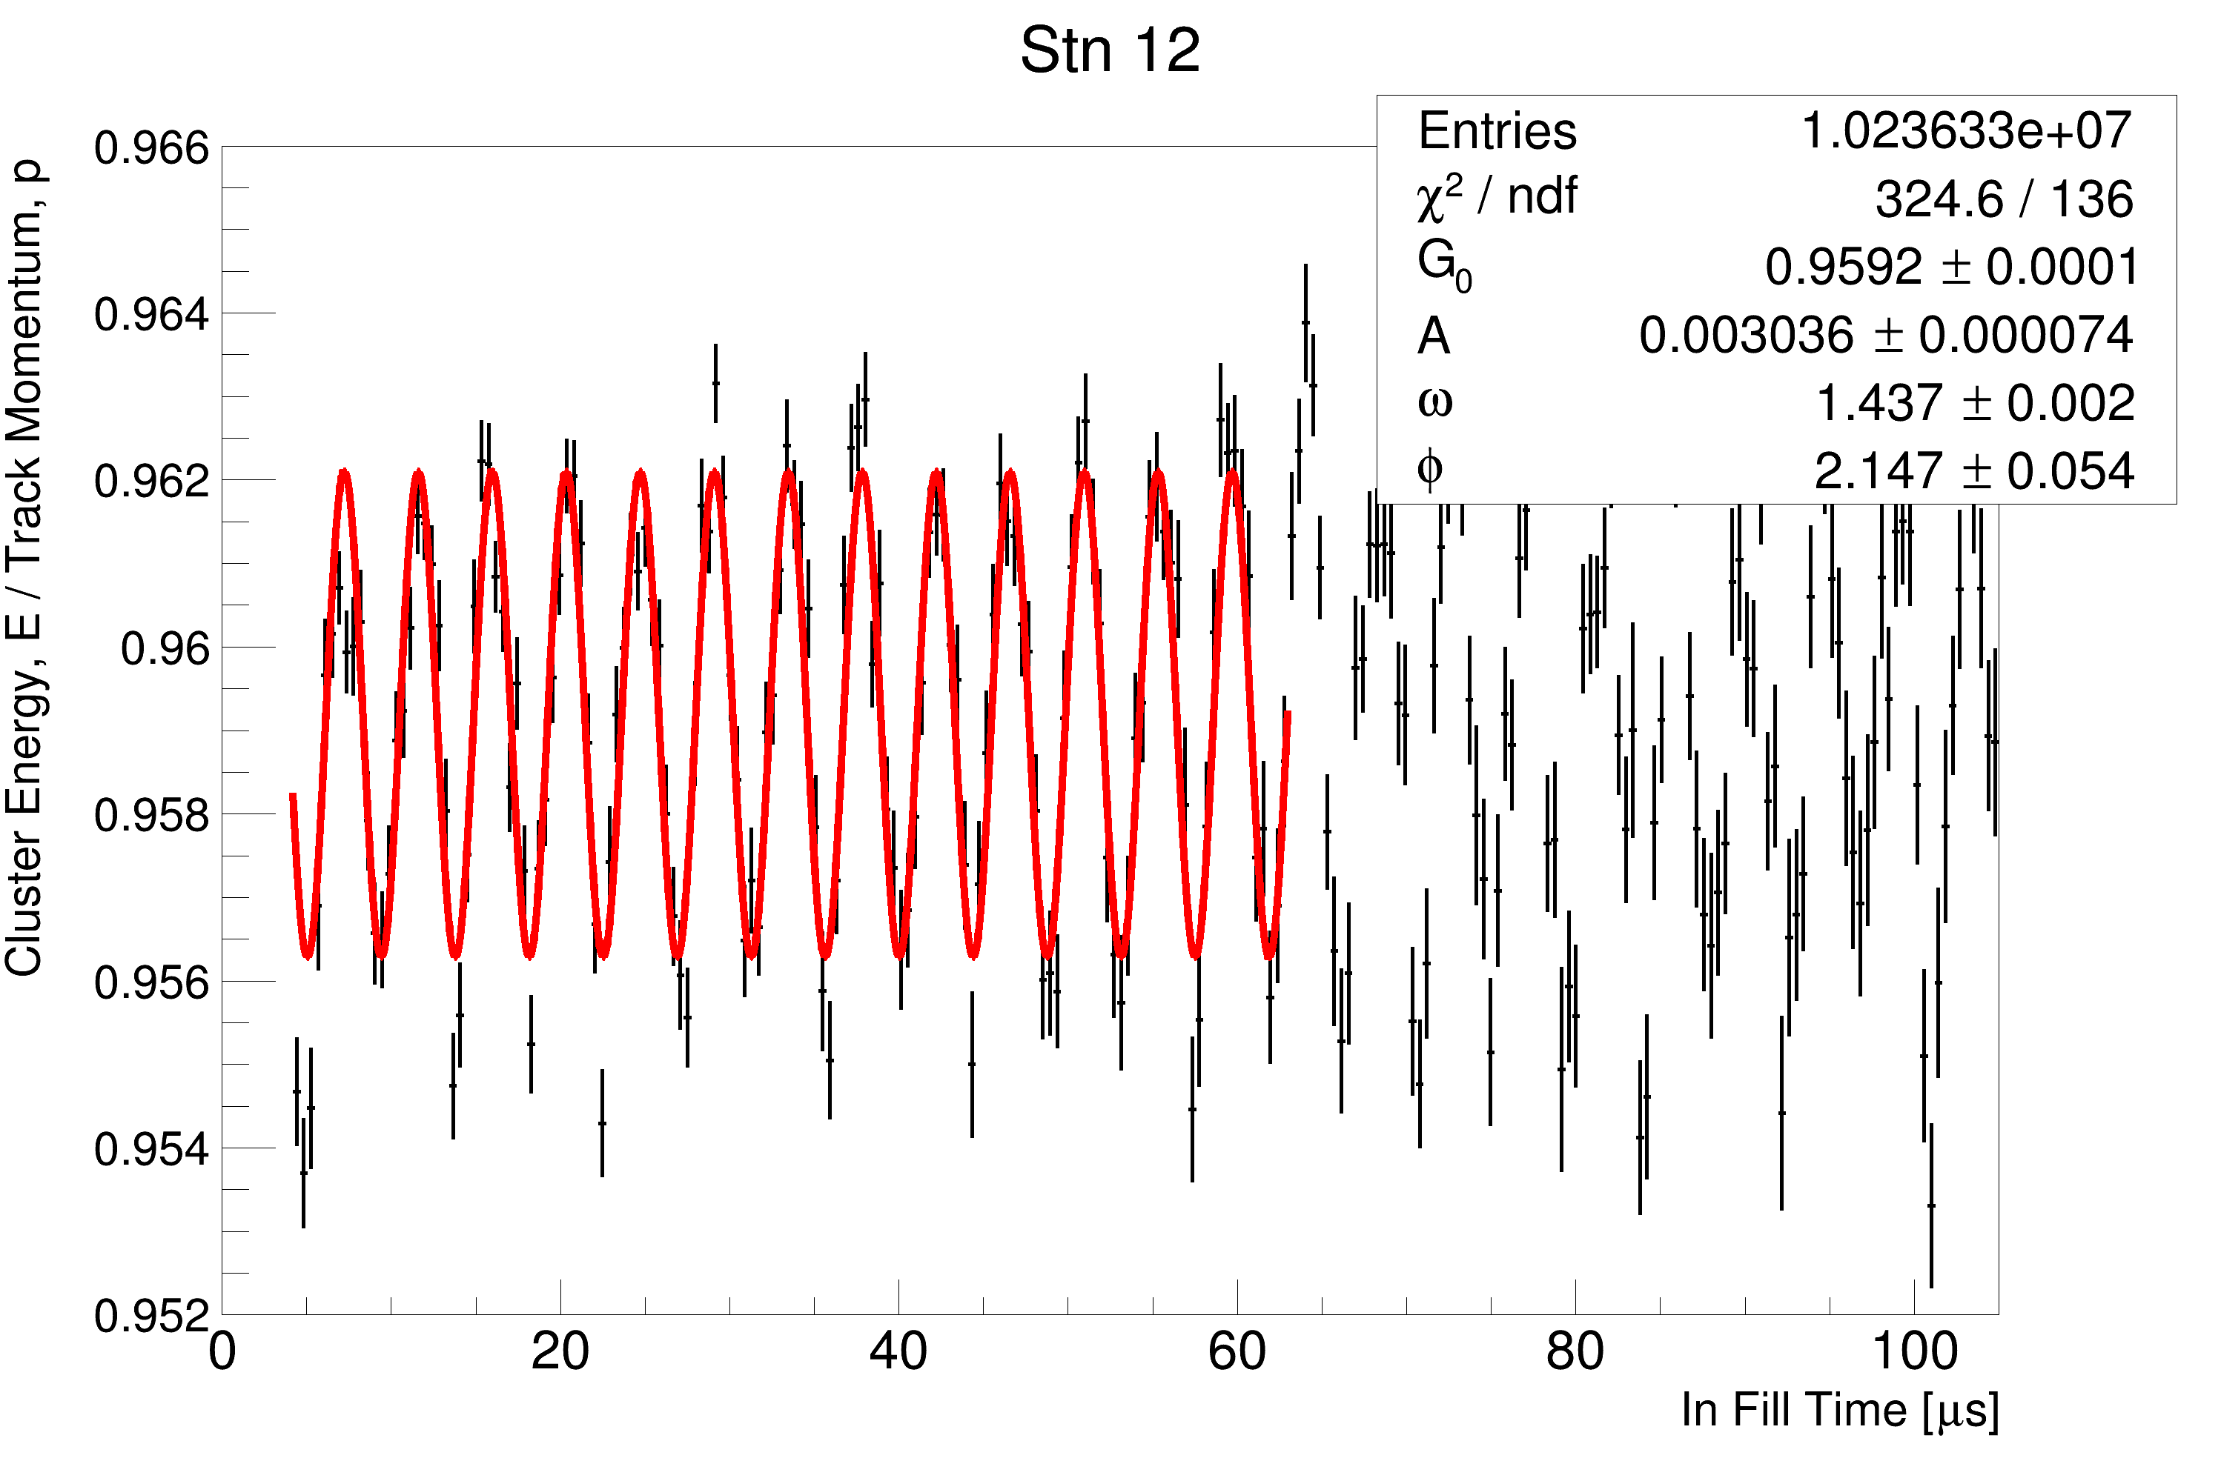
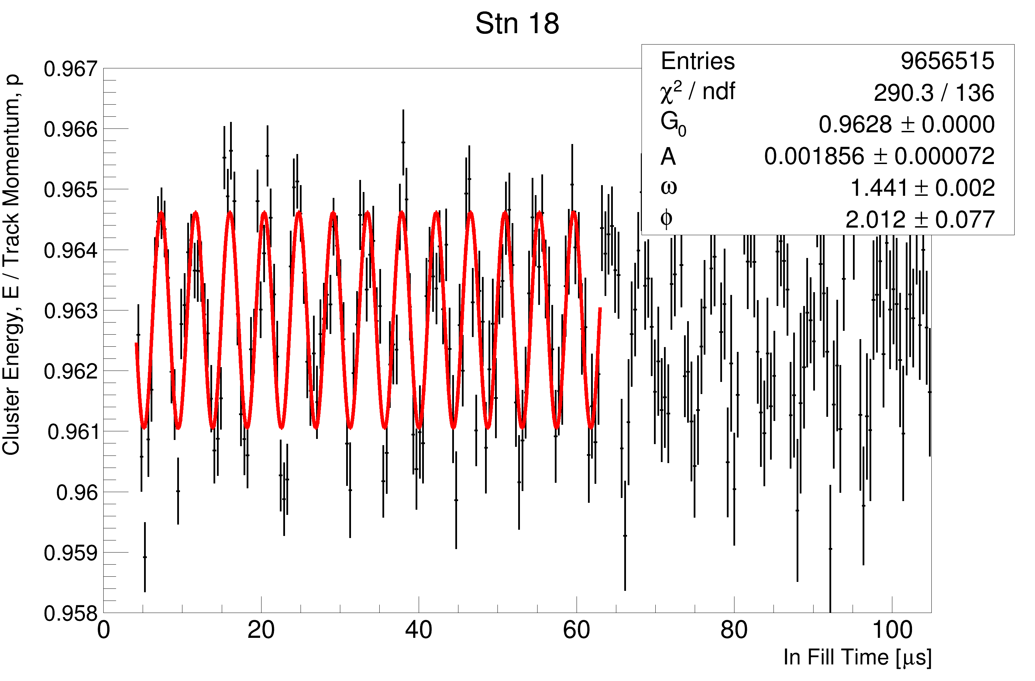
My Fits
There is an oscillation at close to g-2
But, E/p has a dependence on E that I don’t understand, so it’s not clear if this means anything.

Slide 4
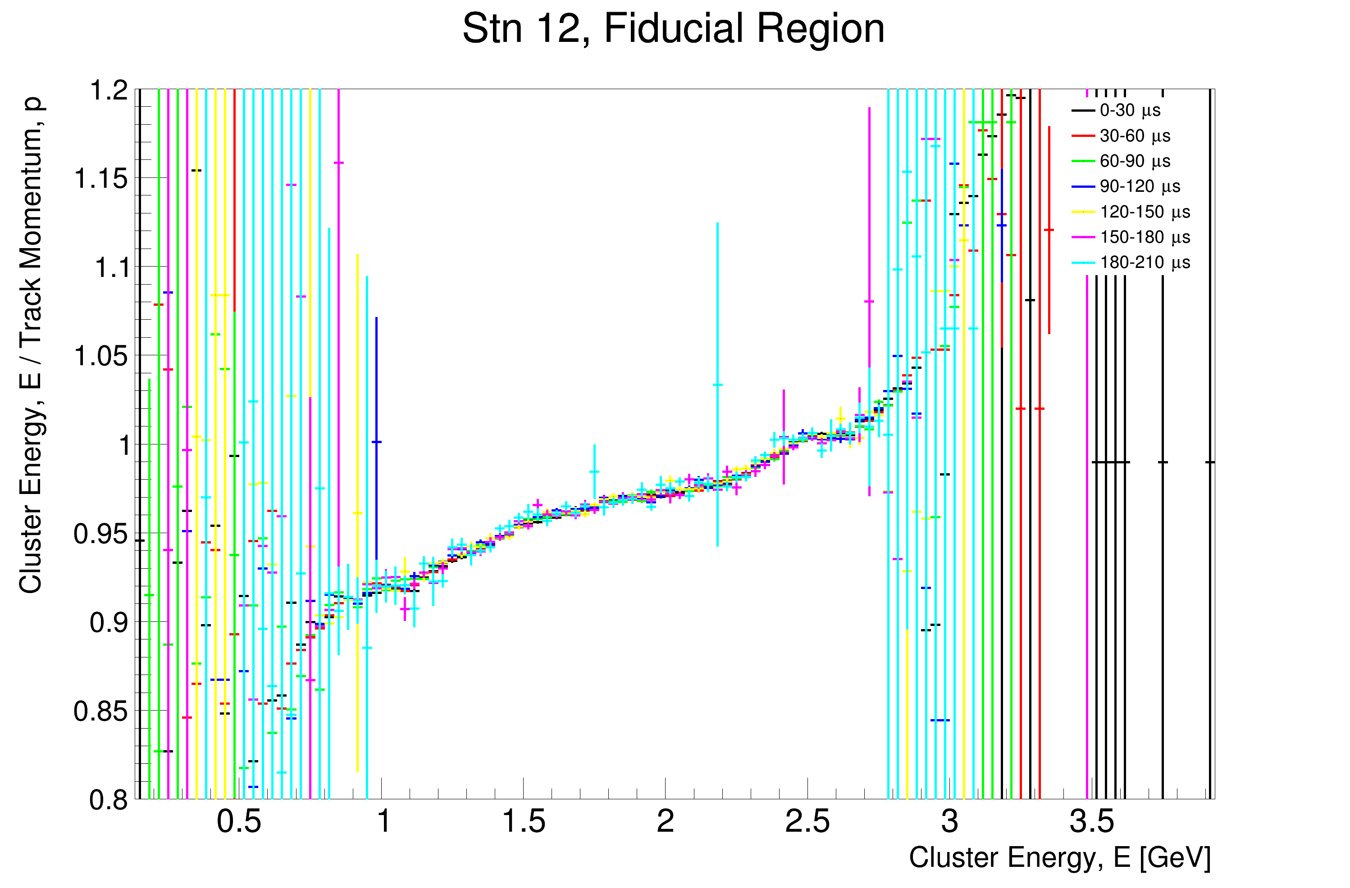
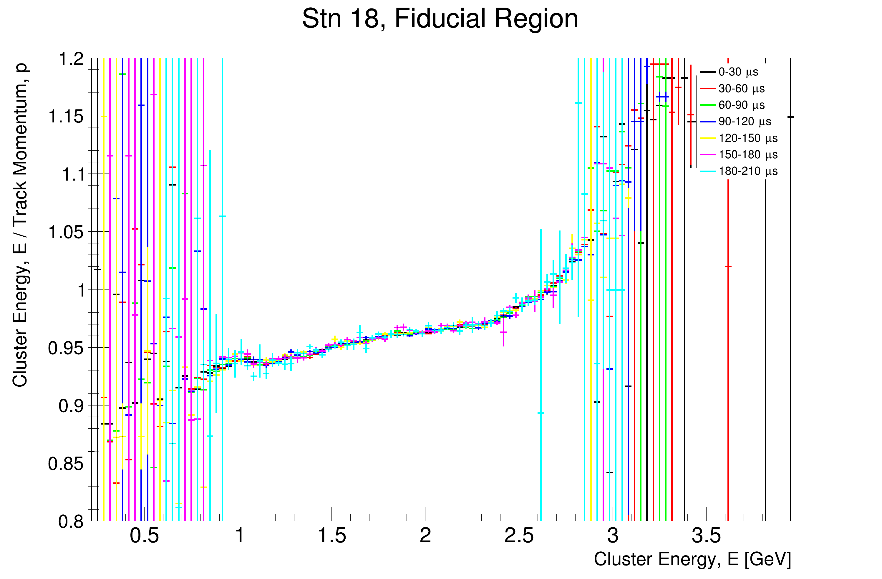
E/p vs E
Dependence is stable over time, which is good I think?

