Slide 1
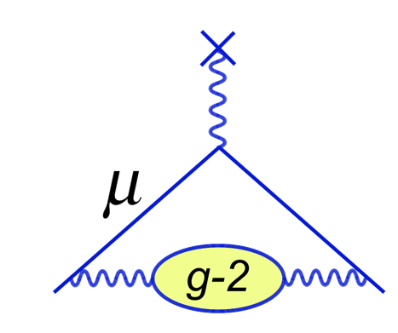
First E/p fits with the 9 day
Sam Grant
20th Sept 2019

Slide 2
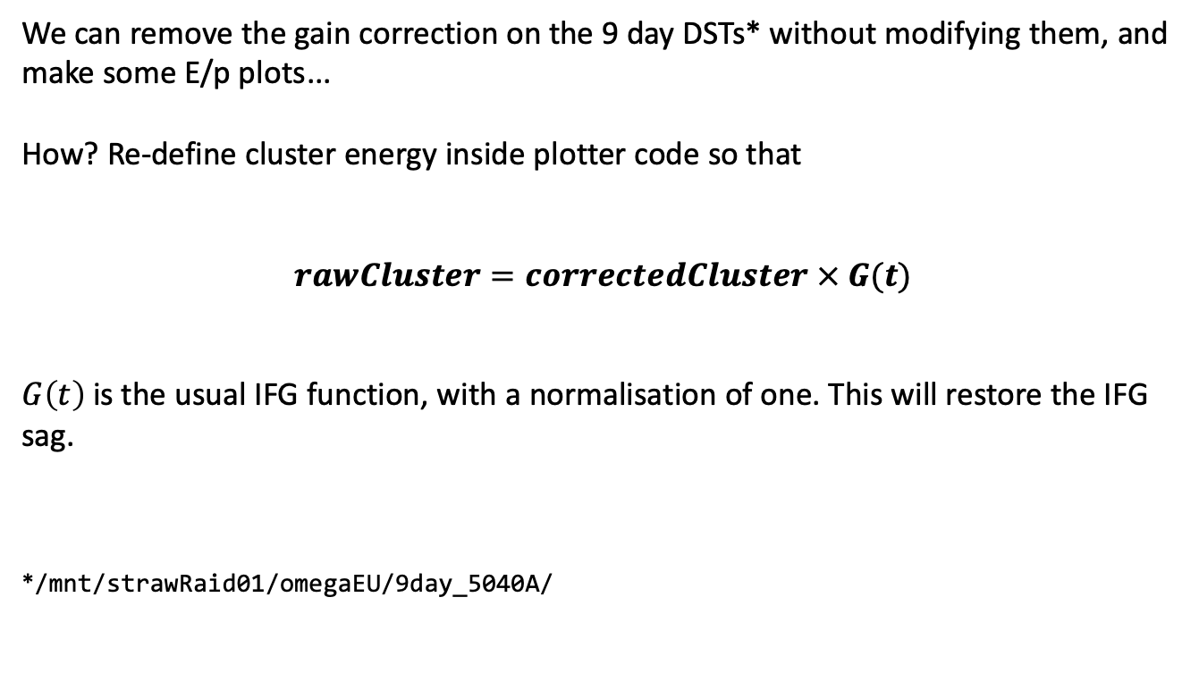
Introduction
We can remove the gain correction on the 9 day DSTs* without modifying them, and make some E/p plots...
How? Re-define cluster energy inside plotter code so that
$$rawCluster=correctedCluster × G(t)$$
$G\left(t\right)$ is the usual IFG function, with a normalisation of one. This will restore the IFG sag.
*/mnt/strawRaid01/omegaEU/9day_5040A/

Slide 3
First fits (per breakout board)
Fits are good;
Short lifetime board has a longer lifetime than it should;
The resolution between the two boards is still not good enough.

Slide 4
First fits (per xtal)
32 xtals pass quality cuts, compared to from 18 for the 60 hour;
Some odd ones, so I increased the stat cut by factor of 3.6 to reflect the increase in stats for the 9 day (next slide).

Slide 5
Fits per xtal, adjusted quality cuts
25 xtals pass quality cuts;
It does remove the odd ones, but too harsh?
Still an significant improvement over the 60 hour.

Slide 6
Comparison with laser
Looks good! Better than the 60 hour (next slide);
I can see some breakout structure;
No uncertainties on the laser yet. 5% uncertainties are a placeholder;
When I get them I will look at the pulls ect.

Slide 7
Comparison with laser (60 hour)
60 hour results look less consistent; and the uncertainties are larger.

Slide 8
Conclusion
I can remove the IFG correction, and make E/p plots with the 9 day;
First results seem promising;
I’m working with Anna to get the laser uncertainties so that I can move forward.
Thanks also to Matteo for his help with this!

