Slide 1
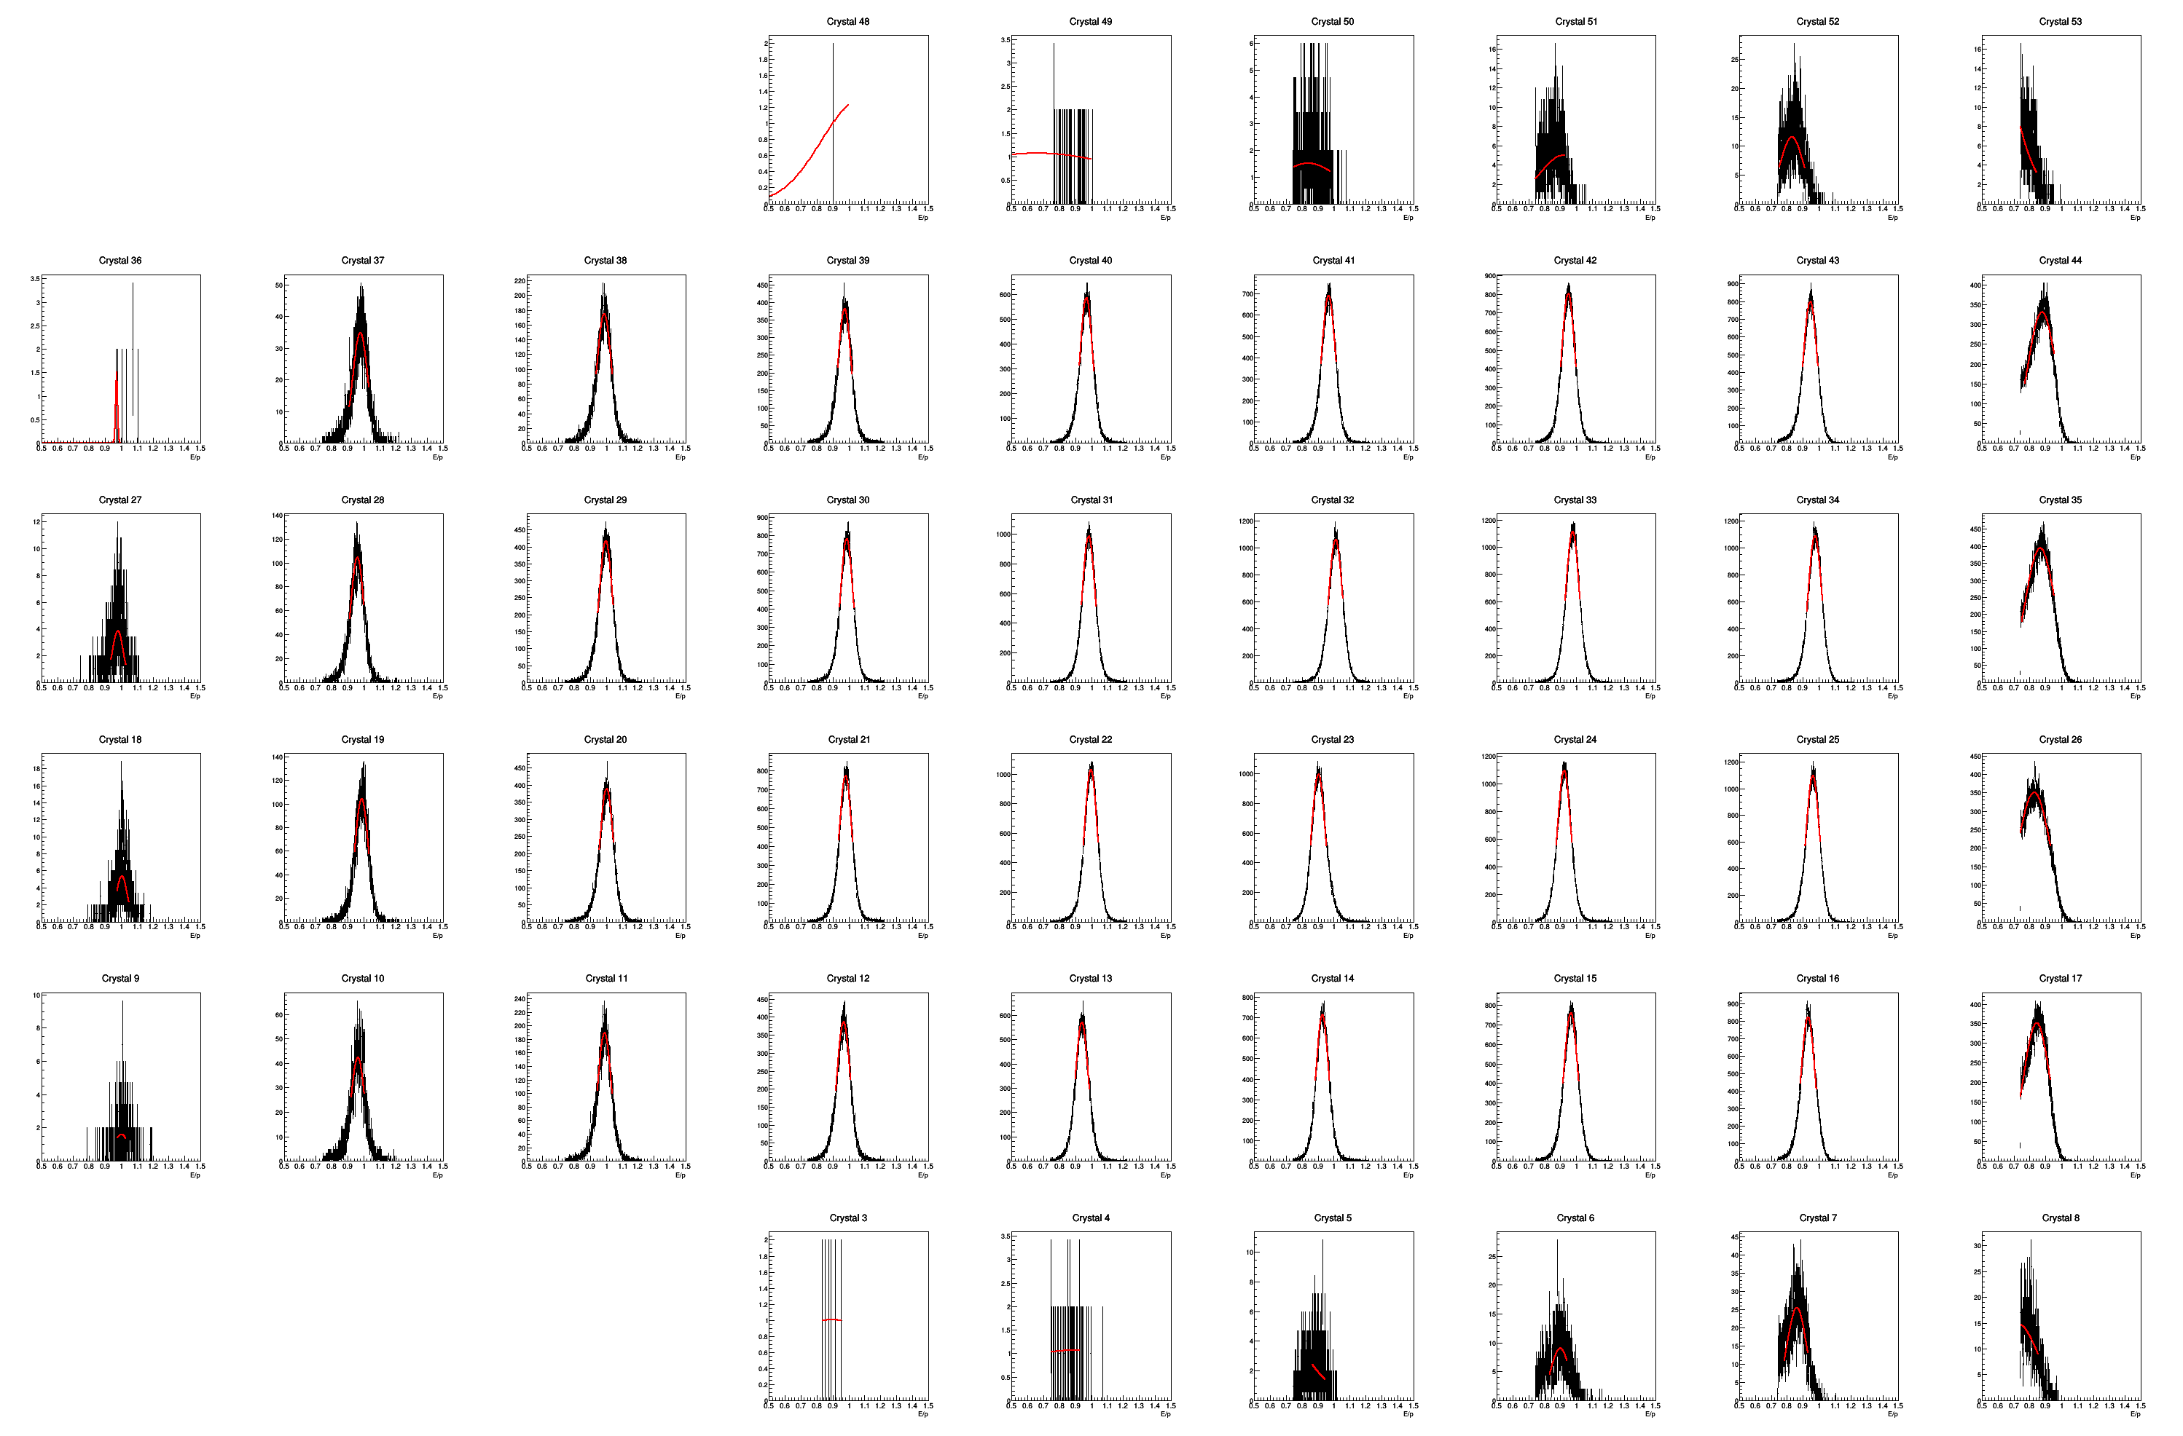
Beam
Ring center

Slide 2
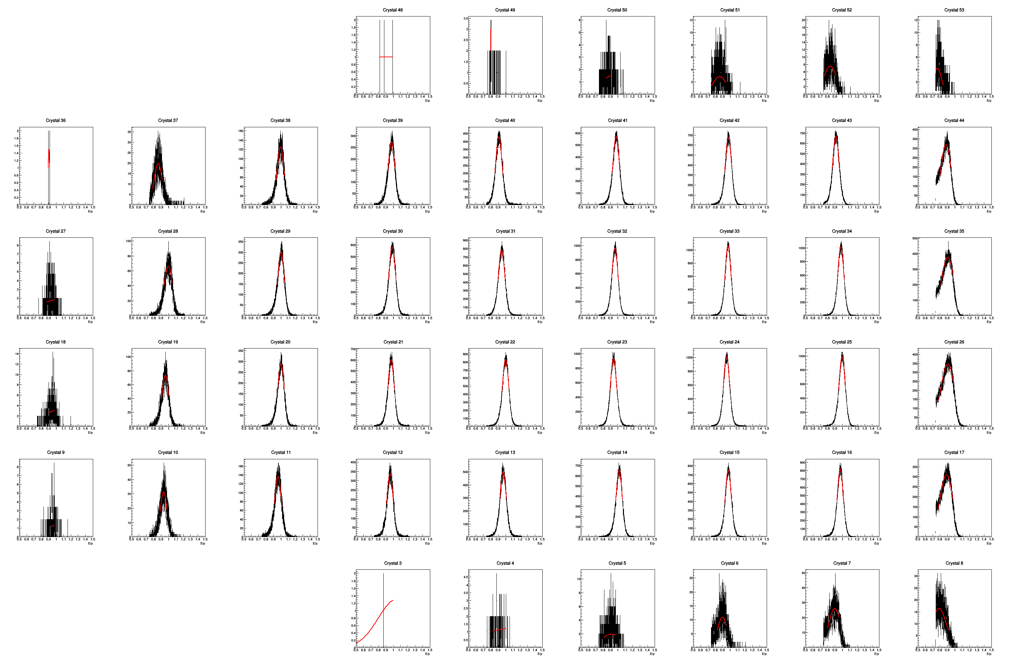
Beam
Ring center

Slide 3
Beam
Ring center
45 | 46 | 47 | 48 | 49 | 50 | 51 | 52 | 53
36 | 37 | 38 | 39 | 40 | 41 | 42 | 43 | 44
27 | 28 | 29 | 30 | 31 | 32 | 33 | 34 | 35
18 | 19 | 20 | 21 | 22 | 23 | 24 | 25 | 26
9 | 10 | 11 | 12 | 13 | 14 | 15 | 16 | 17
0 | 1 | 2 | 3 | 4 | 5 | 6 | 7 | 8

