Slide 1
Uncertainties from E/p vs time for the 60 hour Sam Grant Europa omega_a 9th August 2019

Slide 2
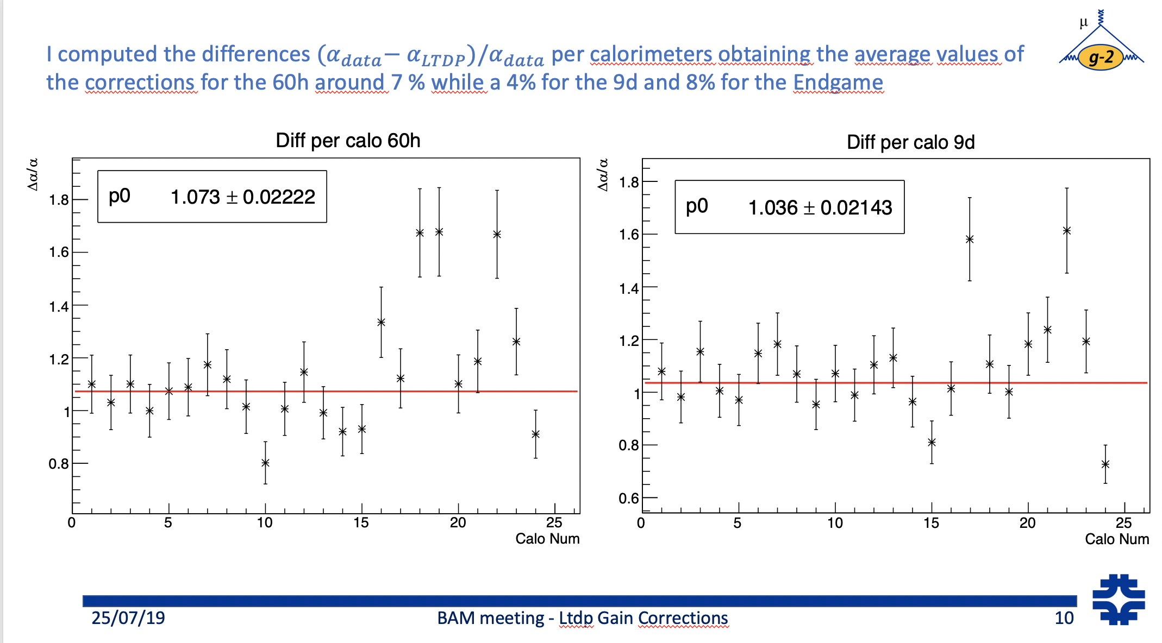
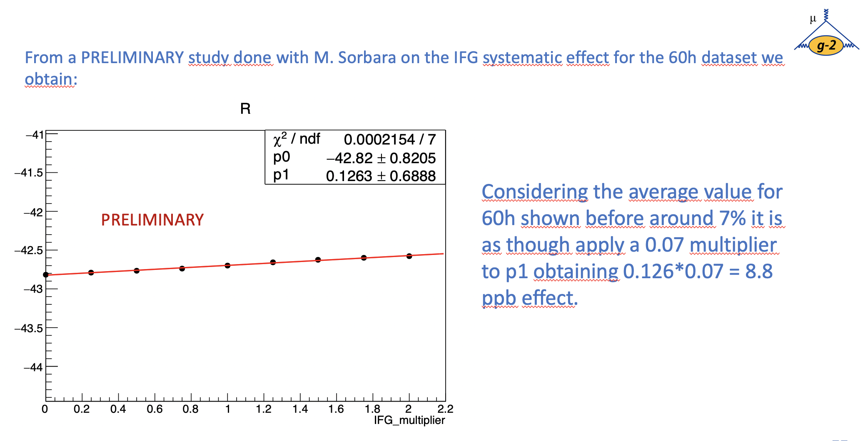
Introduction
I want a useful systematic from this study (see previous talks on doc db)
I decided to borrow an idea from Elia’s BAM talk (GM2-doc-18943):

Slide 3
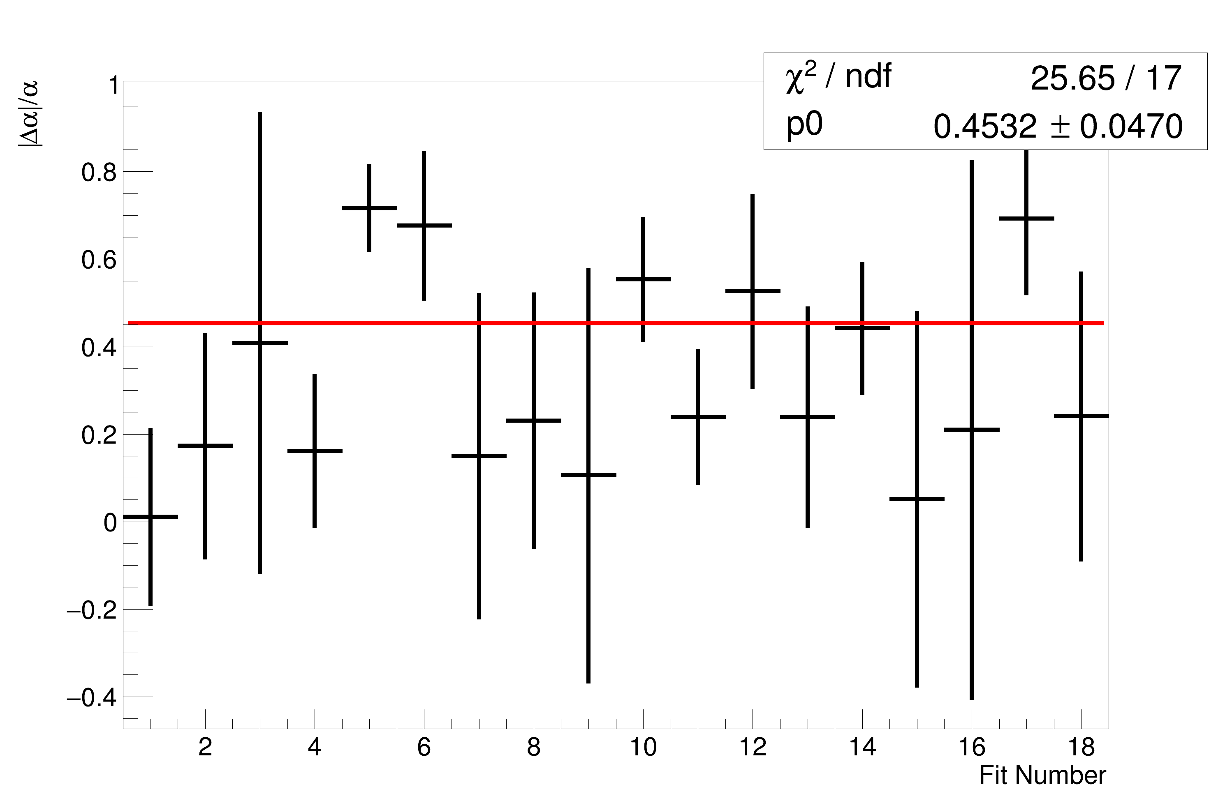
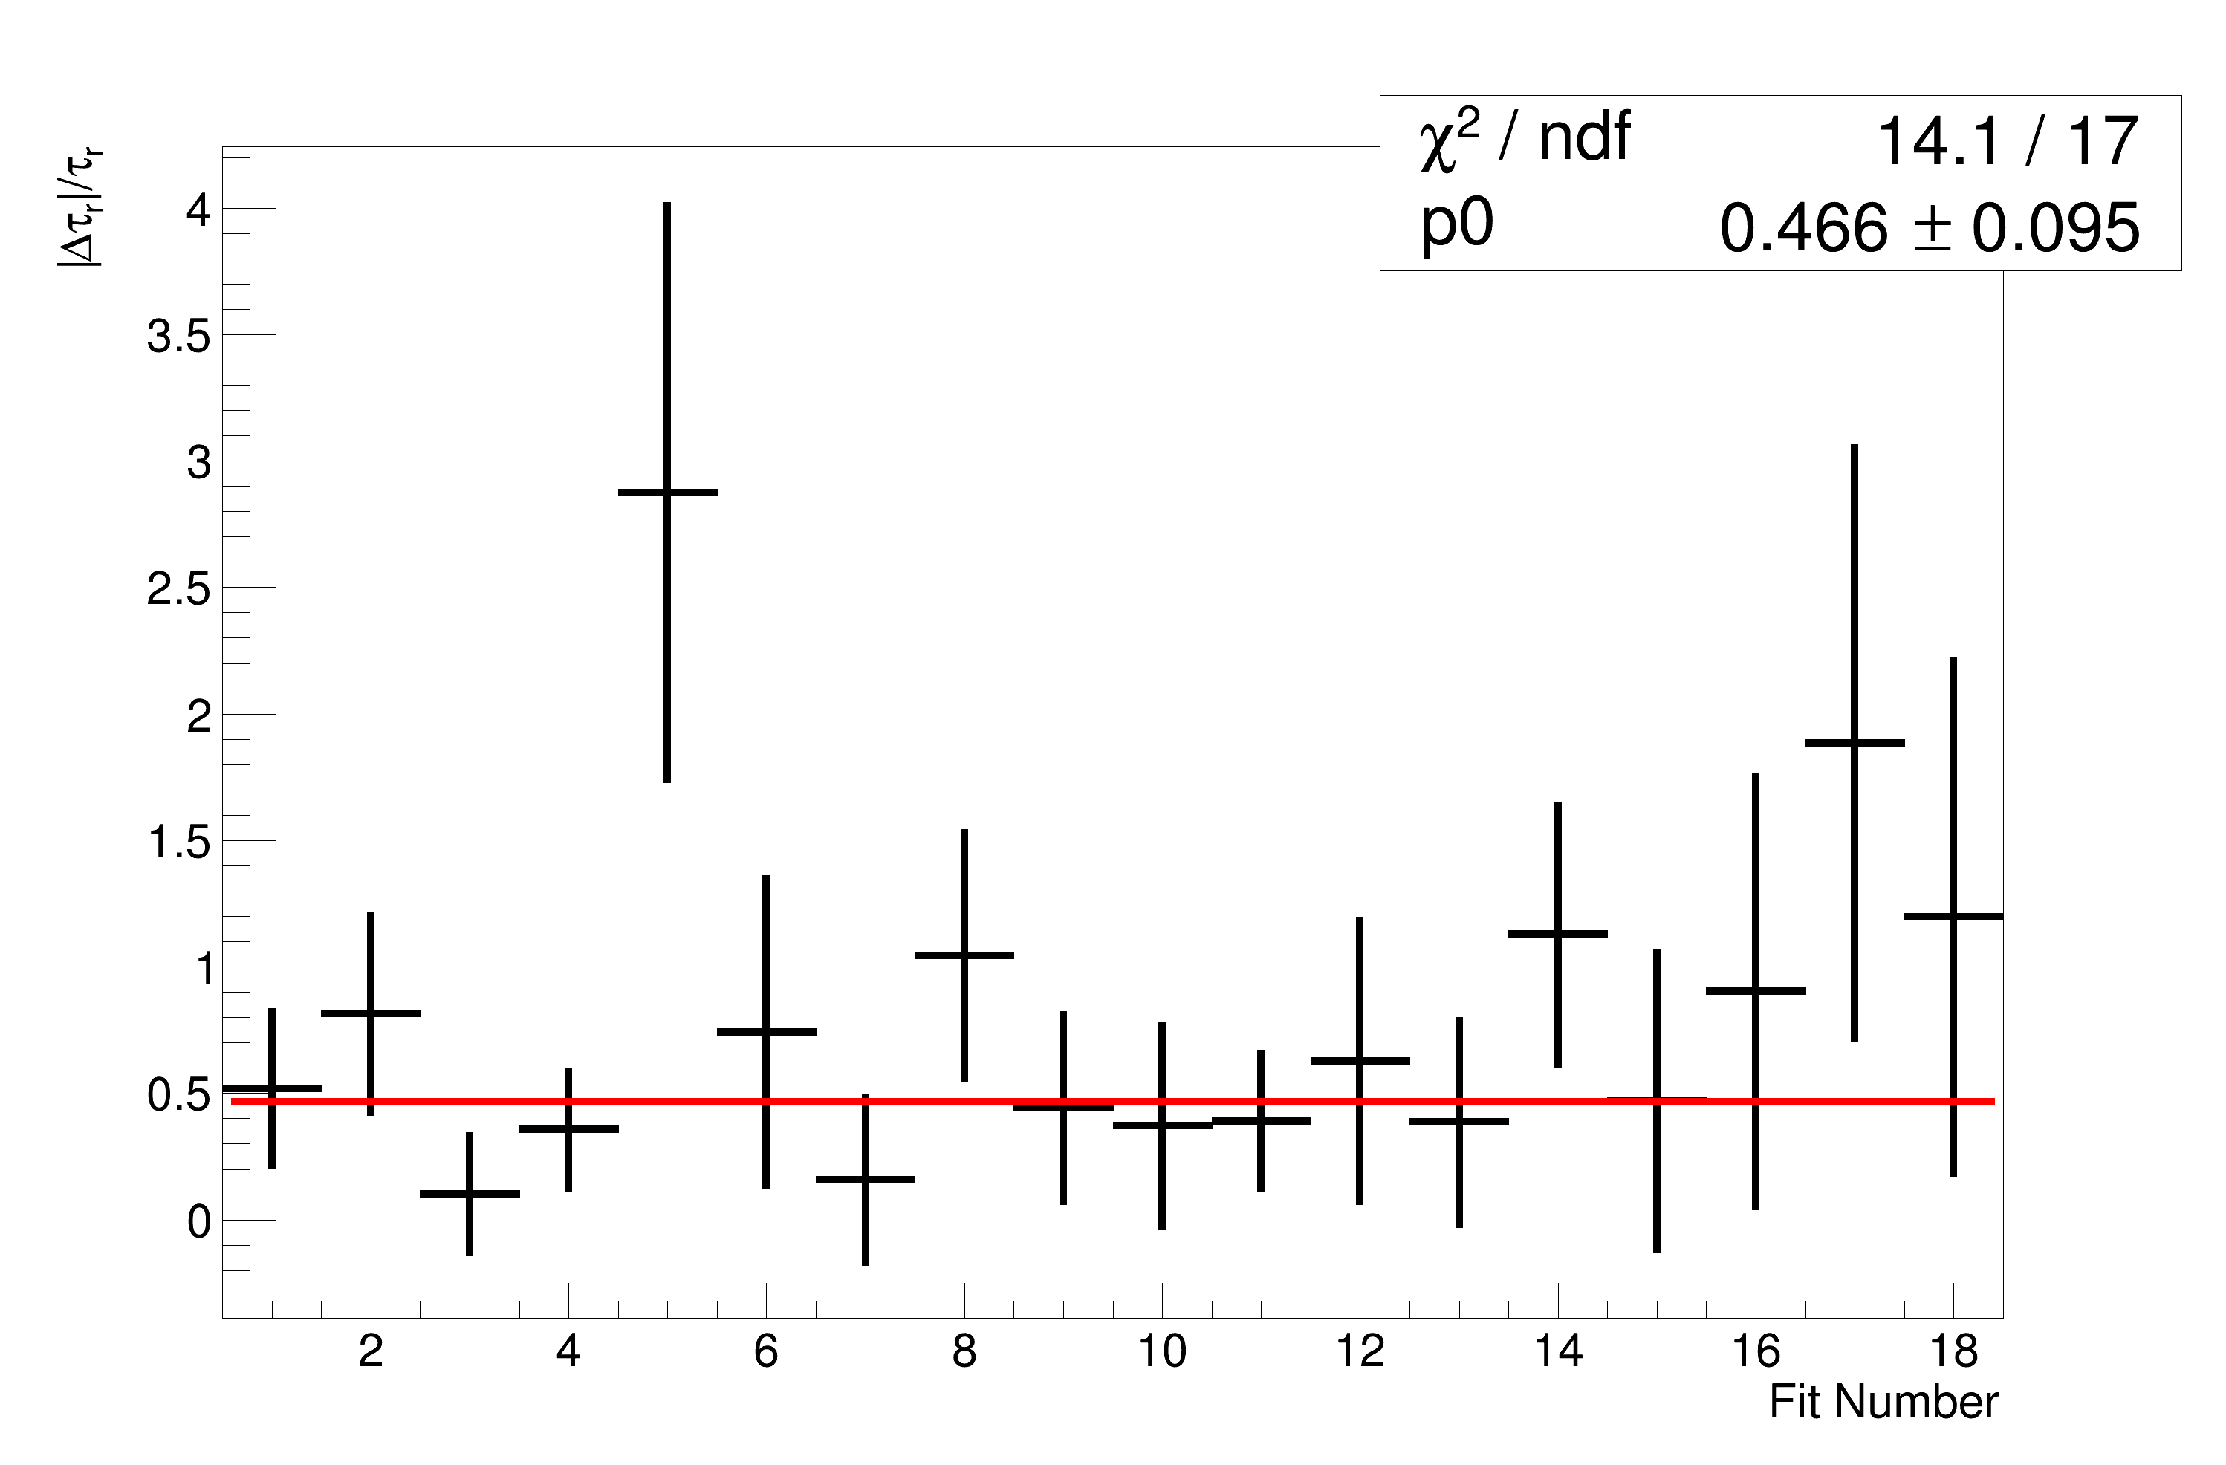
My Fits
|∆⍺|/⍺ = 45 ± 5%
|∆𝛕_{r}|/ 𝛕_{r} = 47 ± 10%

Slide 4

$$δR$$
$\frac{\left|∆α\right|}{α}=45±4\%$
$0.1263×\left(0.45±0.04\right)=$
$$0.057 ±0.005 ppm$$
$δR≈57±5 pbb$

Slide 5
Conclusion
This is obviously well above the 20 ppb allowed for gain fluctuations.
I would take this result with a pinch of salt, I mostly just wanted to see what I get out.
I’d guess that things would improve with more tracks

