Slide 1
Lost Muon Contamination 6 Quality Flags Applied (No Gain Correction)
Sam Grant
28th April 2019

Slide 2
Aims?
“How do lost muons affect beam position measurements”
Lost muons do not pass the energy threshold for the calorimeter wiggle plots, but position measurements from the trackers will still be affected. How to quantify this?...
Find the difference in the means/widths of two sets of radial and vertical tracker only decay vertex histograms; one set without lost muons subtracted, and one with lost muons subtracted.
Questions to answer before this:
What is the relative efficiency of the calorimeter compared with the tracker for lost muons – this is needed to scale the lost muon population before subtraction.

Slide 3
Details!
Using Europa NTuples with available by: gm2/data/g2be/Production/Trees/v9_17_01/60hr/
“Track quality = true”, “candidate quality = true” and “hit volume = false”
Additional cuts for cluster matched tracks
Cluster track time difference between -8 and +3 ns for station 12, and between -9 and +1 ns for station 18
Radial difference, dR < 30 mm
Lost muon selection:
Momentum > 2300 MeV,
-3.2 < log(E/p) < -2.4 *
Magic Radius (7112 mm) is set to zero throughout!
*Consistent with lost muon selection used by Europa omega_a group (Feb 2019):
https://gm2-docdb.fnal.gov/cgi-bin/private/RetrieveFile?docid=16402&filename=Nota5_LostMuons.pdf&version=3

Slide 4
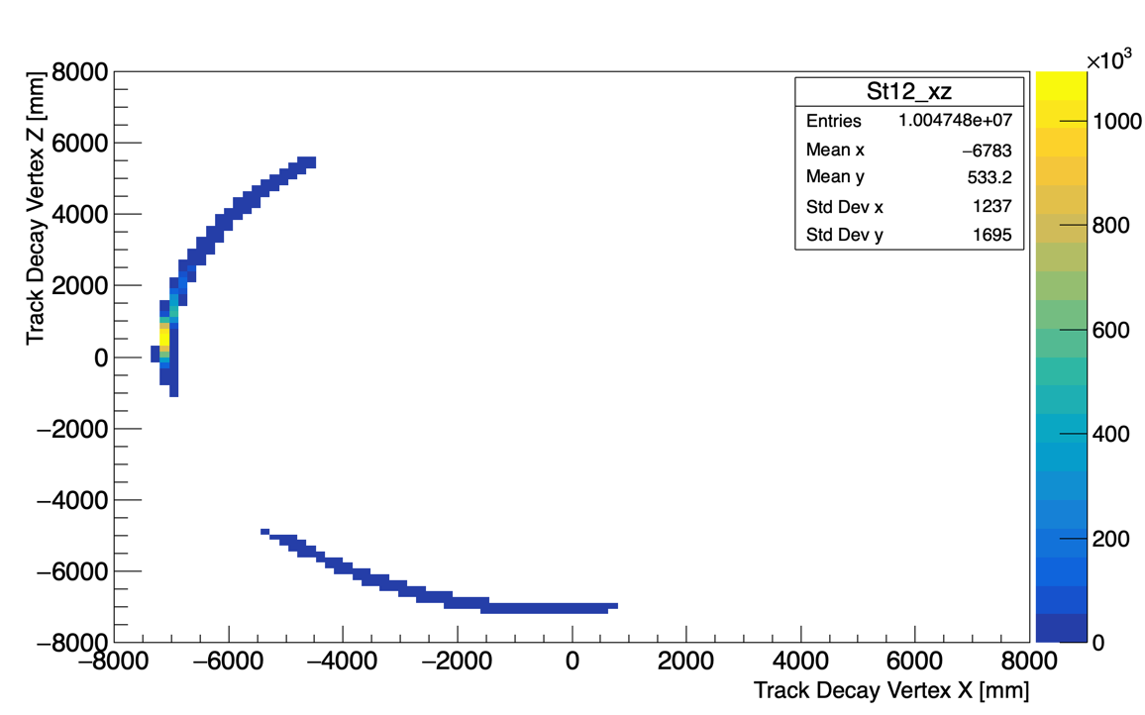
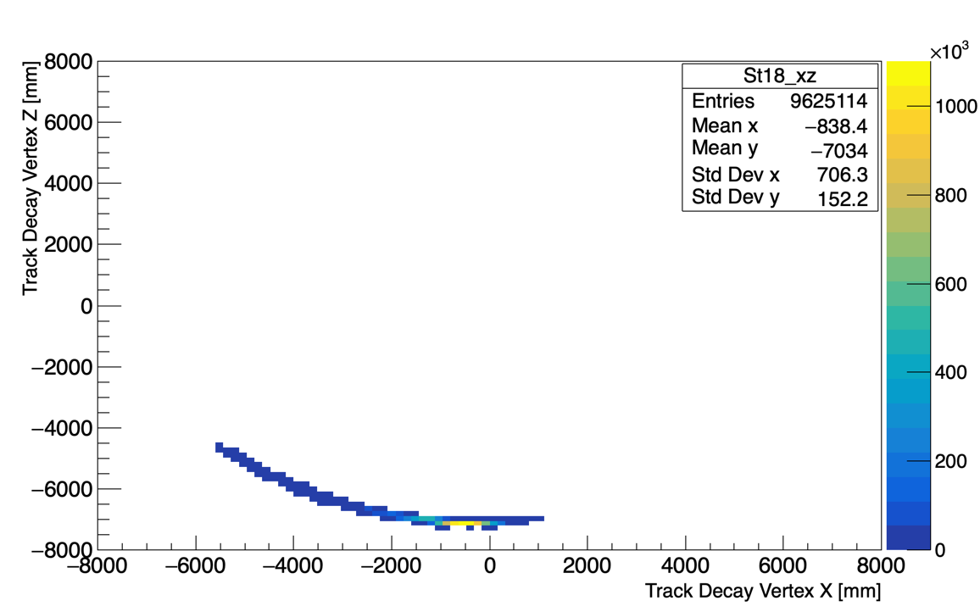
Bug in Europa NTuples?
Stn 12
Stn 18
For tracker only Ntuples, there is some mixing up of tracks with station 12.
Temporary solution: do a combined analysis with both stations.
(Also do a station 18 analysis)

Slide 5
Contents
Relative efficiencies and scale factors
Numbers for the differences in the means and widths with and without lost muons, with and without 60 mm range

Slide 6
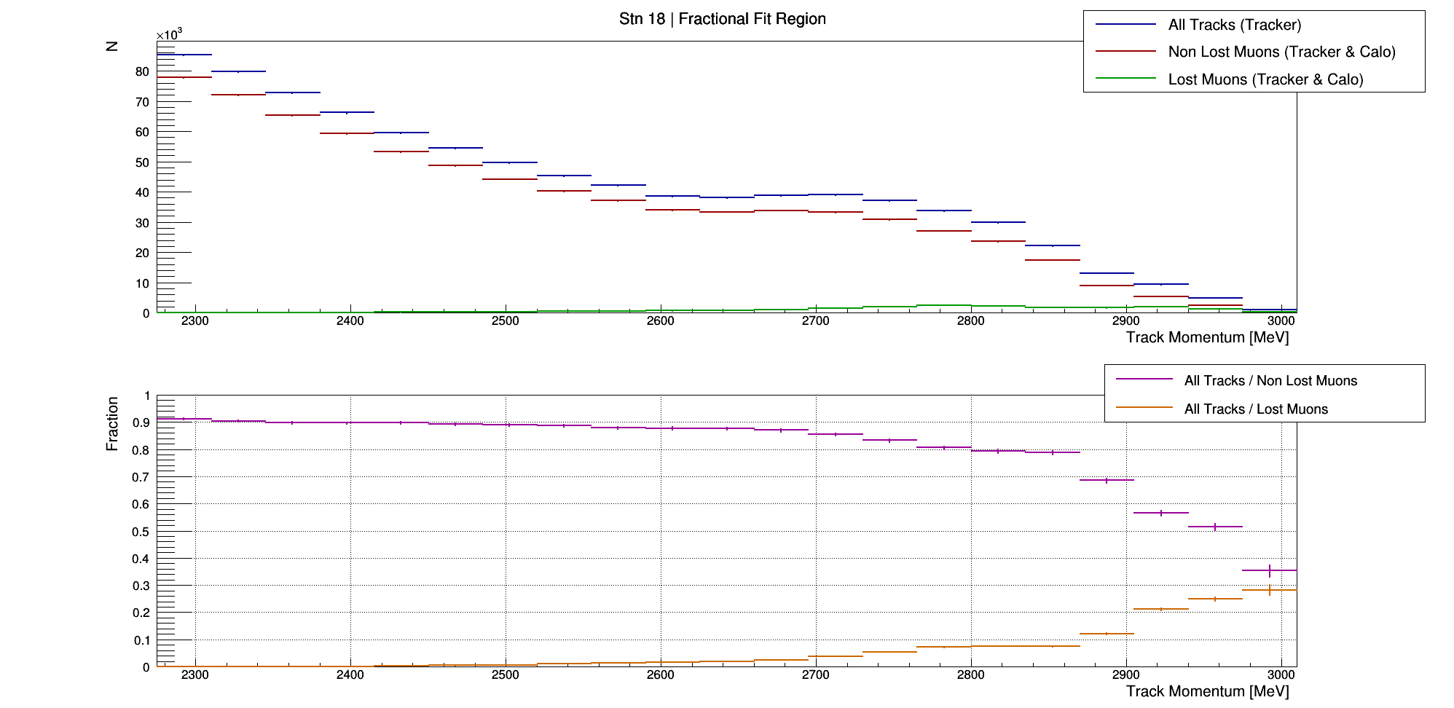
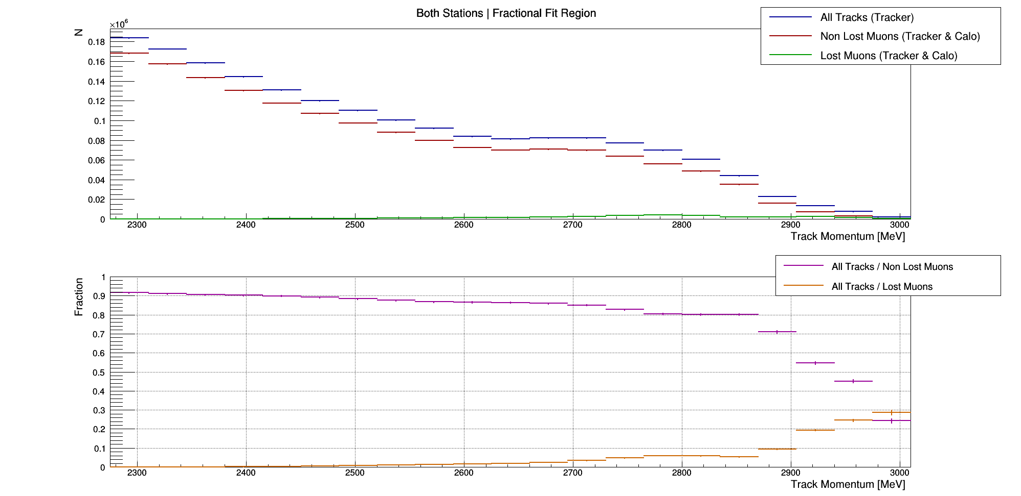
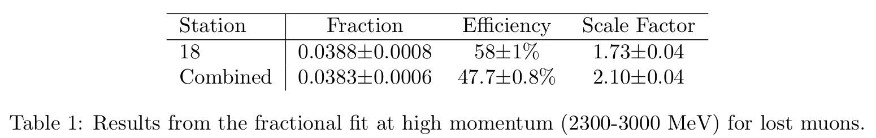
Relative efficiency of the calorimeter and scale factor for lost muons

Slide 7
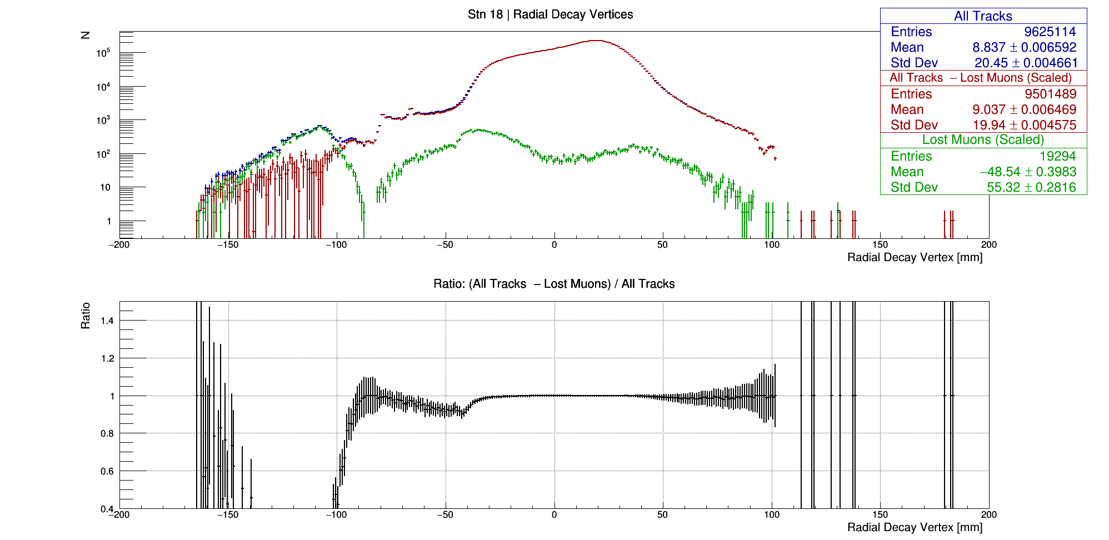
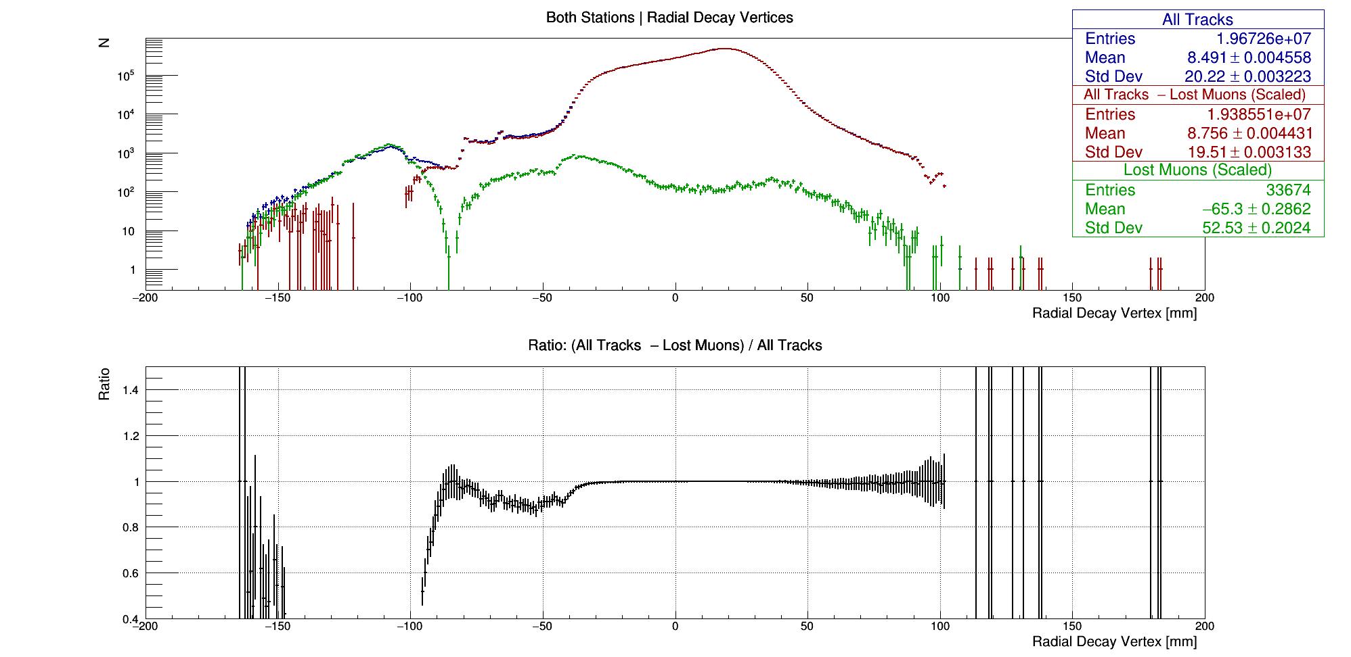
Radial decay vertices of all tracks (tracker only) with lost muons and non lost muons subtracted
Showing the lost muon only distribution as well...
Overcorrection?
******************* RESULT *******************
St 18 dMean = 0.199761+/-0.00923631
St 18 dRMS = -0.510212+/-0.00653106
******************* RESULT *******************
Combined dMean = 0.265951+/-0.00635663
Combined dRMS = -0.706982+/-0.00449481

Slide 8
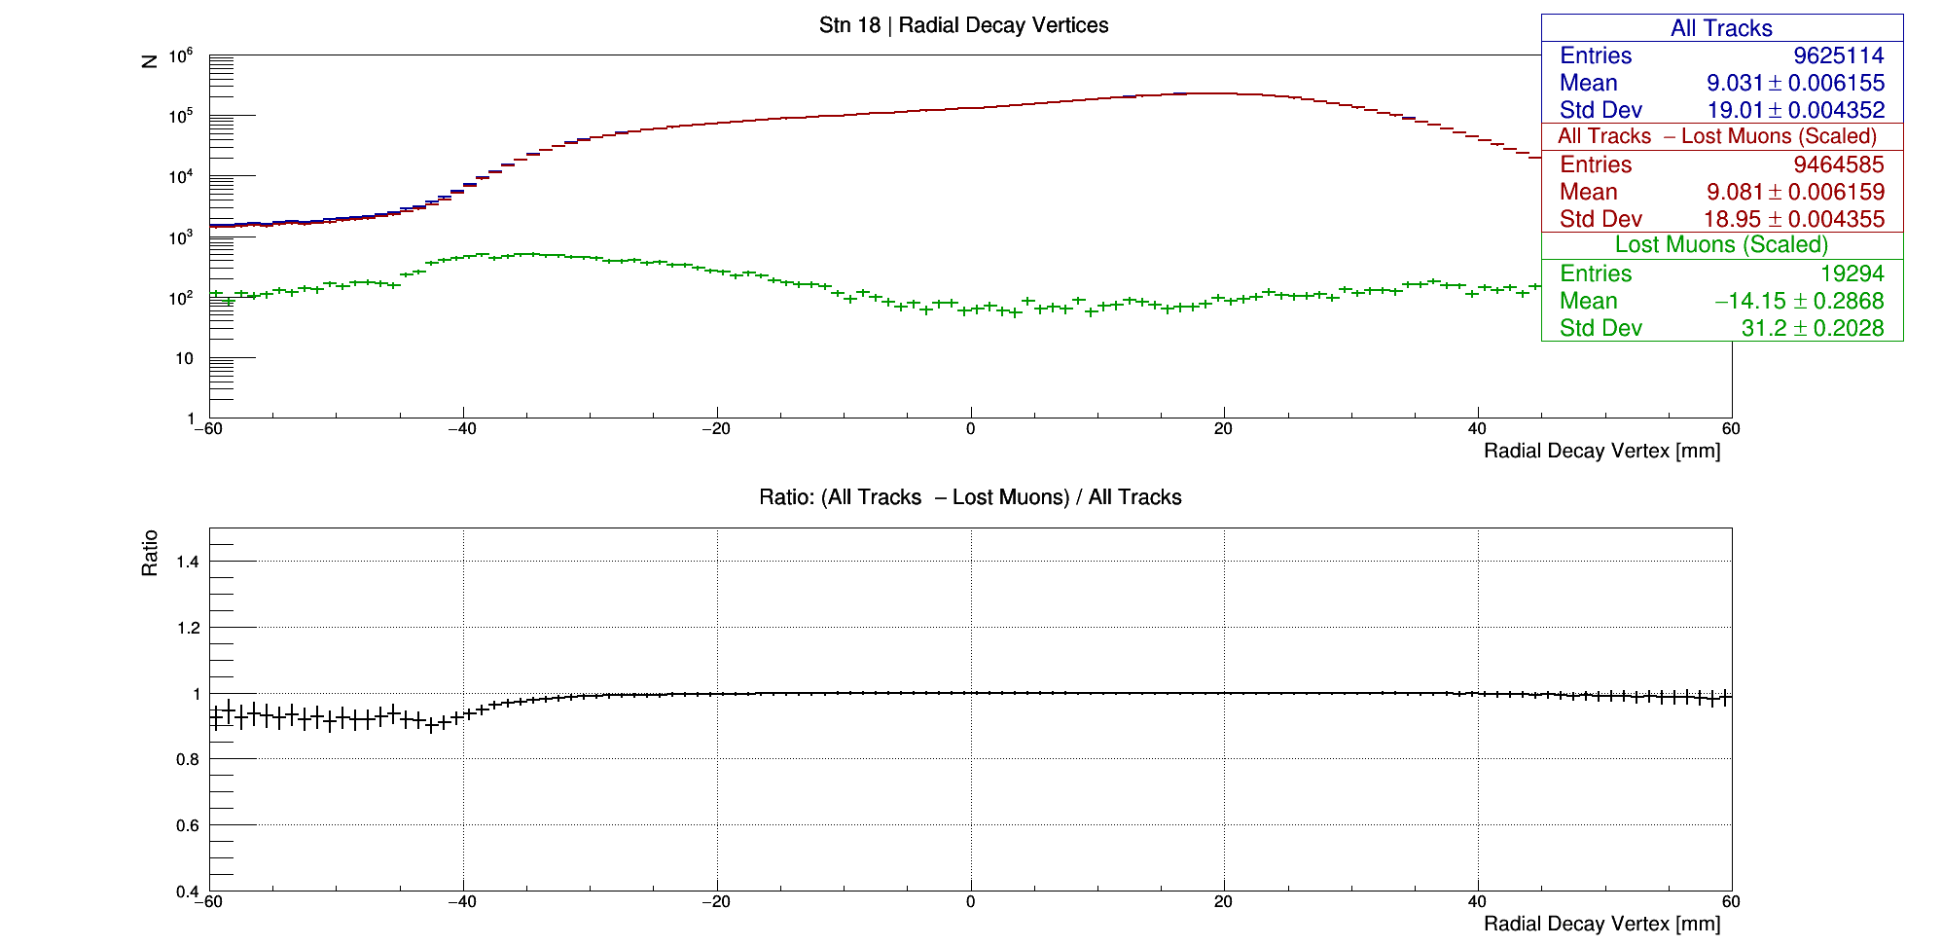
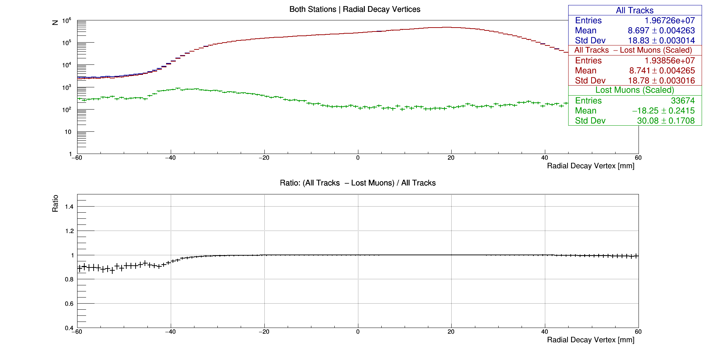
Radial decay vertices of all tracks (tracker only) with lost muons and non lost muons subtracted
+/-60 mm
******************* RESULT *******************
St 18 dMean = 0.049911+/-0.00870726
St 18 dRMS = -0.0630797+/-0.00615696
******************* RESULT *******************
Combined dMean = 0.0449787+/-0.00603013
Combined dRMS = -0.0545994+/-0.00426395

Slide 9
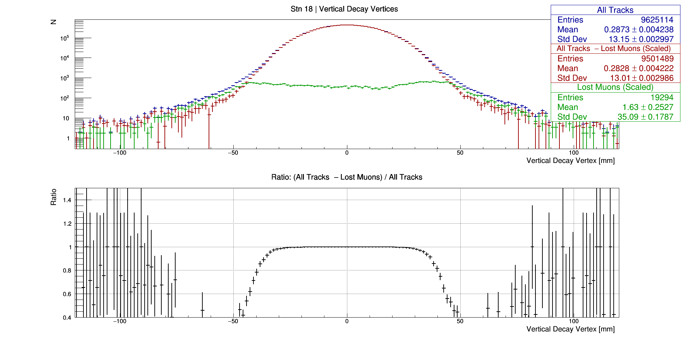
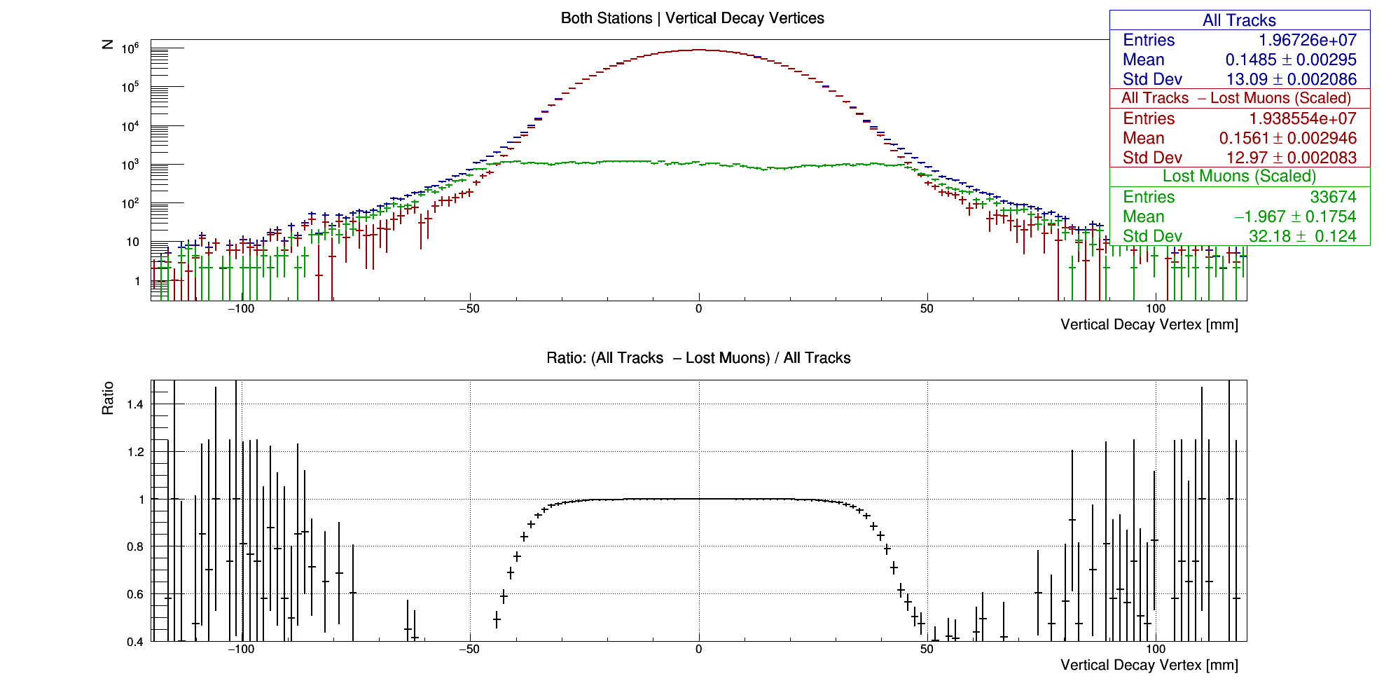
Vertical decay vertices of all tracks (tracker only) with lost muons and non lost muons subtracted
******************* RESULT *******************
St 18 dMean = -0.00456875+/-0.00598232
St 18 dRMS = -0.133843+/-0.00423014
******************* RESULT *******************
Combined dMean = 0.00765212+/-0.00416957
Combined dRMS = -0.113017+/-0.00294833

Slide 10
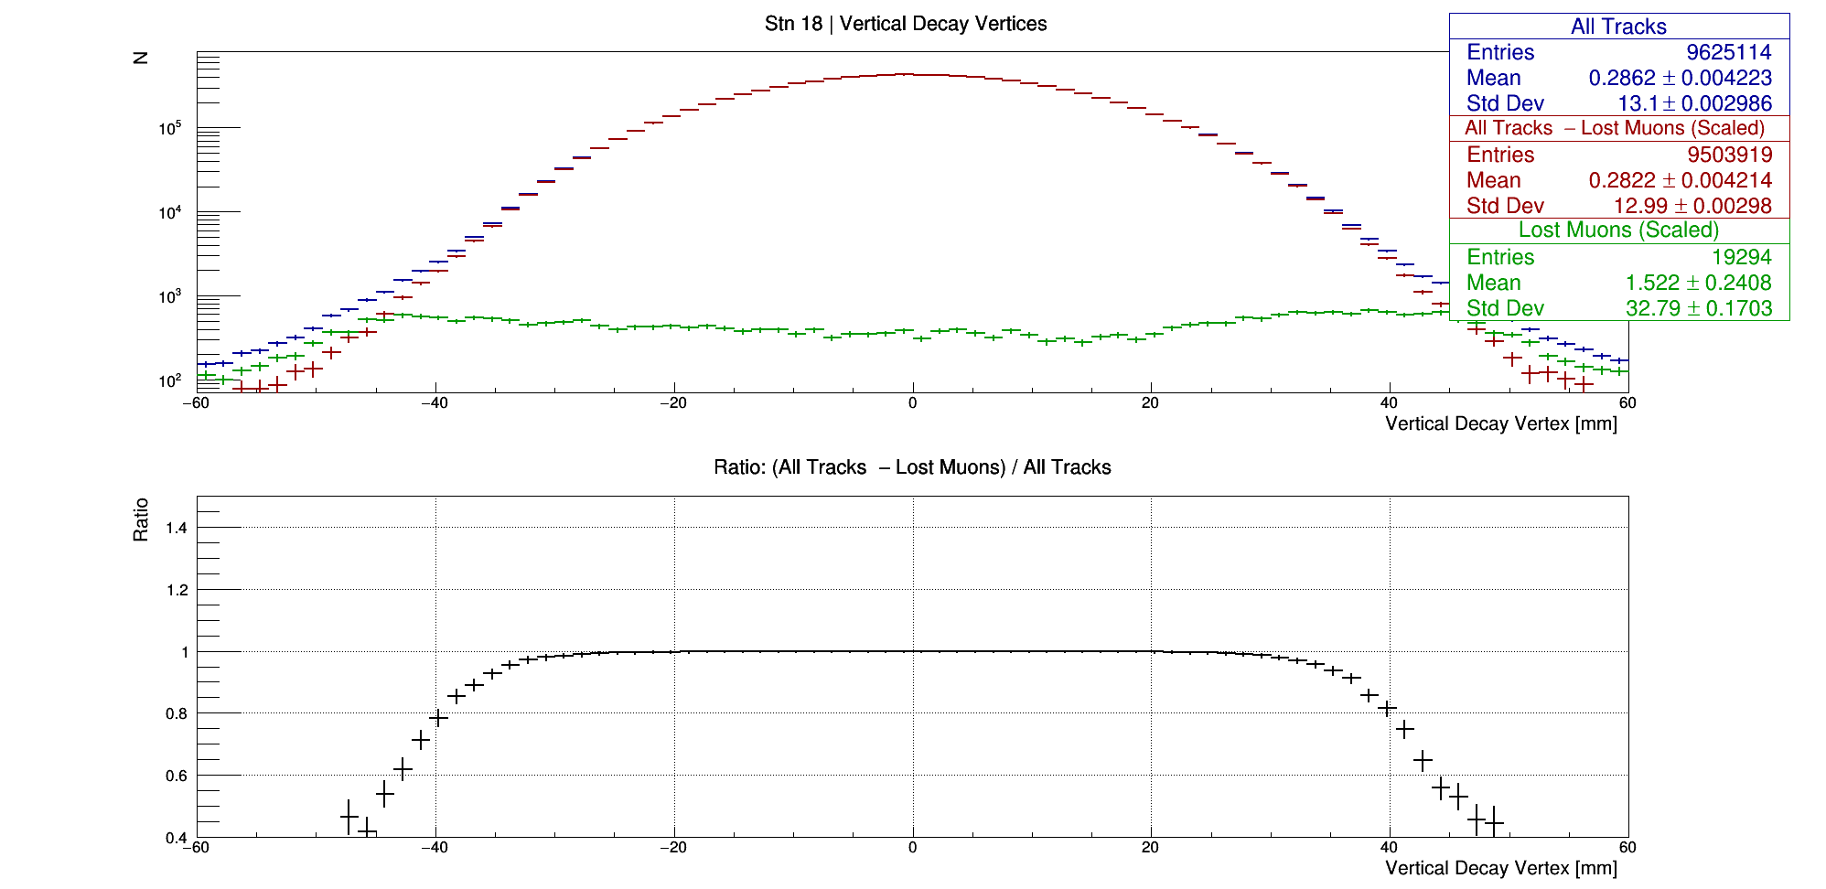

Vertical decay vertices of all tracks (tracker only) with lost muons and non lost muons subtracted
+/-60 mm
******************* RESULT *******************
St 18 dMean = -0.00403079+/-0.00596568
St 18 dRMS = -0.108883+/-0.00421838
******************* RESULT *******************
Combined dMean = 0.00796125+/-0.00416132
Combined dRMS = -0.0935658+/-0.0029425

Slide 11
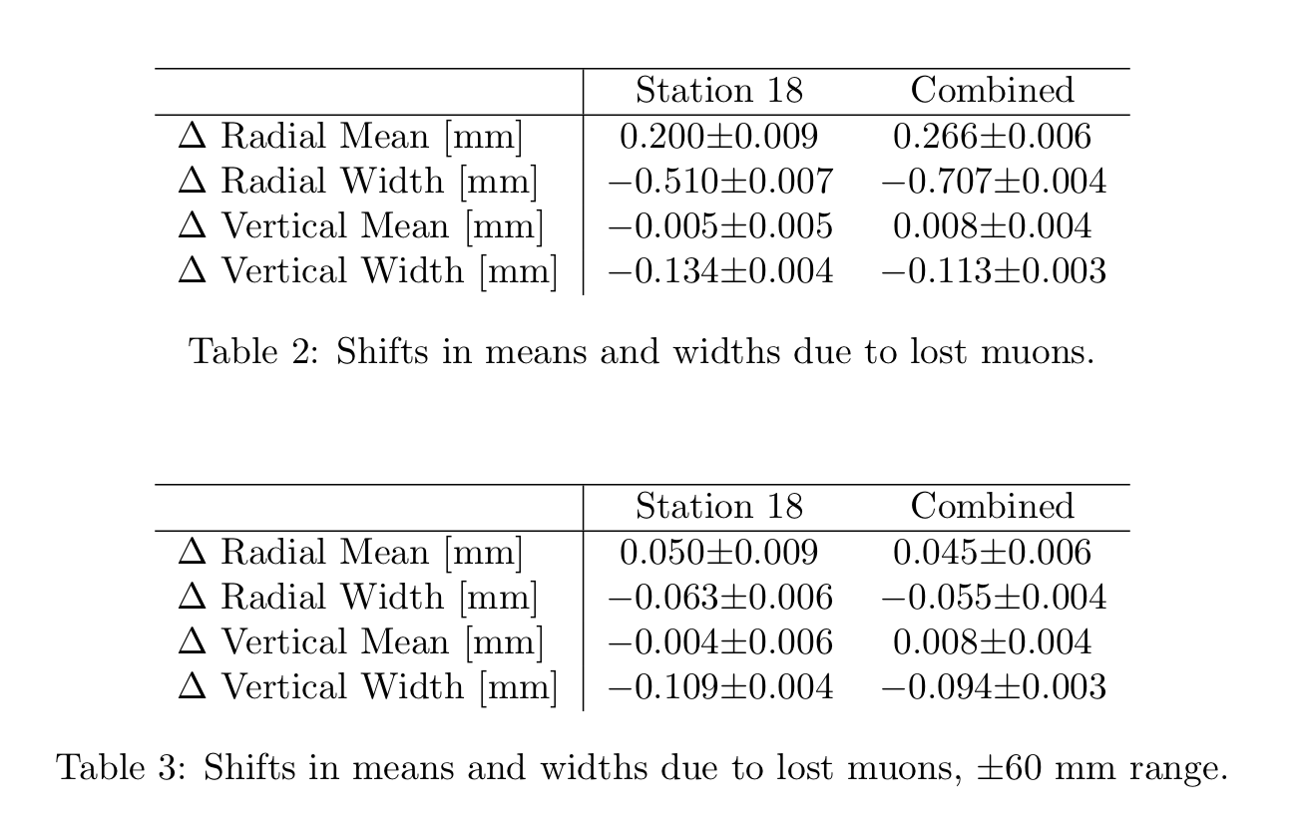
Results, presented nicely

