Slide 1

Introduction to Git(hub)
Notes:
Fonts: Use Futura for Headings, Tw Cen MT for everything else
Colors: Custom Color Pallette – CBA Official Colors Only (Look at style guide/ SC Johnson Branding website)
BI BAD

Slide 2
What is Git?
A version control system
A way to record and manage changes to a set of files
Can easily revert back to a previous state
Created in 2005 by Linus Torvalds
Guy who created Linux
Open source
Used for software development
Operated on the command line

Slide 3
What is Github?
Not Git
A website for hosting Git repositories
Owned by Microsoft as of 2018
Bought for $7.5B
Why? Developer relations
Compared to Apple or Android ecosystems, Microsoft development community is lacking
Largest host of open source code in the world
31 million users
57 million repositories
Used by individuals and businesses
Additional features
Documentation
Commit history
Visualization

Slide 4
Why use Git + Github?
Large, complex codebase
Multiple people working on codebase
Backup code to the cloud
Safely experiment with changes
Easily revert changes if they don’t work
Accountability of changes
Share code + documentation with the world
Street cred

Slide 5
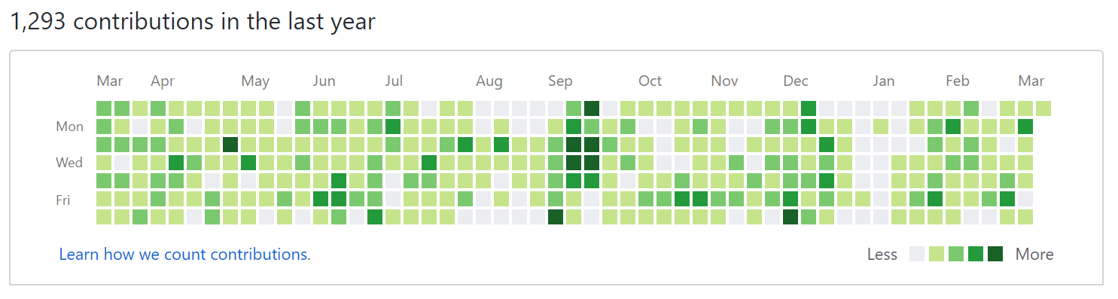
Street cred

Slide 6
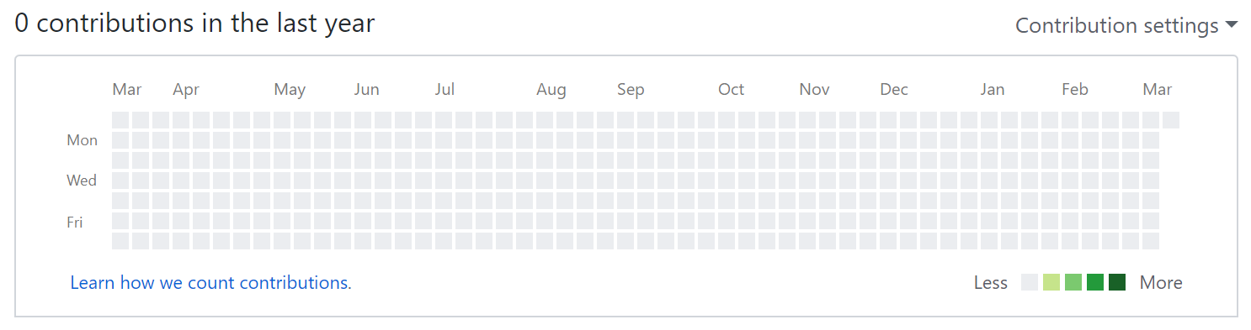
Not street cred

Slide 7
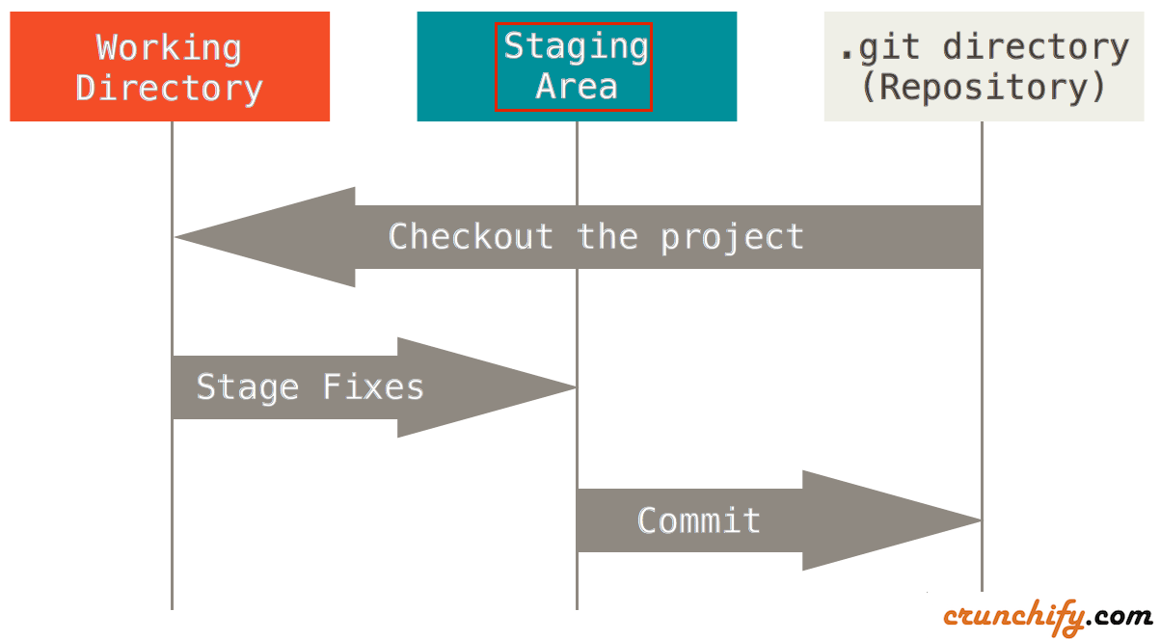
Git workflow

Slide 8
Git commands
git init
Initialize a git repository on your local file system
git clone <url>
Copy an existing repository to your current directory
git pull
Retrieve changes from remote branch
May have to merge those changes with yours if remote branch is ahead
git add <filename>
Add file(s) to staging area
Separates changes you want to commit from those you don’t

Slide 9
Git commands (cont’d)
git commit –m “<commit message>”
Commit files in staging area to repo
Files aren’t updated in remote branch yet
git push
Send local committed changes to remote branch
Only works if local branch is in sync with yours
git reset --hard origin/master
You f***ed up
Drop all local changes & commits and revert to head of remote master branch

Slide 10
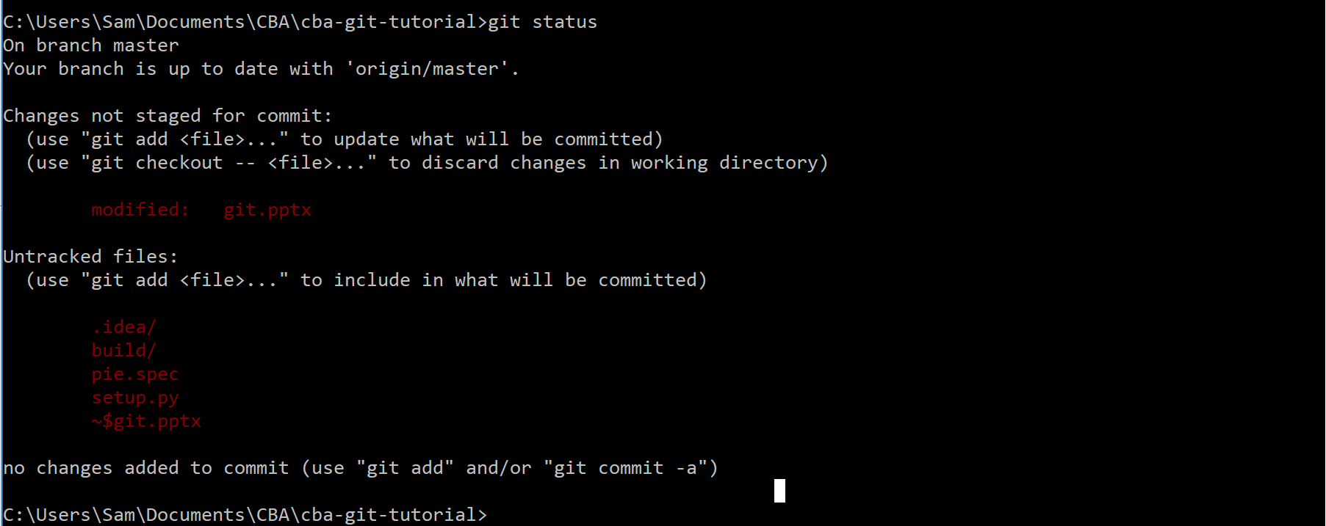
git status

Slide 11
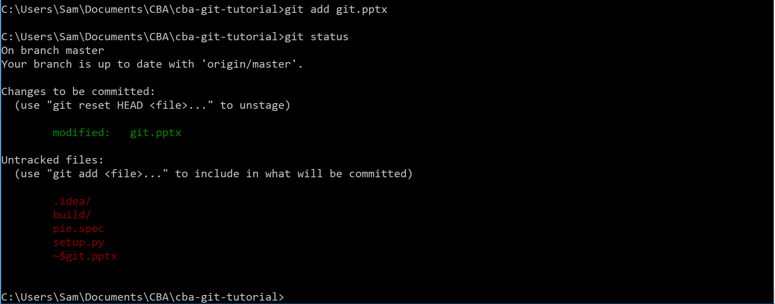
git add

Slide 12
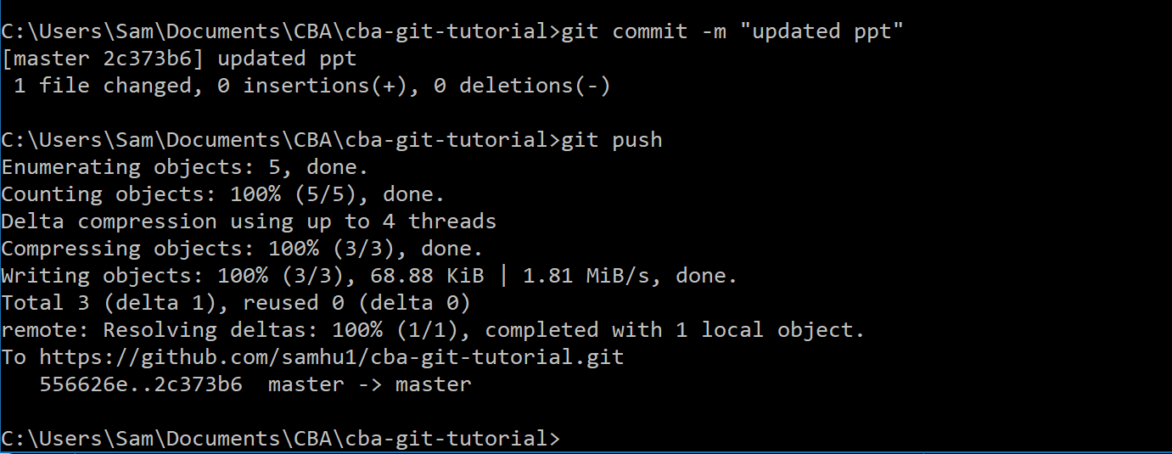
git commit/push

Slide 13
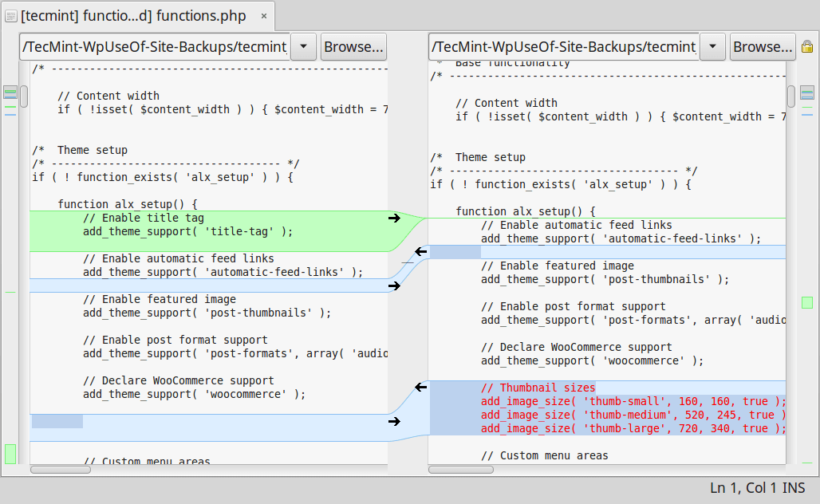
Merging changes (easy)

Slide 14
Merging changes (harder)
Newer changes
Older changes
Local |  | Remote
# | File 1 [Last pull: Commit 0] | File 1 [Commit 1] | File 1 [Commit 0]
1 | Type your name & fav animal! | Type your name & fav animal! | Type your name & fav animal!
2 | Jeff: Lion | Jeff: Lion | Jeff: Lion
3 | Sam: Capybara | Naviya: Tiger
4 | Jamal: Moose | Jon: Bear
5 | Victor: Dolphin
6

Slide 15
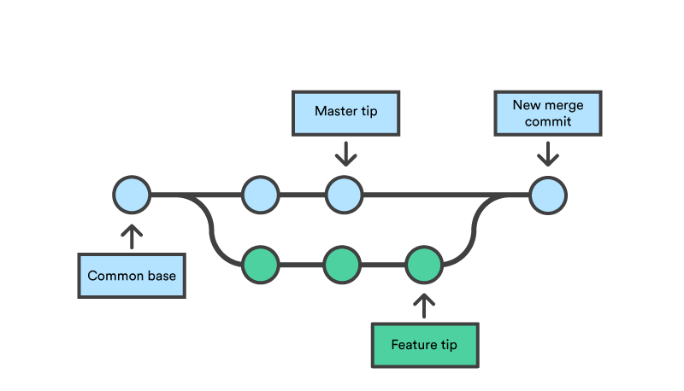
Branches

Slide 16
Exercise
Install Git
Mac:
Open Terminal
Type “git --version” into command line
Click Install
Windows
Go to “git-scm.com/download/win”
Download & execute the file
Go through install wizard with default settings

Slide 17
Exercise
Navigate to your Documents directory in command line
Type “git clone https://github.com/samhu1/cba-git-tutorial.git”
Navigate to the “cba-git-tutorial” folder in command line
Open “animals.txt”, type your favorite animal, and save
In command line, type:
git add animals.txt
git commit –m “<your name>”
git pull
git push origin master
Get an error? git reset –-hard origin/master and try again!

Slide 18
?

