Slide 1

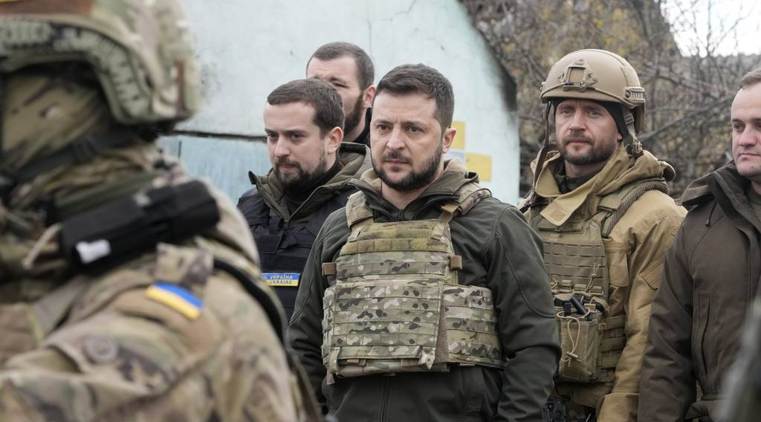

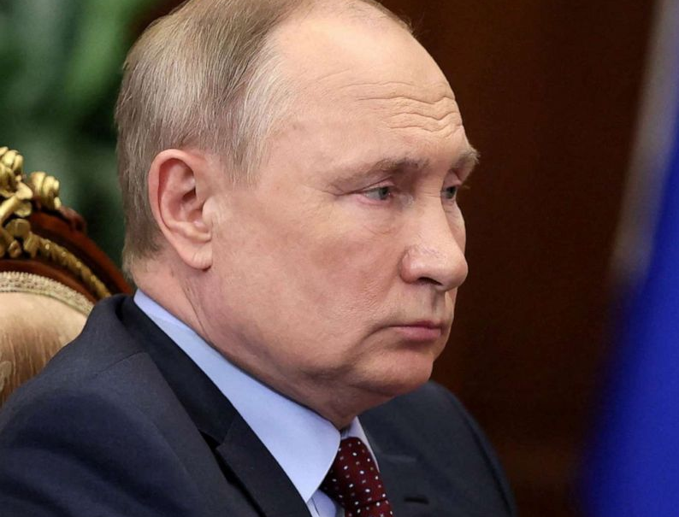

Slide 3
Russo-Ukrainian Conflict and Twitter: A Big Data Analysis
By Oscar Karlsson, Sam Hurenkamp and Ramin Darudi

Slide 4
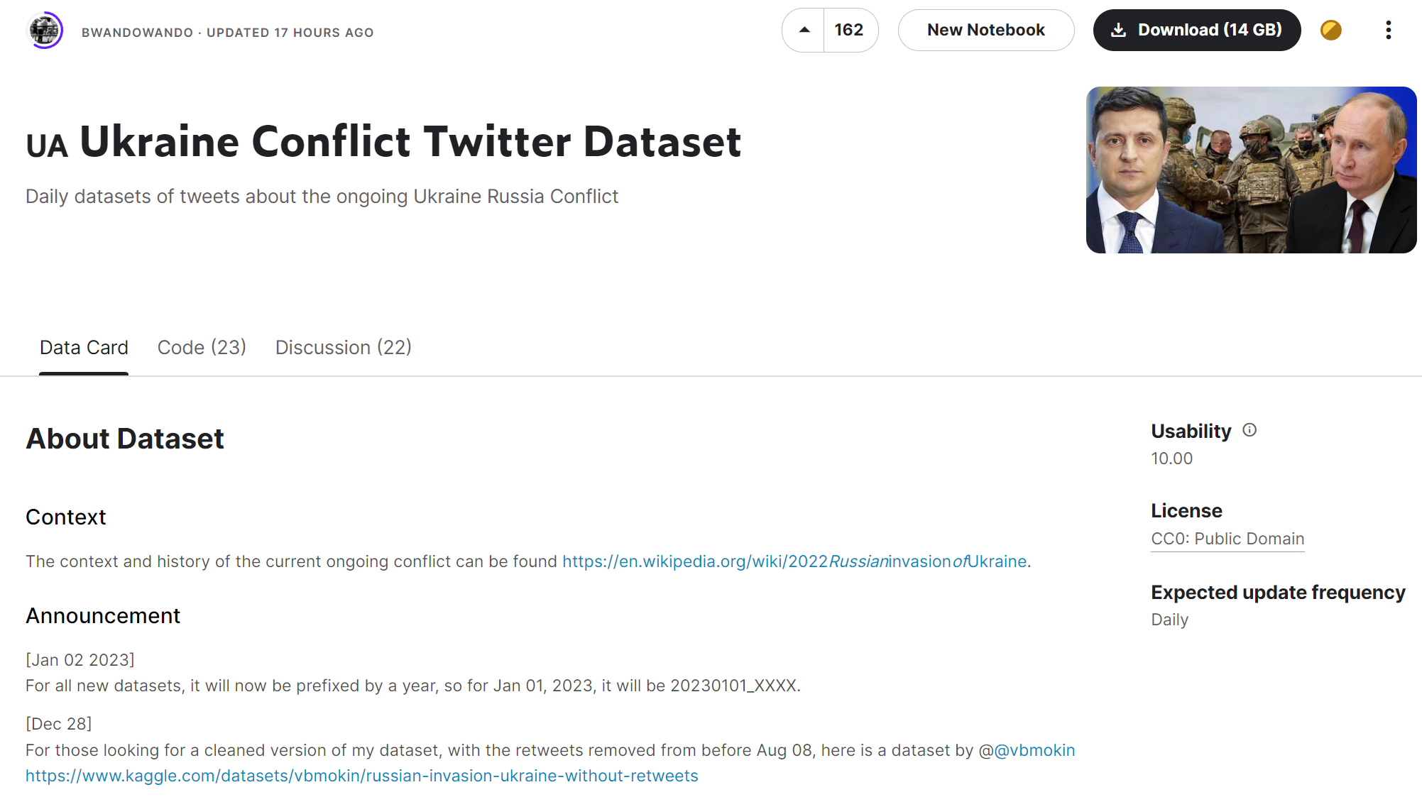
The Dataset
Available on Kaggle
10/10 Stability Score
Large 14GB twitter dataset
>1.2 million rows
Updated daily

Slide 5









Technologies Used

Slide 6
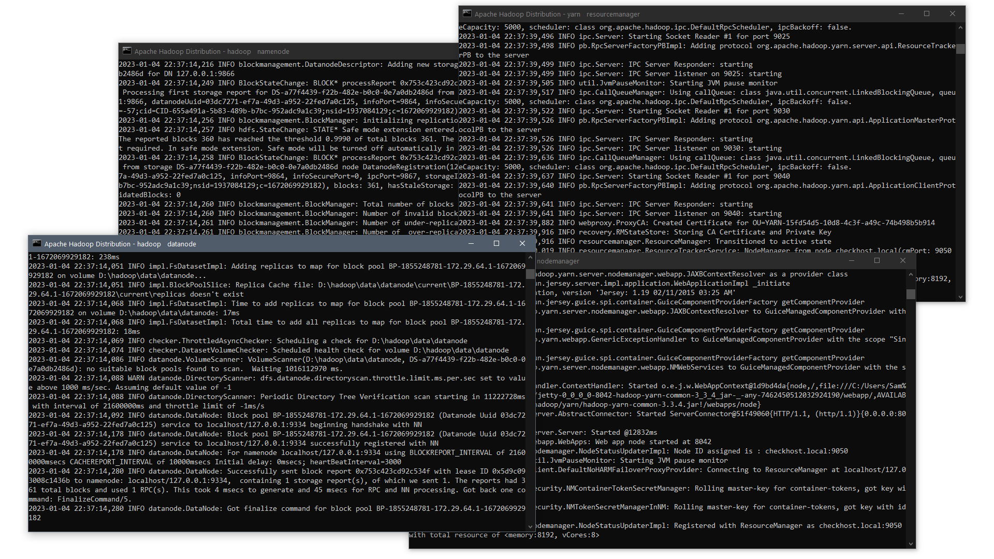
Technologies Used
Name node
Data node
Resource Manager
Node Manager

Slide 7
Technologies Used
Name node
Data node
Resource Manager
Node Manager

Slide 8
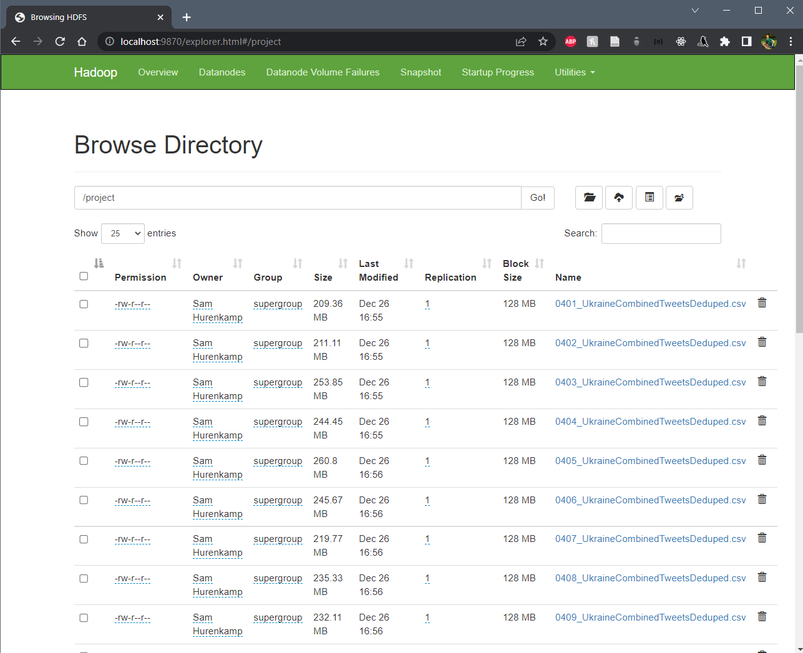
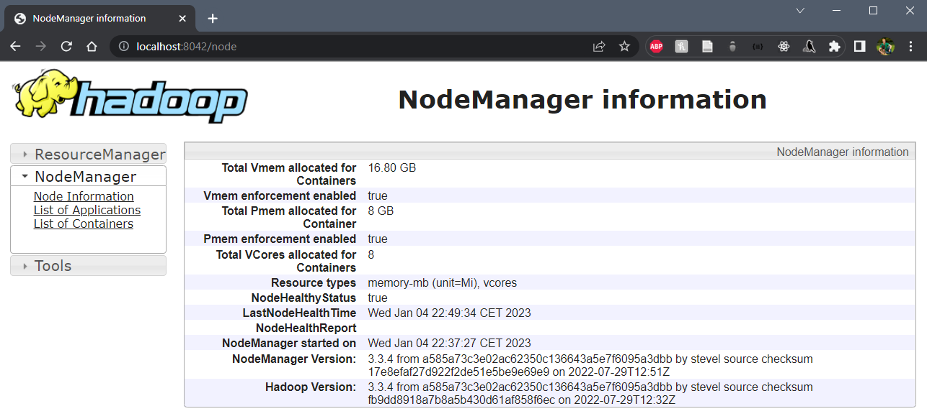
Technologies Used

Slide 9
Technologies Used
Actions and Operations
groupBy
agg
array_distinct
collect_list
explode
flatten
count
regexp_extract

Slide 10
Technologies Used

Slide 11
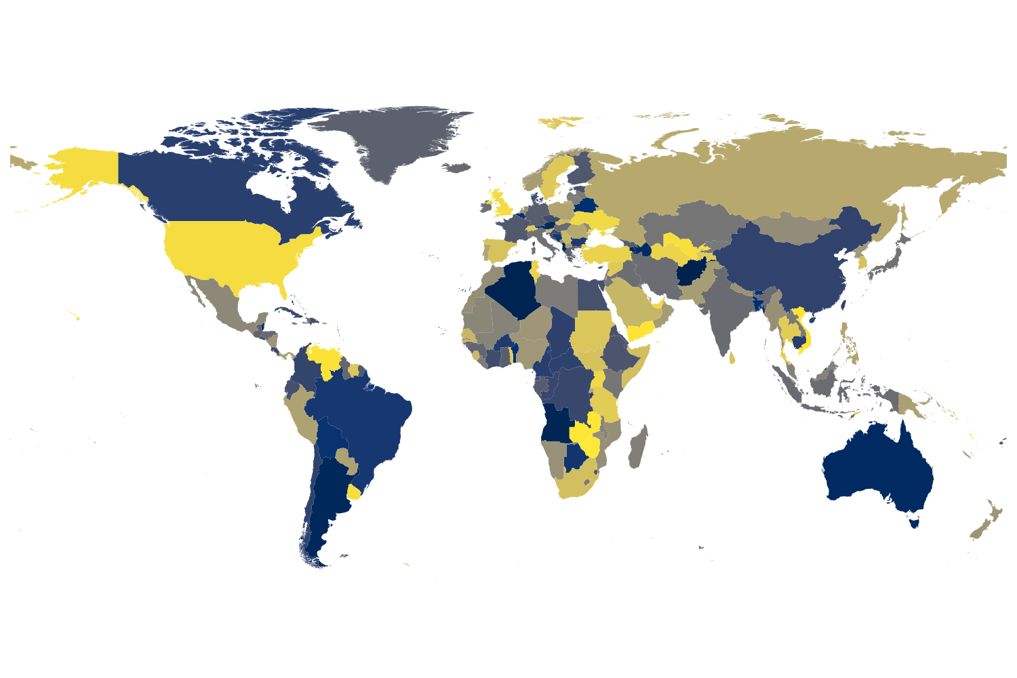
Technologies Used
.shp
Final Analysis

Slide 12
Revisions
We had originally wanted to calculate countries based on location as well
Worked fine on smaller datasets, but not on the accumulative
Had hoped to use mobileBERT or similar to classify a hashtag on whether is was negative or not
The probabilities obtained from these could have been used to color choropleth map tiles.
The results of these could have been applied to statistical models to investigate significance in various relationships

Slide 13
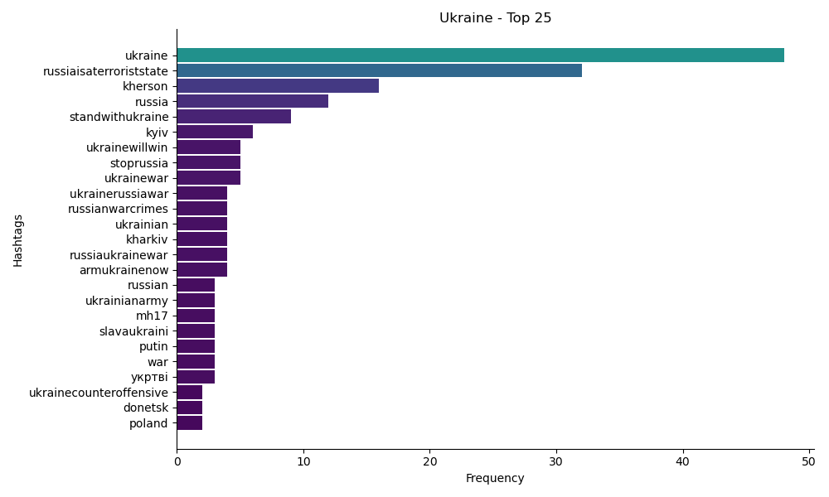
Revisions
Sample from 1118_UkraineCombinedTweetsDeduped.csv

Slide 14
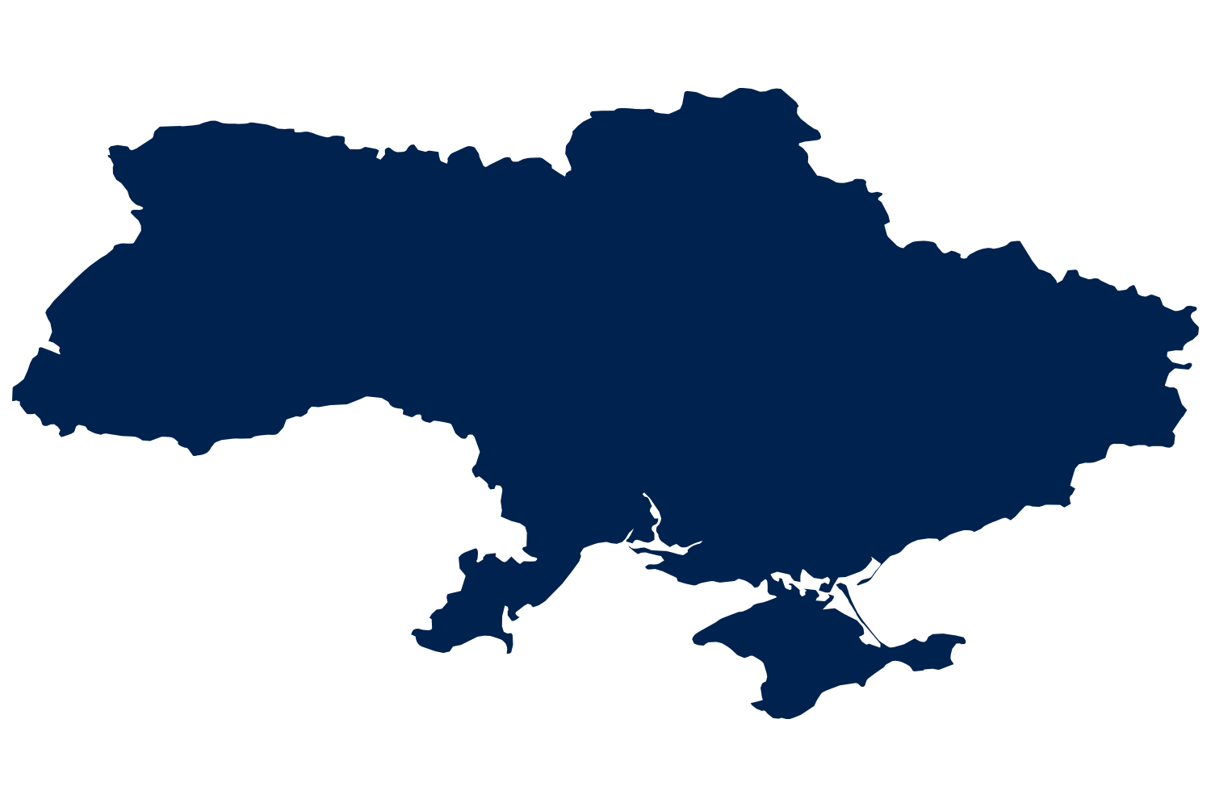
Revisions
Sample from 1118_UkraineCombinedTweetsDeduped.csv

Slide 15
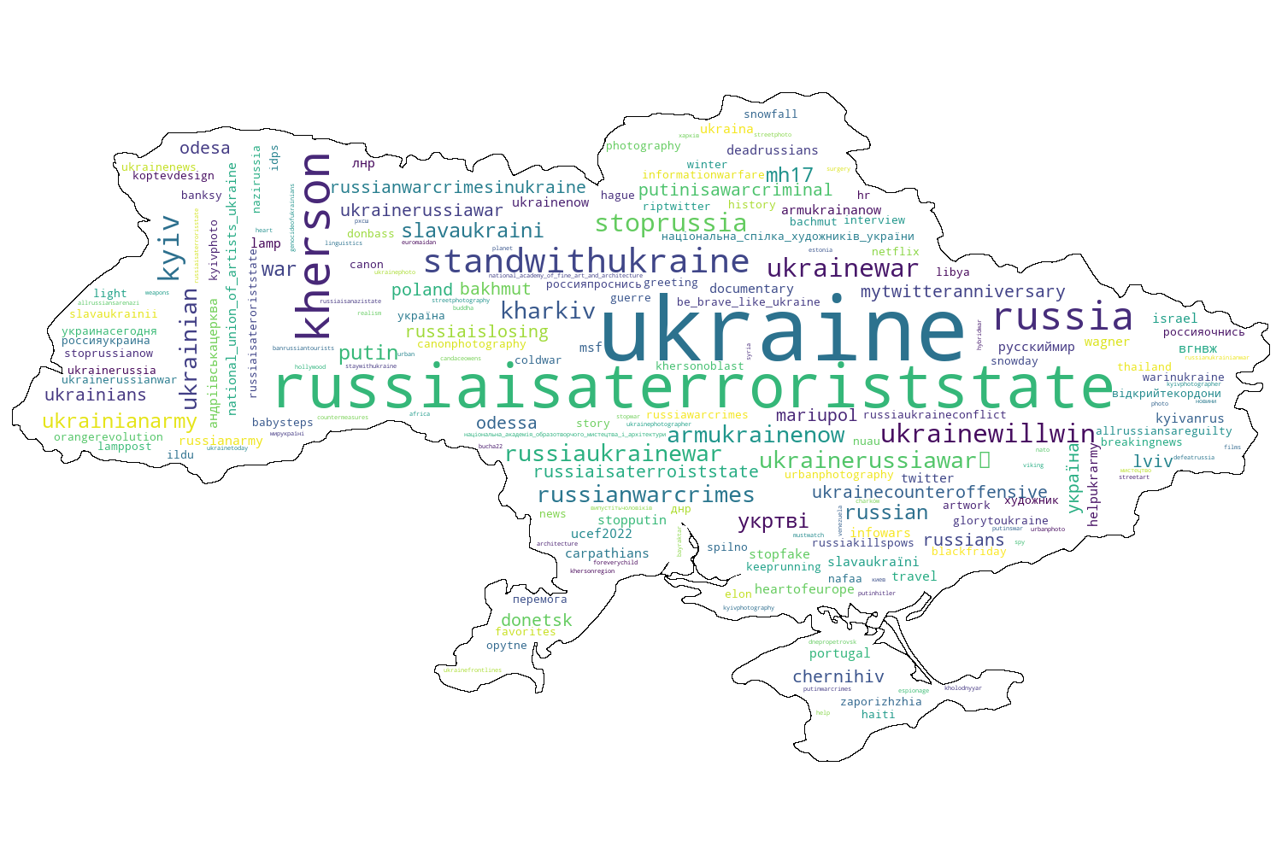
Revisions
Sample from 1118_UkraineCombinedTweetsDeduped.csv

Slide 16
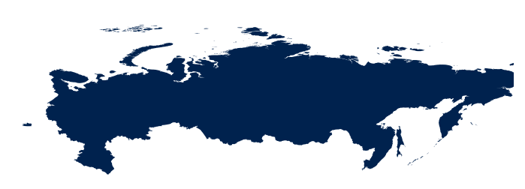
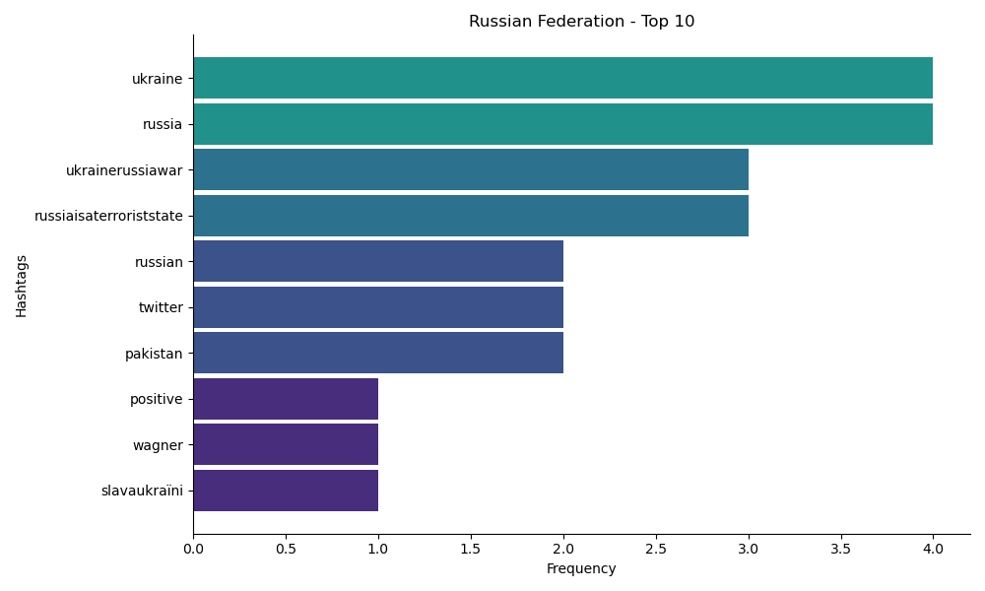
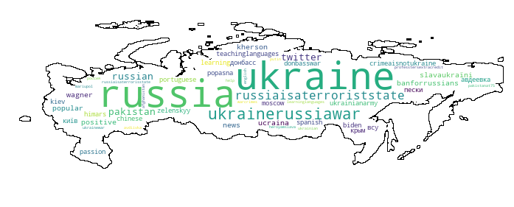
Revisions
Sample from 0814_UkraineCombinedTweetsDeduped.csv

Slide 17
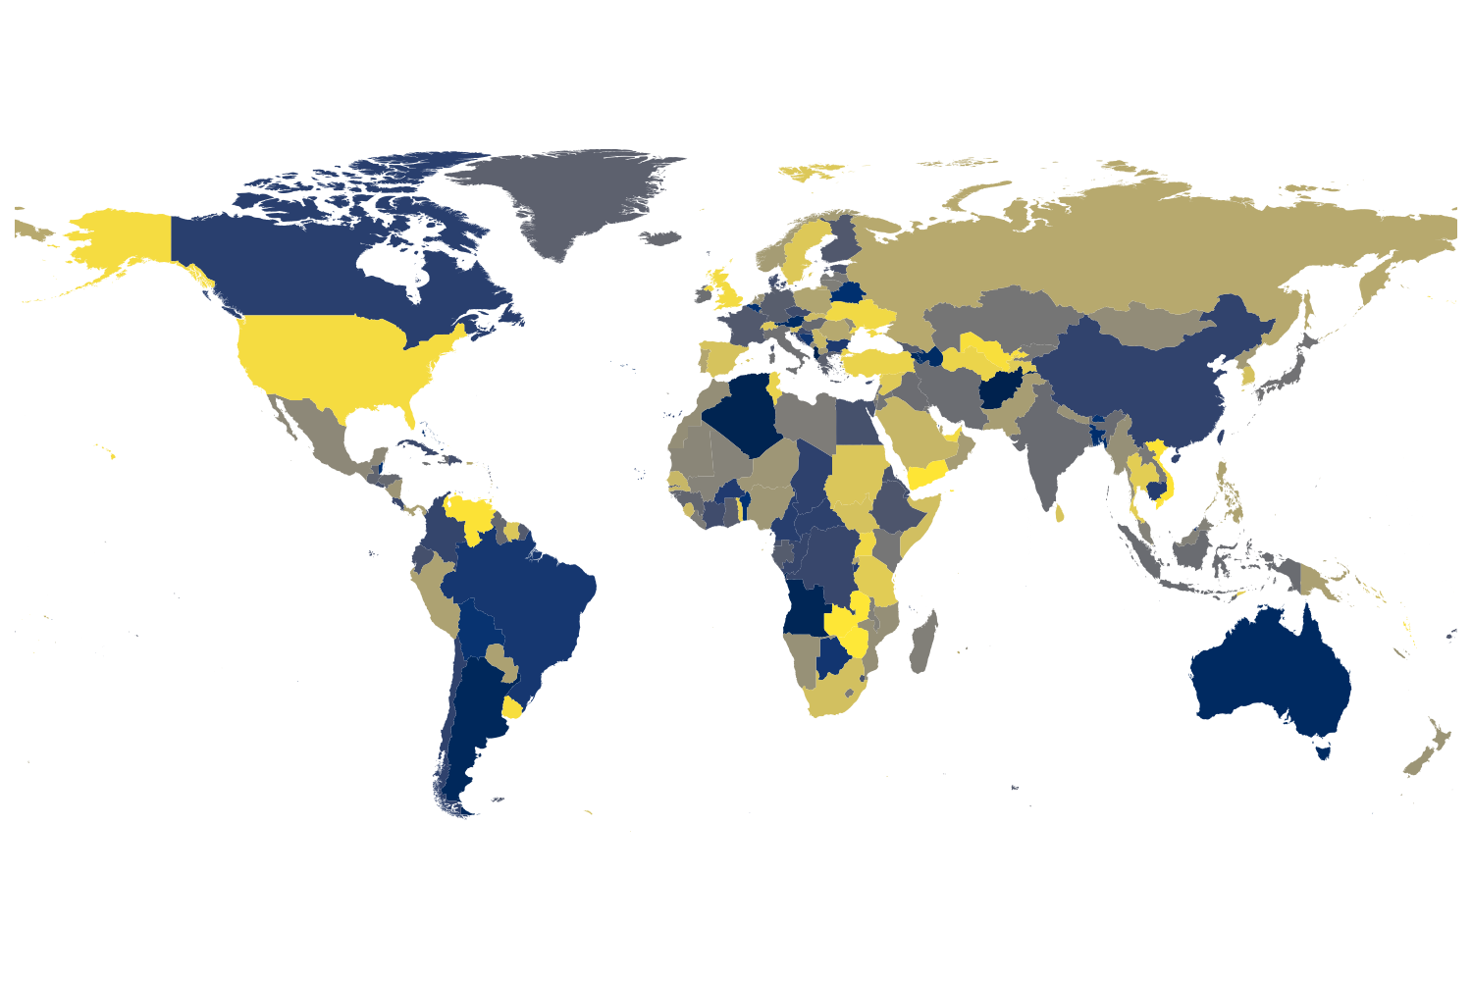
Results
Hashtags on global tweets without filtering for country

Slide 18
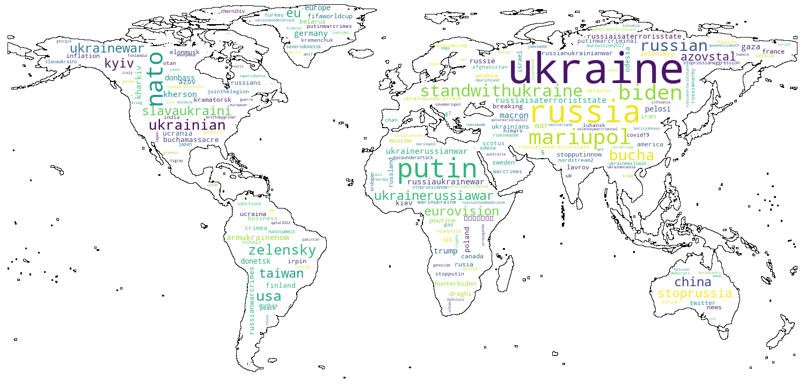
Results
Hashtags only on global tweets without filtering for country

Slide 19
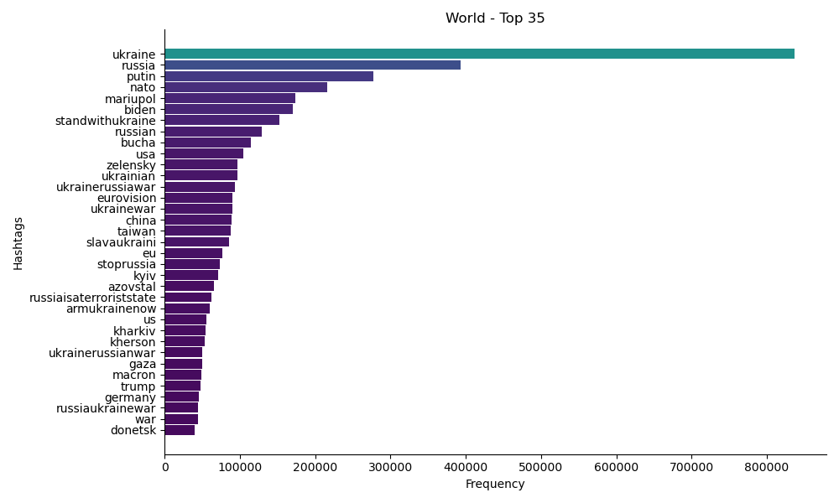
Results
Hashtags only on global tweets without filtering for country

Slide 20
Summary
The tools provided by Apache Hadoop & PySpark allowed us to perform data pre-processing and analysis on datasets of large sizes, for which traditional sequential methods (e.g., Pandas) are unsuited.
Although our initial goals were not realized within the constraints of this project, we feel that we have obtained a very useful insight into the world of Big Data as a result of our work

Slide 21
Thank You

