Slide 1
Agentic AI Assistant for Enterprise Task Automation
Overview, Architecture, Deployment & Management

Slide 2
Introduction
This tool enables enterprise users to automate repetitive tasks using natural language commands. It integrates with applications like Jira, SAP, etc., via APIs, and performs actions securely with role-based access control.

Slide 3
Key Features
- Natural language task execution
- Role-based permissions
- Application-specific plugin tools
- Integration with enterprise software (Jira, SAP, etc.)
- Logging and audit trails

Slide 4
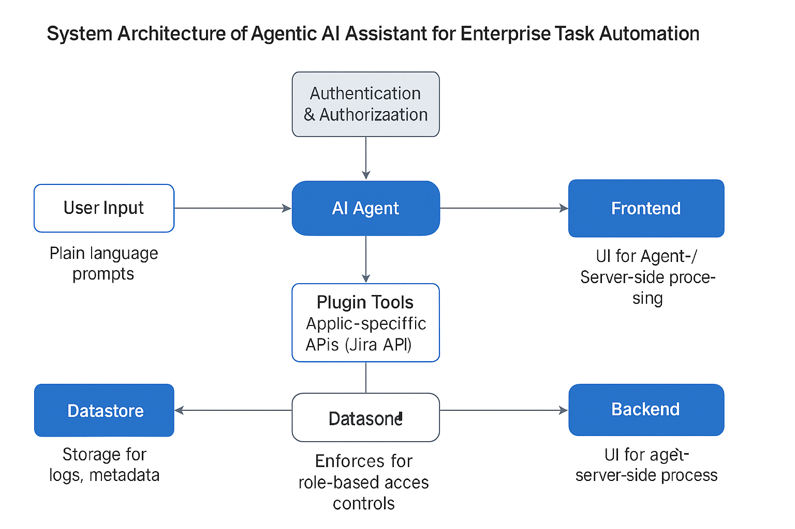
System Architecture

Slide 5
Process Flow
1. User logs in via frontend interface
2. Enters task using natural language
3. AI agent parses input and determines task
4. Agent verifies permissions based on role
5. Connects to plugin tools (e.g., Jira API)
6. Executes task and returns result to user
7. Logs operation in datastore

Slide 6
Technology Stack
- Frontend: React / Angular
- Backend: Node.js / Python (FastAPI)
- AI Layer: OpenAI GPT-4 + LangChain or similar
- Data Store: PostgreSQL / MongoDB
- Auth: OAuth 2.0 / SSO (Keycloak)
- DevOps: Docker, Kubernetes, CI/CD

Slide 7
Deployment & Management
- Hosted on secure cloud (AWS, Azure, GCP)
- Containerized using Docker
- Scaled with Kubernetes
- Logs monitored via ELK or Prometheus
- RBAC managed via central Auth service
- API rate limiting & audit logging enabled

Slide 8
Summary
Agentic AI Assistant can streamline repetitive enterprise operations across tools like Jira. It is modular, secure, and scalable. This deck outlines the steps to build, deploy, and manage it as an extensible solution.

