Slide 1
Data Sci 450 Capstone Project
Kaggle Competition: Understanding the Amazon From Space
Team Megaseed
By Sam Robinson

Slide 2
Overview
 | Time Spent | Additional Notes
Understanding the data | 3 Days | First time working with images for machine learning algorithm.
Data Exploration | 2 Days | Sped up a lot by the resources available at kaggle.com
Features / Feature Engineering | 7 Days | Learned about NVDI and NDWI. Was great learning about techniques for image manipulation and I wish I had more time to work on more features.
Building the Model | 1 Day | Was great getting the basics of Keras and Tensorflow down. I was really proud of the layer merging that I did and came up with alongside my features.
Evaluating the Model | 1 Day | Wish I had more time for this. I need more time to get the model visualization down and to run with enough epochs to get better answers.

Slide 3
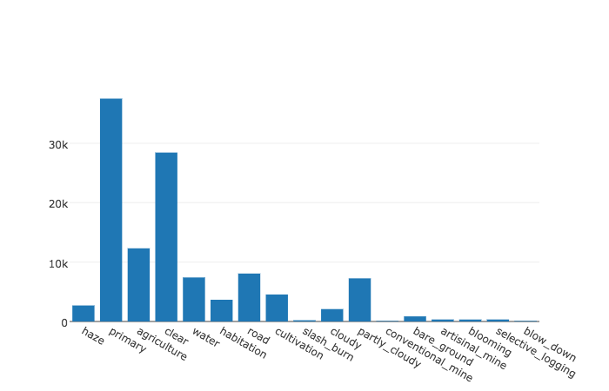
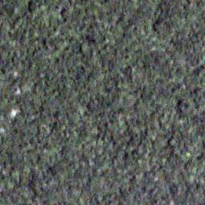
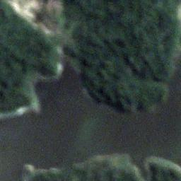
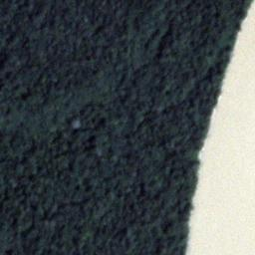
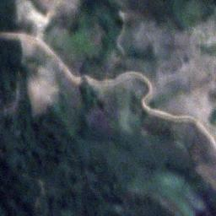
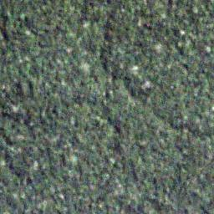
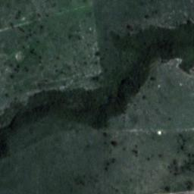
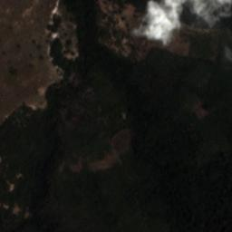
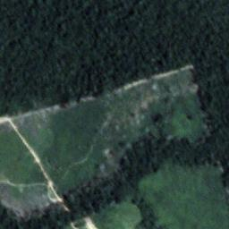
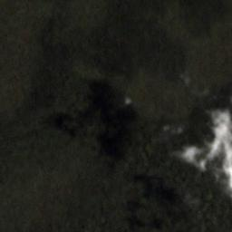
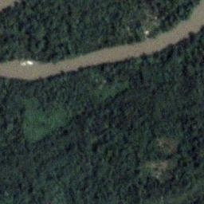
Data
The data I am working with is TIFF images. TIFF images can hold many bands of information on the same image but the TIFFs in this data set are RBG and also NIR which stands for Near Infrared. The NIR data is particularly interesting because it is used in image manipulation to make water and vegetation pop out of the image more. Ideally we would have many bands of light (visible and not visible) per image but even with NIR we can do some interesting things. The Kaggle competition calls them chips where each pixel represents 3X3 meters of space.
The data was also tagged, the tags represented many features and many of the chips has 2-3-4 features on them. There were 17 tags in total which I ended up representing as a binary array of data. Getting output into this format with Tensor Flow was easy.

Slide 4
Feature Engineering
In addition to being able to use the images themselves as my features I created 5 additional versions of the image to assist in my neural network training and testing. As a result I ended up with 6 images to feed into 6 branches of my neural network.
1. RGB version of the image
2. A normalized difference vegetation index (NDVI) version of the image.
3. A normalized difference water index version of the image.
4. An edge detection of the rgb image.
5. An edge detection of the NDVI image.
6. An edge detection of the NDWI image.
While the edge detection of the NDVI and NDWI image may seem redundant I believe it does a better job of highlighting the important features when being processed by the NN.

Slide 5
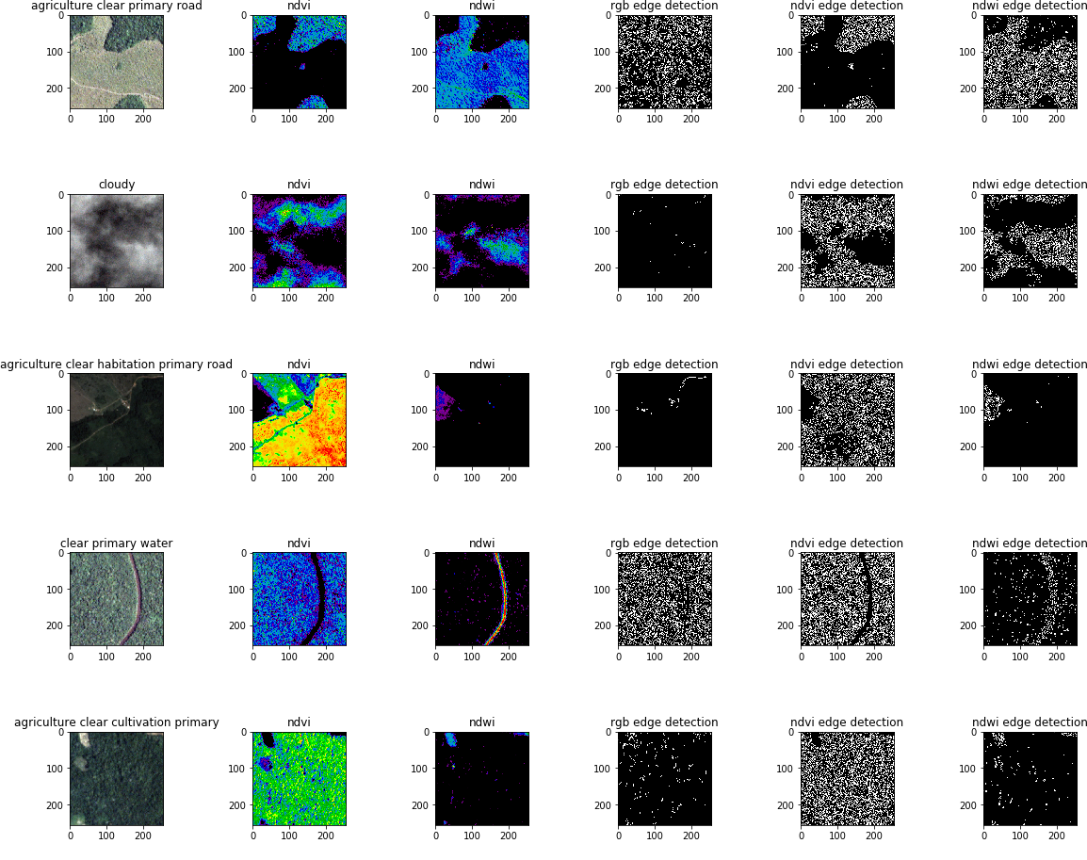
Feature Visualization

Slide 6
Tensor Flow Model
Model: Tensor Flow – Convoluted Neural Network
I am using merged layers to get my final results. This is not a true ensemble approach but it lets me take many branches with different inputs to get my singular output.
I used jupyter notebook with tensor flow to get my results.
RGB IMG Branch
2d Convolution Layer
Dense NN Layer
Additive Branch Merge
Change
Shape
NDVI IMG Branch
2d Convolution Layer
Dense NN Layer
Flatten Data
NDWI IMG Branch
2d Convolution Layer
Dense NN Layer
Convert To
Output Shape
Change Data Shape
RGB Edge Branch
2d Convolution Layer
Dense NN Layer
Dense NN to 17 Data Points
NDVI Edge Branch
2d Convolution Layer
Dense NN Layer
NDWI Edge Branch
2d Convolution Layer
Dense NN Layer
Final Output

Slide 7
Model Evaluation
I used an F score to determine my model’s accuracy.
Unfortunately the model takes too long to run and I could not get a sufficient number of Epochs.
Epoch 1/3: 4281s - loss: 2.6718 - acc: 0.8299
Epoch 2/3: 4161s - loss: 2.6844 - acc: 0.8322
Epoch 3/3: 4343s - loss: 2.6844 - acc: 0.8322
Going forward I need to optimize my model. I believe I can do this by combining the edge images into a single image. Each type of edge would become Red, Blue or Green and then the 3 images would be combined into one. Not used currently due to time constraints.
Current F-Score: 0.657506315582 (needs a lot more time to train right now)

Slide 8
Key Learning
How to work with tensor flow, keras, sklearn, jupyter notebooks, matplot lib and general rules around image processing.
Really fun to learn about image manipulation to detect features like water and vegetation. I wish I had more data available to perform more complex analysis.
First foray into neural networks with Python, I clearly need to do some major optimizations.

Slide 9
WHATS NEXT!
Improved my features to use less disk space and processing power.
Playing around with the individual branches of my model to improve their predictive accuracy.
Changing the order and cadence to merging to see if it improves accuracy.
Run the model with many more epochs.

