Slide 1
Data Science UW
Methods for Data Analysis
Introduction and Data Exploration
Lecture 1
Nick McClure

Slide 2
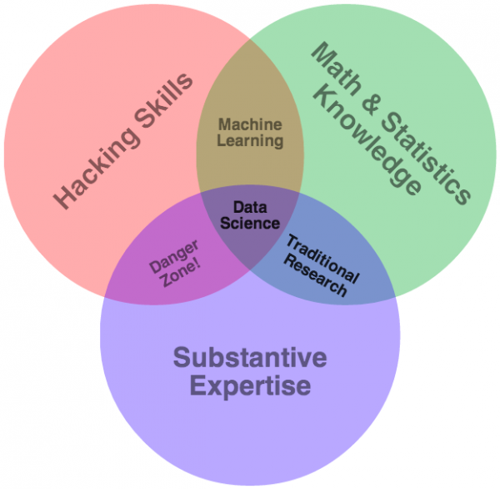

Slide 3
Course Purpose
This course isn’t designed to make you an expert
This course is designed to point you in the right direction
Course Objectives:
Statistical tools for data exploration
The use of R to apply these tools to real data
Using inferential statistics to interrogate data
Testing and experimental design
Bayesian and classical statistics
See syllabus for more information:
On Canvas
Or http://nfmcclure.github.io/DataScience350/

Slide 4
Course Requirements and Grading
This course will be graded by attendance, homework, and an individual project.
Attendance: You MUST attend at least 6 out of 10 classes. This is non-negotiable, a UW requirement.
Homework must be completed by the start of the next class. (Assigned weeks 1-8).
Returned as a score between 0 and 2.
2 pts: The homework is well done, submitted on time.
1.5-1.9 pts: The homework mostly satisfies the criteria. The major concept of the homework was done correctly with minor programming or statistical errors.
1-1.4pts: The homework misses some key points of the objectives.
0-1pt: The homework needs much more work in both the statistical and programming structure.
All late homeworks receive a 0.5 point deduction.

Slide 5
Individual Project
Individual Project: Due at the start of the last class.
Counts as 8 points.
Must use at least two distinct statistical methods covered in this class.
Projects are usually heavily involved either with data gathering xOR with statistical methods.
Doing a project that is heavy on both is not recommended.
By the beginning of the third class, you will have sent me a project proposal email. It is worth 0.25 points as part of homework #2.
Ideal project schedule:
By the 5th class, have acquired all necessary data.
By the 8th class, have written all code for the project.
By the 9th class, have a first draft of the project write up.
By the 10th class, submit project.

Slide 6
Course Requirements and Grading
There is a total of 24 possible points. (16 pts for hmk + 8 project)
Must get 18 total points to pass.
4 homework assignments must be made in a production level script (every other one = 2,3,5,7).
4 homework assignments are regular script writing (every other one = 1,4,6,8).
The individual project must be production level code.

Slide 7
Office Hours and Contact Information
List of ways to contact me:
nickmc@uw.edu (updated every hour or so)
nfmcclure@gmail.com (updated quite continuously)
When I’m usually available:
Off/on for simple things during work. (M-F 8am-5pm PST)
Mon-Wed 7pm-10pm.
Sunday various afternoon/evening times.
Emergency contact: 402-980-3192

Slide 8
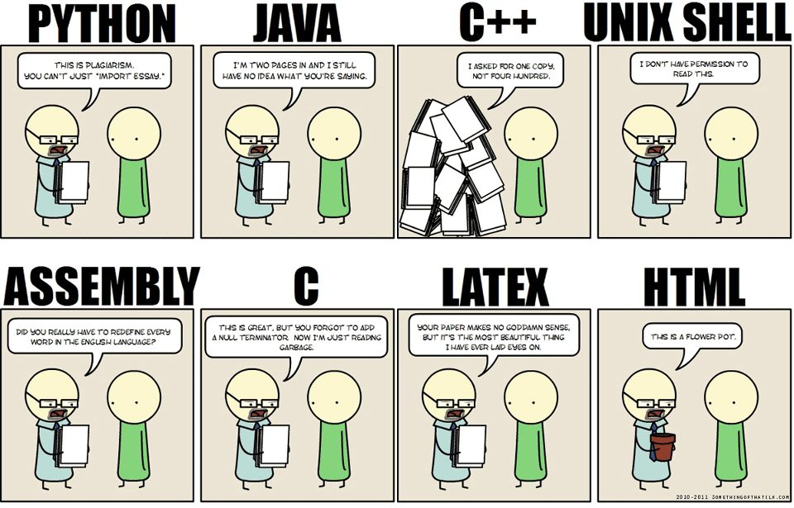
Review

Slide 9
Topics
Probability and Statistics
Counting
Axioms of Probability
Probability Examples
R Programming Review
R Resources
Data Exploration in R

Slide 10
Why Counting?
Counting is fundamental to probability theory.
Probability is the extent or likelihood of an event or set of events.
Depends heavily on the ability to count up potential outcomes.

Slide 11
Counting
This is one of the biggest areas of mathematics, called Combinatorics.
Example:
Subway has 4 different breads, 5 different meats, 4 different toppings. How many sandwich combinations?
How many different 4-beer tasters can I have in a bar with 10 beers on tap?
Solve these using the ‘Multiplication Principle’.
Subway Problem:
Beer Problem:
4
*
5
*
4
= 80
(# of breads)
(# of meats)
(# of toppings)
10
*
9
*
8
*
7
= 5,040
(# for 1st beer)
(# for 2nd beer)
(# for 3rd beer)
(# for 4th beer)

Slide 12
Multiplication Principle
If there are A ways of doing task a, and B ways of doing task b, then there are A*B ways of completing both tasks.
Example:
If I have 5 books, how many ways can I order them on the bookshelf?
= 5 factorial = 5! = 120
5 choices *
4 choices *
3 choices *
2 choices *
1 choice
1st book
2nd book
3rd book
4th book
5th book

Slide 13
Factorials
Factorials
Count # ways to order N things = N!
Factorials get VERY large quickly.
21! Is larger than the biggest long-int in 64 bit.
21! = 5.1E19
Biggest long int (64 bit) = 9.2E18
Fun fact, every 52 card shuffle is highly likely to be the only time that shuffle has ever occurred.

Slide 14

Counting Subgroups
Revisit: 10 beers on tap, need a sample of 4 different beers.
Let’s assume order matters, i.e., Amber-Stout-Porter-Red is different from Red-Porter-Stout-Amber.
Use ‘Permutations’ (pick):
$$10∗9∗8∗7=\frac{10!}{6!}=\frac{10!}{\left(10−4\right)!}=10P4=P(10,4)$$

Slide 15



Counting Subgroups
Now, Let’s assume order doesn’t matter.
Use ‘Combinations’ (choose):
$$10∗9∗8∗7=\frac{10!}{6!}=\frac{10!}{\left(10−4\right)!}=10P4=P(10,4)$$
$$\left(\# of orderings of 4 beers\right)=4!$$
$$=\frac{10!}{4!\left(10−4\right)!}=10C4=C\left(10,4\right)=\left(\begin{matrix}10 \\ 4\end{matrix}\right)$$

Slide 16
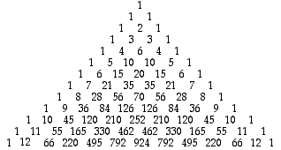

More on Combinations
Combinations appear on the Pascal’s Triangle!
C(N,x) appears on the Nth row, xth number (starting at 0)
$$\left(\begin{matrix}10 \\ 4\end{matrix}\right)$$

Slide 17


Counting Examples
There are 10 Light beers on tap, and 10 Dark beers on tap, how many ways can Rick get a 4-beer sampler that contains exactly 1 light beer? (ordering doesn’t matter)
$$\frac{(\# of ways for light beer)∙(\# of ways for dark beer) }{(\# of ways to order 1L and 3D)}$$
$$\frac{(10)∙\left({10 \atop 3}\right)}{4}=\frac{10∗120}{4}=300$$

Slide 18
Counting Examples
6:5 Blackjack is dealt with a 6 shoe deck (52*6=312 cards). How many ways can someone get dealt two rank 10 cards?
$$\left({6decks∗4ranks∗4suits \atop 2}\right)=\left({96 \atop 2}\right)=\frac{96!}{2!(94!)}=\frac{96∗95}{2}=4560$$

Slide 19
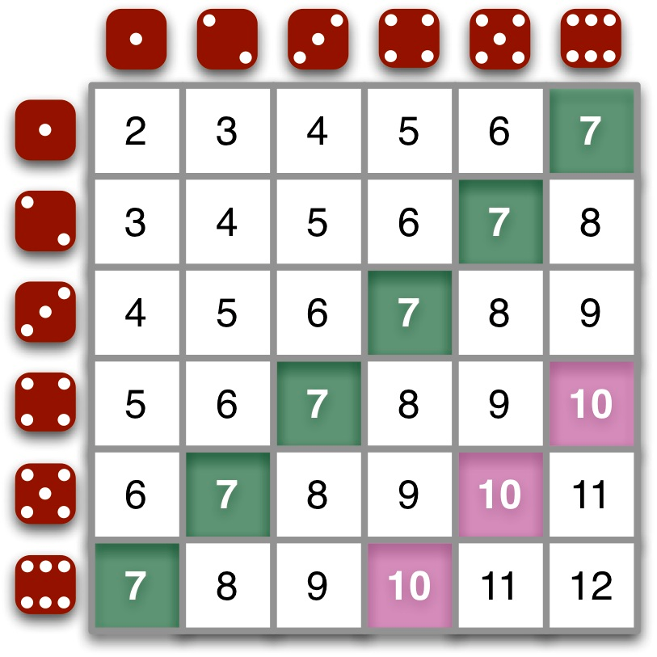
Counting Examples
How many ways can two dice be rolled to get a sum of 10?

Slide 20
Counting in R
expand.grid() – function that creates a data frame from all combinations of vectors supplied.
R-demo

Slide 21
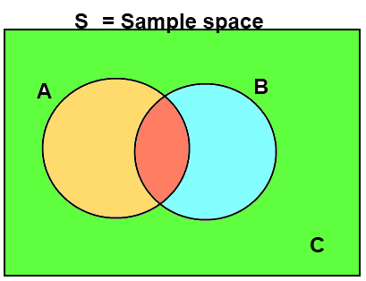

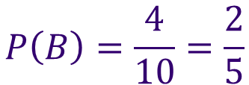
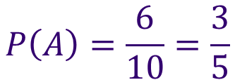
Probability
The Probability of an event, A, is the number of ways A can occur, divided by the number of total possible outcomes in our Sample Space, S.
If is an event, then
$$P\left(A\right)=\frac{N(A)}{N(S)}$$
$$P\left(A\right)=\frac{6}{10}=\frac{3}{5}$$
$$P\left(B\right)=\frac{4}{10}=\frac{2}{5}$$

Slide 22
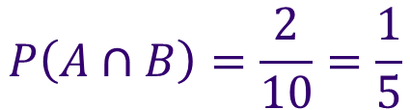
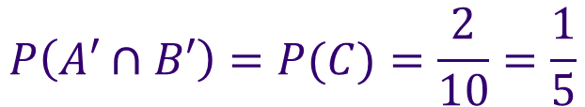
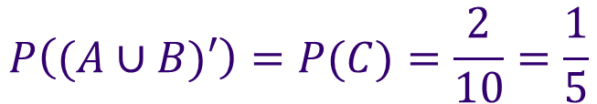
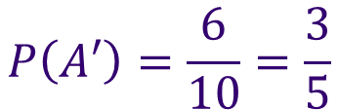
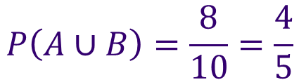
Probability
If is an event, then
Intersection:
Union:
Negation:
$$P\left(A∩B\right)=\frac{2}{10}=\frac{1}{5}$$
$$P\left(A∪B\right)=\frac{8}{10}=\frac{4}{5}$$
$$P\left(A′\right)=\frac{6}{10}=\frac{3}{5}$$
$$P\left((A∪B)′\right)=P(C)=\frac{2}{10}=\frac{1}{5}$$
$$P\left(A′∩B′\right)=P(C)=\frac{2}{10}=\frac{1}{5}$$

Slide 23



Axioms of Probability
Probability is bounded between 0 and 1.
Probability of the Sample Space = 1.
The probability of finite mutually exclusive unions is the sum of their probabilities.
$$0≤P\left(A\right)≤1$$
Note: “Percent” literally means per one hundred
$$P(S)=1$$
$$P\left(A∪B\right)=P\left(A\right)+P(B)$$
If A and B are M.E.

Slide 24
Data Exploration (Descriptive Statistics)
Purpose: To gain a clear understanding of your data.
How large is it?
What columns are of interest?
Missing data?
Outliers?

Slide 25
Numerical Exploration
str(): structure of the data frame
summary(): summary of each of the columns
head() / tail(): top / bottom of data frame
table(): frequency table

Slide 26
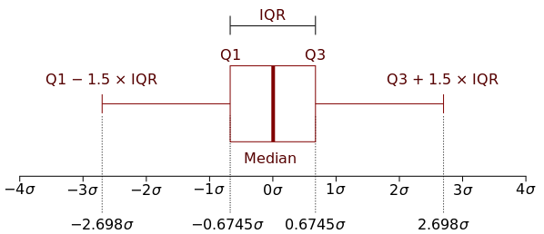
Numerical Exploration
IQR(): inner quartile range (Q3 – Q1)

Slide 27
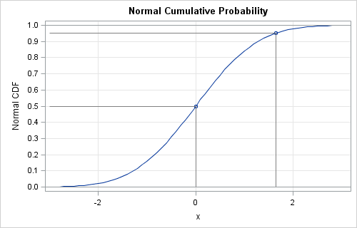
Numerical Exploration
quantile(): quantiles of numerical vectors
Quantiles are inverse values of the CDF (cumulative distribution function).
Standard Normal: (shown in figure)
Quantile(0.5) = 0, means at x=0, 50% of the distribution lies to the left. (This is also the median)
Quantile(0.95) = 1.65

Slide 28
Numerical Exploration
Relationships:
cov(): covariances
Interpretation: Expected value of the differences between x and y and their corresponding mean.
E.g. if x is above it’s mean when y is also above it’s mean, then they will have a high covariance.
Highly interpretable, but not bounded.
$$cov\left(x,y\right)=E\left((x−μ_{x})(y−μ_{y})\right)$$

Slide 29
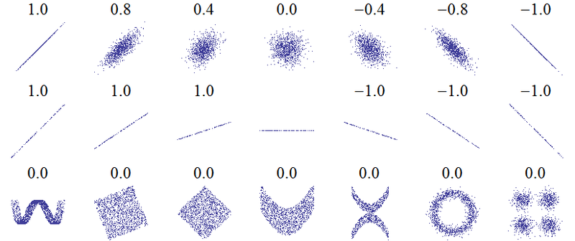
Numerical Exploration
Relationships:
cor(): correlations (pearsons)
Bounded between 0 and 1.
Not as interpretable.
$$cor\left(x,y\right)=\frac{E\left((x−μ_{x})(y−μ_{y})\right)}{σ_{x}σ_{y}}$$

Slide 30
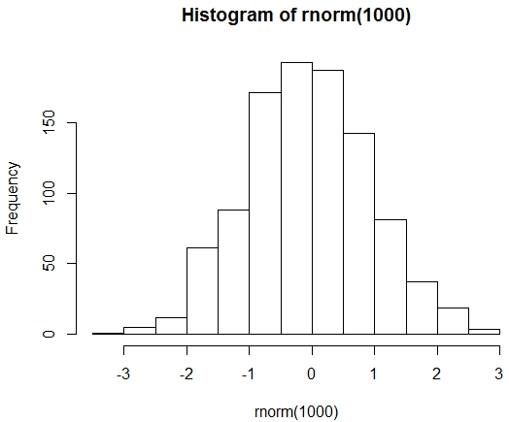
Visual Exploration
Histograms:
Base:
hist()
ggplot2:
+ geom_histogram()

Slide 31
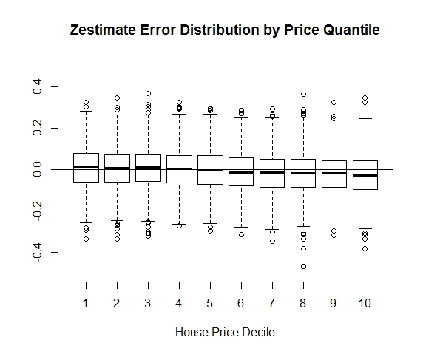
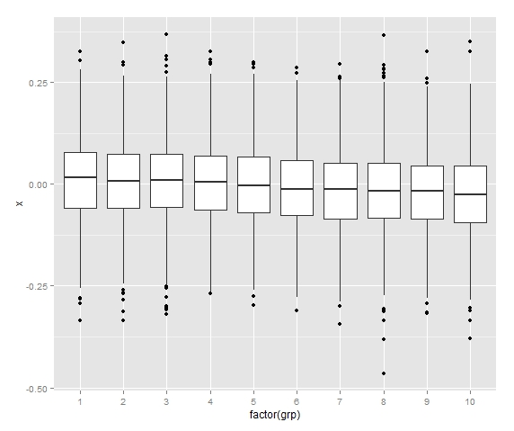
Visual Exploration
Boxplots:
Base:
boxplot()
ggplot2:
+ geom_boxplot()

Slide 32
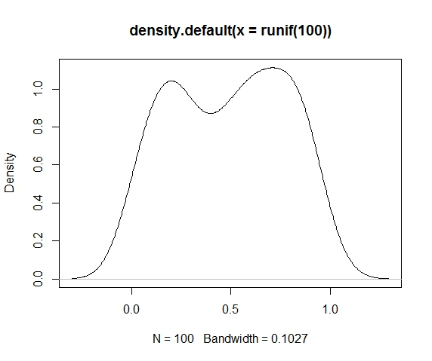
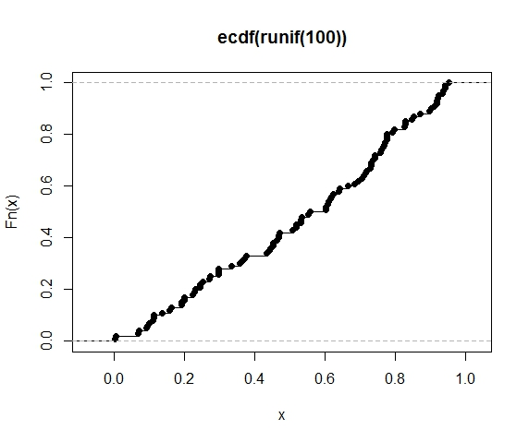
Visual Exploration
Densities/CDFs:
Base:
plot(density())
plot(ecdf())
ggplot2:
+ geom_density()
+ stat_ecdf()

Slide 33
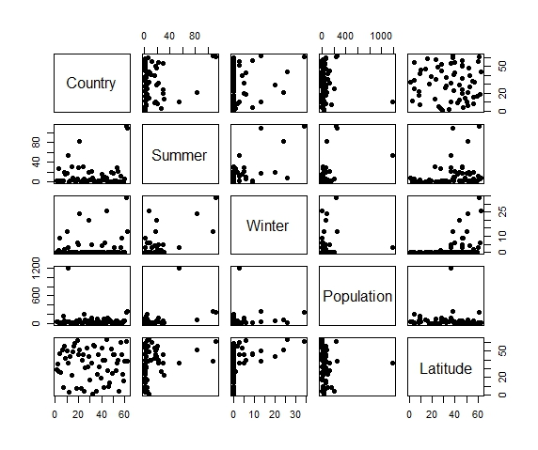
Visual Exploration
Scatterplots
Base:
pairs()
ggplot2:
ggpairs()

Slide 34
R Resources
R page:
http://www.r-project.org/other-docs.html
Stackoverflow:
http://www.stackoverflow.com
‘Little’ R intro:
http://cran.r-project.org/doc/contrib/Rossiter-RIntro-ITC.pdf
Quick R:
http://statmethods.net/
There are many tutorials available online, e.g.,
http://cyclismo.org/tutorial/R/
Notes from a two day course at UW:
http://faculty.washington.edu/tlumley/Rcourse/
Hadley Wickham’s Style Guide:
http://adv-r.had.co.nz/Style.html
DataCamp R Exercises:
Link in Canvas announcements.

Slide 35
Assignment
Go to:
Vote for extra topics (time permitting)
https://www.surveymonkey.com/r/SK6VX5T
Complete Homework 1:
Explore ‘JitteredHeadCount.csv’, a data set from Caesar’s Entertainment that has falsified/jittered table headcounts.
Write script level R program that shows/illustrates 3 key takeaways of your choosing from exploring the data.
You should submit:
ONE R-script.
One word document with 3 key points. (example next page).

Slide 36
Example Takeaway
The aggregate table headcounts on the weekends are X% higher than non-weekends (figure 1). In fact, the game that has the highest difference between average highs and average low days is Gamecode AA with a difference of x.xx heads/table.
R script Example Demo

