Slide 1
Data Science UW
Methods for Data Analysis
More on Hypothesis Testing, The Central Limit Theorem,
And an introduction to Regression
Lecture 4
Nick McClure

Slide 2
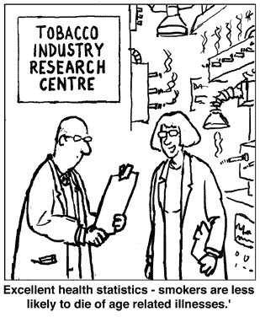

Slide 3
Topics
Review
More on hypothesis testing
Central Limit Theorem
Introduction to Regression

Slide 4
Review
Sampling Methods
Law of Large Numbers
Hypothesis Testing
Normal testing
One tailed vs Two tailed
P-values
T-test (Student’s, Welch’s)
Chi-Squared
Fisher’s Exact
Outliers

Slide 5
Fisher’s Exact Test
Hypothesis: (Assume we know the total # of successes)
Null: The proportion of successes in Category 1 is not less than that in Category 2.
Alternative: The proportion of successes in Category 1 is less than in Category 2.
We observe this outcome
Same outcome or worse, with the same marginals (row sums).

Slide 6
Hypothesis Testing Summary (so far)
If data is normal,
If you know population mean and variance,
Use standard normal ‘z-test’.
If you just know population mean,
Use t-test (unpaired data).
Use Welch’s t-test (paired data).
For categorical comparison tests,
If the sample/subgroup size is large enough,
Use Chi-squared test
If the sample/subgroup size is small,
Use Fisher’s Exact test.
How do we know the data is normal?

Slide 7
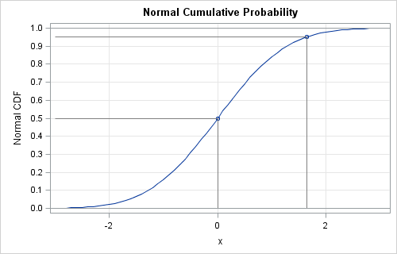
Testing for Normality
Kolmogorov-Smirnov test (K-S test).
Tests if two distributions are similar.
Consider the Normal Cumulative Distribution Function (CDF), the sum of the area to the left of x.
Any similar distribution should have a similar CDF.

Slide 8
Testing for Normality
The K-S statistic is just the maximum vertical distance between two CDFs.
Note: the K-S test can test departure from any hypothetical distribution, not just normal.
R-demo

Slide 9
Testing for Normality
Also, the Shapiro-Wilk test can tell us a test statistic for normality.
Tests the difference in expected and sample ‘moments’.
Moments:
1st moment = mean
2nd moment = variance
3rd moment = skewness
4th moment = kurtosis
…
Slightly more powerful than the K-S test, which means there are more assumptions made (see all the above moments).

Slide 10
Testing for Normality
ALWAYS do a qq-plot to look at normality. (qqnorm())
R-demo.

Slide 11
Testing Between Multiple Groups
What if we had multiple groups and we wanted to compare their means?
Why can’t we just do multiple two-sample t-tests for all pairs?
Results in increased probability of accepting a false hypothesis.
E.g., if we had 7 groups, there would be (7 Choose 2)=21 pairs to test. If our alpha cutoff is 5%, then we are likely to accept about 1 false hypothesis (21*0.05).

Slide 12

Testing Between Multiple Groups
Null Hypothesis:
All groups are just samples from the same population.
Alternative Hypothesis:
At least one group has a statistically different mean.
This type of analysis is called “ANalysis Of VAriants”, or ANOVA.
We make data independence and normality assumptions first.
Our test statistic is based on:
$$statistic\sim \frac{between group variability}{within group variability}$$

Slide 13

Performing Multiple Hypothesis Tests
For non-ANOVA methods, remember that performing many hypothesis tests increases our risk of incorrectly rejecting one of the null-hypotheses.
To compensate for this we decrease the p-value cutoff.
The most common way of doing this is with the Bonferroni Correction.
This correction is argued to be too strong and other approximations for a new-p can be used instead.
Tukey’s Range Test
This is VERY important in genetics/bioinformatics.
R Example
p’$=\frac{p}{(\# of Hypotheses)}$

Slide 14
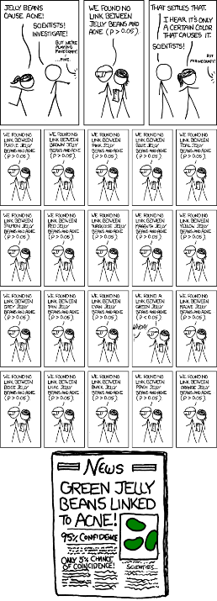

Slide 15
Additional Hypothesis Tests
Parametric test types:
Mean comparison
Variance comparison
More distribution comparisons
All hypothesis tests generate a statistic that follows a specific known distribution under the NULL.
The actual statistic generated tell us the p-value, which is “The probability of observing the sample distribution assuming the null hypothesis is true.”

Slide 16
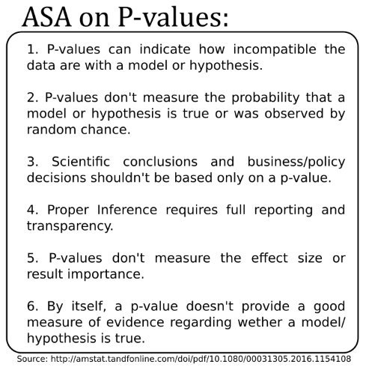
A Caution on P-Values
P-values have been glorified and grossly abused in science, statistics, the media, journals, etc…

Slide 17

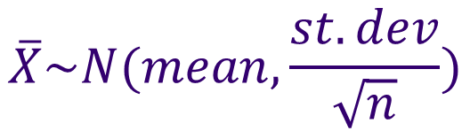
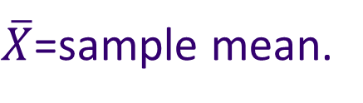
Central Limit Theorem
If we sample a population over and over, the set of means of all samples are normally distributed, regardless of the population distribution.
Compare to Law of Large numbers (‘proof’ by R), shown in previous class.
$\overline{X}$=sample mean.
$$\overline{X}\sim N(mean,\frac{st.dev}{\sqrt{n}})$$
$$\overline{X}\sim N(μ,\frac{σ}{\sqrt{n}})$$

Slide 18
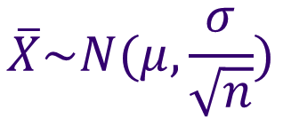
Central Limit Theorem
$$\overline{X}\sim N(μ,\frac{σ}{\sqrt{n}})$$
We can use this central limit theorem to generate confidence intervals on expressing the population mean.
We know the sample mean, sample variance, and number of samples.
Then we know how our estimate of the population mean is distributed (from above formula).
We can then generate 90%, 95%, … confidence intervals around our sample mean.

Slide 19


Confidence Intervals
Confidence intervals are a way to express uncertainty in population parameters, as estimated by the sample.
E.g. If we create a 95% confidence interval for the population mean, say
Then we say that the true population mean, , has a 95% chance of being between 5 and 15.
$$\hat{μ}=\overline{X}=10±5$$
$$μ$$
It is not correct to say:
“95% of the sample values are in this range.”
“There is a 95% chance that the mean of another sample will be in this range.”

Slide 20
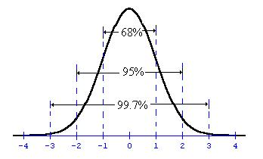
Confidence Intervals
To create confidence intervals for population means, we use the central limit theorem and create confidence intervals based on the normal distribution.
Repeatedly sample from the population.
Calculate the mean for each sample.
Use the average of the sample means as the population estimate and create a C.I. based on the s.d. of the sample means.
R demo

Slide 21
Regression Models
The goal of regression is to produce a model that represents the best fit to some observed data.
Typically the model is a function describing some type of curve (lines, parabolas, etc.) that is determined by a set of parameters (e.g., slope and intercept).
“Best fit” means that there is an optimal set of parameters according to an evaluation criteria we choose.

Slide 22
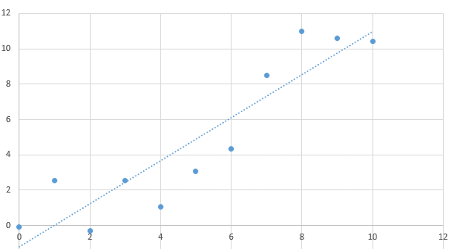
Regression: Linear

Slide 23
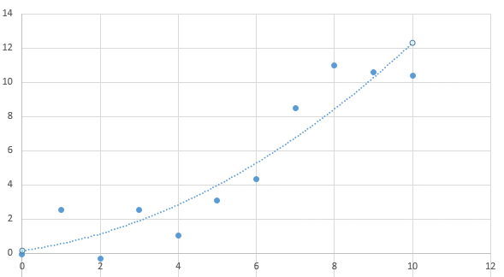
Regression: quadratic

Slide 24
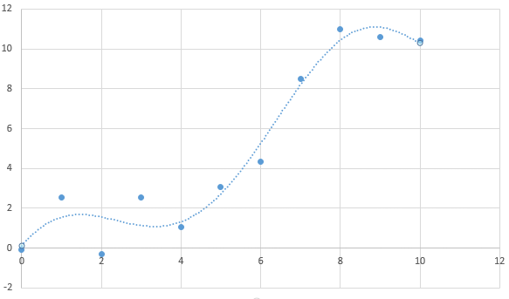
Regression: High Order

Slide 25
Regression Models
Which one of the preceding examples is correct?
In a sense, all of them are. They all give decent approximations to the data.
It’s hard to tell, just from looking at these plots whether any of them in fact will continue to perform well as more data is received.
We don’t know if these models will generalize

Slide 26
Linear Regression
Response (Dependent) variable: the variable of primary interest in a study- the one you are trying to predict or explain.
Explanatory (Independent) variable: the variable that attempts to explain the observed outcomes of the response variable.
There are two types of parameters in linear models:
The intercept (y-intercept).
The slope, rise over run, or change in Y divided by change in X

Slide 27
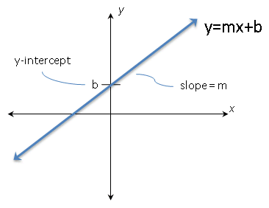
Linear Regression
When x = 0, then y = b.
When x = -(b/m) then y = 0.

Slide 28
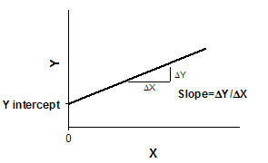



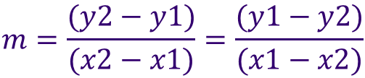
Linear Regression
Interpret slope:
If x changes by , then y must change by in order for the slope to stay the same (and it must).
$$m=\frac{rise}{run}=\frac{∆y}{∆x}$$
$$∆x$$
$$∆y$$
Given two points, (x1,y1), (x2,y2)
$$m=\frac{(y2−y1)}{(x2−x1)}=\frac{(y1−y2)}{(x1−x2)}$$
R example!

Slide 29
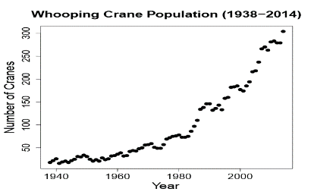
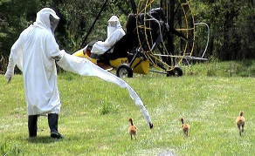

Linear Regression
Consider the relationship between Whooping Crane population and year below.
Possible regression solutions:
Transform the response variable, to linearize the relationship.
Fit a nonlinear regression model to the data.

Slide 30
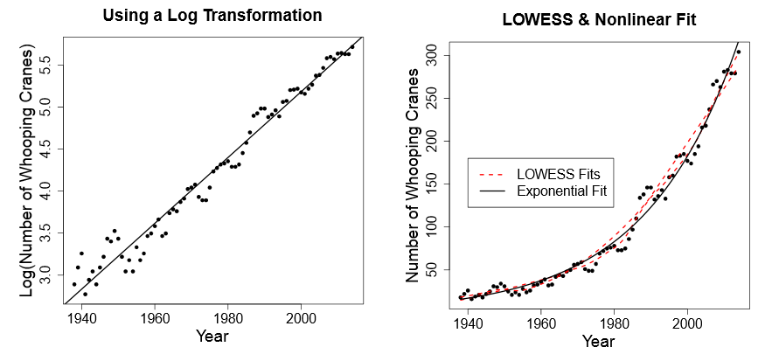
Linear Regression
How would we decide on a ‘best’ model?

Slide 31
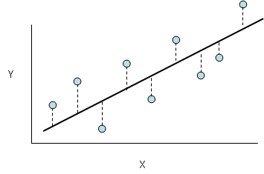

Linear Regression
How do we find the best fit line?
First consider the equation representing our line:
$$y_{i}=mx_{i}+b+ε_{i}$$

Slide 32

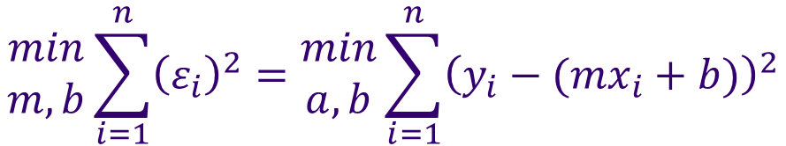
Linear Regression
We use the method of least squares to find the best fit line:
Explicit solutions exist (using calculus).
Computers are really good at finding minimums of equations. We let them do this for us.
$$y_{i}=mx_{i}+b+ε_{i}$$
$$\begin{matrix}min \\ m,b\end{matrix}\sum_{i=1}^{n}{{\left(ε_{i}\right)}^{2}}=\begin{matrix}min \\ a,b\end{matrix}\sum_{i=1}^{n}{{\left(y_{i}−({mx}_{i}+b)\right)}^{2}}$$

Slide 33
Linear Regression
The method of least squares finds the best fit line.
The mean of the errors from the best fit line is zero.
This means there is no ‘bias’ in our prediction.

Slide 34
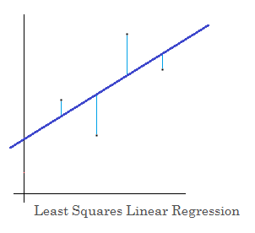
Linear Regression
Linear regression is the most common.
Fit a line (2D), plane (3D), or a hyperplane to the observed data.
We need to define an error metric for a line through points.
We use the sum of the squared error between the predicted and actual.
R demo.

Slide 35
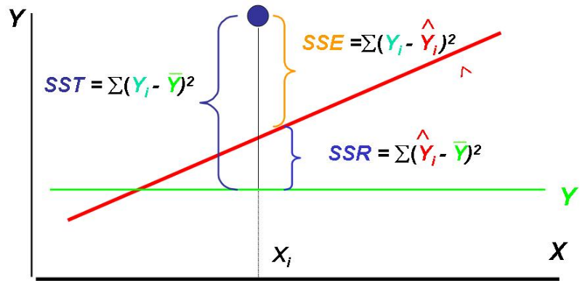
Linear Regression
With modeling, we are interested in the SSE, SSR, SST.

Slide 36

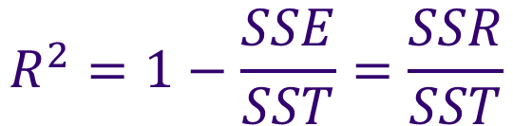
Linear Regression
R-squared is called the coefficient of determination.
It indicates how well the data fits a specified model.
For linear models, we define this as:
$$R^{2}=1−\frac{SSE}{SST}=\frac{SSR}{SST}$$

Slide 37
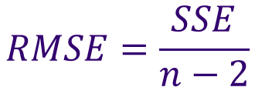
Linear Regression
We can also measure accuracy of the line using Root Mean Squared Error (RMSE).
Using this as an estimate of the error means we are losing one more degree of freedom than the standard deviation, so we write the RMSE as
$$RMSE=\frac{SSE}{n−2}$$

Slide 38
Linear Regression in the News
Tacoma Narrows Bridge:
http://mse.redwoods.edu/darnold/math55/DEproj/sp03/seanmatt/presentation.pdf (pg 12 and 13)
https://www.youtube.com/watch?v=j-zczJXSxnw
Challenger Space Shuttle O-Rings:
http://people.stern.nyu.edu/jsimonof/classes/2301/pdf/challlog.pdf
A Linear Book-Pricing Model with no limits:
http://www.michaeleisen.org/blog/?p=358

Slide 39
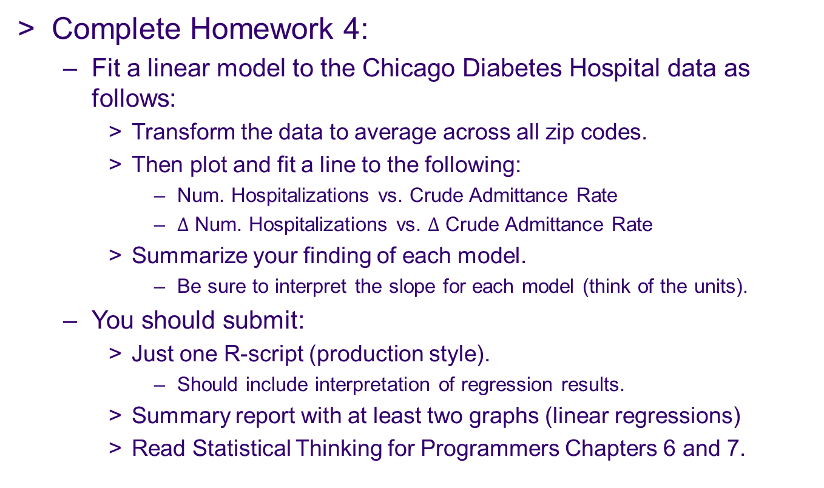
Assignment
Complete Homework 4:
Fit a linear model to the Chicago Diabetes Hospital data as follows:
Transform the data to average across all zip codes.
Then plot and fit a line to the following:
Num. Hospitalizations vs. Crude Admittance Rate
$∆$ Num. Hospitalizations vs. $∆$ Crude Admittance Rate
Summarize your finding of each model.
Be sure to interpret the slope for each model (think of the units).
You should submit:
Just one R-script (production style).
Should include interpretation of regression results.
Summary report with at least two graphs (linear regressions)
Read Statistical Thinking for Programmers Chapters 6 and 7.

