Slide 1
Capstone Project
Team :- Saumya Prabhakar Vishal Kumar
Ashutosh Kumar Akshay Kumar
October 31, 2022
Private & Confidential

Slide 2


Slide 3
AGENDA
Introduction​
Objective
Application
​Methodology
Hardware And Software Required
​Summary​

Slide 4
INTRODUCTION
Our team has developed a full fledge Responsive Web Application . On the successful completion of our Java Training , we have been assigned to complete a project named “GHARELU – A Smart City Project”.
GHARELU is a platform which provides services to their customers with finding the right house of their choice and they can even check the things that are near to them. They can check nearest ATMs, Restaurants, Schools etc.

Slide 5
OBJECTIVE
To create a full stack java project.
To demonstrate the coding standards
To learn and understand the architecture and development cycle of project
To develop a skill to work in a team

Slide 6
Technology Stack
Front-end: | HTML, CSS, Bootstrap, JavaScript
Back-end: | JAVA, Spring, MySql
Library/ Framework: | Spring Boot, Spring Security, REST APIs .Bootstrap, ReactJs
Tools: | Visual Studio (IDE), Visual Studio Code, GIT & GitHub, Postman, Spring Tool Suite
Database: | MySql
Dependencies: | Spring Web, Spring Security, ThymyLeaf, Spring Dev Tools, MySql Connector, Spring test
October 31, 2022

Slide 7
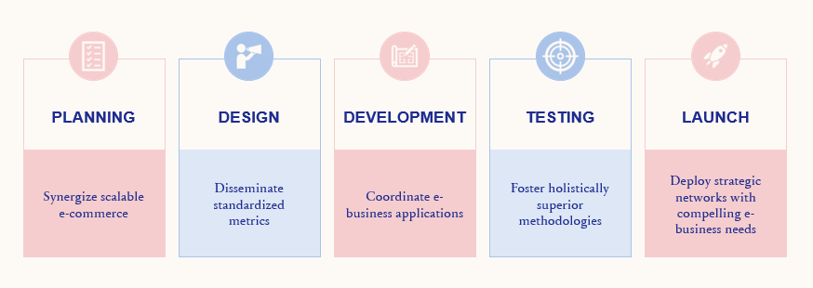
PLAN FOR PRODUCT DEVELOPMENT

Slide 8
PLANNING
The planning phase will determine project goals and establish a high-level plan for the intended project. Planning is, by definition, a fundamental and critical organizational phase. The three primary activities involved in the planning phase are as follows:
Identification of the system for development
Feasibility assessment
Creation of project plan
Gathering business requirement
Creating process diagrams
Performing a detailed analysis

Slide 9
DESIGN
In the design phase, we describe the desired features and operations of the system. This phase includes business rules, pseudo-code, screen layouts, and other necessary documentation. The two primary activities involved in the design phase are as follows:
Designing the IT infrastructure
Designing the system model

Slide 10
Modules
Login & SignUp
Contact Us
Find nearest ATM & Hotels
Know more about the place
User dashboard
Info about the events
October 31, 2022

Slide 11
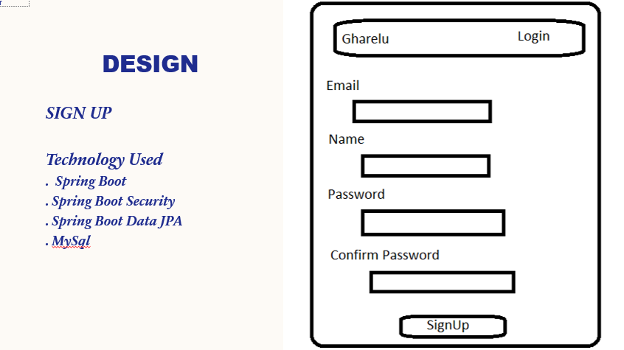
DESIGN

Slide 12
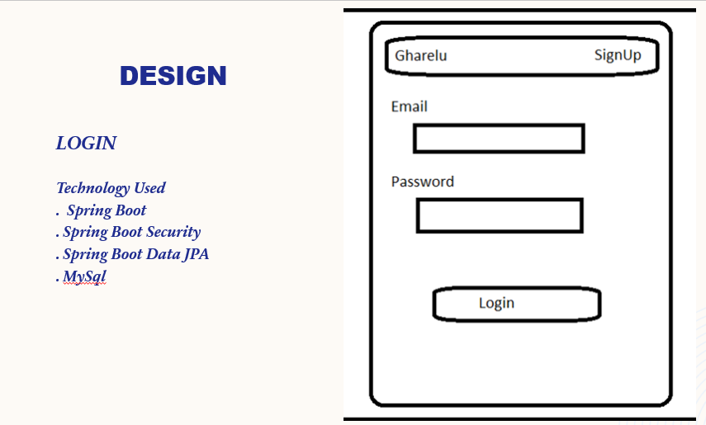
DESIGN

Slide 13
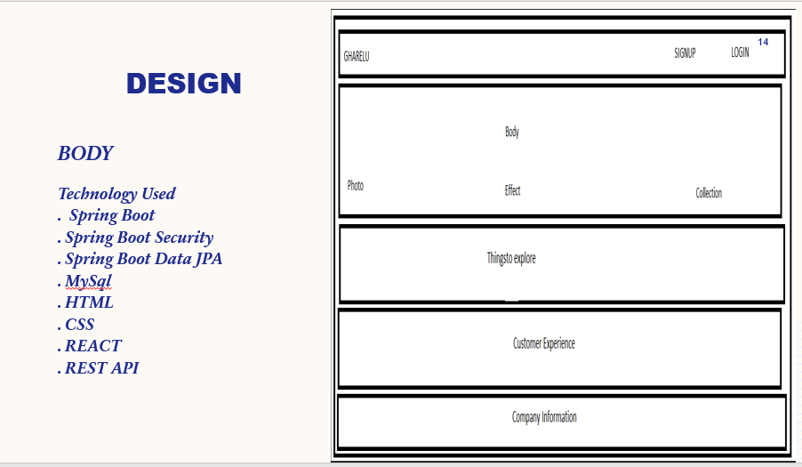
DESIGN

Slide 14
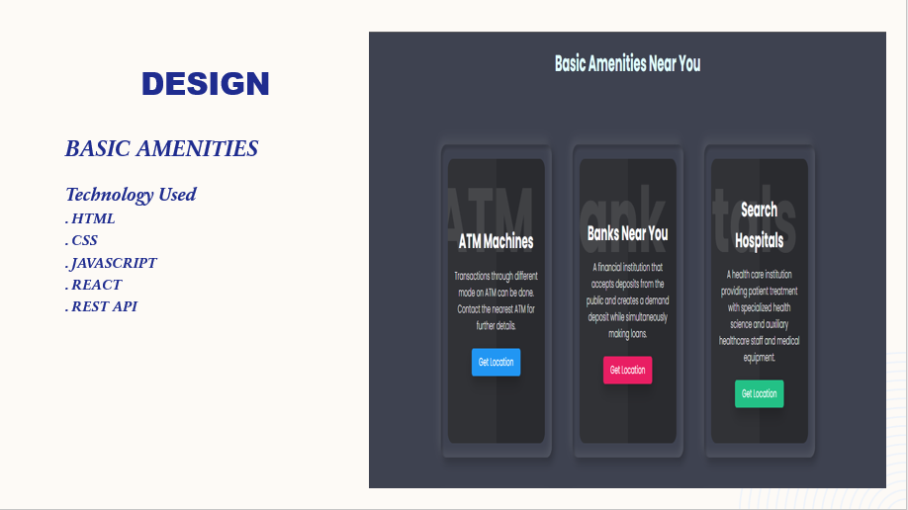
DESIGN

Slide 15
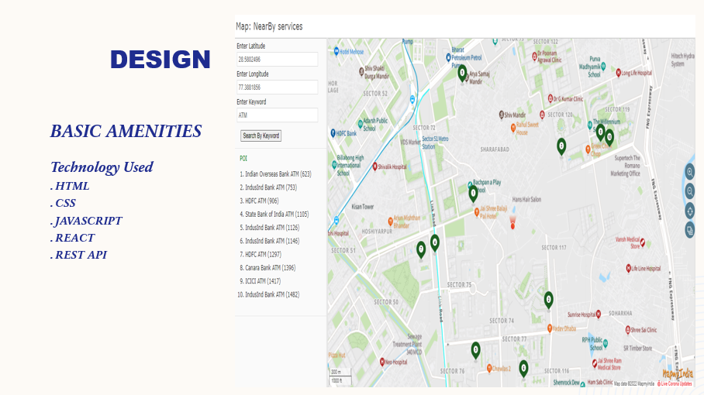
DESIGN

Slide 16
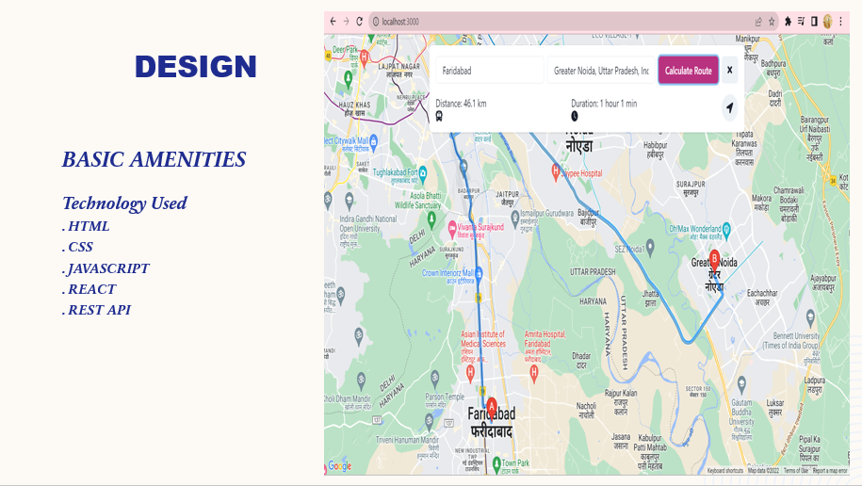
DESIGN

Slide 17
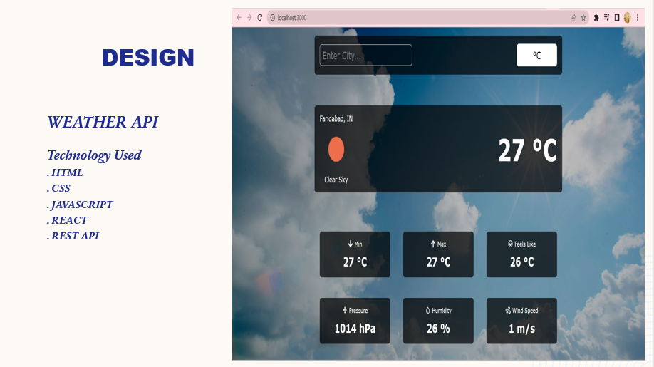
DESIGN

Slide 18
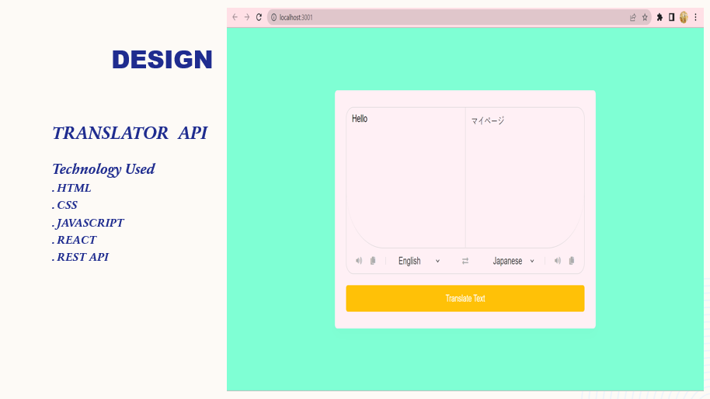
DESIGN

Slide 19
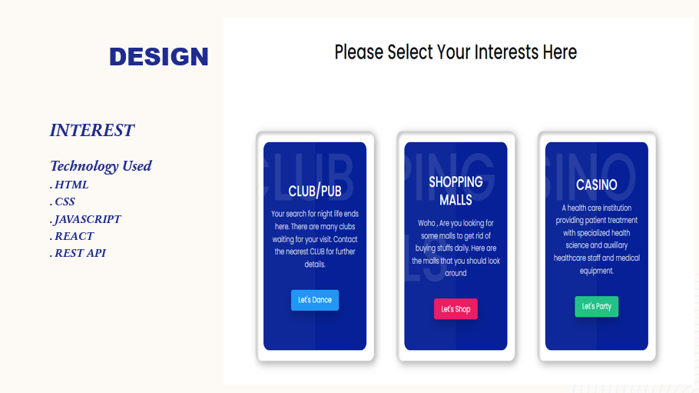
DESIGN

Slide 20
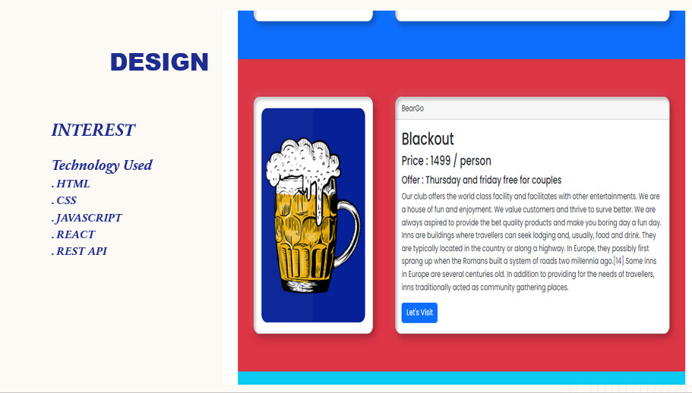
DESIGN

Slide 21
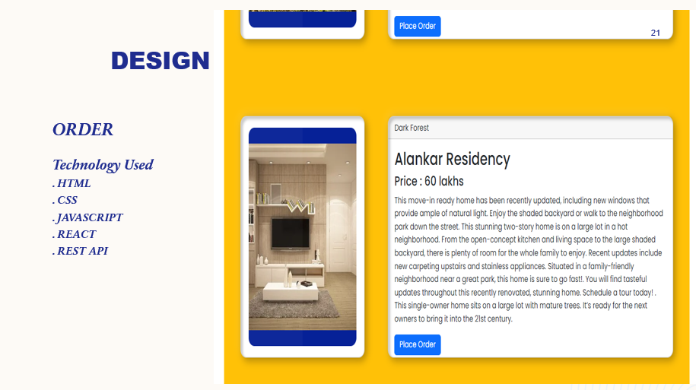
DESIGN

Slide 22
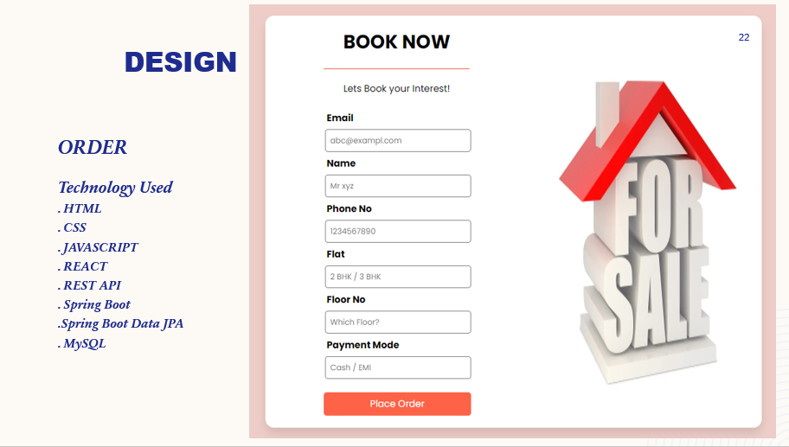
DESIGN

Slide 23
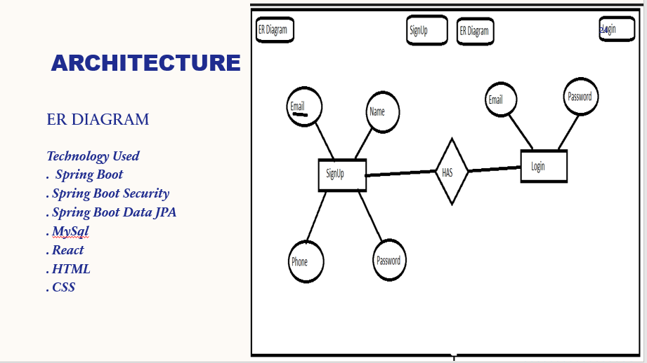
DESIGN

Slide 24
Features
User can register on the website.
User can avail the access to the products after login.
User data is kept encoded and there is no leakage of the password in the database.
User can perform all the functions of his interest after successful account creation and login.
User can also see the current weather of any area and can translate words .
Website provide service to find nearest ATM ,hotels, park, casino, malls, water parks, etc.
There are role based dashboards and users can place a order online.
In profile section user can see own details.
User can get to know more about their home , know more about the events being organized.

Slide 25
CRUD
AUTHENTICATE USER
ADD NEW USER
USER
INTEREST
CRUD
OPERATIONS
EDIT USER
Account
PASSWORD ENCODING
DELETE USER ACCOUNT

Slide 26
DEVELOPMENT
The development phase is when all documents from the previous step transfer into the system. The primary activities involved in the development phase are as follows:
Development of IT infrastructure
Development of database and code

Slide 27
Project Flow
HOME PAGE
Other Function
Navbar
Login / SignUp
Other Function
ATM
Interest
HOTELS
WEATHER
Ameneties
BANK
TRANSLATOR
HOSPITALS
TRANSPORT
MALLS
EVENTS

Slide 28
TESTING
All pieces of code are integrated during the testing phase and deployed in the testing environment. Testers then work through Software Testing Life Cycle activities to check the system for errors, bugs, and defects to verify the system’s functionalities work as expected. The two primary activities involved in the testing phase are as follows:
Writing test cases
Execution of test cases

Slide 29
DEPLOYMENT
During this next phase, the system is deployed to a real-life (the client’s) environment where actual users can begin operating the system. All data and components are present in the production environment. This phase is also called ‘delivery.’

Slide 30
REGARDS
“Everyone wants to live on top of the mountain, but all the happiness and growth occurs while you’re climbing it. “
- Thank you
Bhavna Corp
"Better than a thousand days of diligent study is one day with a great teacher.“
- Thank You
Niteen Sir

Slide 31
SUMMARY
It was quite a good experience woring in a team and completing a full fledge Full Stack Project Development. We learnt a lot of things during this training and project building cycle.
Our project comprised of Java technology along with spring boot and spring security. We used Html, Css, JavaScript, React for the completion of Full stack Development

Slide 32
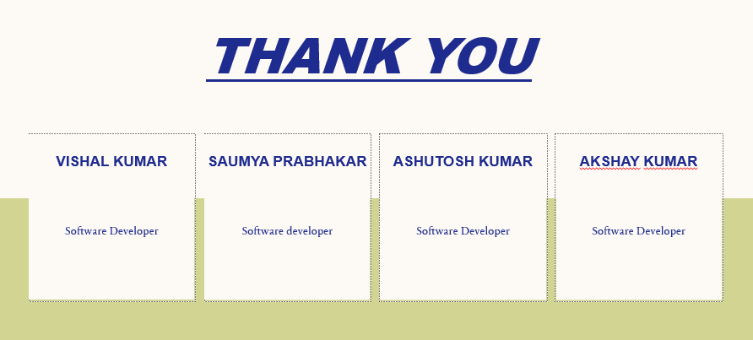


Slide 33
Thank You!
October 31, 2022

