Slide 1
IoT Device for Electrocardiography Summary Statistics Monitoring
by Sam Luby

Slide 2
Motivation
Cardiovascular diseases (CVDs)
17 million mortalities annually worldwide
Representing 32% of all mortalities
Disproportionality between countries
80% are in low to middle-income areas

Slide 3
Notes:
Say that current measures aren’t enough, need more cost-effective solution.

Slide 4
Project Aim
A novel solution to heart monitoring
Automate monitoring & analysis processes

Slide 5
Project Approach
Collect ECG data & store locally
Run QRS detection & HRV analysis
Detect anomalies and store results in cloud

Slide 6
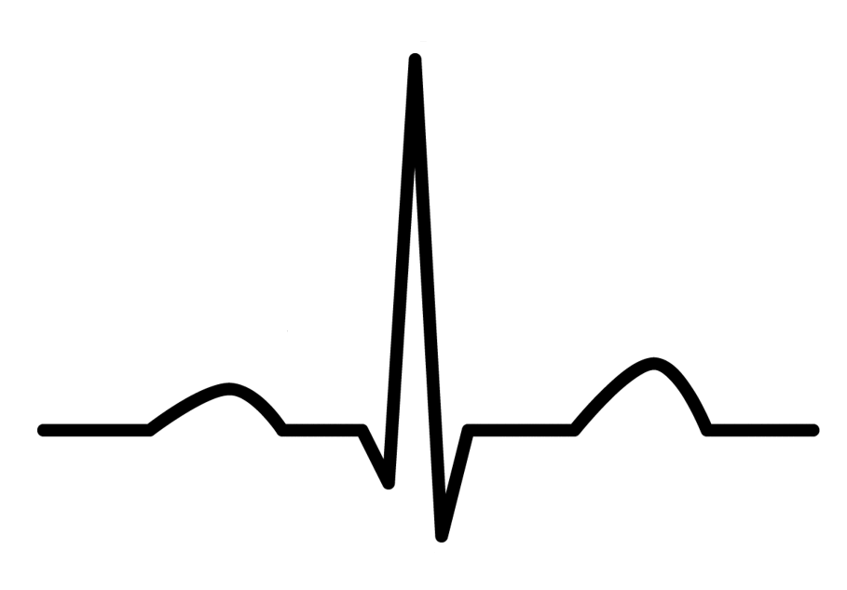
ECG Signal

Slide 7
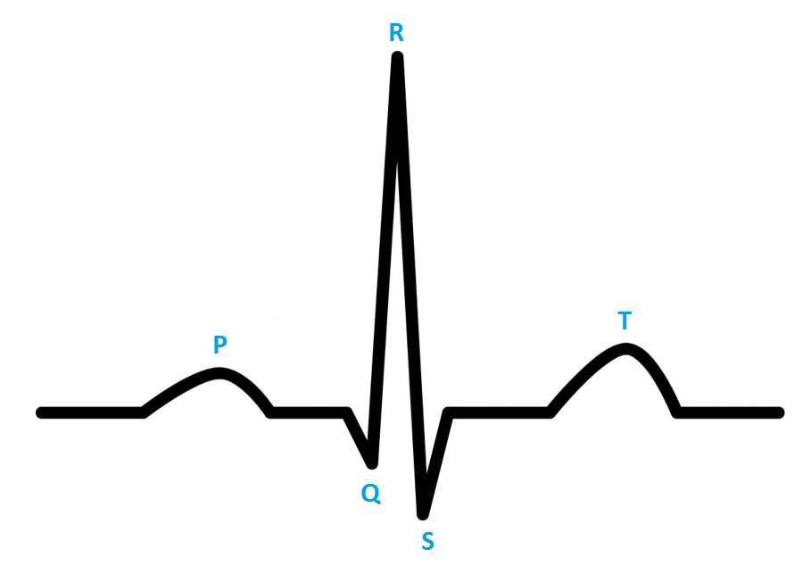
ECG Signal

Slide 8
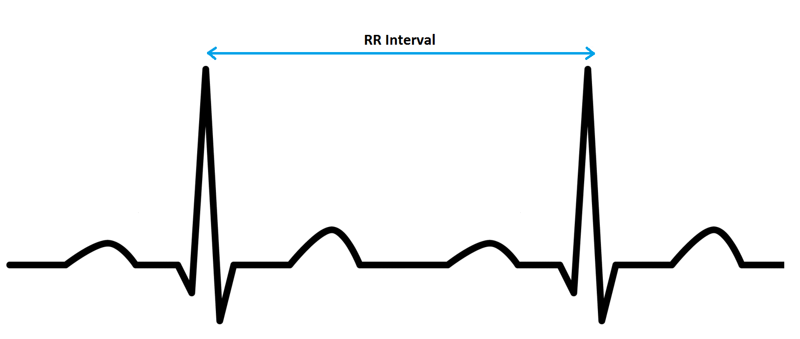
HRV

Slide 9
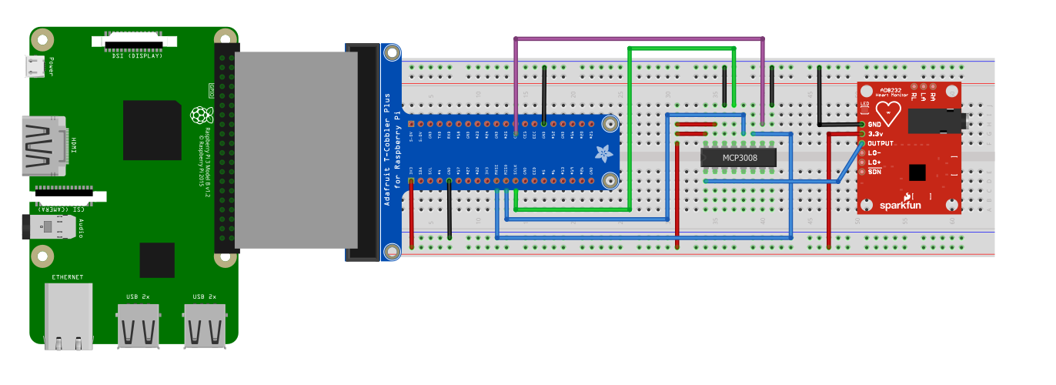
Hardware

Slide 10
Software
Pan Tompkins – detect ECG peaks
Heart Rate Variability (HRV) Analysis
File storage
Uploading to cloud

Slide 11
Pan Tompkins
ECG Signal
LFP
HFP
Differentiator
Squaring
Rolling Mean
QRS Detection

Slide 12
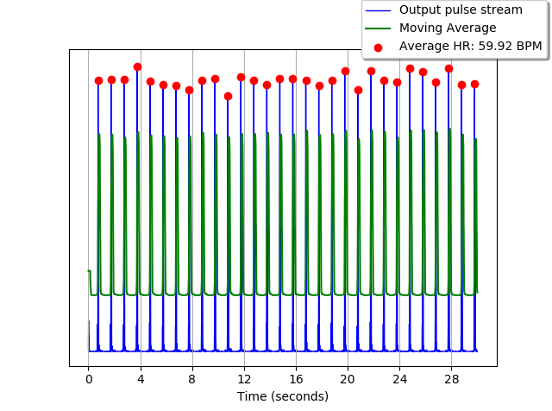
Detected QRS Peaks

Slide 13
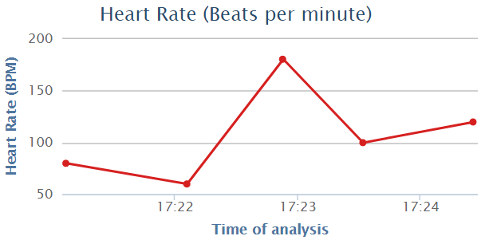
ThingSpeak

Slide 14


Slide 15


