Slide 1
ECG Heart Monitoring System Using Arduino/Cloud Analysis
Sam Luby

Slide 2
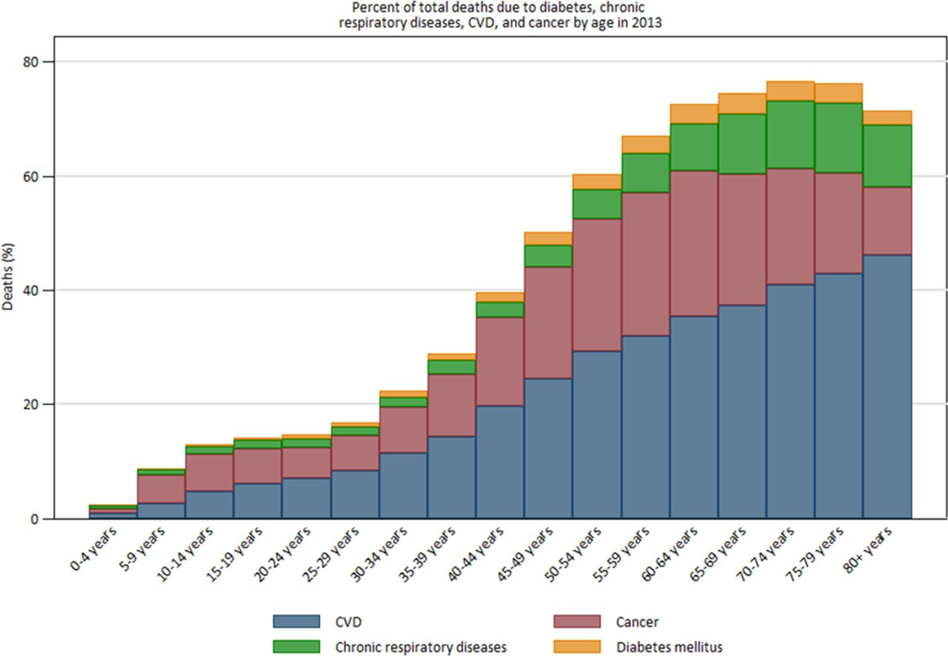
Motivation
Cardiovascular disease
(CVD)
#1 cause of premature
death in the world
Source: http://circ.ahajournals.org/content/circulationaha/132/17/1667.full.pdf

Slide 3

CVD in Ireland
As Ireland’s health problems gets
worse, CVD numbers increase
10,000 CVD deaths per year
90,000 with heart failure with
10,000 more each year
Source: http://www.cso.ie/en/releasesandpublications/ep/p-vsys/vitalstatisticsyearlysummary2015/
Source: http://www.cso.ie/en/releasesandpublications/ep/p-vsys/vitalstatisticsyearlysummary2015/

Slide 4
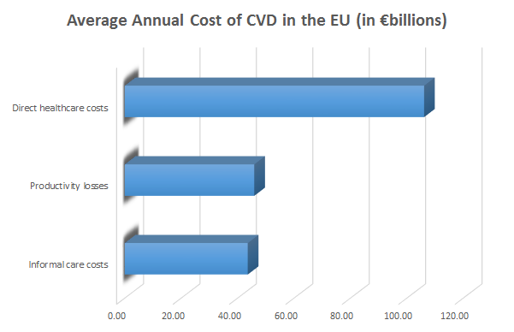
Current monitoring methods are not enough
Costs are too high
Drives insurance premiums up
Puts healthcare out of reach of
low/middle income families.
Need automation in monitoring process
Source: https://academic.oup.com/europace/article/15/suppl_1/i59/526826

Slide 5
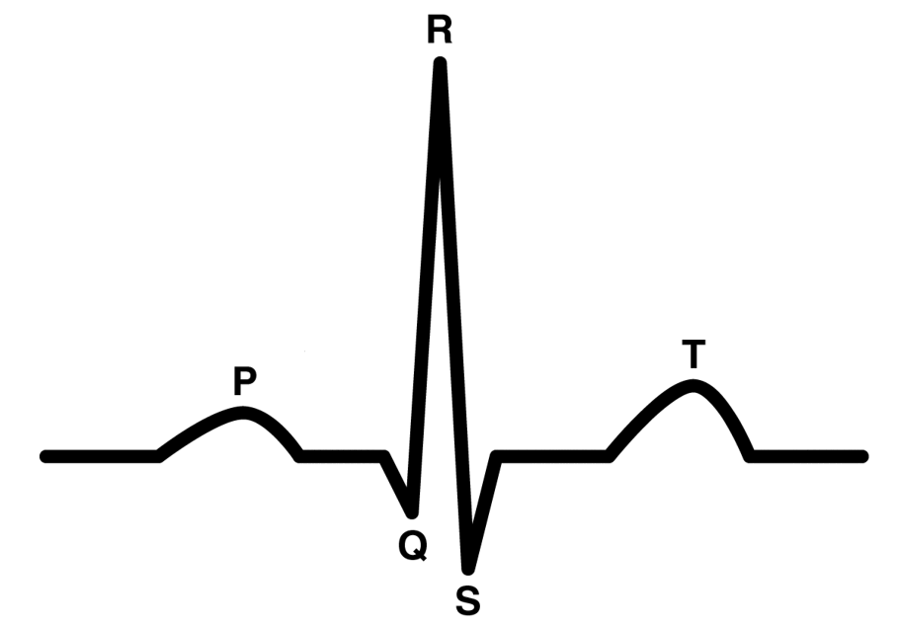
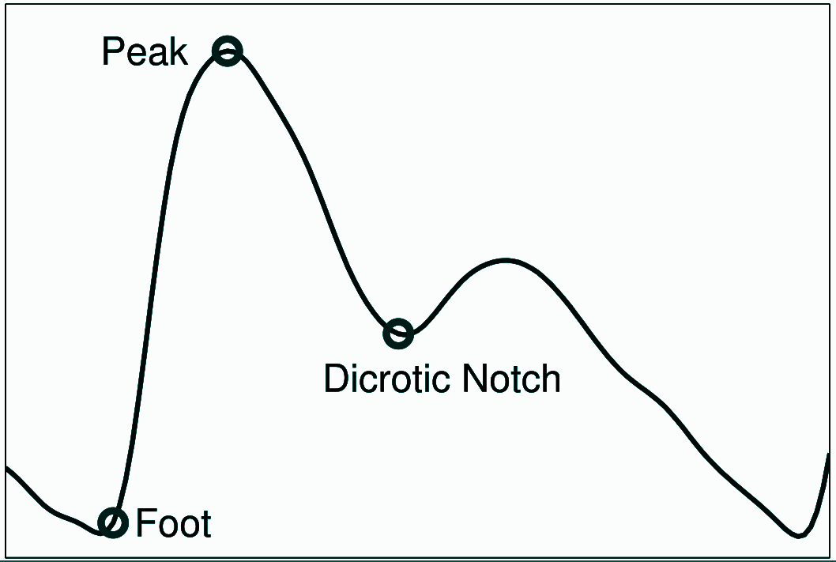
Heart Rate Monitoring (HRM)
ECG (Electrocardiogram) PPG (Photoplethysmogram)

Slide 6
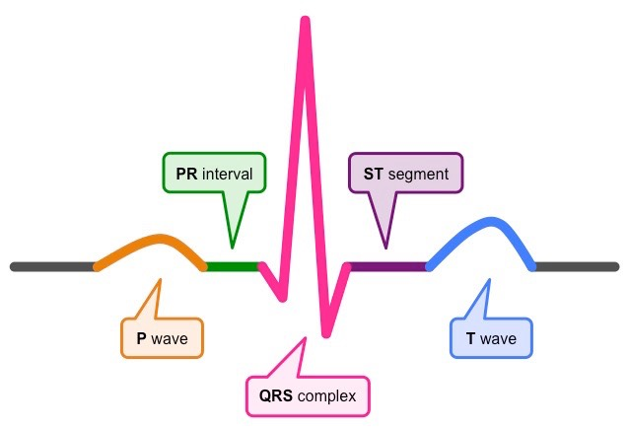
ECG signal
Measures heart’s electrical activity
Represented as a PQRST wave
ECG can reveal much about patient’s health

Slide 7
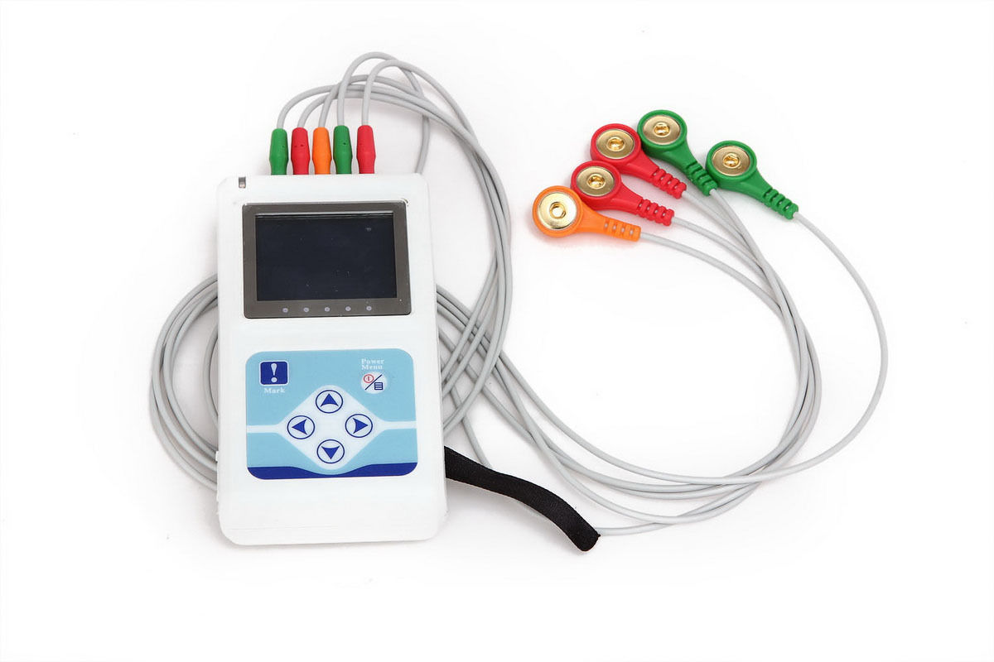
Existing solutions
Patient wears for 24-48 hours
Sent off for manual analysis
No immediate analysis/diagnosis
A typical ambulatory ECG monitor

Slide 8
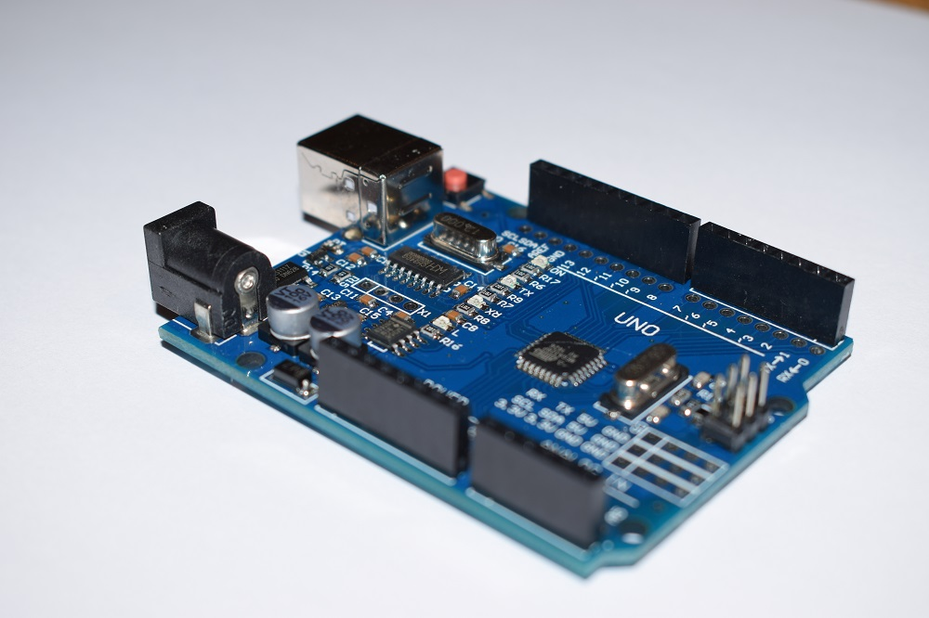
My proposal & aims
Arduino cloud-based prototype ECG
monitoring device
Automate the monitoring process by
analysing heart metrics in real-time
Reduce manpower required to manually
monitor and review patient data

Slide 9
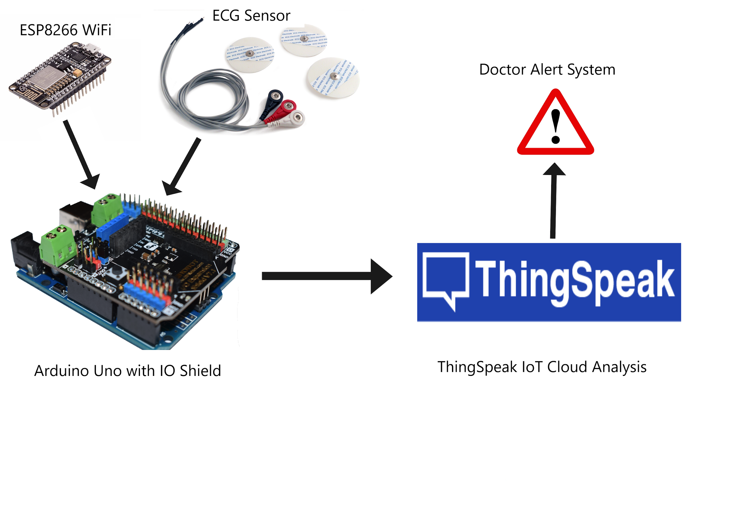
Design

Slide 10
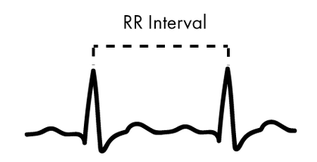
Analysis
ECG gives a wealth of information about patient’s health
Range of metrics can be analysed, including HRV - Heart Rate Variation
Standard HRV measuring is done by RMSSD - Root Mean Square of Successive Differences
RMSSD =

Slide 11

Future work
Examine existing solutions for ECG monitoring
Determine important ECG metrics to be analysed
Develop algorithms for data analysis with
low complexity and high accuracy
Give instant patient preliminary results

Slide 12
Questions?

