Slide 1
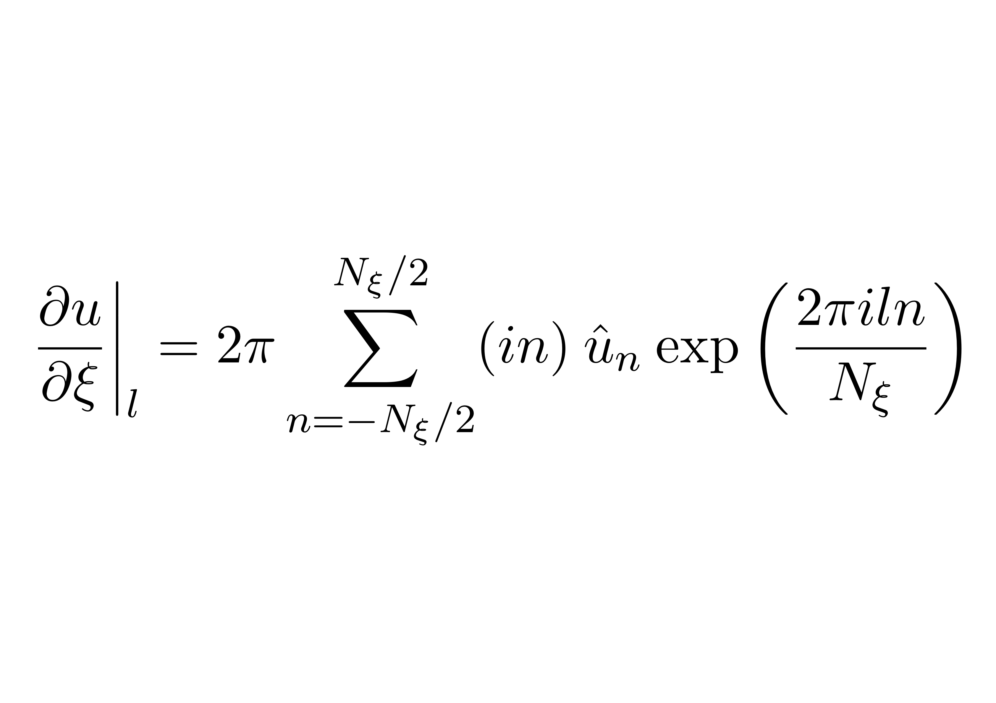
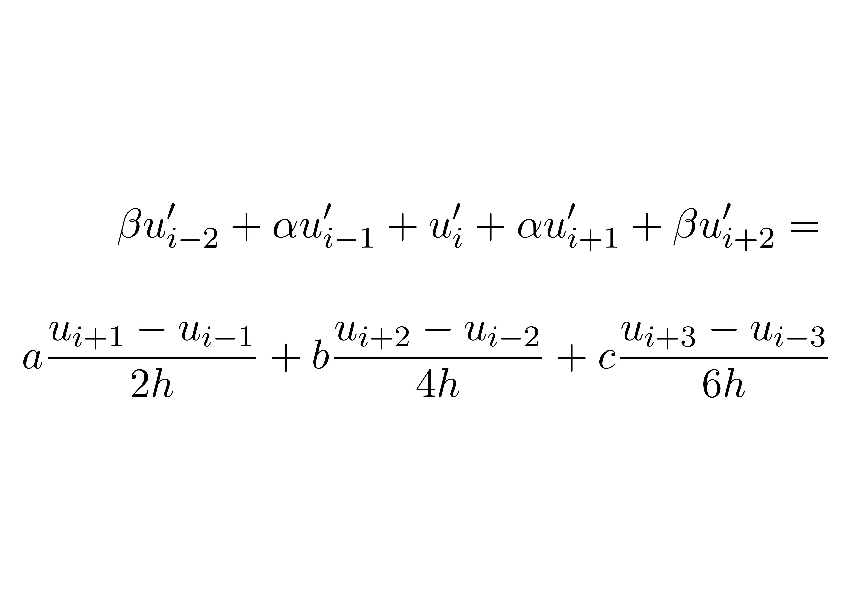
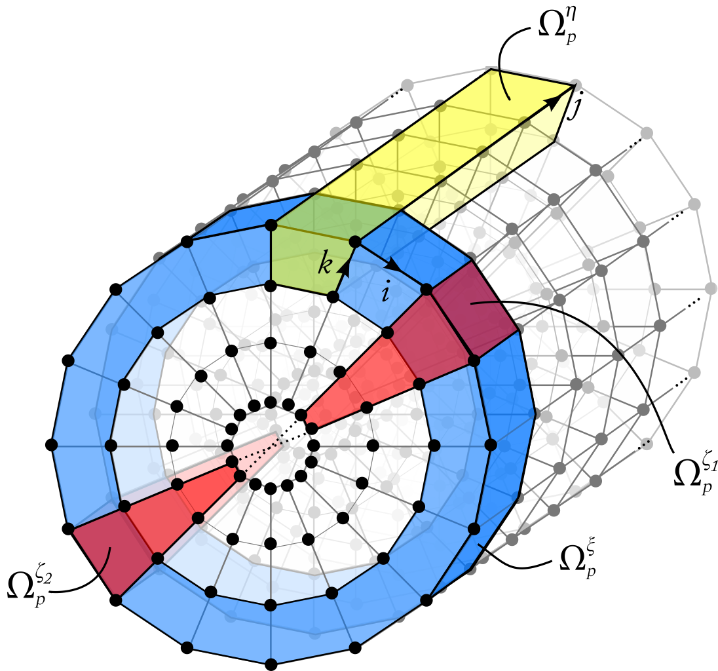


Title of the student project
Master thesis by <yourself>
Supervised by <your supervisor>
Title
Use a two-column layout if possible. Pictures may span both columns. Try to stay with the given layout as closely as possible. Use the “ETH light” font (downloadable for free from ides.ethz.ch). The template uses a DIN-A0 poster format. For printing out on A4 you must select the option “An Papiergrösse anpassen”.
Text body
A list:
One
Two
Three
The second column
Some more text
Inset
Use a text inset to highlight a text block, e.g. for definitions, for describing a special application, or to give some background information.
Formulas
Formulas look nice if you cut-and-paste from a PDF file(“snapshot tool”).
A picture
Use pictures which do not need a lot of explanation. A figure caption is not necessary for posters.
Concluding remarks
In conclusion, ...

