Slide 1
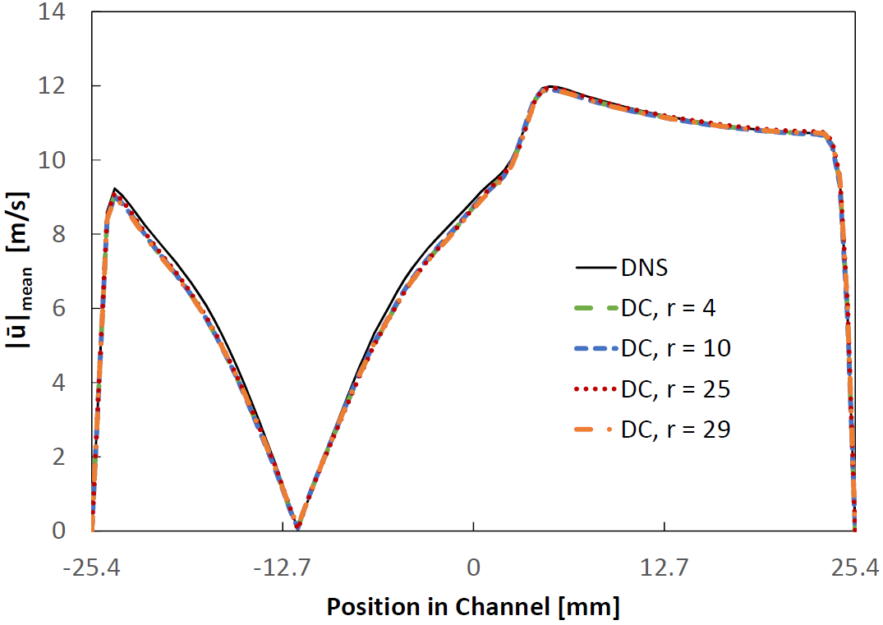
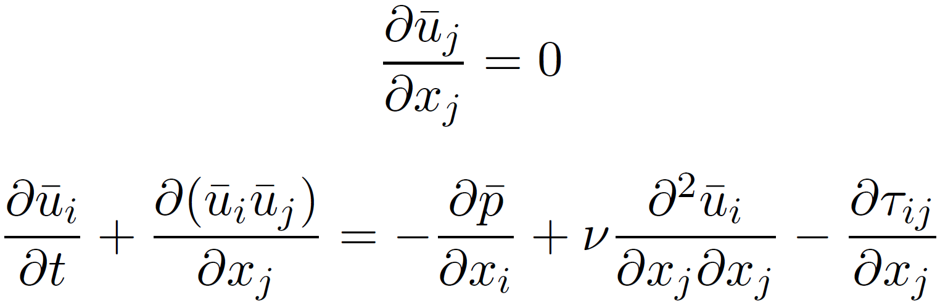
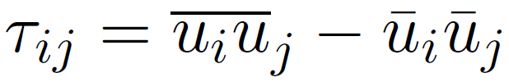
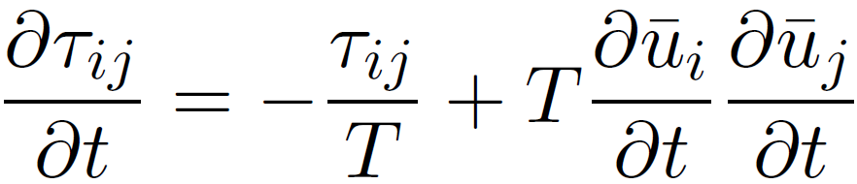
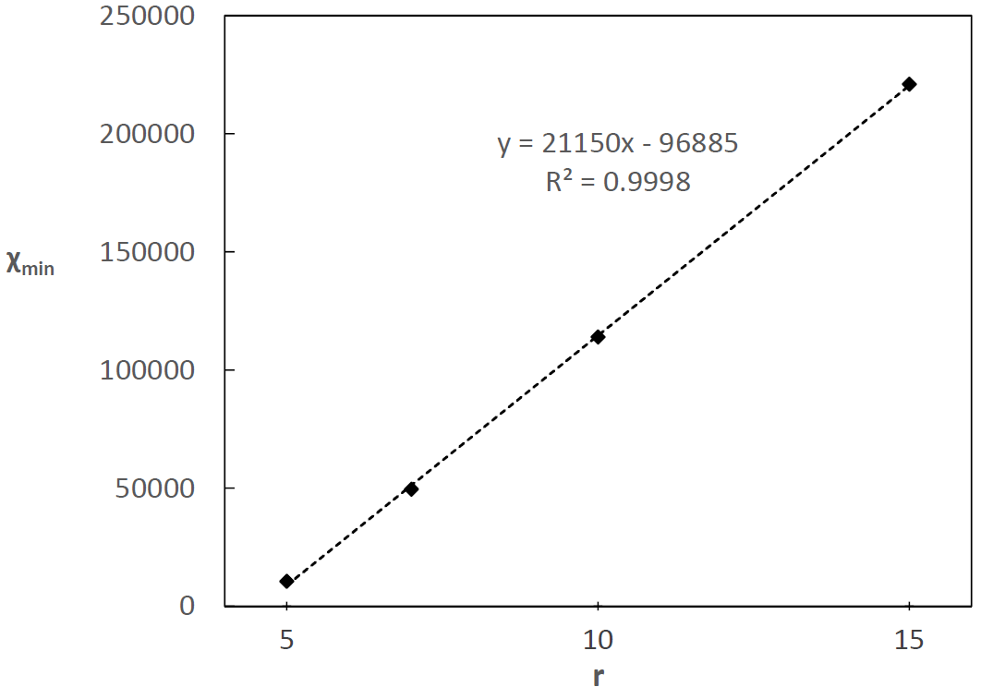

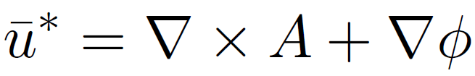
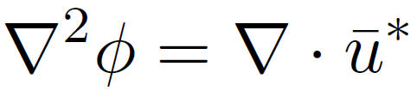

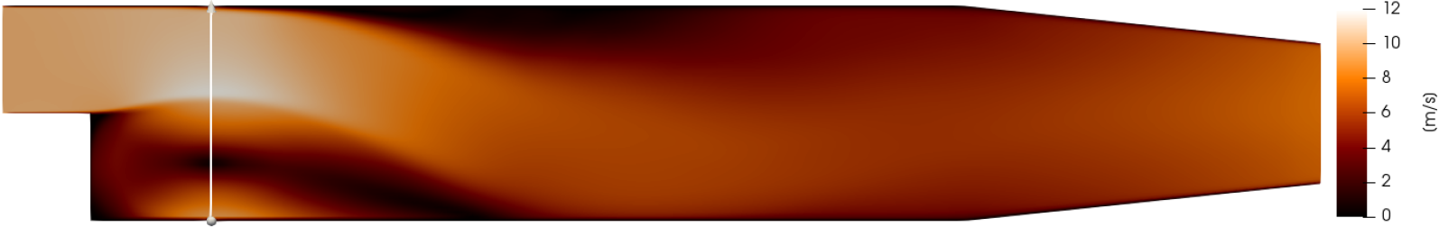


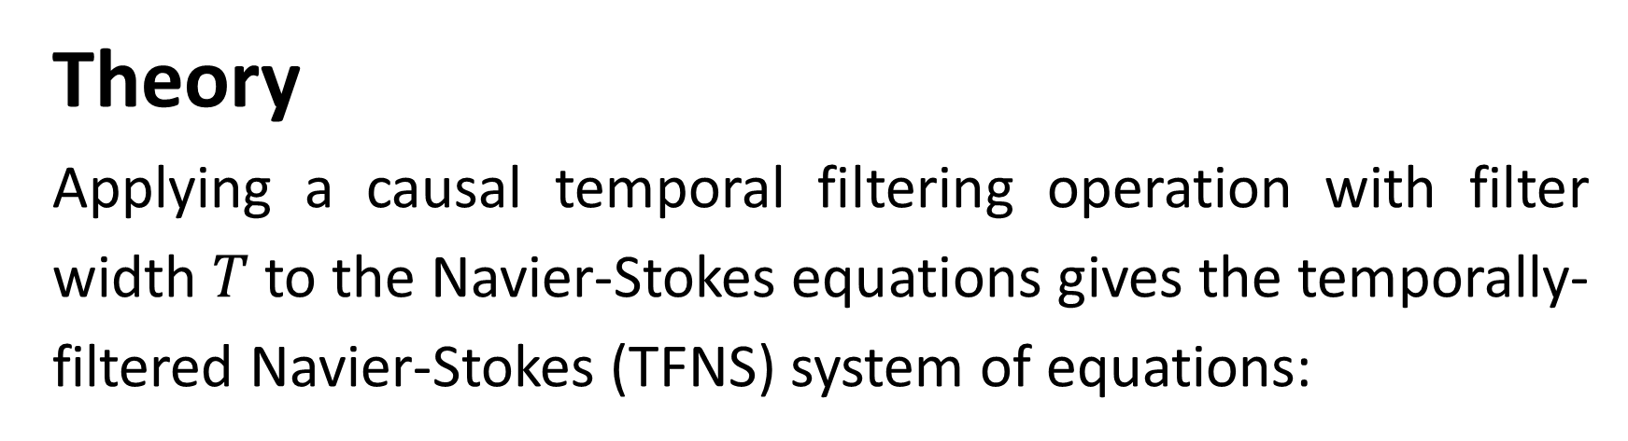
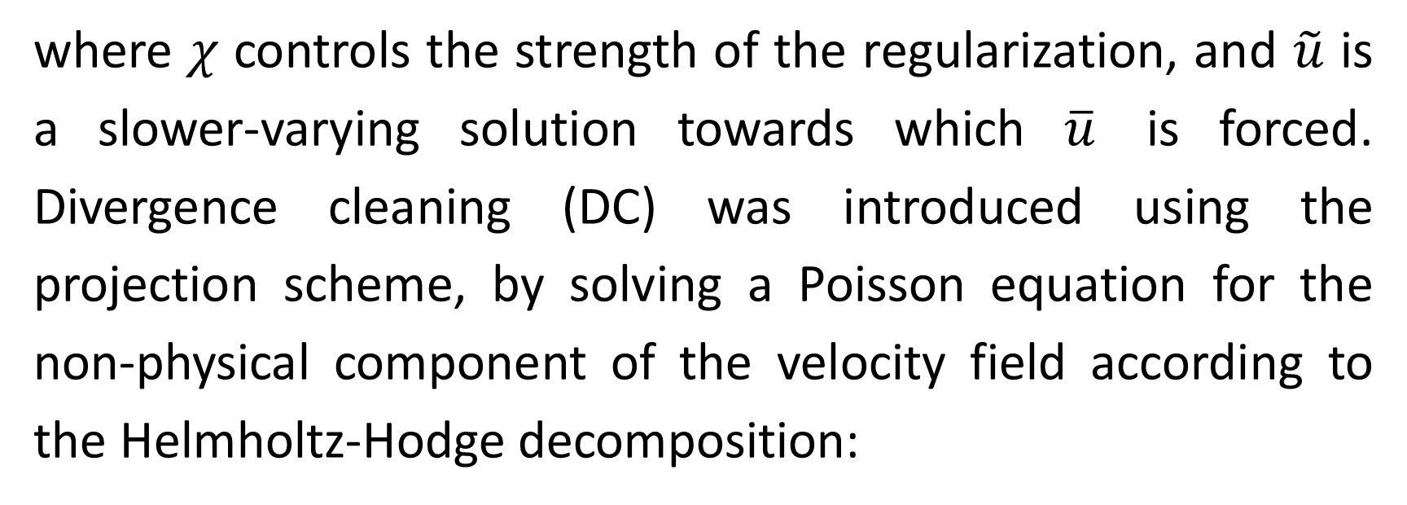
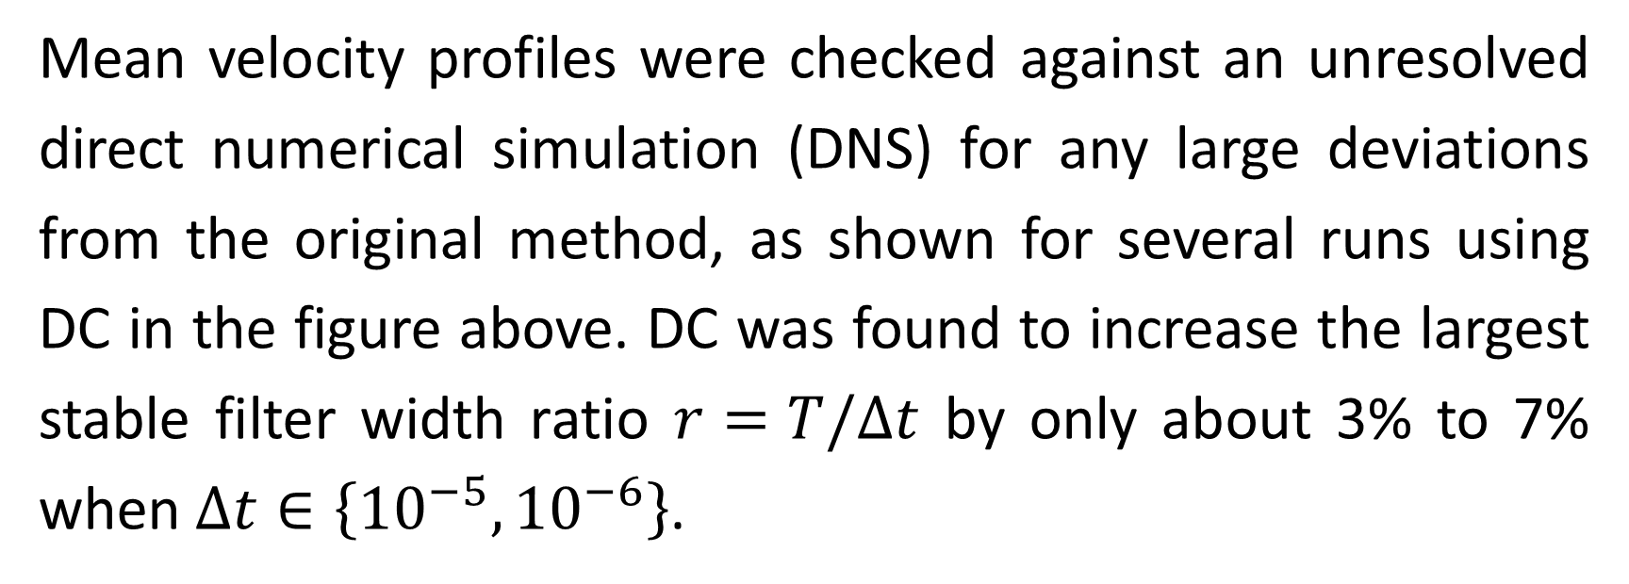
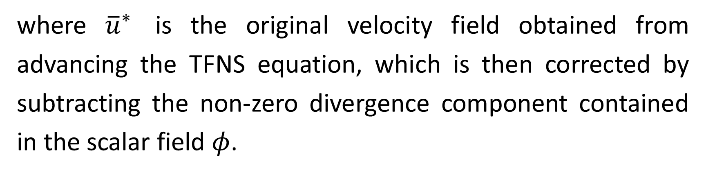
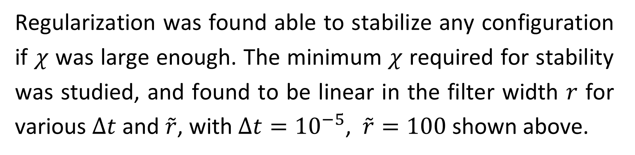
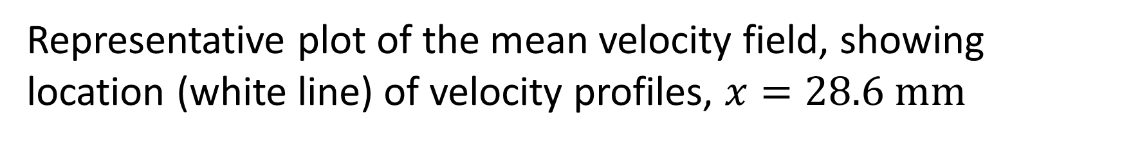
Development of a regularization term in a TLES code in OpenFOAM
Seminar in Fluid Dynamics for CSE by Samuel Maloney Supervised by Daniel Oberle and Prof. Dr. Patrick Jenny
Theory
Applying a causal temporal filtering operation with filter width $T$ to the Navier-Stokes equations gives the temporally-filtered Navier-Stokes (TFNS) system of equations:
Results
The newly developed temporal exact deconvolution method (TEDM) can then be used to find a closure for the evolution of the temporal stress tensor, given by :
Mean velocity profiles were checked against an unresolved direct numerical simulation (DNS) for any large deviations from the original method, as shown for several runs using DC in the figure above. DC was found to increase the largest stable filter width ratio $r=T/Δt$ by only about 3% to 7% when $Δt∈\left\{{10}^{−5}, {10}^{−6}\right\}$.
This equation and the TFNS system can then be solved in alternation to evolve the system in time. Regularization can be introduced through a proportional feedback term on the right hand side of the TFNS momentum equation as:
where $χ$ controls the strength of the regularization, and $\tilde{u}$ is a slower-varying solution towards which $\overline{u}$ is forced. Divergence cleaning (DC) was introduced using the projection scheme, by solving a Poisson equation for the non-physical component of the velocity field according to the Helmholtz-Hodge decomposition:
Regularization was found able to stabilize any configuration if $χ$ was large enough. The minimum $χ$ required for stability was studied, and found to be linear in the filter width $r$ for various $Δt$ and $\tilde{r}$, with $Δt={10}^{−5}$, $\tilde{r}=100$ shown above.
where ${\overline{u}}^{∗}$ is the original velocity field obtained from advancing the TFNS equation, which is then corrected by subtracting the non-zero divergence component contained in the scalar field $φ$.
Conclusions
It was found that DC improved the stability of the method only slightly, implying that non-zero divergence was present in the system, but was not the root cause of the instabilities. Regularization was able to stabilize every configuration tested if the strength of the regularization was made sufficiently high, although this stabilization came at the cost of substantial slowdown in the time-evolution of the flows towards their statistically stationary final states.
Representative plot of the mean velocity field, showing location (white line) of velocity profiles, $x=28.6 mm$

