Slide 1
Development of a regularization term in a TLES code in OpenFOAM
Samuel Maloney, Seminar in Fluid Dynamics for CSE
Supervisor: Daniel Oberle
Professor: Patrick Jenny

Slide 2
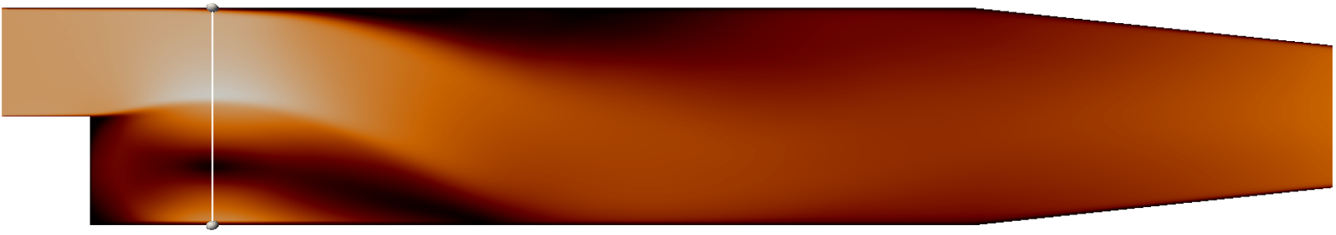
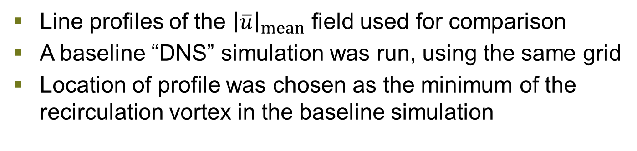

Velocity Profile Comparisons
Line profiles of the ${\left|\overline{u}\right|}_{mean}$ field used for comparison
A baseline “DNS” simulation was run, using the same grid
Location of profile was chosen as the minimum of the recirculation vortex in the baseline simulation
$$x=28.6 mm$$

Slide 3
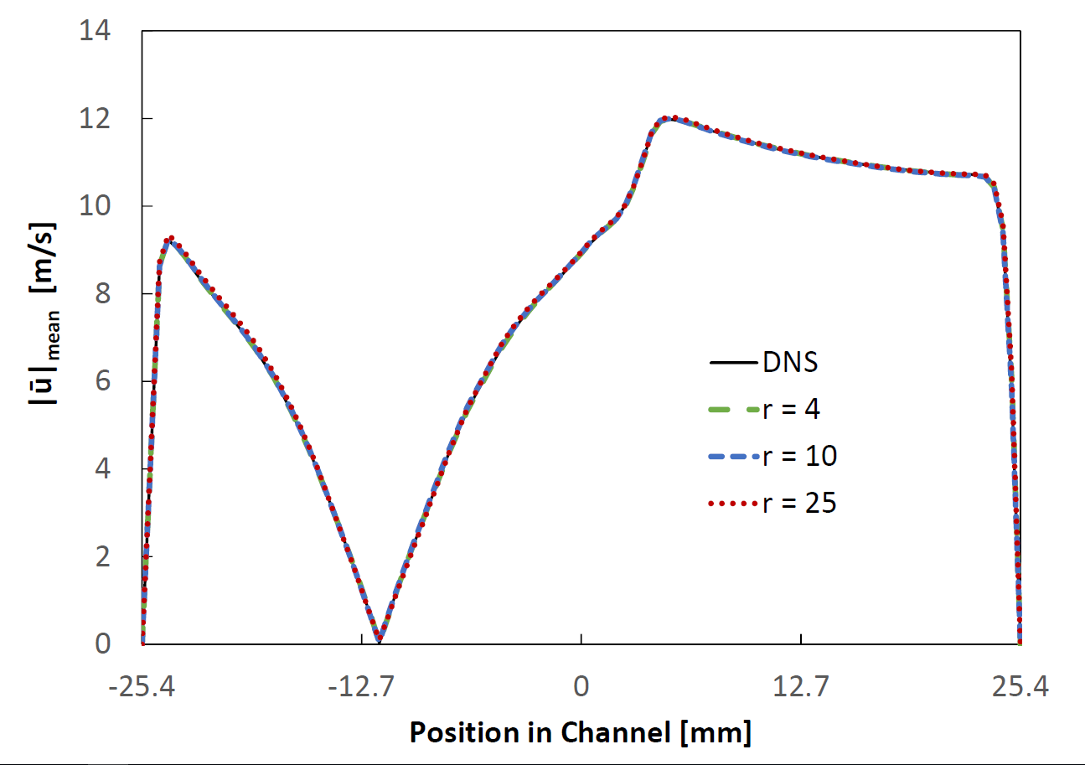
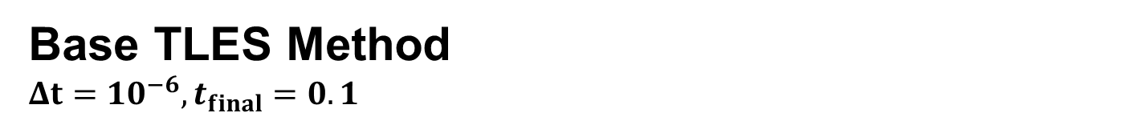
Base TLES Method $$Δt=10^{−6},t_{final}=0.1$$

Slide 4
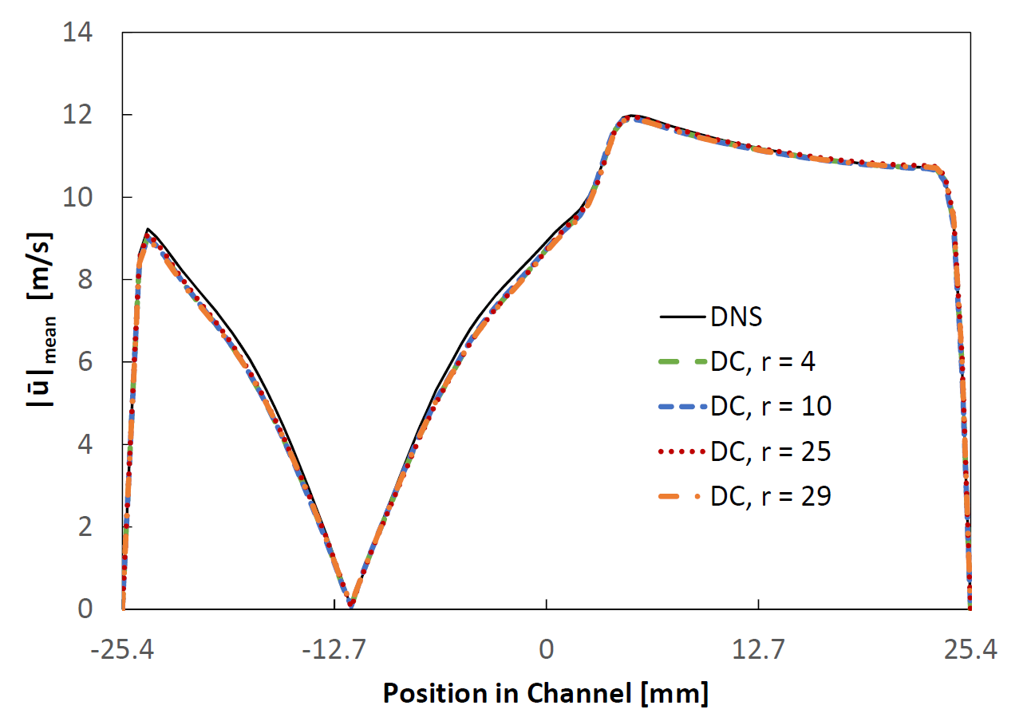
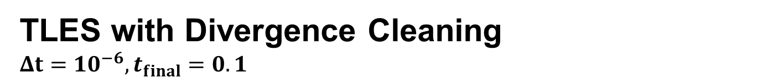
TLES with Divergence Cleaning $$Δt=10^{−6},t_{final}=0.1$$

Slide 5
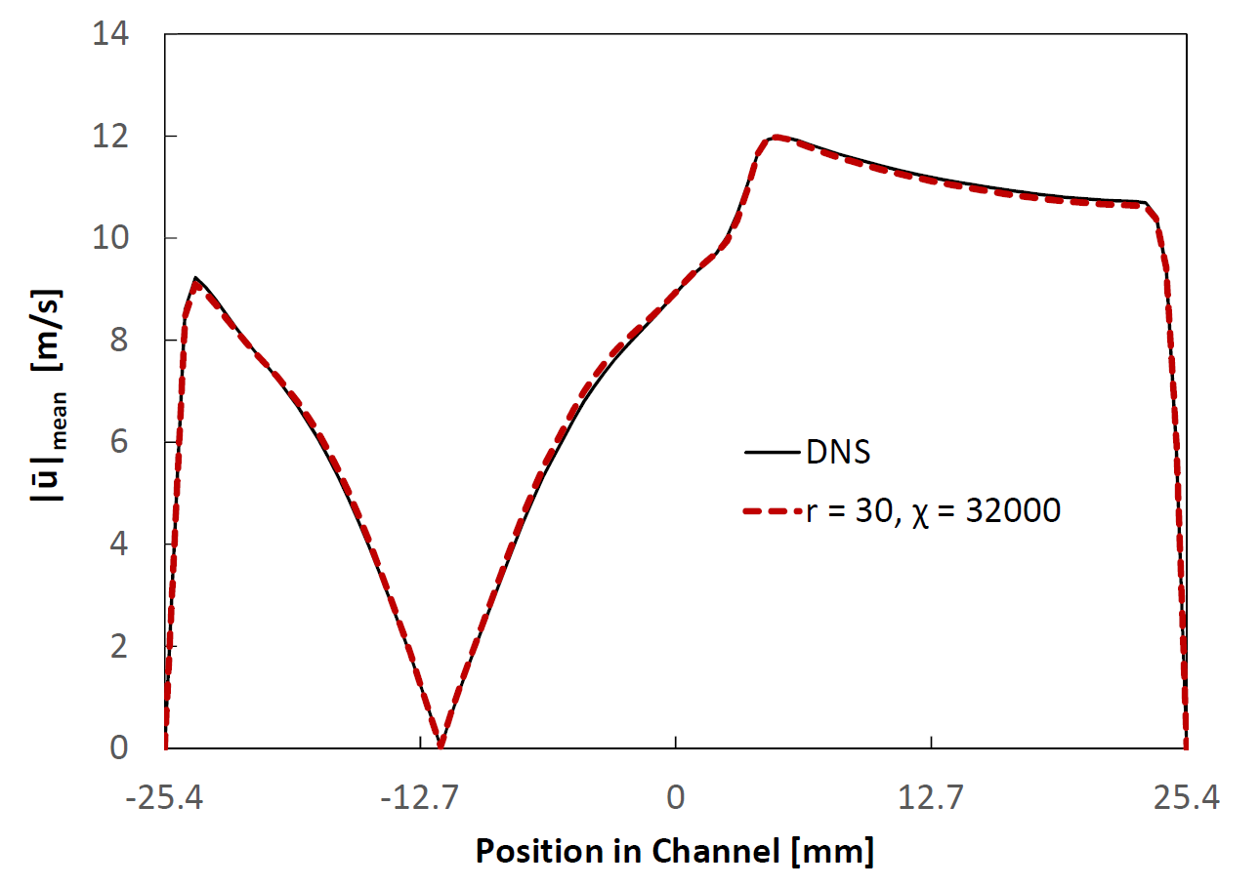
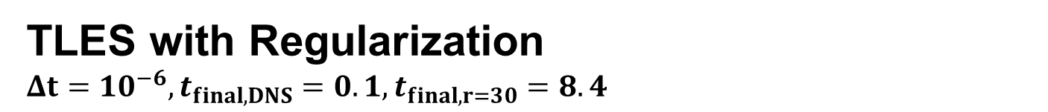
TLES with Regularization
TLES with Regularization $$Δt=10^{−6},t_{final,DNS}=0.1,t_{final,r=30}=8.4$$

Slide 6
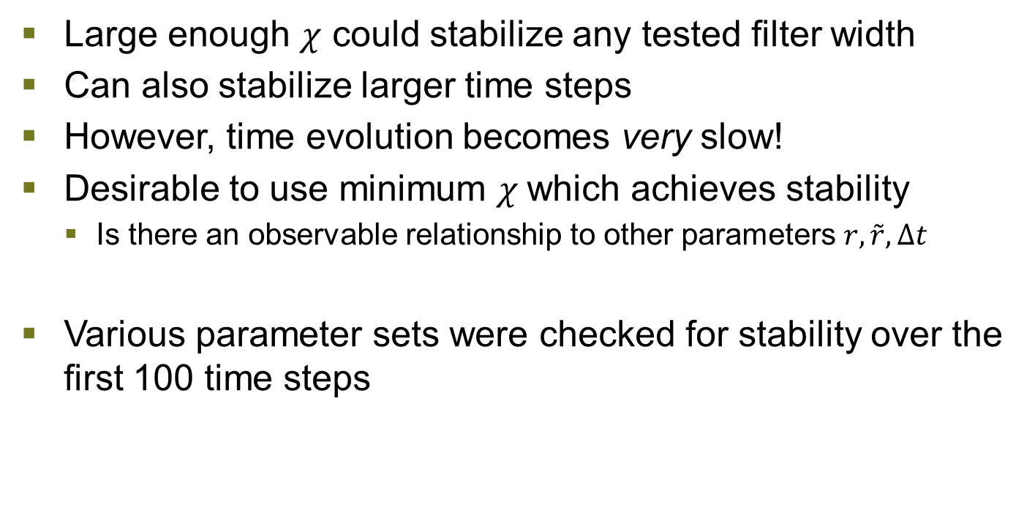
TLES with Regularization
Minimum $χ$ Required for Stabilization
Large enough $χ$ could stabilize any tested filter width
Can also stabilize larger time steps
However, time evolution becomes very slow!
Desirable to use minimum $χ$which achieves stability
Is there an observable relationship to other parameters $r, \tilde{r}, Δt$
Various parameter sets were checked for stability over the first 100 time steps

Slide 7
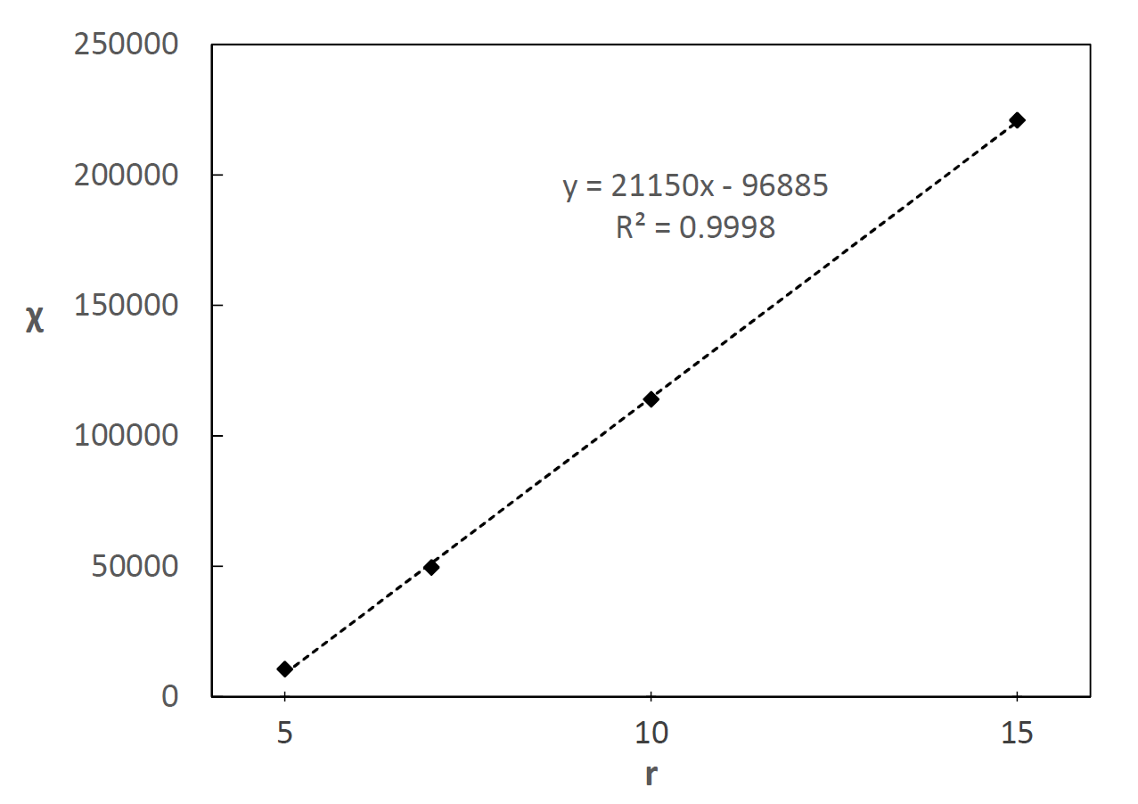
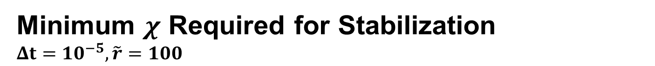
TLES with Regularization
Minimum $χ$ Required for Stabilization
$$Δt=10^{−5}, \tilde{r}=100$$

Slide 8
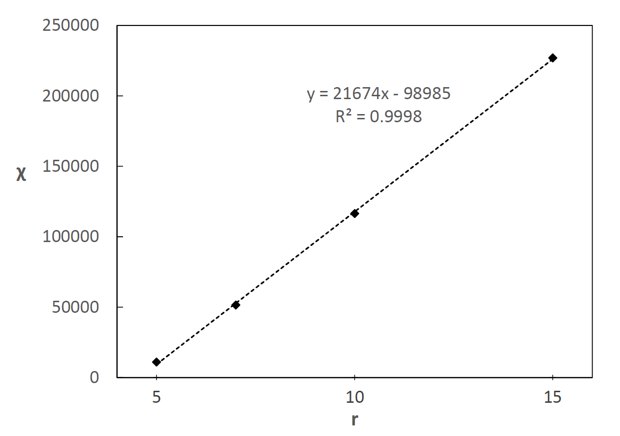
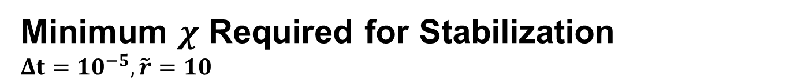
TLES with Regularization
Minimum $χ$ Required for Stabilization
$$Δt=10^{−5}, \tilde{r}=10$$

Slide 9
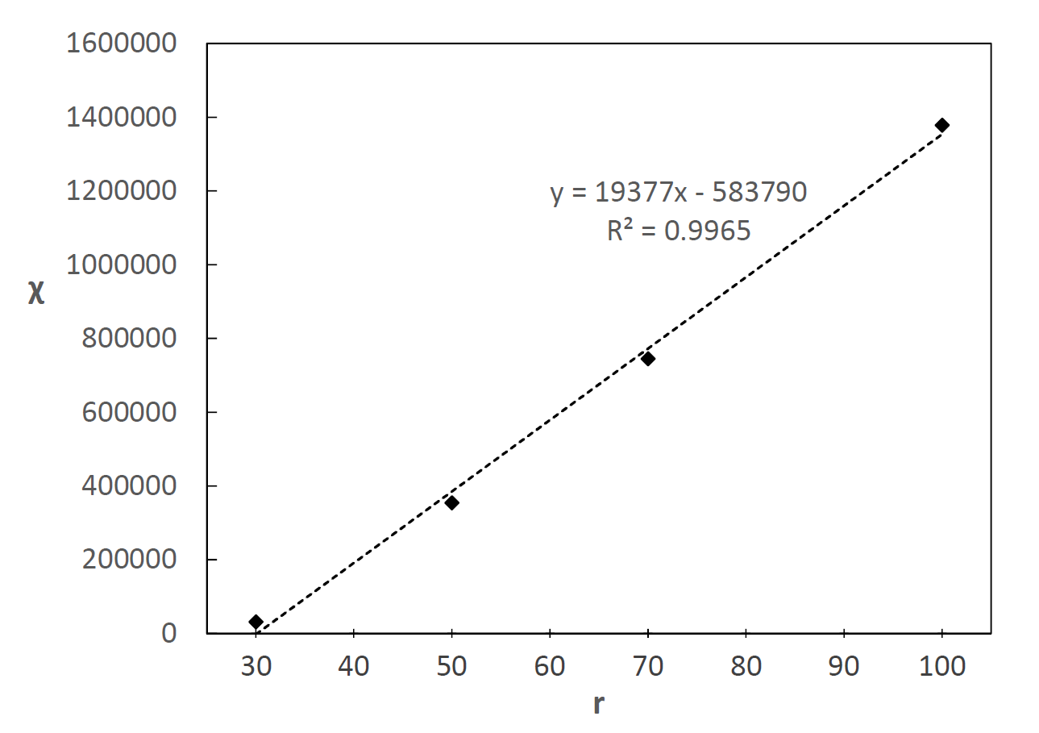

TLES with Regularization
Minimum $χ$ Required for Stabilization
$$Δt=10^{−6}, \tilde{r}=100$$

