Slide 1
Well-Balanced Methods for Computation of the Standing Accretion Shock Instability (SASI)
Samuel Maloney, work for MSc Thesis in RW/CSE
Supervisors: Prof. Dr. Siddhartha Mishra and Dr. Roger Käppeli

Slide 2
Standing Accretion Shock Instability (SASI)
Accretion shocks in several astrophysical phenomena
star formation, white dwarf/neutron stars, core-collapse supernovae
Unlike planar shocks, geometry could trap perturbations
Potential instability could be of interest in driving the evolution of core-collapse supernovae [Blondin2003]
An advective-acoustic feedback cycle has been hypothesized as a candidate [Foglizzo2009, Sato2009]
Used an external potential to model fluid deceleration
Should be amenable to a well-balanced method [Käppeli2014]

Slide 3
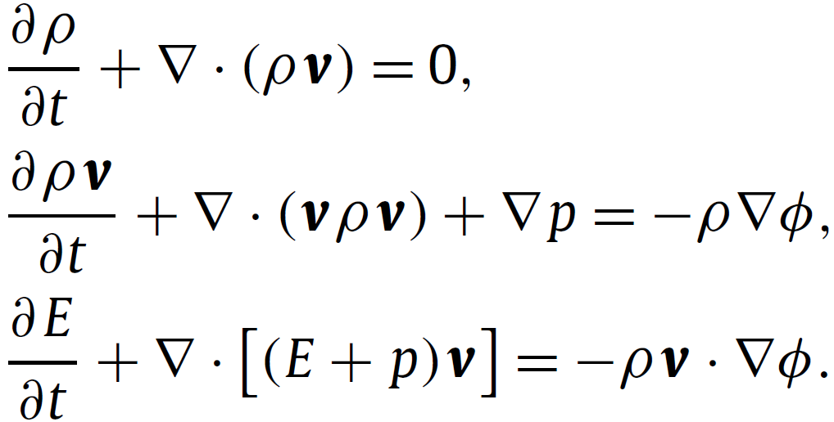
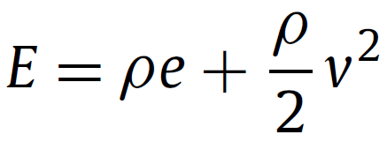

Euler Equations
With the Energy and Equation of State (EOS)

Slide 4
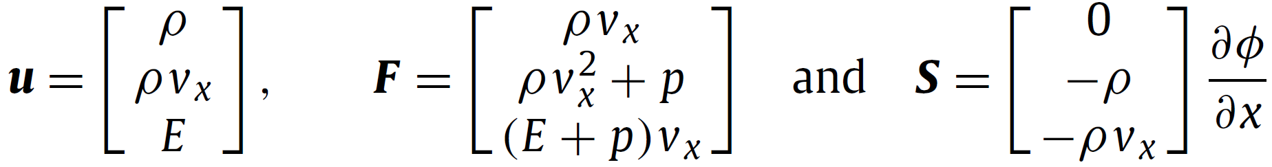
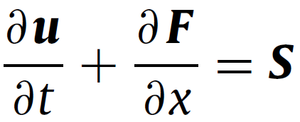


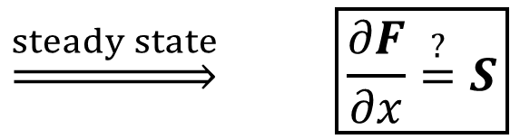
A More Convenient Form (1D)
$$\underset{⇒}{steady state} \boxed{\frac{∂F}{∂x}\overset{?}{=}S}$$
With the primitive vector and ideal gas EOS

Slide 5





Numerical Method
$$w(x)$$
cell average value
Finite Volume Method (FVM)
Solve for cell averages
Reconstruct to faces
Solve Riemann problems
However, we desire a better reconstruction for steady states
limited linear reconstruction
unbounded linear
$$x_{i}$$
$$x_{i+1}$$
$$x$$
$$x_{i+\frac{1}{2}}$$

Slide 6
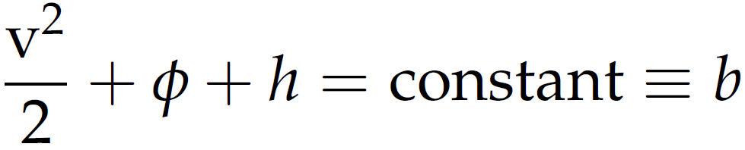
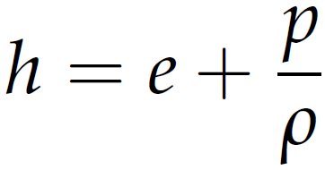
Steady States
Weak solutions; require entropy condition for uniqueness.
For our case, isentropic flow → Bernoulli constant
With specific enthalpy
Use this constant to compute the reconstruction

Slide 7


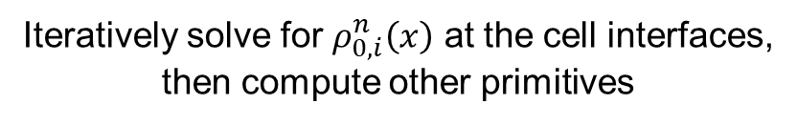
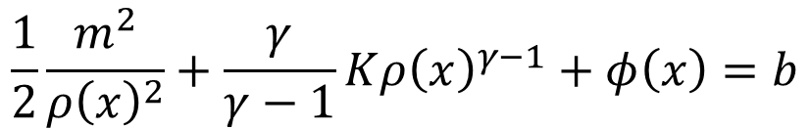
Well-Balanced Scheme
A few additional constants
$$ρv≡m=const$$
$$p=p\left(K,ρ\right)=Kρ^{γ}$$
Recast Bernoulli constant as function of just one unknown
$$\frac{1}{2}\frac{m^{2}}{{ρ\left(x\right)}^{2}}+\frac{γ}{γ−1}K{ρ\left(x\right)}^{γ−1}+φ\left(x\right)=b$$
Iteratively solve for $ρ_{0,i}^{n}\left(x\right)$ at the cell interfaces,
then compute other primitives

Slide 8
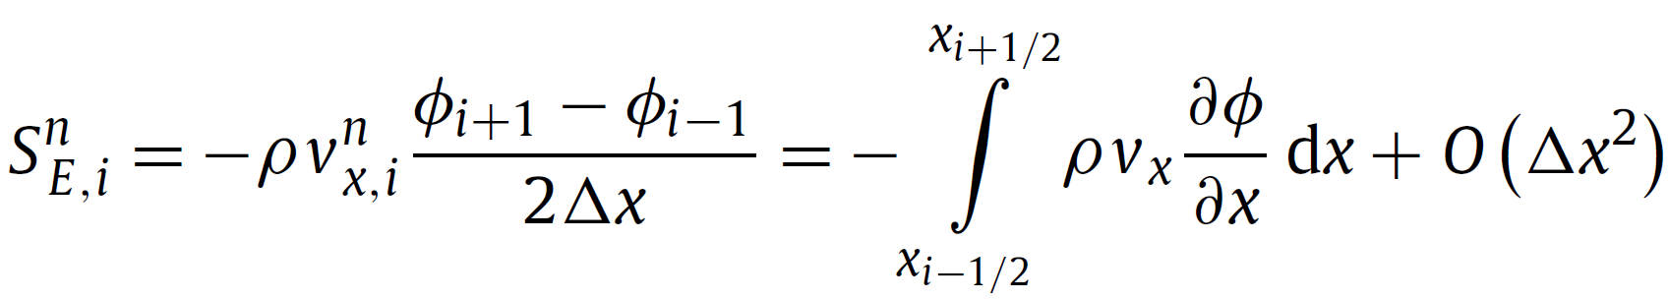
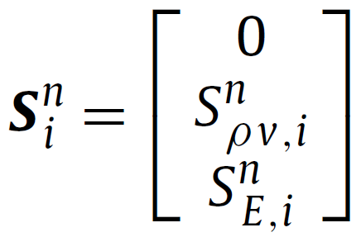
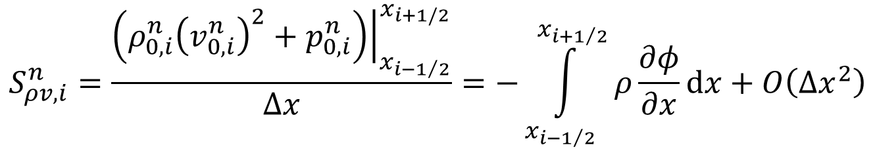
Discretization of the Source Terms
$$S_{ρv,i}^{n}=\frac{{\left.\left(ρ_{0,i}^{n}{\left(v_{0,i}^{n}\right)}^{2}+p_{0,i}^{n}\right)\right|}_{x_{i−1/2}}^{x_{i+1/2}}}{Δx}=−\int_{x_{i−1/2}}^{x_{i+1/2}}{ρ\frac{∂φ}{∂x}dx+O\left(Δx^{2}\right)}$$

Slide 9
Implementation
foam-extend-4.0 fork of OpenFOAM
dbnsFoam solver
Several limiters and Riemann solvers already implemented
Written in C++
Provides a lot of general field manipulation capability
Uses a very general FVM mesh description
Few restrictions on number and orientation of cell faces
Runtime selection of many parameters
But it’s large and complicated (>1 000 000 lines of code!)

Slide 10


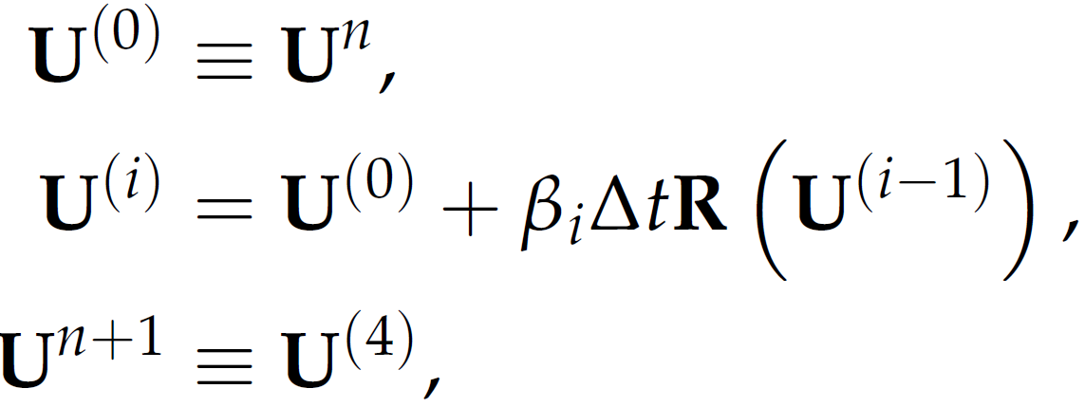
Time-Marching Scheme
Low storage Runge-Kutta: 4 stages, 2nd order accurate, maximizes CFL
number [Lallemand1990] and strong stability preserving (SSP) [Shu1988]

Slide 11
Test Problem [image:Sato2009]
supersonic
Direction
of flow

Slide 12
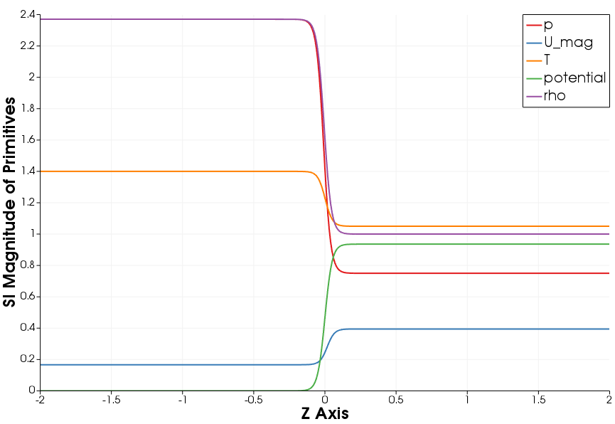
Sub Problem 1 – Initial Conditions
Direction
of flow

Slide 13
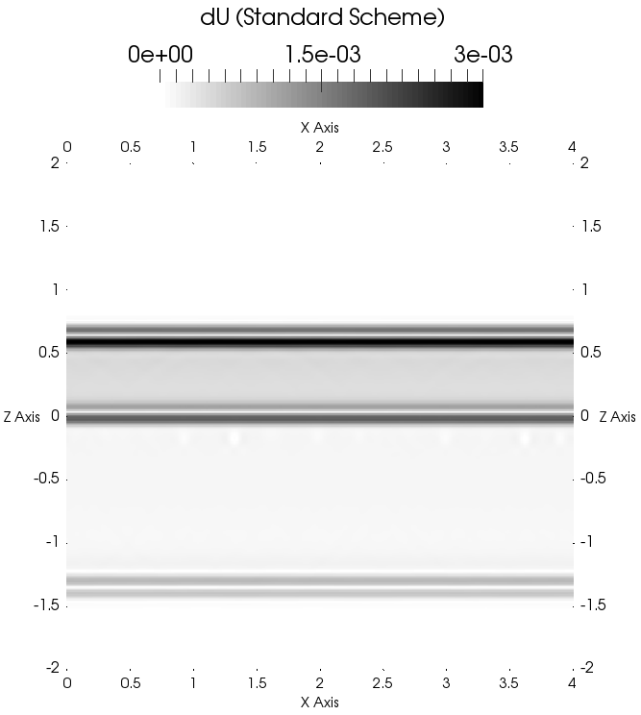
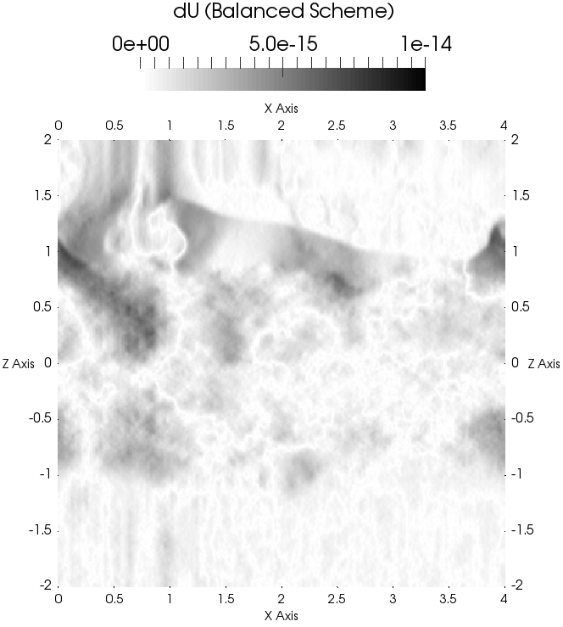

Sub Problem 1 – Equilibrium $t=1, dt=0.001$

Slide 14
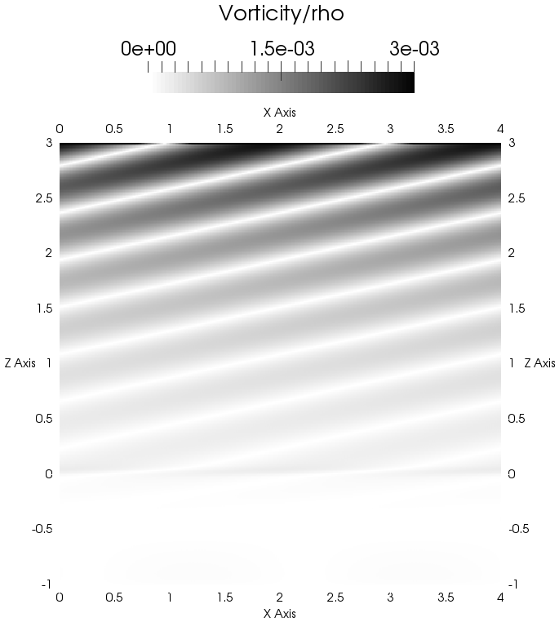
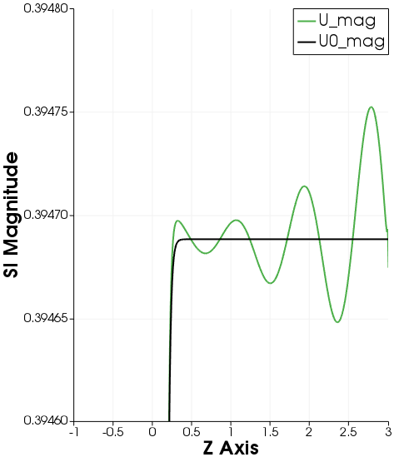
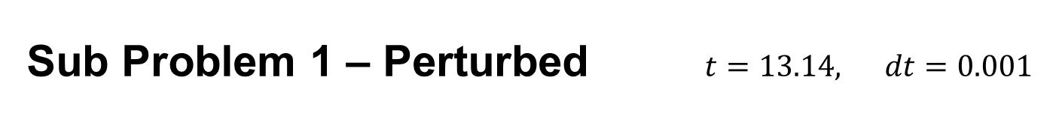
Sub Problem 1 – Perturbed $t=13.14, dt=0.001$

Slide 15
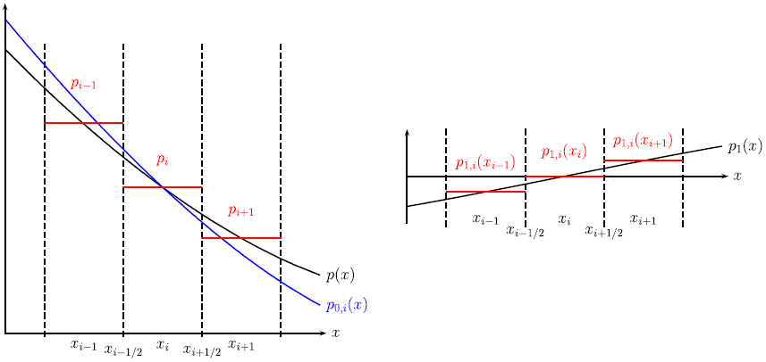


Second Order Extension [images:Käppeli2014]
$$q_{i}\left(x\right)=q_{0,i}\left(x\right)+Dq_{1,i}\left(x−x_{i}\right)$$
$$q_{1,i}\left(x\right)=q\left(x\right)−q_{0,i}(x)$$

Slide 16
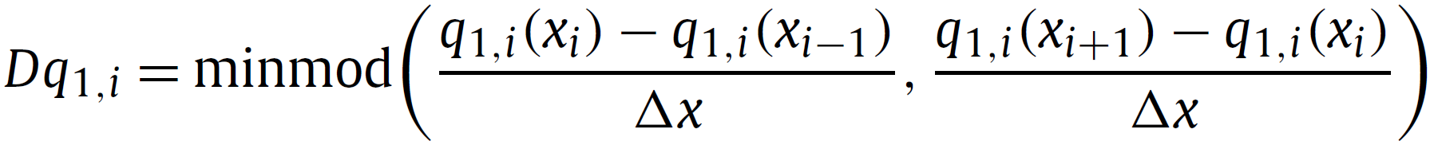
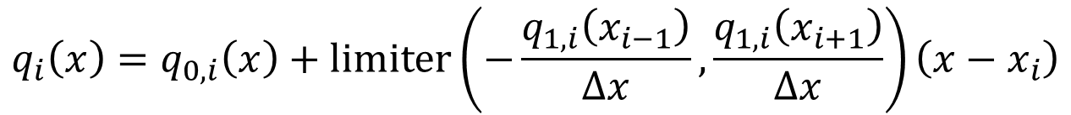
Second Order Extension
limiter
$$q_{i}\left(x\right)=q_{0,i}\left(x\right)+limiter\left(−\frac{q_{1,i}\left(x_{i−1}\right)}{Δx},\frac{q_{1,i}\left(x_{i+1}\right)}{Δx}\right)\left(x−x_{i}\right)$$

Slide 17
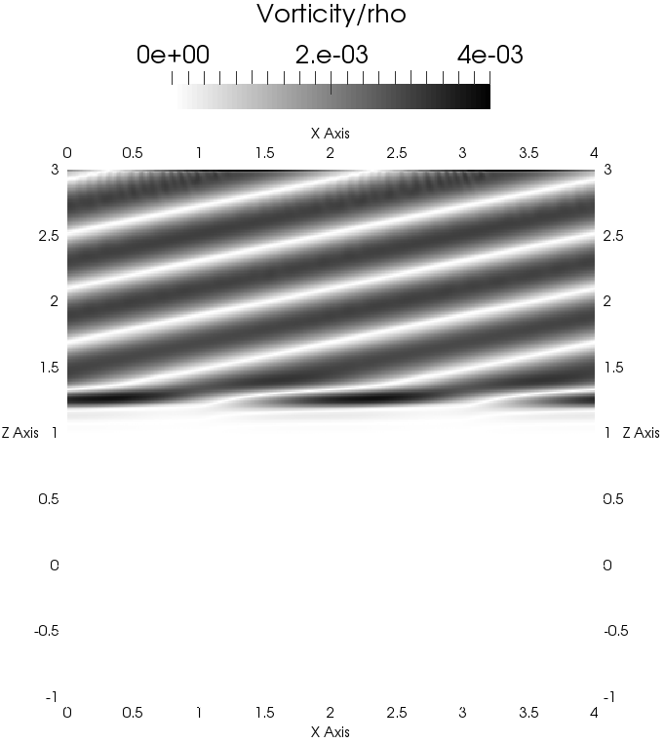
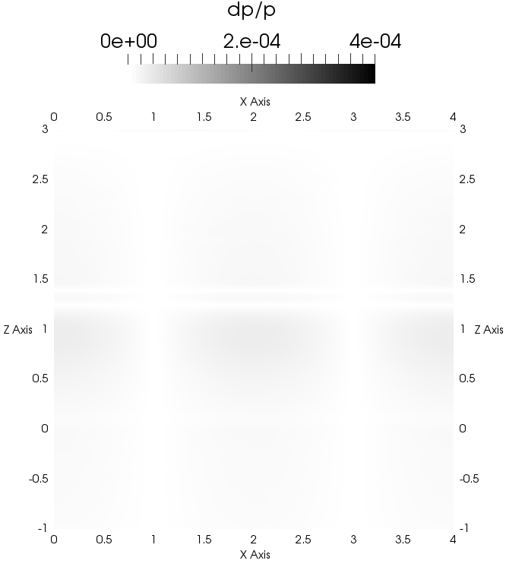
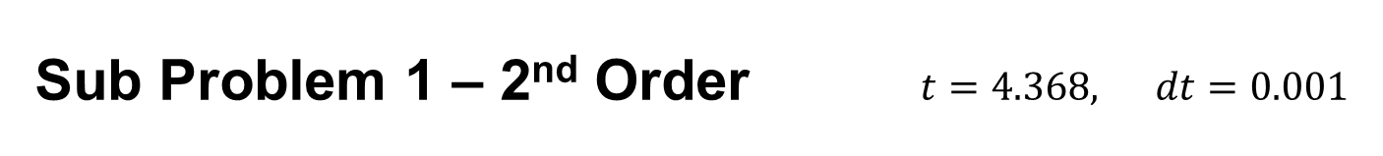
Sub Problem 1 – 2nd Order $t=4.368, dt=0.001$

Slide 18
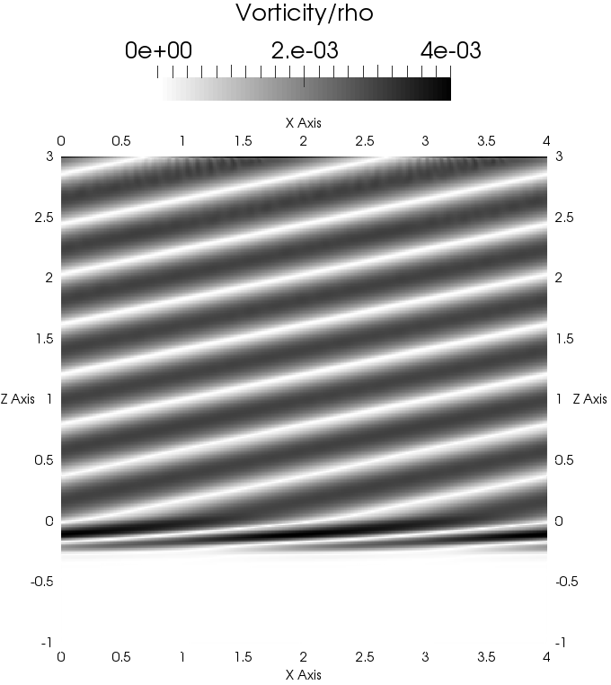
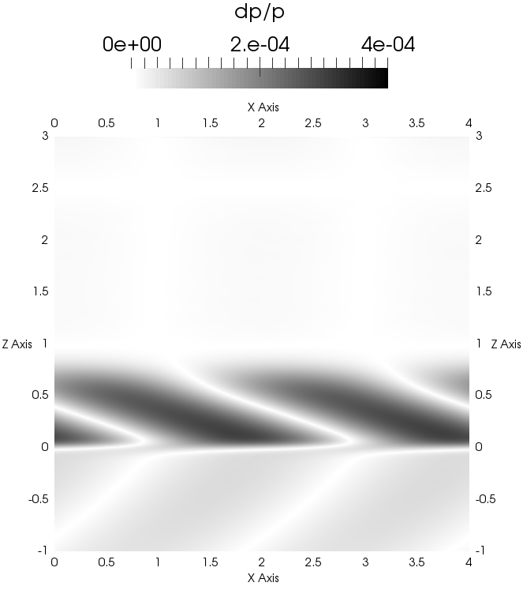
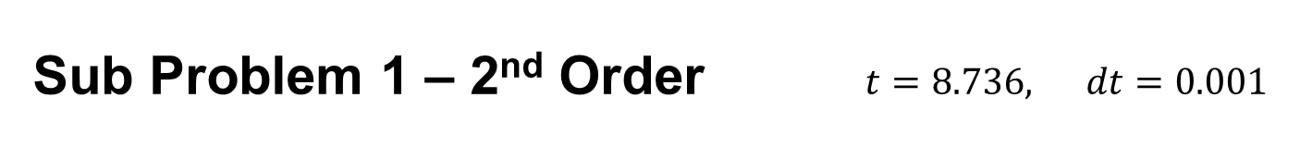
Sub Problem 1 – 2nd Order $t=8.736, dt=0.001$

Slide 19
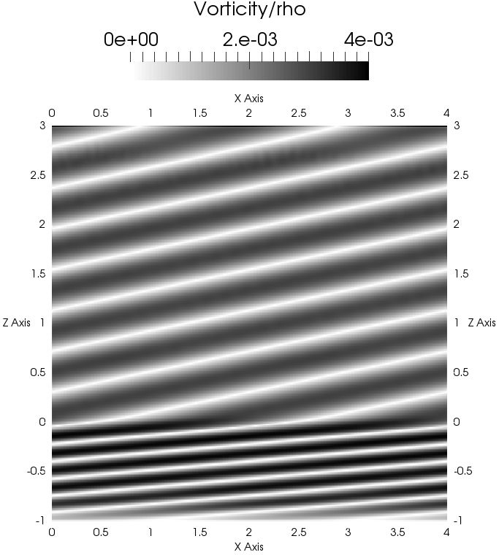
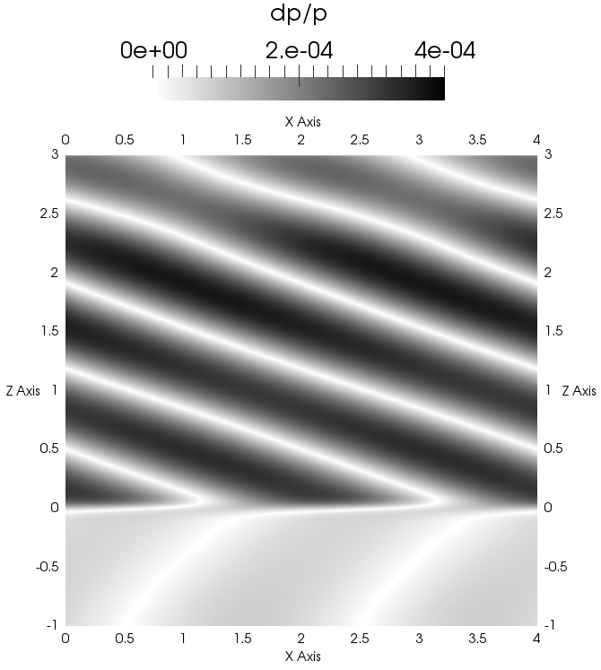

Sub Problem 1 – 2nd Order $t=13.14, dt=0.001$

Slide 20
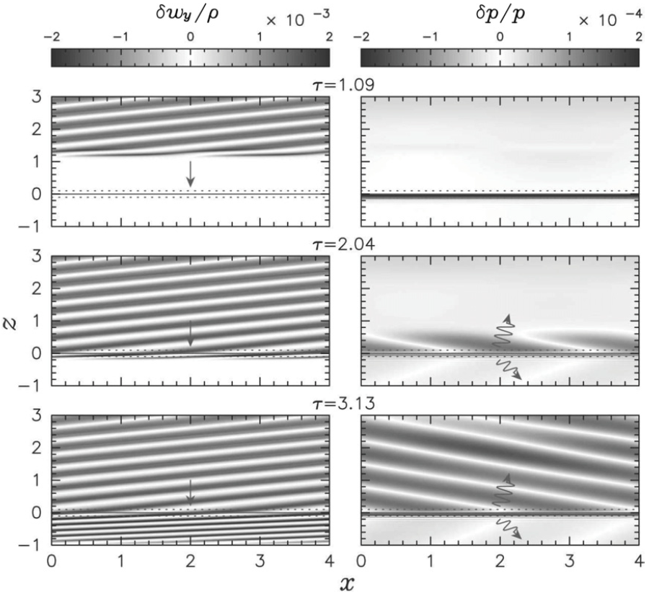
Comparison to Paper Results [image:Sato2009]

Slide 21
Next Steps
Convergence study
Clean up code
Improve use of OpenFOAM’s generalizability
Separate as stand alone library plug-in
Possible optimizations
Simulate the full test problem
Attempt on an annular geometry if time permits
And of course, write it all down! ☺

Slide 22
References
J. M. Blondin, A. Mezzacappa, C. DeMarino. Stability of standing accretion shocks, with an eye toward core-collapse supernovae. The Astrophysical Journal, 584(2):971–980, February 2003.
T. Foglizzo. A simple toy model of the advective-acoustic instability. I. Perturbative approach. The Astrophysical Journal, 694(2):820–832, March 2009.
J. Sato, T. Foglizzo, S. Fromang. A simple toy model of the advective-acoustic instability. II. Numerical simulations. The Astrophysical Journal, 694(2):833–841, March 2009.
R. Käppeli, S. Mishra. Well-balanced schemes for the Euler equations with gravitation. Journal of Computational Physics, 259:199–219, February 2014.
M. Lallemand. Dissipative Properties of Runge-Kutta Schemes with Upwind Spatial Approximation for the Euler Equations. PhD thesis, Rapport de Recherche 1179, INRIA Sophia-Antipolis, Valbonne, January 1990.
Chi-Wang Shu and Stanley Osher. Efficient implementation of essentially non-oscillatory shock-capturing schemes. Journal of Computational Physics, 77(2):439–471, August 1988.

Slide 23
Questions?
Thank you for listening!

